Slide 1
Making the right choices

Slide 2

Content
By the end of this presentation, you will:
understand the choices available to you when you leave school
understand the different types of higher education courses
know the next steps you need to take if you want to apply to higher education

Slide 3

Choices available
Higher education
Apprenticeships and traineeships
Studying abroad
Gap year
Getting a job
Understand the options available and make choices that are right for you.
Visit ucas.com/alternatives

Slide 4
Apprenticeship advice
UCAS provides apprenticeship advice to help students make informed decisions about their post-16 and post-18 opportunities.
Find out about:
the different types of apprenticeships
how to find and apply for apprenticeships
preparing for the application and interview process
With the predicted growth of higher and degree apprenticeships, you’ll also find a dedicated degree and professional apprenticeships section on ucas.com, which profiles current programmes in more detail.

Slide 5
Why higher education?
Essential for some career paths.
Develop new transferable skills and subject knowledge.
Increase your confidence and independence.
Broaden your experiences.
Show yourself what you can do.
Invest in your future

Slide 6
Higher education study options
Certificate of Higher Education (CertHE) and Diploma of Higher Education (DipHE): first and second year of a degree course.
Higher National Certificate (HNC) and Higher National Diploma (HND): HNC is a one-year work-related course, and the HND is a two-year work-related course.
Foundation degree: flexible vocational qualification, combining both academic study and workplace learning. It usually takes two years to complete.
Bachelor’s or undergraduate degree: a three to four-year course which can also be available as a part-time option, allowing you to study and work.

Slide 7
Types of courses available
Single: study one subject.
Joint honours degree: divide your time 50:50 between two subjects.
Major/minor: study two subjects, normally at a 75:25 ratio.
Combined honours programme: study between two to four subjects, specialising in just two subjects in years two and three.
Modular courses: build a personalised course by choosing modules you’re interested in.
Sandwich courses: courses with one year in industry or a year abroad.
Foundation year: if you don’t have the right qualifications, some universities and colleges offer this to help students prepare for and enter higher education.

Slide 8

What’s right for you?
There are a number of things for you to consider when applying for higher education, such as:
a subject you enjoy – you are investing time, money, and effort
whether it’s right for your career path – check with employers
location – city or rural, transport links
a study style that suits you
extracurricular activities
finances

Slide 9

Before you apply
Register in the UCAS Hub to explore your options, such as:
explore careers, subjects, universities and apprenticeships
find and favourite over 35,000 courses
search for virtual tours and online events
turn predicted grades into Tariff points
speak to those in the know using Unibuddy
Go to: ucas.com/hub

Slide 10
‘I’m overwhelmed by all the choice…’
Get organised:
Tools to search, favourite, shortlist, reflect, diary, and build application.
Make it yours:
Organise tools, remove the ones they don’t need, and tick off their to do list. It’s their space, and their future.
Define what’s important:
Distance from home, teaching satisfaction, work experience options, job outcomes…
You might not have thought of…
Expand horizons by pushing options they might not have considered.

Slide 11



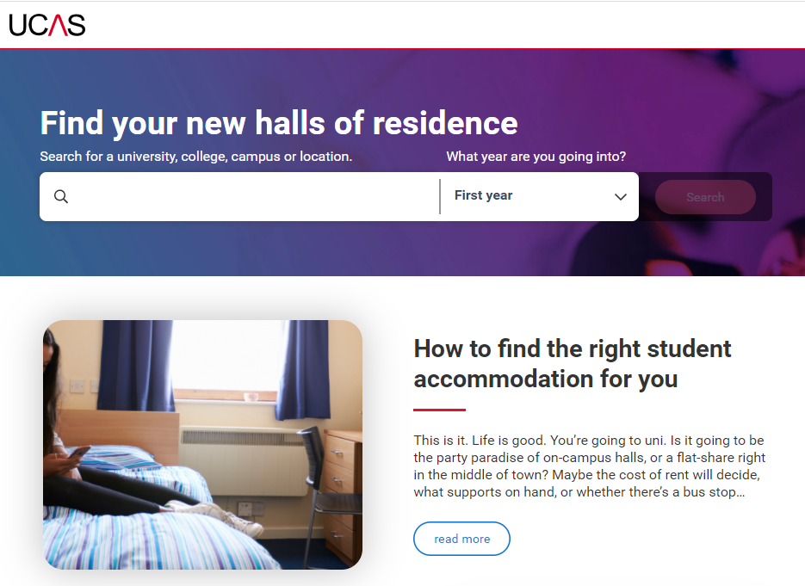

Research – it's free!
New - Accommodation Search- accommodation is high on the list when considering where you want to study, but it’s not always easy to compare what’s on offer. Understand what options there are using our new Accomodation search.
Join our UCAS Hub lives and Facebook lives -each live session is hosted by an expert panel to give you what you need to make an informed decision.
UCAS Futures - a chance to explore courses you're interested in and speak to universities and colleges from around the UK. You can talk to subject and admissions experts, discover apprenticeships, get advice on personal statements, applying through UCAS, and more.

Slide 12

Research – it’s free!
Learning from others – chat to uni students student videos and blogs.
Career options – use the job profiles to explore different career roles and pathways.
Take the Buzz quiz to find out more about individual strengths, and what roles may suit you.
The Career Finder tool is ideal for considering options after education, including searching for apprenticeships.
Security marking: PUBLIC
23 October 2020
| 12

Slide 13



Additional help
UCAS Customer Experience Centre
0371 468 0 468
From outside the UK:
+44 330 3330 230
Monday to Friday, 08:30 – 18:00 (UK time)
Stay up to date online at:
facebook.com/ucasonline
twitter.com/UCAS_online
Security marking: PUBLIC
23 October 2020
| 13

Slide 14
Thank you
Security marking: PUBLIC
23 October 2020
| 14

