Slide 1
General Data Protection
Regulation (GDPR)
How it affects the services UCAS provides – myths and realities
Nigel Parr – Information Governance Manager

Slide 2

GDPR myths
The Information Commissioner’s Office (ICO) has expressed concern about ‘GDPR myths’ – ‘GDPR is not Y2k’.
Myths include:
You must have consent to use personal data.
Every personal data breach must be reported to the ICO.
The ICO will always issue huge fines for non-compliance.
You’ll always have to delete personal data when asked.
GDPR builds on the existing data protection regime, however, we need to work together to ensure compliance.

Slide 3
GDPR – at a glance
GDPR builds on the existing data protection regime.
Came into force on 25 May 2018 – 173 recitals and 99 Articles.
Brought into UK law through the Data Protection Bill.
The impact of GDPR will not be known immediately.
Primary concepts of GDPR:
Privacy.
Transparency.
Giving individuals enhanced rights.
Enhanced obligations on organisations.

Slide 4
Some key terms
Personal data – ‘information relating to identified or identifiable natural person…by reference to…a name, an identification number…online identifier’ – the identifiable natural person is a ‘data subject’.
Must satisfy an ‘Article 6’ condition to process this personal data.
Article 9 (1) ‘special category’ personal data – includes personal data about racial and ethnic origin, biometric data, health, sexual orientation, religious beliefs, and trade union membership – must satisfy an Article 9 (2) condition to process this personal data.
Article 10 – personal data about criminal convictions – must satisfy a condition in parts 1 – 3 of schedule 1 to the Data Protection Bill to process this personal data.
Data controller – organisation deciding the purposes personal data is processed for.
Data processor – organisation processing personal data on behalf of a data controller.

Slide 5

Our relationship – GDPR
We’re both ‘data controllers’ in respect of the admissions data we process.
UCAS – decides what we collect, who we share it with, etc.
Providers have the same responsibilities:
  Providers decide retention periods for personal data, based on such things as legal requirements, and continued use.
  Providers decide the nature of the communications sent to applicants, and if additional consent to issue them is required.
However, we need to work together to achieve GDPR compliance.

Slide 6

Consent
GDPR myth – you must have consent to process personal data.
Reality – consent is subject to stricter conditions under GDPR.
Must be a clear pro-active action, no more pre-ticked boxes.
Must be informed.
Specific and ‘unbundled’.
Must be as easy to withdraw as it is to provide.
Data is invalid if you don’t stop processing it when consent has been withdrawn.
UCAS – making changes to some of our consent mechanisms.
ICO guidance – don’t rely on consent if another basis for processing exists.
Don’t rely on UCAS’ ‘consents’ within our privacy statements.

Slide 7
Basis for processing
Article 6 – ‘Personal data’
  Data subject has given consent to the processing.
  Necessary for the performance of a contract.
  Necessary for compliance with a legal obligation.
  Vital interests of the data subject.
  Legitimate interests, unless overridden by the rights of the data subject.
  Performance of a task carried out in the public interest.
Article 9 (2) – ‘Special category personal data’
  Explicit consent.
  Substantial public interest.
Article 10 – ‘Criminal convictions’
  Meet a condition listed at parts 1 – 3 to schedule 1 of the Data Protection Bill.

Slide 8
Basis for processing – UCAS
Necessary for the performance of a contract | ‘Public task’ processing | Value added processing using additional consent | ‘Legitimate interests’
Provision of personal data from a applicant to support an application, and sharing this information with providers to enable an admissions decision to be made. | Processing of personal data to enable providers to measure their success in meeting equalities legislation or producing HESA returns. | Sharing personal data with providers as part of the direct contact service. | Issuing ‘direct marketing’ (specifically about UCAS services) to applicants with whom we have an existing relationship (opt out/unsubscribe permitted).
Processing of personal data to support the operation of the admission schemes, e.g. provision of examination results from awarding bodies, and sharing this data with providers, or sharing personal data for fraud and verification purposes. | Sharing personal data with statutory agencies for crime prevention purposes in individual cases. | Receipt of commercial messages from UCAS on behalf of educational and commercial organisations.

Slide 9
Basis for processing – UCAS
Article 9 – Personal data relating to sexual orientation, ethnicity, religious beliefs | Article 9 – Personal data relating to disabilities
Article 9 (2) (g) substantial public interest – Data Protection Bill provides clarity that a lawful basis for processing is for the purpose of identifying or keeping under review the existence or absence of equality of opportunity. This will not apply where this data is used to support individual decision-making. | Article 9 (2) (b) – satisfying obligations and rights under social protection laws.

Slide 10
Criminal convictions
UCAS currently asks two questions:
  All applicants are asked whether they have any unspent criminal convictions.
  Where an applicant applies to a course leading to professions exempt from the Rehabilitation of Offenders Act (1974), we ask whether they have any spent and unspent convictions
Discussion with ICO:
  Cannot meet a condition in the Data Protection Bill to ask the first question. Following discussions with stakeholders, we have decided to remove it.
  We will continue to ask the second question.
Unlikely that providers can ask this question directly.

Slide 11
Privacy information
GDPR contains enhanced standards about providing information to data subjects about uses of personal data (Articles 13, 14).
Where personal data is collected directly from the data subject, the privacy information should be provided at the time it is obtained.
Where personal data is not collected directly from the data subject, the privacy information should be provided within a reasonable period of having obtained the data – ICO advises within one month.
  If the data is used to communicate with the data subject, it should be provided no later than when the first communication occurs.
  If disclosure to another recipient is envisaged, it should be provided before the data is disclosed.
Applies to providers who obtain information through UCAS’ admissions schemes.

Slide 12
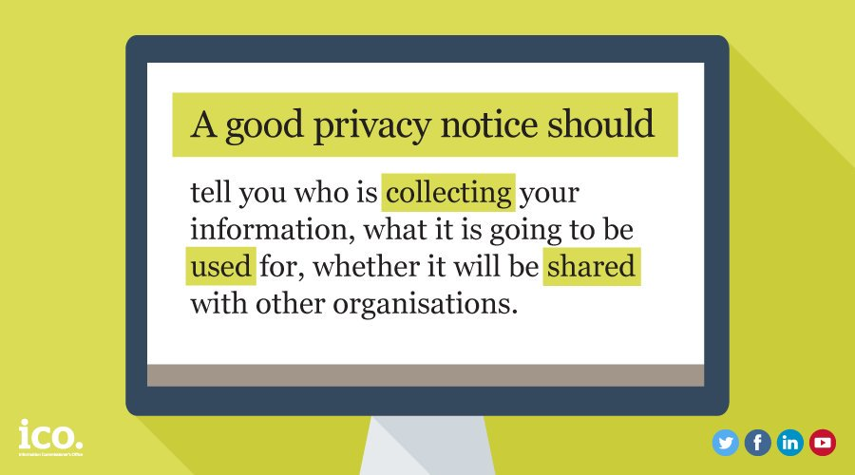
Privacy information
UCAS’ privacy information includes the following:
‘We share personal information with your application with the universities and colleges that you have applied to, so they can consider and process your application. This will include sharing your results from the examination and awarding bodies with the universities and colleges where you hold offers.’
What should you tell people (this is not an exhaustive list):
Identity of the data controller.
Purpose for processing.
Basis for processing.
Who you share it with (name if known).
Retention of personal data.
Individuals’ rights – subject access, right to be forgotten.
Right to lodge a complaint with the ICO.

Slide 13
Privacy information
Provider question about applications submitted by agents:
How do we notify data subjects about uses of personal data if the agent supplies their own contact details?
Responsibility of agent to notify their clients about uses of personal data.
Article 14 5 (b) of the GDPR states the provisions of Article 14 will not apply where:
‘the provision of such information proves impossible or would involve disproportionate effort [….] in such cases, the controller shall take appropriate measures to protect the data subject’s rights and freedoms, and legitimate interests, including making the information publicly available’.
In cases where an agent provides their own contact details, a provider can’t be certain any privacy information has been shared and, therefore, these provisions are likely to apply.

Slide 14
Privacy information
UCAS is also taking the following actions to further reduce this risk:
The current applicant declaration which individuals are required to accept before they apply will be amended, to make it clear that, where the individual submitting the application is doing so on behalf of an applicant, they have notified them of the privacy information.
We’ve written to agents, making sure they’re aware of their responsibilities to notify applicants about uses of their personal data, and ensuring they submit applicant contact details within the application.
We also discourage agents from completing their own details in the applications, identifying those who’re doing so.

Slide 15
‘Marketing’ communications
Provider question:
Do we need additional consent to send communications to applicants? UCAS had seen ICO advice suggesting certain communications (including accommodation and post-offer open days) would be considered as ‘direct marketing’.
Summarised ICO guidance:
These communications are direct marketing, as defined by the Data Protection Act (DPA). The Privacy and Electronic Communication Regulations 2003 (PECR) are relevant.
You can apply a ‘soft opt-in’, if:
you have obtained the contact details in the course of a sale (or negotiations for a sale) of a product or service to that person
you only ‘market’ your own similar products and services
you provided the person with a simple opportunity to refuse or opt out of the marketing, both when first collecting the details, and in every subsequent message

Slide 16
‘Marketing’ communications
ICO – ‘a pragmatic approach’ – communications such as accommodation and open day services were ‘similar enough’, given the applicant has expressed an interest in studying at that provider – additional consent would not be required.
This decision must be documented – record basis for processing.
A clear and simple opt out opportunity must be given to applicants when details are first collected, and in every subsequent message.
Will not apply to strictly operational emails – such as invites to interviews, or requests for further information.

Slide 17
‘Right to be forgotten’
Individuals can request deletion of personal data – most typically where it’s no longer necessary for the data controller to retain the personal data, or consent is the basis for processing.
Not an absolute right, doesn’t apply where retention is necessary:
  For the defence of legal claims.
  Performance of a task in the public interest.
  For archiving, historical, and research purposes.
In general, UCAS does not share personal data with providers on the basis of consent – provides stronger justification for retention.

Slide 18
Breach reporting – myths
Myth – all data protection breaches must be reported, and all details must be provided immediately. Huge fines for non-reporting.
It will be mandatory to report some breaches if it’s likely to result in a risk to people’s rights and freedoms, such as the person suffering damage to their reputation, or financial loss.
Have to provide notification within 72 hours, but don’t have to provide all details of the breach straight away.
Should review your breach procedures, and have an approach to the types of incident you would report.
If you become aware you’ve received personal data through UCAS that you shouldn’t have (e.g. erroneous report, inappropriate access), please let us know immediately through existing reporting channels.

Slide 19
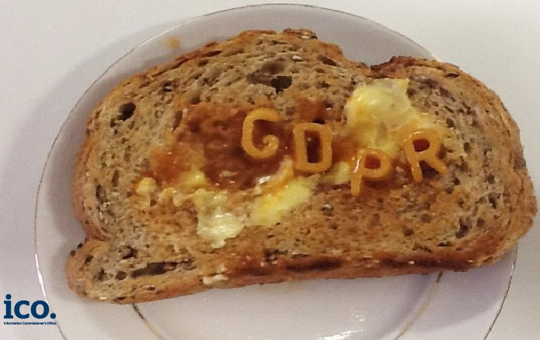
New requirements
Right of data portability.
Privacy impact assessments.
Appoint a data protection officer.
Document personal data processing activities:
  ‘Paper shield’.
Enhanced requirements for data processors.

Slide 20
What next?
UCAS is involved in a wider working group to produce some common standards and guidance about uses of personal data.
We continually review guidance and case law produced by the ICO.
If you have any GDPR related concerns in respect of the services we provide, please contact datagovernance@ucas.ac.uk.

