Slide 1
Applying to study in the UK

Slide 2
Why chose the UK?
The UK has a long history of welcoming international students.
In 2019, over 140,000 people from outside the UK applied through UCAS.
There are over 35,000 undergraduate courses at over 400 course providers.
A UK degree means you are well placed to secure global employment.
UK qualifications are recognised and respected throughout the world.
British universities and colleges provide a multi-cultural, diverse, creative, and innovative environment.
Security marking: PUBLIC
23 October 2020
| 2
Notes:
2

Slide 3
What is UCAS?
UCAS is the organisation responsible for connecting people to UK higher education.
You can apply for up to five different courses in one UCAS application.
The UCAS website can be used to:
research courses
find out about universities and colleges
read blogs from international students
find open days
download UCAS publications
see entry requirements
make and track your application
Security marking: PUBLIC
23 October 2020
| 3

Slide 4

Top research tips
There are a number of things for you to consider when applying for higher education in the UK, such as:
choosing a subject you will enjoy as you are investing time, money, and effort
whether it’s right for your career path
the location, including transport links
a study style that suits you
extracurricular activities to take part in
finances
Security marking: PUBLIC
23 October 2020
| 4

Slide 5
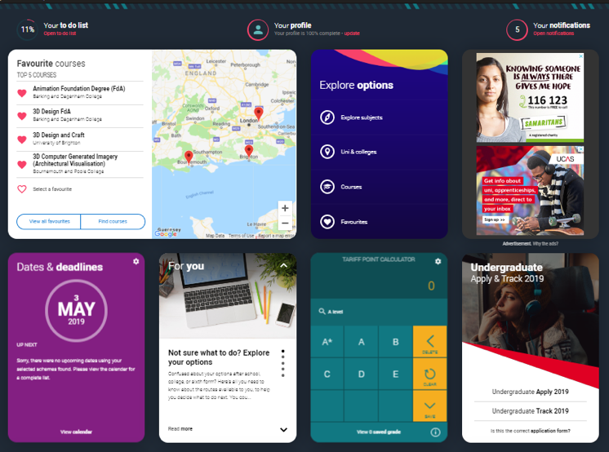
The UCAS Hub
Provides students with a central place to store and collate information and research when looking into higher education.
Provides all necessary tools and guidance on what to do next, where to look, and how to do things.
Is free to use and allows UCAS to personalise the right content to students.
Register to explore your options and research your choices: ucas.com/hub.
Security marking: PUBLIC
23 October 2020
| 5

Slide 6





Apply key facts
It’s an online application
Maximum of five choices.
Choice restrictions:
  medicine, veterinary, medicine/science, dentistry
  (maximum of four)
  Oxford or Cambridge
Simple application cost:
  one choice – £20
  two to five choices – £26
Equal consideration.
‘Invisibility’.
5
Security marking: PUBLIC
23 October 2020
| 6

Slide 7
When to apply for 2021 entry
19 May UCAS Undergraduate Apply opens for 2021 entry.
8 September First day for receipt of completed applications.
15 October* Application deadline for courses in medicine, veterinary medicine/science, and dentistry, and courses at Oxford or Cambridge.
15 January* Equal consideration application deadline.
25 February Extra opens.
30 June* Last date for applications before Clearing.
* 18:00 UK time
Security marking: PUBLIC
23 October 2020
| 7

Slide 8

Making a UCAS application
Begin at ucas.com/apply.
Sections to be completed:
Personal details
Choices – make up to five
Education
Employment
Personal statement
Reference
Security marking: PUBLIC
23 October 2020
| 8

Slide 9







The personal statement
The only section you have full control over
Your only chance to market themselves individually
UCAS’ similarity detection service:
every personal statement is run through software to check for plagiarism.
The same for all of your choices
A maximum of 4,000 characters, or 47 lines
A minimum of 1,000 characters
There isn’t a spelling or grammar check
No formatting is allowed
Security marking: PUBLIC
23 October 2020
| 9

Slide 10

Personal statement
Shows university and college admissions tutors that:
you are suited to the chosen course
you are motivated and dedicated
you have relevant knowledge and experience gained from education, work, or other extracurricular activities
you understand the demands of the chosen course
you will fit into the university’s culture and environment
Security marking: PUBLIC
23 October 2020
| 10

Slide 11
Universities decisions
After receiving your application, a university or college will make one of three decisions:
  unconditional offer
  conditional offer
  unsuccessful
  Or, they can offer a place on an alternative course.
Universities and colleges can also:
  request an interview
  ask to see your portfolio
  ask you to take an admissions test
Security marking: PUBLIC
23 October 2020
| 11

Slide 12
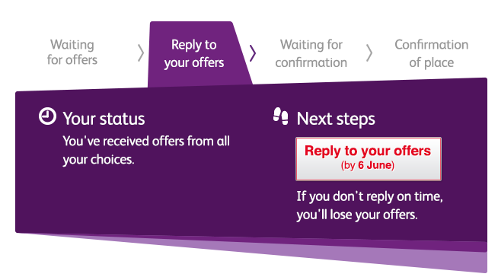

Tracking applications
Track allows applicants to:
follow the progress of their application 24/7
see their choices and personal information
view their offers
reply to offers online
In Track, a student can hold up to two offers:
  firm – if they meet the conditions of the offer they will be placed here
  insurance –if they are not placed with their firm choice, they may be placed with their insurance choice.
Security marking: PUBLIC
23 October 2020
| 12

Slide 13
Other things to consider
English language requirements – most universities/colleges will require you to demonstrate proficiency in English, or to take an English language test. Look at the university/college’s website or contact its admissions office to find out which tests are acceptable.
Immigration and visas – once you have been offered a place on a course, the university or college will advise you how to apply for your student visa from UK Visas and Immigration (UKVI).
Finance – course fees, travel, and living costs.
Travel – to and from your country, and within the UK.
Accommodation – university/college halls or private residence.
Visit www.ucas.com/finance for more information and links.
Security marking: PUBLIC
23 October 2020
| 13

Slide 14
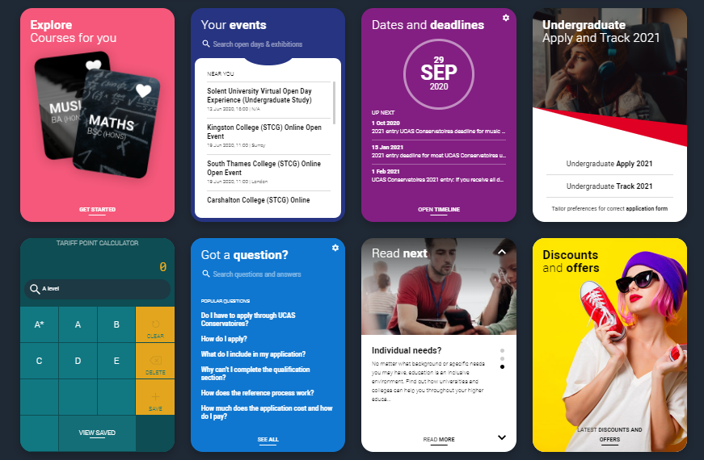


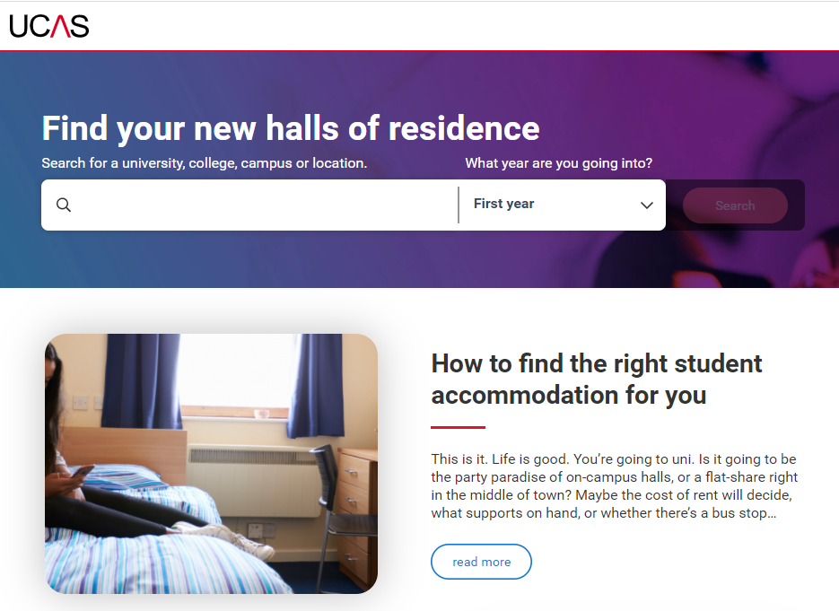

Research – it's free!
New - Accommodation Search- accommodation is high on the list when considering where you want to study, but it’s not always easy to compare what’s on offer. Understand what options there are using our new Accomodation search.
Join our UCAS Hub lives and Facebook lives -each live session is hosted by an expert panel to give you what you need to make an informed decision.
UCAS Futures - a chance to explore courses you're interested in and speak to universities and colleges from around the UK. You can talk to subject and admissions experts, discover apprenticeships, get advice on personal statements, applying through UCAS, and more.

Slide 15

Research – it’s free!
Learning from others – chat to uni students student videos and blogs.
Career options – use the job profiles to explore different career roles and pathways.
Take the Buzz quiz to find out more about individual strengths, and what roles may suit you.
The Career Finder tool is ideal for considering options after education, including searching for apprenticeships.
Security marking: PUBLIC
23 October 2020
| 15

Slide 16



Additional help
UCAS Customer Experience Centre
0371 468 0 468
From outside the UK:
+44 330 3330 230
Monday to Friday, 08:30 – 18:00 (UK time)
Stay up to date online at:
facebook.com/ucasonline
twitter.com/UCAS_online
Security marking: PUBLIC
23 October 2020
| 16

Slide 17
Thank you
Security marking: PUBLIC
23 October 2020
| 17

