Slide 1
Applying to university through UCAS

Slide 2

Content
By the end of this presentation, you will:
identify what resources are available to support you
understand' how to apply to a UK university or college
know the deadline of when you need to send your application
understand how to track your application and reply to offers
Security marking: PUBLIC
23 March 2021
| 2
Notes:
2

Slide 3
Choosing the right university for you
Style – from the traditional, with a focus on subject-based courses and research, to modern universities, with a greater focus on vocational courses.
Location – some are based in large cities, others in smaller towns - a major influence on the environment and lifestyle.
Size – larger universities can have more than 20,000 students, whereas some of the smallest have only a few thousand.
Culture and facilities – influenced by a range of factors, including the diversity of students who attend.
What graduates do – all universities collect destination statistics. It can be interesting to find out the types of jobs or further study students go on to.
Tuition fees – can vary between universities and colleges. Check if there are any scholarships or bursaries available.
Living costs – accommodation, transport, and food can vary enormously.
Security marking: PUBLIC
23 March 2021
| 3

Slide 4
Choosing the right course for you
What does the course cover?
Courses with the same title may be very different.
Look carefully at the core course content, and the range of optional studies/modules available.
Which modules are the most interesting and relevant to your career aspirations?
See if the course or university/college offers any internship, placement, or study abroad opportunities.
How is the course taught – structured teaching, or more independent research? How many lectures are there, and how much group work will be done in seminars?
How is the course assessed?
Security marking: PUBLIC
23 March 2021
| 4

Slide 5
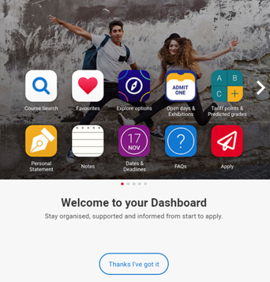
Starting your research
Register in UCAS Hub to:
explore careers, subjects, universities and apprenticeships
find and favourite over 35,000 courses
search for virtual tours and online events
turn predicted grades into Tariff points
speak to those in the know using Unibuddy
speak to career, higher education, and application specialists by attending the Hub lives.
explore job profiles to discover different career roles and pathways.
Start an application for 2022 entry (from May 2021)
Security marking: PUBLIC
23 March 2021
| 5

Slide 6
Organise everything in one place…
Get organised:
Tools to search, favourite, shortlist, reflect, diary, and build application.
Define what’s important:
Distance from home, teaching satisfaction, work experience options, job outcomes…
Make it yours:
Organise tools, remove the ones they don’t need, and tick off their to do list. It’s their space, and their future.
You might not have thought of…
Expand horizons by pushing options they might not have considered.
Security marking: PUBLIC
23 March 2021
| 6

Slide 7
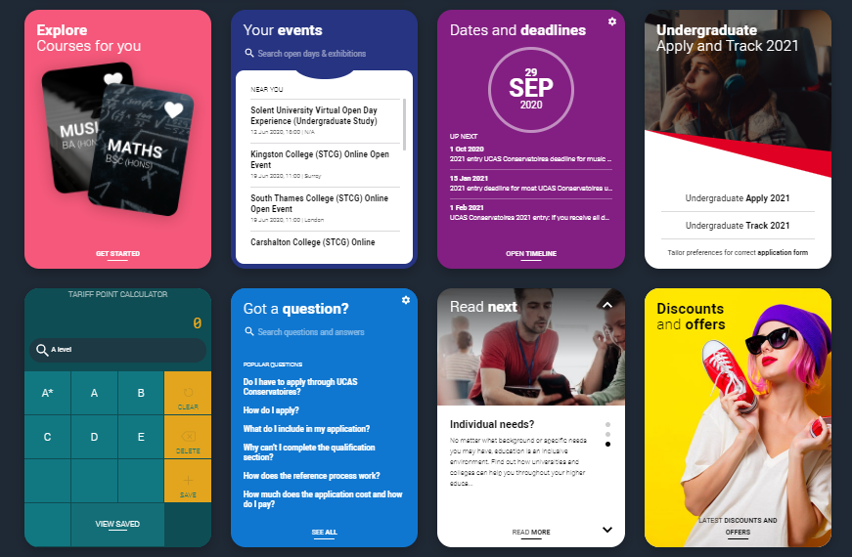


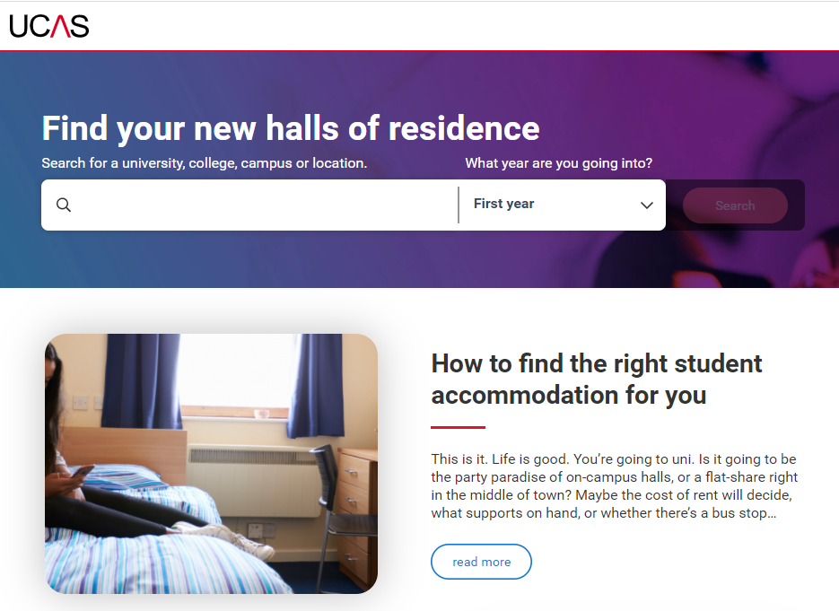

Free tools to help…
Discovery Days - at UCAS/Discovery you can explore all kinds of possibilities. Talk to subject and admissions experts, discover apprenticeships, get advice on personal statements, applying through UCAS, and more. Get stuck in and open your mind to a world of opportunities.
Join our UCAS Hub lives and Facebook lives -each live session is hosted by an expert panel to give you what you need to make an informed decision.
Accommodation Search- accommodation is high on the list when considering where you want to study, but it’s not always easy to compare what’s on offer. Understand what options there are using our new Accomodation search.

Slide 8
When to apply for 2022 entry
18 May
UCAS Undergraduate Apply opens for 2022 entry.
7 September
First day UCAS can receive a completed application to process
15 October
UCAS Application deadline for courses in medicine, veterinary medicine/science, and dentistry, and courses at Oxford or Cambridge.
January
UCAS Equal consideration application deadline.
February
UCAS Extra opens.
End of June
Last date for applications before Clearing opens.
Security marking: PUBLIC
23 March 2021
| 8

Slide 9
Applying - key facts
Register with UCAS via the Hub
Use your username and password to apply online
Students can add up to 5 choices, unless they’re applying to study medicine, veterinary, medicine/science, dentistry – then it’s 4 choices
Students can’t apply to BOTH Oxford and Cambridge
Applying costs £22 for 1 choice, or £26.50 for 5 choices
Apply by the equal consideration date
Providers can’t see other choices when you apply

Slide 10
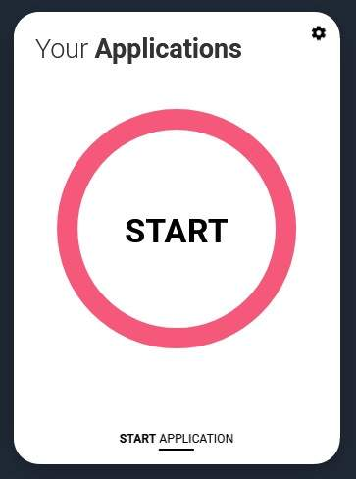
Registering
To start an application you need a UCAS Hub account.
Register for a UCAS Hub account at any time
From 18 May 2021 you’ll see a new ‘Your applications’ tile in your UCAS Hub
Click ‘Start application’ to get started…

Slide 11
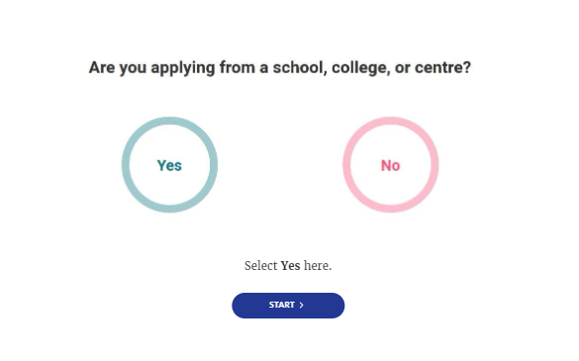
Linking to a school
If you’re applying with the help of a school, college or centre you should enter their ‘buzzword’ to link your application to them.
The buzzword is a unique code set by your school, college or centre.
By linking your application you’re giving your school, college or centre permission to view and track your application. It also means they’ll provide you with a reference, and send your application to UCAS on your behalf.

Slide 12
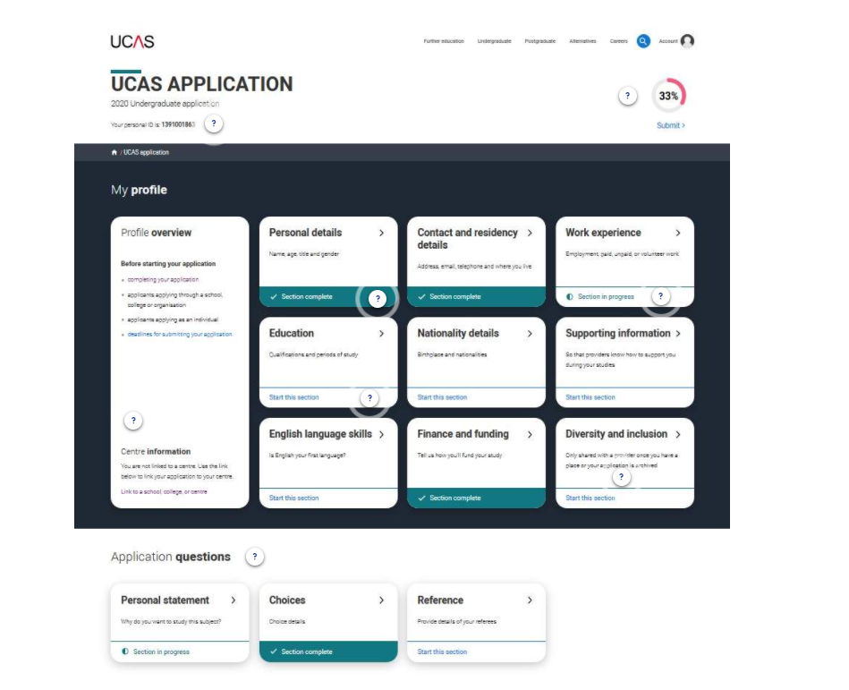
Making an application
Sections to be completed:
Personal details
Contact and residency details
Work experience
Education
Nationality details
English language skills
Supporting information
Personal statement
Choices – make up to five
References (not visible for students linked to centres)
Finance and funding
Diversity & inclusion (for students with a UK home address)
Security marking: PUBLIC
23 March 2021
| 12

Slide 13







The personal statement
The only section you have full control over
Your only chance to market yourself as an individual
UCAS’ similarity detection service:
every personal statement is run through software to check for plagiarism.
The same for all of your choices
A maximum of 4,000 characters, or 47 lines
A minimum of 1,000 characters
There isn’t a spelling or grammar check
No formatting allowed
Security marking: PUBLIC
23 March 2021
| 13

Slide 14

Start early
Include:
  academic achievements, past and present
  why you’re interested in the subject area
  your knowledge of the subject area
  your enthusiasm to go beyond the syllabus
  what you enjoy about studying
  details of your independent study skills
Security marking: PUBLIC
23 March 2021
| 14

Slide 15

Consider…
  Universities and colleges will consider:
  Have you chosen the right subject for the right reasons?
  Can you survive in an intense and pressured atmosphere?
  Do you have a range of interests and aptitudes?
  Do you have a depth of interest in the subject?
  Have you studied independently?
  Do you appear motivated and committed?
  Do you possess good numeracy and literacy skills?
Security marking: PUBLIC
23 March 2021
| 15

Slide 16



Decisions
Universities and colleges will review the:
They may also ask for:
personal statement
admissions test
qualifications
interview
reference
portfolio/audition
Security marking: PUBLIC
23 March 2021
| 16

Slide 17
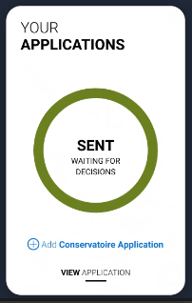
Tracking your application
Head to your UCAS Hub to track your application. Click your application to:
follow the progress 24/7
see your choices and personal information
view your offers
reply to offers online
You’ll receive one of three decisions from your choices:
Unconditional offer
Conditional offer
Unsuccessful
Security marking: PUBLIC
23 March 2021
| 17

Slide 18

Replies to offers
Once you have decisions on all your choices, you can hold a maximum of two offers:
  one as a ‘firm’ acceptance – your first choice
  the other as an ‘insurance’ acceptance. This acts as a back-up if you do not get into your ‘firm’ choice
You must then decline any remaining offers.
Once all your decisions and replies have been made, if you are not holding an offer, you may be able to use Extra or Clearing to find available places.
Security marking: PUBLIC
23 March 2021
| 18

Slide 19

Other options
Extra (Feb – Jul)
  Used all five choices and had no offers.
  Add Extra choices for consideration one at a time in Track.
Clearing (Jul – Oct)
Apply after 30 June, receive no offers, decline all offers, not met conditions.
Find vacancies from early July, and add a Clearing choice to your application.
Security marking: PUBLIC
23 March 2021
| 19

Slide 20



Additional help
UCAS Customer Experience Centre
0371 468 0 468
From outside the UK:
+44 330 3330 230
Monday to Friday, 08:30 – 18:00 (UK time)
Stay up to date online at:
facebook.com/ucasonline
twitter.com/UCAS_online
Security marking: PUBLIC
23 March 2021
| 20

Slide 21
Thank you
Security marking: PUBLIC/INTERNAL USE ONLY/CONFIDENTIAL
23 March 2021
| 21

