Slide 1
My Application
Registering for an Undergraduate application.
Updated: 25 March 2021

Slide 2

Using this slide deck
This presentation deck has been designed to allow teachers and advisers to share the application journey with students.
The information relates to the 2022 application cycle which will open in May 2021. Up until this point you will not be able to replicate the journey on ucas.com.
You can copy and paste the screenshots included into your own materials and guides to support students. However please note at the time of publishing this document (March 2021) the 2022 application is in the final stages of testing.
There may be minor enhancements to the application – for example updated help-text or question text. As such, some screenshots will change and we will update this slide deck periodically.

Slide 3
Registering for an account.

Slide 4
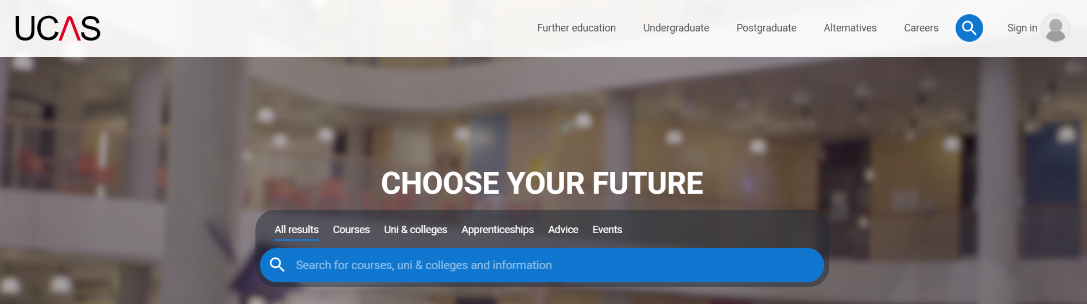
Registering for an account
Head to ucas.com
Select Sign in from the drop-down menu.

Slide 5
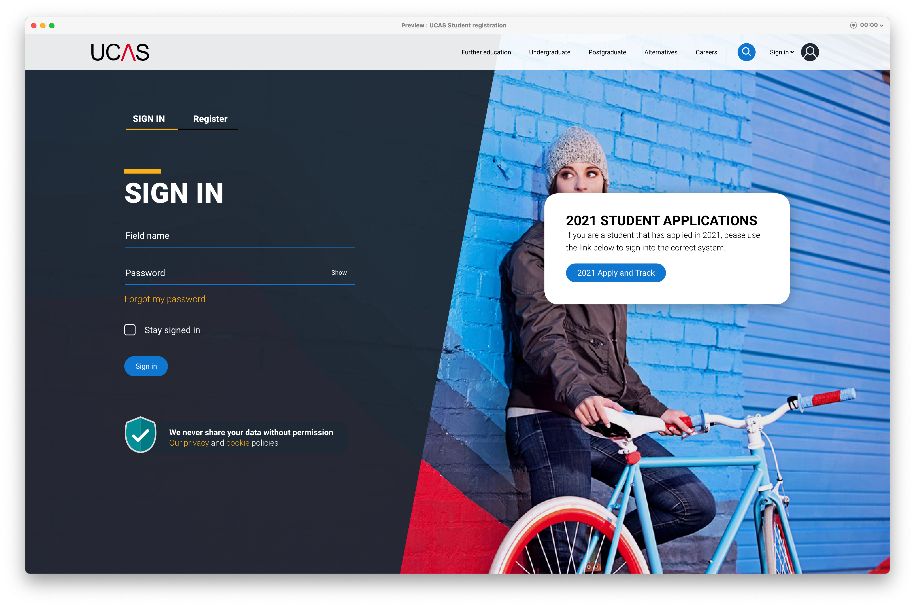
Registering for an account
Choose Register.
Note: The design of this screen is likely to evolve as we proceed through the application cycle.

Slide 6
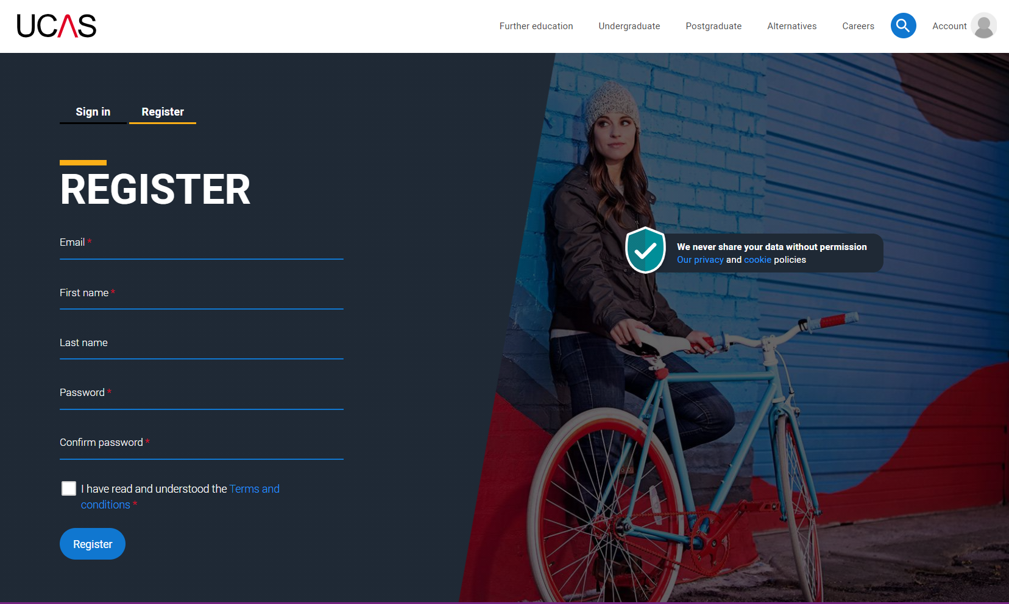
Registering for an account
Complete the short form.
Make sure the password is memorable.

Slide 7
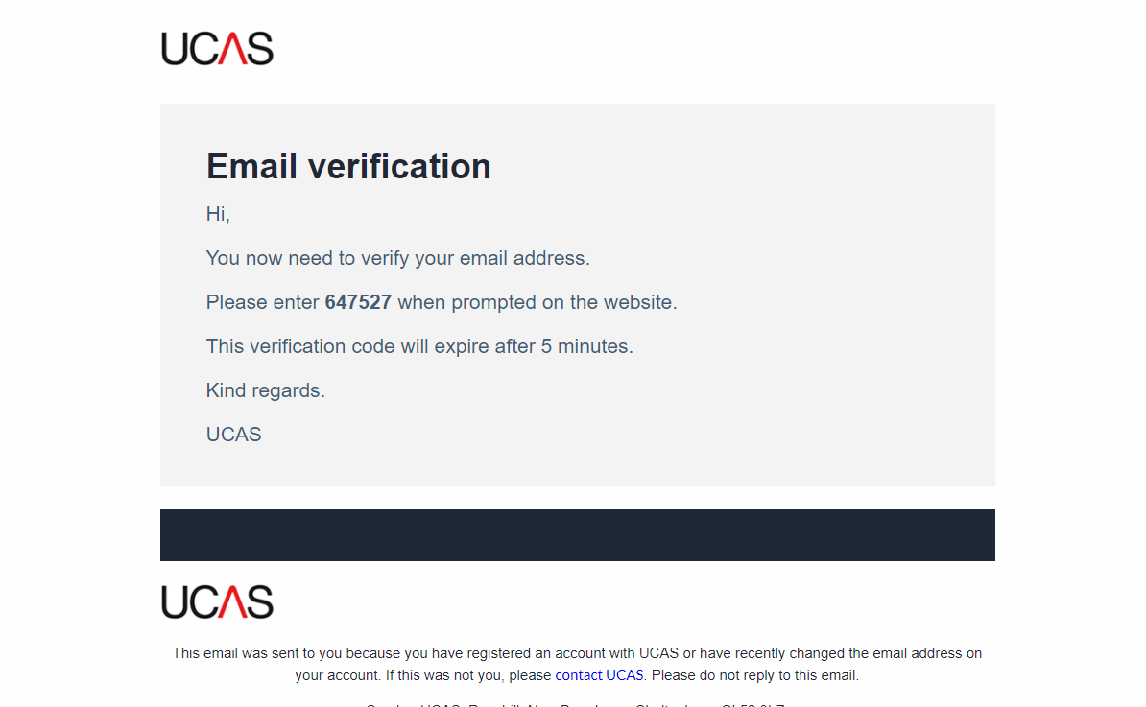
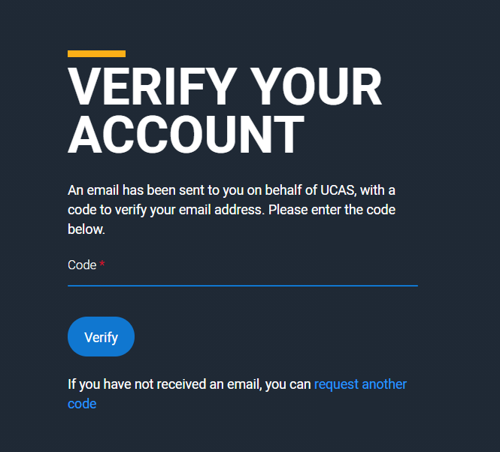
Registering for an account
We’ll email you a code to verify your email address, so we know we’ve got the right details.

Slide 8
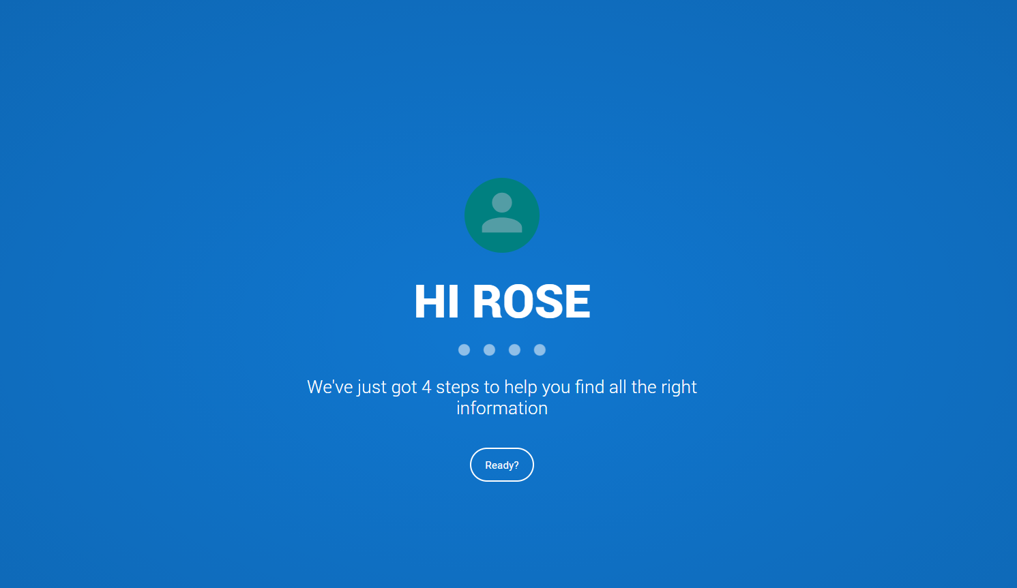
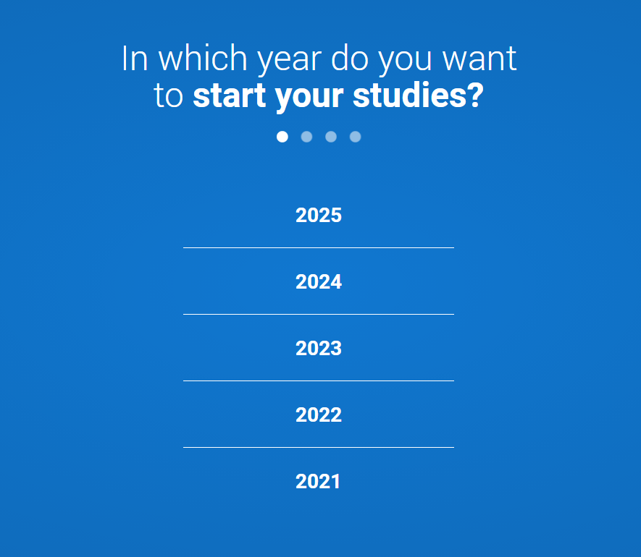
Registering for an account
Once you’ve registered, we ask you a few questions like when you want to start studying, where you live and what you’re interested in so we can tailor the information you see.
Make sure you choose the correct study year, 2022 if you want to start next year.

Slide 9
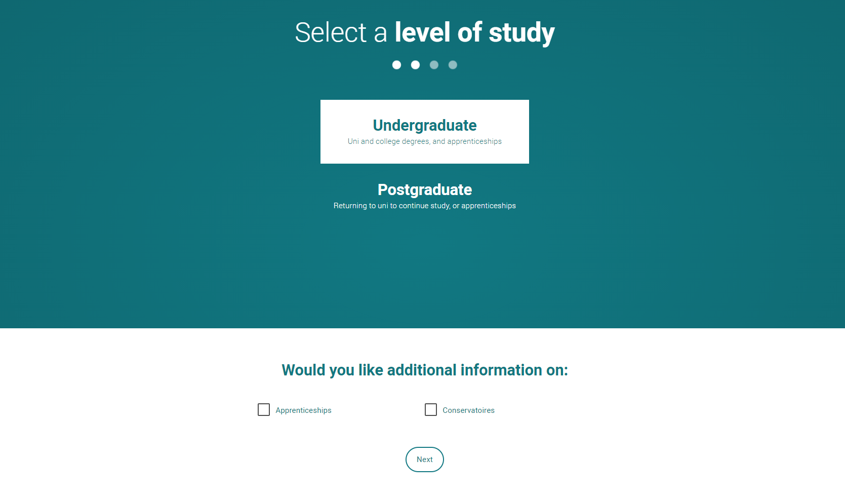
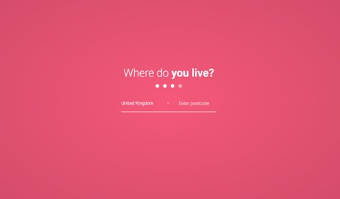
Registering for an account
Choose the correct level of study, it's Undergraduate if you are still at school/college.
You can choose to get information on apprenticeships and conservatoires here too.
Tell us where you live so we can direct you to the right information.

Slide 10
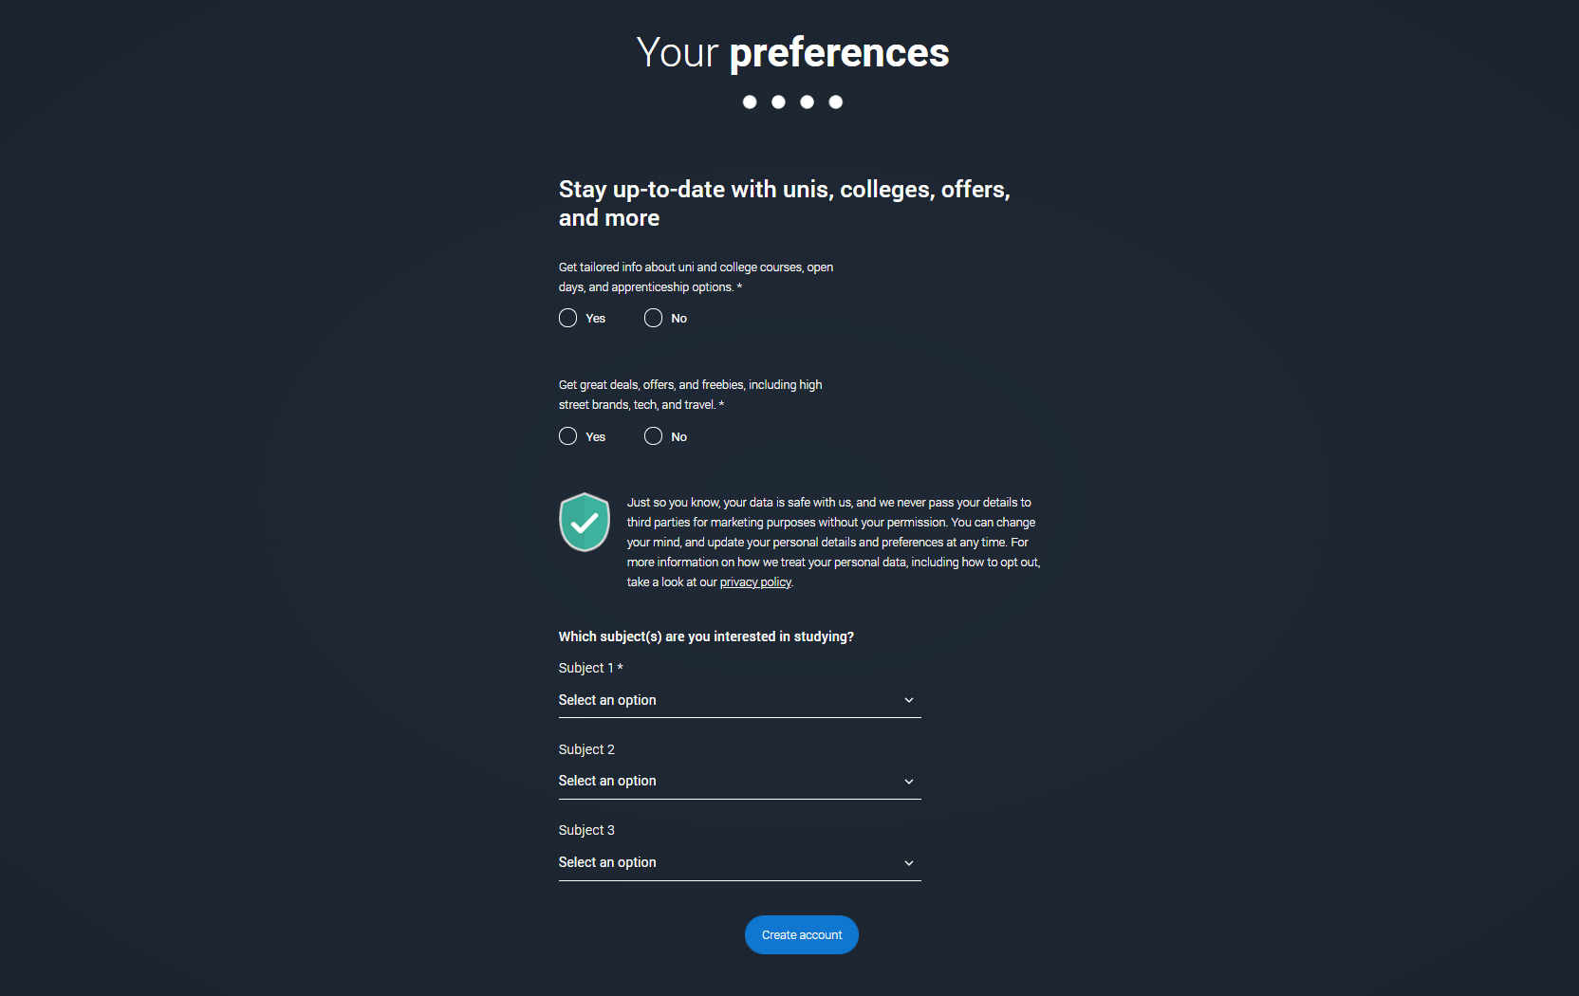
Registering for an account
Choose if you want to get tailored information about uni, college and apprenticeship options.
Select the subjects that you are interested in – you can change these at any point in your preferences.
Then scroll right to the bottom to Create account.

Slide 11
Starting your application.

Slide 12
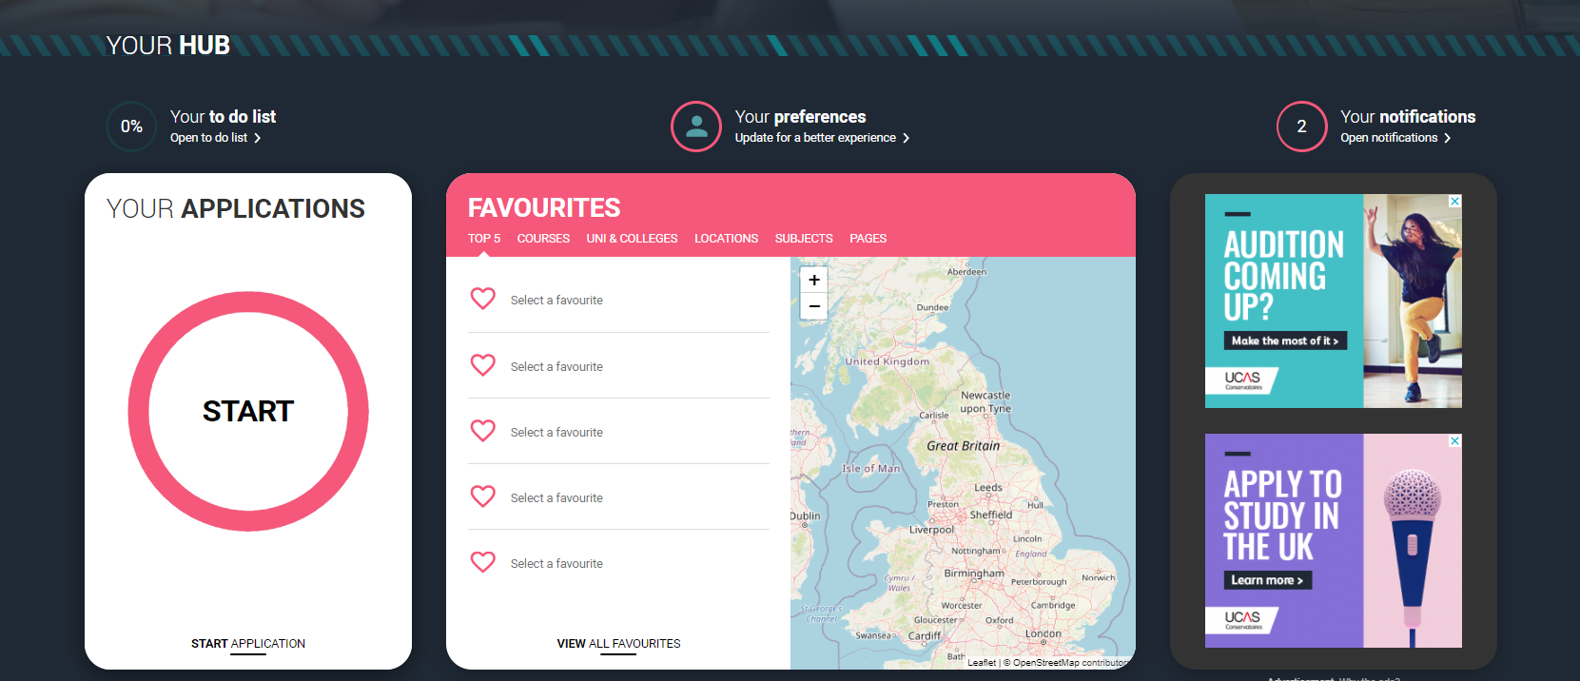
Starting your application
To start your UCAS application click on the Your application tile.
This will be visible from 18 May 2021 for students applying to study in 2022.

Slide 13
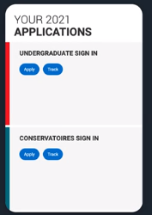
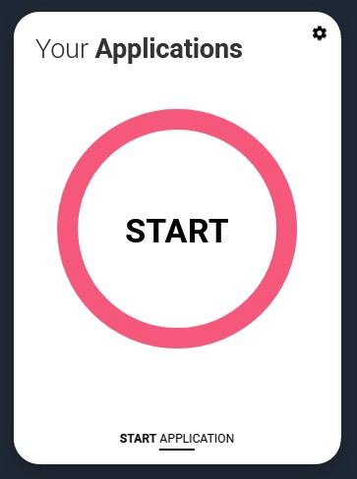
Make sure you have the correct year
If you already have a Hub account and have said you are interested in courses for the 2021 cycle, you’ll see this card.
To start your 2022 UCAS application click on the Your application tile with the red circle.

Slide 14
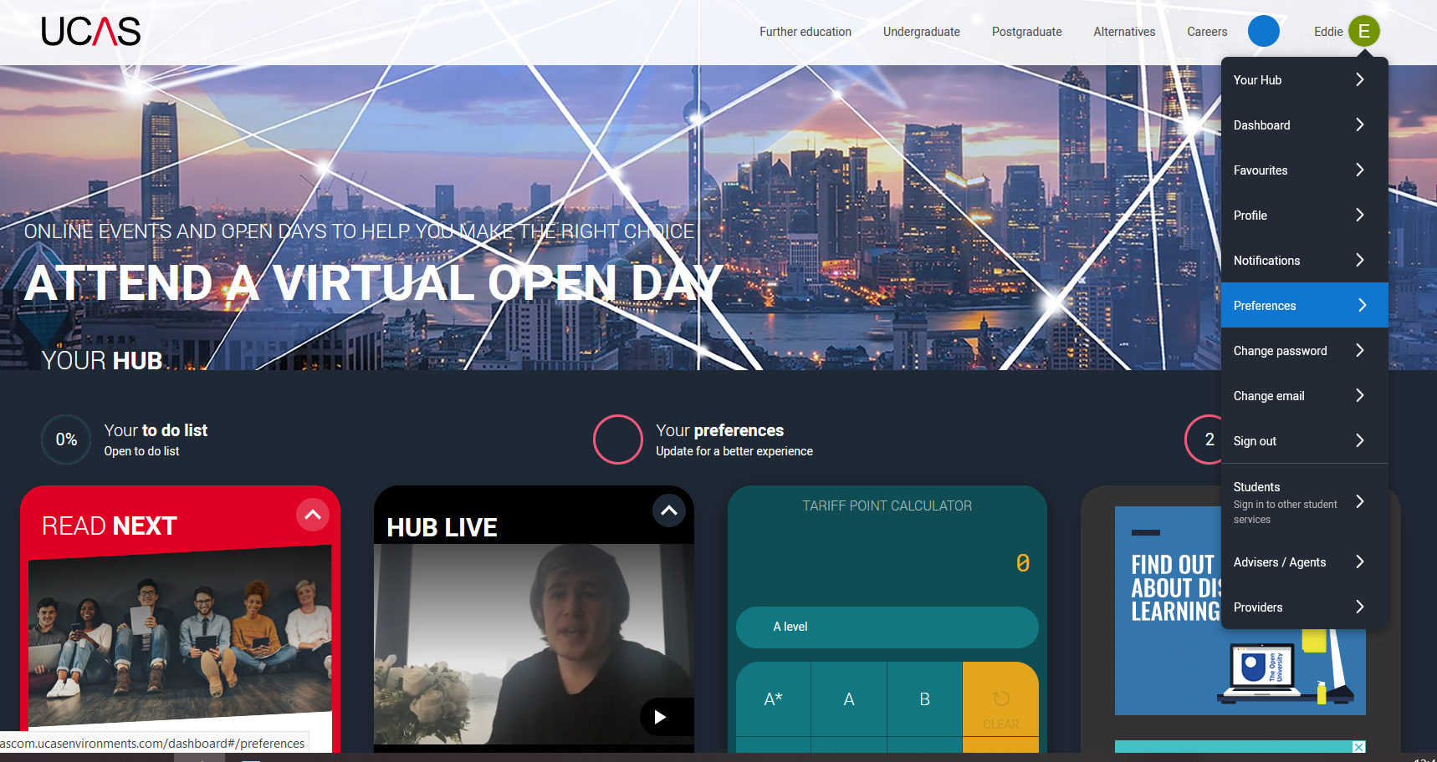
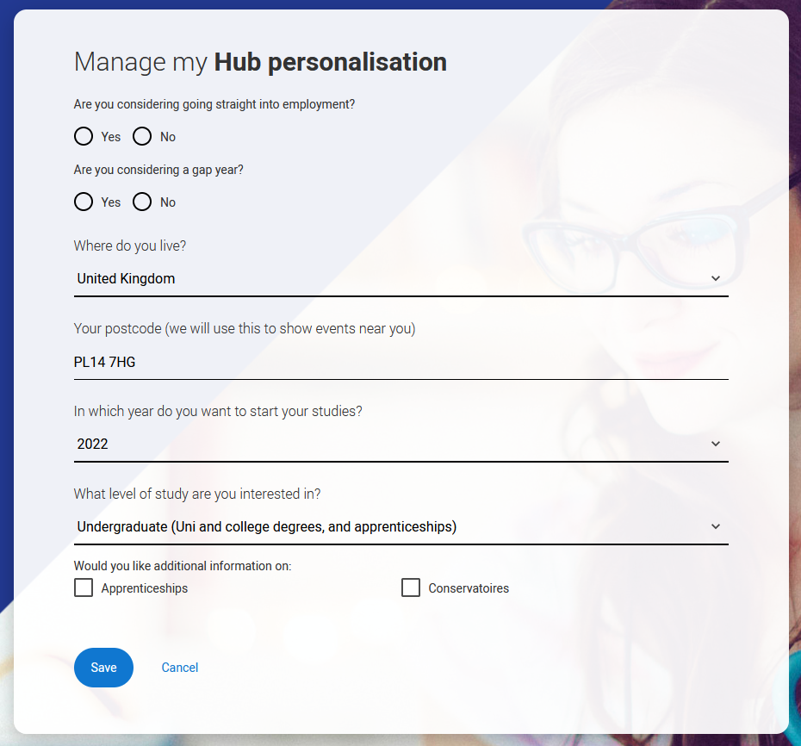
Update your preferences
If you need to change the application cycle to show the Your application tile for 2022, click on Preferences from the main menu.
Then select 2022 in answer to the question In which year do you want to start your studies?

Slide 15
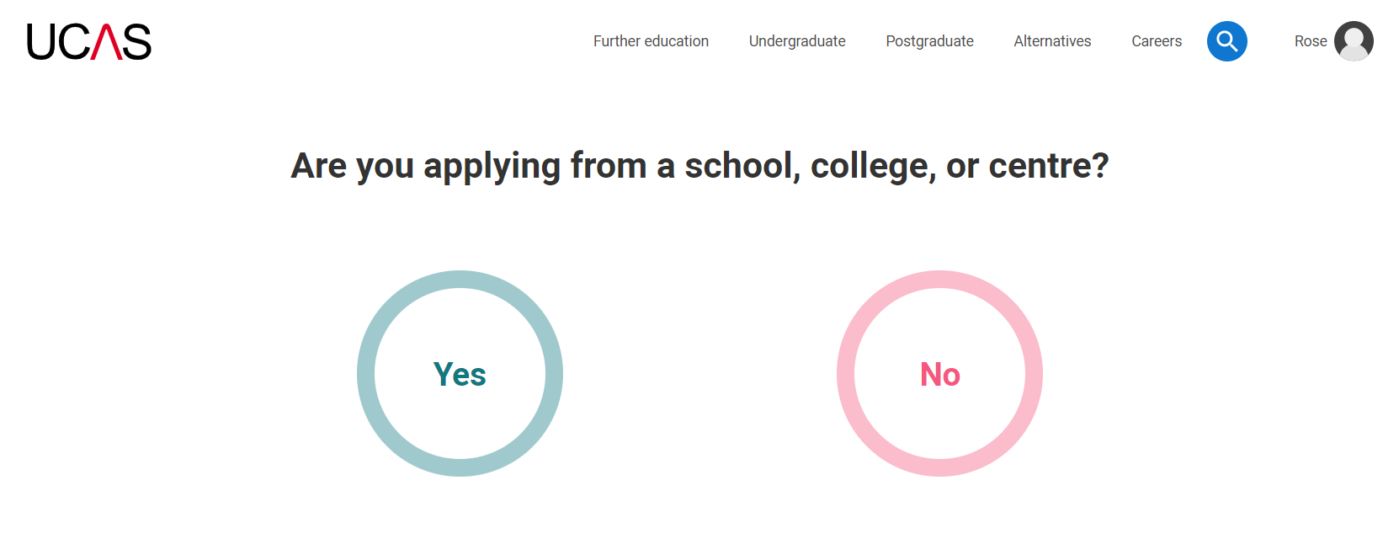
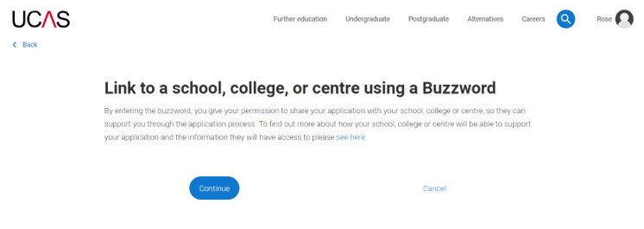
Linking to your school, college or centre
If you're applying with the help of your school, college or centre then select Yes and enter our Buzzword.

Slide 16
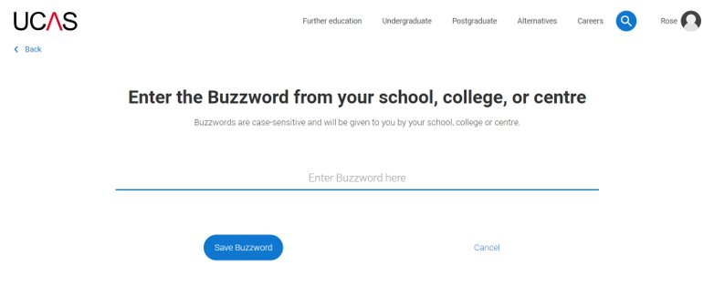
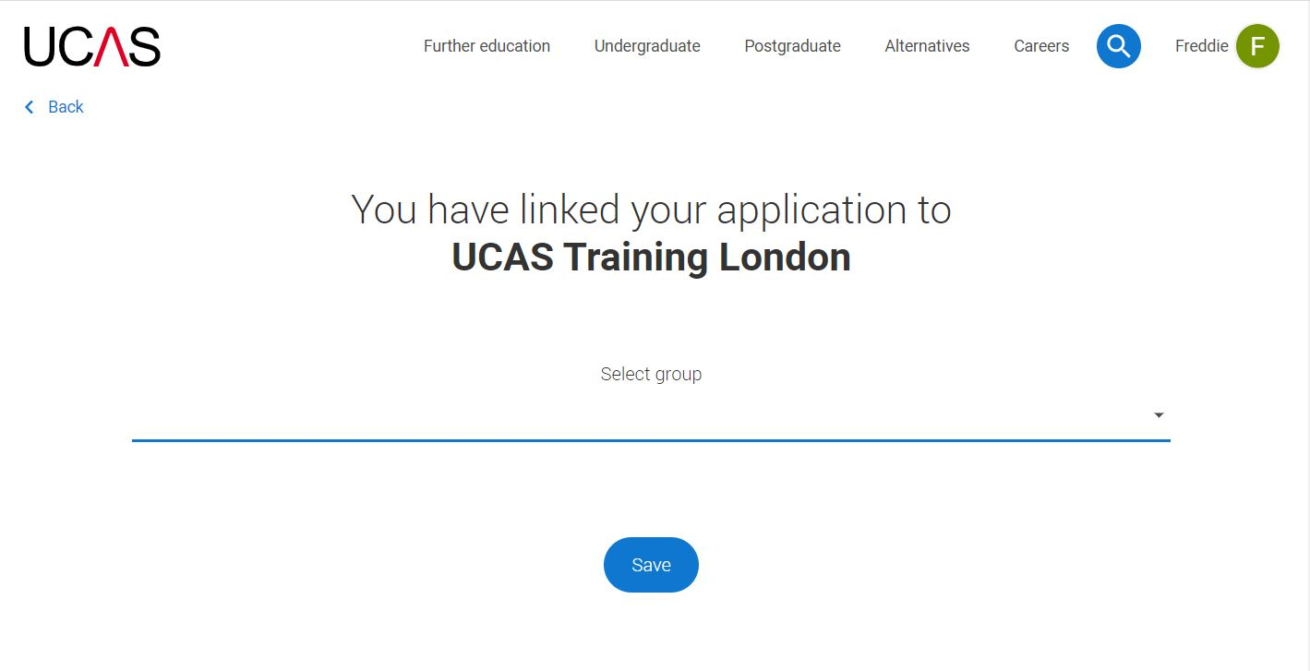
Linking to your school, college or centre
Enter the buzzword, and confirm the details are correct.
This will link your application to your school or college, so they can track your progress and provide support, including adding your reference

Slide 17
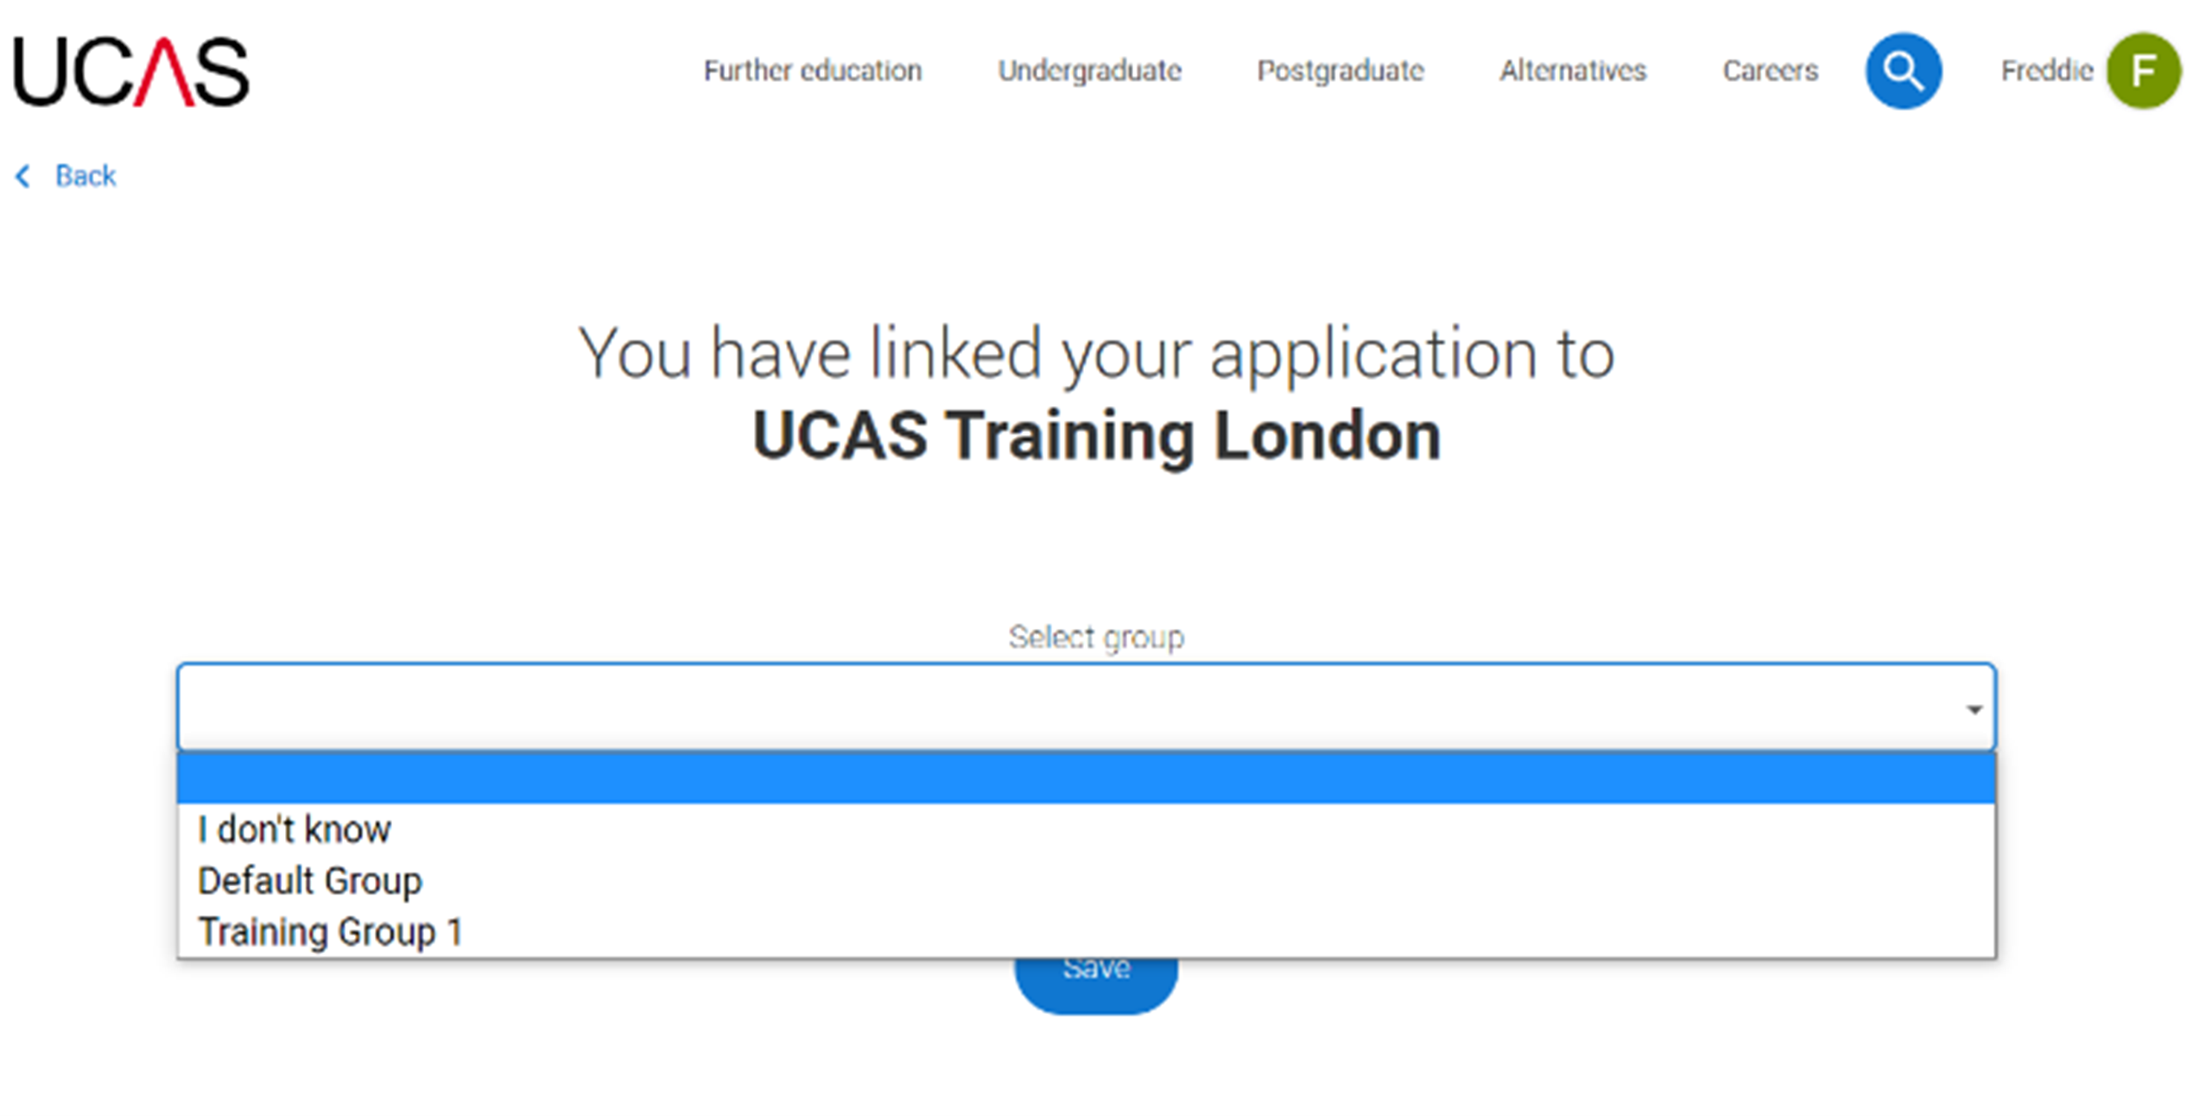
Linking to your school, college or centre
Once your application has been linked, you can then select a group (if this has been set up by your school or college) for your application.

Slide 18
Application overview.

Slide 19
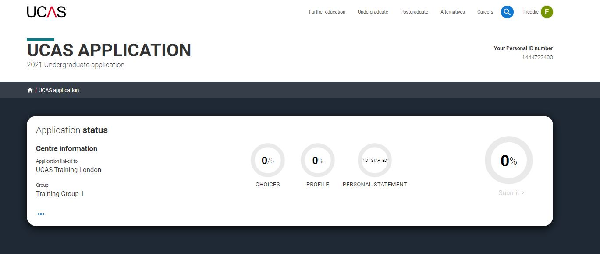
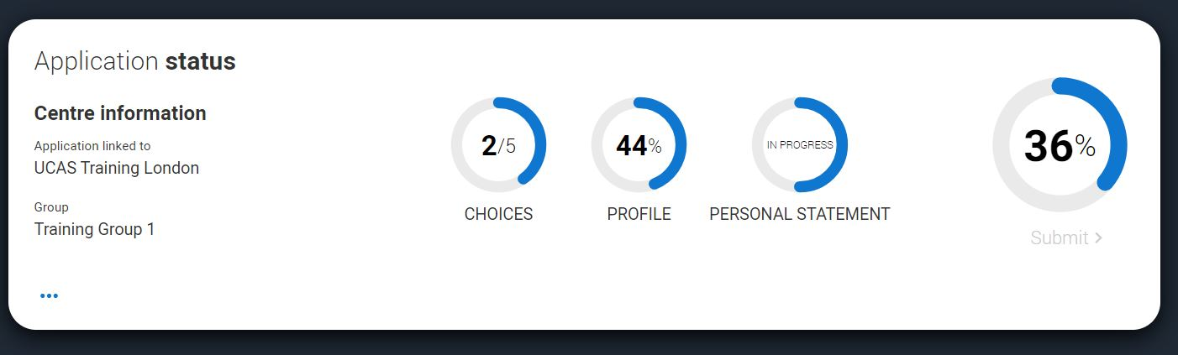
Application overview
Your homepage is where you'll see the sections that need completing.
You don’t need to complete the application at once, you can log in and out at any time until you're finished.
As you add information to each tile, the percentage complete dial should increase each time you mark a section as complete.

Slide 20
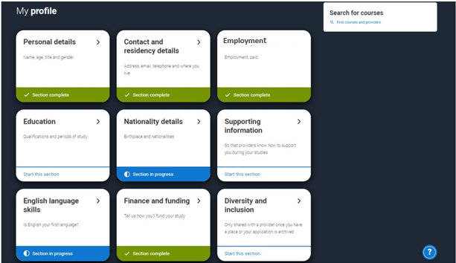
Application overview
The second section is your profile - information about you.
The tiles will give you an overview; if a section is complete, in progress, or you need to start it.
All sections must be marked as complete to send to UCAS.
You must complete all mandatory questions to mark a section as complete (they have a *).

Slide 21
Personal details.

Slide 22
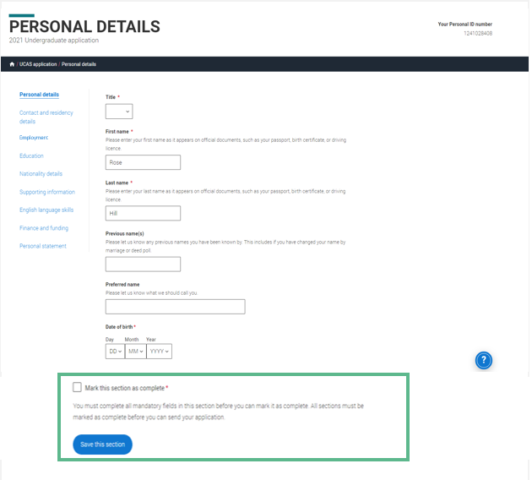
Personal details: your name should already be visible, but you'll need to add your title and complete the other mandatory fields (marked with a *).
Once you have completed a section you must remember to mark the section as complete at the bottom of each page.

Slide 23
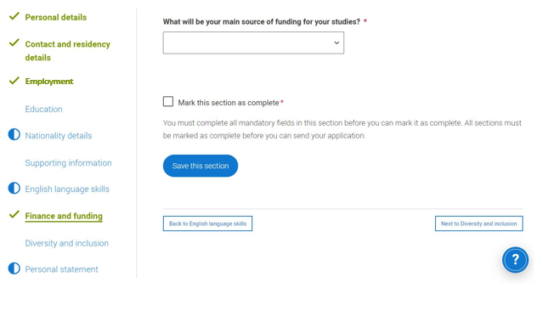
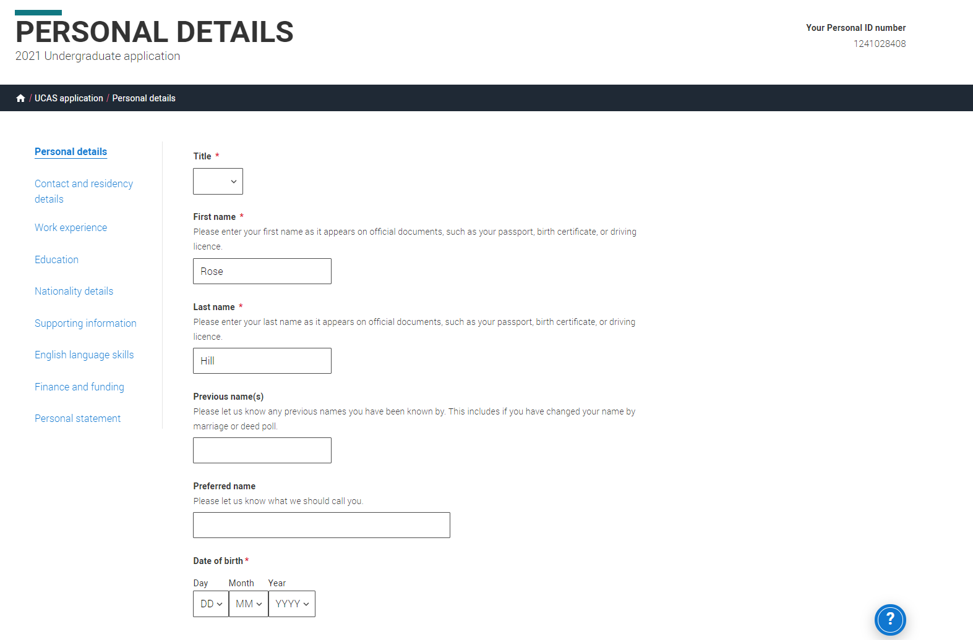
Application overview
The list on the left of each section will show which sections are completed (with a tick), which are in progress (with a half-moon) and which have yet to be started (no icon).
Click on the throughout for help text to provide advice about what to put.

Slide 24
Contact and residency details

Slide 25
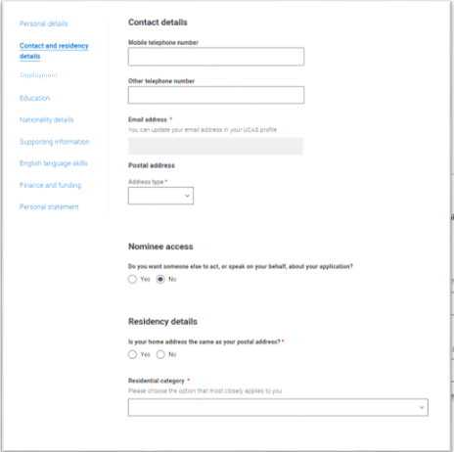
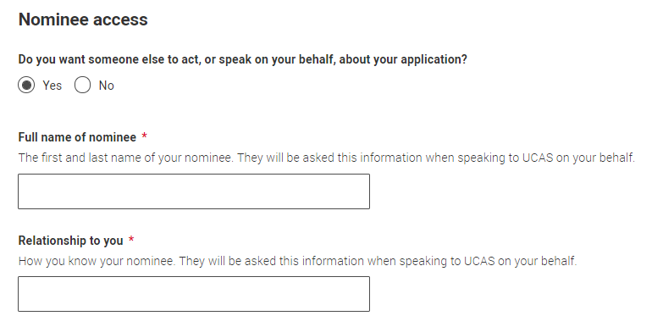
You should provide either a landline or a mobile number in this section.
You'll only see the fields to add the nominated contact details if you answer Yes to the question.
This means someone else can speak to us about your application.

Slide 26
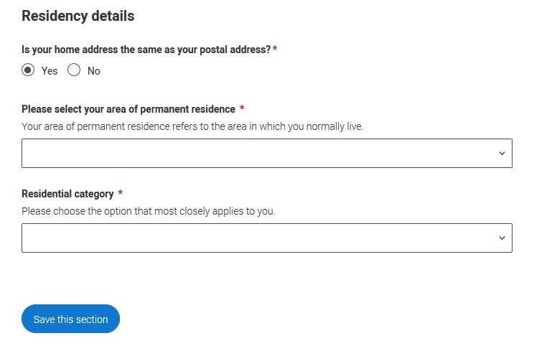
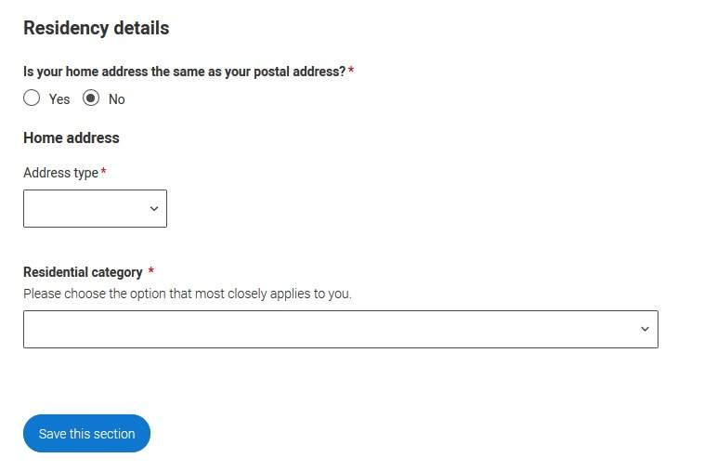
If you select No, additional Home address questions will appear.

Slide 27
Employment

Slide 28
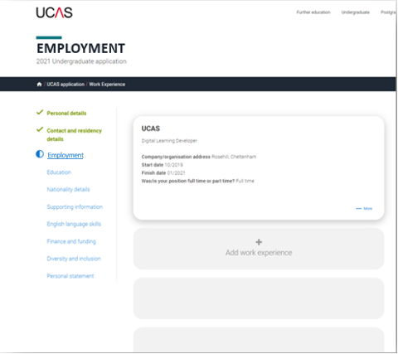
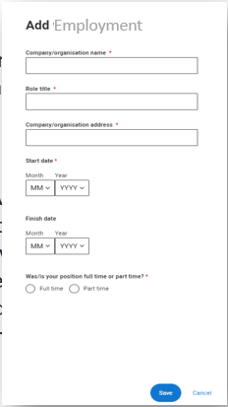
If you add more than one employment it will appear in chronological order with the most recent at the top.
Not everyone will have something to enter here. It's up to you whether you create an employment record here or not - but remember to mark the section as complete!

Slide 29
Education

Slide 30
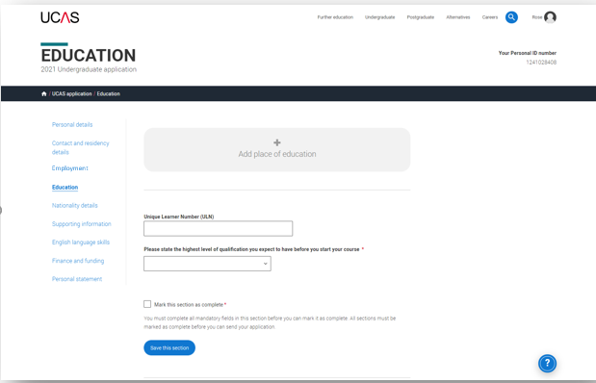
You’ll add details of all qualifications you’ve already achieved and those you’re studying towards.
First you need to add details of where you’ve studied, or are studying, then add qualifications.
Start by clicking Add place of education.
You’ll be asked for a Unique Learner Number – if you don’t have one leave the question blank.

Slide 31
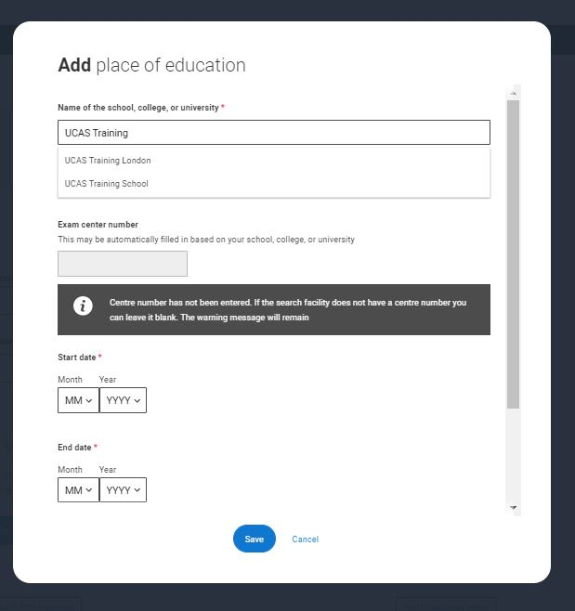
Type the name of where you studied. Once you find your centre, click on the name and the Exam centre number will automatically populate.
If an exam centre number doesn’t appear that’s ok, it’s because we don’t have it.
Add when you started and finished, and if you’re still studying there add the month, you’re due to finish.

Slide 32
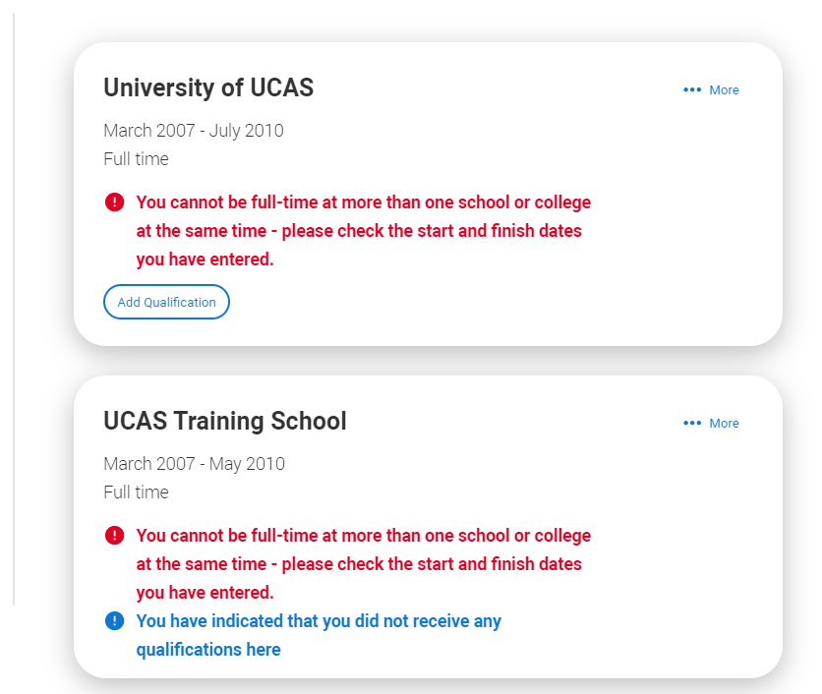
There are warning messages to help you.
For example, you can't say you attended 2 or more places of study full-time during the same date range.
Red text are warnings and mean something is wrong and blue text is for information you need to be aware of.

Slide 33
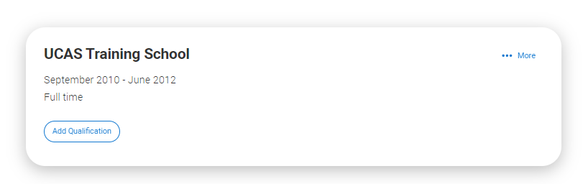
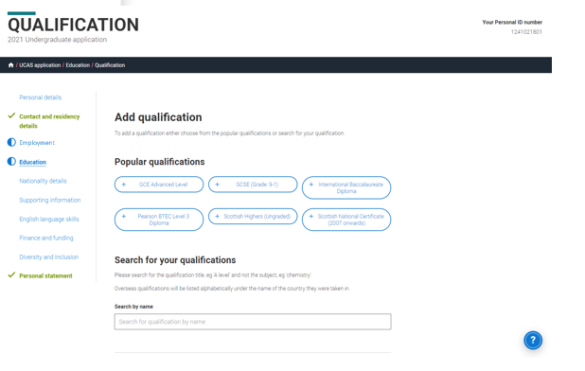
Once you’ve added where you studied you can enter the qualifications.
Click the Add qualification button and search for your qualification.

Slide 34
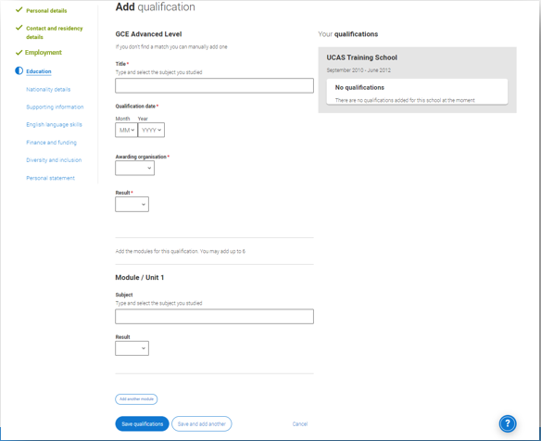
The qualification dates you can select are based on those you entered when you set up the centre.
If you know which awarding organisation it is, enter it here – speak to your teacher or tutor if you’re not sure.
If you haven't finished the qualification or had your result, then you must choose Pending.

Slide 35
Nationality details.

Slide 36
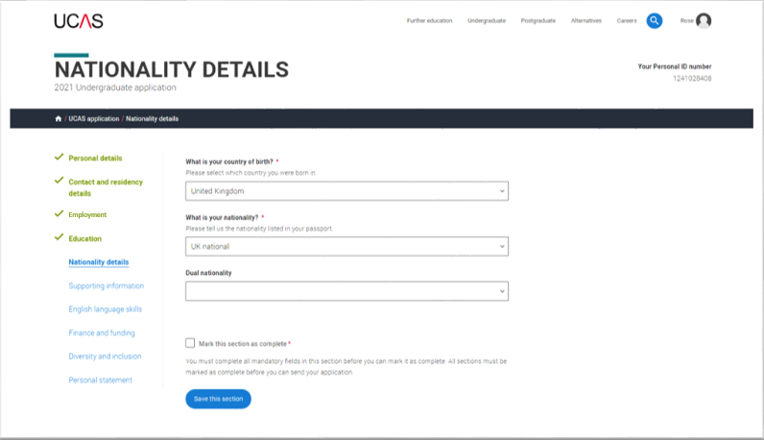
If you are a UK national, this is what you will see.

Slide 37
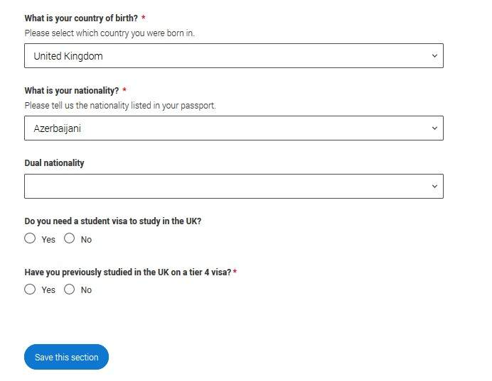
If you were born in the UK but have a different nationality, you will be asked additional questions.
The information you provide will help universities and colleges in determining your eligibility and allow them to assist you with the visa application process, if required.
There's some possible combinations but we'll only show relevant fields depending on your answers.

Slide 38
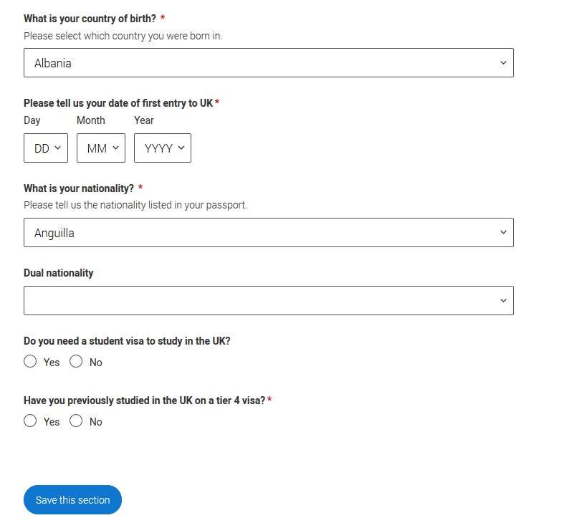
If you weren't born in the UK you’re asked for the date of first entry to the UK.
If you’re not in the UK yet, put the first of the month you plan to arrive.
There's some possible combinations but to help you we'll only show relevant fields depending on your answers.

Slide 39
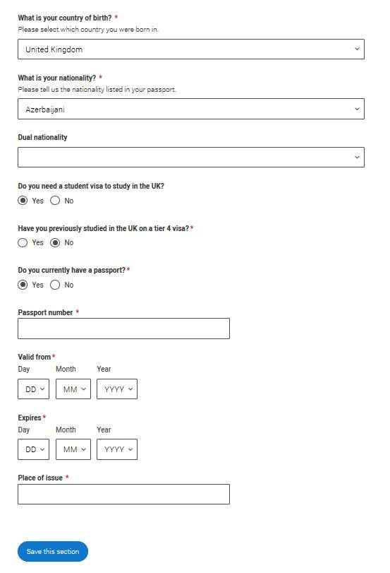
If you select you will need a visa, you’ll also be asked for your passport details.
If you have a passport, we ask you for your passport number, valid from and expiry dates; and place of issue.

Slide 40
Supporting information

Slide 41
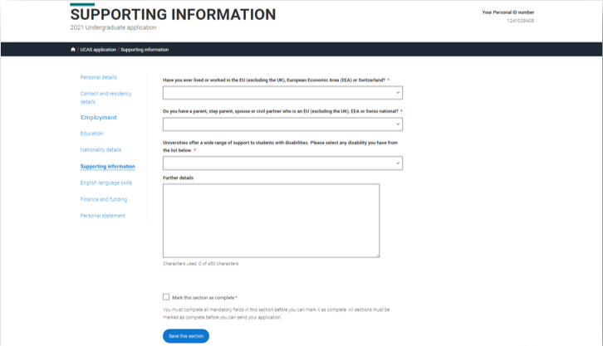
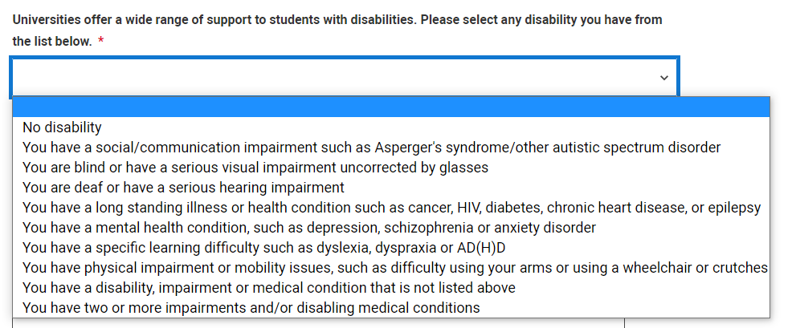
All questions are mandatory (*), but you have the option of I don't know and Prefer not to say for the first two.
You don't have to declare a disability if you don't want to, you can select No disability.
Information completed here is not used to make a decision on your application. It’s only shared with those involved in supporting you, or making the arrangements for support.

Slide 42
English language skills.

Slide 43
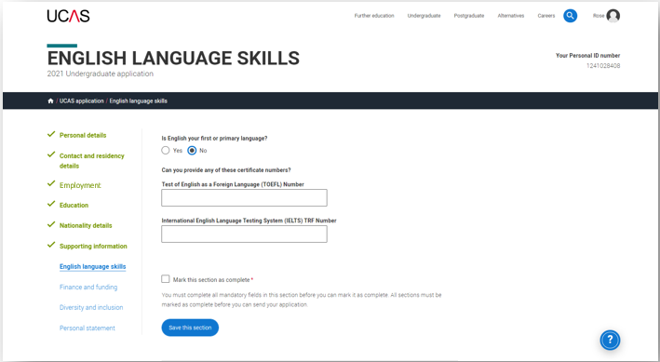
If English isn't your first or primary language, we'll ask for your TOEFL or IELTS registration numbers, you only need to enter reference numbers if you’ve been assigned one and you know it.

Slide 44
Finance and funding.

Slide 45
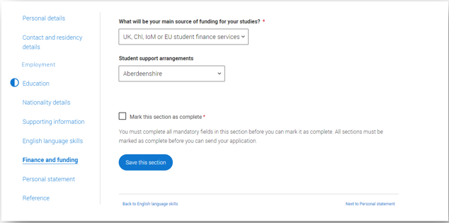
You will only be asked further questions in finance and funding if you select UK, ChI, IoM or EU Student Finance Services.
We'll ask you for your local authority under ‘Student support arrangements’.
For more information head to: ucas.com/finance

Slide 46
Diversity and inclusion.

Slide 47
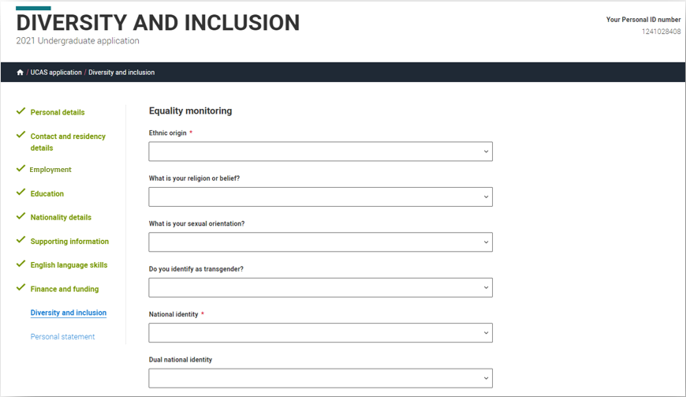
You’ll only see these questions if you have a UK home or postal address.
There are two mandatory fields(*), but you have the option to respond with I prefer not to say.
This information is only shared with universities or colleges once you have secured a place, it does not influence any decision making. It’s used to ensure applications are treated fairly.

Slide 48
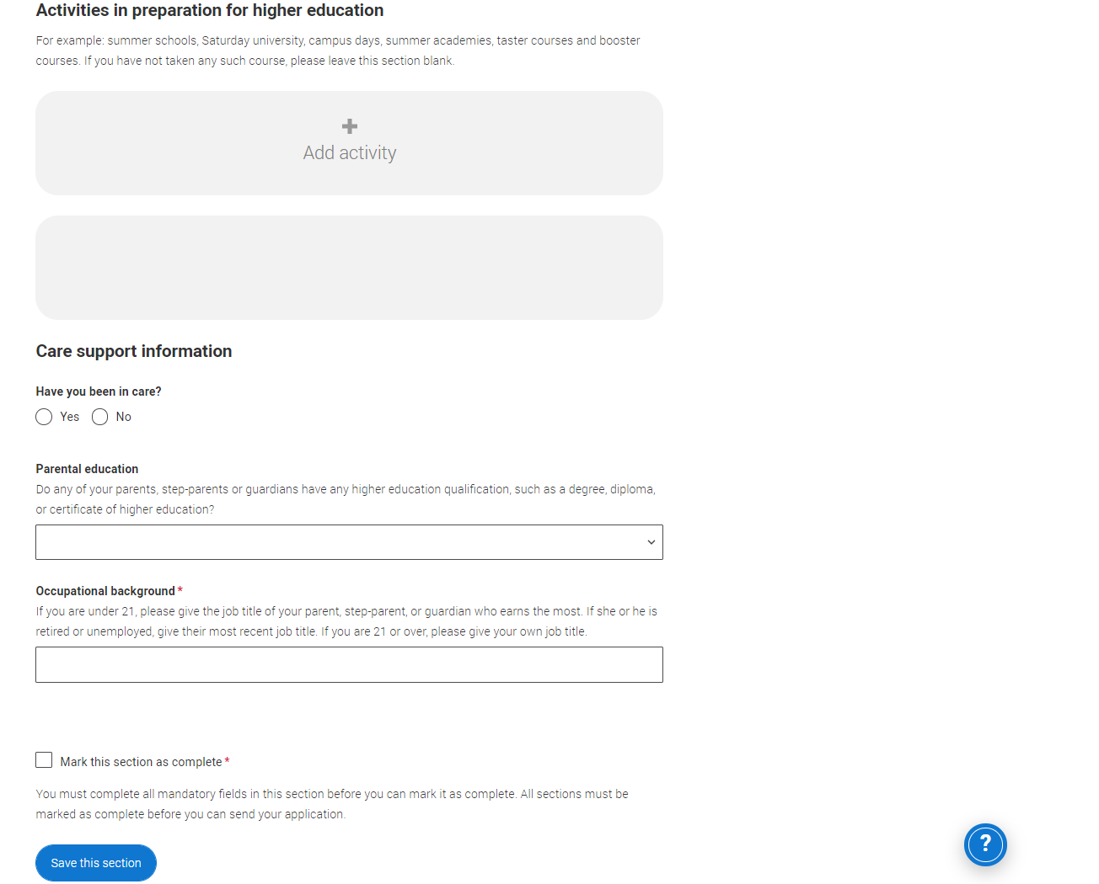
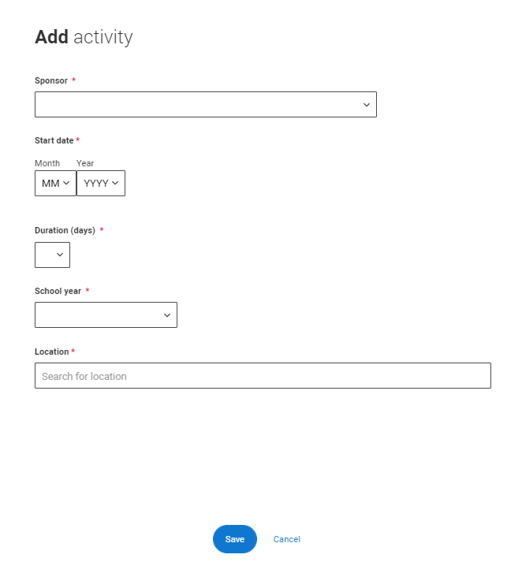
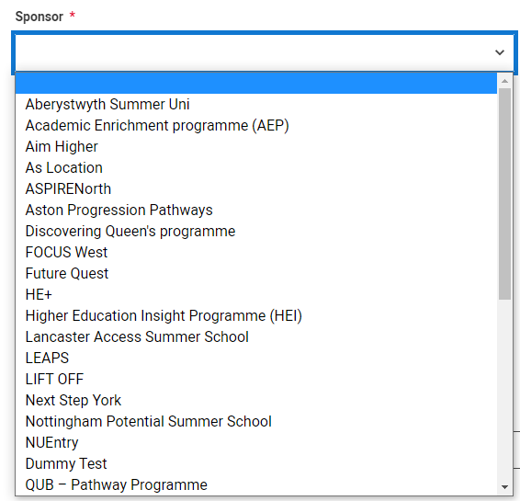
Details of specific organised preparation activities should be entered here; these will normally take place at a University or College campus. You will know if you have participated in such activities.
When adding the activity there is a drop-down box with options to choose from.

Slide 49

You can select I prefer not to say for the parental education question.
For the occupational background, you must type at least 3 letters into the response field, and then select an option from the menu that appears below it.

Slide 50
Personal Statement.

Slide 51


You can save and edit this section as many times as you need to.
If you try to navigate away without saving your work. We'll remind you with a pop-up warning.

Slide 52

The Mark this section as complete feature is only available on the Preview screen.

Slide 53
Adding a choice.

Slide 54


To add your choices, click the Choices section.
Start typing the name of the university or college into the institution field. Select from the options displayed.
Do the same for the course you have selected.
Locations and start dates are displayed according to the course details.

Slide 55

Some courses may require you to disclose your criminal conviction status.
We'll only show this question if the course choice requires it.

Slide 56

There is a maximum of 5 choices and choice restrictions still apply (a maximum of four courses in any one of medicine, dentistry, veterinary medicine or veterinary science).
Once all choices are added select confirm choices to mark the section as complete.

Slide 57

Some courses have extra admissions tests and assessments.
We'll show these in blue text on the choice card. This should not be a surprise to you, as you should have seen details of this when researching the course.

Slide 58


Clicking the 3 dots in the bottom right of a card enables you to see it as a summary.
Any choice combinations that are not permitted will be flagged with red text on the right of each relevant card.
For example these screens show error messages for students trying to apply to University of Cambridge and University of Oxford.

Slide 59

Submitting the application.

Slide 60


There are 4 steps to the submission process.
The application must be complete (showing 100%) before pressing submit.
Security marking: PUBLIC
| 60

Slide 61


This shows the full application and you can download it as a pdf (in the top right) to help you check it.
At the bottom of the application, click Accept and proceed (or return to application if you want to make more changes).
Security marking: PUBLIC
| 61

Slide 62

We then need you to update your preferences.
Security marking: PUBLIC
| 62

Slide 63

You must tick the box at the bottom of the page to confirm you have read and understood the terms and conditions.
You can collapse these by clicking the .
Then click Accept and proceed, or you can Return to application, or Return to marketing preferences.
Security marking: PUBLIC
| 63

Slide 64
Pay and Submit.

Slide 65

If your school or college pay for your application you wont need to enter any credit card details.
Security marking: PUBLIC
| 65

Slide 66

If you need to pay by card you will see this, click Pay now and you will be asked to enter your card details.
£26.50
Security marking: PUBLIC
| 66

Slide 67

When you've paid and submitted your application, it will go to your school/college to check.
They will submit the application to UCAS.
If you log in you will see a read only version.
| 67

