Slide 1
Service Provider Meeting 13 December 2021

Slide 2
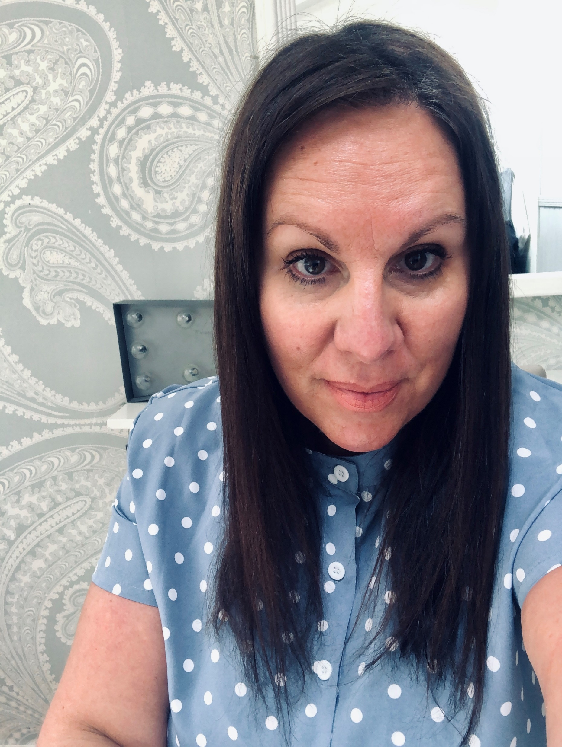
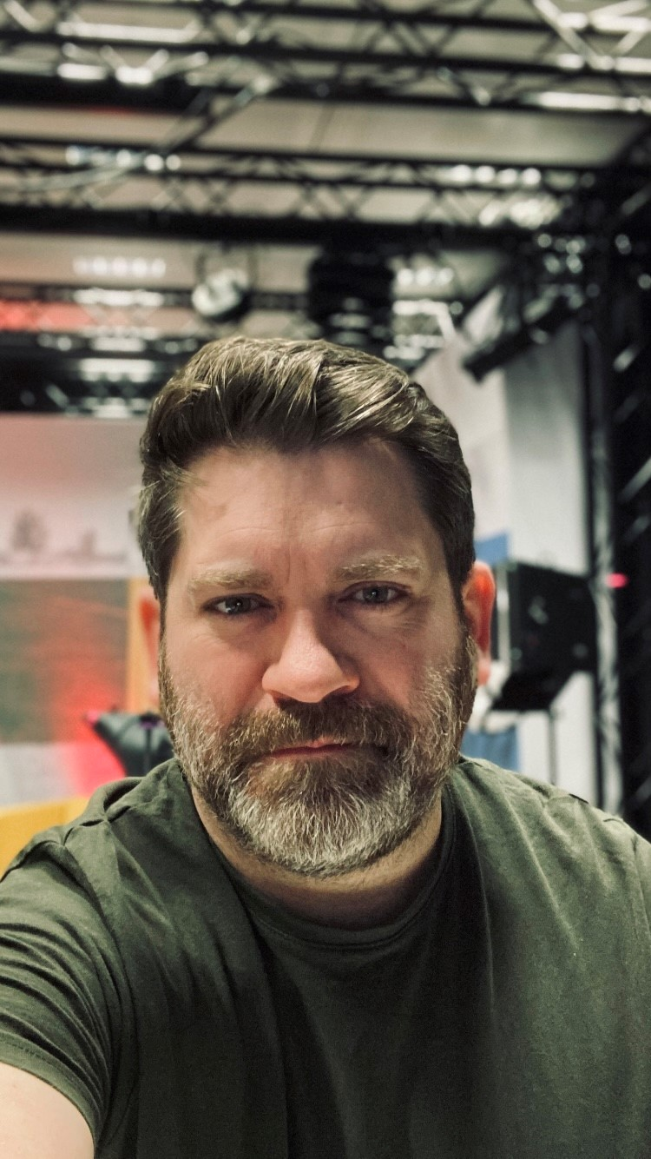
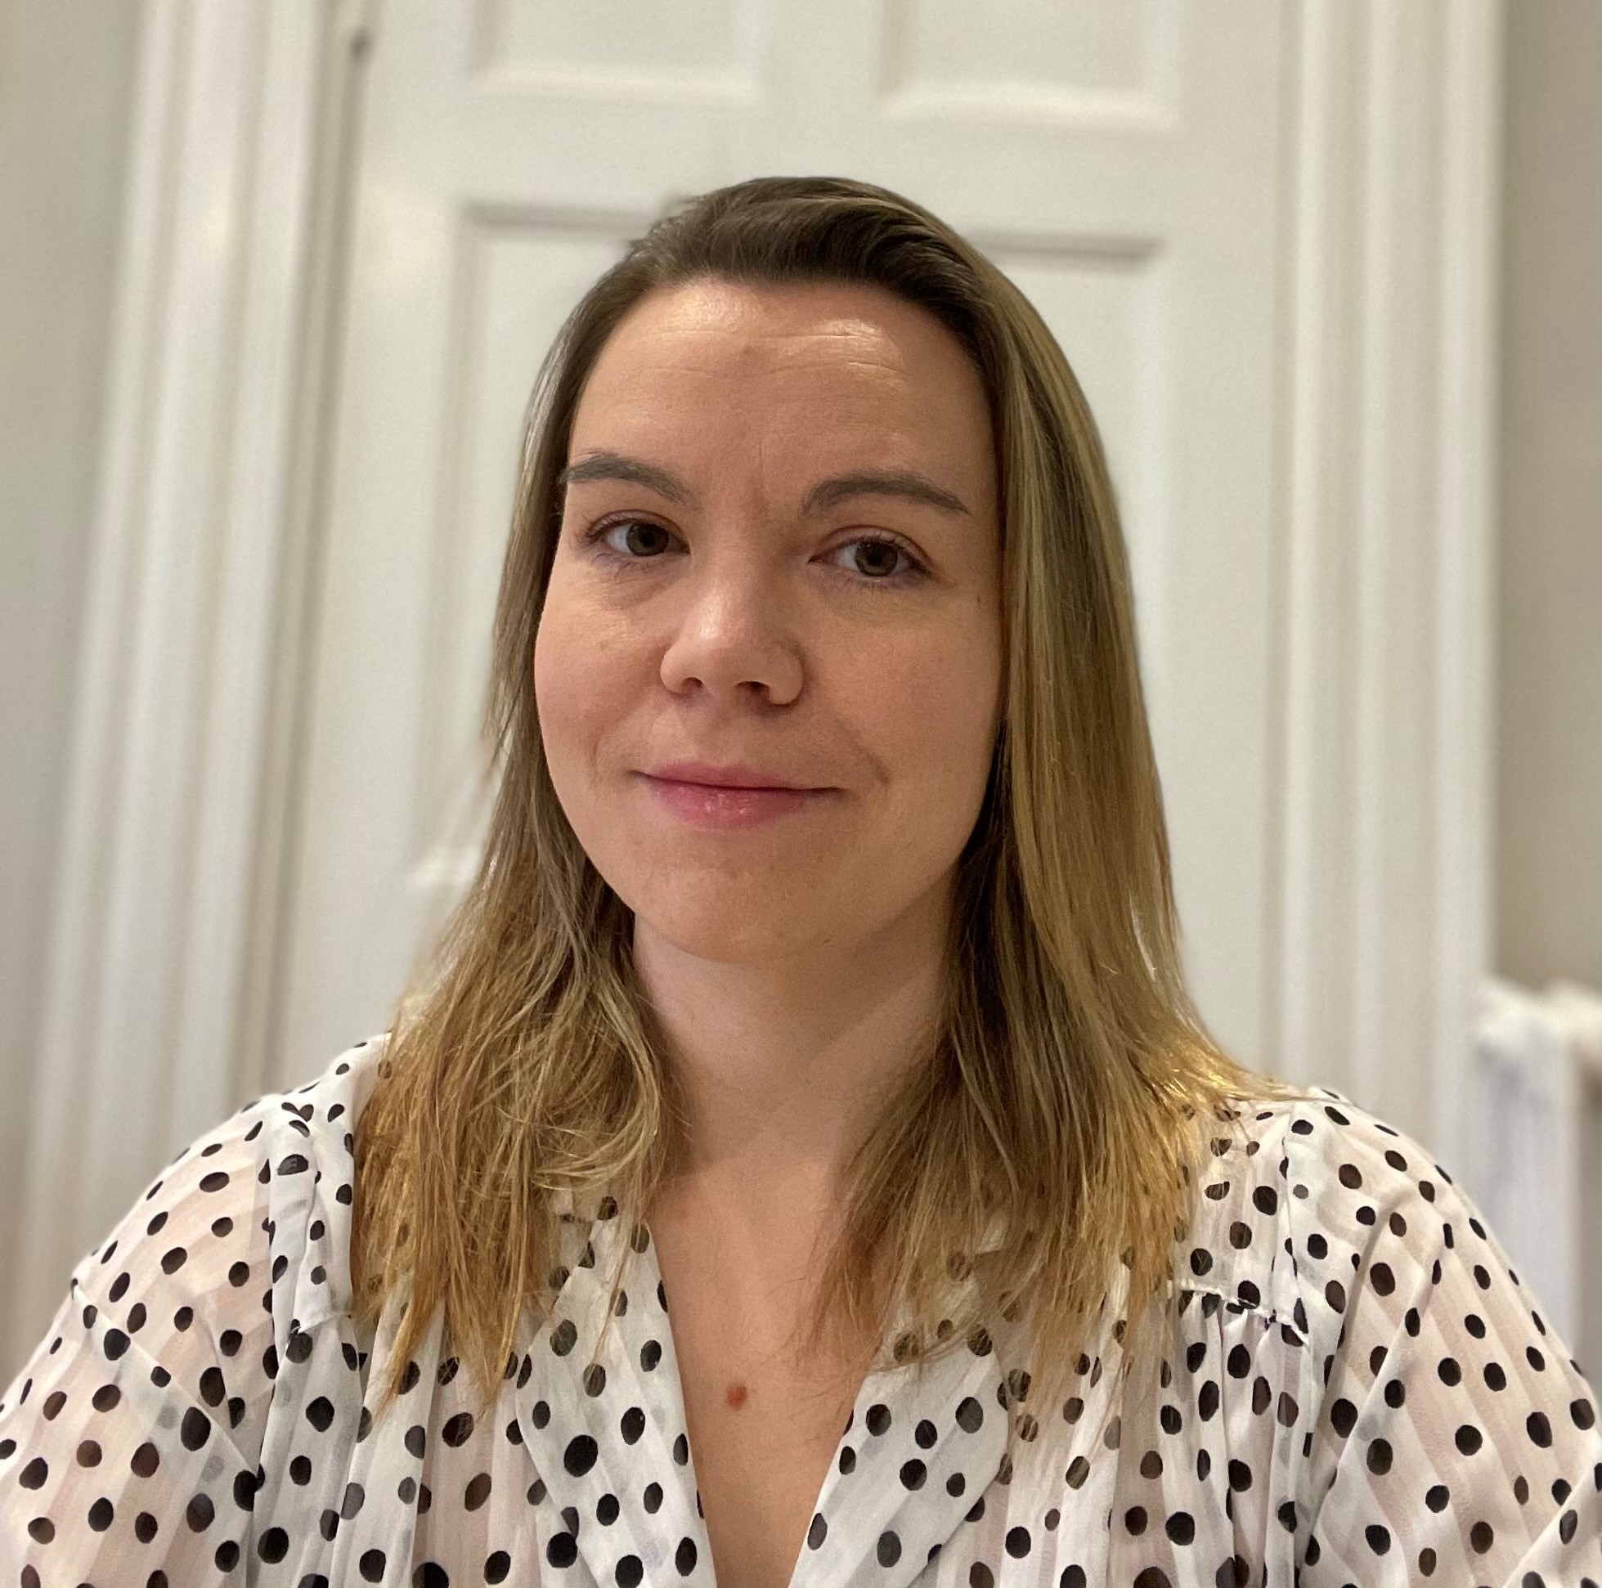
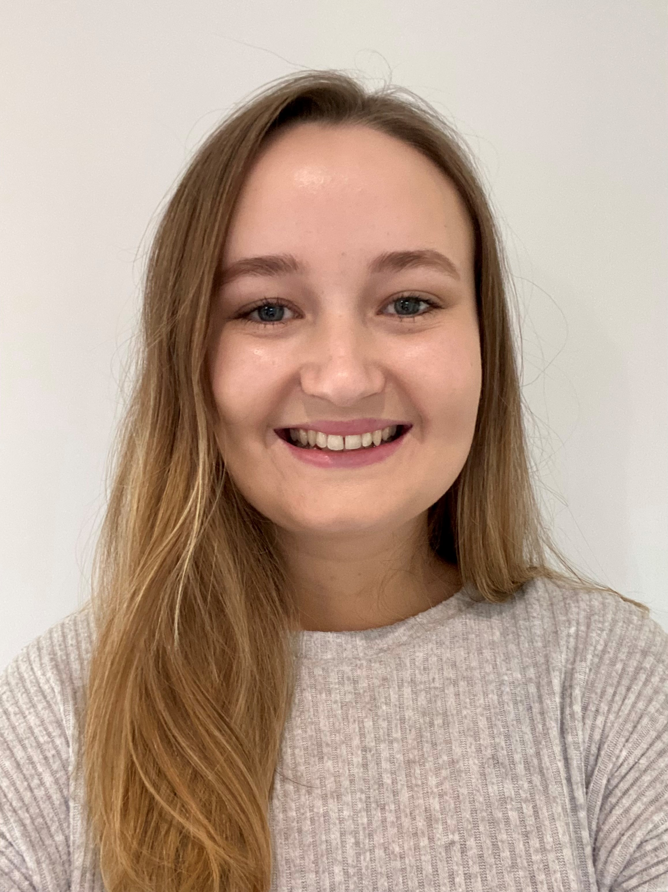
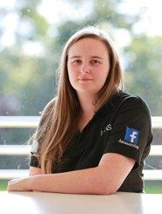
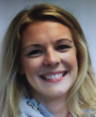
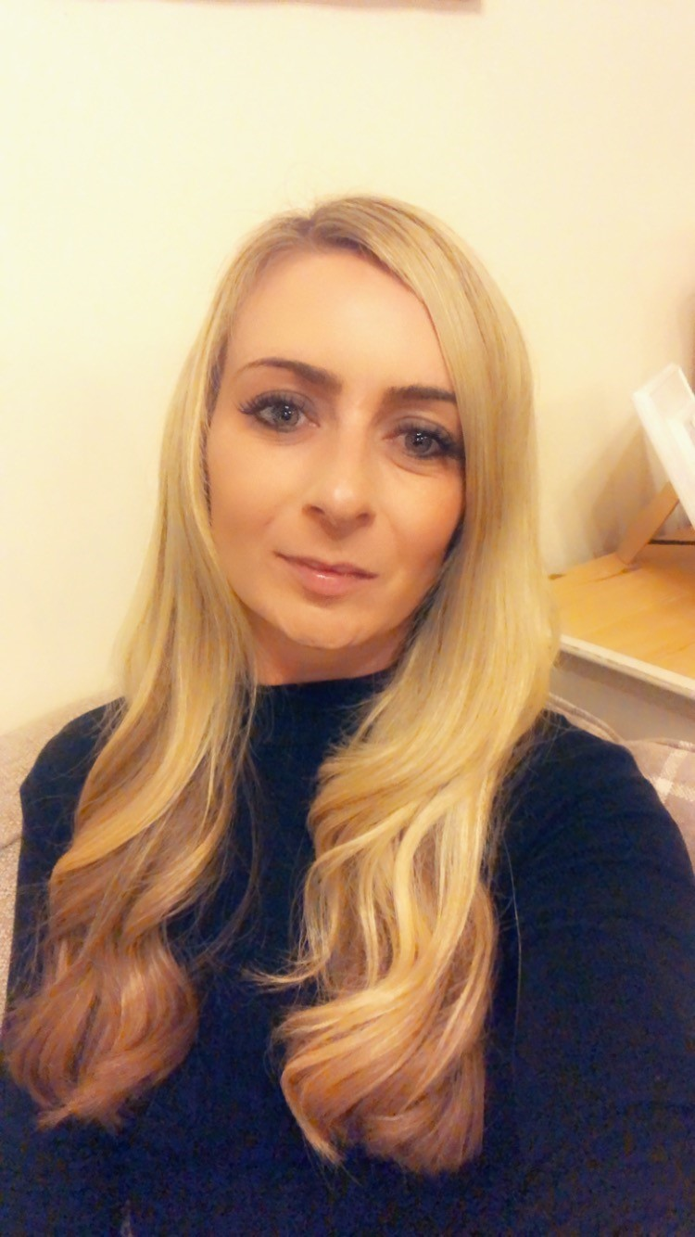
Introductions
Aimee Okafor
Head of Events
David Hale
Technical Operations Manager
Hannah Wells
Senior Events Organiser
Danielle Swain
Exhibitions & Conference Manager
Grace Rishworth
Events Organiser
Holly Golden
Events Organiser
Emily Bibby
Senior Events Organiser
Becky Jones
Senior Events Organiser

Slide 3
Overview of this morning
Introductions | 10.00 – 10.10
What has changed in the last 18 months | 10.10 – 10.40
2022 Update on visitor bookings Exhibitor sales Previous feedback and results UCAS top tips 2022 exhibition guide | 10.40 – 11.15
Break | 15 minute break
Event lead introduction breakout groups | 11.30 – 11.45
Health & Safety | 11.45 – 12.15
Measuring success | 12.15 – 12.30
Discussion breakouts | 12.30 – 13.00

Slide 4
What we want you to take away today
1.
2.
3.
4.
5.
6.
UCAS
Discovery
How to plan a 2022 event
How we should work together
Who your point of contact is and contact details
How we will measure success
Health & Safety guidelines
Notes:
CS

Slide 5
A look at new developments over the past 18 months

Slide 6
A changed landscape
Covid
IRL to URL
Demand for HE
Increase search on Apprenticeships

Slide 7
Students aren’t getting the information they need, and their journey is difficult
1/5 students couldn't study a degree subject that interested them because they didn't have the right subjects to progress.
1/3 students say they did not receive any information about apprenticeships from school.
1/4 HE students say they would make different GCSE choices now they know what their degree course involves.
1/3 HE students say that they would have chosen another course if they could choose again.

Slide 8
More students than ever say they want to hear about apprenticeships
Source: UCAS pre-applicant database, December 2021
Notes:
For those applying in 2022, those telling us they are interested in apprenticeships has more than doubled in a year (increase of 123% - 2021 151,635 vs 2022 338,408).
This has increased from around 10% in 2018 , to almost half now. For those interested in applying in 2023, and to caveat we are at an early stage in this cycle, for the first time more people are interested in hearing about apprenticeship opportunities than not. (Total PAD23 students at 18 Nov: 40,499 - 23,519 interested in apprenticeships or 58%).

Slide 9
Demographic increases mean the landscape will become more competitive
The 18-year-old population is due to increase each year until the end of the decade, with the biggest increases before 2025.
In an increasingly competitive environment, it is vital that all students have access to high-quality information and advice about all their post-secondary options.
UCAS forecasts there could be one million applications to higher education in the UK.
Notes:
As the landscape gets more complicated it will also get increasingly complicated as the number of 18-year-olds increases each year for the rest of the decade.

Slide 10
“To empower people to discover the next step on their learning journey by providing accessible, insightful and inspirational information, advice and guidance across all higher education pathways, including apprenticeships.”
UCAS, Discover Your Future
Notes:
Our strategic objectives commit UCAS to supporting students with all post-secondary options:
At the heart of our strategy, Discover Your Future, is our vision to connect people to their future. We aim to inspire and empower people to make aspirational choices and enhancing our apprenticeships offer is key to this.

Slide 11
UCAS is a trusted source of information and advice for millions of people
14,500
Network of registered advisers in schools and colleges
160,000
Attendees at UCAS events each year
350,000
For Careers Quiz in first two-months
30m
Annual visitors to ucas.com
Notes:
Each year there are 30m unique visits to ucas.com, with students exploring content across the full range of post-secondary options, including technical education, apprenticeships and flexible learning. UCAS’ network of advisers support students across the country with their next steps.
Our network of hundreds of UCAS advisers in schools and colleges across the country is unparalleled.
Our new Careers Quiz tool helps students understand what areas of work might interest them and suggests paths to get there. The tool has been used more than 350,000 people since it launched in September. This is two and a half times more than our previous tool during the same period.
160,000 young people attend national programme of physical and virtual exhibitions.

Slide 12
Shift to Discovery brand

Slide 13
UCAS/Discovery events

Slide 14
UCAS Discovery purpose
UCAS Discovery is an inspiring event experience for young people who want to look at the different choices available to them after school and college.
UCAS Discovery inspires young people. It empowers everyone to discover, connect and explore different opportunities, possibilities and pathways after school or college.

Slide 15
UCAS Discovery
UCAS/Discovery online
Start exploring your options and all kinds of opportunities at our interactive online events. Watch. Listen. Chat. Be inspired. Discover different possibilities. Fine the path you want to take.
UCAS/Discovery near you
Meet universities and employers, and talk about the subjects you’re passionate about. Get the answers to your questions. Listen to talks. Chat face-to-face with real students, apprentices and UCAS advisers. Narrow down your favourite university and career options.
UCAS/Discover Subjects
Discover more about the subject you’re passionate about. Learn about different degrees in that area. Choose the right course for you. Get ready to apply for the right courses for you at your favourite universities with UCAS.

Slide 16
UCAS/Discovery
The series of UCAS/Discovery events should be designed to cover the essentials at every event
Get their questions answered
Pick up expert tips
Experience what could be
Get advice to inform decision-making
Compare and shortlist options
Talk with universities, colleges and alternative providers.
Join live sessions on everything from how to choose to how to make a successful application
Take part in tours, taster sessions and student Q&A’s.
Opportunity to hear from current students and get practical advice from subject-matter experts.
Download and takeaway course and programme info to reflect on.

Slide 17
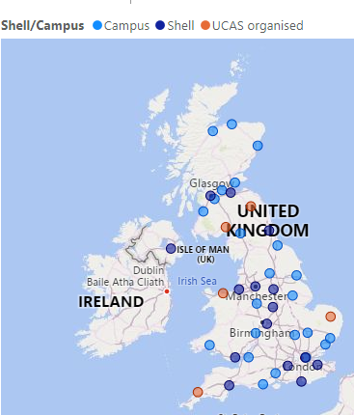
2022 Events ​
England, Wales, and Northern Ireland:
15 campus events, organised in partnership with UCAS
13 shell events, organised by UCAS
4 UCAS regional, organised by UCAS
Scotland:
7 campus events, organised in partnership with UCAS
2 shell events, organised by UCAS
2 Scottish regional events, organised by UCAS
Other:
8 Discovery Day virtual events
3 conferences ( 2 physical / 1 virtual)

Slide 18
Conferences 2022
Annual Teachers & Advisers Conference
8 – 9 February
Harrogate Convention Centre
Annual Admissions Conference
5 – 6 April
Harrogate Convention Centre
International Teachers & Adviders Conference
7 – 8 June
Virtual

Slide 19
2022 programme of campus events
EVENT | VENUE | DATES
Lincolnshire | University of Lincoln | 23 March
Hereford and Worcester | University of Worcester | 24 March
West Wales | University of Wales Trinity St. David, Carmarthen Campus | 5 April
Dorset | Bournemouth University | 6 April
Hampshire | The University of Winchester | 7 April
Tees Valley | Teesside University | 4 May
East London | University of East London | 7 - 8 June
Suffolk | University of Suffolk | 14 June
Essex | University of Essex | 15 June
West and North Yorkshire | Leeds Beckett University, Headingley Campus | 16 - 17 June
Humberside | University of Hull | 21 June
Staffordshire | Staffordshire University | 23 June
Bedfordshire | The University of Bedfordshire | 27 – 28 June
Cambridge | Anglia Ruskin University | 30 June
North and West Cumbria | University of Cumbria | 8 July

Slide 20
Calendar changes 2022
Norfolk is now being directly organised by UCAS, and will be held at Norfolk Showground
North Wales is replacing North East Wales and North West Wales (held at Arias Park)
East Midlands is now being held at Derby Arena
Bristol is now being held at SGS College, Wise Campus
Introduced Farnborough shell scheme exhibition at Farnborough International
Notes:
Lancashire – reasons focus is on trying to balance the broadest range of items and contents for our visitors alongside sustainable geographical coverage, Liverpool is 20 minutes away
North Wales – maximising what the student will see and its an efficiency gain for exhibitors,
Norfolk – Venue made the decision not to host, that was the driver, not looking to lose contact with the providers
Cornwall – a reason to be there – previous reason could not fit it al exhibitors
Drive as many as possible to be as effective as possible

Slide 21
Any questions?

Slide 22
2022

Slide 23
Working together in 2022
Update on visitor bookings
Exhibitor sales
A look back at previous feedback and top tips
2022 exhibition guide
Creating a collaborative working partnership

Slide 24
Visitors and bookings

Slide 25
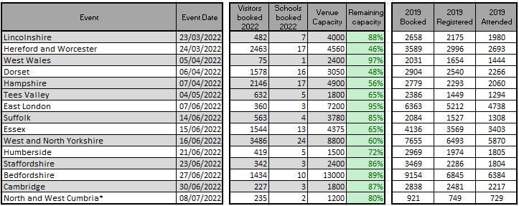
2022 Bookings Capacities Update

Slide 26
Visitor group booking process
1
Visitor goes to ucas.com to select the event and clicks book now button.
2
Visitor (Group leader adviser) chooses:
Create new group booking
Join group booking
Individual registration
Manage group booking - (this is where advisers can amend their booking and manage group members)
3
Group leader (adviser) creates a new a group booking confirming the time slot they would like to attend, and the number of tickets required.
4
Group leader receives booking confirmation email containing next steps, booking reference and personal ticket.
5
Group leader (advisers) logs in to manage group booking and uploads a list of students and staff they would like to make a booking as part of their group (an invite email is sent with a personal link to all students and staff on the list).
6
Group member (students and advisers) join the booking using either the personal link from the invite email or go to the event on ucas.com and click book now and join group booking, they will need to enter the booking reference.
7
Group member receives a confirmation email with personal ticket.

Slide 27
Individual booking process
1
Individual visitor (student, parent or individual adviser) goes to ucas.com to select the event and clicks book now button.
2
Visitor chooses:
Create new group booking
Join group booking
Individual registration
Manage group booking
3
Individual confirms the time slot they would like to attend.
4
Individual receives booking confirmation email containing next steps, booking reference and personal ticket.
It is crucial visitors have their own ticket – once registered, their personal ticket is emailed to them. This can be accepted on a mobile device or printed ticket.
We use a paper-based approach for any on-site registration at your event, but we have a priority ambition to move to a digital solution.
We have a calls to schools programme to encourage students to register before the event. This is to reduce on-site registrations.

Slide 28
Booking process
It is crucial all visitors have their own ticket – once registered, their personal ticket is emailed to them. This can be accepted on a mobile device or printed ticket.
We use a paper-based approach for any on-site registration at your event, but we have a priority ambition to move to a digital solution.
We have a calls to schools programme to encourage students to register before the event. This is to reduce on-site registrations.
It is crucial visitors have their own ticket – once registered, their personal ticket is emailed to them. This can be accepted on a mobile device or printed ticket.
We use a paper-based approach for any on-site registration at your event, but we have a priority ambition to move to a digital solution.
We have a calls to schools programme to encourage students to register before the event. This is to reduce on-site registrations.

Slide 29
Using data-driven analysis of performance and reach for 2022 events
Translating bookings to registrations, into attendance, and reducing drop off.
Identify low engagement schools, and target with bespoke messages.
Comprehensive marketing programme to communicate Discovery proposition and benefits.
Implement a comprehensive calls to schools programme.
Work with our exhibition network to promote the value of attendance.

Slide 30
Exhibitor Sales
Positive outlook, 225 unique exhibitors booked so far
New customers:
College of Esports (new provider)
Sponsorship proposals out
Cambridge sequential draw: 10 HEPs moved to waiting list (have been informed)
New products/services: shell events only
Gobo light: moving spotlight above your stand to project your logo/image on the floor in and around your stand (capture visitor attention)
Welcome video by entrance queue: bring your organisation to live and increase awareness of your attendance while visitors arrive at the event

Slide 31
Any questions?

Slide 32
Working together in 2022

Slide 33
We want to create a collaborative way of working as we move forwards
We want to offer areas where you need UCAS support vs blanket approach
How do you feel UCAS could best support you with implementing events in 2022?
Survey will be sent out w/c 13th December for completion by 7th January

Slide 34
A look back at previous feedback and results

Slide 35
Student Visitor Feedback from 2019
89.3% rated the overall experience of campus exhibitions as great or good.
Have the talks in more accessible areas.
Would like more signage throughout the exhibitions.
Better crowd management.

Slide 36
Exhibitor Feedback from 2019
81.8% rated the overall experience of campus exhibitions as great or good.
Exhibitors require clearer parking information, maps, and signage.
Polite and helpful event staff.
Good flow of visitors.

Slide 37
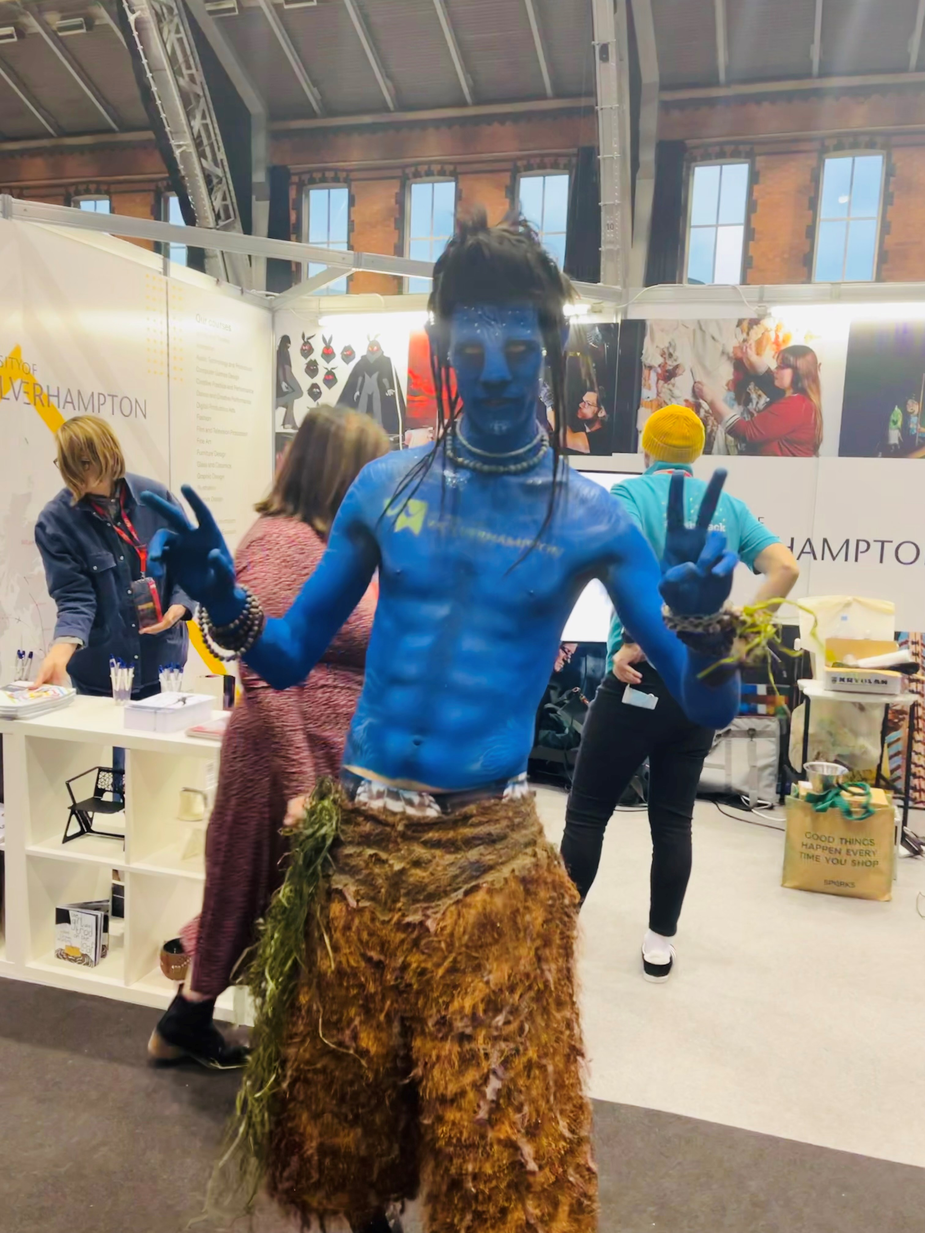
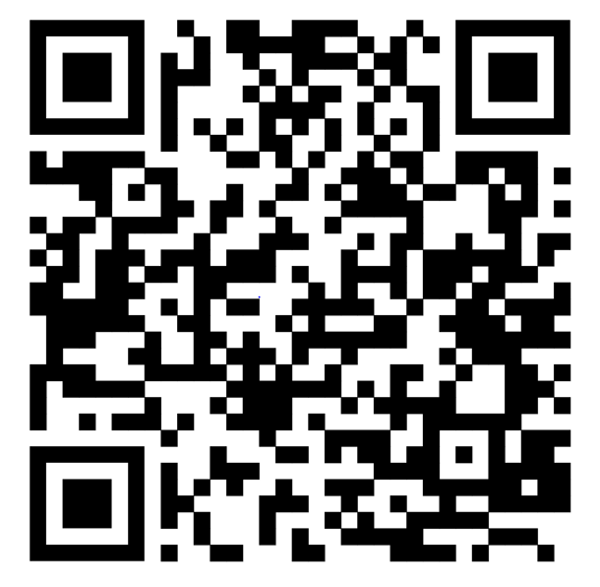
Top tips
Get Creative!! Create that memorable in-event experience!!
In event content – popular talks
How to start researching
Personal Statements
Finance
Top tips for admissions interview
Student insight stories
QR code for online prospectuses
Popular Apprenticeship talks
- What top employers look for
- Real-life apprentice stories
- How to find your dream apprenticeship
- Interview and recruitment day prep

Slide 38
Any questions?

Slide 39
2022 exhibition guide

Slide 40
Working together to create a great UCAS Discovery event
Organisation falls to the service provider, but they are delivered as a UCAS discovery event.
All marketing and event collateral must reflect the UCAS discovery brand. This ensures the events remain impartial and give a consistent experience.
We will support you in that with signage templates, UCAS organiser t-shirts, and access to marketing materials for advertising locally.

Slide 41
Your role
Covered on pages 16 – 19 in the service provider guide
Risk assessments
Produce and display signage
Venue liaison
Service provider
Organise logistics info for exhibitors and visitors
On the day event management
Review the floorplan and exhibitor list
Manage registration scanning
Producing and printing z-card
Organise a student talks programme

Slide 42
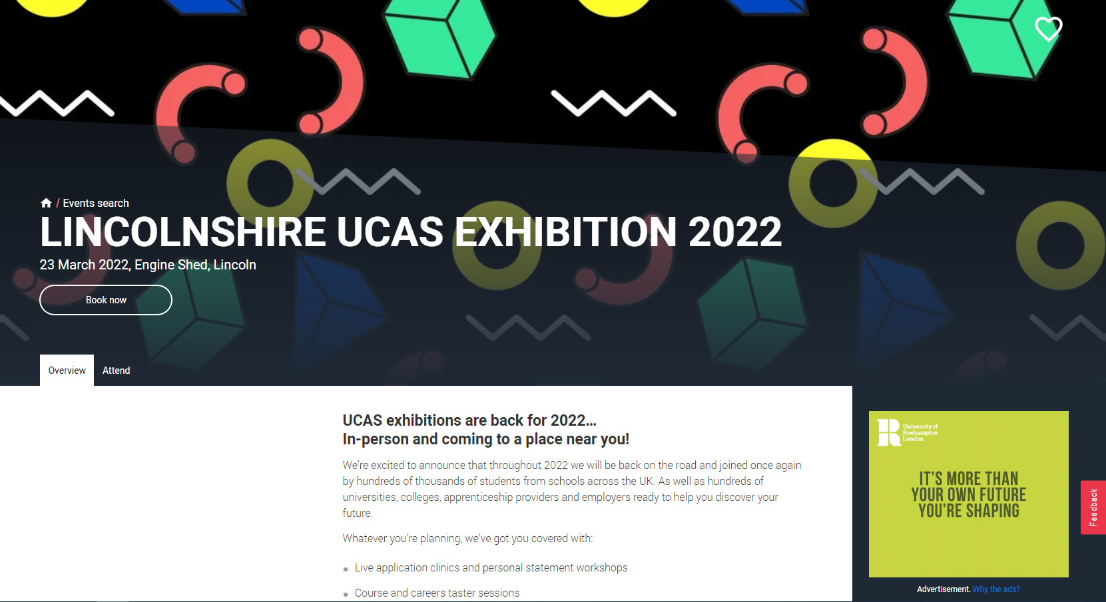
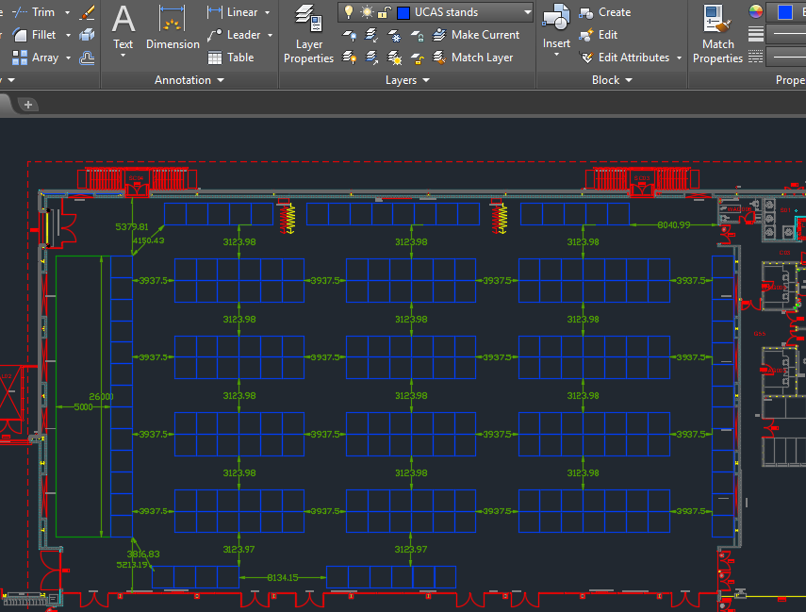
We will...
remind you of all upcoming deadlines
allocate exhibitors on the CAD (DWG files) plan provided by you
collate and collect all artwork/sponsorship sold
build the event webpages
support you in the planning of the event

Slide 43
Operational top tips
Order extra furniture, as spares are always needed
Give yourself enough time to
set up
Know your stuff
(deadlines , measurements, build and
breakdown plan, coach/traffic plan)
Make sure you have clear signage
throughout
Don't be afraid
to ask
(we are here to help)
Check the weather forecast

Slide 44
Continued focus on reducing our carbon footprint
1
Encourage recycling ​
Have appropriate bins around the venue, not just general waste.
Encourage a reduction of prospectus waste
'Don’t want that prospectus' signage to encourage visitors to return unwanted books. These can then be delivered back to exhibitors or recycled properly.
Eradicate use of plastic
Encourage exhibitors to bring re-usable water bottles.
2
3

Slide 45
Exhibitor code of conduct
Reporting any breaches
Any member of staff including contractors and couriers, who are rude, disregard instructions from the organisers, or behave in any way deemed inappropriate for a UCAS exhibition, will be asked to leave the event.
Dismantling of stands.
Exhibitors coming off stands into aisle.
Number of exhibitors on a stand, no more than:
two on a 2m x 1m stand*
three on a 3m x 2m/3m x 3m stand*
four on a 4m x 3m/5m x 3m stand*
six on a 6m x 2m/6m x 3m stand*
eight on a 6m x 6m stand*
* may be altered in line with any covid restrictions if necessary
Contact event lead
Sales team informed
Comms with booker

Slide 46
Contribution of funds
The event category will be determined by 2019 attendance figures.

Slide 47
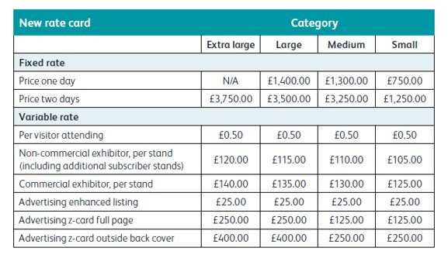
Funding claim form
Funding claim will be produced two weeks after the event
Based on criteria from rate card
One or two day event
Visitor numbers
Stand sales – commercial exhibitors
Marketing sold

Slide 48
Expenditure form
Record all expenditure on the form
Collate all evidence of expenditure
Send all information back to your event organiser

Slide 49
Calculation of funds
Once all information is received, we calculate the amount that can be claimed.
This will either be the funding claim amount if the evidenced expenditure is higher, or the evidenced expenditure total if this is lower than the funding claim total, unless:
50% of the evidenced expenditure is more than the funding claim total.
If this is the case, then UCAS will increase funding further to the below capitations.

Slide 50
Finally…
UCAS Event Organiser will then confirm the amount.
Raise an invoice with a purchase order number quoted.
Send through to the UCAS Event Organiser for processing.
UCAS Event Organiser will then process the payment with our finance department.
Any questions? Template forms are available.

Slide 51
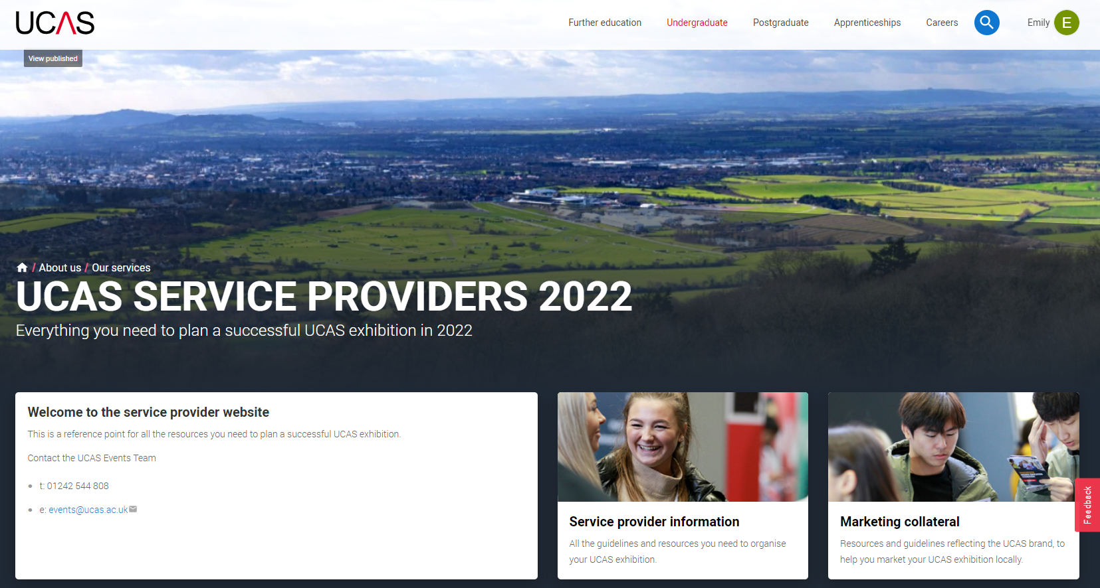
Service provider website
The service provider website has a wealth of resources and templates to help you organise your event:
Organisers checklist – Excel format.
Marketing collateral.
Exhibition guide resources.
Risk assessment template.
Signage templates.
Exhibitor manual and visitor information pack templates.
https://www.ucas.com/ucas-service-providers-2022

Slide 52
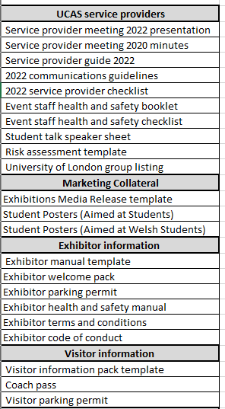
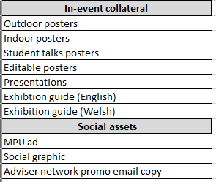
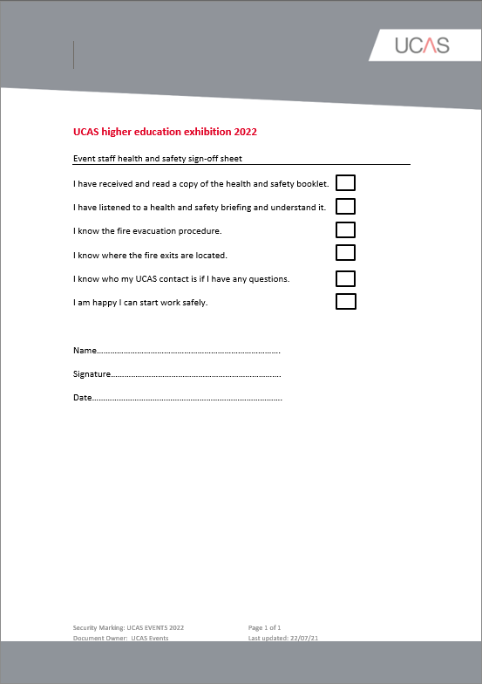
Service provider website
Live from 17th Dec:
Service provider info
Exhibitor info
Visitor info
Live from Jan:
Marketing collateral
In-event collateral
Social assets

Slide 53
Notes:
Individual event schedules

Slide 54
Any questions?

Slide 55
Working together in 2022

Slide 56
We want to create a collaborative way of working as we move forwards
We want to offer areas where you need UCAS support vs blanket approach
How do you feel UCAS could best support you with implementing events in 2022?
Survey will be sent out w/c 13th December for completion by 7th January

Slide 57
How do you feel UCAS could best support you with implementing events in 2022?

Slide 58
Event leads introduction

Slide 59
Meet the full team
Aimee Okafor
Head of Events
Justine Atkin
Event Systems and Support Manager
Danielle Swain
Exhibition & Conference Manager
David Hale
Technical Operations Manager
Hannah Cherry
Events Data Analyst
Filipa Semiao
Tom Paterson
Events Technical Support Specialist
Becky Jones
Emily Bibby
Hannah Wells
Senior Event Organiser
Dan Hartfield
Production Technician
Grace Rishworth
Holly Golden
2 x New EO’s
Event Organiser
Claire Feeney
Event support executive
Notes:
Talk through team
Conferences
Admissions Conference (largest held in April – Harrogate Eveetn Centre 2020
Annual Teachers & Advisors – Large residential event - Feb
International Teachers & Advisors – June
Inspiring Choices – Progression to HE – Leeds Marriot (June)
Annual Provider Update & UCAS Teacher Training – Virtual event held in November
Justine team, build websites, booking sites & content
David, on-site technical – 360 dome, inflatable pods – staging and Lighting

Slide 60
Your UCAS contact
EVENT | Month | Your UCAS Contact
Lincolnshire | March | Becky
Hereford & Worcester | March | Holly
West Wales | April | New Event Organiser
Dorset | April | Holly
Hampshire | April | Emily
Tees Valley | May | Grace
East London | June | New Event Organiser
Suffolk | June | Hannah W
EVENT | Month | Your UCAS Contact
Essex | June | Grace
West & North Yorkshire | June | Becky
Humberside | June | New Event Organiser
Staffordshire | June | New Event Organiser
Bedfordshire | June | Becky
Cambridge | June | Holly
North & West Cumbria | July | Grace

Slide 61
Getting to know your event lead
We will now all go into 10 minute breakout sessions where you have the opportunity to meet your event lead, ask questions and talk through next steps after today

Slide 62
Health & Safety

Slide 63
Health and safety: Key areas
Risk assessments:
created by you, monitored by UCAS
When your event is in build…
2022 Events
At your events
Managing Events post covid

Slide 64
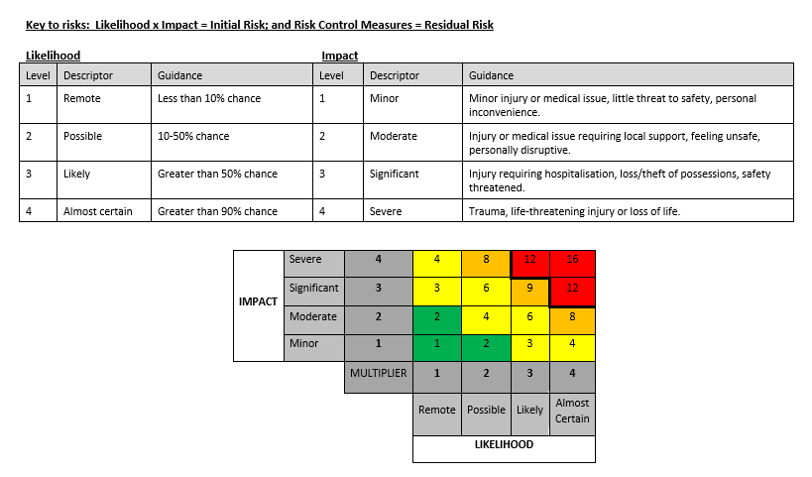
Risk assessments:
created by you, monitored by UCAS

Slide 65
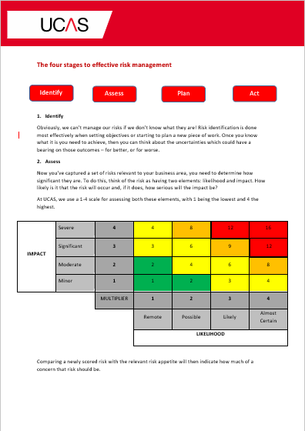
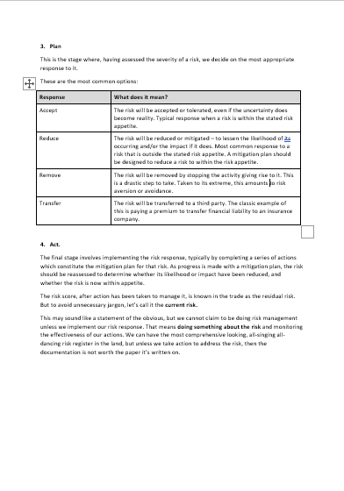
Risk assessments:
created by you, monitored by UCAS
www.ucas.com/ucas-service-providers

Slide 66
Pre-Event
Exhibition and Venue risk assessment
Fire evacuation policy and fire risk assessment
Security and staff dot plan for the venue
Copy of public liability insurance certificate
When your event is in build…
CDM (Construction Design and Management) Regulations
Health and Safety at Work Act 1974. This legislation also applies when at an event.
Service provider must provide a first aid provision appropriate for the size of event
Accident book, providing a copy of the entry to ucas
At your events
Talking to your team
Common sense
Service provider must provide a first aid provision appropriate for the size of event
Accident book, providing a copy of the entry to ucas

Slide 67
Managing Covid secure events
Measures implemented at Create
Track and Trace QR code
COVID pass
Positive messaging regarding face coverings and hand sanitizer
Social distancing
Cleaning and hygiene
Hand sanitizer
Crowd density
Stand risk assessment with additional covid measures
Self-scan for tickets and onsite registration
Larger Aisles
Dedicated Covid marshals
Temperature checks
Covid precautions visitors:
Entry to venue for under 18s
Visitors under the age of 18 will either need proof of double vaccination or will need to have been tested within 48 hours of attending the event, with a negative result. For schools bookings a member of staff from the school may confirm that the group have all been tested within 48 hours of attending the event, with a negative result.
Entry to venue for over 18s
Proof of double vaccination, Covid-19 antibodies or a negative lateral flow test will be required to gain entry.

Slide 68
Next steps
Monitoring government advice over the next couple of months
Talking to your own H&S leads
Flag any concerns with UCAS
Not a 'one size fits all' approach & we will be taking your lead on how you've managed your open days and current events offer.
Working with your UCAS event organiser

Slide 69
Any questions?
David Hale Technical Ops Manager
T: 01242 544 707
M: 07977 109 289
E: d.hale@ucas.ac.uk

Slide 70
Measuring success

Slide 71
Measuring success
Attendance across individual in person and virtual events
Behavioural analytics from the blend of virtual and in person events
Geographical coverage of attendance to all events including in person and virtual
Survey feedback from students, advisers and exhibitors

Slide 72
Discussion breakouts

Slide 73
What combined learnings do we need to consider from running Covid safe events

Slide 74
How can we support you to encourage more schools to attend?

Slide 75
Thank you, we are looking forward to working together in 2022

