Slide 1
EVENT LOCATION INFORMATION
Location specific information for
<INSERT EVENT HERE>
1

Slide 2
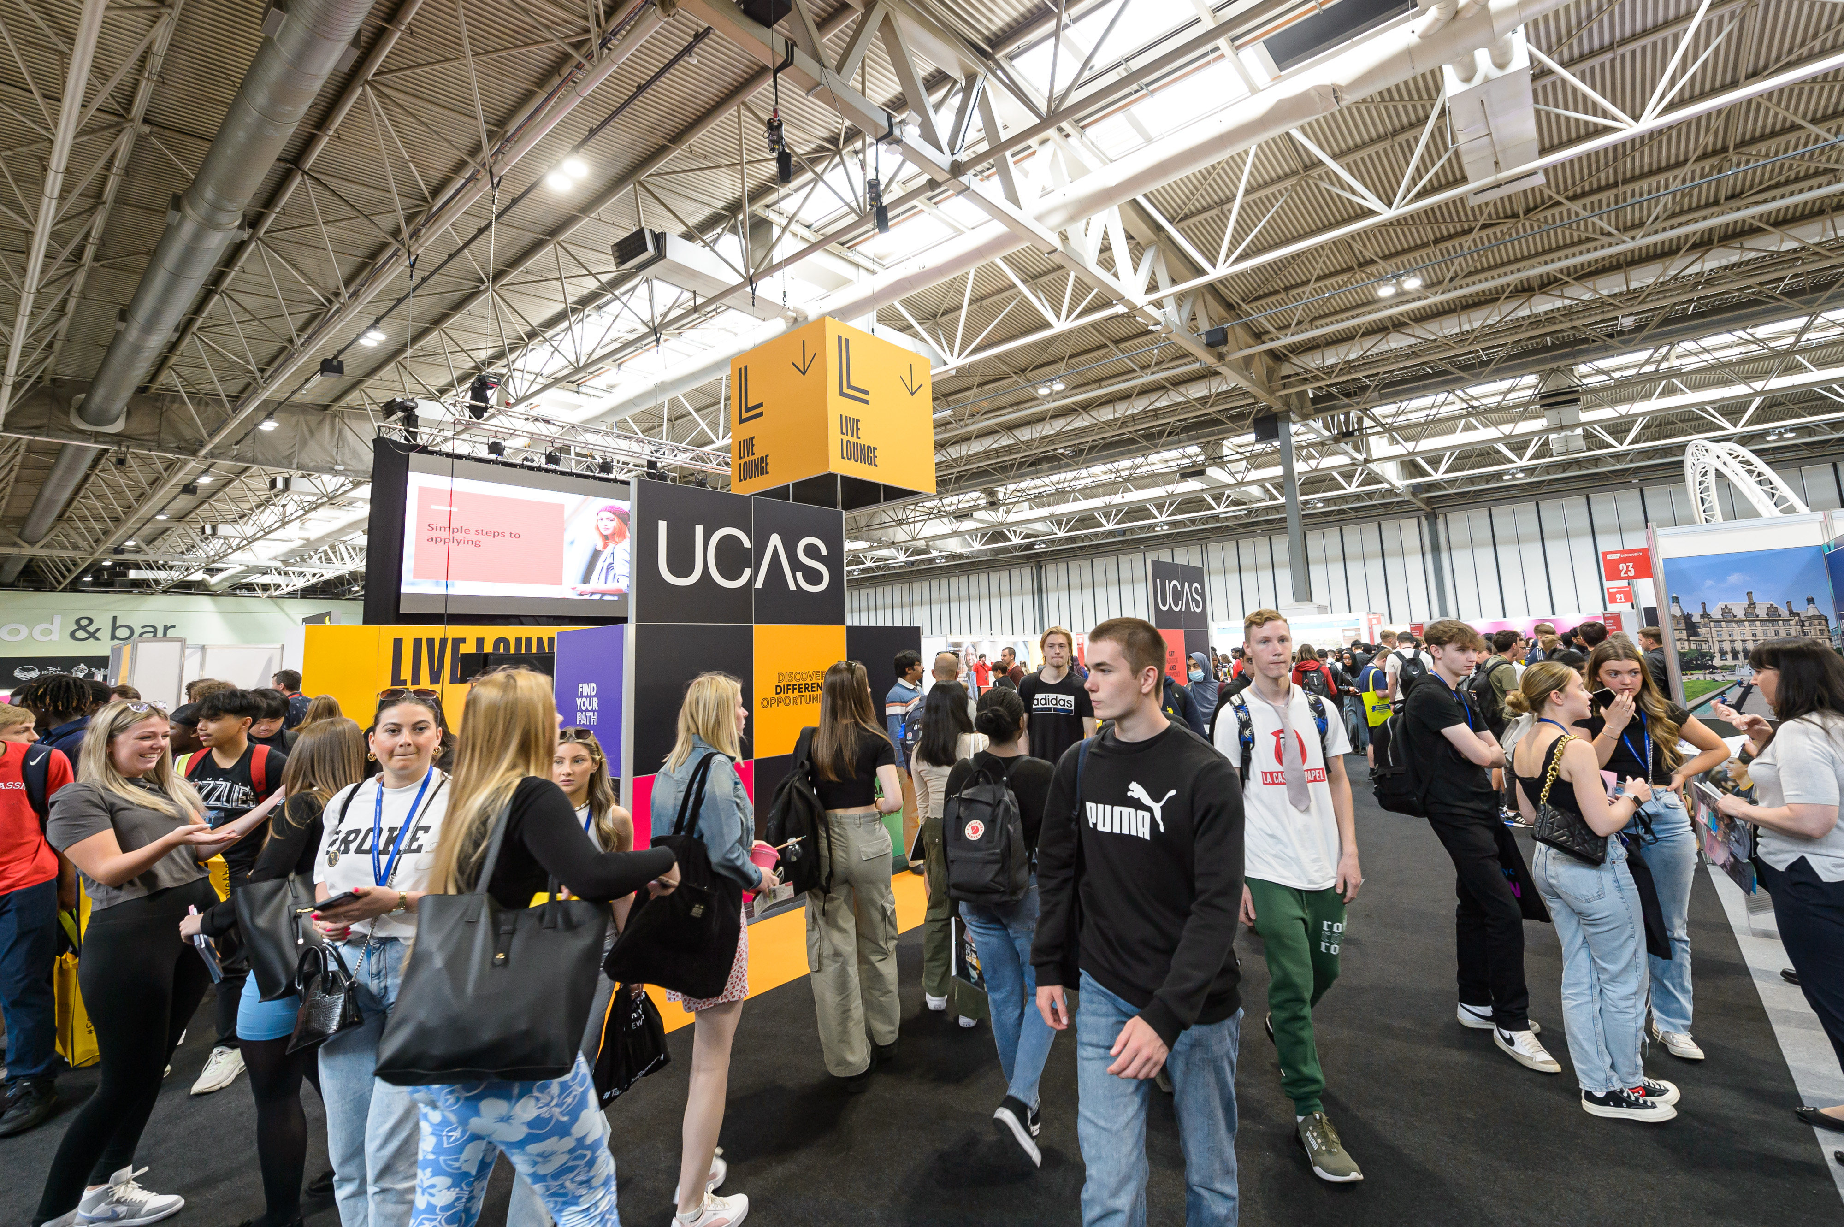
EXHIBITING AT
EVENT: Event Name
DATE: Day Month Year
OPENING TIMES: Times
VENUE: Address
15

Slide 3
EVENT INFORMATION
ACCESSIBILITY
Please enter all details on accessibility here with any links to website.
ACCOMMODATION
Please find below details of hotels in the vicinity of the venue:
Hotel 1
Hotel 2
Hotel 3
Please note that these hotels are just a guide for exhibitors, and are not recommended by UCAS.
CARPARKING
Please enter car parking details here for exhibitors. Note any permits needed to be displayed, any parking charges. Feel free to link to external websites for maps or details if applicable.

Slide 4
EVENT INFORMATION
CATERING
Please enter details of exhibitor catering, water and tea and coffee location
FIRST AID
Please enter first aid location.
INTERNET
Please enter details of wifi available to exhibitors, if it's chargeable and any passwords needed.
SCANNING
To take advantage of lead scanning at this event, you need to download the Smartlead UCAS and have purchased scanning for the UCAS/Discovery events. You will need a license code per device per event which are assigned to you when you purchase the scanning. Make sure your staff at the event have been provided with the license codes. You will find a guide to setting up your device and how to manage your data in the Exhibitor zone [link] along with a Scanning Instructions document that you can share with your staff attending the event. Hard copies are also provided on your stand. A member of the UCAS team will be on hand at the exhibitor/scanner help desk [not sure what this is called] to support you at the event or you can call 01242 544808 or email events@ucas.ac.uk.
RISK ASSESSMENTS
All exhibitors need to provide a risk assessment for your stand build and any activities that will be happening on your stand. Please send this through to Emily Bibby e.bibby@ucas.ac.uk least 4 weeks before the exhibition date. The event organiser has completed a risk assessment for the event.

Slide 5
LOGISTICS
SCHEDULE: Please check and edit timings
BUILD DAY: (Please enter build date)
08:00 – 16:00 Event set up – deliveries can be made during this time
16:00 – 18:00 Exhibitor/contractor access.
EVENT DAY: (Please enter event date)
08:00 – 09:00 Exhibitor access.
09:30 – 15:00 Exhibition open – trolleys will not be allowed on the exhibition floor once the exhibition has opened to the public.
15:00 – 16:00 Stand replenishment.
EVENT DAY 2 (if applicable)
08:00 – 09:00 Exhibitor access.
09:30 – 15:00 Exhibition open – trolleys will not be allowed on the exhibition floor once the exhibition has opened to the public.
15:15 – 16:15 Exhibitor/contractor breakdown.
16:30 event breakdown

Slide 6
LOGISTICS
ARRIVAL
Please enter here where an exhibitor should go when arriving. Does a loading pass need to be displayed? Where do they need to go to register?
BUILD-UP
Build-up times:
Build day and time
Event day and build time
Please enter all info in here about unloading. Where is the unloading? Can an exhibitor park there during build or do they need to park else where after unloading? Is there a permit needed?

Slide 7
LOGISTICS
BREAKDOWN
Breakdown time: time on date.
Please enter here all details about breakdown. Can exhibitors drive round to the loading doors? What time can they access loading doors?
If you think you might need extra time to build your stand (outside the build-up times stated above), please contact events@ucas.ac.uk. In some circumstances, early access to the venue on the build-up day may be given, but this is only with the advance permission of the organiser. If advance permission has not been granted, exhibitors will be turned away from the venue until the exhibitor build-up session starts.
DELIVERIES
Please enter the delivery address with timings and dates.
ORGANISERS
Please enter where sexhibitors can find organiser if needed during the event with a telephone number if possible
STORAGE
Please enter where storage will be located.

Slide 8
CONTACT DETAILS
UCAS Events Team
E: events@ucas.ac.uk
T: 01242 544 808
Onsite general enquiries:
Look out for event ambassadors wearing coloured t-shirts, they can offer advice and answer any questions.
Please familiarise yourself with the onsite organisers office at each event for any questions you have or help you need
15

