Slide 1


Get ready for

Slide 2


Introducing UCAS Discovery
These activities have been created to help you prepare for your visit to UCAS Discovery!
At the event, you'll have the chance to meet over 100 unis, colleges, and apprenticeship employers in one place, explore the career options available to you after school or college, and ask the experts your questions, so that you can start planning your next steps.
Press play to learn more.

Slide 3

Learning objectives
In 20 minutes, you will…
be able to describe where you currently are on your discovery journey.

Slide 4

Assessment
Having run UCAS Discovery events for almost a decade, we’ve noticed that the students who come along are usually in one of the four following mindsets:​
1. Pathway discovery: I don’t know what I want to do after school or college
2. Subject discovery: I know what subject I want to study
3. Career discovery: I know what career I want to do
4. Application discovery: I want to know how to apply for my chosen pathway

Slide 5







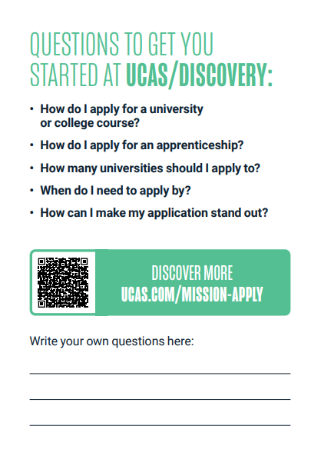


Mission Cards at UCAS Discovery
Click on a card to see what kinds of questions someone in that mindset might ask...
Discuss in partners: from reading the above categories and questions, do you know which one you’re in? No problem if you don’t, we are going to explore further!

Slide 6
Pathway discovery
1. Pathway discovery: I don’t know what I want to do after school or college
Things someone in this pathway might think:
Things someone in this pathway might say:
“I’m not sure where to start researching my options”
“It all feels overwhelming”
“All my friends are ahead of me”
“How do I know where to start?”
“Should I just do what I’m good at?”
“Where should I start?”

Slide 7
Subject discovery
2. Subject discovery: I know what subject I want to study
Things someone in this pathway might think:
Things someone in this pathway might say:
“I’m picking it because it’s my favourite subject, but I don’t know where it will lead my career”
“I don’t know the full range of options available within the subject”
“Where can I find more information on courses?”
“Where can I learn more about where this could take my career?”
“What would happen if I decided I didn’t like the course?”

Slide 8
Career discovery
3. Career discovery: I know what career I want to do
Things someone in this pathway might think:
Things someone in this pathway might say:
“I feel like I’ve made my choice, but need to plan my route to get there”
“There are so many uni and apprenticeship choices, it’s a lot to read!”
“Where recruits people within the career I want to do?”
“As well gaining qualifications, what skills do I need to focus on?”
“How can I learn from others already in this career?”

Slide 9
Application discovery
4. Application discovery: I want to know how to apply for my chosen pathway
Things someone in this pathway might think:
Things someone in this pathway might say:
“The application process is scary, what if no unis accept me?”
“I have no idea where to start with my personal statement!”
“How should I structure my personal statement?”
“When do I need to get my applications submitted?”
“How do I make the most of my UCAS Hub?”

Slide 10

Assessment
Once you have made your way through all four stages, you will know…
The pathway you want to take
The subject you want to study or apprenticeship you want to do
The career that course or apprenticeship will lead you to
How to apply to your chosen course or apprenticeship
How do you think it would feel to have all four of these areas decided upon?

Slide 11


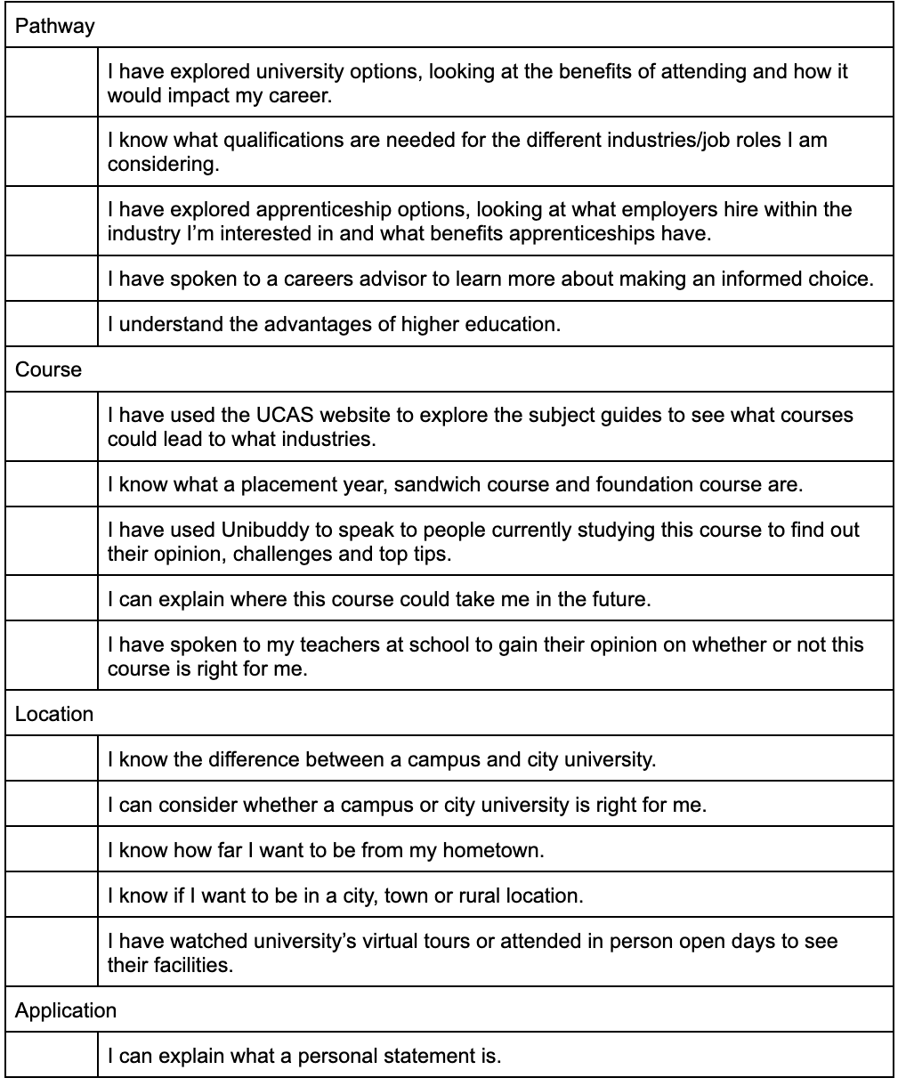
Assessment
Activity:
Use the assessment worksheet to see what category you fall into.
The statements on your worksheet are grouped into four categories: Pathway, Course, Location and Application.
Start at the top and work your way down the list, ticking the statements that apply for you.
If you have ticked four or more statements in a category, it means you have completed that category.
For example, if someone has tickets 4 statements in “Pathway” but only 2 in “Subject” it is likely that they are in the course discovery category.

Slide 12
Learning objectives
In 20 minutes, you will…
be able to name the three different types of organisations who will be at the UCAS Discovery event

Slide 13

Types of organisation
Discuss in partners: Why might the below three organisations have a stand at a UCAS discovery event?
There are three types of organisation that attend our UCAS Discovery events.
They are all very different but have one thing in common, they are there to help you decide your next steps!
University
College
Employer
Information
Click to reveal
To educate students on courses, accommodation, facilities and how to choose the best university for them.
To discuss their specialised courses and how they differ from mainstream providers.
To share information on their apprenticeship programmes, how to apply and tips for interview/assessment.
As we move through the next few slides, use your worksheet to make notes about anything you think is important or that you want to remember in readiness for the UCAS Discovery event.

Slide 14
University
Universities often have recruitment teams who attend events across the country. This could be at a college, school or a UCAS discovery event.
The university recruitment teams are experts on their university’s offer so you can literally ask them anything, it is there job to know the answer and help you!
Universities may also bring student ambassadors, who are current students at their university. These ambassadors are paid for their time and can answer questions about their experience, their course and their journey so far.
On the day, universities will also be running expert talks so make sure you look at the schedule and attend any you’re interested in.
The types of question you might ask a university:
“How many of your graduates go into employment in their area of study?”
“Where has the university invested money recently? How has this helped students?”
“What is your course specialism?”

Slide 15



University
As a class: Vote for one of the below videos. Your teacher will click and play the video that gets the most votes!
Don’t worry if the video you want to watch isn’t picked, they’re all available on our YouTube channel so you can check them out any time.

Slide 16
College
The colleges that attend the UCAS Discovery events are usually specialists within a certain subject, such as media, performing arts or IT.
They offer a range of courses that could be:
Level 3 (equivalent to A Levels)
Level 4 (equivalent to a Higher National Certificate)
Level 5 (equivalent to a Higher National Diploma)
Level 6 (equivalent to a Bachelor's Degree - the same as you would study at university)
The colleges that attend will be different depending on the geographical area you are attending a UCAS Discovery Event within.
The types of question you might ask a college:
“What make your courses unique?”
“Why do students choose to study with you?”
“Do any of your courses have work placements as part of the course?”

Slide 17
Employer
Employer’s recruitment teams usually attend UCAS Discovery Events. Like universities, they may also bring current apprentices to talk about their course.
Employer’s will provide information on their apprenticeship opportunities, how to apply and when their application opens.
You can also ask for specific information on their roles, progression opportunities and interview process.
Remember, apprenticeships are hard to secure so use this opportunity to gain as much help and information as you can.
The types of question you might ask an employer:
“What assessments do you run as part of your interview process?”
“Are there any key skills you are looking for?”
“What work experience would you expect apprentices to have?”

Slide 18
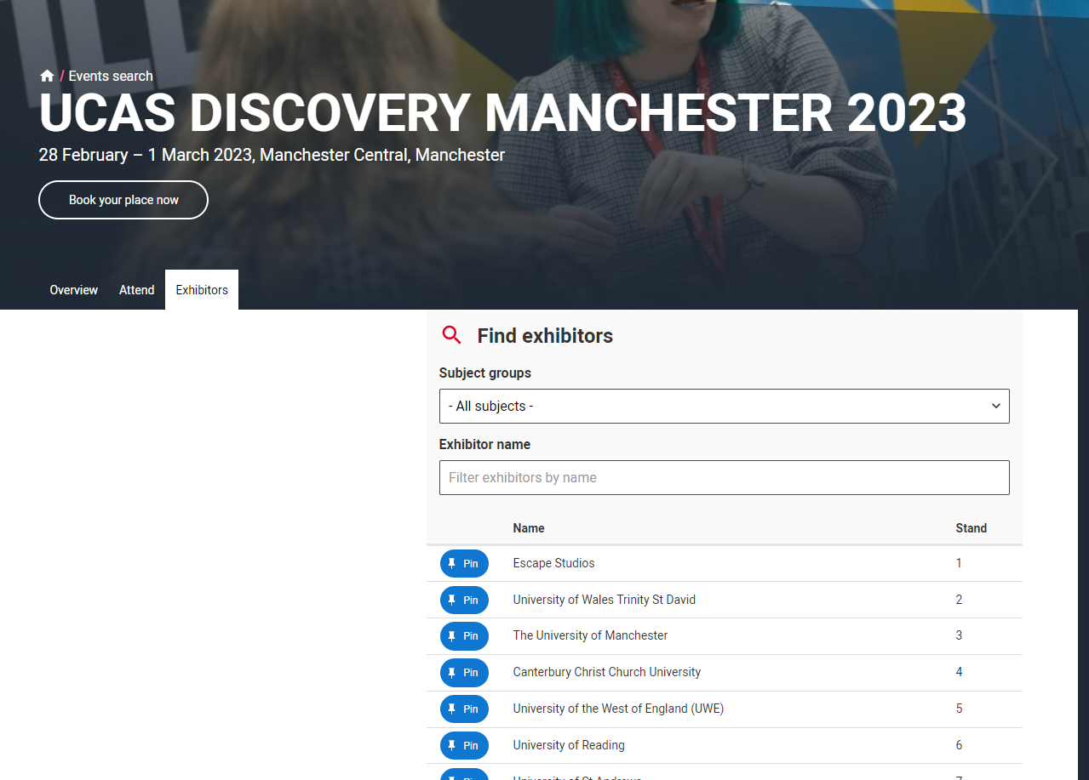
Planning your visit
Activity:
Go to www.ucas.com/discovery
Visit the event page for the UCAS Discovery event you’ll be attending
Fill in the table in your worksheet with at least 5 exhibitors from the list to go and visit at the event.
Exhibitors can be filtered by subject/industry, and searched for by exhibitor name. You can use the filtered lists to find out more about the universities, apprenticeship employers and other exhibitors.
Top tip: To help you choose who to speak to at the event, you can learn more about different universities, colleges and employers in the UCAS Hub:
Universities & colleges
Employers

Slide 19
Learning objectives
In 20 minutes, you will…
feel more confident in your ability to converse with new people.
have a list of questions you will ask exhibitors at the UCAS Discovery event.

Slide 20

Introducing yourself
A great way to introduce yourself, whether it’s at a UCAS discovery event, speaking to an employer about work experience or at an interview, using an elevator pitch can be a really helpful technique.
This means summarising yourself, highlighting your key skills and the purpose for your introduction in the time it would take to ride an elevator (usually 30-60 seconds!).
Press play to learn more.
Discuss in partners: When was the last time you had to introduce yourself? How did it go? Could it have been improved using an elevator pitch?

Slide 21
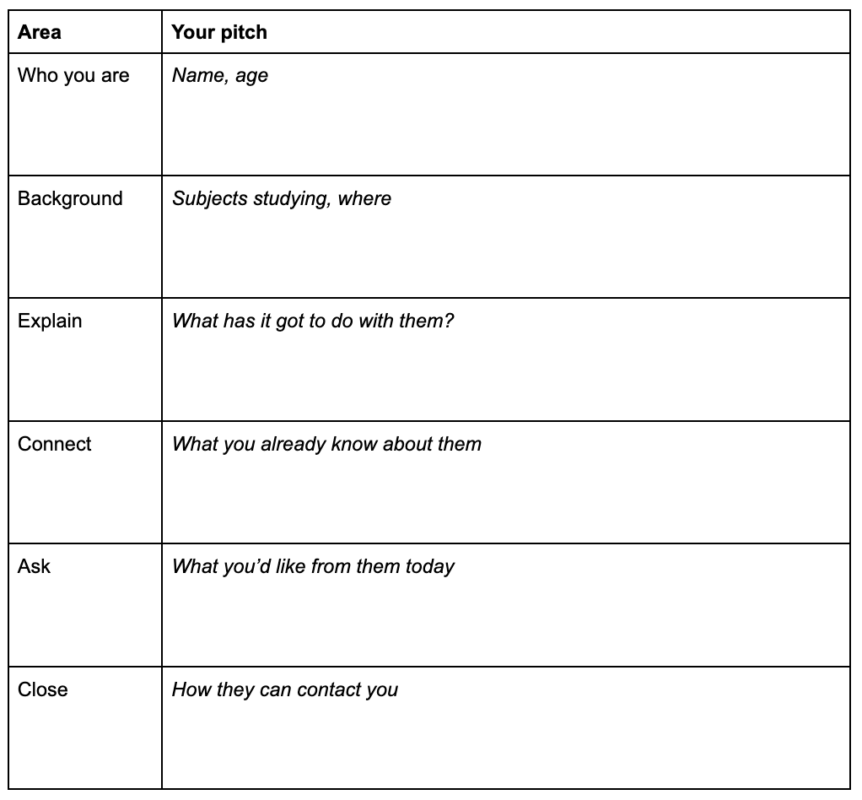
Introducing yourself
Activity:
Using your worksheet, write your elevator pitch as if you were approaching a university or employer stand at a UCAS discovery event.
Example: Hello, my name is Emily and I’m 17 years old. I am studying English, Psychology and Law at HighSchool Sixth Form. I am attending today to learn more about law courses and where I would like to apply. I have read about your undergraduate courses on the UCAS website and would like to learn more about what modules you cover in the first year. Please can you help me with this?

Slide 22
Introducing yourself
Discuss as a class:
Do you think that using the elevator pitch will help you to have more meaningful conversations when you attend a UCAS discovery event?
What other things do you need to be mindful of when speaking with someone new?
Body language
How you are taking notes
Listening skills
Feeling comfortable to ask questions
Tone of voice
Potential answers
Click to reveal
Did you know?
Research shows that it takes four minutes to make a first impression, and, according to a widely cited study by UCLA professor Albert Mehrabian, body language accounts for 55% of that impression (38% comes from tone of voice; the remaining 7% from our actual words).

Slide 23
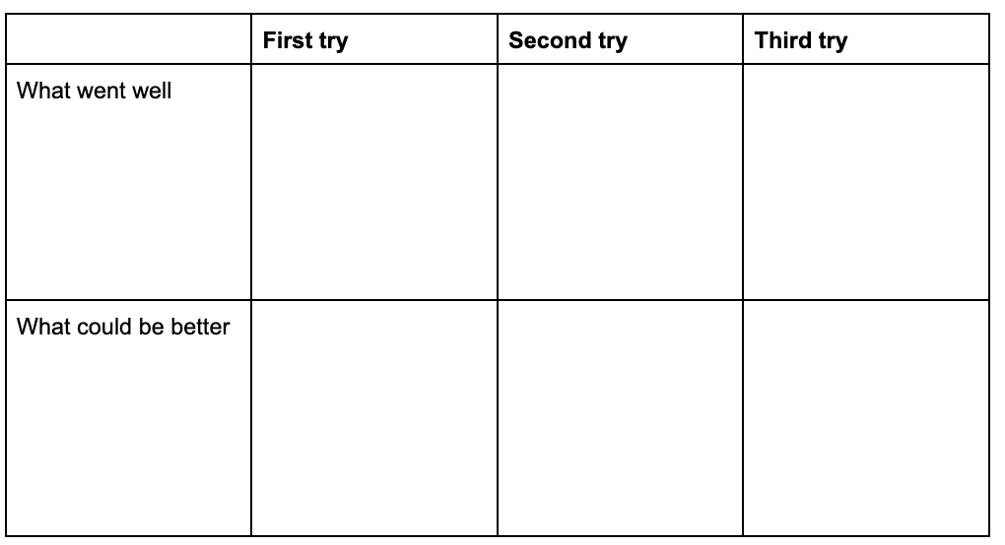

Practicing confident introductions
Activity:
In groups of 4, practice your elevator pitch with three different people. Each time, ask them to leave their feedback on the table on your worksheet.
Activity:
Once you have all three people’s feedback, summarise at the bottom to outline how you will improve your introduction before using it in real life at a UCAS discovery event.

Slide 24
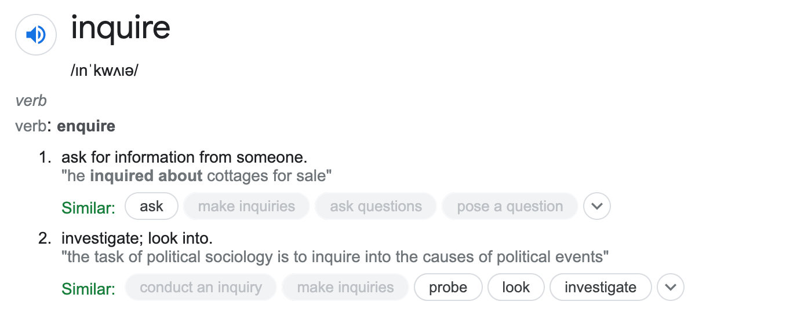
Speaking to organisations
In partners, come up with a definition for the word “inquire”.
Definition
Click to reveal
Exhibitors at UCAS Discovery events will expect everyone attending to have an inquiring mind and ask them questions about who they are and what they offer. Do not be afraid to approach the stands!

Slide 25
Speaking to organisations
There are different questions you can ask to inquire in different ways about… Well, any topic you like! The more information you can gather, the more you will learn from the organisations attending the UCAS Discovery event.
To help you come up with questions that are going to help you get the answers and advice you need, we need to learn more about what questions can lead to what type of answers.
Press play to learn more.
Discuss in partners: When was the last time you asked a question to someone you had never met before? How did it go? Could it have been improved by using a different question type?

Slide 26





Speaking to organisations
Activity:
Using the table on your worksheet, plan any organisations you know you want to speak to, what you want to ask them and how you want to record the information they provide you with.
Recording information could be be a note on your phone, writing information down or something more elaborate. Whatever works best for you.
At the UCAS discovery event, there'll be Mission Cards for you to pick up which will have question prompts - but it is also important to plan your own questions to ask!

Slide 27
Use the mission card questions to help you think of some questions of your own you'd like to ask at UCAS Discovery!

Slide 28

See you at UCAS Discovery soon!

