Slide 1
Confirmation & Clearing 2023 The student journey
Last updated 18/04/2023

Slide 2
Using this deck
This deck is designed to help you understand the applicant journey for Confirmation and Clearing for the 2023 cycle.
You can copy and paste the screenshots into your own materials and guides to support applicants.
Please note help text and guidance is updated based on feedback. As such, some screenshots will change, and we’ll update this deck periodically.

Slide 3
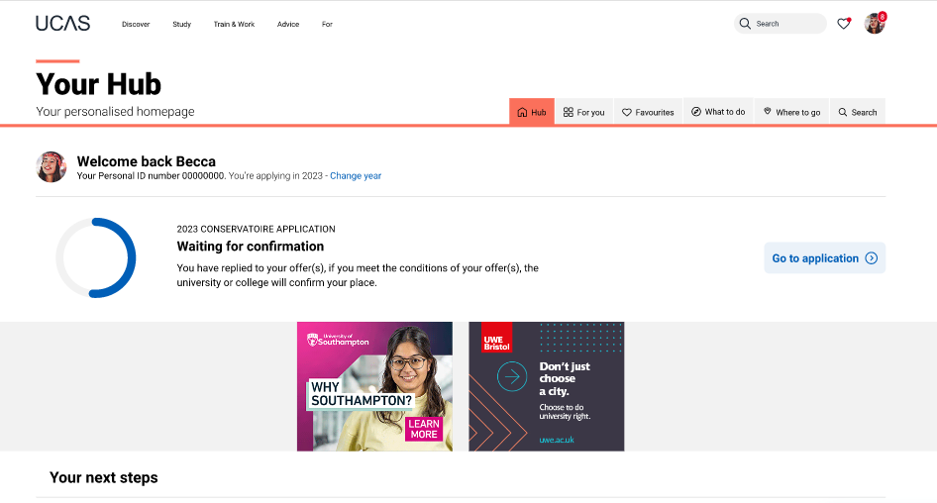
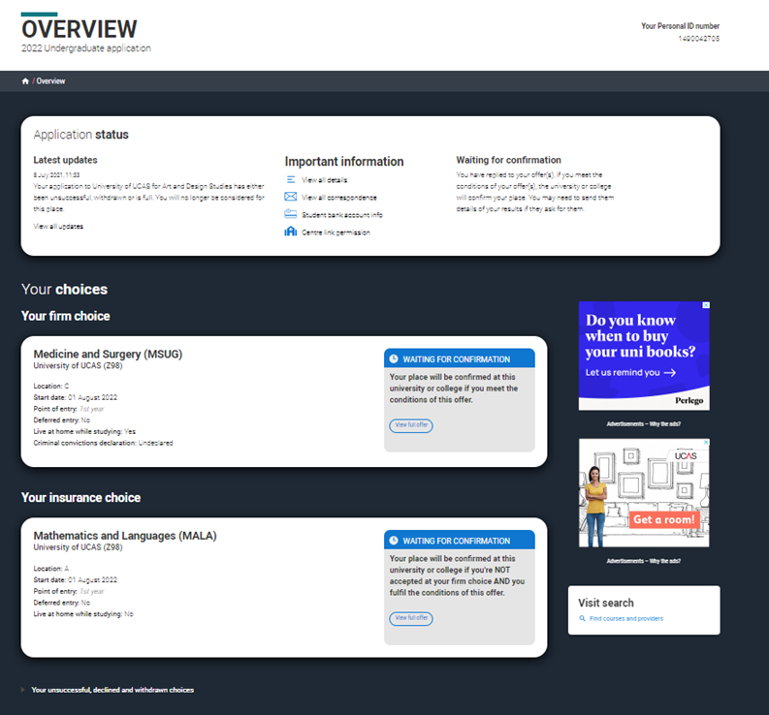
Waiting for confirmation (from July 5)
If an applicant has submitted an application, and accepted Conditional offers, they will see Waiting for Confirmation, whilst universities and colleges confirm their qualifications and other entry criteria.
If applicants select Go to application the firm and insurance choice will also show a blue waiting for confirmation banner.​

Slide 4
Find a course in Clearing (from July 5)
If an applicant has no offers and is not waiting for any decisions, or has declined any offers they received, they will see they have not been placed at firm or insurance choices. From here they can search for courses in Clearing.
An applicant must discuss their choice with the university or college first, and only add a Clearing choice if the university or college has advised them to.

Slide 5
Making an application direct to Clearing
If an applicant has not started an application for 2023 they will be able to start a direct to Clearing application. All sections, including a personal statement and reference, should be completed.
They will need to submit their application without any choices and then add their Clearing choice.
If an applicant started their application and added choices to it before 30 June, these will be removed from the application if it is submitted after 30 June.

Slide 6
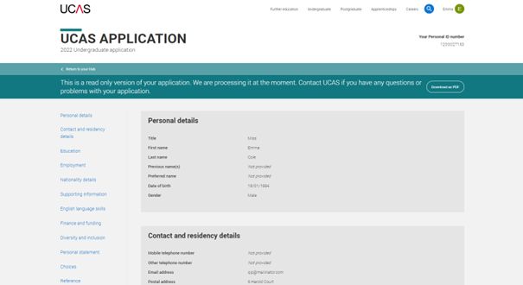
During the examination results embargos
If an application has been submitted, during the results embargo periods, the applicant will be taken to a read-only version of their application.
Just before both results days applications will be unavailable whilst our systems are prepared for them.

Slide 7
SQA results day (8 August)
Just before SQA results day on 8 August (UK time) applications will be unavailable whist UCAS systems are prepared for SQA results day.
On results day applicants will be able to see their confirmation decisions and access their application.
Please note on 8 August the 2024 application service will be unavailable.

Slide 8
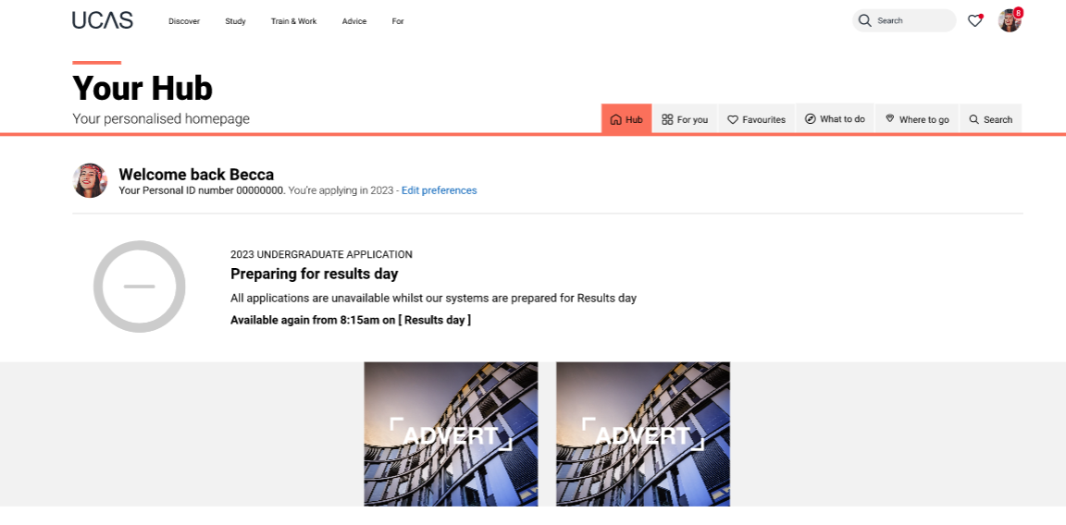
JCQ results day (17 August)
Just before JCQ results day on17 August (UK time) applications will be unavailable whist UCAS systems are prepared for JCQ results day. This will update to reflect the status of the application when the embargo ends
If students want to access their application they may see a timer at busy periods.
Please note on 17 August the 2024 application service will be unavailable.

Slide 9
You’ve been placed!
If an applicant has been successful with their undergraduate application, they’ll see a confirmation banner confirming their place at their firm or insurance choice, we'll also email them. They should receive details from the university or college about what to do next.

Slide 10
Unconditional change of course
Applicants may be offered an unconditional place with substantial changes to the original choice. This usually happens if an applicant didn't meet their conditions, but the university or college wants to offer them a different course, start date and/or point of entry.
Applicants should check the details in the application, and must reply to the offer. If they have any questions or concerns about the change, they need to speak to the uni or college to find out why they’ve made this change.

Slide 11
Reason for confirmation pending
If an applicant has submitted their undergraduate and/or conservatoire application, the provider may not have been able to make a confirmation decision due to outstanding conditions.
This could be because the applicant has not yet supplied proof of qualifications or other entry requirements.
There may be a reason given to explain why the conditional offer hasn't been confirmed yet.
If they have any concerns they should contact their university or college to discuss.

Slide 12
Eligible for Clearing
If an applicant didn't meet the conditions of the offers at either their firm or insurance choice they will be able to use Clearing to search for another course and view their personalised course matches through Clearing Plus.
Applicants can add a Clearing choice from 10:00 on SQA results day and 13:00 on JCQ results day*.
*All timings are UK time

Slide 13
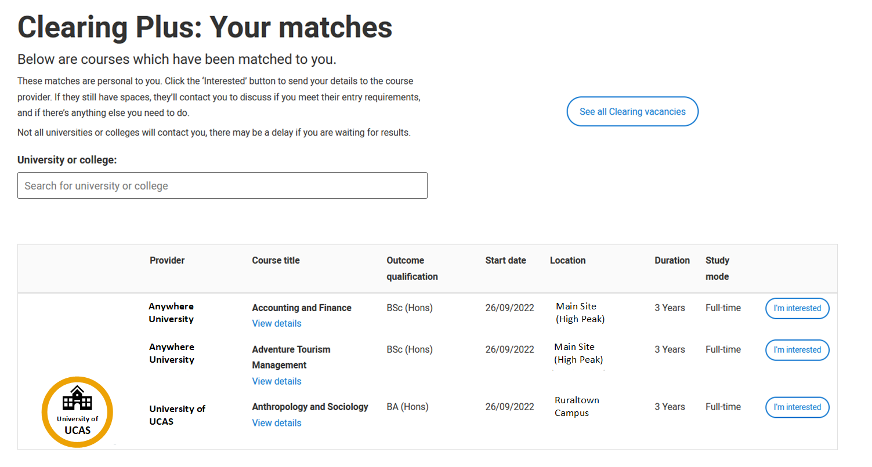
Clearing Plus
In Clearing Plus the matches an applicant sees are unique to them and constantly updated.
If they express an interest in a course (up to 5 at a time), that university or college can contact them.
Remember, courses in Clearing fill up quickly, and they may not be contacted by a university or college they have expressed interest in.
We’d recommend they also look for courses in Clearing using our search tool.

Slide 14
Application status
The status bar at the top of the application shows current status, and eligibility for Clearing.
Latest updates will reflect the latest action.
It will display their Clearing number (six digits) if eligible.
Students also have a ten-digit Personal ID (PID), and may need to quote one or both of these when contacting universities and colleges in Clearing.
For more information see our advice on what different application statuses mean.

Slide 15
Adding a Clearing choice
Eligible applicants can add a Clearing choice from:
10:00 on SQA results day*.
13:00 on JCQ results day*.
*All timings are UK time

Slide 16
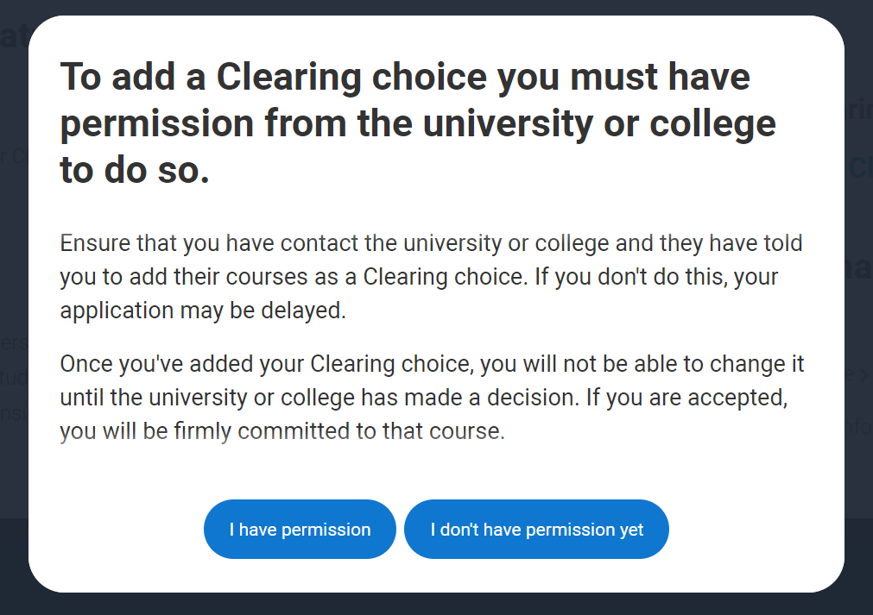
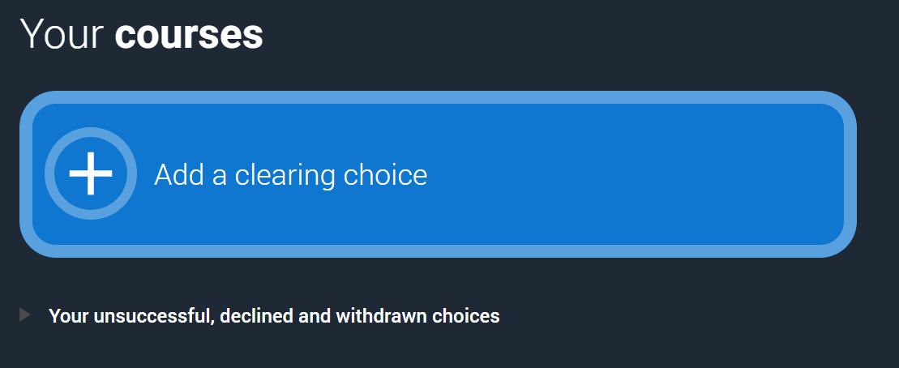
Adding a Clearing choice (Step 1)

Slide 17
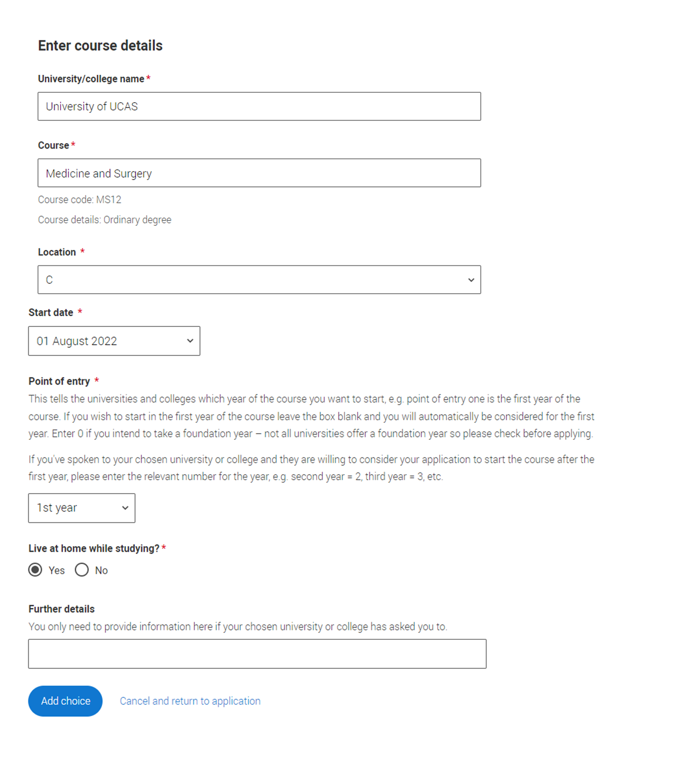
Adding a Clearing choice (Step 2)
Applicants should only add a Clearing choice once they have permission from the university or college.
They need to enter the course details by the date the university/college have given them.

Slide 18
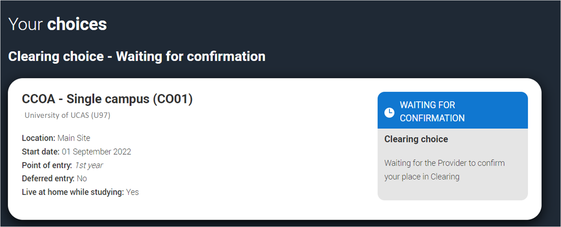
Adding a Clearing choice (Step 3)
Only one Clearing choice can be added at a time.
If the university/college does not accept the Clearing choice (Unsuccessful) or the applicant chooses to use 'Decline my place' after Clearing choice has been accepted, then they'll be able to add a new Clearing choice.

Slide 19
University/College Supplied Code
If the university or college has supplied the applicant with a specific course code for a course available in Clearing, they must enter it using this option.
This may be the case for competitive courses where vacancies are rare and usually filled quickly.

Slide 20
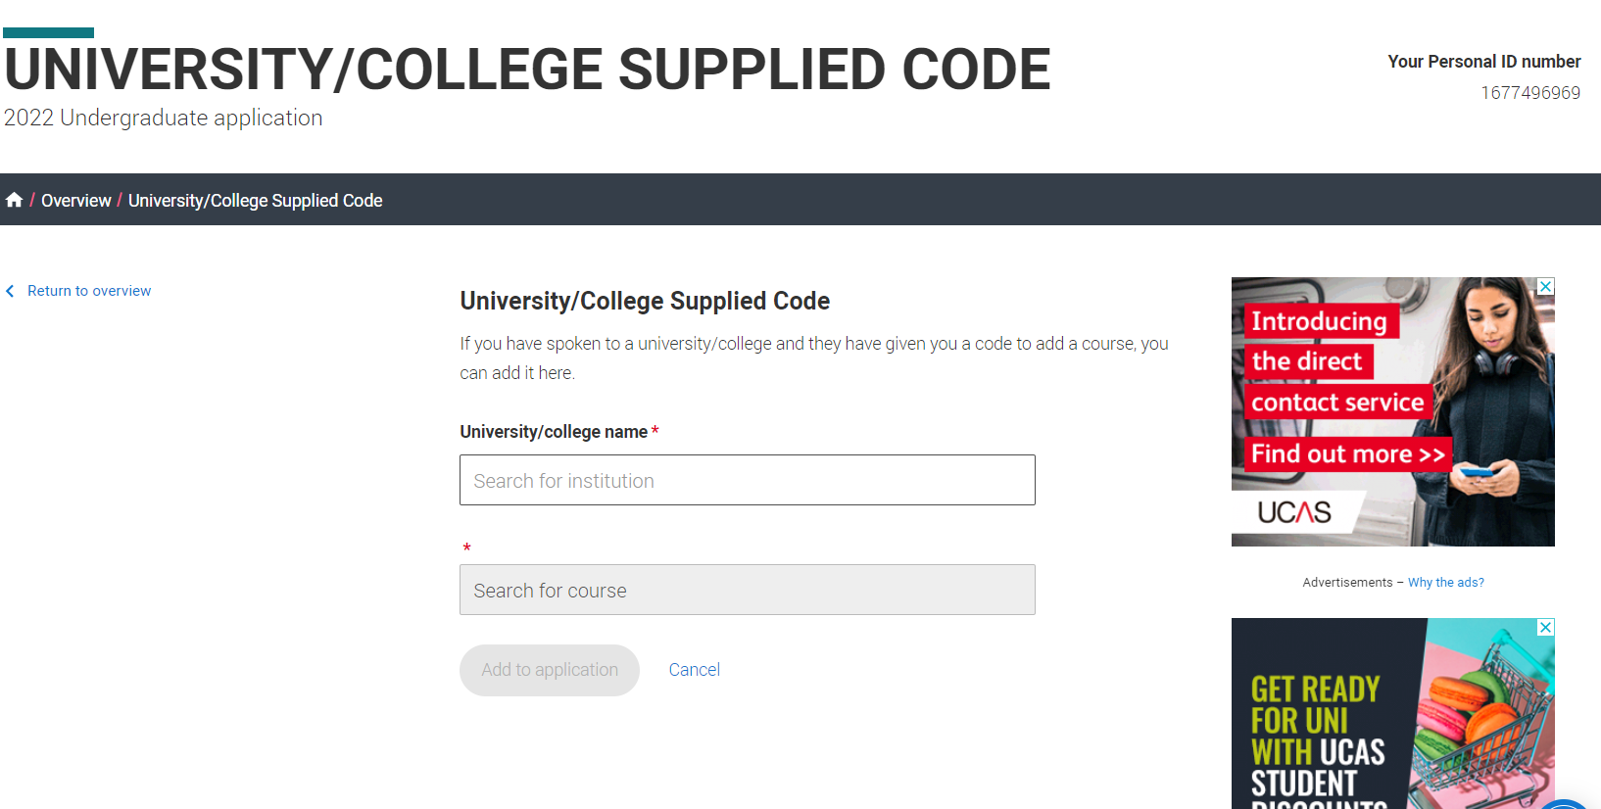
University/College Supplied Code

Slide 21
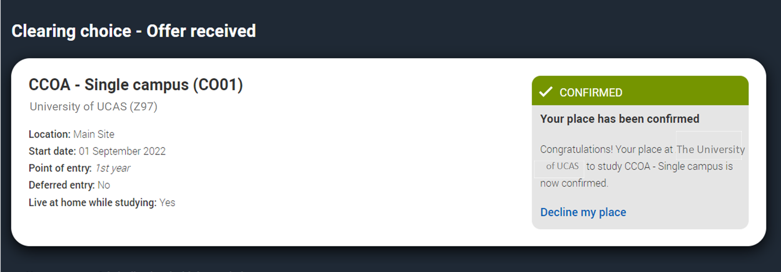
Clearing choice
Applicants don’t need to reply to a Clearing offer.
Once the choice has been added, it’s up to the university or college to confirm the place.
The confirmation will reflect in their application.

Slide 22
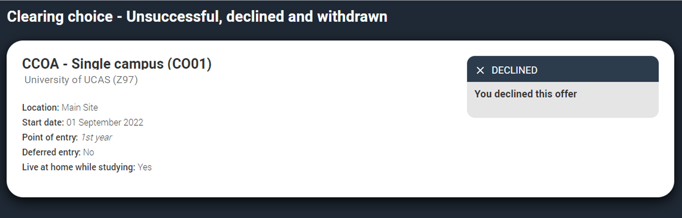
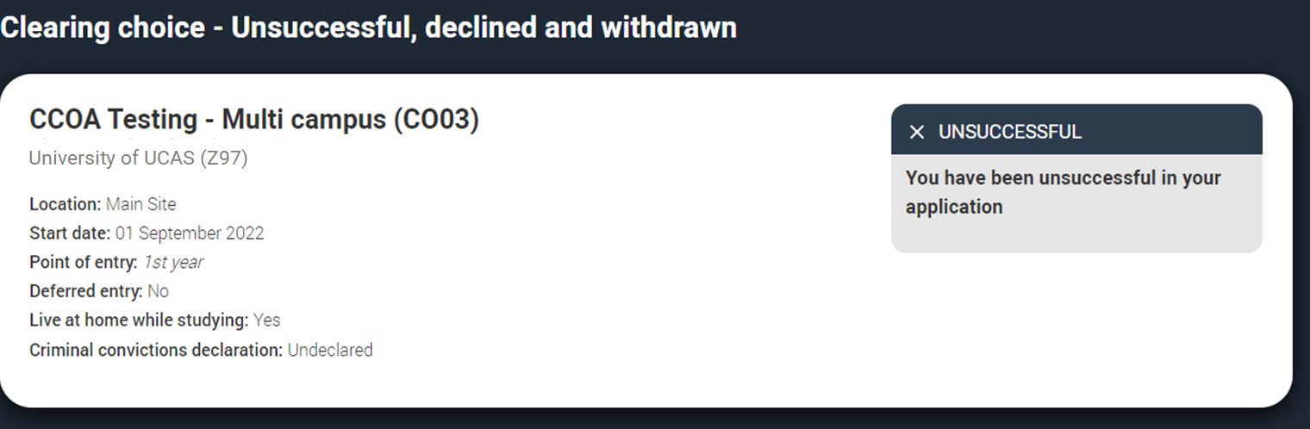
Clearing choice
If the university/college does not accept the Clearing choice (Unsuccessful) or the applicant chooses to use 'Decline my place' after Clearing choice has been accepted, then they'll be able to add a new Clearing choice.

Slide 23
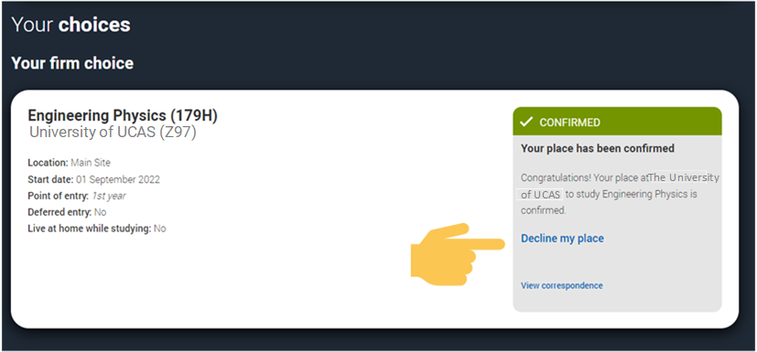
Decline my place (Step 1)
From 5 July, if an applicant is holding an unconditional firm place, they can release themselves into Clearing, by using the ‘Decline your place’ button in the application.
This is available until 6 September 2023.

Slide 24
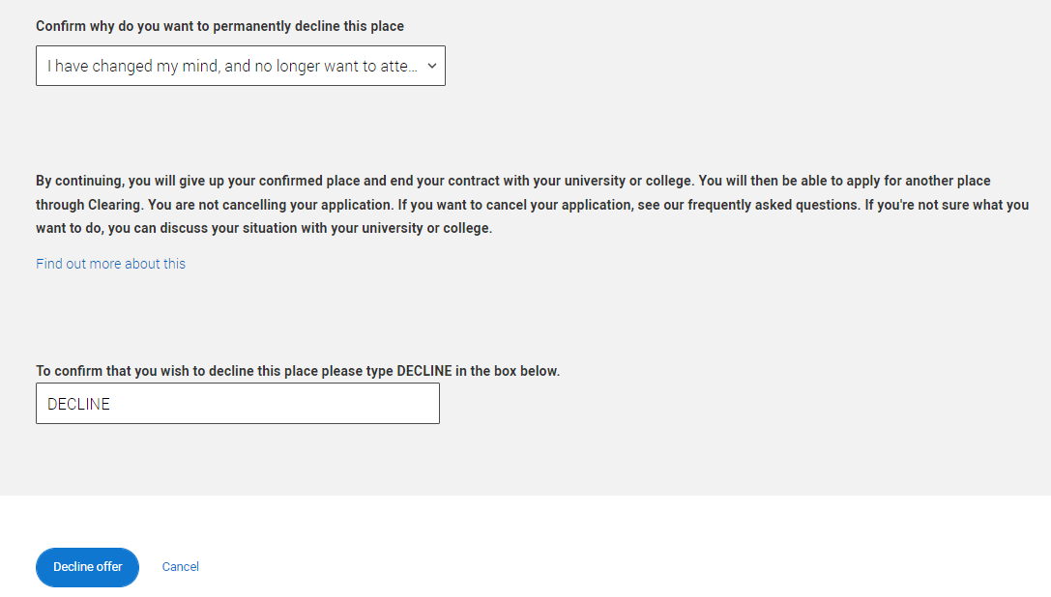
Decline my place (Step 2)
They should only use this if they no longer wish to take up their place at their confirmed firm choice.
Using it will mean their place will be declined and their contract with the university or college will be cancelled, including any arrangements made for accommodation or scholarships.
Students will need to confirm they want to decline their place.

Slide 25
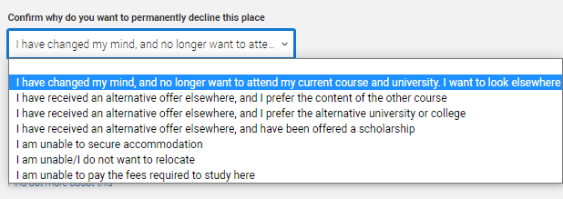
Decline my place (Step 3)
They may find the best option isn't to decline their place; other options are available.
Applicants should never be pressured into making a decision, if they seem unsure, suggest they give UCAS a call to discuss their options.

Slide 26
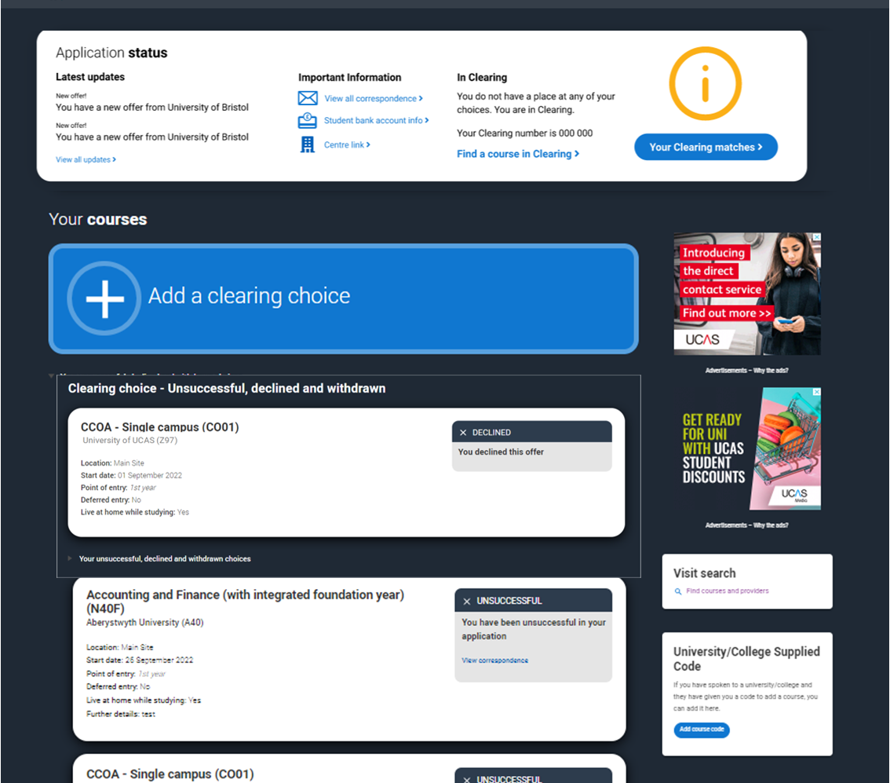
Decline my place (Step 3)
If an applicant uses ‘Decline my place’ they will then enter Clearing.
They will be able to apply for another course through Clearing or view their matches in Clearing Plus.

