Slide 1
LEEDS LOCATION INFORMATION
Leeds Beckett University
Headingley Campus
Tennis Centre
Leeds LS6 3QQ
1

Slide 2
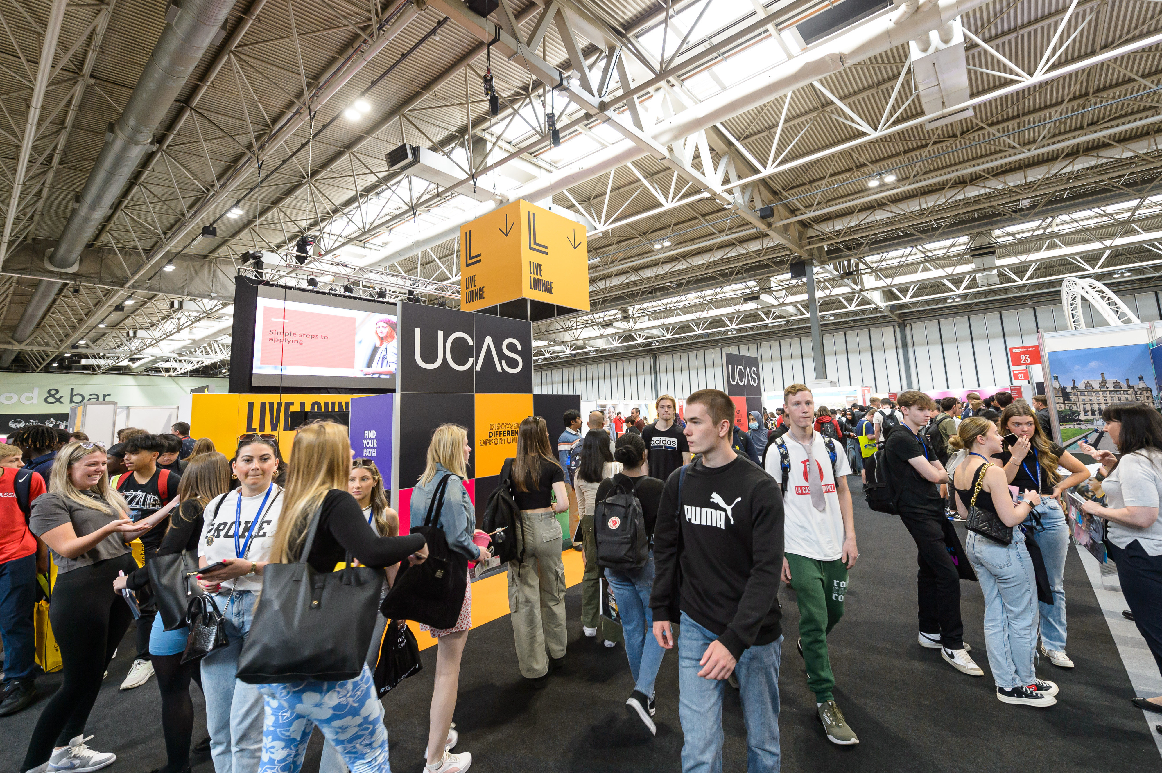
EXHIBITING AT
EVENT: LEEDS UCAS
DATE: 14-15 June 2023
OPENING TIMES: 9.30-15.00
VENUE: Leeds Beckett University, Tennis Centre, Headingley Campus, Leeds LS6 3QQ
15

Slide 3
EVENT INFORMATION
ACCESSIBILITY
All routes to the Tennis Centre will have clear accessible routes. There will be clearly marked accessible routes and lifts. We have an access ramp down into the tennis centre and then an access ramp leading onto the tennis courts. There are also two access points through the double fire doors at court one end and court four end.
ACCOMMODATION
Please find below details of hotels in the vicinity of the venue:
Village Hotel, Leeds North t: 0113 323 6150
Weetwood Hall t: 0113 230 6000
Ascot Grange Hotel t: 0113 293 4444
Premier Inn Headingley t: 0871 097 1063
Please note that these hotels are just a guide for exhibitors and are not recommended by UCAS.
CARPARKING
During the exhibition on Wednesday 14th and Thursday 15th June, all exhibitors will get one free parking space per stand. Please use the Church Wood Avenue entrance. Exhibitors can park free of charge in the pay and display car park on the right-hand-side as you enter the campus. A parking permit must be displayed on the windscreen of your vehicle. Permits can be found at the end of this pack, please print off and display.

Slide 4
EVENT INFORMATION
CATERING
Use the Food Court for exhibitor lunches. Please ask ambassadors for directions.
The event will not close for lunch. Exhibitor tea and coffee will be available free of charge in the exhibitor break room. Hot drinks taken into the exhibition hall must have lids. Water fountains are available around the hall but please bring your own water bottles with you.
FIRST AID
If you sustain any personal injuries, or are present when an accident happens, please ask for assistance from the organisers or visit the information/registration marquee outside the exhibition hall.
INTERNET
Eduroam is available on our campus. For those exhibitors not on Eduroam, we can supply visitor log ins on the day.
SCANNING
To take advantage of lead scanning at this event, you need to download the Smartlead UCAS and have purchased scanning for the UCAS/Discovery events. You will need a license code per device per event which are assigned to you when you purchase the scanning. Make sure your staff at the event have been provided with the license codes. You will find a guide to setting up your device and how to manage your data in the Exhibitor zone along with a Scanning Instructions document that you can share with your staff attending the event. Hard copies are also provided on your stand. A member of the UCAS team will be on hand at the exhibitor/scanner help desk in the Tennis Centre to support you at the event or you can call 01242 544808 or email events@ucas.ac.uk.
RISK ASSESSMENTS
All exhibitors need to provide a risk assessment for your stand build and any activities that will be happening on your stand. Please send this through to Emily Bibby e.bibby@ucas.ac.uk at least 4 weeks before the exhibition date. The event organiser has completed a risk assessment for the event.

Slide 5
LOGISTICS
SCHEDULE:
BUILD DAY: (Tuesday 13th June)
08:00 – 15:00 Event set up
15:00 – 19:00 Exhibitor/contractor access.
EVENT DAY: (Wednesday 14th June)
07.30 – 09:00 Exhibitor access.
09:30 – 15:00 Exhibition open – trolleys will not be allowed on the exhibition floor once the exhibition has opened to the public.
15:00 – 16:00 Stand replenishment.
EVENT DAY 2 (Thursday 15th June)
07.30 – 09:00 Exhibitor access.
09:30 – 15:00 Exhibition open – trolleys will not be allowed on the exhibition floor once the exhibition has opened to the public.
15:00 – 16:15 Exhibitor/contractor breakdown.
16:30 - event breakdown

Slide 6
LOGISTICS
ARRIVAL
To gain entry to the Tennis Centre, exhibitor lanyards must be worn at all times. Your lanyard will be ready to collect when you arrive at the
Tennis Centre. You must register details of who will be attending before the event, through your ENet account – instructions on
how to do this will be emailed to the lead booker. Please find a campus map linked here.
BUILD-UP
Build-up times:
13th June 2023 12.00 – 15:00 Logistics & stand build firms only
15:00 – 19:00 All exhibitor access
14th June 2023 07:30 – 09:15 All exhibitor access
15th June 2023 07:30 – 09:15 All exhibitor access
THE EVENT
Event day and times:
14th & 15th June 2023 09:30 – 15:00

Slide 7
LOGISTICS (added an extra page here)
UNLOADING
Please unload your vehicle on the morning of the event outside the Tennis Centre and then park your vehicle in the pay and display car park which will be free for this event. Unloading of your vehicle must happen before 8.45am on event days.
If you are arriving by taxi, please make your way to Leeds Beckett University, Headingley Campus, LS6 3QQ (please see campus map) where someone can direct you to the Tennis Centre.
Trolleys are not provided at the venue, so please bring your own if you need one to deliver goods to your stand. Trolleys are only permitted on the exhibition floor outside event opening hours, for the safety of visitors.
BREAKDOWN
15th June 2023 From 15:00
Exhibitors must remain on their stands, and not start dismantling them until the exhibition is clear of visitors. We anticipate this to be 5 to 10 minutes after the exhibition closes. To help facilitate this, and ensure health and safety is maintained, the loading doors will stay closed until the venue is clear of visitors.
If exhibitors start dismantling stands while the event is still open, there will be no alternative but to close the exhibition, irrespective of how many visitors remain in the hall – this is standard industry practice, in line with guidance in the eGuide. This is because stands which are broken down while visitors are still in the hall pose a health and safety risk. As stated in the exhibitors’ code of conduct, all issues raised will be logged and reviewed regularly by UCAS and HELOA. The same principles apply for dismantling, as accessing.
Logistics contractors must not enter the campus arrive prior to 15.15.

Slide 8
LOGISTICS
DELIVERIES
Please refer to the build-up and breakdown section in addition to the information below.
The venue address for couriers is:
Exhibitor name
Stand number
UCAS Leeds
Stand number [***] (see floorplan for your stand number)
[Organisation name]
c/o Leeds Beckett University
Tennis Centre, Headingley Campus
Leeds, LS6 3QQ
Deliveries can be made anytime between 12.00– 19:00 on the 13th June. Any deliveries made before this time will not be accepted by the venue and returned to the sender.
If you are expecting goods to be delivered by courier, please make sure they are aware of the dates of the event, and venue opening times. All deliveries not clearly addressed, or those which arrive prior to the stated time, are likely to be lost or returned to the sender. Please make sure the staff on your stand are aware of:
• who your courier is
• your courier’s contact details
• what is being delivered
Note: All deliveries must access campus via the Church Wood Avenue entrance – for satnav, use LS6 5LF.
No pallets/pallet trucks will be allowed inside the exhibition venue. All delivery companies must remove any pallets immediately following unloading.

Slide 9
LOGISTICS (added an extra page here)
ORGANISERS
The organisers can be contacted through the staff at the Registration/Information marquee outside of the Exhibition Hall. The lead organiser is Klaudia Gawrysiak. During the exhibition, Klaudia can be contacted on 07387233317
Before the exhibition, please contact recruitmentevents@leedsbeckett.ac.uk.
STORAGE
Storage space at the venue is extremely limited, so please only deliver resources that can be accommodated within the confines of your stand.

Slide 10
CONTACT DETAILS
UCAS Events Team
E: events@ucas.ac.uk
T: 01242 544 808
Onsite general enquiries:
Look out for event ambassadors wearing peach coloured t-shirts, they can offer advice and answer any questions.
Please familiarise yourself with the onsite organiser’s office at each event for any questions you have or help you need
15

