Slide 1
EVENT LOCATION INFORMATION
Location specific information for
UCAS Discovery Carlisle 2023
1

Slide 2
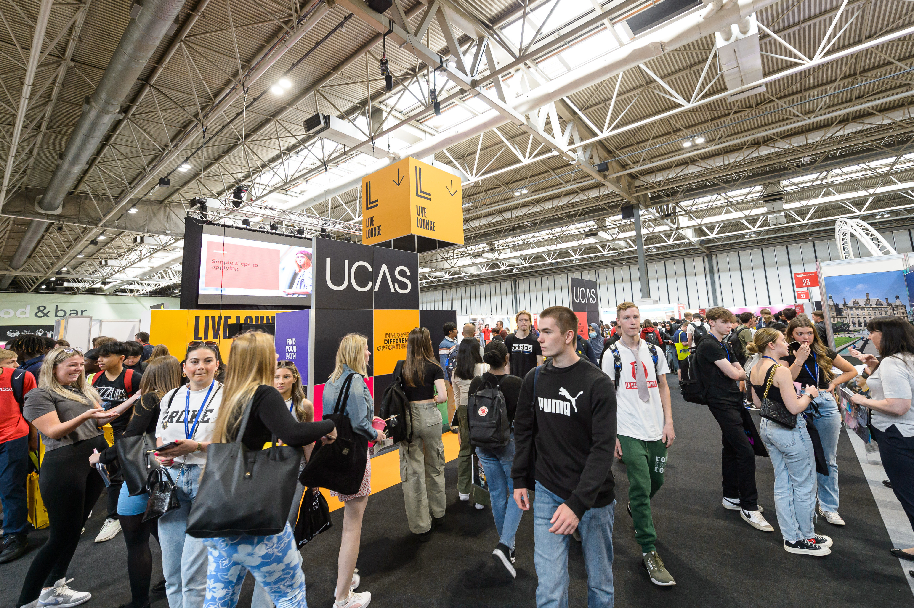
EXHIBITING AT
EVENT: UCAS Discovery Carlisle 2023
DATE: Wednesday 5th July 2023
OPENING TIMES: 9:30am – 2:30pm
VENUE:
University of Cumbria Sports Hall
Fusehill Street, Carlisle
CA1 2HH
15

Slide 3
EVENT INFORMATION
ACCOMMODATION
Please find below details of hotels in the vicinity of the venue:
Travelodge Carlisle City Centre 08719 846374
Ibis Carlisle City Centre 01228 587690
The Crown and Mitre Hotel 01228 525491
Please note that these hotels are just a guide for exhibitors and are not recommended by UCAS.
CAR PARKING
Limited exhibitor car parking is available in the vicinity of the sports hall, within reserved bays which will be clearly identified by signage.
The sports hall is located to the rear of the campus and can be accessed via the one-way entry system to the campus from Fusehill Street.
Additional pay and display parking is available at Cecil Street Car Park, 12 Aglionby Street, Carlisle, CA1 1NX.
Please print off the parking pass at the back of this pack and display in the windscreen of your vehicle if parking onsite.
CATERING
The exhibitor lounge (staff room) is located within the sports hall where you can access free hot and cold drinks.
Seating in this space will be limited. You will also find a grab and go snack facility in our catering outlet 'The Cube', where you can purchase food and drinks such as sandwiches, snacks, cold drinks and a small selection of hot items. Cashless purchasing only.
The event will not close for lunch. If you’re a lone exhibitor and don’t want to leave your stand during the day, we have event staff who will be happy to fetch you any refreshments, if they are able to do so.

Slide 4
EVENT INFORMATION
FIRST AID
If you sustain any personal injuries, or are present when an accident happens, please ask for assistance from the organisers.
Please go to the sports hall reception desk immediately if you require first aid assistance.
INTERNET
Internet access is available free via Eduroam and via the University of Cumbria conference network. You will be required to create a login to our cloud-based conference network of which details will be provided to you on your stand and via the sports hall reception desk.
SCANNING
To take advantage of lead scanning at this event, you need to download the Smartlead UCAS and have purchased scanning for the UCAS/Discovery events. You will need a license code per device per event which are assigned to you when you purchase the scanning. Make sure your staff at the event have been provided with the license codes. You will find a guide to setting up your device and how to manage your data in the Exhibitor zone [link] along with a Scanning Instructions document that you can share with your staff attending the event. Hard copies are also provided on your stand. A member of the UCAS team will be on hand at the exhibitor/scanner help desk [not sure what this is called] to support you at the event or you can call 01242 544808 or email events@ucas.ac.uk.
RISK ASSESSMENTS
All exhibitors need to provide a risk assessment for your stand build and any activities that will be happening on your stand. Please send this through to Emily Bibby e.bibby@ucas.ac.uk least 4 weeks before the exhibition date. The event organiser has completed a risk assessment for the event.

Slide 5
LOGISTICS
SCHEDULE:
BUILD DAY: Tuesday 4th July
15:30 – 17:00 Event set up – deliveries can be made during this time
15:30 – 17:00 Exhibitor/contractor access.
EVENT DAY: Wednesday 5th July
08:00 – 09:00 Exhibitor access.
09:30 – 14:30 Exhibition open – trolleys will not be allowed on the exhibition floor once the exhibition has opened to the public.
14:40 – 17:00 Stand replenishment.

Slide 6
LOGISTICS
ARRIVAL
If you are arriving by vehicle, please access the campus through the one-way entry system, following the road round to the sports hall at the rear of the campus. Limited reserved parking bays are available for exhibitors immediately in the sports hall vicinity on a first-come, first-served basis and these will be clearly marked. See Parking section for more information. If you are arriving on foot, please follow the same one way system road round to the rear of the campus where the sports hall is located.
BUILD-UP
Build-up times: Tuesday 4th July 15:30 – 17:00
Event day and build time: Wednesday 5th July 08:00 – 09:00
Access is available to the sports hall through both the entrance door and via the double exit doors that will be open directly into the sports hall. Trolley access is available via small ramp. Any deliveries must be brought into the sports hall by you or your courier and left within your allocated stand space. Any deliveries left outside the sports hall will not be accepted. Parking and drop off facilities for couriers is available next to the sports hall.
Please clearly place a parking permit in your windscreen.
BREAKDOWN
Breakdown time: 14:40-17:00
Event helpers will be available to remove any empty cardboard boxes from your stand area and there are skips directly located outside next to the sports hall for any rubbish. Access is available to the sports hall through both the entrance door and via the double exit doors that will be open directly into the sports hall. Trolley access is available via small ramp.
If you think you might need extra time to build your stand (outside the build-up times stated above), please contact events@ucas.ac.uk. In some circumstances, early access to the venue on the build-up day may be given, but this is only with the advance permission of the organiser. If advance permission has not been granted, exhibitors will be turned away from the venue until the exhibitor build-up session starts.

Slide 7
LOGISTICS
DELIVERIES
The venue address for couriers is:
Exhibitor name
Stand number
UCAS Discovery Carlisle
University of Cumbria Sports Hall
Fusehill Street
Carlisle
CA1 2HH
Deliveries can be made from Tuesday 4 July from 15:30 – 17:00. Any deliveries made before this time will not be accepted by the venue and returned to the sender.
ORGANISERS
The organisers can be found at the sports hall reception desk. The lead organisers are Shannon May Blaylock and Carly Scott. During the exhibition, Shannon can be contacted on 07791511888 and Carly can be contacted on 07841339563. Before the exhibition, please contact Shannon on 01228 279 305, or at
Shannon-May.Blaylock@cumbria.ac.uk / studentrecruitment@cumbria.ac.uk
STORAGE
There is limited storage space at this event, please ask staff for access to store your items.

Slide 8
CONTACT DETAILS
UCAS Events Team
E: events@ucas.ac.uk
T: 01242 544 808
Onsite general enquiries:
Look out for event ambassadors wearing coloured t-shirts, they can offer advice and answer any questions.
Please familiarise yourself with the on-site organisers office at each event for any questions you have or help you need
15

