Slide 1
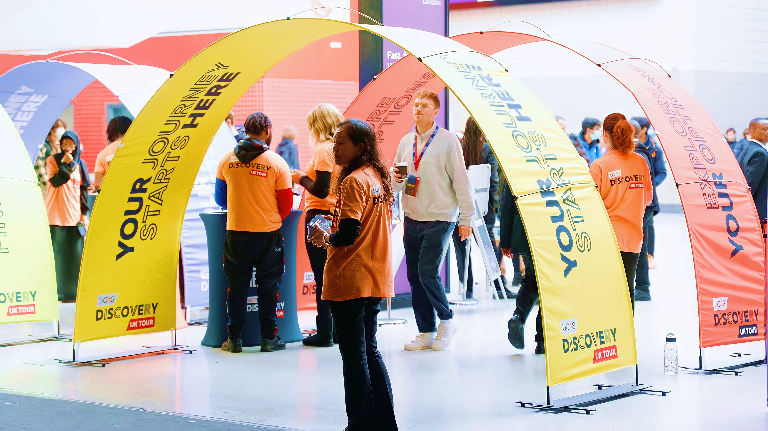
VISITOR
INFORMATION
GUIDE
DATE: Wednesday 5th July 2023
VENUE: University of Cumbria Sports Hall,
Fusehill Street Campus

Slide 2

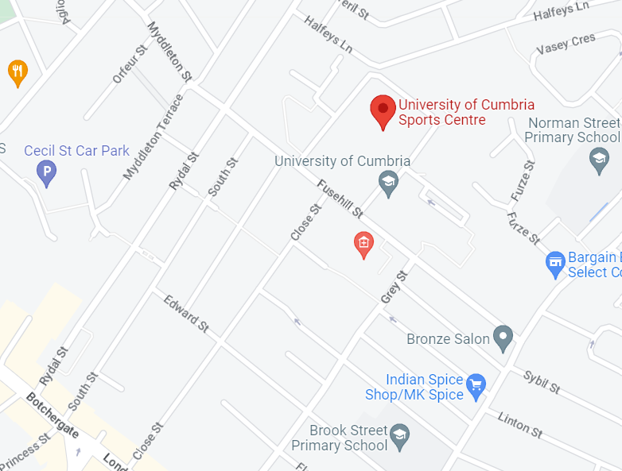

GETTING HERE
University of Cumbria Sports Centre, Fusehill St, Carlisle CA1 2HH
https://www.cumbria.ac.uk/student-life/locations/carlisle---fusehill-street/
TRAVELLING BY CAR OR COACH?
Visitor car parking will not be available on campus except for those requiring a disabled parking space. Disabled parking bays can be found to the front of the campus and the rear. Please follow the one-way system round the campus to access the parking area at the rear. Alternative car parking can be found at Cecil Street Car Park, 12 Aglionby St, Carlisle, CA1 1PA.
Coaches must drop off at the roadside outside the campus on Fusehill Street. Access to coaches on campus is not permitted due to capacity, health and safety and narrow roads. Coach parking can be found in Carlisle city centre during the event and coaches must return for pick up on the roadside outside campus.

Slide 3
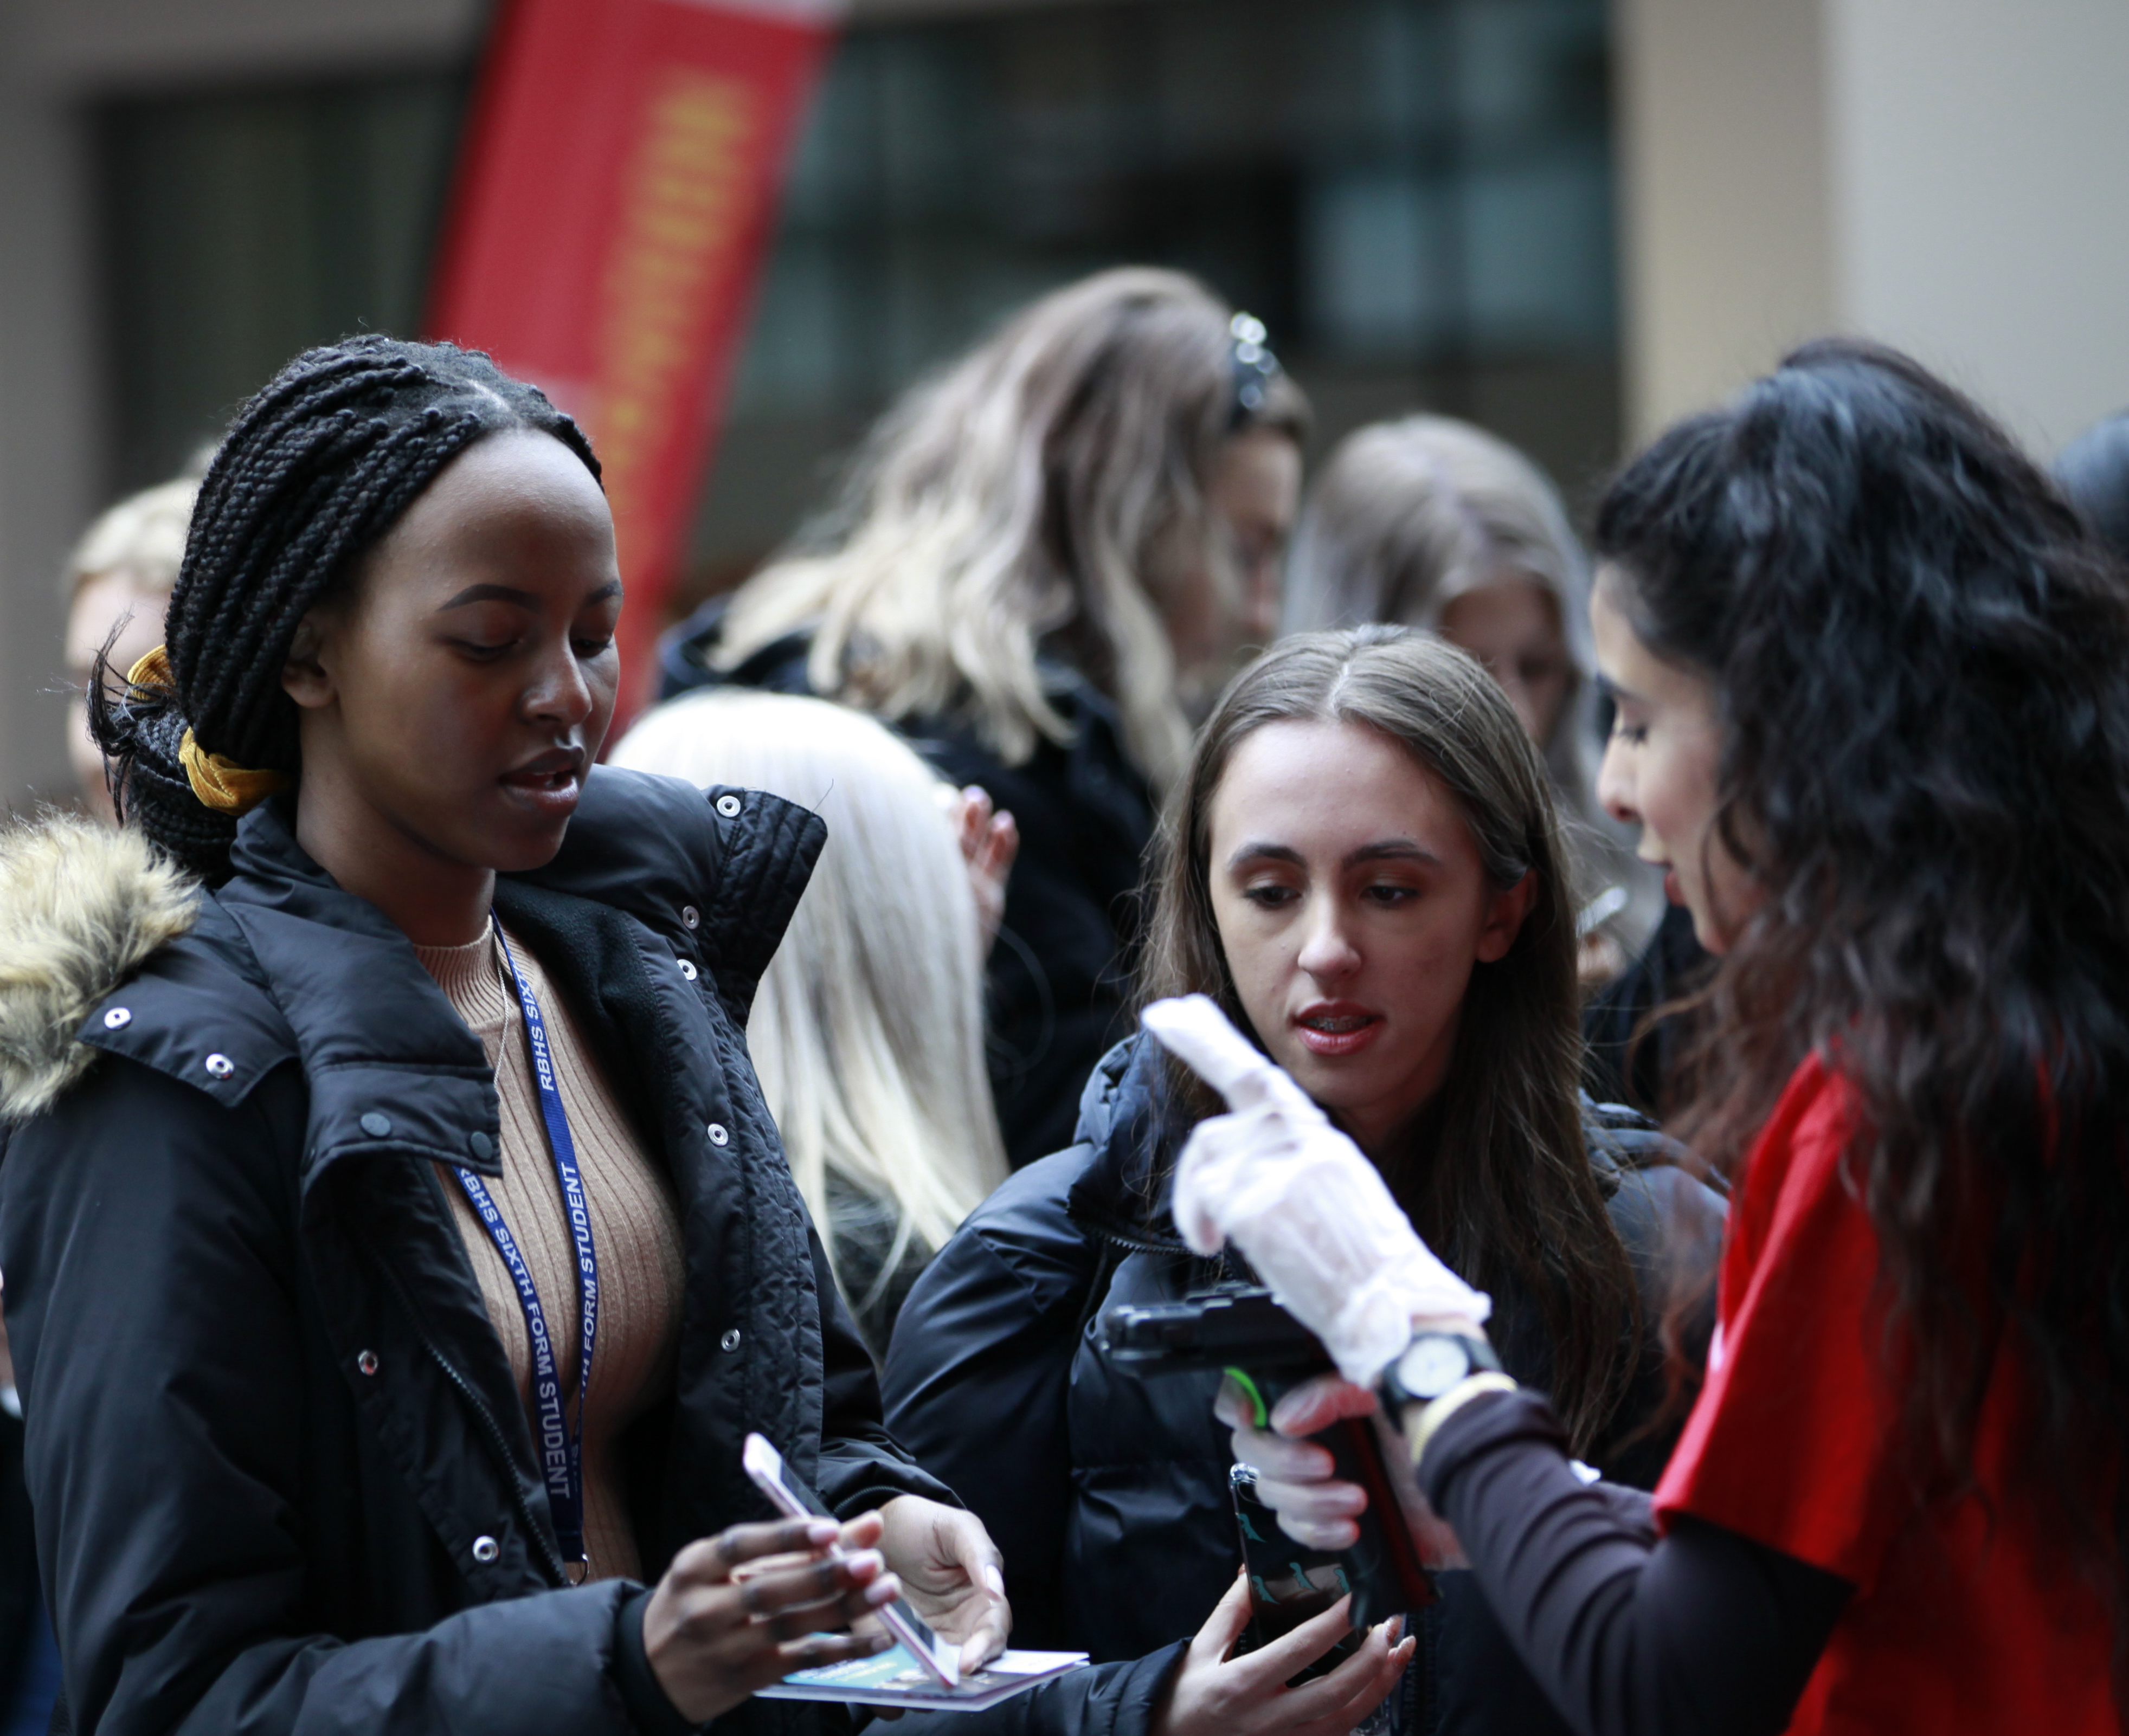



WHILST YOU’RE HERE
WHEN YOU ARRIVE
On arrival, please head to the University of Cumbria Sports Hall. Please have your ticket ready for inspection. If you don’t have a ticket on arrival, please report to the registration desk at the Sports Hall.
Your exhibition ticket is personal to you and should not be
passed on to other group members, as this could compromise the security of your data. To comply with data protection regulations, it’s essential that individuals at our exhibitions use their own ticket – both on entering, and when visiting exhibitors’ stands. Anyone found to be in breach of this will be asked to leave the event and register again to be readmitted.
Please be aware, the venue may be conducting random
bag and wand searches. We thank you for your patience while this takes place.

Slide 4
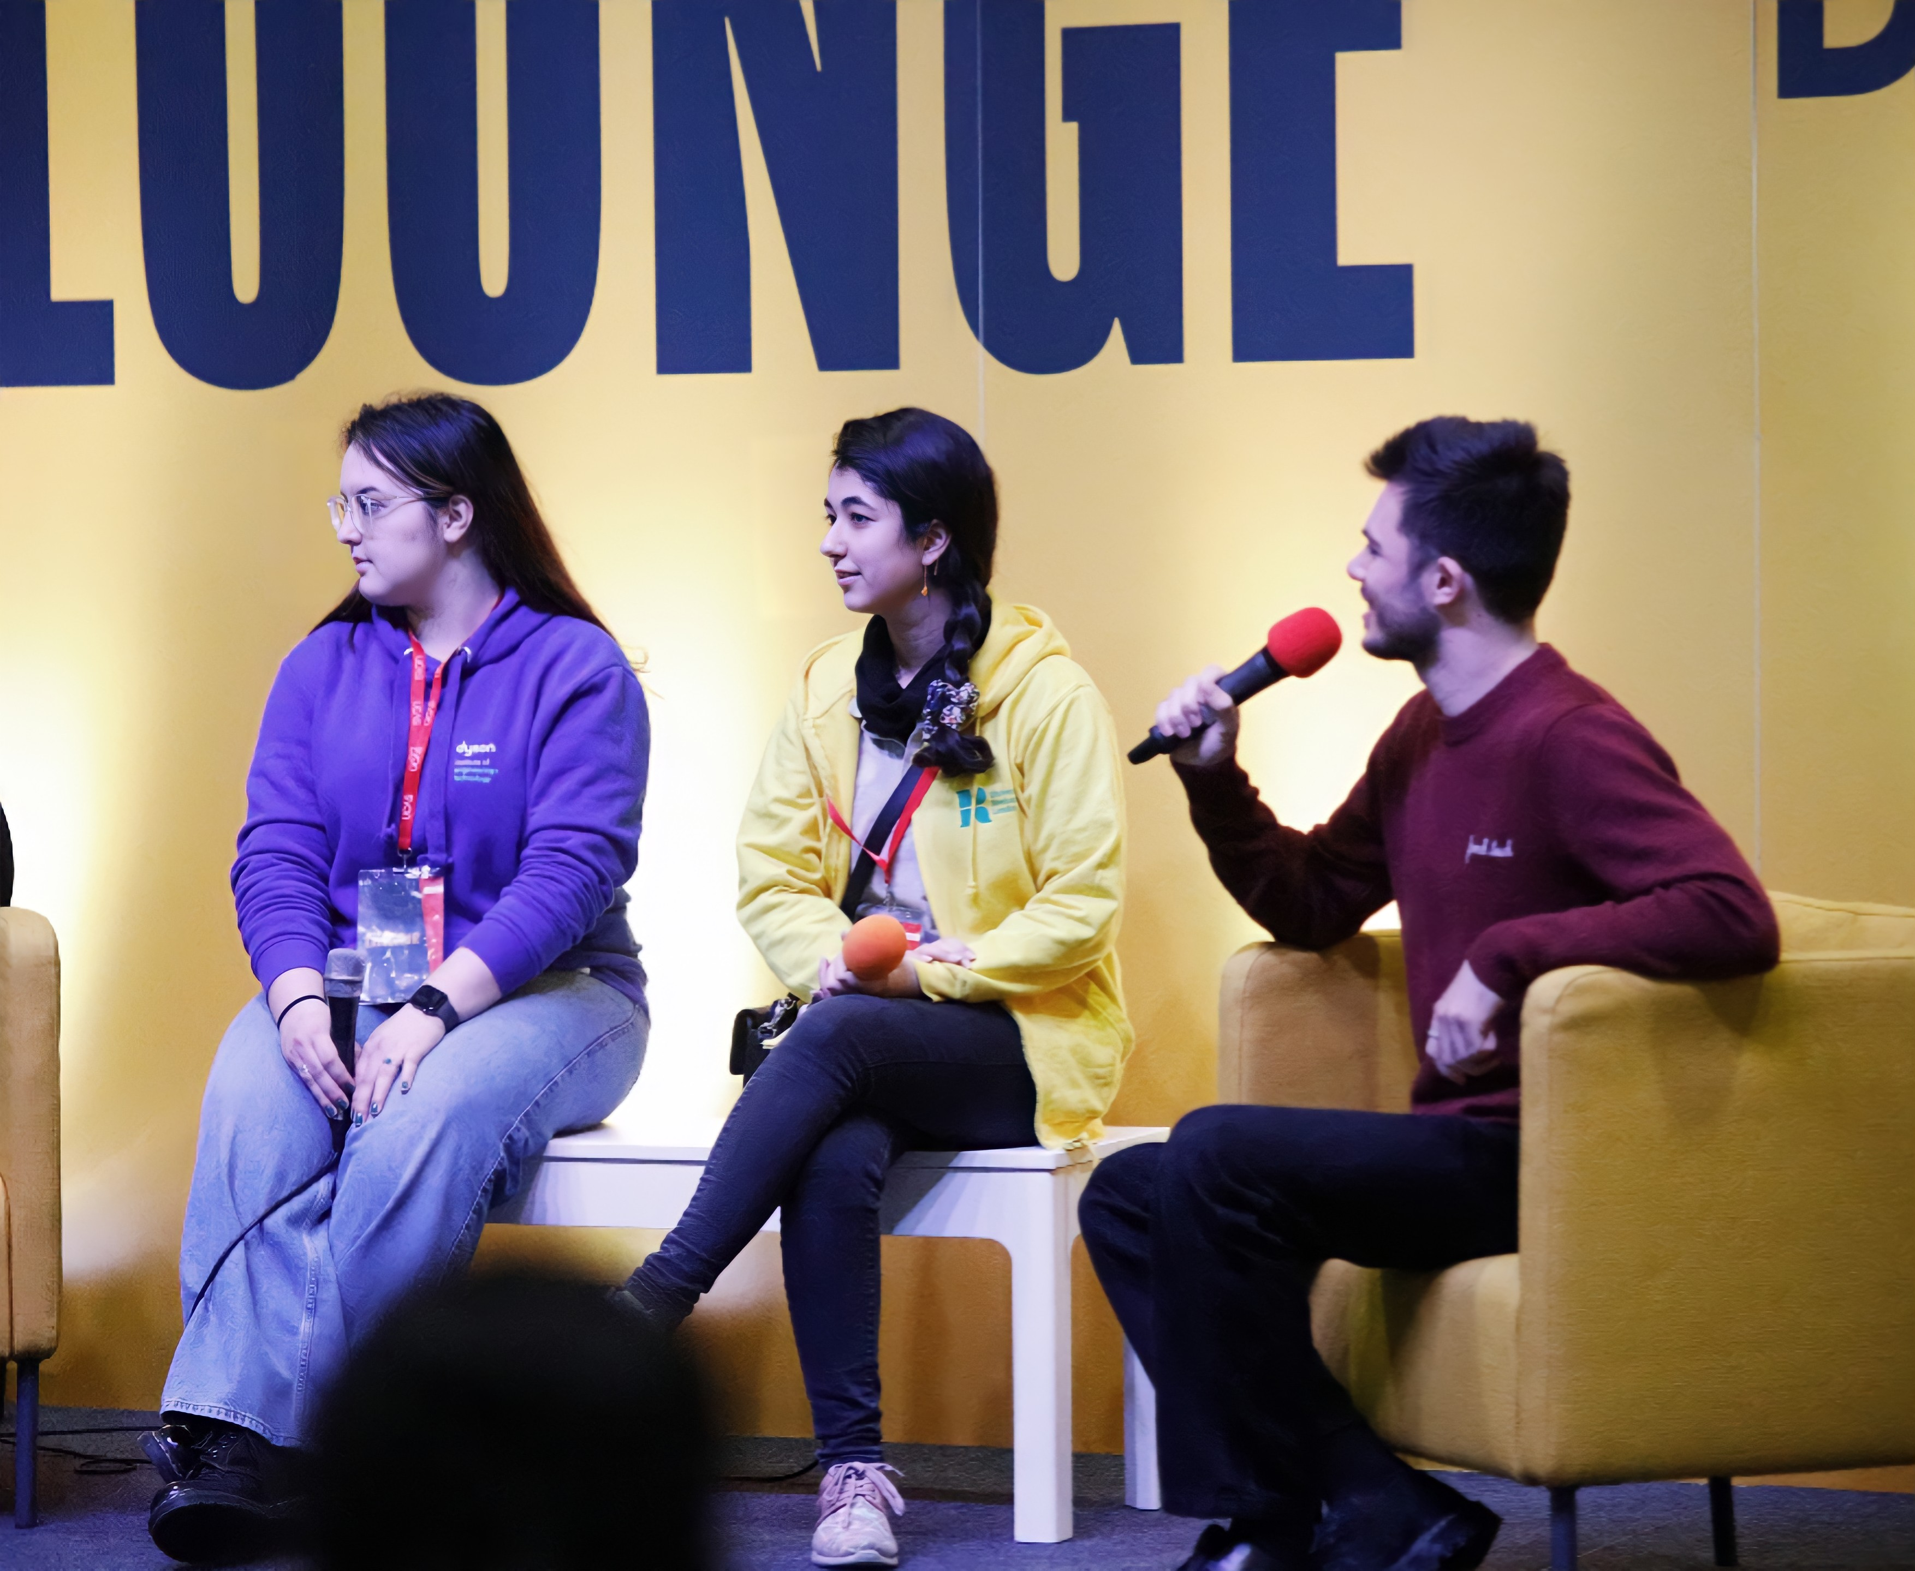
WHILST YOU’RE HERE
WIFI
Free internet access is available via the University of Cumbria Conference system. To use the account, you must follow the registration instructions. The password is available on posters around the Sports Hall.
ACCESSIBILITY
Our campus is fully accessible, with disabled toilets in every building
The Big Q&A and Subjects Talks
Student talks, workshops, and performances will run throughout the event within our Main stage and Mini Stage. These can all be found in the main hall and will be signposted. A full programme of events can be found on the event webpage.
CATERING
There will be refreshments available for visitors to purchase in our catering outlet 'The Cube' in a grab and go facility where snacks, cold drinks and a selection of hot food can be found. Vending machines can also be found in The Learning Gateway building for snacks, cold and hot drinks.
EVENT STAFF
For general queries during the event (e.g., directions to facilities), ask any of the event staff, who can be identified by their UCAS-branded t-shirts.

Slide 5
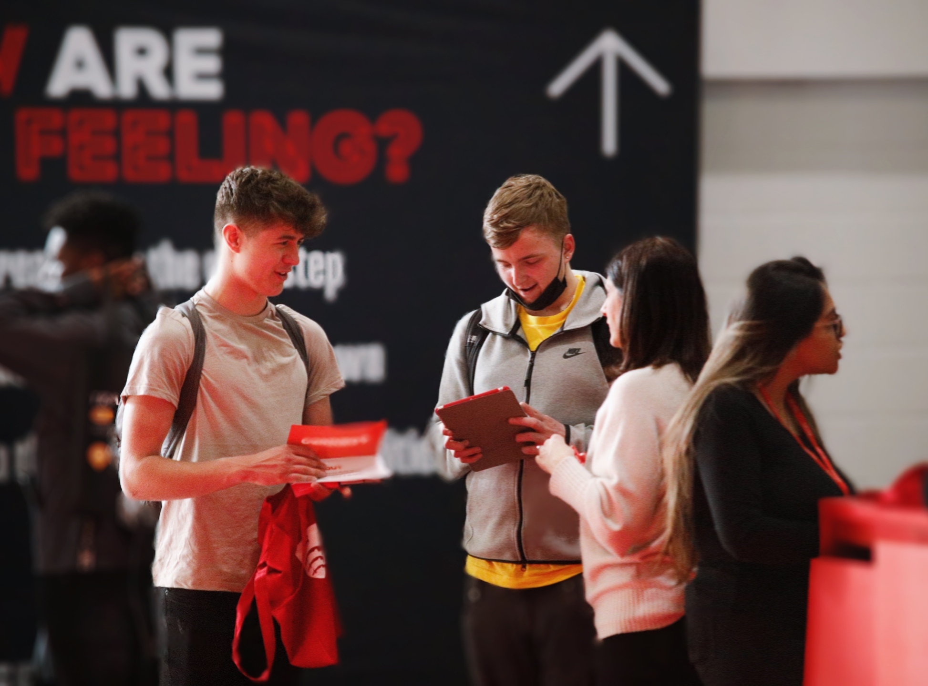
JUST IN CASE
ORGANISERS
If you wish to speak to the event organiser, they will be based in the exhibition venue, and can also be identified by UCAS branded t-shirts. If you need to speak to the organiser by phone prior to the event, please call 01228 279 305
ACCIDENTS & NEAR MISSES
If you are involved in, or witness an accident or near miss while on-site, please report it to the general information desk immediately.
EMERGENCY PROCEDURES
Should an evacuation of the building occur, please follow the instruction of the event staff, and leave the build via the nearest exit.
FIRST AID
In the event of required first aid assistance, please go to the Sports Hall Reception Desk where the UCAS events team will be able to assist you.

Slide 6
FREQUENTLY ASKED QUESTIONS
WHAT INSURANCE IS IN PLACE FOR THE EVENT?
The organiser has adequate public and employee liability cover. While the organisers take every precaution to protect visitors’ property during an event, they are not responsible for any loss or damage. All group leaders should ensure they have adequate public and employers’ liability cover, in line with the booking terms and conditions.
WHAT HAPPENS TO ANY LOST PROPERTY?
If any property is lost or found in the venue, please report it to The Sports Hall Help Desk.
CAN I SMOKE/VAPE ON SITE?
Please note, throughout the build-up, duration, and break down of the exhibition, there is a strict policy of no smoking/vaping or drinking of alcohol on the University campus.
This campus operates a no smoking policy within any buildings or adjacent to buildings. Smoking areas can be found on campus. Please ask at the Sports Hall Help Desk where you will be directed to these areas.
WHAT SECURITY IS THERE?
Security will not be on site during the exhibition times on campus. If you are a victim of theft, please report it to the event manager immediately.
WHERE CAN I GET A COPY OF THE RISK ASSESSMENT FOR THE EVENT?
The organiser has completed a risk assessment for the event and this will be uploaded to the group bookers enet account.

Slide 7
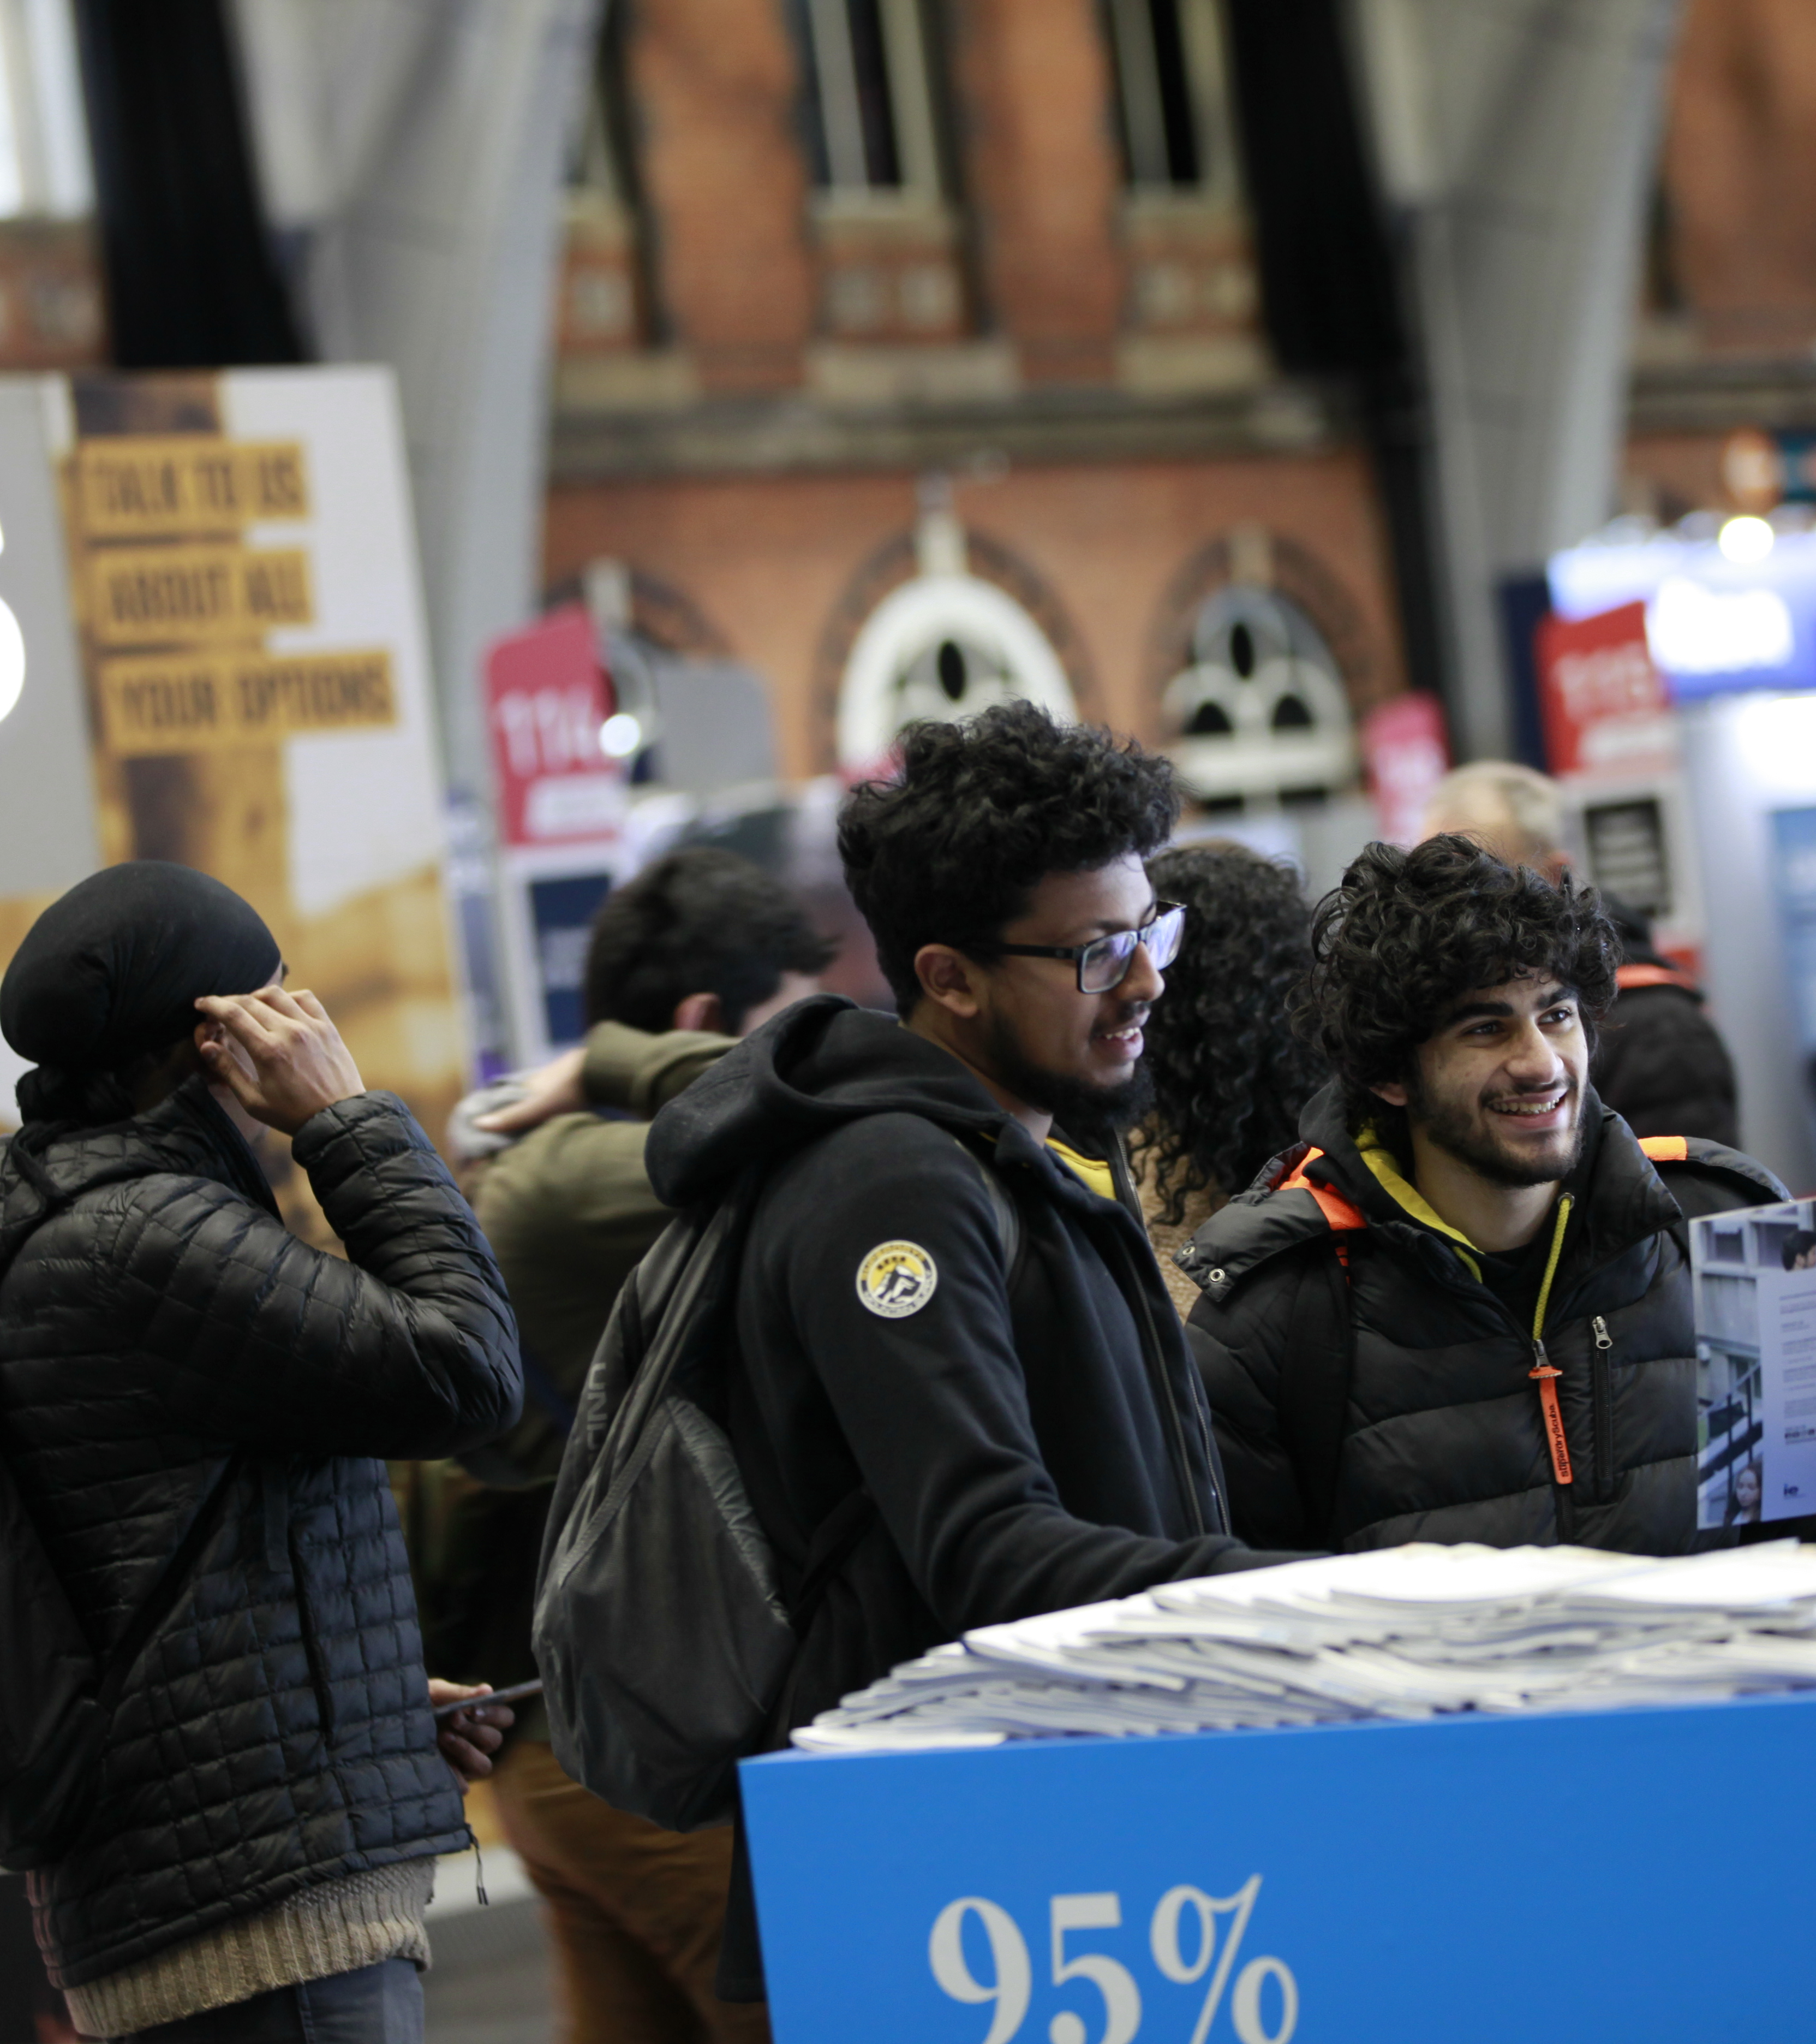




CONTACT DETAILS
VENUE
University of Cumbria Sports Hall, Fusehill Street Campus
studentrecruitment@cumbria.ac.uk
01228 616 333
ON SITE GENERAL ENQUIRIES
Event ambassadors, wearing UCAS t-shirts, will also be available to offer help and advice if you have any queries
CONTACT DETAILS
Prior to the exhibition 01242 544 808 or email events@ucas.ac.uk
Thank you for registering to attend the Carlisle UCAS Discovery exhibition.

