Slide 1

Adviser Portal
Bulk download of applications

Slide 2
Summary
In preparation for the launch of the 2025 cycle – you can download your cohort’s applications in bulk in a PDF format via the Adviser portal.
This new feature can be found in the Application management tile.
You can download applications by group (by using the filtering function available) or your whole year cohort.
It does take up to 15 minutes to process the request due to the size of the file.
UCAS will email you when the file is ready for you to download and save it to your own system’s confidential files.
Handy step by step guide available in the following slides.

Slide 3
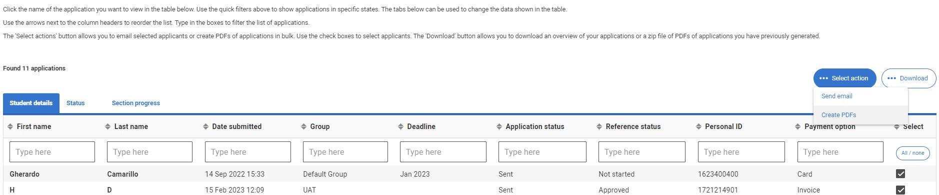
Create PDFs button - step one
Sign-in to the Adviser portal and click on Application management tile
Use the select button to identify the applications you want to download
Click ‘select action’ and ‘create PDF’
filter and download by group? use ‘Type here’ and input the name of the group and follow steps above

Slide 4
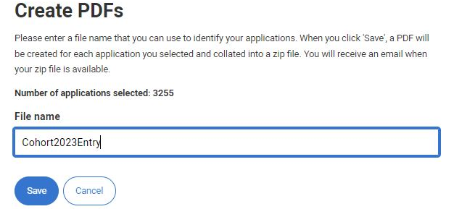
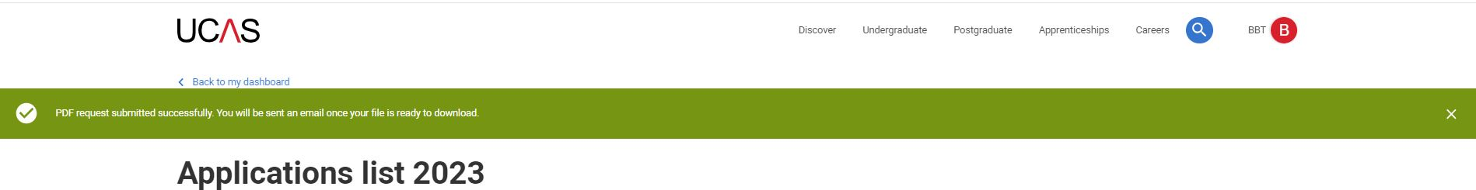
Save and name file – step two
Name your file and save
A green bar confirms successful request
An email from UCAS confirms your download is ready (can take up to 15 minutes)
You do not have to wait you can come back and sign-in later to retrieve

Slide 5
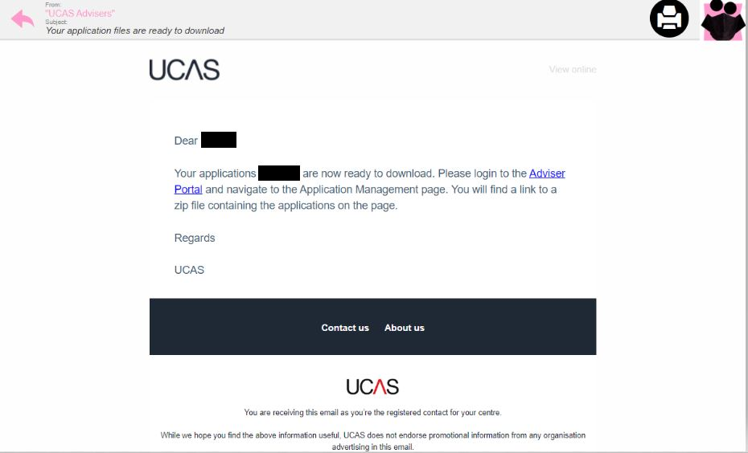
Email confirmation – step three
Example email you will receive from UCAS

Slide 6
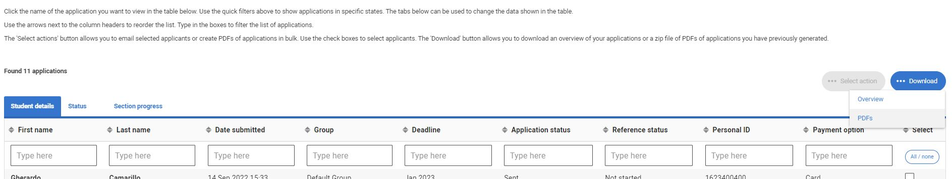
Download ready to retrieve – step four
Once you’ve received the email confirmation, sign-in to the Adviser Portal and access Application Management tile
Now click on the ‘download button’ and PDFs

Slide 7
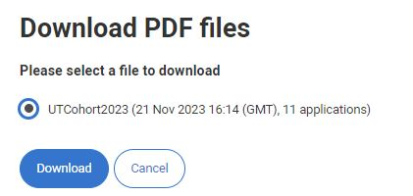
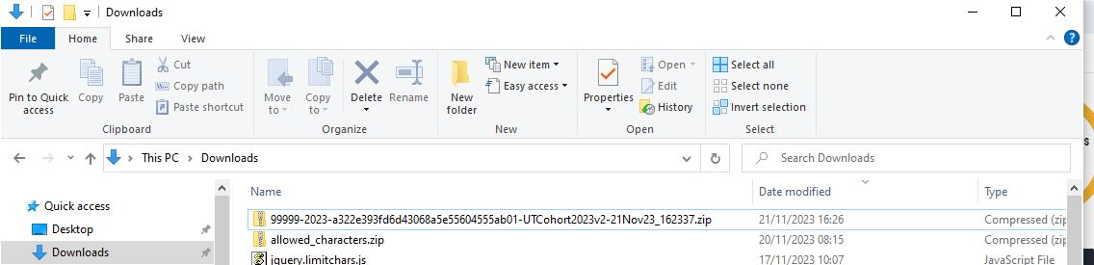

Download ready to retrieve – step five
Click on your named PDF files and click download.
Retrieve your files in your computers’ downloads and identify the file (as you would for single PDF downloads).
Save the document to your local/central confidential network within your school

