Slide 1
Applying through
UCAS
For courses starting in 2025
Updated: 09 April 2024

Slide 2

Using this slide deck
This deck has been designed so you can support those on the application journey.
Information relates to the 2025 application cycle.
You can copy and paste the screenshots included into your own materials and guides to support applicants.
Please note changes to the design of the UCAS Hub and application can take place during a cycle, along with updates to help text and guidance. This is based on feedback and is to improve accessibility and navigation. Screenshots will change, and we will update this deck periodically. Please see date stamp on the title slide.
Find more help and advice on filling in the undergraduate application on ucas.com.
NOTE: images shown are for desktop/laptop users. Mobile users may see a different layout for some sections.

Slide 3
Registering for an account.

Slide 4

Registering for an account
Head to ucas.com and select Sign in.

Slide 5
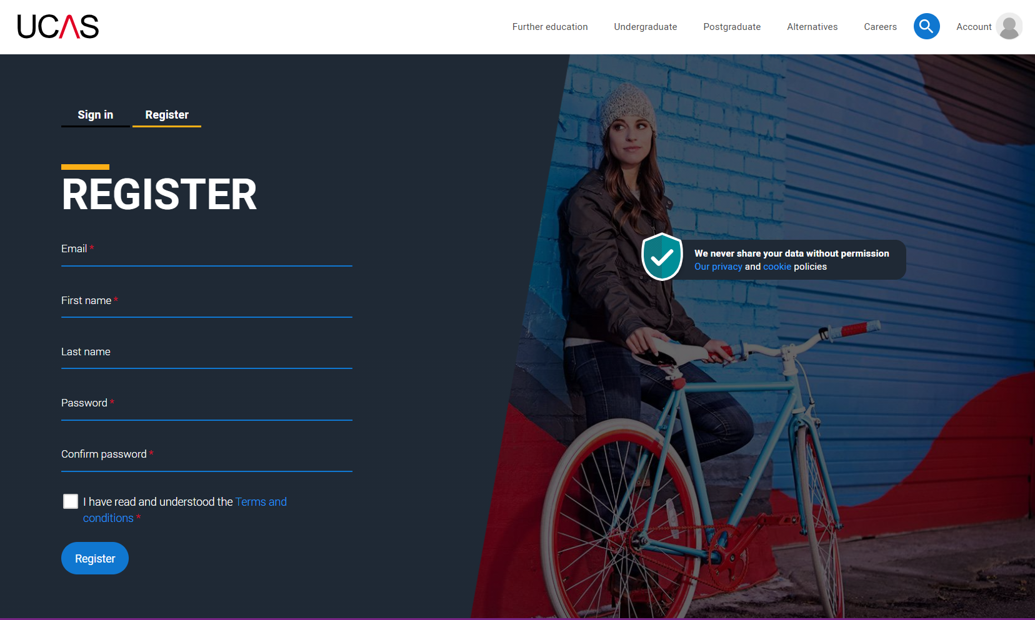
Registering for an account
Complete the short form. Make sure the password is memorable.
We recommend you use a personal email address so you always have access to updates.

Slide 6
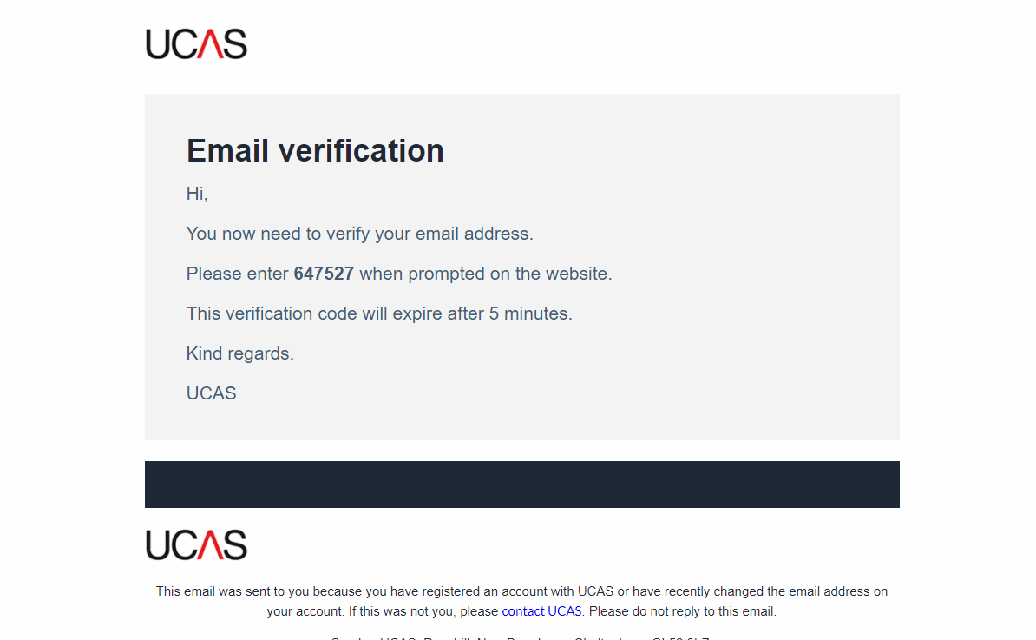
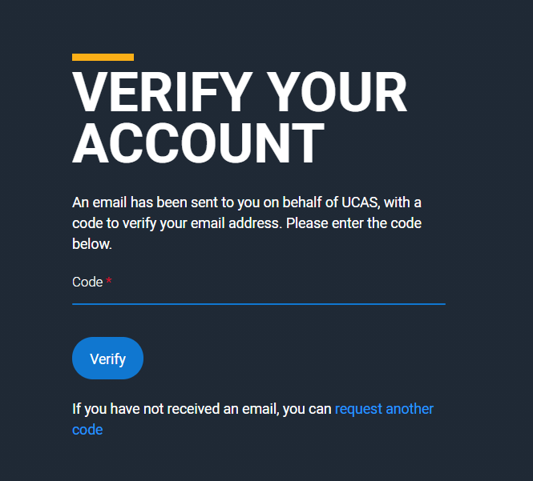
Registering for an account
We’ll email you a code to verify your email address, so we know we’ve got the right details.

Slide 7
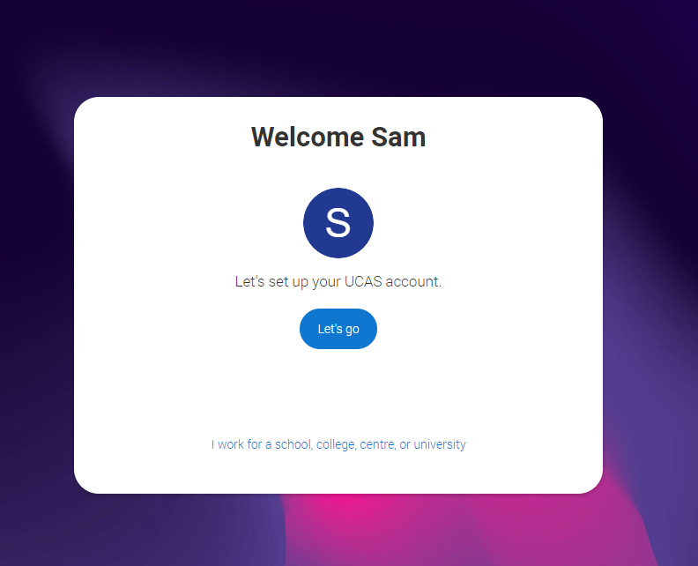
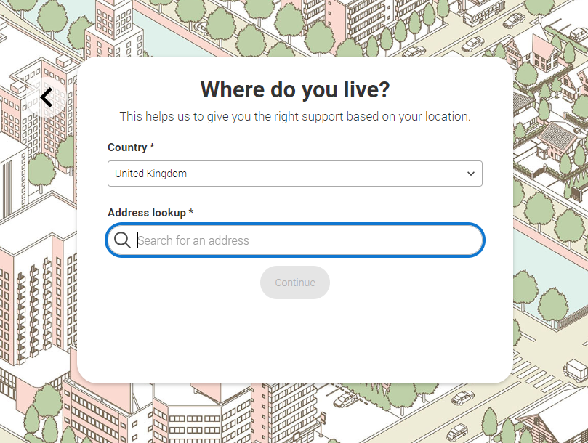
Registering for an account
Once you’ve registered, you’re ready to get started.
We’ll ask you a few questions like where you live so we can tailor the information you see.

Slide 8
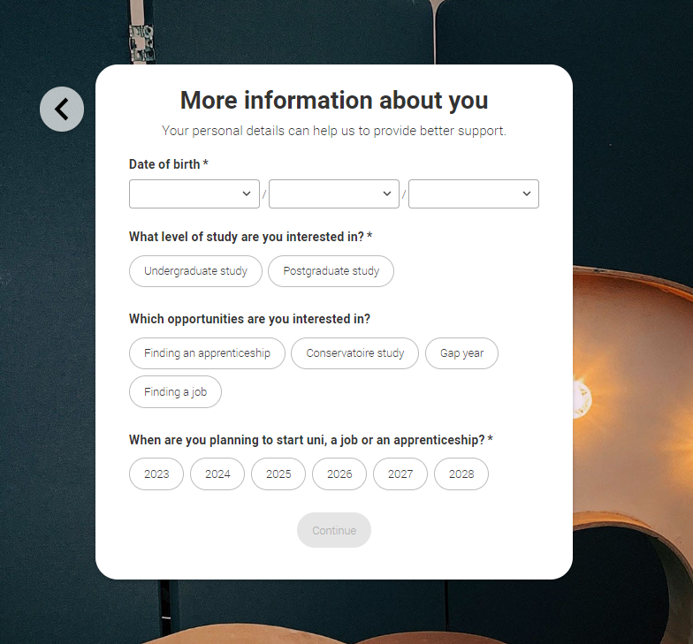
Registering for an account
We’ll ask you a few questions about yourself; your level of study is Undergraduate if you’re still at school/college.
You can choose to get information on apprenticeships, conservatoires, finding a job or gap years.
We also want to know when you’re interested in starting a course, so that we show you relevant courses in your search results. You can change this at any time, and you can use the Hub before you are looking to apply.

Slide 9
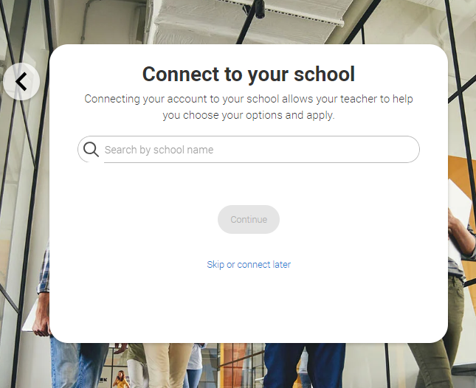
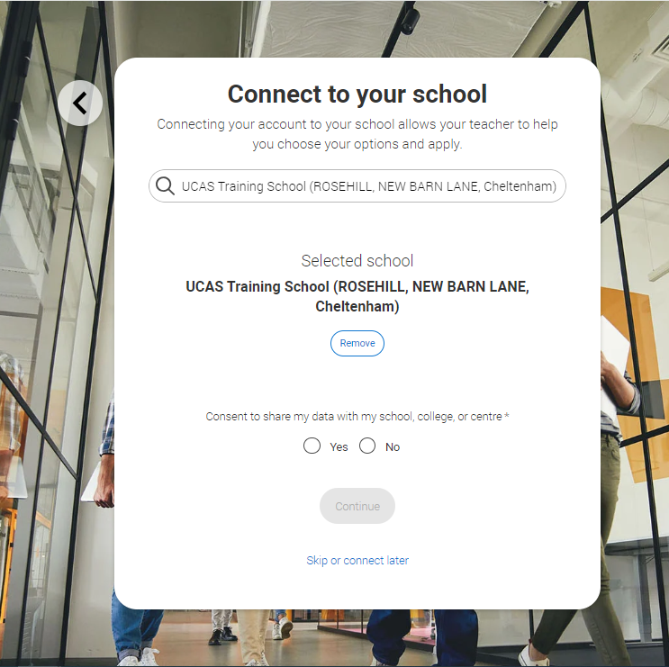
Registering for an account
If you want to you can connect to your school or college. This is so UCAS can share your UCAS Hub activity with your school, college, or centre, so they can support you.
You’ll also need to enter your school/college buzzword when you start your application so they can support you with applying.

Slide 10
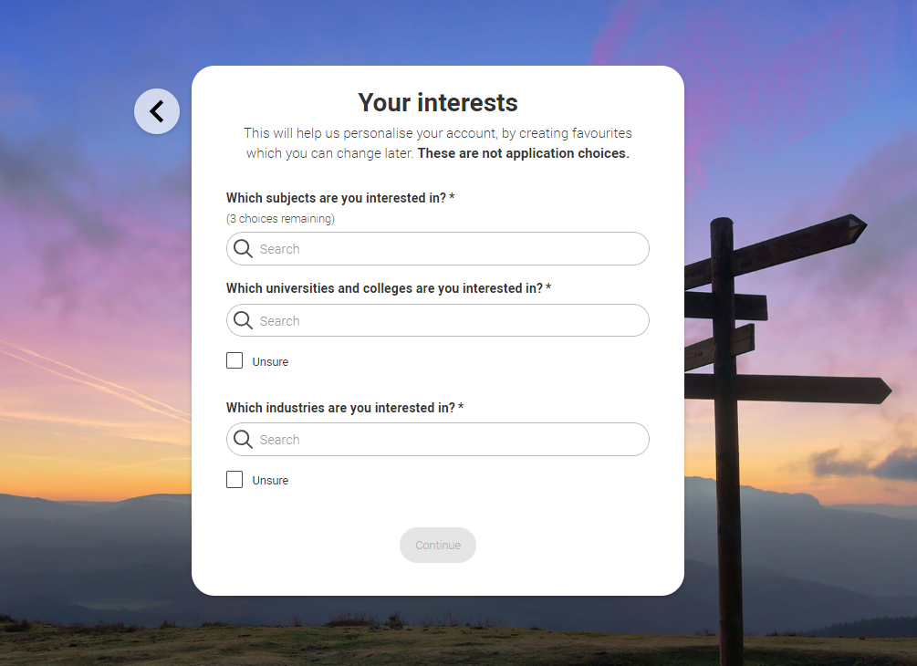
Registering for an account
Choose if you want to get tailored information about uni, college and apprenticeship options.
Select the subjects, locations or industries that you are interested in – you can change these at any time in your preferences.

Slide 11
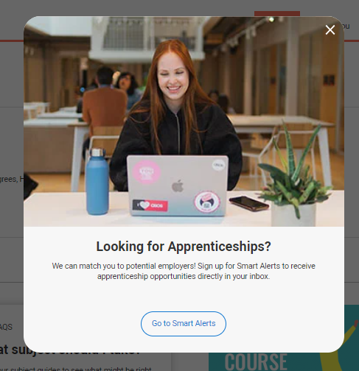
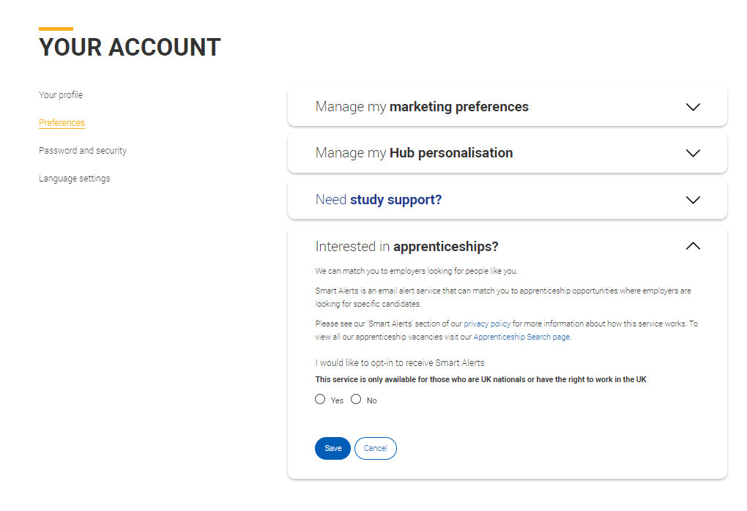
Registering for an account
If you’re interested in apprenticeship opportunities, we can match you to potential employers if you sign up to smart alerts.
You’ll get these directly to your inbox. It’s totally optional.

Slide 12
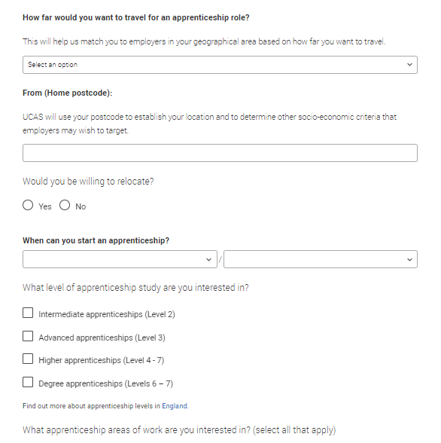
Registering for an account
If you want to there are a few more questions to answer to make sure the information you’re sent is useful.
You can manage this at any time in your ‘Preferences’.

Slide 13
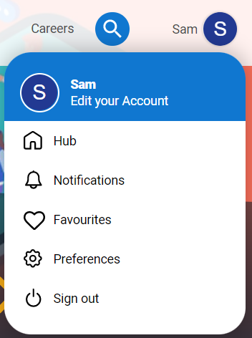
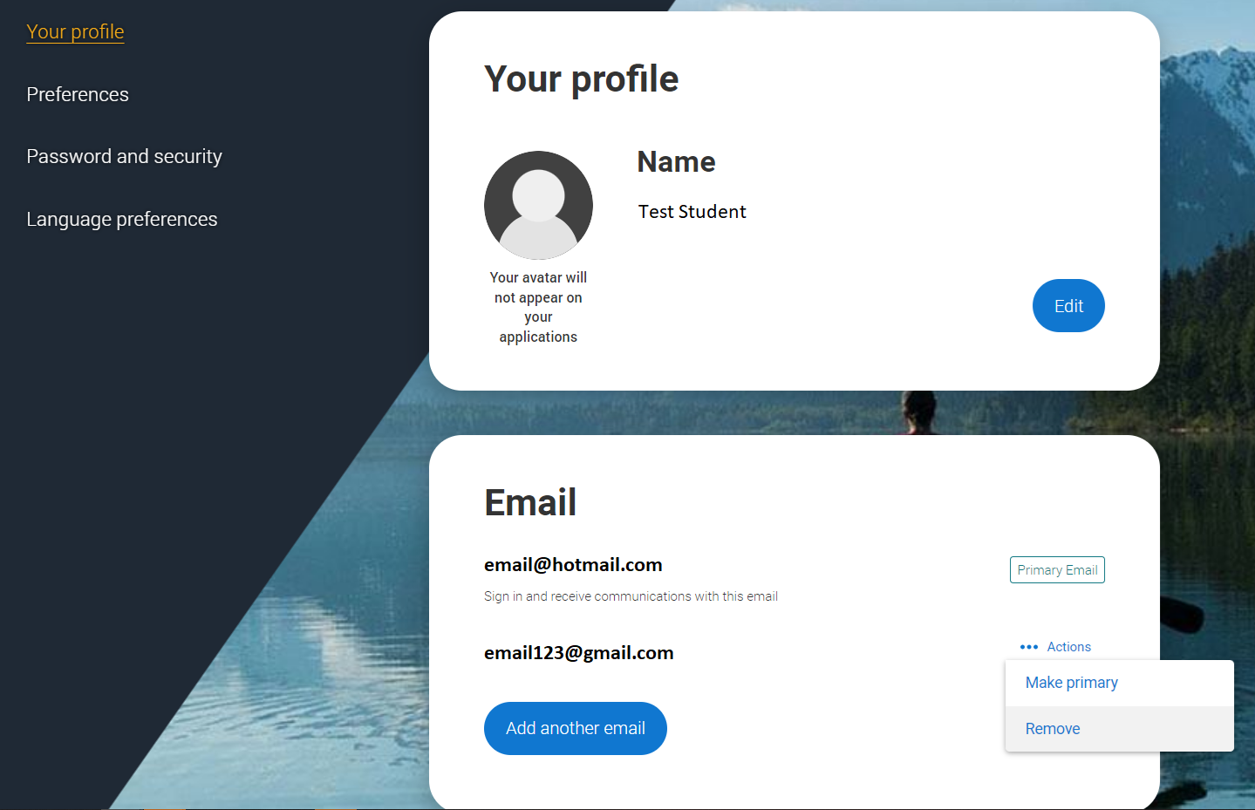
Your email
It’s important your contact details are kept up to date throughout your application.
We recommend using a personal email address as your primary email, rather than a school/college one, so that you have access to it throughout your application journey.
To update your email address, go to ‘Preferences’ and ‘Edit your account’ from drop-down, where you can change your email.

Slide 14
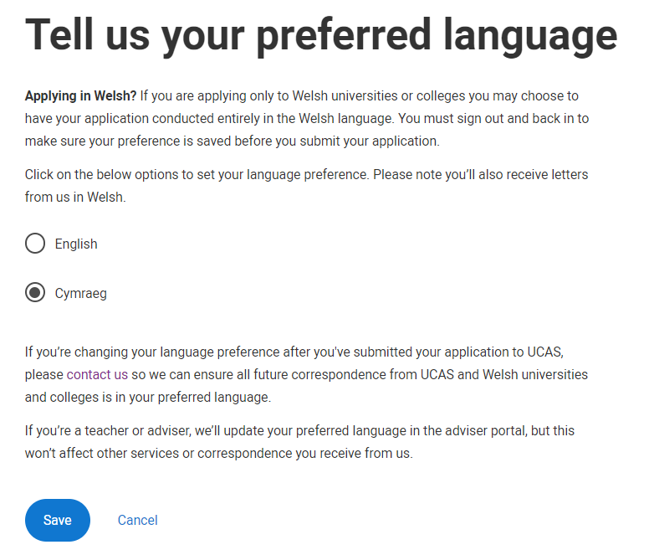
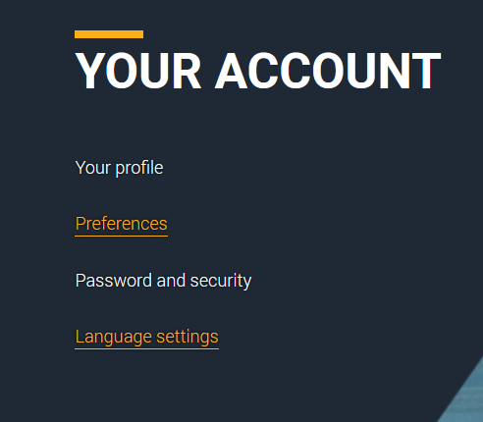
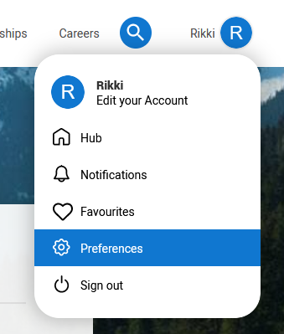
Welsh language preferences
If you would prefer to view your application, along with the help text and receive communications from us in Welsh, you can update your language preferences.

Slide 15
Starting your application.

Slide 16
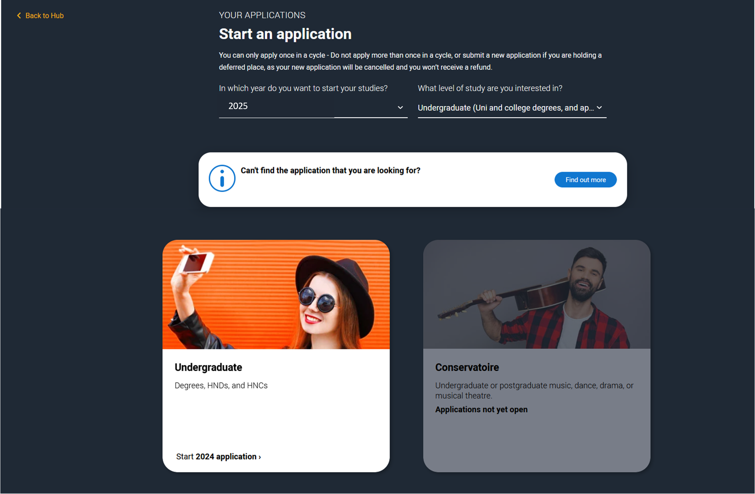
Starting your application
Choose the year you want to start your studies, level of study (it's Undergraduate if you are still at school/college) and type of application you wish to make.
Make sure you choose 2025 if you want to start next year, including if you want to defer entry.

Slide 17
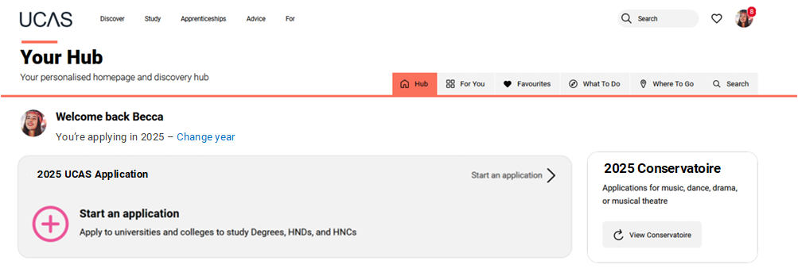
Starting your application
To start your UCAS application click on the red cross to get started.

Slide 18
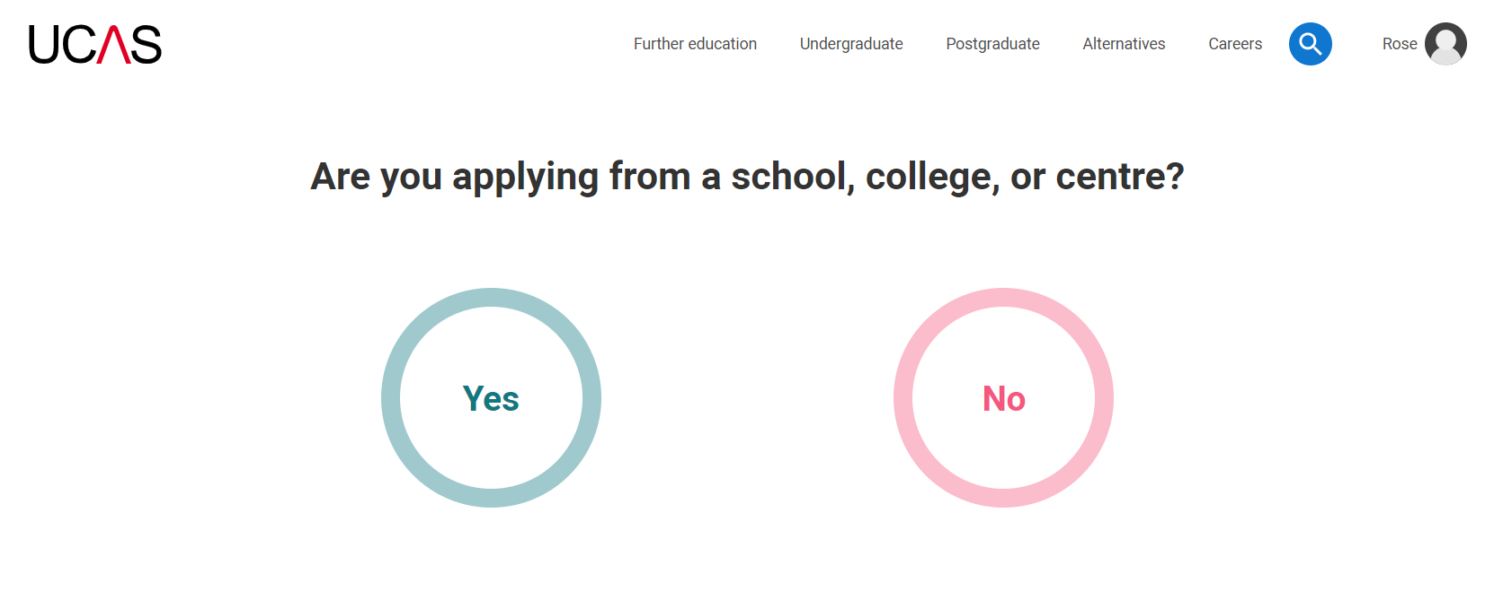
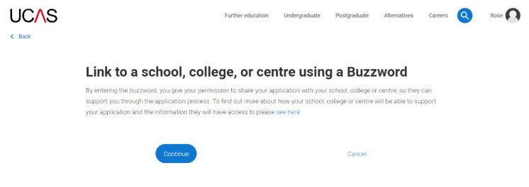
Linking to your school, college or centre
If you're applying with the help of your school, college or centre then select ‘Yes’.
You will then need to enter the Buzzword.
The Buzzword is given to you by your school, college or centre.

Slide 19
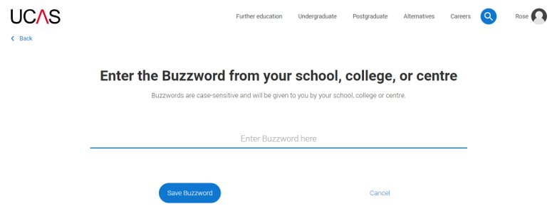
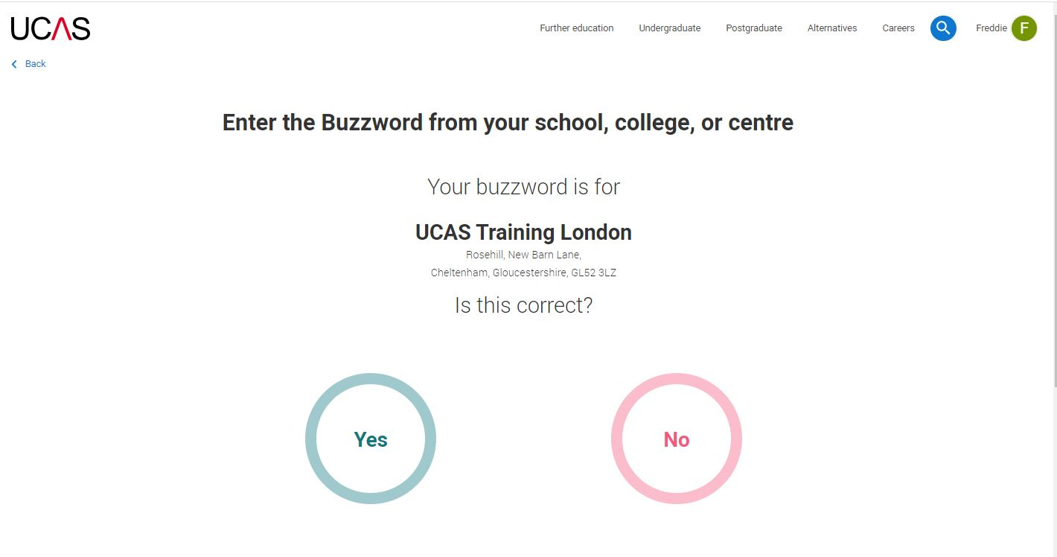
Linking to your school, college or centre
Enter the buzzword, and confirm the details are correct.
This will link your application to your school or college, so they can track your progress and provide support, including adding your reference.

Slide 20
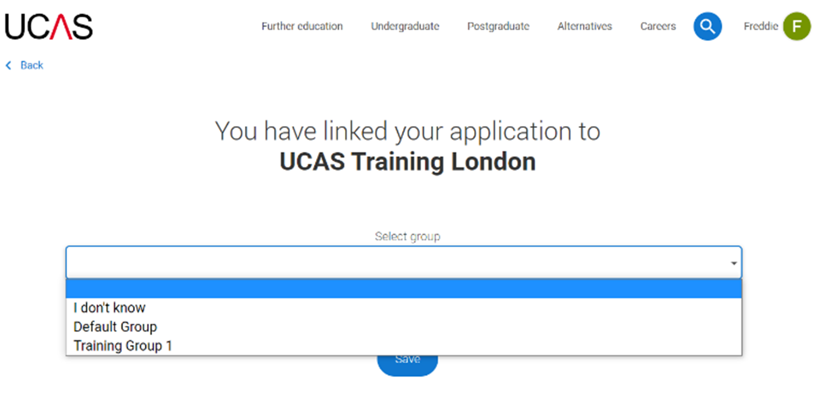
Linking to your school, college or centre
Once your application has been linked, you can then select a group (if this has been set up by your school or college) for your application.
Every school/college has a ‘Default Group’..

Slide 21
Application overview.

Slide 22
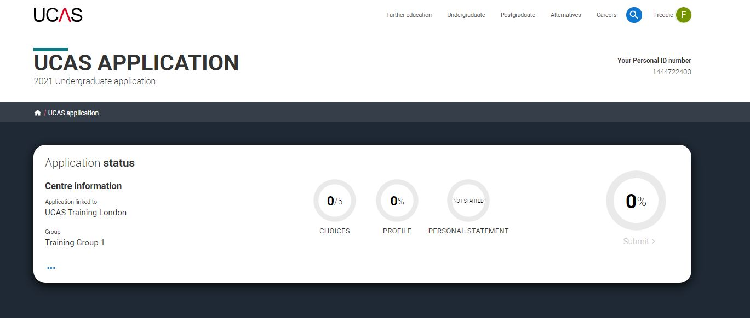
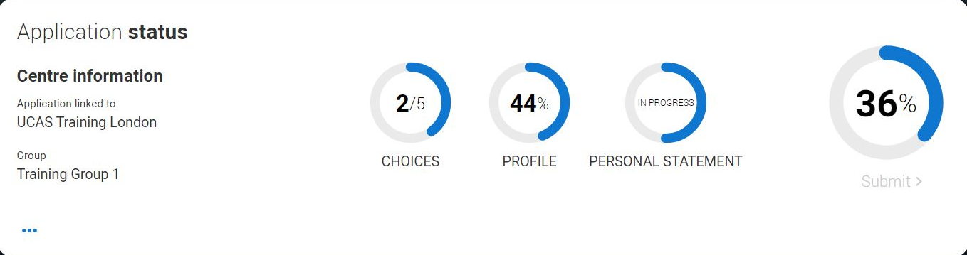
Application overview
Your ‘Application status’ helps you keep track of your progress.
As you add information to each tile, the percentage complete updates each time you mark a section as complete.
You don’t need to complete the application straight away; you can log in and out at any time until you're finished.

Slide 23
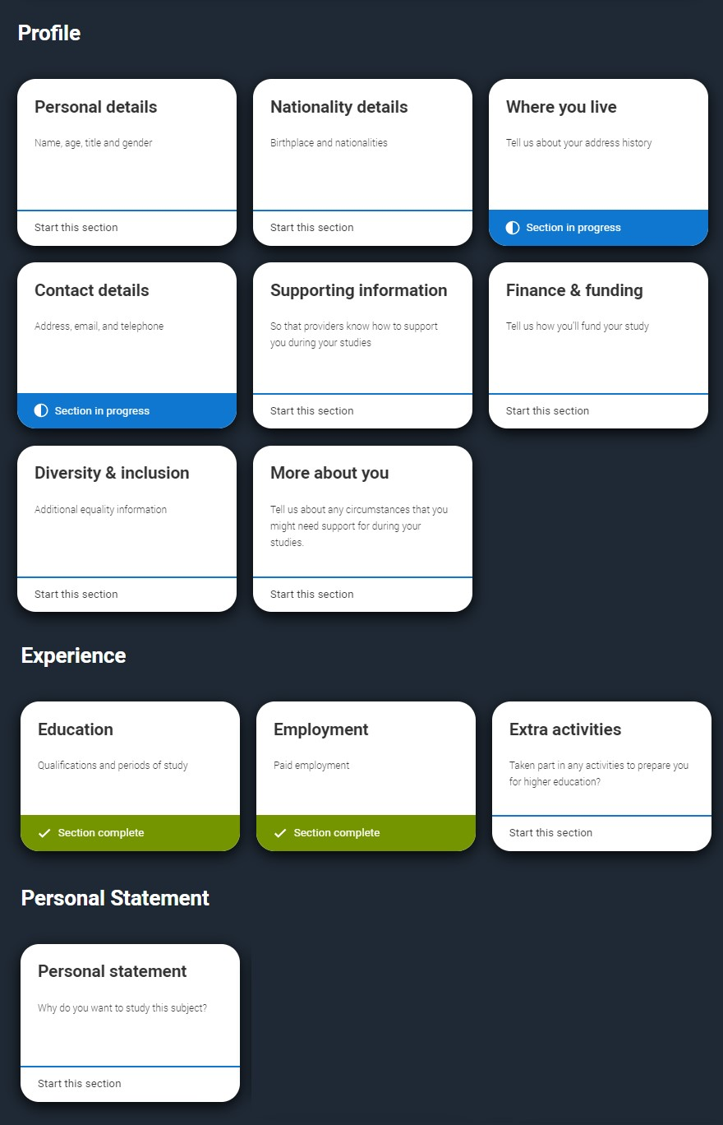
Application overview
The application form is responsive to make it easier to complete.
Once you’ve completed ‘Where you live’ if your permanent residence is in the UK, you’ll also see the ‘Diversity and inclusion’ and ‘Extra activities’ sections to complete.
All sections must be marked as ‘Complete’ to send to your school or college that you may be linked to for review. You must complete all mandatory questions to mark a section as complete (they have a *).

Slide 24
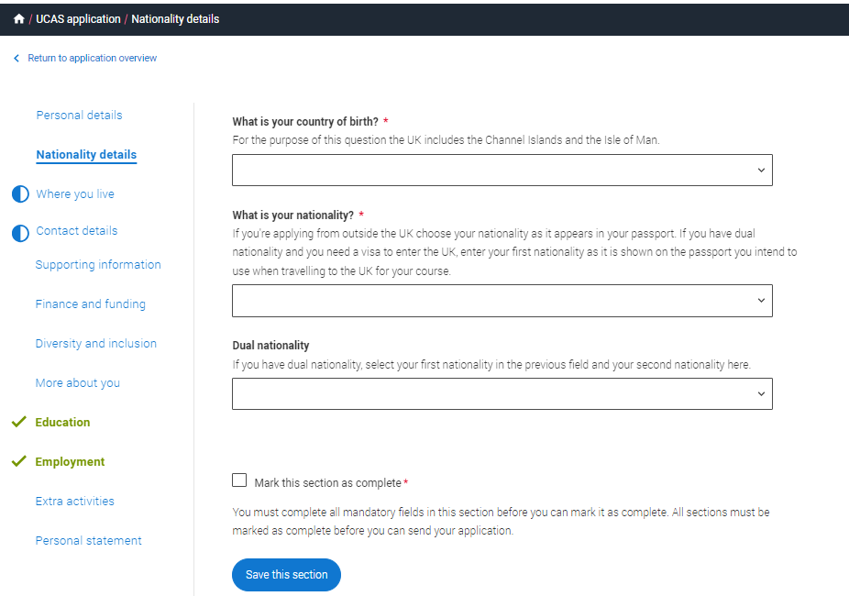
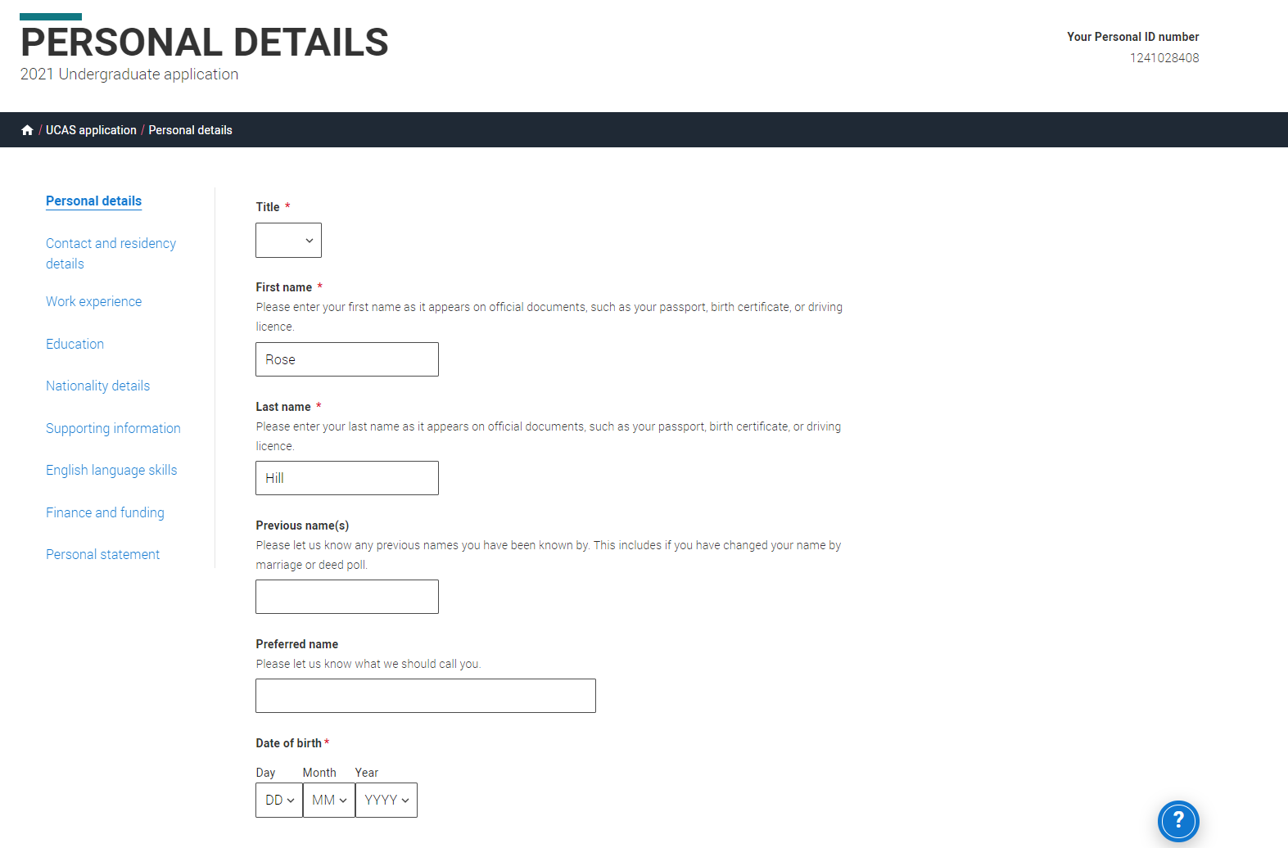
Application overview
The list on the left of each section will show which sections are completed (with a tick), which are in progress (with a half-moon), and which have yet to be started (no icon).
Click on the throughout for help text to provide advice about what to put.

Slide 25
Personal details.

Slide 26
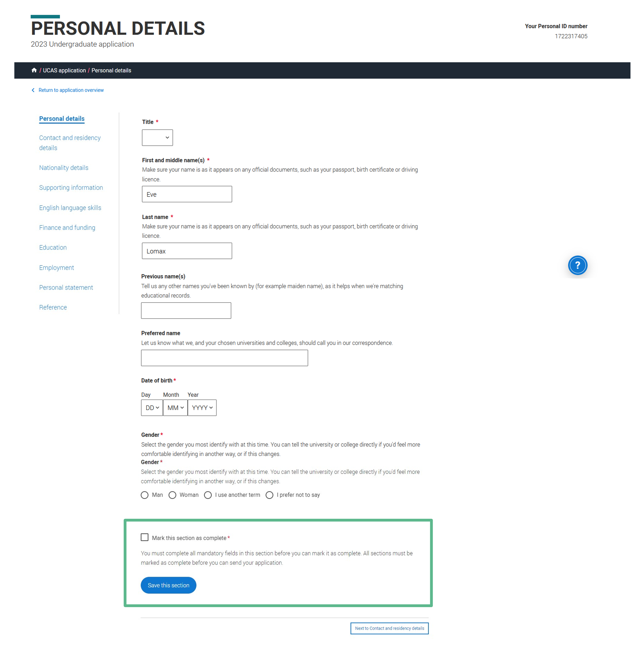
Personal details: your name should already be visible, but you'll need to add your title and complete the other mandatory fields (marked with a *).
Once you have completed a section you must remember to mark the section as complete and save it at the bottom of each page.

Slide 27
Contact details.

Slide 28
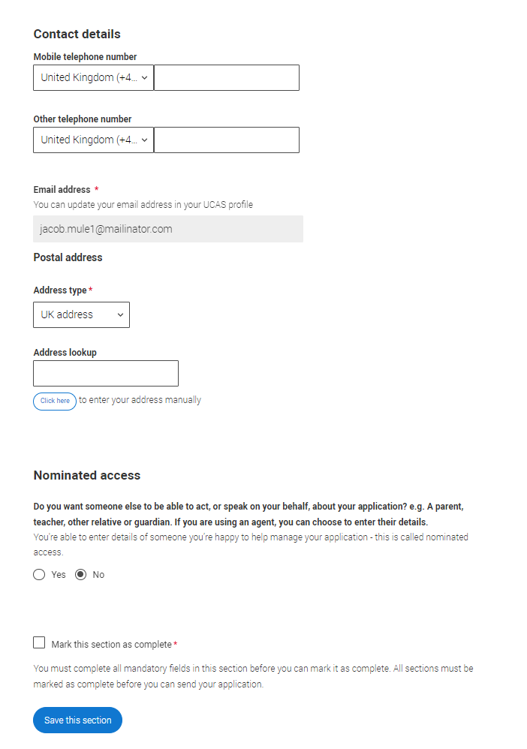
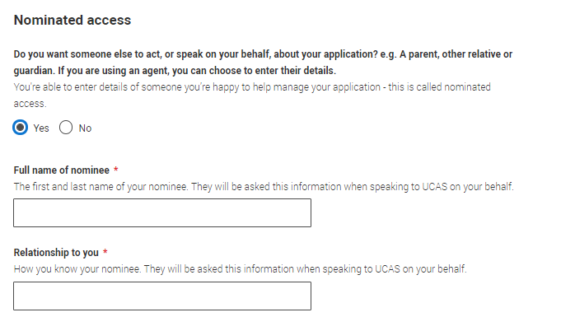
Your email will be used by both UCAS and your choices to update you. If you're using a school/college email address, make sure you can access it at all times so you don’t miss anything important.
We would advise using a personal email address, which can be updated in the Hub preferences.
You'll only see the fields to add the nominated contact details if you answer Yes to the question.
This means someone else can speak to us about your application.
Security marking: PUBLIC
| 28

Slide 29
Nationality details.

Slide 30
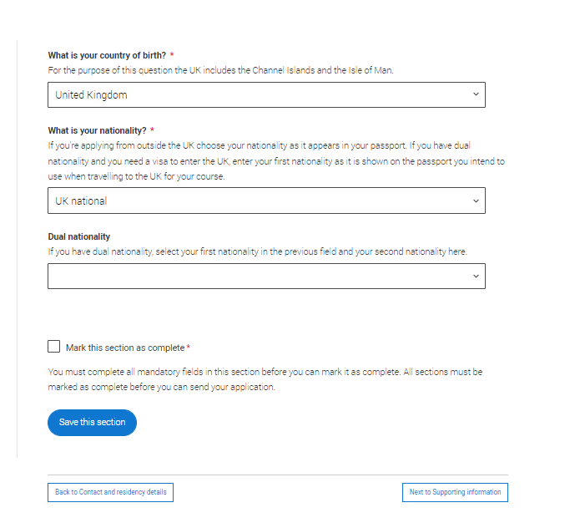
In the Nationality section, depending on the information you provide, you may see more questions.
Your nationality is associated with the country that would issue you a passport for international travel. If you don't have a passport, it is usually the country in which you were born.
This is not your ethnicity. Ethnicity refers to your cultural identity and ancestry. UK resident applicants are asked about ethnicity in the diversity and inclusion section.
Remember, everything with a red asterisk must be answered. Select to see our help text with advice about this.

Slide 31
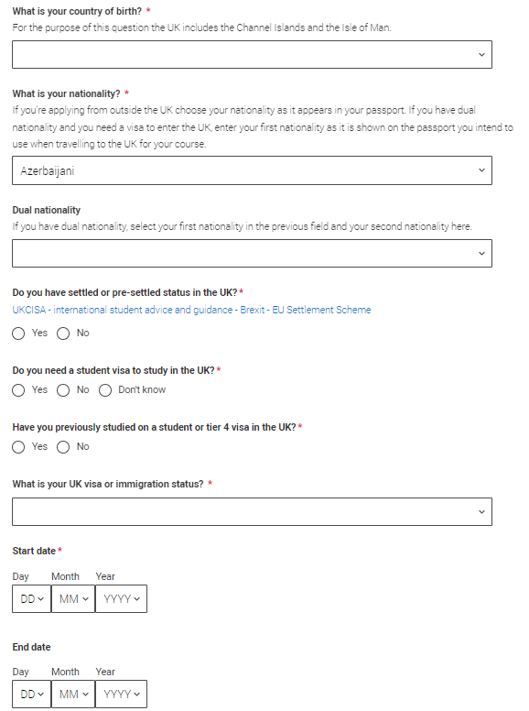
If you have dual nationality, please list both nationalities.
The information you provide will help universities and colleges in determining your fee status and allow them to assist you with the visa application process, if required.
There's some possible combinations but we'll only show relevant fields depending on your answers.
Select to see our help text with advice about this.

Slide 32
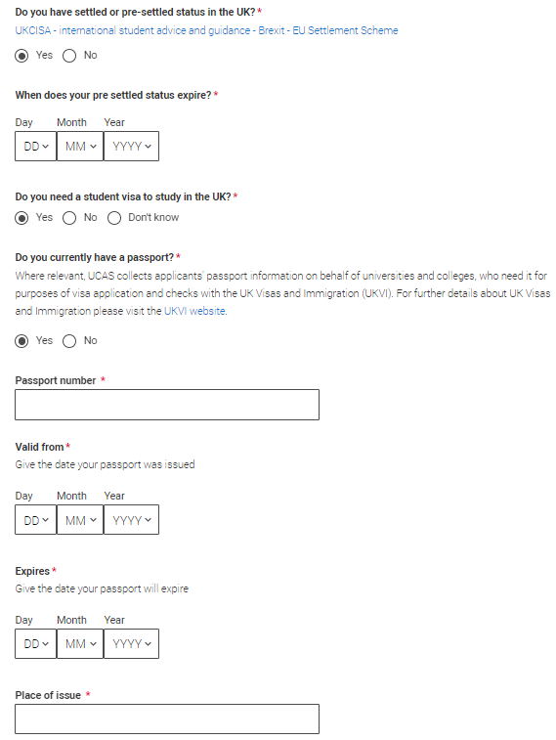
If you select that you have pre settled status you will be asked for an expiry date.
If you select that you will need a visa, you’ll also be asked for your passport details.
If you have a passport, we ask you for your passport number, valid from and expiry dates; and place of issue.
Select to see our help text with advice about this.

Slide 33
Where you live.

Slide 34
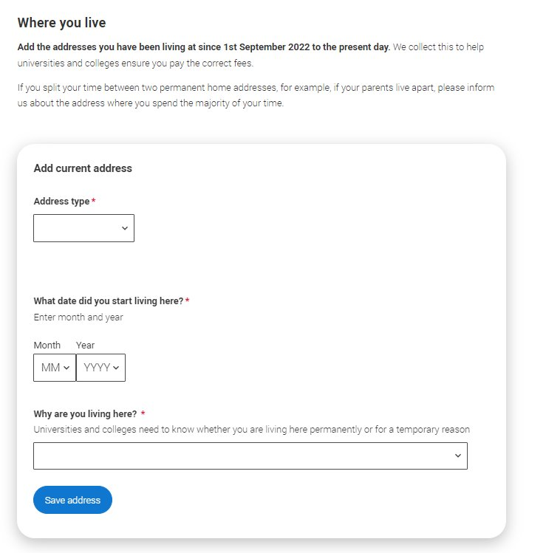
You must add three years of residency history between 1st September 2022 and 1st September 2025.
Your current address should be added first, followed by your previous addresses until September 2022.
Select to see our help text with advice about to help with this section.

Slide 35
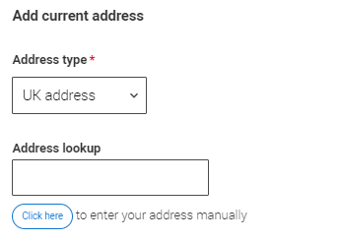
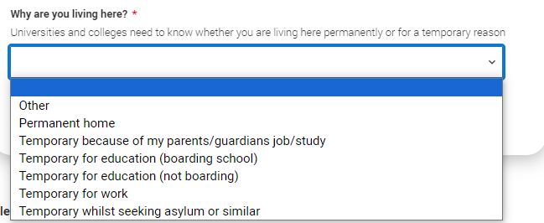
UK addresses can be added using the address look up tool.
BFPO addresses can also be added by using the address type drop down.
For each address tell us why you are living there; any reason can be selected, for example you may have two permanent homes.

Slide 36
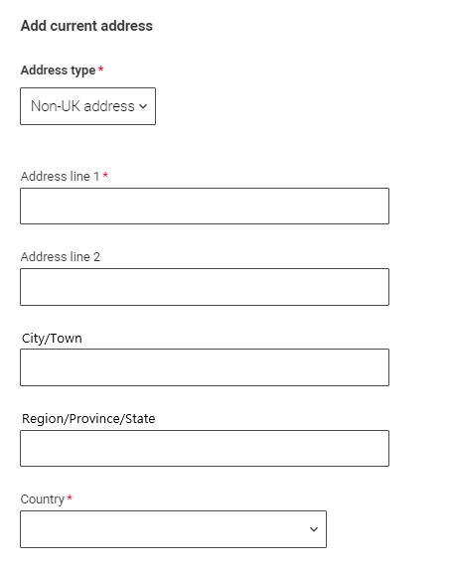
International applicants can add a non-UK address by using the address type drop down.
All addresses must be written using the English alphabet.

Slide 37
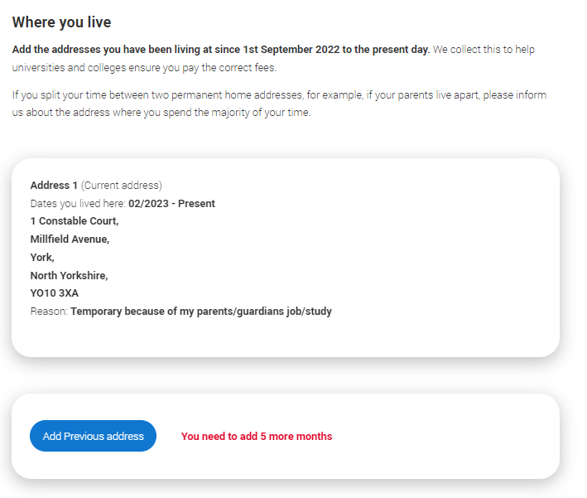
Until the required duration of address history is reached, you’ll see the ‘Add previous address’ option.
Gaps in the address history will be flagged for you to fill in so that a full history is provided.​
​
Overlapping addresses are allowed.
Select to see our help text with advice about this.

Slide 38
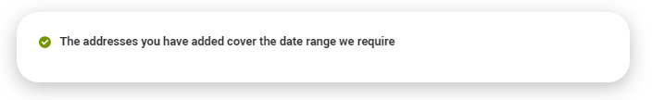
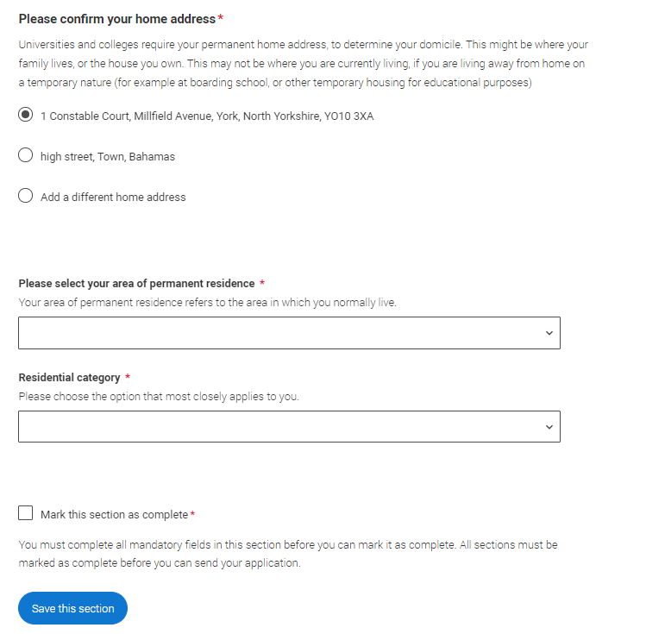
When you’ve added enough addresses to cover the required duration, you’ll see a success message. You’ll then need to confirm your home address.
This can be selected from the list of addresses you entered, or a new one can be added.
You then need to select your area of permanent residence and residential category.
Remember to use our help text for advice about this question if you are unsure what to enter.

Slide 39
Supporting information.

Slide 40
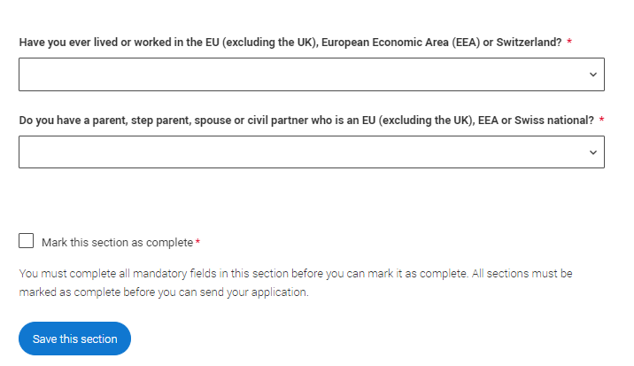
All questions are mandatory (*), but you have the option of
I don't know
Prefer not to say.

Slide 41
Finance and funding.

Slide 42
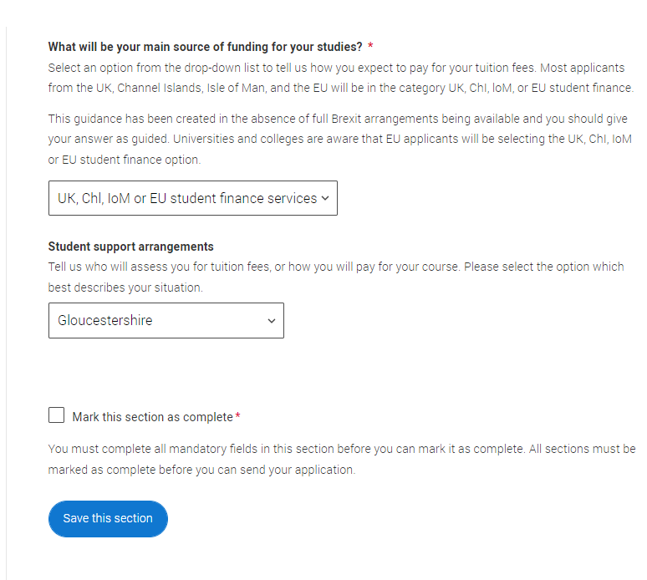
You will only be asked further questions in finance and funding if you select UK, ChI, IoM or EU Student Finance Services.
We'll ask you for your local authority under ‘Student support arrangements’.
For more information head to: ucas.com/finance
Security marking: PUBLIC

Slide 43
Diversity and inclusion.
You’ll only see these questions if you have a UK home address.

Slide 44
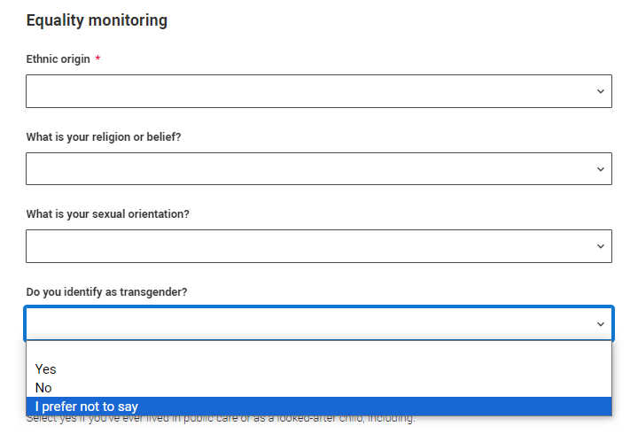
You’ll only see these questions if you have a UK home address.
There are two mandatory fields(*), but you have the option to respond with I prefer not to say.
This information is only shared with universities or colleges once you have secured a place, it does not influence any decision making. It’s used to ensure applications are treated fairly.

Slide 45
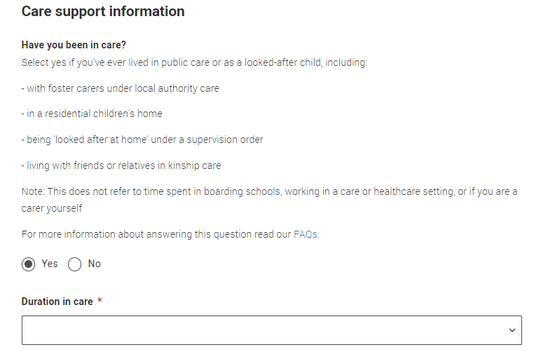
Growing up in care means you are entitled to a range of practical support; for example, during your application, financial assistance, year-round accommodation, or help with managing your health and wellbeing.
When you give this information, you are letting the university or college know that you may need additional support during your studies. They may get in touch to tell you more about the benefits and options available, if you want it.

Slide 46
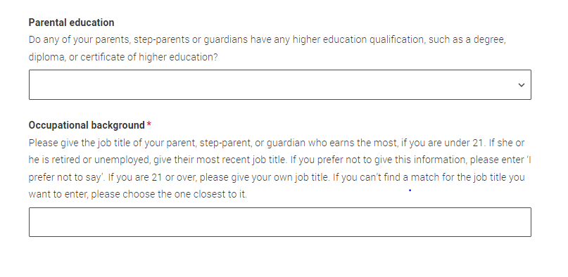
You can select I prefer not to say for the parental education question.
For the occupational background, you must type at least 3 letters into the response field, and then select an option from the menu that appears below it.
If you prefer not to give this information, please enter ‘I prefer not to say’.

Slide 47
More about you.

Slide 48
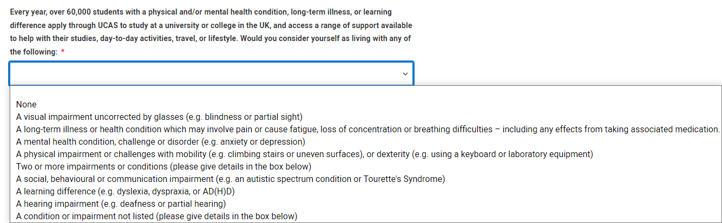
You can tell us about any circumstances that you might need support for during your studies. We don't need you to give details – this information will be shared with those involved in making arrangements to support you at the university or college (e.g. the student support team, admissions staff), and they may get in touch to tell you more.
To mark the section as complete you will need to select an answer: either to share information or select 'No disability’. You will see this question if you have a UK or non-UK home address.

Slide 49
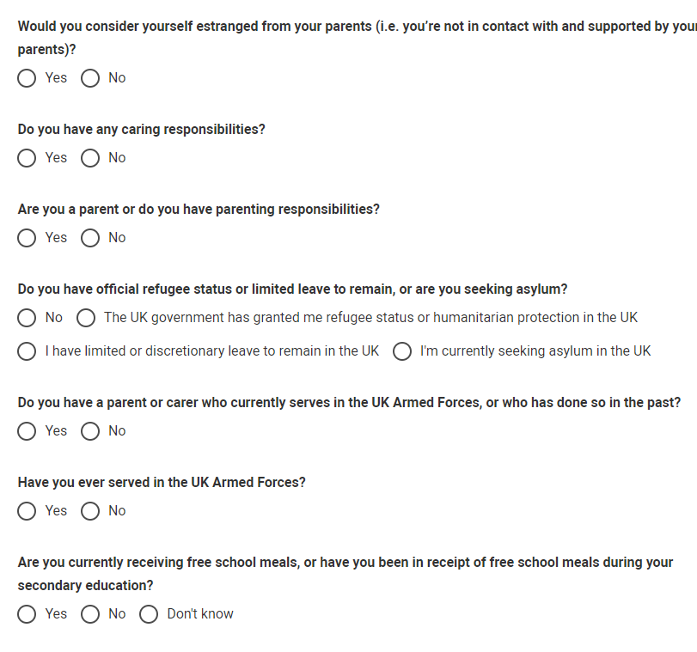
You might feel uncertain about sharing personal circumstances, please feel reassured this information is confidential and will not negatively impact your application.
These questions are intended to connect you to the right support for your needs.
You will only see these questions if you have a UK home address.

Slide 50
Education.

Slide 51
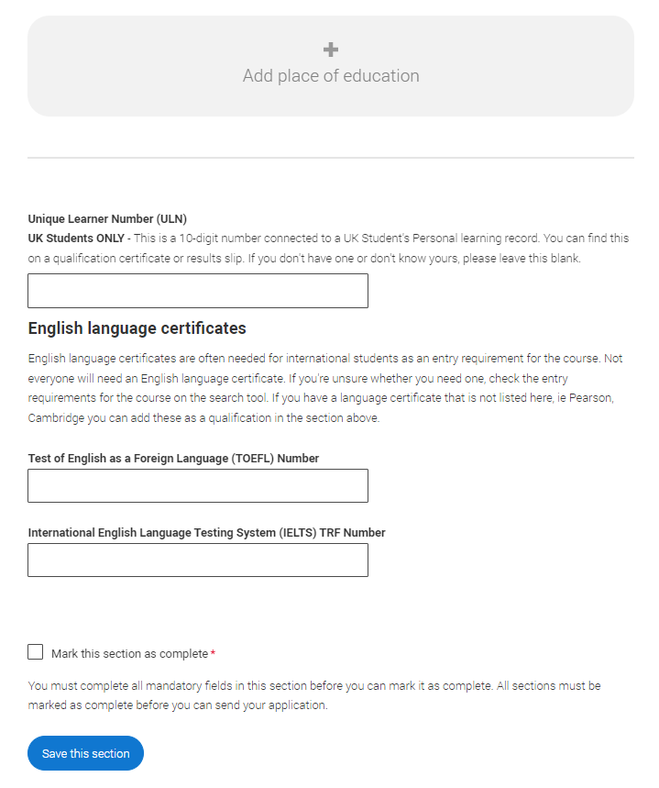
You must enter all your qualifications from secondary education onwards – whether you have the result (even any that were ungraded) or you’re still awaiting exams and results.
First you need to add details of where you’ve studied, or are studying, then add qualifications.
Start by clicking Add place of education.
You’ll be asked for a ‘Unique Learner Number’ – if you don’t have one leave the question blank.
English language tests can be entered here too, if you have any other English language tests they can be added as a qualification.
Security marking: PUBLIC

Slide 52


If you are linked to a centre, when you click on ‘Add place of education’, you’ll be asked if you’d like to add it.
If you’ve attended another centre, type the name of where you studied. Once you find your centre, click on the name and the Exam centre number will automatically populate.
If an exam centre number doesn’t appear that’s ok, it’s because we don’t have it.
Add when you started and finished; if you’re still studying there add the month you’re due to finish.
You are linked to UCAS SCHOOL, CHELTENHAM, would you like to add this centre?
Security marking: PUBLIC

Slide 53

Tell us how you studied at each place of education.
For type of study did you attend full time, part time or exam only.
For study mode did you attend a centre in person or if you studied a course completely remotely, select online.

Slide 54

There are warning messages to help you.
For example, you can't say you attended two or more places for full-time study during the same date range.
Red text are warnings, it means something is wrong and the section can’t be completed until you change it.
Security marking: PUBLIC

Slide 55

Once you’ve added where you studied you need to ‘Add qualification’.
Security marking: PUBLIC

Slide 56

Select the qualification type you are trying to find. If you are linked to a centre their shortlisted qualifications will appear, followed by the rest of the category.
The search can then be used to narrow this down. If you are searching for a qualification, make sure you use the qualification title. For more help and advice head to ucas.com.
International qualifications are grouped together and are listed by name and country, but don’t worry if yours isn’t there – type ‘other’ into the search box and select the relevant option.
Security marking: PUBLIC

Slide 57

The qualification dates you can select are based on those entered when you added your place of education. You need to enter the awarding organisation – speak to your teacher or adviser if you’re not sure what this is.
If you haven't finished the qualification or had your result, then choose Pending* in the Grade field.
It's entirely up to you whether you include module information. However, some courses may state in their entry requirements that they'd like to see module results – in which case make sure you include them.
* If presented with a free text box then the result must be left blank.
Security marking: PUBLIC

Slide 58

You must enter at least one qualification OR record of employment history before marking the sections as complete. Warnings on the screen will make it clear what the next steps are to complete the sections.

Slide 59
Employment.

Slide 60

Only enter paid work here, so not everyone will have something to enter.
If you add more than one employer, it will appear in chronological order with the most recent at the top.
Any work experience or volunteering should be covered in your personal statement.
If you leave this section blank remember to mark it as complete.

Slide 61
Extra Activities.
You’ll only see these questions if you have a UK home address.

Slide 62

Please add any activity you have taken part in to prepare for higher education.
These include national or regional schemes, university-run programmes, summer schools, taster courses, and booster courses.
Open days are not relevant to this question.
If you haven’t attended any such activity, please leave this sections blank.

Slide 63

If this section is relevant to you, you need to include:
type of activity
name of the activity provider (from a drop-down list)
name of the activity/programme (a free-text box)
dates of the activity.
If the type of activity you attended is not listed, please select ‘Other’.

Slide 64

The activity provider is the organiser of the activity. It may be a university or college, or a national, regional, or local organisation.
If the activity provider isn’t listed, please select “Other”. If you’re unsure of the answer, contact whoever organised the activity to find out, and, if you’re still unsure, select ‘Don't know’.

Slide 65

Add the official title of the activity. If you’re unsure of the answer, contact whoever organised the activity to find out.
Remember you can use your personal statement to include more details about the activities you took part in, the skills you learned, and how this prepared you for higher education.

Slide 66
Personal statement.

Slide 67


You can save and edit this section as many times as you need to.
If you try to navigate away without saving your work. We'll remind you with a pop-up warning.
For advice on how to write your personal statement head to ucas.com or use the personal statement builder in the UCAS Hub.
Security marking: PUBLIC

Slide 68

You can only mark this section as complete on the Preview screen.
Remember we'll carry out checks to verify your personal statement is your own work.
If it appears to have been copied from one or more other sources, we'll inform the universities and colleges to which you have applied. They will then take the action they consider appropriate.
We'll also contact you by email to tell you this has happened.
Security marking: PUBLIC

Slide 69
Adding a choice.

Slide 70


To add your choice start typing the name of the university or college into the institution field. Select from the options displayed.
Do the same for the course you have selected.
Locations and start dates are displayed according to the course details.
You don’t have to select a point of entry, but if you want to, it will usually be year 1 or foundation year (if available).
Security marking: PUBLIC

Slide 71

Some courses may require you to disclose your criminal conviction status.
We'll only show this question if the course choice requires it.
Security marking: PUBLIC

Slide 72


There is a maximum of five choices and choice restrictions may apply. A maximum of four courses from medicine, dentistry, veterinary medicine or veterinary science, and either the University of Oxford OR the University of Cambridge).
Once all choices are added you must mark the section as complete to be able to submit.
Choices do not need to be added in any preference order. Universities / colleges can only see where else you’ve applied once they’ve made their offer and you’ve decided whether to accept them as your firm or insurance choice.
Security marking: PUBLIC

Slide 73

Some courses have extra admissions tests and assessments.
We'll show these in blue text on the choice card.
This should not be a surprise to you, as you should have seen details of this when researching the course.
Security marking: PUBLIC

Slide 74


Click anywhere on a choice card to expand it or collapse it.
Any choice combinations that are not permitted will be flagged with red text on the right of each relevant card.
For example, these screens show error messages for students trying to apply to University of Cambridge and University of Oxford.

Slide 75
Submitting the application.

Slide 76

There are 4 steps to the submission process.
The profile must be complete and showing 'Ready to Send' before being able to review and submit.

Slide 77


This shows the full application; you can download it as a pdf (in the top right) to help you check it.
At the bottom of the application, click Accept and proceed (or return to application if you want to make more changes).
Security marking: PUBLIC
| 77

Slide 78

We need you to check, and where necessary, update your preferences.
Security marking: PUBLIC
| 78

Slide 79

You must tick the box at the bottom of the page to confirm you have read and understood the terms and conditions.
You can collapse these by clicking the .
Then click Accept and proceed, or you can Return to application, or Return to marketing preferences.
Security marking: PUBLIC
| 79

Slide 80
Pay and Submit.

Slide 81

If your school or college pay for your application, you won't need to enter any card details.
Security marking: PUBLIC
| 81

Slide 82

If you need to pay by card, you will see this screen. Click Pay now and you will be asked to enter your card details.
£27.00
Security marking: PUBLIC
| 82

Slide 83

When you've paid and submitted your application, it will go to your school/college to check.
They will submit the application to UCAS.
If you log in after you’ve submitted your application, you’ll see a read-only version of it.
| 83

Slide 84
Tracking your application.

Slide 85





The banner at the top of your UCAS Hub will update as the status of your application changes. Click on it to go to your application.
Security marking: PUBLIC

Slide 86



You’ll be taken to your application status, which displays the key information relevant to your application.
It will update to reflect your status and clearly state any actions you need to take, particularly when you will need to reply to any offers.
All deadlines are in UK time – make sure you keep this in mind and don't miss any.
Security marking: PUBLIC

Slide 87


Latest updates – displays offer and decision notifications, click view all updates for full history.
Student bank account info – you’ll need this to open a student bank account (when eligible).
View all correspondence – all correspondence is grouped by choice.
Centre link permission – if you are linked to a centre this enables you to update your sharing preference. Remember if you don’t share with your centre then they will be unable to help support you with your application.
View all correspondence

Slide 88


It’s important your contact details are kept up to date.
We recommend using a personal email address, rather than a school/college one, so that you have access to it throughout your application journey.
To update your email address, go to ‘Preferences’ and ‘Edit your account’ from drop-down, where you can change your email.

Slide 89

Your application details are displayed below your choices.
All are read-only with the exception of ’Contact’ details. Here you can edit your phone numbers and postal address.

Slide 90


You can substitute a choice within 14 days of your application being sent to UCAS. Select the option from the actions box and complete the short substitution form.
If you want to change the course, but still apply to the same university or college, speak to them directly before you do anything.

Slide 91


The details of your offers will be shown including any conditions.
The full text of the offer can be seen by clicking ’View full offer’.
Your inactive choices (withdrawn, declined, unsuccessful) are in an accordion section below the active choices.

Slide 92


If a university or college has notified UCAS of an interview the invitation details will be shown alongside a button to enable you to respond.
There are three options you can select from to respond to the invitation.

Slide 93

Once all decisions have been received, you will make your reply and confirm your choices.
If you choose a conditional offer as your firm choice, you have the option to add an optional insurance choice.
If you choose an unconditional offer as your firm choice, you cannot have an insurance choice.
All other offers will be declined offers, underneath the Firm choice.
You must remember to ‘Save’ your choices.

Slide 94

The application status updates to show you have replied to your offer(s) and that you are waiting for the university or college to confirm your place when your results are available.
You are able to view the full text at any time by clicking ‘View full offer’.
Your application status on the Hub will also update.

Slide 95


There is a link to ’Withdraw the whole application’.
If you withdraw, you will not be able to apply again during the academic year, and you will not be eligible for Clearing.
Do not use this if you wish to add another choice or apply somewhere else.
Follow the onscreen warnings or speak to your adviser to ensure you are taking the right action.

Slide 96
UCAS Extra.

Slide 97


If you've used all five choices, and you're not holding any offers, you can add another single choice using Extra from the end of February.
Extra is another chance for you to gain a place at university or college. If you're eligible, during this period you'll be able to apply to additional universities, one at a time.
Your status bar will tell you if you are eligible to add an Extra choice.

Slide 98

The Add choice button will change to ‘Add Extra choice’.
Your unsuccessful choices will be displayed below.
Before you add an Extra choice, speak to the university / college you want to apply to, and make sure the course still has vacancies and that they will consider your application.

Slide 99

Add your Extra choice in the same way as before.
It will appear at the top of your choices.

Slide 100


If you don't get the offer you want in Extra, don't worry – you can still use Clearing to add another choice, from the beginning of July.

