Slide 1
References
for undergraduate entry 2026
Thursday 12 June 2025

Slide 2
UCAS registered centre linked applications
The following guidance is for references for applications linked to a registered centre; either for full application management or reference only.
Applicants will need to enter a unique buzzword, set by the UCAS registered centre, to link an application.

Slide 3

Using this deck
This presentation deck has been designed so you can copy and paste slides into your own materials and guides to support staff training and CPD.
We’ll continue to communicate key operational changes to you through our monthly newsletters. Please encourage all colleagues who advise applicants to sign up to receive them.

Slide 4
UCAS References
The remains is in three sections to help you focus on what universities and colleges want to know about and help them to identify relevant information about students.
The reference is designed to add context to a student’s application. References should be factual, specific, and concise.
Please ensure all staff involved in reference writing and support read the full information and guidance, including frequently asked questions and resources on ucas.com/advisers/references
As with all aspects of the application process, including entry requirements, use of personal statements and contextual admissions, we would always recommend that applicants and advisers check specific requirements for universities and colleges.

Slide 5
Key information and guidance
The maximum 4,000 characters includes spaces, section headings, and line breaks, all of which take up at least one character. This means that your entered text will need to be under 3,800 characters; most references will not need to use the total character count.
Extenuating circumstances (section 2) – we have provided guidance as to what should be included and how this information might be used. If there are complex or sensitive circumstances (particularly if this relates to safeguarding considerations), it may be appropriate to highlight there are extenuating circumstances in this section and contact universities and colleges with more detailed additional information directly.
Other supportive information (section 3) –this should contain short, concise, and factual sentences to demonstrate suitability for the course(s) applied for and share relevant context to the application. Please only indicate there is ‘no other information to provide’ in circumstances where you are unable to provide any additional supportive individual context to the application.
Please read the full information and guidance on ucas.com.
This includes answers to our frequently asked questions.

Slide 6
The Reference Sections
Section 1: Enter a general statement about your school/college/centre (mandatory).
Section 2: If applicable, enter any information about extenuating circumstances which may have impacted the applicant's education and achievement.
Section 3: Outline other supportive information specific to the applicant and relevant to the course(s) applied for that you think universities/colleges should be aware of.

Slide 7

Section 1: Enter a general statement about your school/college/centre.
Information could include:
context of your school, college, or centre e.g. performance, intake demographics, progression rates to higher education etc.
your portfolio of qualification provision and any restrictions on options students may have.
non-UK qualification information – if you are providing a reference for a student studying outside the UK school system, it can be helpful to include a brief overview of the qualification profile.
information about your school, college or centre which may affect performance, such as significant staff changes, (sustained closure of buildings due to circumstances such as fire, flooring or RAAC), or other sustained disruptions or events that have impacted a whole cohort of students.
any policies or processes used for predicting grades (e.g. internal assessments). This is an opportunity to articulate any policy about not predicting grades for qualifications where the school or college feels the assessment method or qualification structure is not suited to predictions.
Please read the full information and guidance on ucas.com/advisers/references which includes answers to our frequently asked questions.

Slide 8
Reference template in Centre management
There is a reference template (under centre management) in the Adviser Portal to create a standard statement which can be added to each student's reference via a tick box.
If a staff member at your centre has entered reference template text in 'Centre management’ the information you enter in the template can be used to complete section 1 and added to each applicant reference in the Application details page.
If you update the reference template at any point the new template information will not update in the references you’ve already added the template to.
Only staff with permissions to manage a centre’s details in ‘Centre management’ will be able to add or edit the reference template.
Staff with ‘Application management’ permission to ‘edit’ references will be able to add the template in to individual references in the application details.

Slide 9
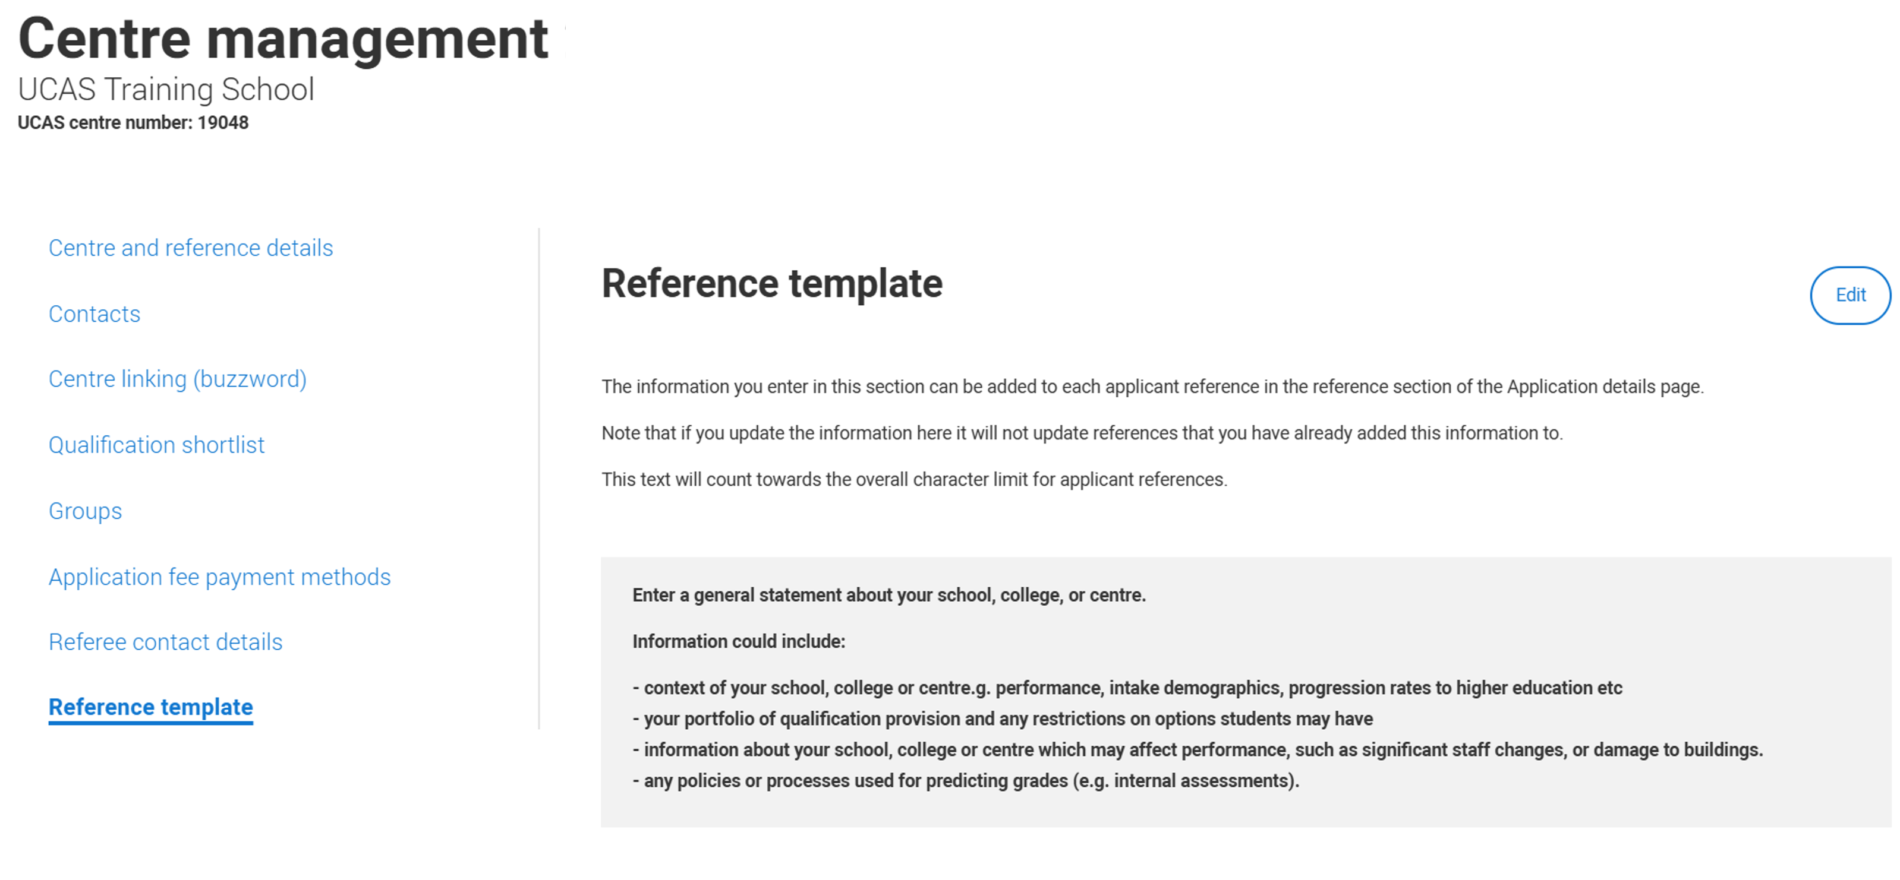

Slide 10
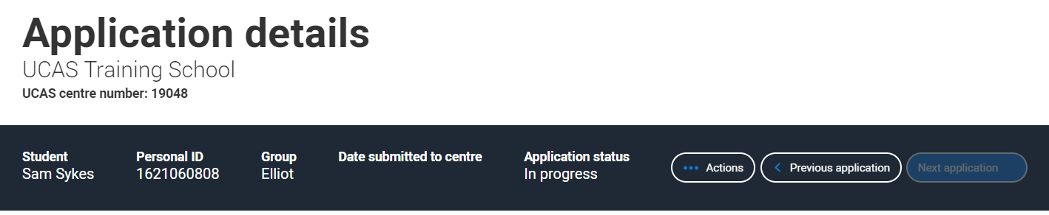
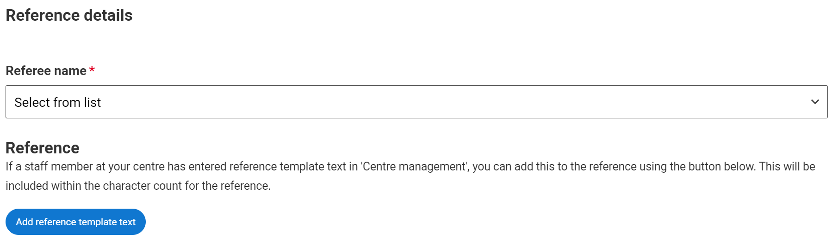

Slide 11
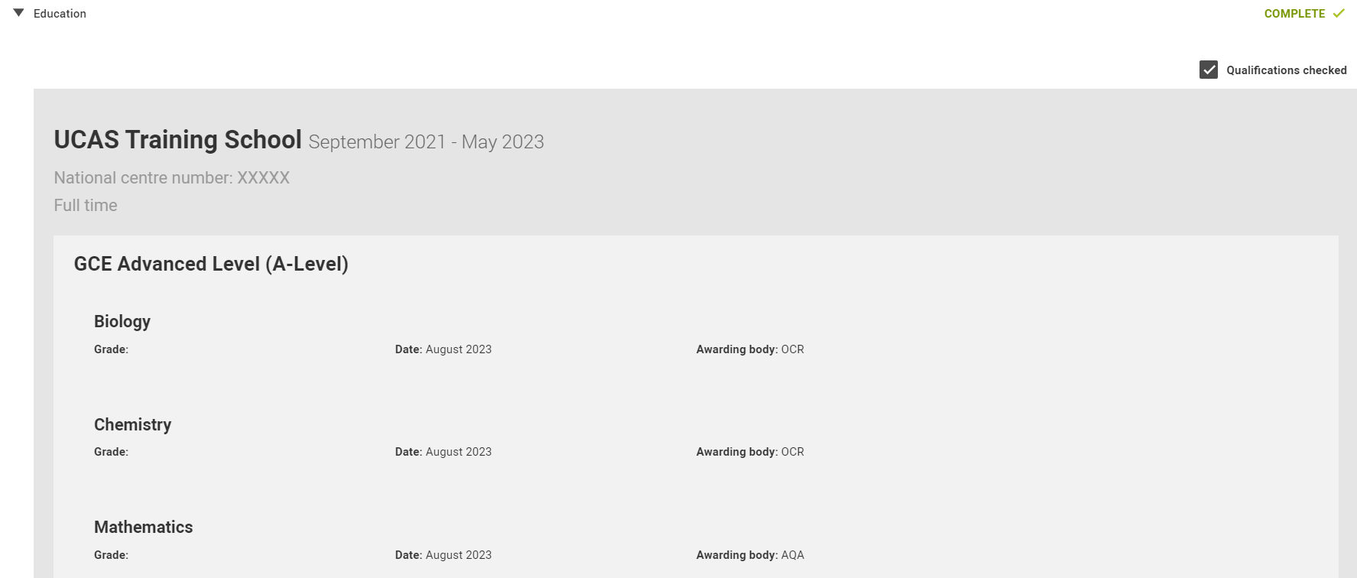
Tick the ‘Qualifications checked’ box if you have checked students’ qualifications. Leave blank if not checked.
This tick box is seen by universities and colleges as
part of the reference.

Slide 12

Section 2: If applicable, enter any information about extenuating circumstances which may have impacted the applicant's education and achievement.
It is likely many students will not have extenuating circumstances; the reference is relevant at the point of submission, if there are no extenuating circumstances at that time, please select .
Applicants will not be disadvantaged if there is no information to be shared. As has always been the case, information about personal circumstances is only ever used to help universities and colleges to better understand individuals’ contexts and support needs – it is never used to decide whether to make the student an offer.
If there are complex or sensitive circumstances (particularly if this relates to safeguarding considerations), it may be appropriate to highlight that there are extenuating circumstances in this section without providing detailed specifics.
Please note information must only be provided in section 2 with the applicant’s consent.
You must be clear whether any of the circumstances outlined in section 2 have already been considered by the student’s examination boards or awarding organisations for the qualifications taken.

Slide 13
Section 2: If applicable, enter any information about extenuating circumstances which may have impacted the applicant's education and achievement.
Include relevant information that contextualises the educational journey; this should be concise and reflect the breadth and depth of impact the circumstance had on the individual. This could include:
individual circumstances – e.g. mature student, disability, serious, acute, or chronic illness, bereavement, significant adverse personal or family circumstances (with applicant consent)
context as to why there is a disparity between an individual’s grades achieved throughout the school or college (e.g. at GCSE/ Scottish national 4/5 equivalent and predicted grades, where applicable)
factors which have limited the individual’s choice of subjects or study load at UK Level 3 or equivalent (factors which have affected the whole centre rather than the individual should be included in section 1)
support that the school, college or centre has had to put in place to ensure the student’s inclusion. Please highlight any access needs or accommodations that may be needed to support the admissions process (e.g. at interview or with assessment testing).
Please read the full information and guidance on ucas.com which includes answers to our frequently asked questions.

Slide 14

Section 3 : Outline other supportive information specific to the applicant and relevant to the course(s) applied for that you think universities/colleges should be aware of.
Information should be provided in short, clear, factual statements to help universities and colleges digest the information. The focus is on providing concise, specific additional context to the application.
Ticking ‘no information to enter’ for this section in the adviser portal will highlight to universities and colleges that no information has been supplied. Please tick in circumstances where you are unable to provide any additional supportive individual context to the application.
You can showcase any additional information that supports a student’s application to the course being applied to.
It is not necessary to craft the perfect paragraph here; providing short, clear, factual statements helps universities and colleges digest the information. Information provided should be concise and evidence based.

Slide 15
Section 3 : Outline other supportive information specific to the applicant and relevant to the course(s) applied for that you think universities/colleges should be aware of.
Useful information should focus on evidence of suitability for the course(s) applied to, some examples could be:
  performance and academic ability in relevant UK Level 3 or equivalent qualifications supported by evidence e.g. assessment scores, performance in specific specialisms or projects, whether an applicant is the strongest performer in their cohort.
  relevant work experience, transferable skills, or extracurricular activities , or participation in outreach programmes.
  any barriers the applicant has faced in accessing work experience opportunities (only if relevant to the course applied to e.g. part of the entry requirements)
  if your student is re-applying, or following a gap year, a brief explanation of those circumstances can be helpful if you are able to provide this.
Please read the full information and guidance on ucas.com which includes answers to our frequently asked questions.

Slide 16
Additional informational and guidance
This information and guidance applies to all references.

Slide 17
Character count
There is a maximum of 4,000 characters within the reference; the character count includes spaces, section headings, and line breaks, all of which take up at least one character.
This means that your entered text will need to be under 3800 characters.
The total count is for the whole reference; there is a character count in the Adviser Portal.
There remains no individual character limits for sections.
Overall character count includes the section headings. Universities and colleges receive the reference under the section headings; Establishment details, Extenuating circumstances, Other supportive information.
Once you approve the reference in the Adviser portal you will view the full reference with headings as received by the universities and colleges.
Character counts may differ if it’s pasted from another electronic source and/or you have entered non-English characters and/or symbols such as £, €, among others.

Slide 18
Formatting information
All references must be written in English, unless the applicant is applying to Welsh universities or colleges and the rest of their application is completed in Welsh, in which case the reference can be written in Welsh.
There is no formatting possible within the reference this includes inserting bullet points or using bold, italics and underlining.
The focus is on using short, concise and factual statements, which could be written in bullet point ‘style’.

Slide 19
Important information
When writing a reference for any applicant, including those outside the UK, please remember that under the Data Protection Act 2018 an applicant can request a copy of the reference and any other personal information we have about them.
Don’t forget, the reference is not your only opportunity to provide information about your applicants. Universities and colleges welcome further dialogue with referees and would urge schools and colleges to inform them of any changes to the applicant’s profile or circumstances that occur after an application is submitted.

Slide 20
Further information
Please ensure you sign up for UCAS updates to be kept up-to-date with the latest advice and guidance.

Slide 21




Information and guidance for advisers
Monthly newsletters
Advisers can stay up-to-date with all the latest news and guidance by signing up at ucas.com/adviser-updates.
Adviser Live sessions
Our regular live studio sessions feature expert speakers from different sectors exploring all student pathways. Take a look at our upcoming events on ucas.com/adviser-lives.
Training and conferences
We host training, events, conferences, and professional development sessions for teachers and advisers right across the year – everything needed to help advisers help their students: ucas.com/advisers/training.
ucas.com/advisers
There is a dedicated area for advisers on ucas.com. Here you’ll find all our latest news, events, and a variety of guides and resources to help plan career guidance sessions and provide support throughout the whole application cycle: ucas.com/advisers.

