Slide 1
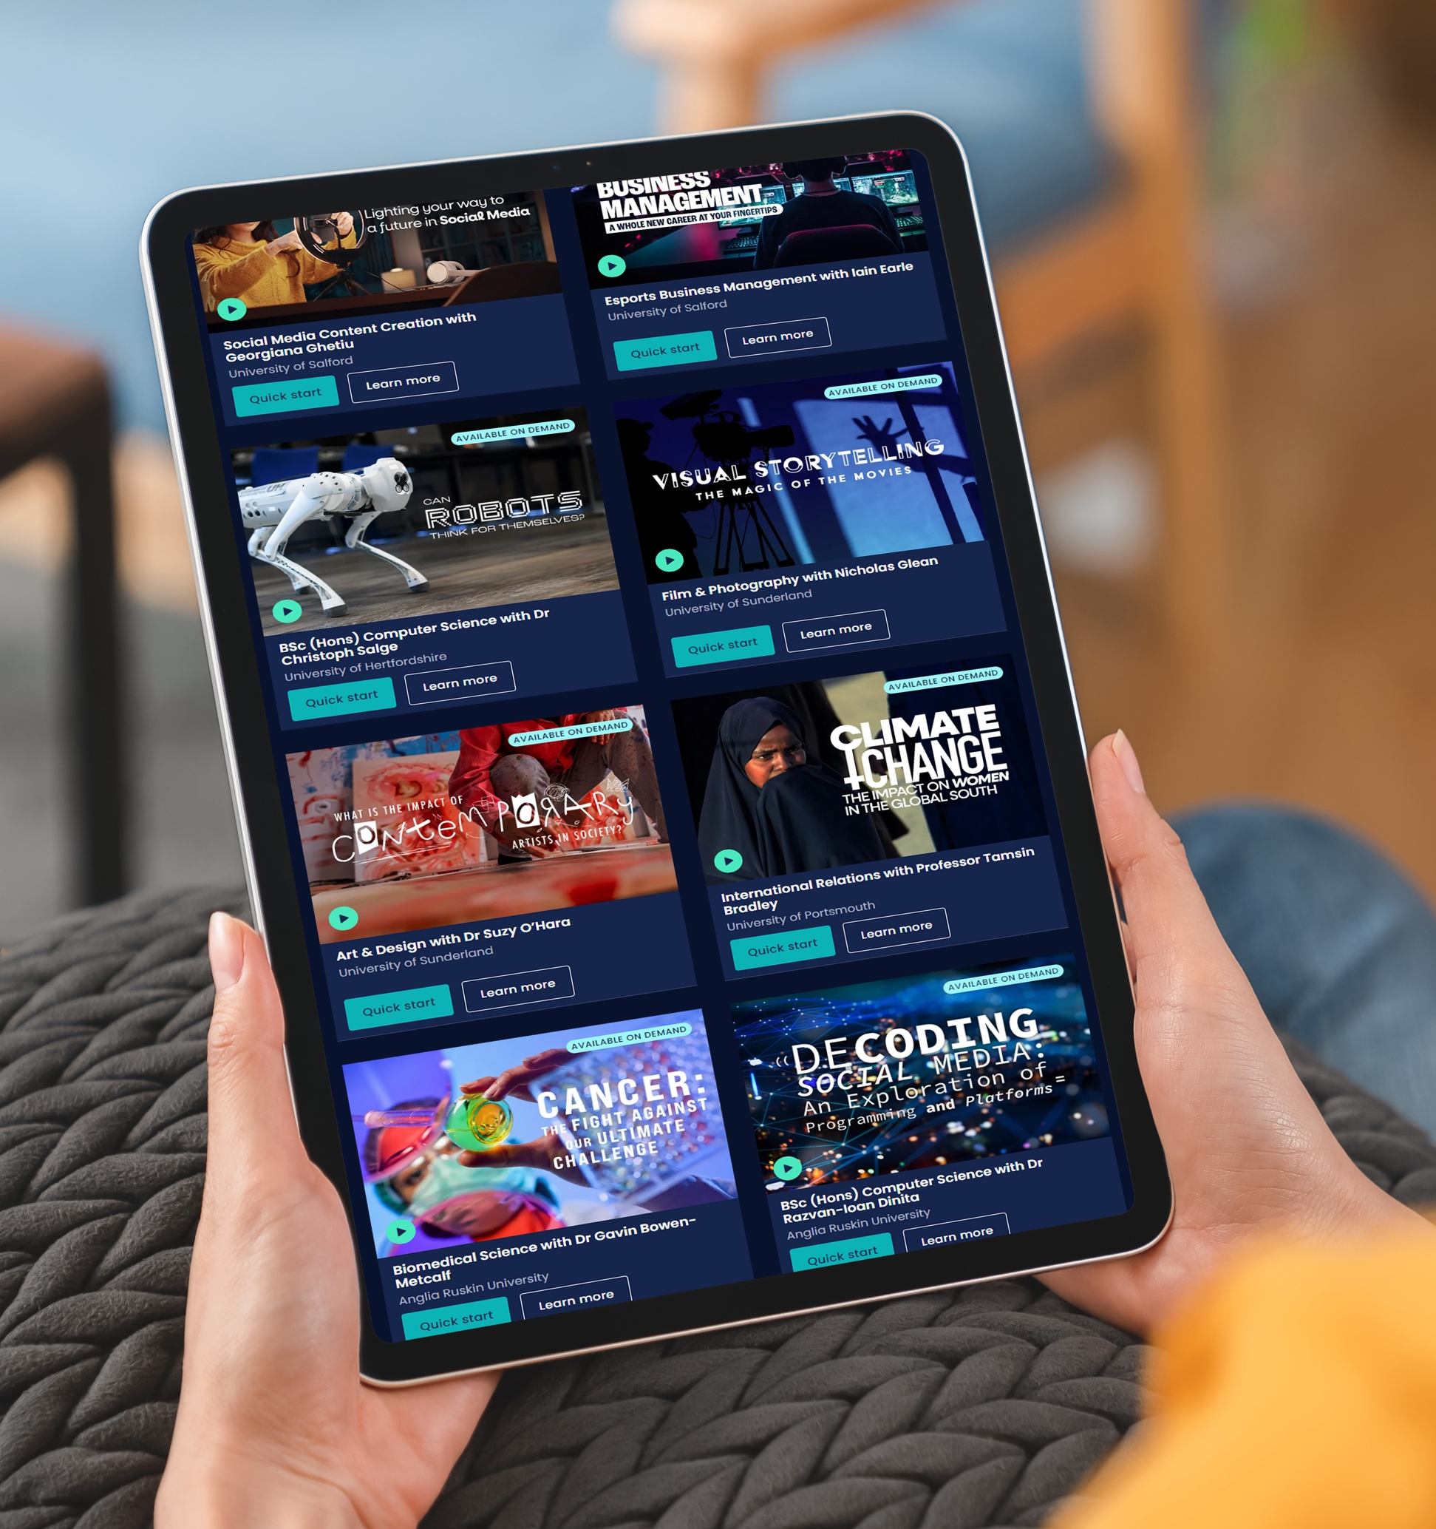


Springpod Subject Spotlights

Slide 2
What are subject spotlights?
On-demand university
degree
tasters
Delivered by university lecturers
Cinematic, interactive video content that you can watch in sections

Slide 3


Slide 4

What are the benefits of Subject Spotlights?
Recognised by universities
Boost your personal statement and university application
Gives you an authentic insight into what studying a subject would be like at university
Will help you decide if a subject is right for you or not
You can filter and search by subject or university

Slide 5
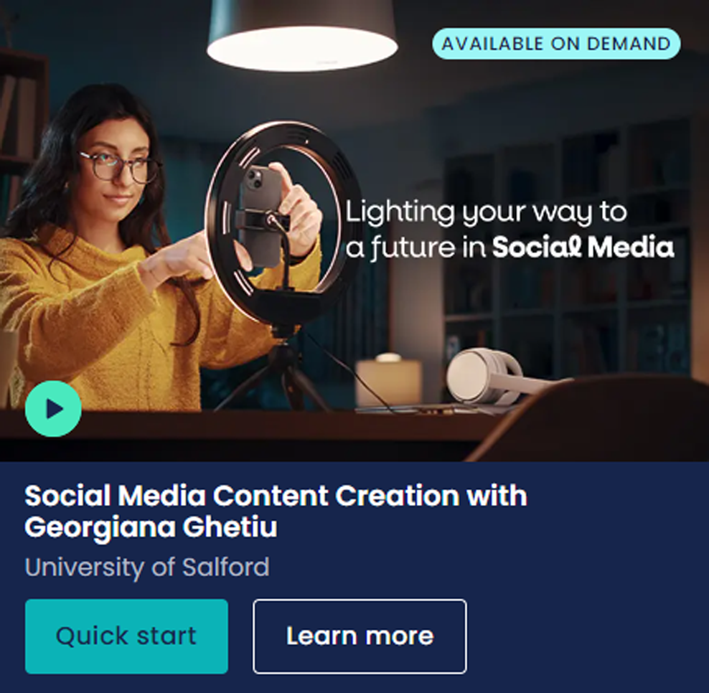


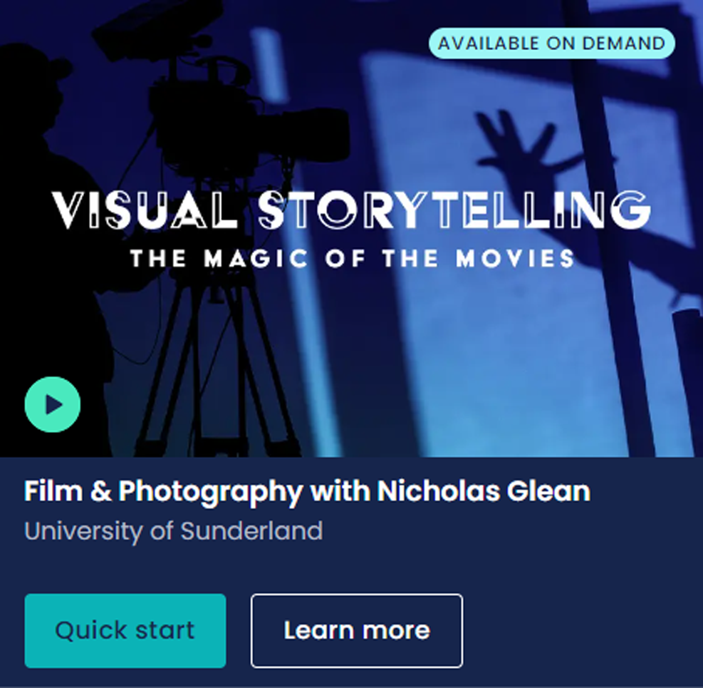
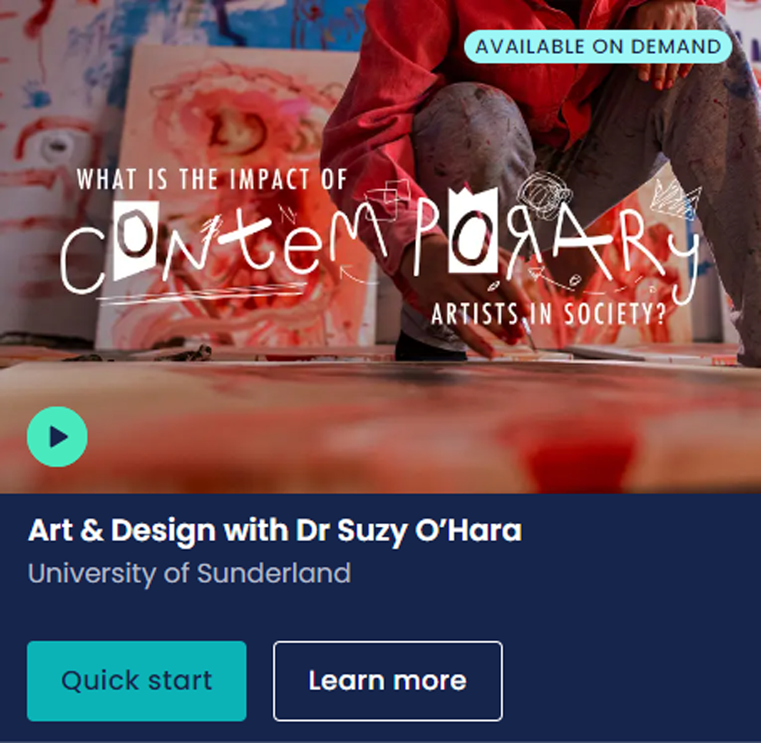

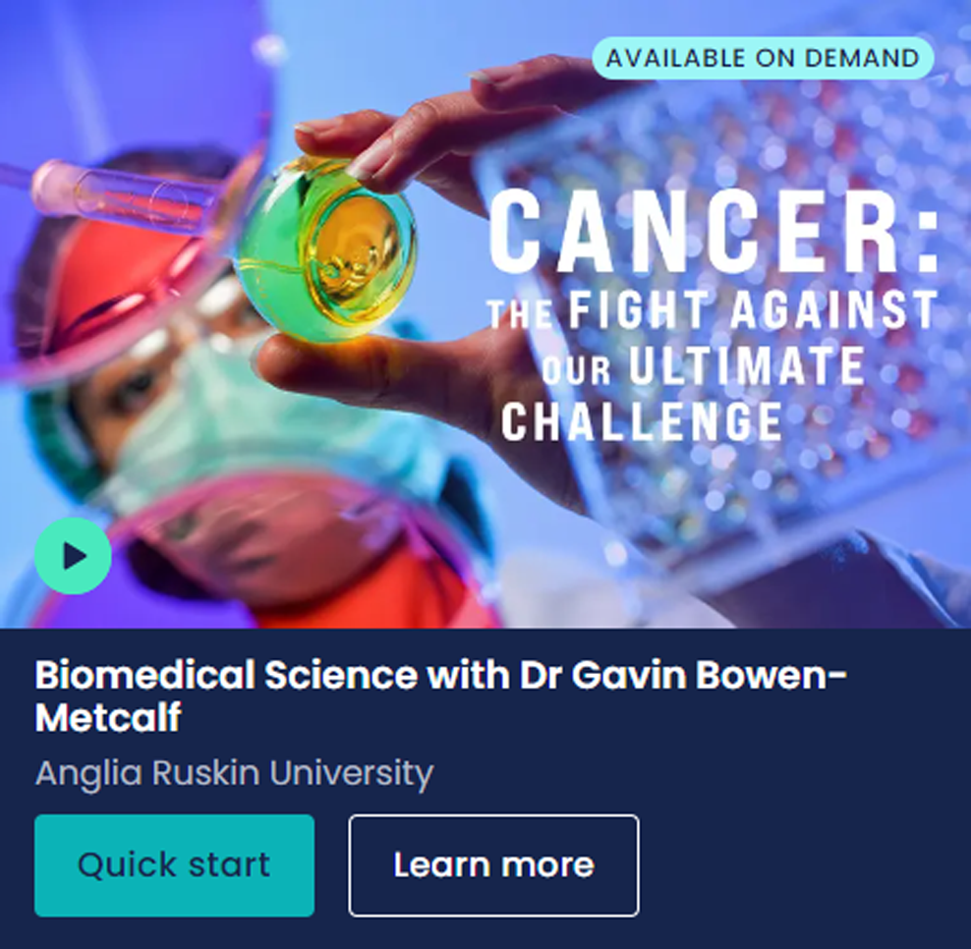
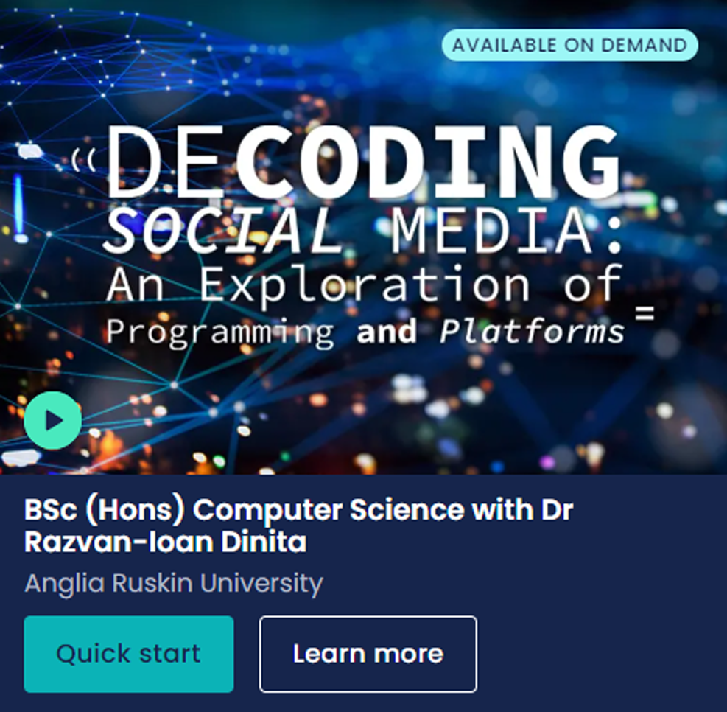
What sort of Subject Spotlights are available?

Slide 6

How do you access
Subject Spotlights?
Find them on ucas.com: You can search and filter
by subject and university to see suggested Subject Spotlights in our search tool. Subject Spotlights
are also found on subject guides.
In the Hub: Once you have signed up and logged in to the Hub, you will be able to watch any Subject Spotlight after you complete the Springpod sign up.
Favourites and For You: You can favourite a Subject Spotlight in order to watch it later - this will appear
in your Hub dashboard in the Favourites section.
Relevant Subject Spotlights are also in your personalised For You section.

Slide 7

Step-by-step guide
1
Choose your Subject Spotlight and
click on ‘Take Subject Spotlight’.
2
Register or sign in to your UCAS Hub
account, then click ‘Accept’ to share
your UCAS account with Springpod.
3
Complete your Springpod sign up, confirming your personal details, communication preferences, education details, and interests.
4
Sit back and enjoy your Subject Spotlight
– remember you can favourite as many
as you like to watch later.

