Slide 1
Outreach Connection Service
Guide to using the Outreach Connection Service
For providers and third-party outreach providers
February 2024

Slide 2
Content
Introduction
User Management
Registering for a UCAS account
Using the Outreach Connection Service
Student UG application
Appendices
- Criteria meanings
- Measure of disadvantage meanings

Slide 3
Introduction

Slide 4
Introduction
In the Outreach Connection Service tool, you can add and manage opportunities and activities for disadvantaged and underrepresented students. This data feeds into the Adviser Portal used by circa 4,000 UK schools and colleges (UCAS registered centres), where advisers can sort and filter those opportunities to support and share with students as appropriate. Students who participate in these activities can add up to two in the ‘Extra activities’ section of the UCAS application – see slide 23 for more information.
The Outreach Connection Service for providers and third-party outreach providers will be live in March 2024. Please note that the Outreach Connection Service for schools and colleges will be launched in May 2024, allowing time for organisations to be onboarded to the service, users registered, and opportunities uploaded.
It’s important that when using the service:
you/your organisation are agreeing to the terms of service as outlined in the welcome letter
opportunities are current, kept up to date and complete as possible [note published opportunities will not be seen by UCAS registered centres until February 2024]
you ensure that all listed opportunities meet the criteria identified
Any queries or feedback, please contact outreachconnectionservice@ucas.ac.uk; or call 0344 984 1111
The Outreach Connection Service forms part of UCAS’ Fair Access Programme and specific I&A pages for providers

Slide 5
OUTREACH CONNECTION SERVICE
ENABLING UNIVERSITIES, COLLEGES AND CHARITIES TO SHOWCASE THEIR OPPORTUNITIES FOR UNDERREPRESENTED AND DISADVANTAGED STUDENT GROUPS TO UK SCHOOLS AND COLLEGES
UCAS Adviser Hub
UCAS Student Hub
Outreach Connection Service
Opportunity Page
Extra activities listings
Search and filter outreach opportunities
Detailed information about the opportunity and booking information
Outreach Connection Service
Opportunity Page
Reporting
Add, edit, publish and close outreach opportunities
Detailed information about the opportunity and booking information
Data and evaluation capabilities
UCAS Provider Hub (Outreach Provider permissions)

Slide 6
Opportunities - criteria
All listed opportunities must meet the following criteria:
All listed activities/opportunities must be free for students
All listed activities should be attributed to widening access/participation - see criteria list* opposite
Campus visits may be listed, but general open days are not eligible for listing through this service
If no outreach programmes or activities are available, you may list the named contact for specific student groups (e.g. those listed opposite). Example on slide 21

Slide 7
User management

Slide 8
User management
Organisations who have completed the register your interest form will be fully onboarded and required to sign the business code of conduct. only need to submit one form for your organisation.
UCAS will give permission to access the Outreach Connection Service to staff who have completed the ‘register your interest’ form on behalf of the organisation.
Each user will have to register an account with UCAS and sign in to access the dashboard to upload and manage opportunities.
Staff at universities and colleges, who already have a UCAS account please sign in the usual way to access the Outreach Connection Service tiles available from your dashboard.
To give other colleagues access to the Outreach Connection Service tool:
Sign in and select ‘Go to user management’ from your dashboard.
on the ‘User management’ screen, click ‘Add user’, enter the relevant email address, assign ‘Outreach Connection Service’ permission, and click ‘Add user’ again.
this will not generate an email to the new user. Instruct the new user to go to www.ucas.com, click ‘Sign in’ from the top-right corner of the screen and register – see next slides.

Slide 9
Registering for a UCAS account
To access the UCAS Outreach Connection Service all users will need a UCAS account

Slide 10
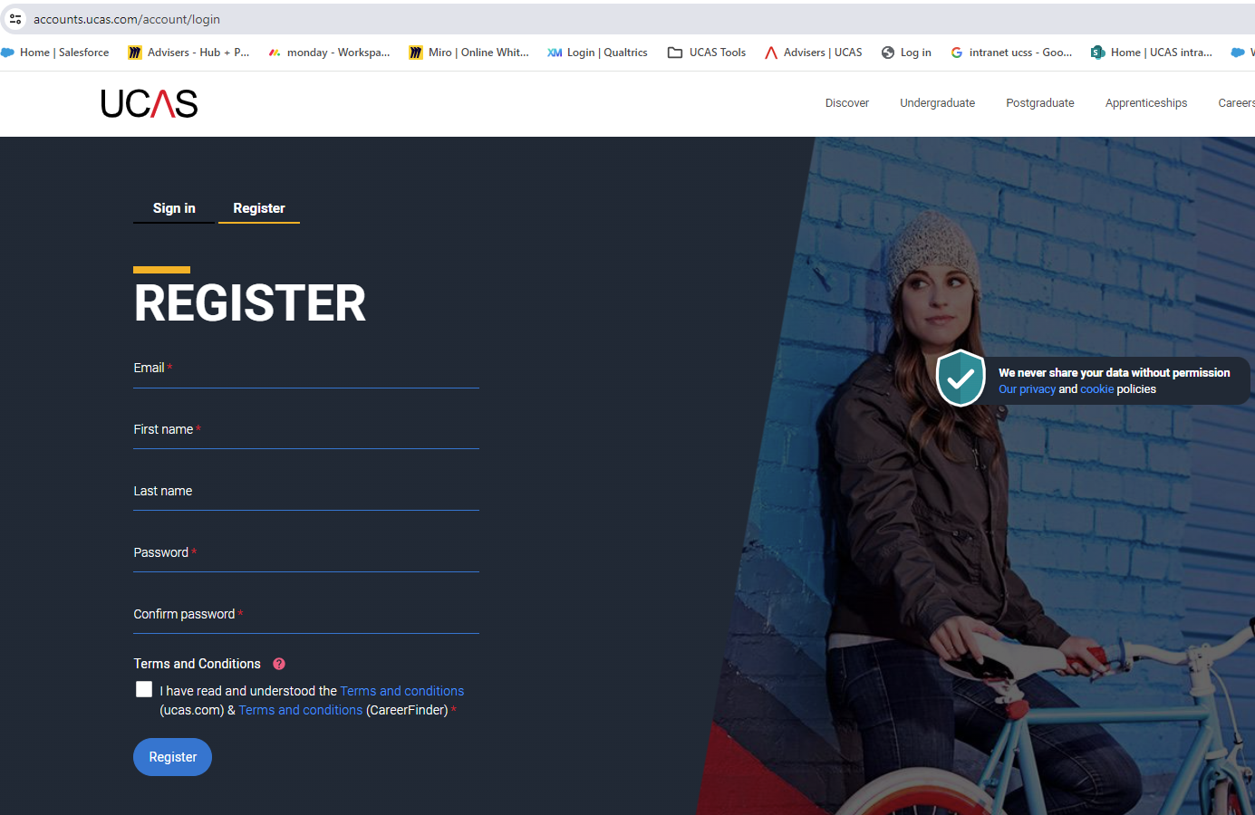
Registering for a UCAS account – step one
Head to ucas.com and click sign in OR
Quick link - https://accounts.ucas.com/account/login
Select register
Complete the short form.
Make sure the password is memorable.
Please ensure you use your work email address

Slide 11
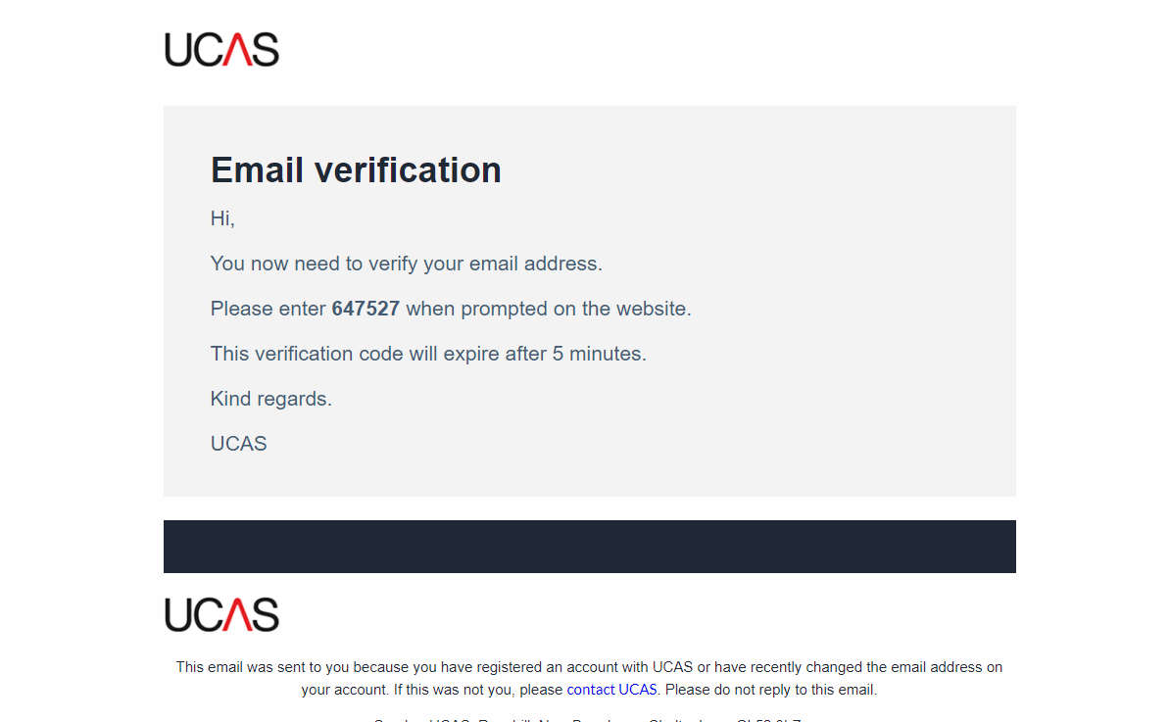
Registering for a UCAS account – step two
UCAS will email you a code to verify your email address you’ve registered with.

Slide 12
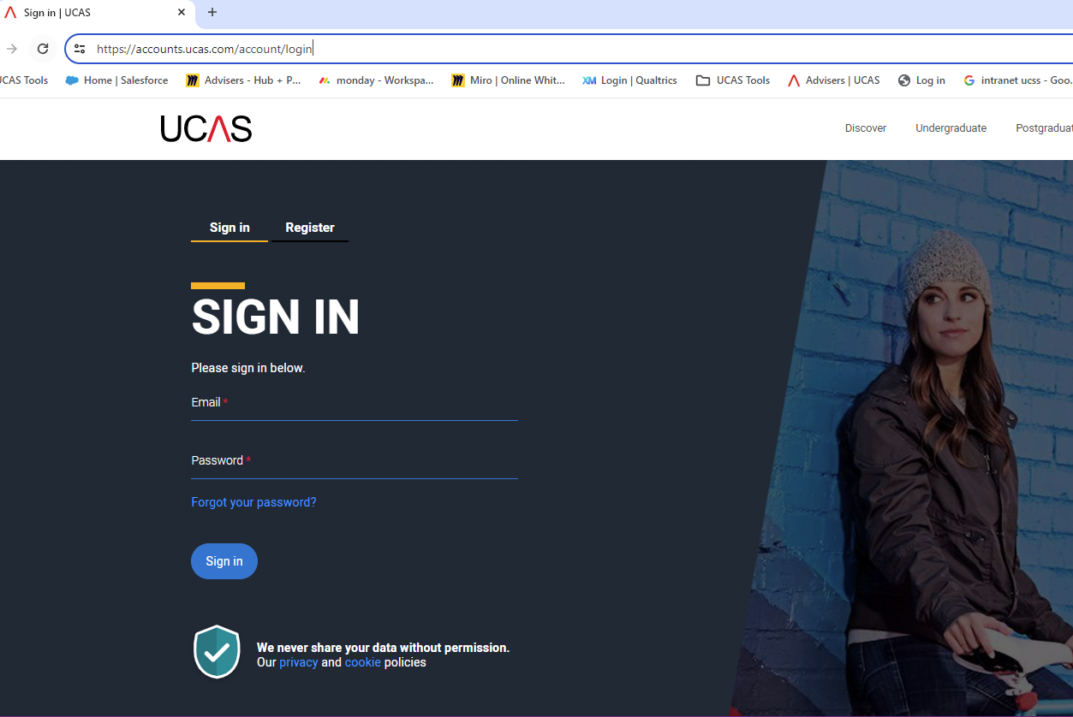
Sign-in to access your Dashboard
Select sign-in
Use the email and password you’ve registered with
There will be a Multi-Factor-Authentication (MFA) code emailed to you to access your dashboard.
LINK TO DASHBOARD - https://digital.ucas.com/search/dashboard

Slide 13
Using the UCAS Outreach Connection Service
Only those organisations who have onboarded with UCAS can use the service, agreed terms of service and signed business code of conduct

Slide 14
Adding an opportunity
The process to add an opportunity is outlined below:
Sign in, click on ‘Outreach Connection Service’ from your dashboard which will take you straight to the Opportunities List page.
Click on ‘add opportunity’
Complete relevant sections and click save, warnings will indicate any omissions or errors
Once you click save, it will give you the chance to review before you publish
You can ‘publish’ at the point of adding, or continue to add opportunities and publish later
From the Opportunities List page, you can also set a list of schools/colleges you want target (if relevant)
You can view your added opportunities in either a list or grid format
Once published the opportunity will appear in the Adviser Portal near real time
Click on the Opportunity listed to either edit, remove or publish/unpublish.

Slide 15
Adding an opportunity – targeting schools/colleges
Click on ‘set targeted schools/colleges list’ from the main Opportunities List page
Choose a local authority from the dropdown list and click on the relevant name. You can add more than one authority and set of schools/colleges
Select the relevant schools/colleges or click ‘all’
Your target list can be updated at any point, but will update for all opportunities where you have selected 'restrict opportunity to targeted schools/colleges'
When adding an opportunity, you may restrict an opportunity to your targeted schools/colleges (as below)
Note: If you do not restrict the opportunity to your targeted schools/colleges, the opportunity will be displayed to all UK schools/colleges and colleges within the Adviser Portal

Slide 16
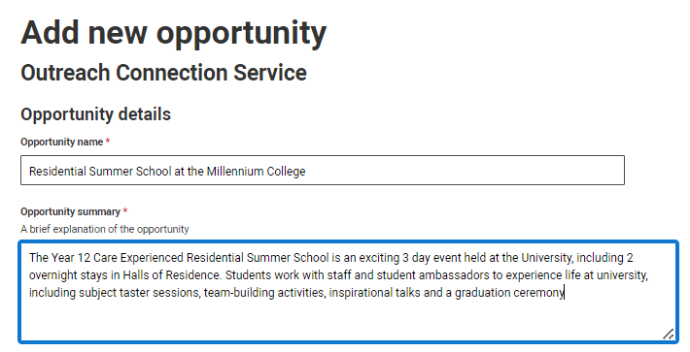
Adding an opportunity
Sign in click on ‘ Outreach Connection Service’ from your dashboard
Click on ‘add opportunity’ from the Opportunities List page and complete:
The opportunity title is mandatory. If your organisation comprises individual departments offering dedicated opportunities (e.g. colleges within a university), we recommend you add this to the title of the opportunity.
All outreach providers registered on the Outreach Connection Service will be visible to UCAS registered centres in either a grid or list format
The summary is your chance to showcase the opportunity. Provide some high-level details and context – but keep it brief.
You might like to identify who students would interact with during the activity, what they will experience, identify a couple of activities or set out the expectation

Slide 17
Adding an opportunity
It is mandatory to identify the type of opportunity by selecting one of the following options:
Summer school
Saturday school
Mentoring
Campus visit
Skills and attainment raising activity
Masterclass/Subject insight
General Information and Guidance
Long term programme
Visit to charity/university
Visit to your school/college
Its mandatory to identify where the opportunity takes place
If appropriate highlight the start and end date, particularly useful if spread over several days, weeks or months and identify the session length.
Indicate if student application is required and identify the application deadline date; once the deadline has passed the opportunity will not be visible.

Slide 18
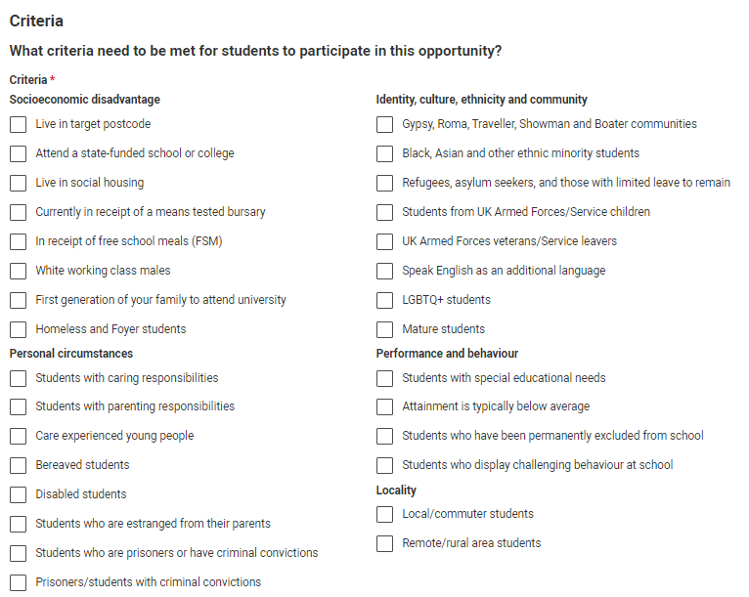
Adding an opportunity – setting the criteria
Setting the criteria for the opportunity is mandatory. By selecting these indicators, it helps advisers identify eligible students who would benefit from these opportunities.
Definitions are listed in the appendices.

Slide 19
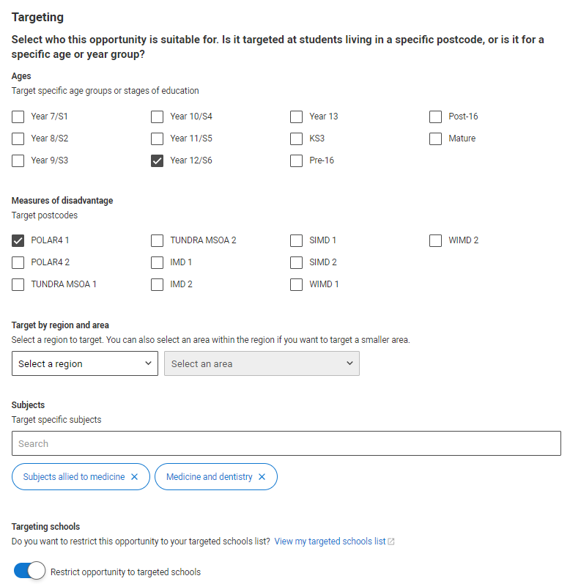
Adding an opportunity – enhanced targeting
It is not mandatory, but you can refine to highlight the opportunity is for specific group of students by age group, measures of disadvantage or region.
You may want to identify the opportunity is for a specific subject grouping (there is an option to add more than one subject grouping).
By selecting the region/area helps advisers filter for opportunities near them but will show to all UK schools/colleges
By selecting any of these indicators, it helps advisers filter and identify eligible students who would benefit from these opportunities
By selecting and using your target school/college list – the opportunity will ONLY show to those schools/colleges.
.

Slide 20
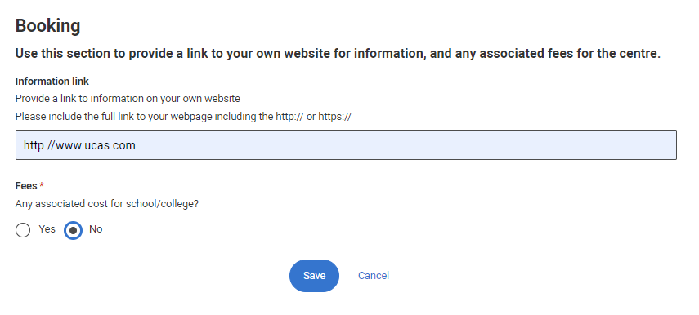
Adding an opportunity
UCAS are not involved in the booking process.
It is advised all opportunities listed will have a link to the outreach provider’s website for further information including how to book.
Individuals are not charged for activities/opportunities, but in some cases there may be a requirement for schools/colleges to fund an activity. Providers are encouraged to highlight if there are associated costs to the school/college.

Slide 21
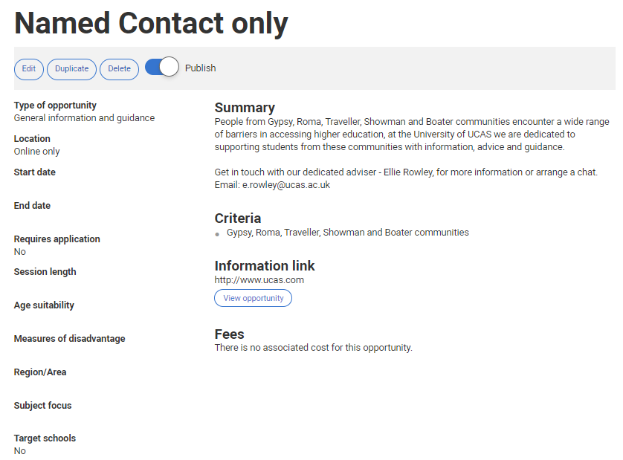
Reviewing your opportunity
Once you’ve added and saved your opportunity you can review before you publish.
This is an example of a named contact for a specific student group.
This will be shown to all UK schools and colleges as general information and guidance.

Slide 22
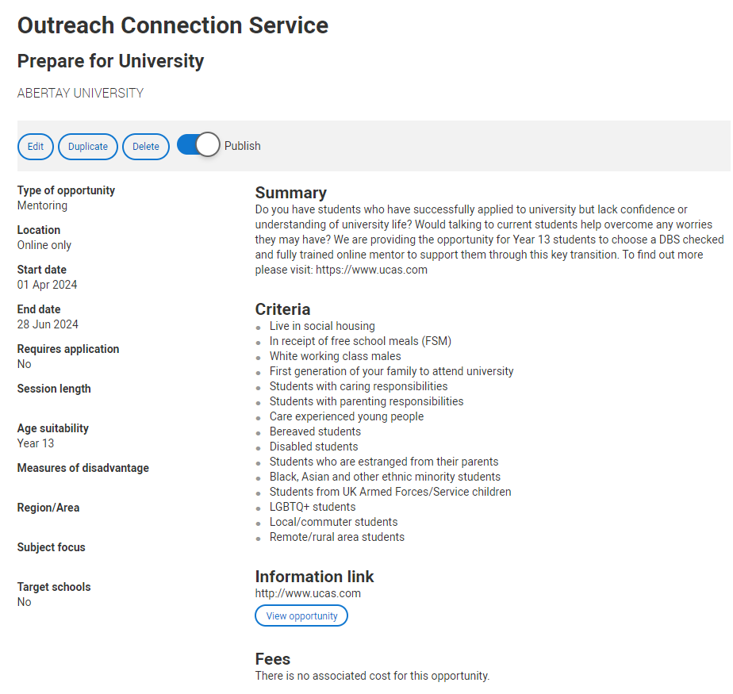
Publish your opportunity
Once you’ve added and saved and reviewed your opportunity, you can publish at the point of upload or publish at a time to suit you.

Slide 23
Student UG application

Slide 24
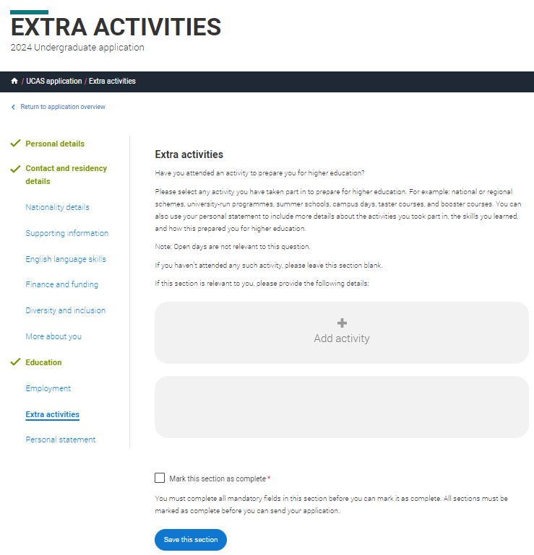
UG Application - Extra Activities
Students can add up to two completed activities on the application.
Please contact Outreachconnectionservice@ucas.ac.uk to request activities/opportunities listed in the UG application from 2025 entry.

Slide 25
Appendices

Slide 26
Criteria
For some students, their individual circumstances can have a significant impact on their decision to go to university or college – and on their experience when they are there. Students from under-represented backgrounds often need extra support throughout their discovery journey and when applying to HE.
The criteria for the Outreach Connection Service, to help teachers and advisers identify eligible students for the opportunities listed. You can select as many criteria as you need for each opportunity you list:
Personal circumstances:
Students with caring responsibilities - A carer is anyone who has a commitment to providing unpaid care to a family member or friend who could not cope without their support – or intends to provide this support. This may include taking care of a sibling when a parent is unable to do so due to their health needs.
Students with parenting responsibilities - This can cover if a student is responsible for the care and wellbeing of a child aged 17 or under, this might mean they are a biological parent, stepparent, adoptive or legal parent, a legally appointed guardian, a foster carer or someone who provides kinship or other parental care to the child of a family member or friend.
Care experienced young people - Being care experienced means someone will have spent time living with foster carers under local authority care, in residential care (e.g. a children’s home), looked after at home under a supervision order, or in kinship care with relatives or friends, either officially (e.g. a special guardianship order) or informally without local authority support.
Bereaved students - Bereaved students are those who have lost a close family member.
Disabled students - A disabled student can mean any student with a physical and/or mental health condition, long-term illness, or learning difference they may live with.
Students who are estranged from their parents - An estranged person is someone who no longer has the support of either of their parents, and often also other family members, due to a permanent breakdown in their relationship which has led to ceased contact. This might mean your biological, step or adoptive parents or wider family members who have been responsible for supporting you in the past.
Prisoners/ students with criminal convictions - If a student is currently imprisoned, has been imprisoned during their lifetime or has a criminal conviction
Socioeconomic disadvantage:
Live in a target postcode – you may have a specific target postcode measure such as POLAR or IMD which is used for your outreach activity, you can add more detail in the measures of disadvantage section and free text.
Attend a state-funded school or college - State schools and colleges receive funding through their local authority or directly from the government.
Live in social housing - social housing are houses and flats owned by a local government or by other organisations that are rented to people on lower incomes.
Currently in receipt of free school meals - Young people in the UK are usually eligible for free school meals if their parents or carers are on a low income or in receipt of certain benefits
White working class males - This group is generally identified by socioeconomic status measures such as education, income and occupation.
First generation to attend university - first generation students are the first in their immediate family to attend higher education.
Homeless and Foyer students - People who are homeless and want to progress to higher education may find there are a number of challenges to overcome – such as qualifications, financial issues, and access to expert information, advice, and guidance.

Slide 27
Criteria
For some students, their individual circumstances can have a significant impact on their decision to go to university or college – and on their experience when they are there. Students from under-represented backgrounds often need extra support throughout their discovery journey and when applying to HE.
The criteria for the Outreach Connection Service, to help teachers and advisers identify eligible students for the opportunities listed. You can select as many criteria as you need for each opportunity you list:
Identity, culture, ethnicity and community:
Gypsy, Roma, Traveller, Showman and Boater communities- The term ‘Gypsy, Roma and Traveller’ encompasses a wide range of individuals who may be defined in relation to their ethnicity, heritage, way of life and how they self-identify.
Black Asian and other ethnic minority students-
Refugees, asylum seekers and those with limited leave to remain- In the UK, a refugee is a person who has fled their country, and is seeking protection because of a fear of being persecuted due to their race, religion, nationality, membership of a particular social group, or political opinion. An asylum seeker is someone who has applied for refugee status and is waiting to find out if it has been granted.
Students from UK Armed Forces/ Service children- students have a parent who currently serves in the regular UK Armed Forces or as a reservist, or has done so at any point during the first 25 years of their life.
UK Armed Forces veterans/ Service leavers- students who have served as a Regular or Reservist in the UK Armed Forces (including: the Royal Navy, Royal Marines, British Army, Royal Air Force, or Merchant Mariners who have seen duty on military operations)
Speaks English as an additional language
LGBTQ+ students- An LGBTQ+ student is someone who is lesbian, gay, bisexual, transgender, queer, questioning or other.
Mature students- A mature student is defined as those aged over 21 or over when they enter higher education
Performance and behaviour:
Students with special educational needs
Attainment is typically below average
Students who have been permanently excluded from school
Students who display challenging behaviour at school
Locality:
Local/commuter students- local/ commuter students are those who live in the same travel to work area as their university or college. This includes students who live in a typical commuting distance of their provider.
Remote/rural students- remote/rural students are those who live in rural regions in the UK, they may have reduced access to education services.

Slide 28
Measures of disadvantage
Area based measures in the Outreach Connection Service can help target outreach opportunities. Below are definitions of the area-based measures.
POLAR4 - The participation of local areas (POLAR) classification groups areas across the UK based on the proportion of young people who participate in higher education.
- It looks at how likely young people are to participate in higher education across the UK and shows how this varies by area.
- POLAR classifies local areas into five groups - or quintiles - based on the proportion of young people who enter higher
education aged 18 or 19 years old.
- Quintile one shows the lowest rate of participation. Quintile five shows the highest rate of participation.
TUNDRA - TUNDRA (tracking underrepresentation by area) is an area-based measure that uses tracking of state-funded mainstream school pupils in England to calculate young participation. It is an official statistic.
- TUNDRA classifies local areas across England into five equal groups – or quintiles - based on the proportion of 16 year old
state-funded mainstream school pupils who participate in higher education aged 18 or 19 years.
- Quintile one shows the lowest rate of participation. Quintile five shows the highest rate of participation.
IMD - English Indices of multiple deprivation (IMD) is a measure of relative deprivation for small, fixed geographic areas of the UK. IMD classifies these areas into five quintiles based on relative disadvantage, with quintile 1 being the most deprived and quintile 5 being the least deprived.
SIMD - The Scottish Index of Multiple Deprivation is a tool for identifying the places in Scotland where people are experiencing disadvantage across different aspects of their lives.
WIMD - The Welsh Index of Multiple Deprivation (WIMD) is the Welsh Government’s official measure of relative deprivation for small areas in Wales. It identifies areas with the highest concentrations of several different types of deprivation. It is a National Statistic produced by statisticians at the Welsh Government.

