Slide 1



Virtual Work Experiences
Springpod

Slide 2





UCAS & Springpod Partnership
UCAS & SPRINGPOD COLLABORATION
VISION STATEMENT:
Introduce experiential learning into the UCAS journey - enabling every young person to undertake career and course experiences -
that inspire, raise aspirations, and support
future pathway choices.

Slide 3

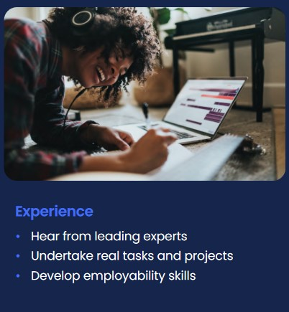

Who Are Springpod?
Online learning community connecting young people with world-leading employers and higher education providers.
Provides life-changing virtual career and course experiences via its market-leading careers education platform with social mobility as its foundation.

Slide 4
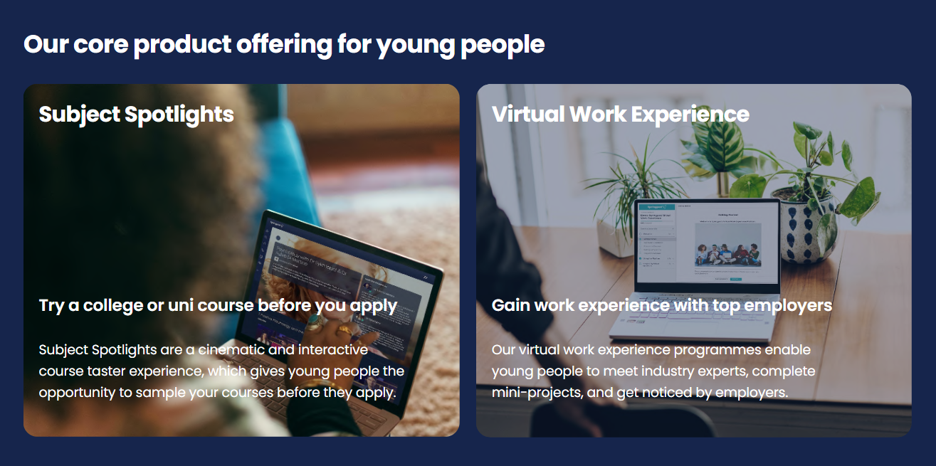
Try a course or career before you apply

Slide 5
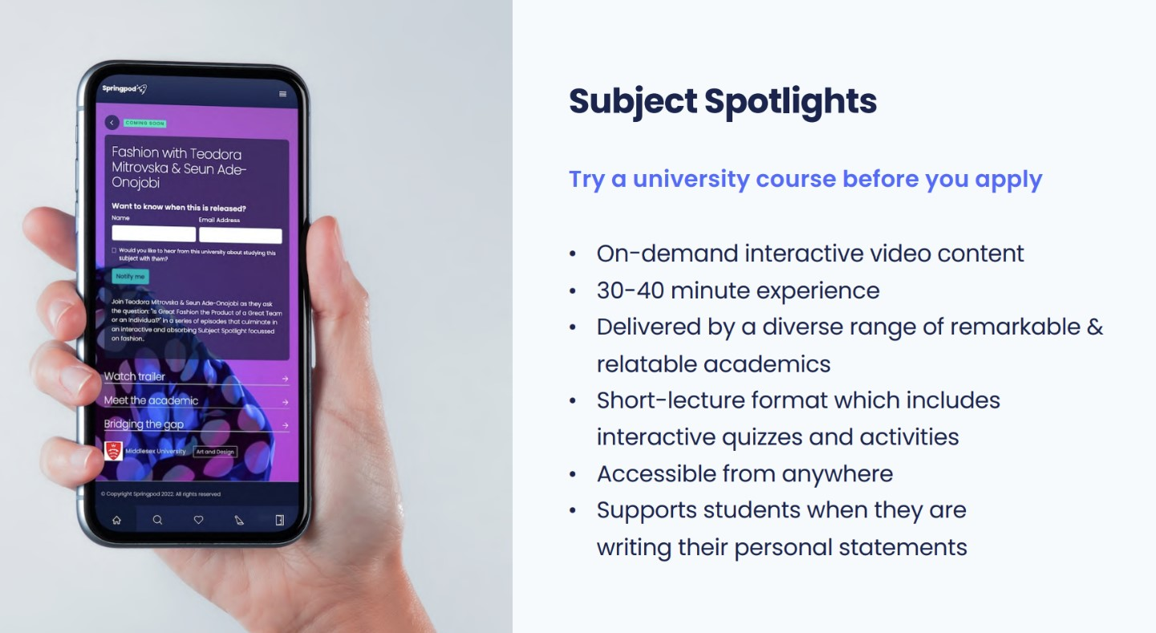
Live on UCAS.com: Subject tasters | UCAS

Slide 6
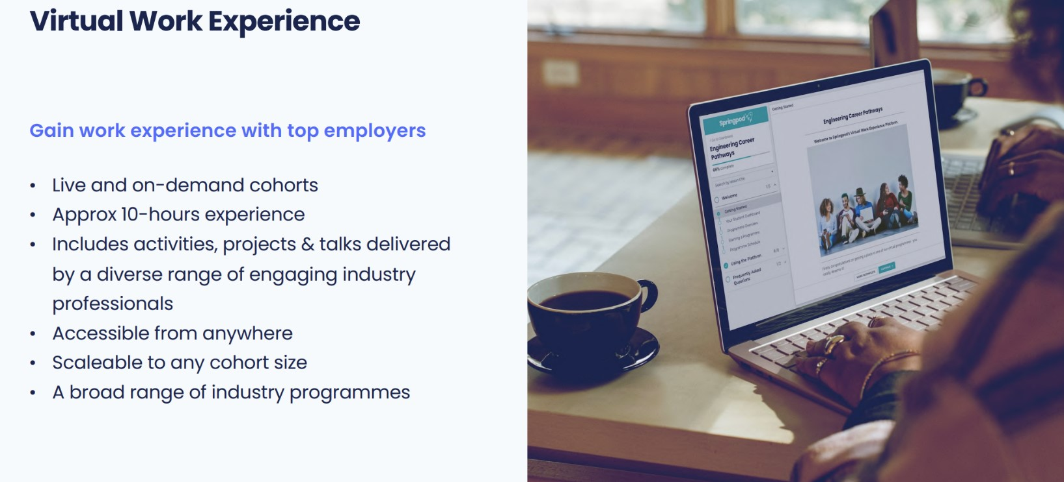
Live on UCAS.com: Virtual Work Experiences | UCAS

Slide 7
What are virtual work experiences?
On-demand virtual work experience programs
Led by industry professionals
Immersive, interactive experiences that incorporate real workplace activities

Slide 8

Benefits of Virtual Work Experiences
Allows young people to have free access to work experience from leading employers anywhere in the world.
Authentic insight and awareness of career pathways, types of roles employers offer, and develops a student’s employability skills and confidence to prepare them for the world of work.
Supports decision-making, boosts their personal statement, CV and apprenticeship applications.
Widens participation and boosts social mobility at national and regional levels via virtual, anywhere, anytime learning programmes, with a certification of completion also included.
Supports the Updated Gatsby Benchmarks.
Helps employers to reach and build diverse, inclusive talent pools of the future.
Will help young people decide if a particular career is right for them or not.

Slide 9

What sort of virtual work experiences are available?

Slide 10

How Do You Access
Virtual Work Experiences?
UCAS.com: Navigate via the ‘Discover’ menu bar or via the direct Landing page Virtual Work Experiences | UCAS - You can search and filter by employer or sector to see suggested Virtual Work Experiences.
Search – Via ‘search everything’ on the home page or direct via our search tool.
Personalisation in the Hub: Once logged into the Hub, use the ‘Hub’ tab to find the Virtual Work Experiences tile, or discover personalised suggestions in the ‘For You’ tab based on your favourites.
Embedded in areas such as subject guides & industry guides.

Slide 11

Step-By-Step Guide
1
Choose your Virtual Work Experience and
click on ‘start now’. Some Virtual Work Experiences are on-demand, and some have a future start date.
2
Register or sign in to your UCAS Hub
account, then click ‘Accept’ to share
your UCAS account with Springpod.
3
Complete your Springpod sign up, confirming your personal details, communication preferences, education details, and interests.
4
Sit back and enjoy your Virtual Work Experience.

