Slide 1
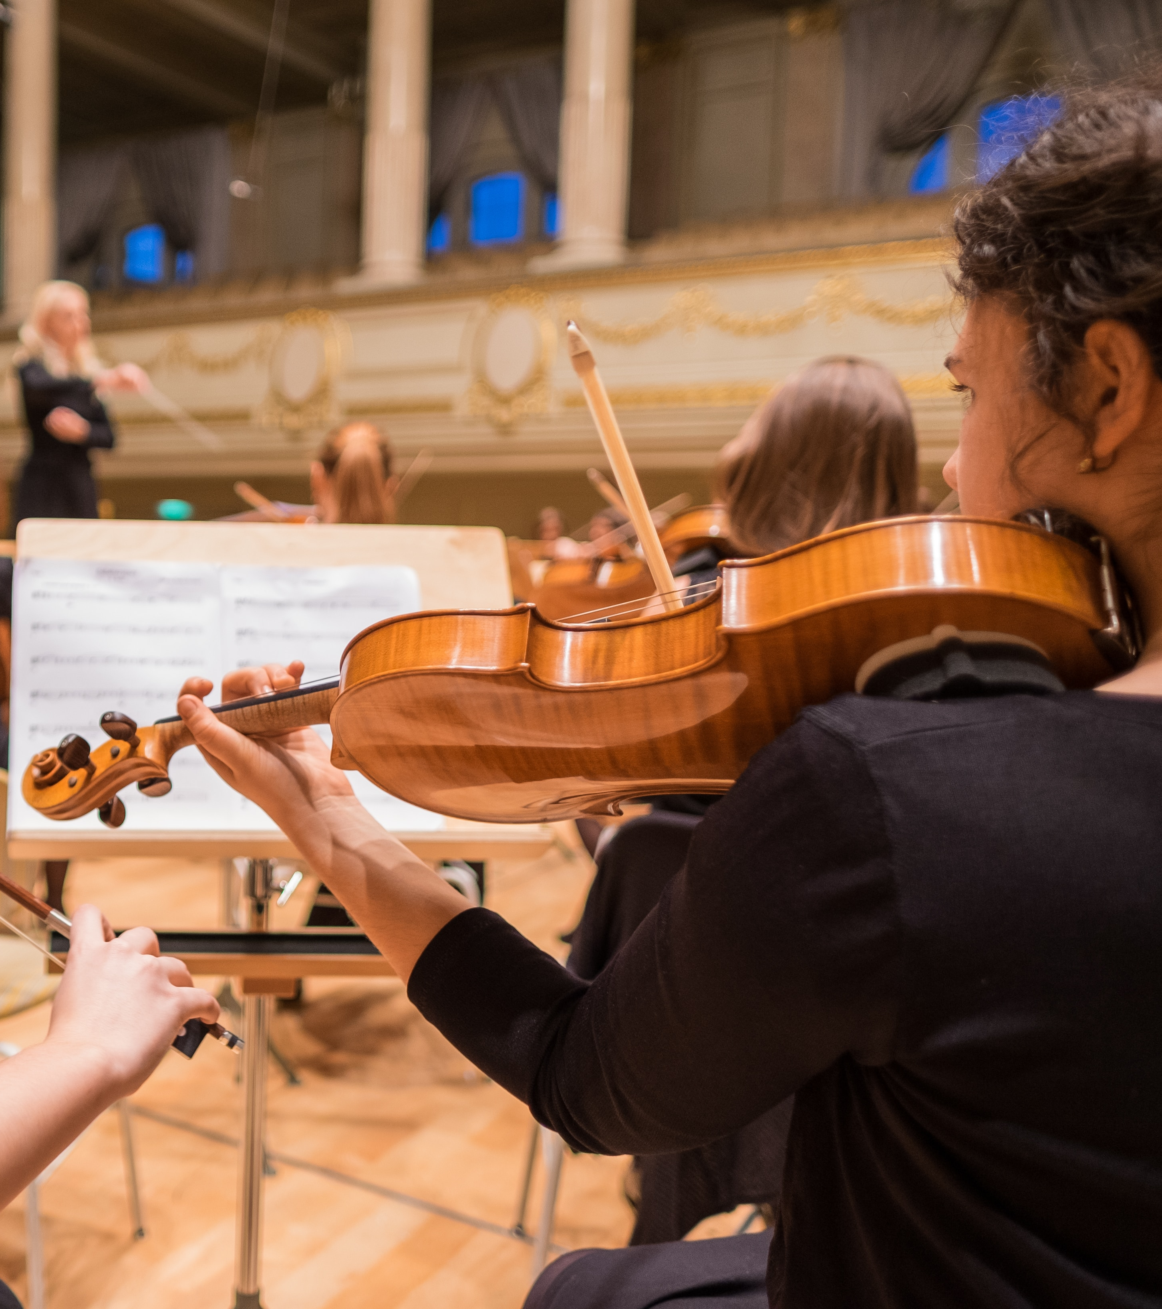
APPLYING TO A CONSERVATOIRE
Last updated June 2025
Public

Slide 2
What is a conservatoire?
Conservatoires provide performance-based higher education, including music, drama, screen and production courses – both at undergraduate and postgraduate levels.
UCAS offers an application route to nine UK conservatoires – each has its own strengths and specialisms, so it’s important you do your research to find the right fit for you:
  Royal Birmingham Conservatoire
  LAMDA
  Leeds Conservatoire
  Royal Academy of Music
  Royal College of Music
  Royal Conservatoire of Scotland
  Royal Northern College of Music
  Royal Welsh College of Music and Drama
  Trinity Laban Conservatoire of Music and Dance
Public

Slide 3
What’s the difference to university?
Facilities
Conservatoires tend to be smaller institutions which are focused on specific areas of study; such as music, dance and drama. They will, therefore, have specialist teaching and facilities dedicated to these areas.
Specialist focus
Universities tend to be much larger and will often offer a broad range of courses which could include anything from maths and engineering to art, history and music.
Practical study is the main focus
Both conservatoires and universities offer degree-level qualifications, however at a university practical study is typically an element of the course, whereas at a conservatoire it’s the main focus, and at the heart of what students do.
Course structures
The year is broken down into a block of academic weeks, followed by a block of performance weeks. Performances and workshops are mostly held in the evenings and at weekends meaning graduates are accustomed to expectations of the industry they are going to work in.
Teaching staff are working professionals
Professional musicians teach at conservatoires as part of their portfolios, and many teach at more than one conservatoire. There is a strong emphasis on one-to-one tuition, alongside group work and performances.
Public

Slide 4
MAKING AN APPLICATION
Public

Slide 5
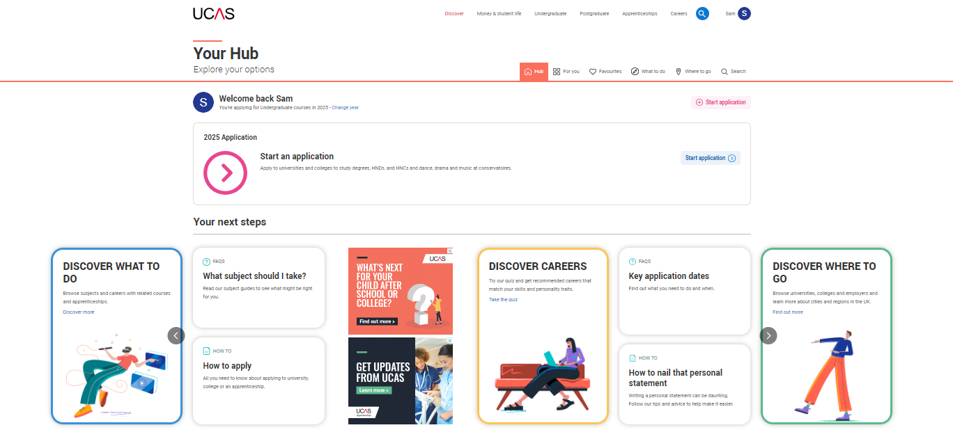
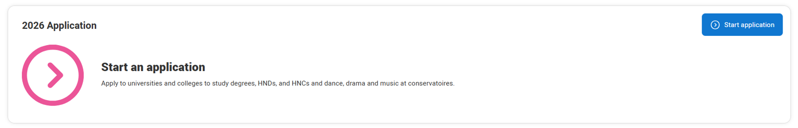
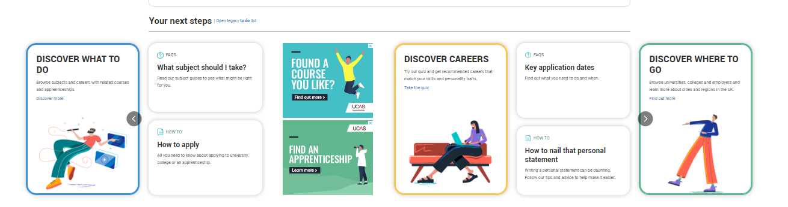
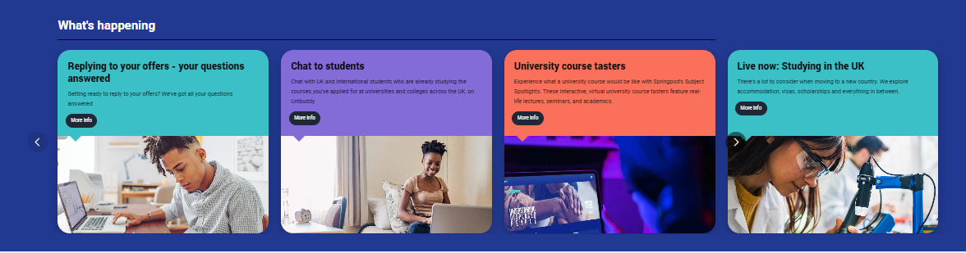
Start your research
Register with the UCAS Hub to:
explore careers, subjects, places, and apprenticeships
find and favourite courses
search for open days and online events
speak to those in the know using Unibuddy
speak to career, higher education, and application specialists by attending the Hub lives.
See ucas.com/conservatoires for more advice and guidance.
Public
Notes:
Key points:
There is no time like the present for students to sign up and access the UCAS Hub. As young as year 9’s, the familiarity of the hub and understanding tools to support early research, will also make it easier when they login to apply later on.
This is a personalised tool, ready to be tailored to each individual. What they put in now, will continue to be moulded around their interests as they login each time.
This is done through the courses they are interested in from the 35k available, locations to study at around the UK and pages of information they save to their favourites box.

Slide 6
When to apply for 2026 entry
10 July 2025
Students can start submitting applications for courses starting in 2026
2 October 2025
UCAS equal consideration date for music applications
14 January 2026
UCAS equal consideration date for dance, drama, or musical theatre course applications.
Public

Slide 7
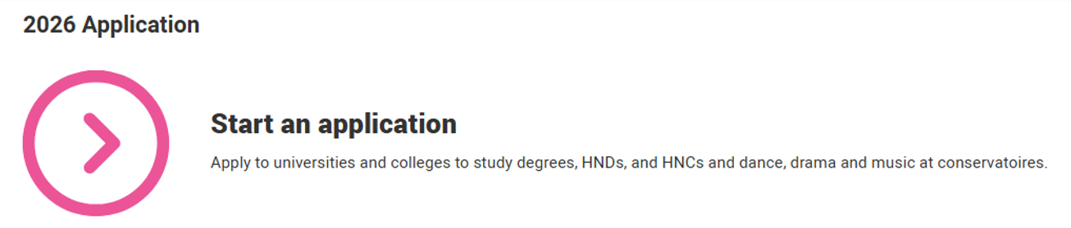
Starting an application
To start an application, you need to register with ucas.com.
You can register at any time.
From 10 July 2025 you’ll be able to start a conservatoire application for 2026 entry.
Courses are listed in our search tool.
Use the ‘conservatoire filter’ to see conservatoire courses only.
Public

Slide 8
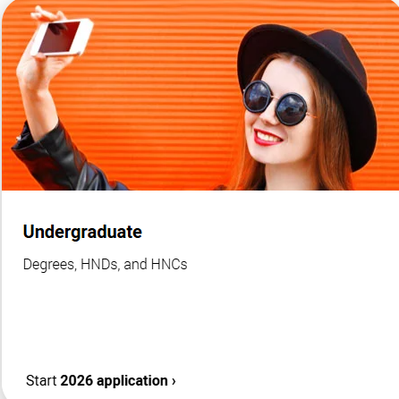
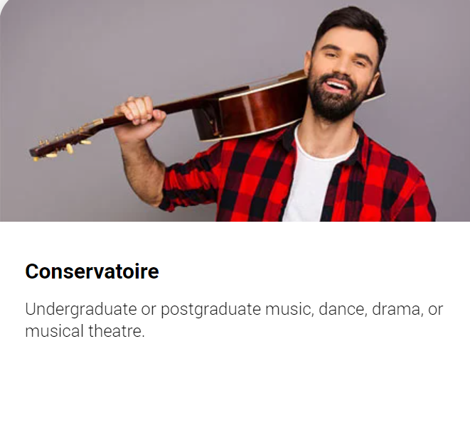
KEY FACTS
You can add up to 6 choices for a conservatoire application.
Applying costs £28.95 for 6 choices.
Apply by the relevant equal consideration date for your specialist area.
It’s likely you’ll need to attend an audition or interview.
There’s usually a fee for this which UCAS collects during the application. In some cases, you’ll need to pay the conservatoire directly.
You can apply through both the Undergraduate and Conservatoire applications at the same time.
Public

Slide 9
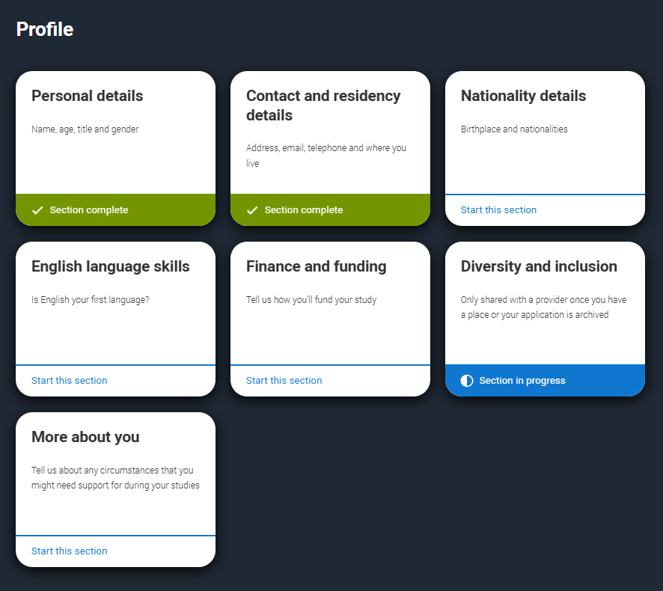
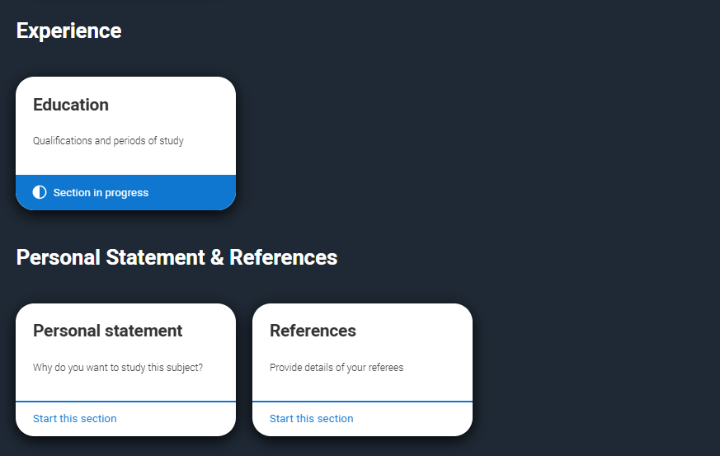
Making an application
Sections to be completed:
Personal details
Contact and residency details
Nationality details
English language skills
Finance and funding
Diversity & inclusion (for students with a UK home address)
More about you
Education
Personal statement
References
Choices – make up to six
Public

Slide 10


Who should be a referee?
Someone who:
Knows the student well enough to write about their abilities and their suitability for the course. (A current tutor, employer or head of department).
Is familiar with their skills and potential in their chosen field of study. (A music teacher, a tutor or personal mentor).
Can provide a balanced view of both their technical skills and personal qualities. (Instrument proficiency, performance skills, commitment and reliability.).
Once a student has chosen a referee who agrees to provide a reference upon request, and has submitted their application, the details are sent straight to the conservatoires.
Each individual conservatoire will only contact the referee if additional information is needed.
Find out more here.
Public

Slide 11

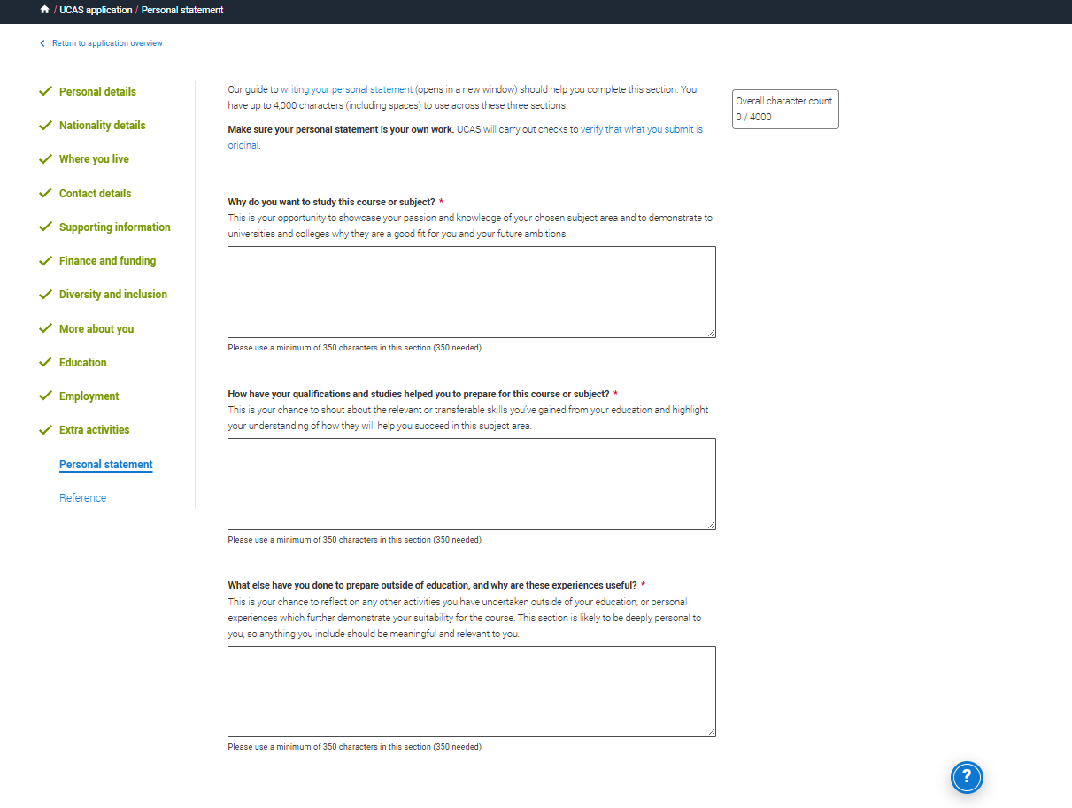






Your chance to show your passion, curiosity, interest.
.
Three separate sections with question prompts.
A maximum of 4,000 characters, minimum of 350 characters per section.
The same for all your choices.
There isn’t a spelling or grammar check.
No formatting allowed.
Every personal statement is run through similarity detection software.
Public
Notes:
Similarity detection is used by UCAS on all applications, to identify personal statements containing content which has similarities with previously submitted personal statements, or with those held as a library resource. Generating (and then copying, pasting and submitting) all or a large part of your personal statement from an AI tool such as ChatGPT, and presenting it as your own words, could be considered cheating by universities and colleges and could affect your chances of an offer.
For more information see:
www.ucas.com/applying/applying-university/writing-your-personal-statement/guide-using-ai-and-chatgpt-your-personal-statement
www.ucas.com/applying/applying-university/writing-your-personal-statement/fraud-and-similarity

Slide 12
What are the questions?
Why do you want to study this course or subject?
How have your qualifications and studies helped you to prepare for this course or subject?
What else have you done to prepare outside of education, and why are these experiences useful?
Public
Notes:
For Teacher and Advisers
Access the full suite of personal statement resources that have been created (including ppt decks) that you can copy and paste into your own materials and guides to support student in writing the personal statement.
www.ucas.com/advisers/help-and-training/guides-resources-and-training/pre-application-support/personal-statements-2026-entry-onwards/personal-statement-2026-entry-classroom-resources
www.ucas.com/applying/applying-university/writing-your-personal-statement/guide-using-ai-and-chatgpt-your-personal-statement

Slide 13


This could be an audition, interview, portfolio, or a recording.
You may have more than one audition/interview, depending on the conservatoire's audition policy.
Main specialism – one audition will be needed.
Joint main specialism – two auditions, one for each specialism, will be needed.
Secondary specialism – some conservatoires will audition on your main specialism only, whereas others will audition on both your main and secondary specialism.
Alternative main specialism – two auditions, one for each specialism, will be needed.
UCAS will usually collect assessment fees during application.
Public

Slide 14
Decisions conservatoires can make
Audition pending (AP) – an invitation to audition, including the date, time and payment.
Guaranteed unconditional (GU) – a binding offer that confirms you’ve met the entry requirements.
Guaranteed conditional (GC) – an offer that’s guaranteed if you meet certain conditions – usually exam results.
Unsuccessful (REJ) – you haven’t been offered a place.
Reserve unconditional (VU) – you'll be in a pool of reserve applicants, if a suitable place becomes available on the course they may make you a guaranteed offer.
Reserve conditional (VC) – you'll be in a pool of reserve applicants, if a suitable place becomes available on the course they may make you a guaranteed offer subject to you meeting certain conditions.
Withdrawal (W) – this is recorded on your application if you withdraw from a particular conservatoire.
Public

Slide 15
Replies to offers
You may only be able to accept one offer as a first choice, or you may be able to accept two offers and state your first and second choices. This depends on the type of offers you have.
Replies
1st Choice | 2nd Choice
Guaranteed Unconditional (GU) offer accepted | Cannot accept a second-choice offer | All other offers will need to be declined.
Guaranteed Conditional (GC) offer accepted | Cannot accept a second-choice offer | You'll be expected to take this place if you meet the conditions. All other offers will need to be declined.
Reserve Unconditional/Conditional (VU/VC) offer accepted | Guaranteed Unconditional offer accepted | If you’re unsuccessful at your 1st choice, you’ll be placed at your 2nd choice.
Reserve Unconditional/Conditional (VU/VC) offer accepted | Guaranteed Conditional offer accepted | If you meet the conditions of your GC second choice and the first choice is unsuccessful, you'll be placed at your second choice.
Reserve Unconditional/Conditional (VU/VC) offer accepted | Reserve/Guaranteed Uncondtional/Conditional offer accepted | If the conservatoire changes a 1st choice reserve guaranteed offer to Guaranteed Unconditional offer (GC1 or GU1), your second choice will automatically be rejected.
Reserve Unconditional/Conditional (VU/VC) offer accepted | No reply made | If you accept a reserve unconditional (VU) or a reserve conditional (VC) offer as your first choice, you can accept any type of offer as your second choice.
Public

Slide 16

Ucas support
UCAS Customer Experience Centre:
0371 468 0 470
From outside the UK:
+44 330 3330 232
Monday to Friday
08:30 – 18:00 (UK time)
We don’t have an email address, but you can direct message on Facebook or Instagram.
@ucas_online
facebook.com/ucasonline
ucas_online
Public

