Slide 1

Cv builder
SUPPORT PACK FOR TEACHERS AND ADVISERS
GATSBY BENCHMARKS 3 and 5
CDI FRAMEWORK: MANAGE CAREER/CREATE OPPORTUNITIES
PUBLIC

Slide 2

This pack includes
What is the CV Builder?
How does it fit in the UCAS Hub Journey?
Activities to support students in the classroom.

Slide 3
What is cv builder?
PUBLIC

Slide 4
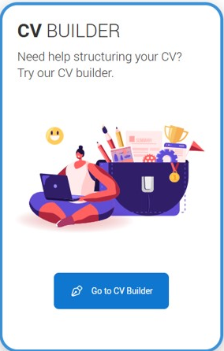
Test drive cv builder
A new tool to support your students
The UCAS CV Builder is designed to help your students create standout, professional CVs that showcase their skills, experience, and achievements.
Perfect for job, internship, work experience or apprenticeship applications, this tool provides step-by-step guidance to craft polished CVs that make an impact.
The CV Builder will be part of your students’ UCAS Hub journey enabling them to easily update and share their details in one place. It’s available for you to test the functionality and plan activities for your students.
Be among the first to explore this new resource and give your students the tools they need to succeed!
PUBLIC

Slide 5
apprenticeship discovery JOURNEY
START A UCAS HUB ACCOUNT
CREATE A CV
TAKE THE CAREERS QUIZ
ATTEND A UCAS DISCOVERY EVENT
DIVE INTO INDUSTRY GUIDES
EXPLORE VIRTUAL WORK EXPERIENCE
COMPARE OPTIONS SIDE BY SIDE
BUILD A PROFILE
FAVOURITE CAREERS
PUBLIC

Slide 6
CV builder lesson plan
ACTIVITIES TO SHARE WITH YOUR STUDENTS
PUBLIC

Slide 7
LESSON PLAN OVERVIEW
Location | Classroom with student access to internet
Recommended time | 45 minutes Depending on age of students, this could be done over two lessons. One lesson could be spent exploring more around skills and competencies.
Objectives | By the end of the lesson, students should be able to: Recall what a CV is and using the UCAS CV builder start their CV and save their changes Through self-reflection, identify their skills and competencies
Main student tasks | Students discuss the contents of CVs and why this document is important. Students are introduced to the UCAS CV Builder tool.
Success criteria | Students will be able to describe the structure of a CV and know how to create their own. Students will recognise the importance of using a CV to make a good impression. They will be able to use the UCAS CV builder to create their CV and update this on a regular basis
Keywords | ‘CV’, work experience, skills and competencies
Competencies | Attention to detail / observation Self-assessment Learning Reading
PUBLIC

Slide 8
LESSON PLAN OVERVIEW
Familiarise yourself | UCAS CV Builder Check your school’s policy on work experience
Key links | https://www.ucas.com/careers-advice/cv-builder https://www.ucas.com/careers-advice/how-identify-your-transferable-skills
Gatsby benchmarks | 3, 5
CDI Framework | Manage career Create opportunities
Career Education Standards | Developing work skills
PSHE association | ‘CV’, work experience, skills and competencies
PUBLIC

Slide 9

What is a cv?
Discuss in pairs the following questions:
1. What does CV stand for?
2. What do we use a CV for?
PUBLIC
Notes:
Teacher’s notes:
Starter activity: Use this quick discussion to gauge students’ understandings of cover letters and CVs. It doesn’t matter if they don’t have a perfect understanding yet – this is what this lesson is for!
Have students heard of CVs? Do any of them have a CV already? Once students have had a chance to discuss, ask them to share their answers with the class.
Keyword: A CV (also known as a ‘curriculum vitae’ or ‘resume’) is a written overview of your skills, education, and work experience. They are often sent to employers when you apply for a job. A CV is your first chance to introduce yourself to an employer, so it’s important to make a good first impression! The layout, language, and spelling will say a lot about who you are.

Slide 10
WHAT IS A CV?
CV stands for Curriculum Vitae which loosely translates from Latin as ‘the course of my life’.
But you don’t need to tell your life story! A CV is a succinct collection of all your achievements and important information for employers.
It is usually up to two pages long, made up of personal details, education and training, work experience, skills, competencies, and volunteering
PUBLIC
Notes:
Teacher’s notes: Use this slide to introduce students to CVs. It’s likely that students will be asked for a CV when they apply for work experience, so it’s a good idea for them to start thinking about what they would include.
Students will include a lot of information in their CVs – contact information, skills, work history and experience, education, and other achievements – so it’s important to write and organise their CV clearly. They are making a first impression as a professional, so their CV needs to set students apart from other applicants. A spelling error could be enough for their CV to be put on the ‘no’ pile!
Students’ CVs should not include their age or a photo, unless it is specifically asked for in relation to the job they’re applying to (e.g. checking that you are old enough to work in a bar).

Slide 11

WHY IS A GOOD CV IMPORTANT?
What are the top two reasons you think a CV is important?
Share ideas with the person next to you and decide on your top two to share with the class.
PUBLIC
Notes:
Teacher’s notes: Ask students to turn to the person next to them and brainstorm reasons why a CV is important. Once they have chosen their two reasons, ask pairs to share their answers with the class.
The purpose of this exercise is to encourage students to see the different ways a CV will be valuable to them, particularly if it is well-written and presented professionally!
What are the top reasons you think a CV is important?
Make a good impression
A CV is your first chance to make a good impression on a potential employer and convince them to hire you. This shows them your skills, and competencies and why they should hire you for a role.
Sell yourself
A CV is a marketing tool that allows you to highlight your skills, achievements, and experience to show why you're the right person for the job.
Get an interview
A good CV can help you get an interview and hopefully – a job!
Stay relevant
An up-to-date CV can help you stay relevant and keep you competitive when applying for jobs or work experience.

Slide 12
WHAT makes a good CV?
A CV is your first chance to make a good impression on a potential employer and convince them to hire you. This shows them your skills, competencies and why they should hire you for a role.
A CV is a marketing tool that allows you to highlight your skills, achievements, and experience to show why you're the right person for the job.
An up-to-date CV can help you stay relevant and keep you competitive when applying for jobs or work experience. It can be the difference between getting an interview or not.
PUBLIC
Notes:
Teachers notes:
It’s part of most job application processes, so it is a document that you’ll use often.
It’s the first chance you get to impress a potential employer. Applying for jobs can be competitive, so your CV might be the difference between getting an interview, or having to look for another job!
It’s a reflection of you as a person; are you very organised, for example? Your CV can show this by being set out neatly and professionally, without you having to use up precious space saying “I’m an organised person”.
Different jobs require you to have different skills and strengths. A CV is important in highlighting that you have those skills and strengths needed for the role.
Your CV contains your contact details. These will become important if the employer needs to get in touch with an interview offer! It is ok to include your personal details on this document, DO NOT include a photo.

Slide 13
Before you start here’s some top tips
Keep it clear and easy to read: Employers have lots of CVs to read and need to decide quickly who to interview.
Think of ALL the things you have done. Work experience, volunteering, holidays jobs, sports teams etc.
Don’t be too generic; make it specific to you and your skills. Sell yourself!
Keep it short: Aim for no more than two pages.
Be honest: Don't lie, as employers often run background checks and will verify your work experience and qualifications.
Use bullet points: Bullet points make it easier to scan for key skills.
Notes:
Teachers notes:
Some top tips to talk through before the student starts to create their own CV.

Slide 14

How do we start?
LOGIN TO YOUR UCAS HUB ACCOUNT OR REGISTER TODAY IT’S QUICK AND SIMPLE.
USE YOUR SCHOOL EMAIL ADDRESS SO YOU CAN ACCESS THE VERIFICATION CODES.
CLICK ON THE CV BUILDER TILE.
PUBLIC
Notes:
Teacher’s notes:
Get students to head over to the UCAS page and create themselves an account.
Use their school email address so they can access the verifications codes needed.
This will be their account they use throughout their journey with UCAS.
UCAS.COM/HUB

Slide 15
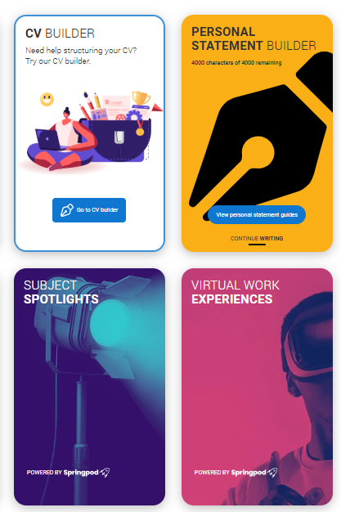
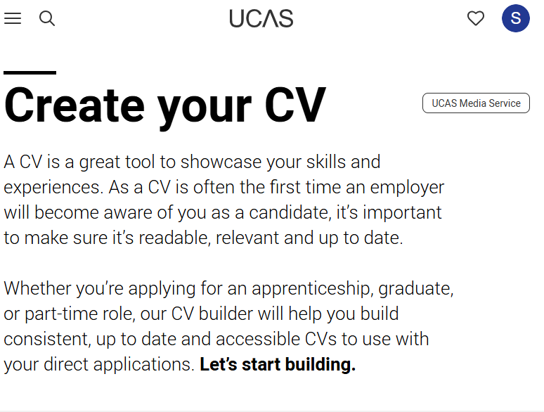
UCAS CV BUILDER
Notes:
Teachers notes:
Once students have created their UCAS account, get them to go onto their HUB
Then look for the tab shown above as CV Builder.
Lets now encourage students to start to create their own CV using the UCAS CV Builder.
Would suggest using a school email address so they can access it and verify this while they are in the classroom.

Slide 16
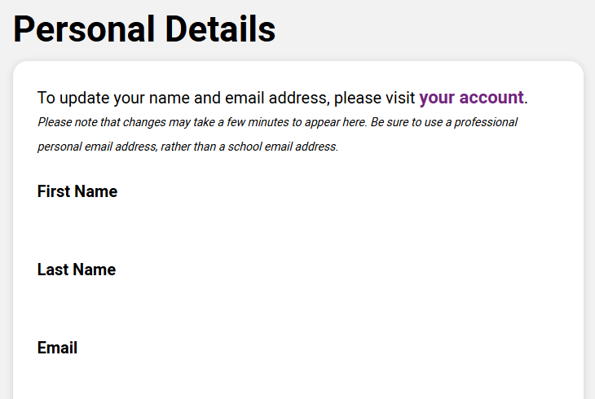
PERSONAL DETAILS
Notes:
Teachers notes:
Students to start including their personal details.
These details will stay private and only on their CV which they will share with relevant employers.
Ensure they take their time and accurately enter their information.

Slide 17
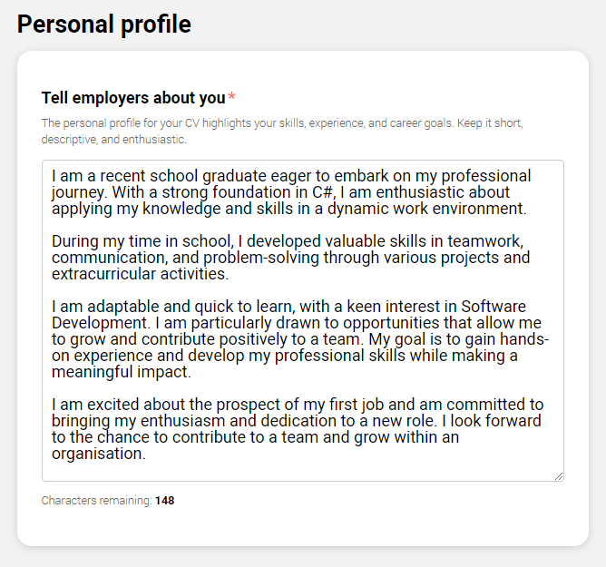
ALL ABOUT YOU
Notes:
Teachers notes:
This is the students chance to tell the employer about themselves.
The personal profile section gives students the opportunity to highlight their skills, experience, and career goals.
This section of the CV is free text with a 1000-character limit.
This is their introduction and first ‘sell’ of themselves to an employer. They may not finish this stage now (this could be another lesson to complete) but they can start and always return to it at a later stage to update.

Slide 18
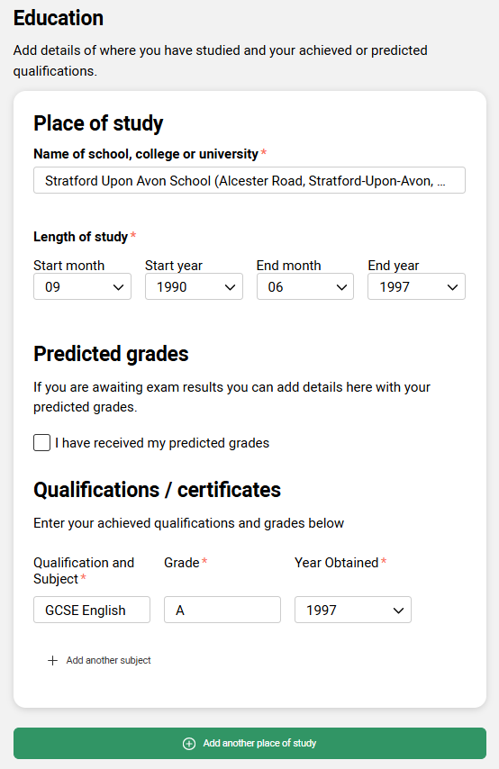
EDUCATION
Search for your school.
If it does not come up, you can write it in.
Specify if these are GCSE, A levels, or equivalent exams.
Add all your qualifications.
Notes:
Teachers notes:
Students can add each new establishment by adding another place of study.
If their place of study does not pre-populate – they can write it is a free text.
We would suggest they don’t include primary school – only include from secondary school onwards.
Students must specify where their grades are GCSE’s, A levels or equivalent.
If they do not have their grades already, they can use their predicted or MEG’s as a starting point

Slide 19
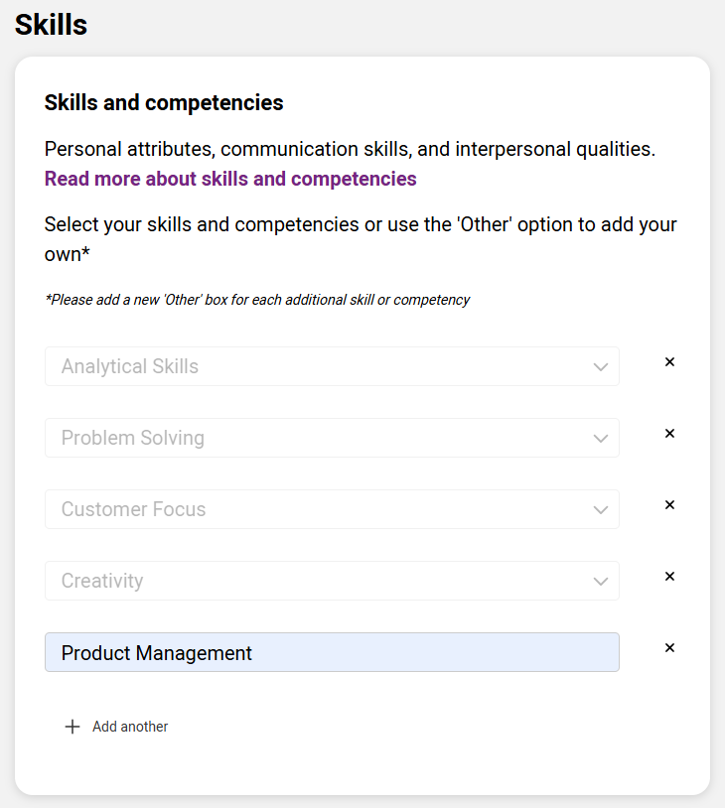
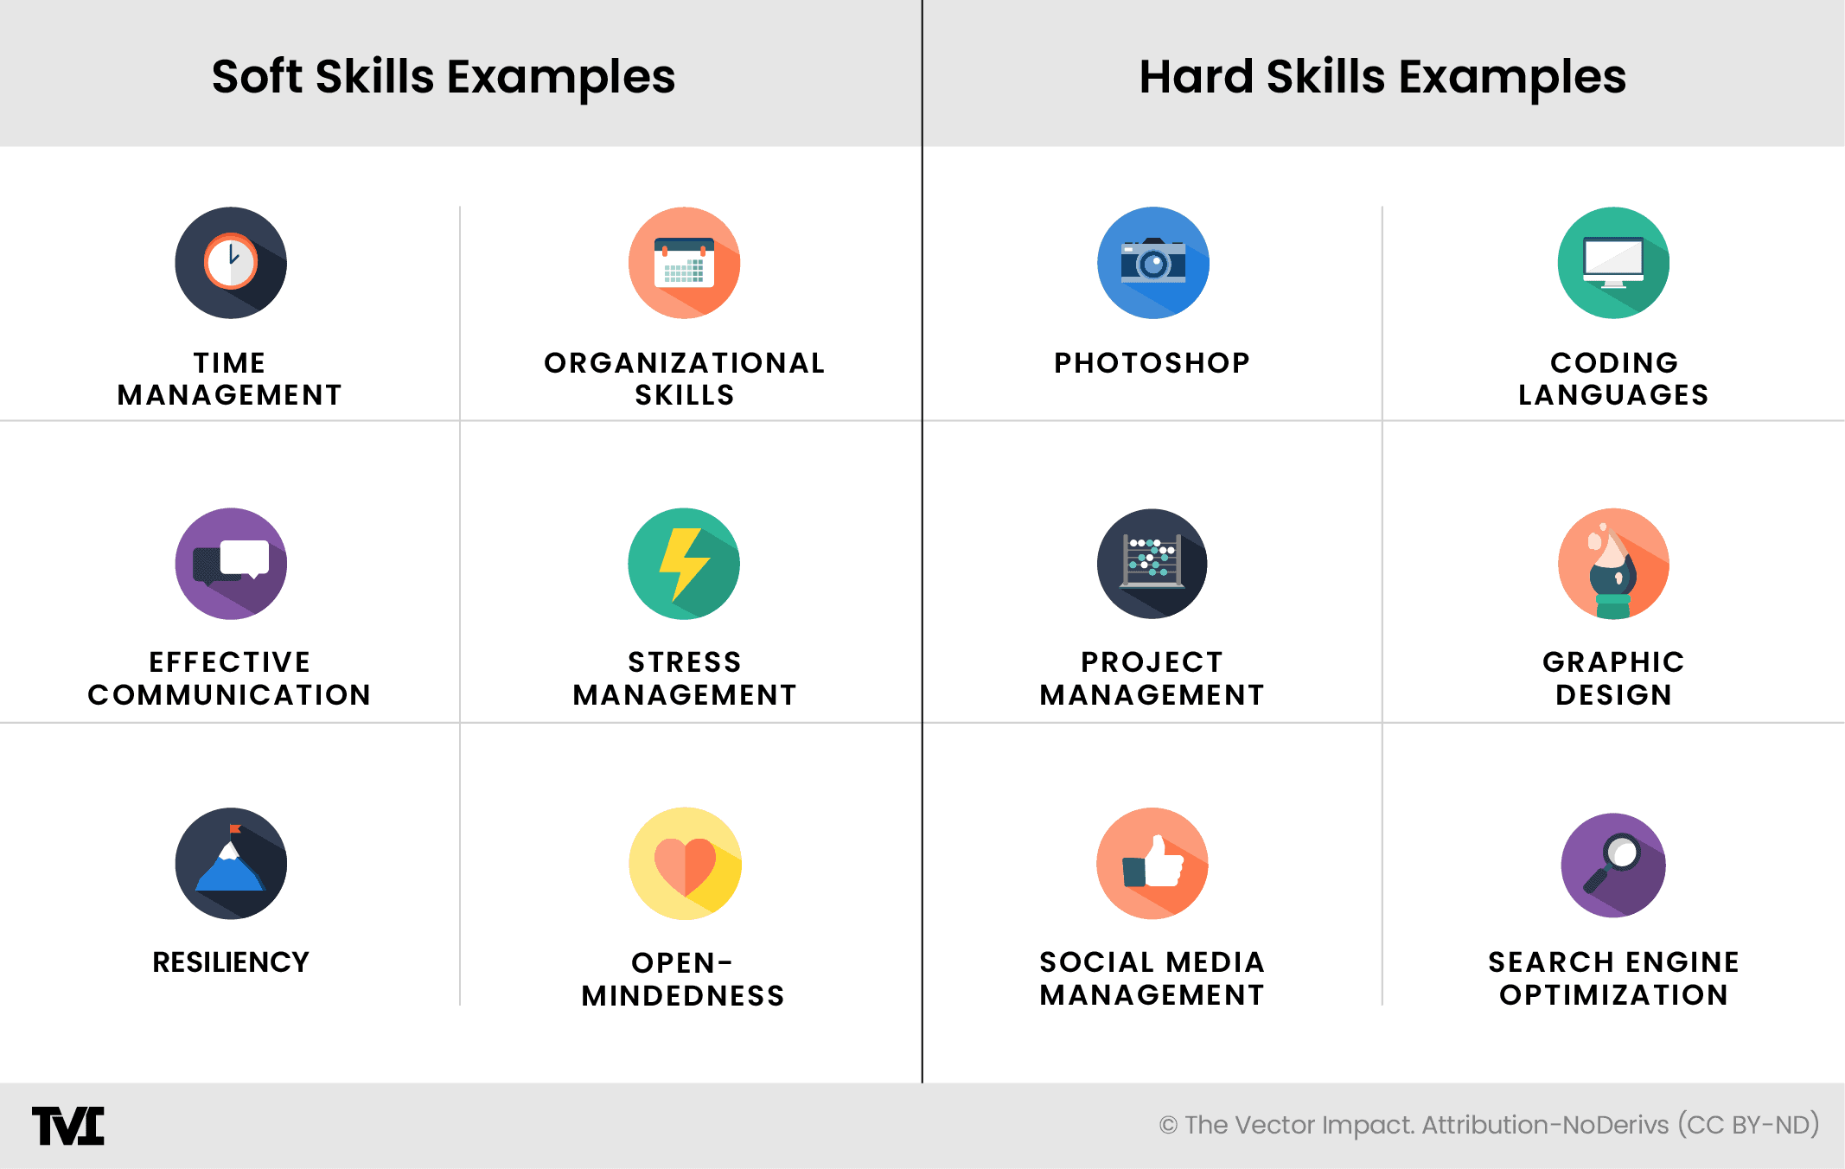
EDUCATION
Notes:
Teachers notes:
Get students to start to think about the skills they have used in their work experience, volunteering or achievements.
On the next slide there are more ideas and a link for further information about skills and competencies.

Slide 20
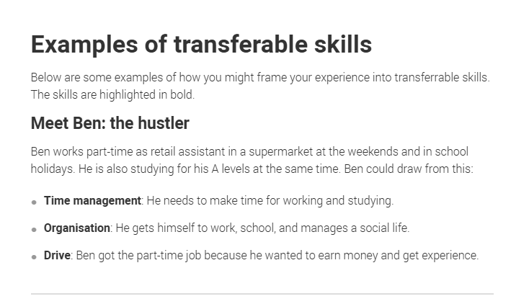
How do we know our skills and competencies?
PUBLIC
Notes:
Teachers notes:
Get students to click on the link: https://www.ucas.com/careers-advice/how-identify-your-transferable-skills and read through skills and competencies.
They can start to include some of these into their own CV.
This may be a section they come back to again at a later stage to spend more time adding in their skills.

Slide 21
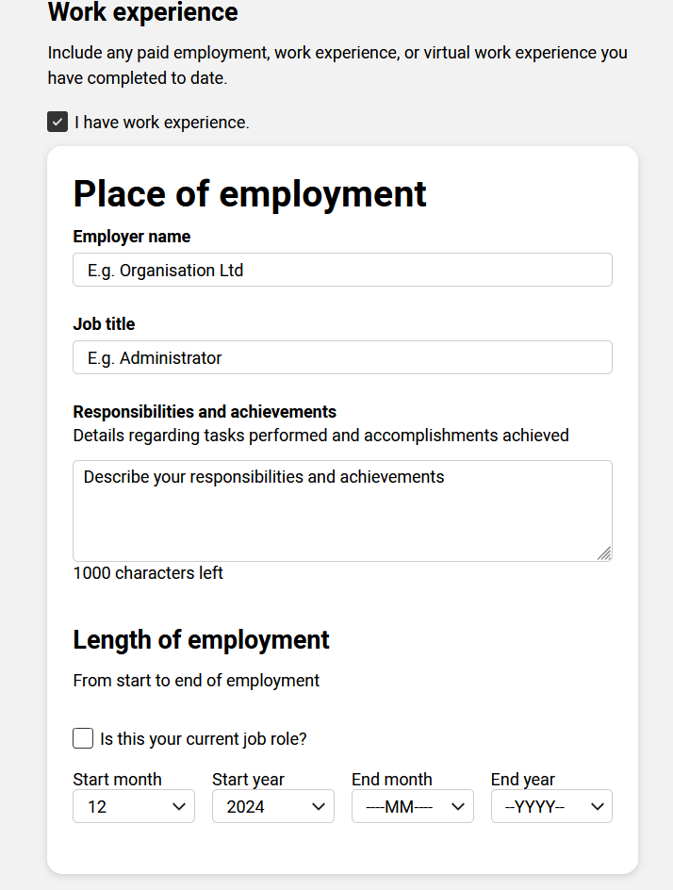
WORK EXPERIENCE
This may be part-time work.
Work experience you have done during school or online.
Doesn’t matter if one day or one month – include it.
If you don’t have work experience, you can leave this blank.
Notes:
Teachers notes:
If students have work experience, they can check the box and add details of any paid employment.
If they have multiples of work experience, they can click + Add another place of work to enter more.

Slide 22

What is work experience?
Some examples you may not have considered:
Babysitting
Retail work
Part time job
Sports coaching
Hospitality work
Helping with a family business
Holiday work
Virtual work experience programmes
PUBLIC
Notes:
Teachers notes:
Ensure students are thinking about ALL the things they do.
They may not think of their babysitting job as work experience – but it is!
Link this back to what skills and competencies they use for these roles (responsibility, time keeping, confidence).
UCAS have virtual work experience opportunities in the Hub they can try out and add to their profile. It ALL counts.
https://www.ucas.com/careers-advice/virtual-work-experiences

Slide 23
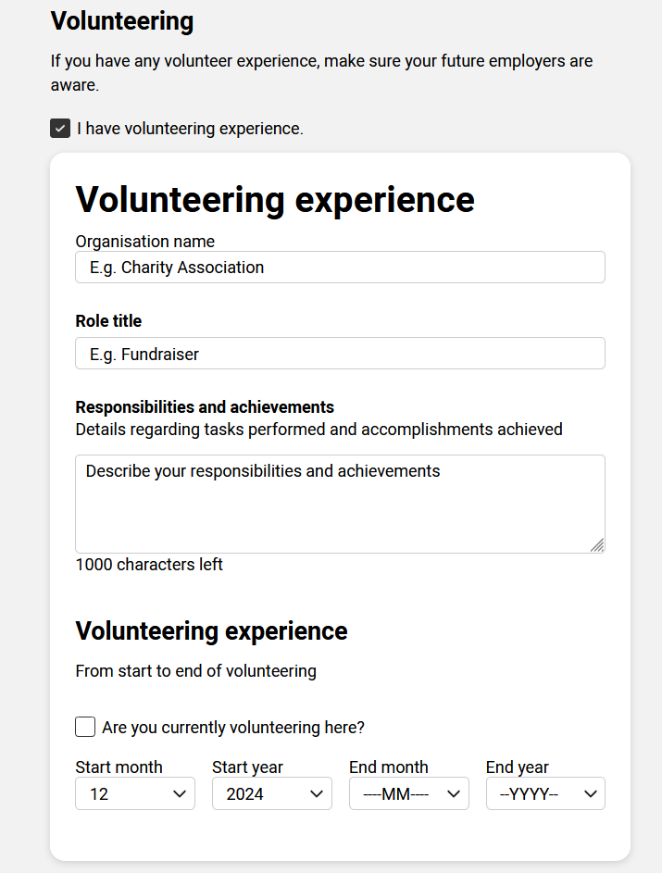
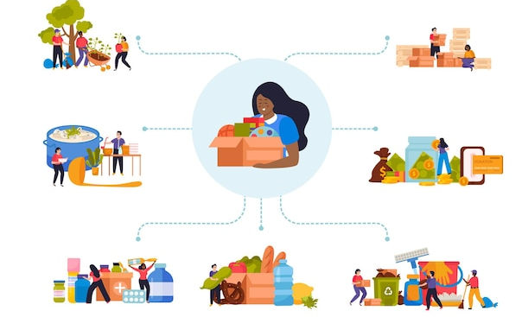
volunteering
Notes:
Teachers notes:
If students have volunteering experience, they can check the box and add details of this.
If they have multiples of volunteer experience, they can click + Add another volunteering experience to enter more.

Slide 24
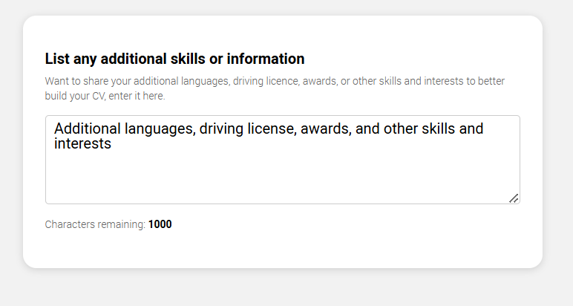
Additional information
Add any extra qualifications you have (First Aid, Lifeguarding)
Any awards you have received
Any other skills
Languages
Achievements at school or college; head girl, prefect.
Clubs, groups or sporting achievements.
Notes:
Teachers notes:
If students want to add any additional information to their CV, such as languages or awards they can do so here.
This section of the CV is free text with a 1000-character limit.

Slide 25
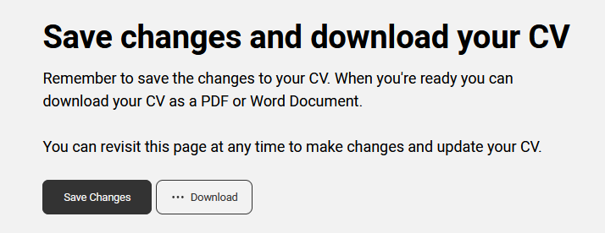
And Finally….save your work
Notes:
Teachers notes:
Get students to save changes; the CV builder DOES NOT auto save so they need to save this on completion.
They can continue to revisit their page and update their CV as many times as they would like to.
Each time saving a copy for their own files if required.

Slide 26
recap
What are three pieces of information you would include in a CV?
Name two things you would write in your own skills and competencies.
One good reason a CV is important.
PUBLIC
Notes:
Teacher’s notes:
As students leave the ask them to list the key elements from the lesson.
Are there parts of their CV’s they can add to and improve on?
Can they see the purpose of having a good CV?
The purpose of this final task is to encourage them to reflect on the information they’ve been given in class.

