Slide 1

The state of play
A round-up of the key takeaways from the conference

Slide 2


What have we heard?
Ensure all that could benefit from Higher Education, do.
Make data and reporting widely accessible so advisers can focus on supporting student choice.
Adviser communities sharing ideas and best practise can overcome future challenges together.
Pathways into higher education can be as squiggly as careers – bring more transparency for the benefit of all.

Slide 3

What is important to advisers?

Slide 4
The ucas ‘funnel’
750k
(-410k)
700k
(-50k)
560k
(-140k)
1.16m Register on the UCAS Hub
Start their higher education journey
Notes:
1.16m students register on the Hub every year.
560k make successful applications.
UCAS is focused on supporting teachers and advisers to support all students to make informed decisions about their future.

Slide 5
1 in 5
One in five students couldn’t study a degree subject that interested them because they
didn’t have the right subjects to progress
(UCAS ‘Where next?’ report).
Notes:
https://www.ucas.com/data-and-analysis/undergraduate-statistics-and-reports/ucas-reports#where-next-what-influences-the-choices-school-leavers-make%E2%80%93-april-2021

Slide 6
37%
By age 31, graduates typically earn 37% more, and the gap is slightly higher (38%) for those from economically deprived areas
(Universities UK)

Slide 7

tools to support students in the hub
Subject Tasters
Industry and Subject Guides
Virtual Work Experience
CV Builder
Chat To Students
Historical Entry Grades Tool

Slide 8
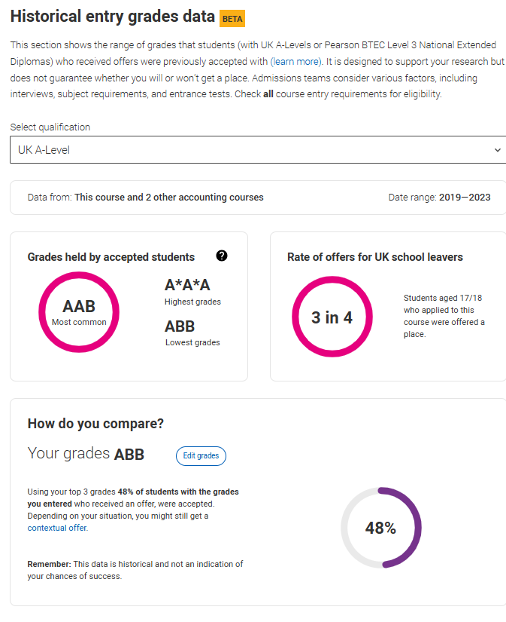
TWO million uses of historical entry grades tool
Notes:
https://www.ucas.com/advisers/help-and-training/guides-resources-and-training/historical-entry-grades-adviser-guide

Slide 9
2026 dates and deadlines
14 January 2026 is the equal consideration deadline for applications to courses starting in 2026. The reject by default deadline is 13 May 2026.
The Adviser Portal opens on 6 May to prepare for 2026 applications which open on 13 May 2025.
14
UCAS is reintroducing the end of March advisory deadline to encourage earlier decision-making.
UCAS will send out dates and deadlines for 2027 entry before the end of this year.

Slide 10
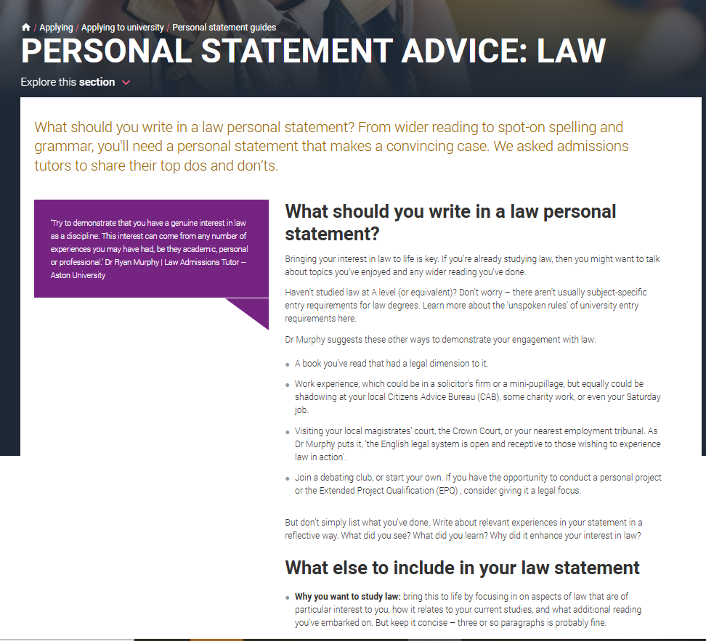


New personal statements for 2026 entry
Access all the resources available for colleagues, parents and students..
Notes:
https://www.ucas.com/applying/applying-university/personal-statement-guides

Slide 11
Preparing for results day
The biggest cohort who use Clearing choose to use it - 42, 320 Decline My Place.
Adviser Guidance for Confirmation and Clearing 2025 released in March.
We want to hear how to shape the future of Clearing – UK roadshows coming soon!

Slide 12
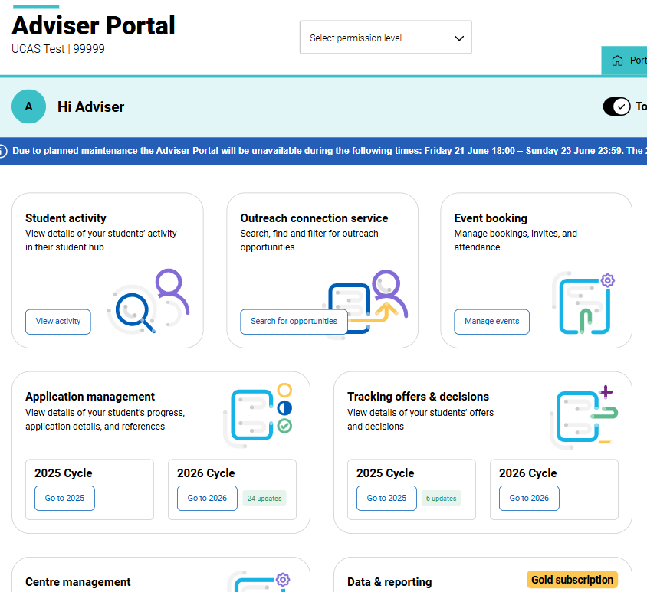
AP
Coming soon
More insight and visibility into your student research journey

Slide 13


Insight Reports
In the BIG UCAS Data presentation, we count down the top ten data insights requested by teachers and advisers, including the key trends for 2025.
UCAS’ report, ‘Where Next? Who applies for Level 4 and 5 qualifications?’ in partnership with the Gatsby Charitable Foundation, explores the behaviour and experiences of Levels 4 and 5 qualification applicants.

Slide 14
next steps: webinars and videos to share conference insight online

