Slide 1

Applying through
UCAS
For courses starting in 2026
Updated: September 2025
Public

Slide 2

Using this deck
This deck supports the 2026 application cycle, with screenshots you can use in your own classroom resources.
Changes to the Hub, application and tracking process, help text, and guidance may occur throughout the cycle to improve accessibility and navigation.
Screenshots will be updated periodically when changes occur; refer to title slide date stamp.
For more help with undergraduate applications, visit filling in the undergraduate application on ucas.com.
Images are for desktop/laptop users; mobile layouts may differ.
Public

Slide 3
Registering for an account
Public

Slide 4

Registering for an account
Head to ucas.com and select Sign in.
Public

Slide 5
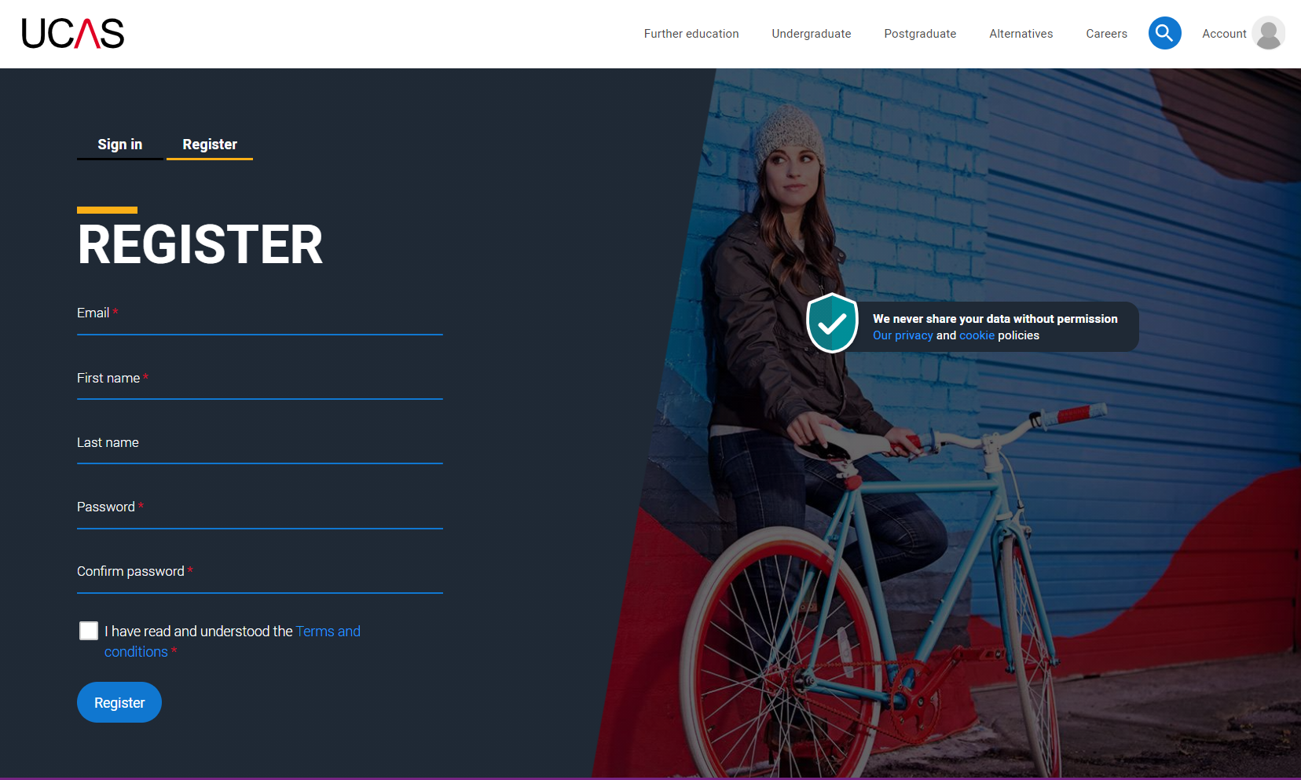
Registering for an account
Complete the short form. Make sure the password is memorable.
We recommend you use a personal email address so you always have access to updates.
Public
Notes:
If you forget your password, use 'Forgot password' to reset it without re-registering.

Slide 6
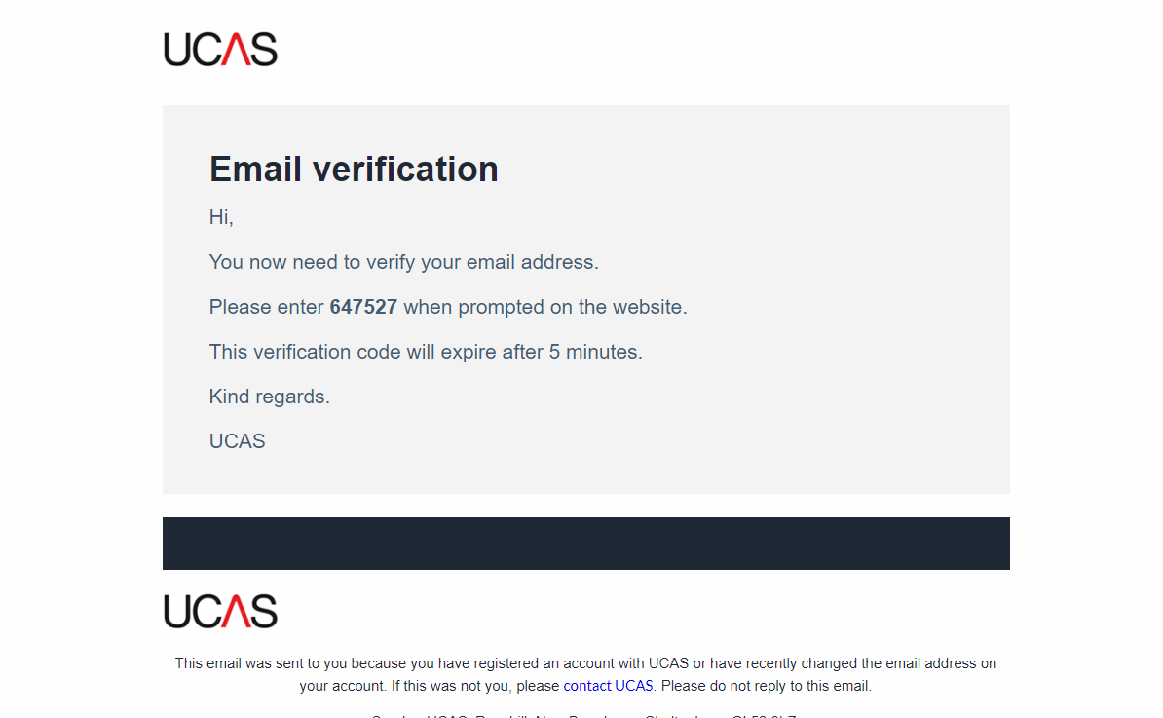
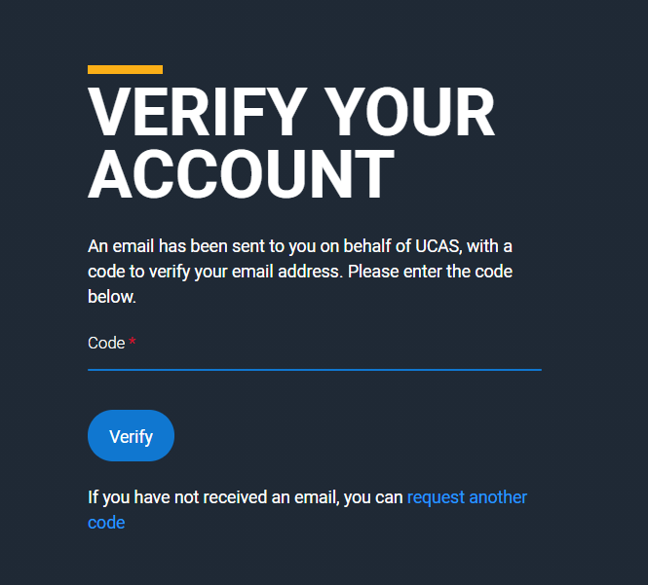
Registering for an account
We’ll email you a code to verify your email address, so we know we’ve got the right details.
Public

Slide 7
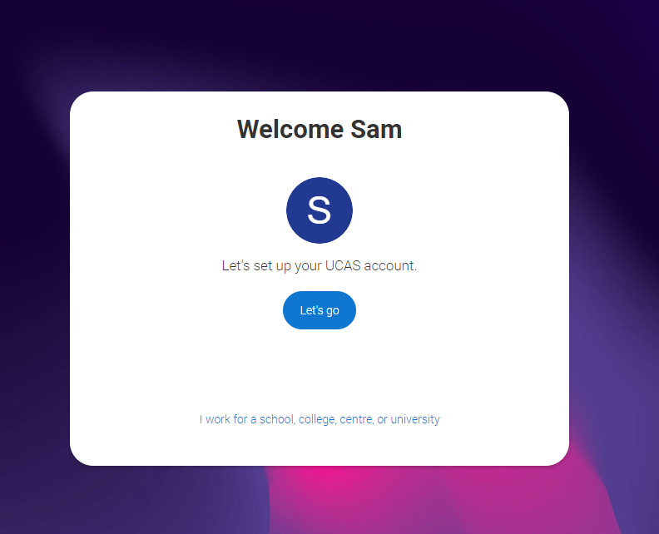
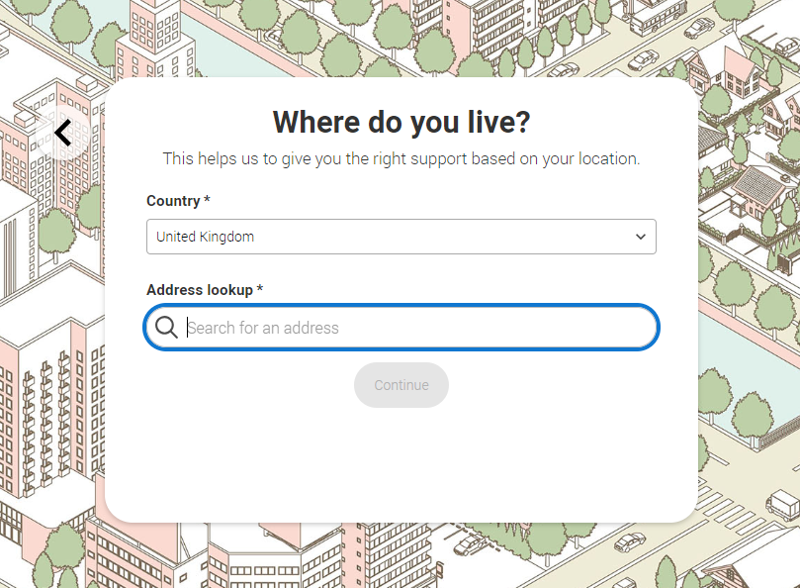
Registering for an account
Once you’ve registered, you’re ready to get started.
We’ll ask you a few questions like where you live so we can tailor the information you see.
Public

Slide 8
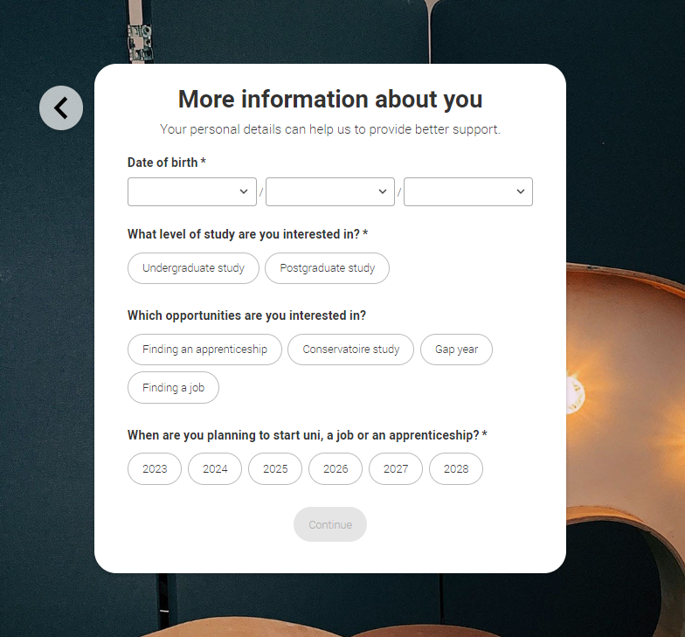
Registering for an account
We’ll ask you a few questions about yourself; your level of study is Undergraduate if you’re still at school/college.
You can choose to get information on apprenticeships, conservatoires, finding a job or gap years.
We also want to know when you’re interested in starting a course, so that we show you relevant courses in your search results. You can change this at any time, and you can use the Hub before you are looking to apply.
Public

Slide 9
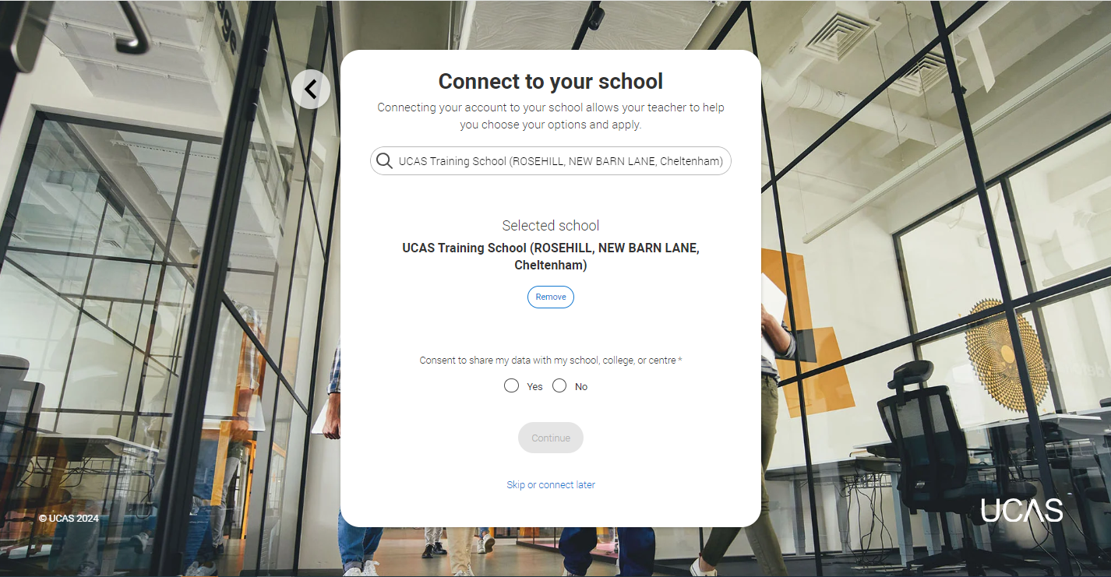
Registering for an account
If you want to you can connect to your school or college. This is so UCAS can share your UCAS Hub activity with your school, college, or centre, so they can support you.
You’ll also need to enter your school or college buzzword when you start your application so they can support you with applying.
Public

Slide 10
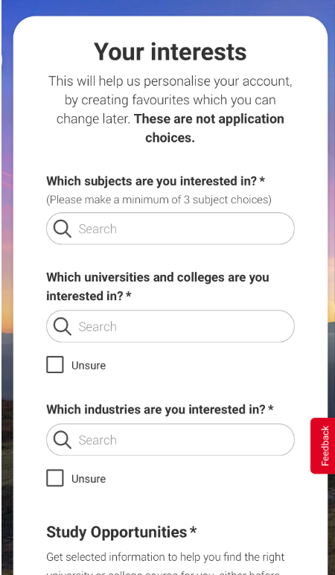
Registering for an account
Choose if you want to get tailored information about uni, college and apprenticeship options.
Select the subjects, locations or industries that you are interested in – you can change these at any time in your preferences.
Public

Slide 11
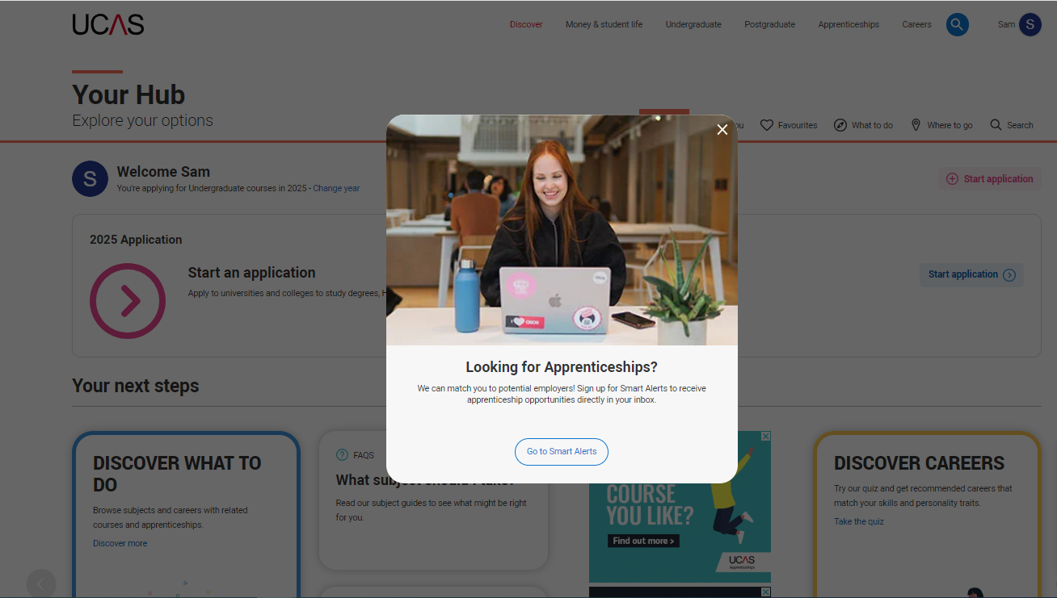
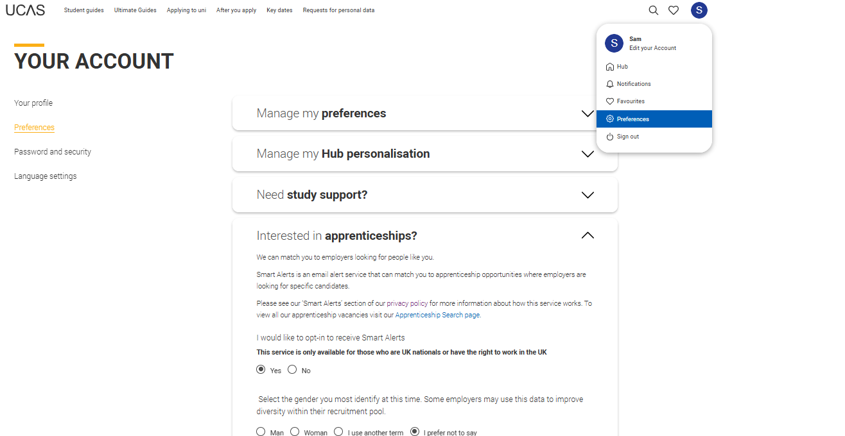
Looking for an apprenticeship
If you’re interested in apprenticeship opportunities, we can match you to potential employers if you sign up to smart alerts.
You’ll get these directly to your inbox. It’s totally optional.
Public

Slide 12
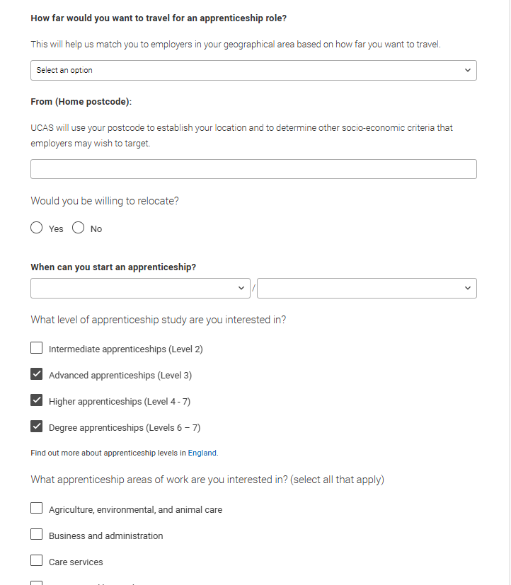
Smart alerts
There are a few questions to answer to make sure the information you’re sent is useful.
You can update this at any time in your ‘Preferences’.
Public

Slide 13
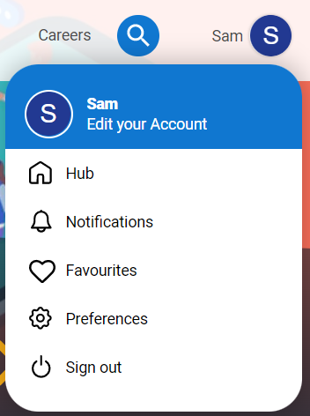
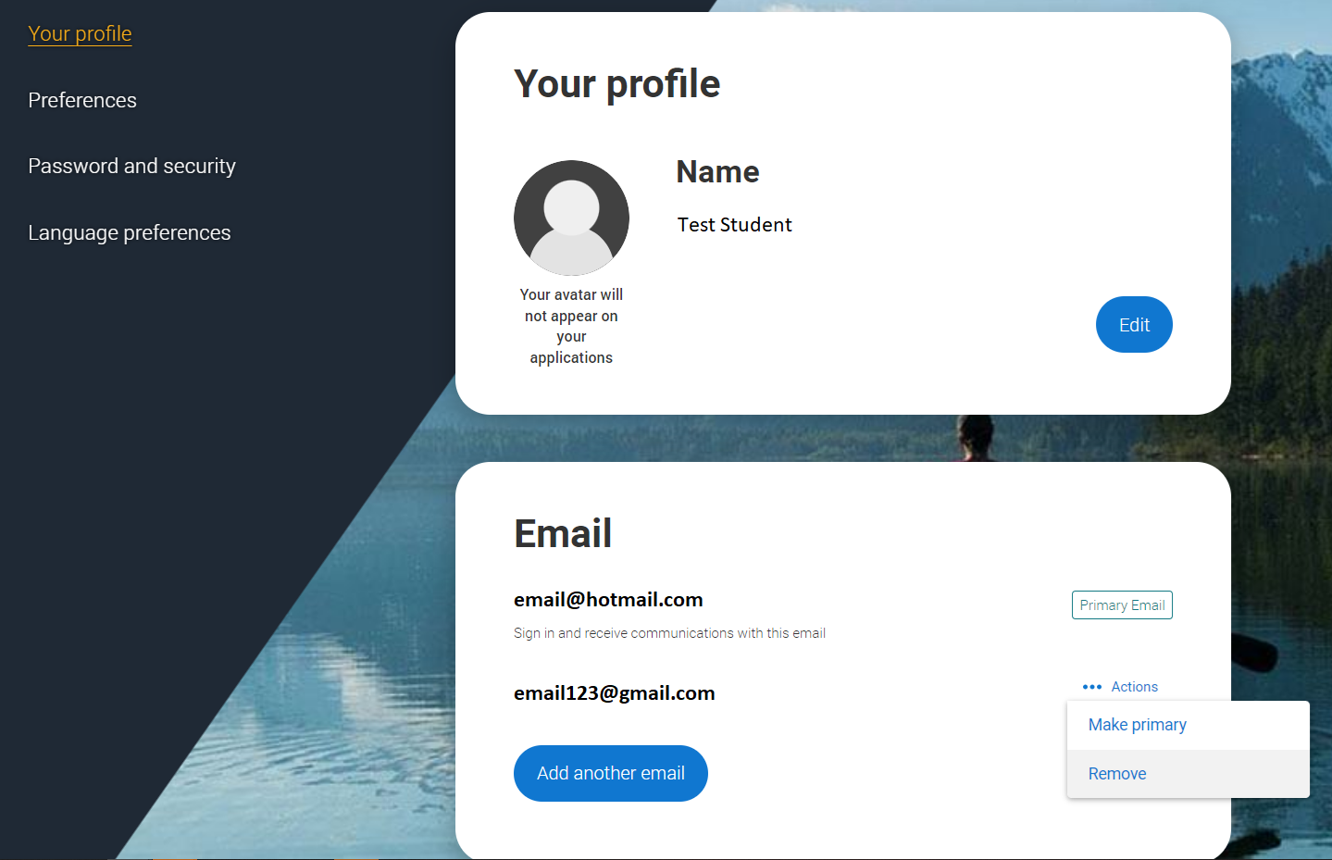
Your email
It’s important your contact details are kept up to date throughout your application.
We recommend using a personal email address as your primary email, rather than a school/college one, so that you have access to it throughout your application journey.
To update your email address, go to ‘Edit your account’ from drop-down, where you can change your email.
Public

Slide 14
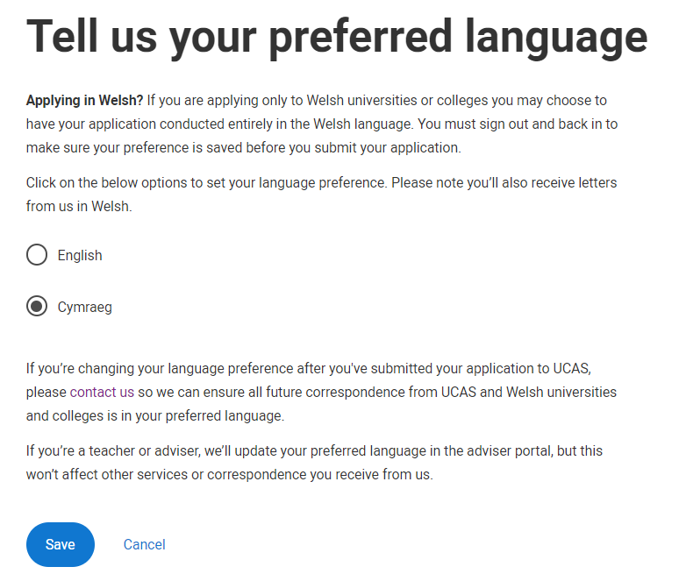
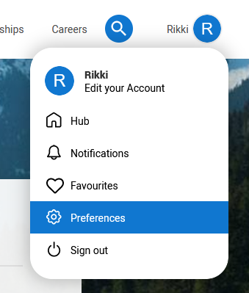
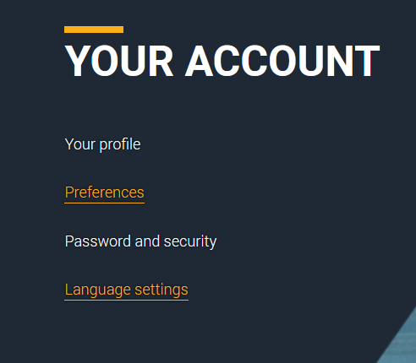
Welsh language preferences
If you would prefer to view your application, along with the help text and receive communications from us in Welsh, you can update your language preferences. The application needs to be completed in English.
Public

Slide 15
Starting your application
Public

Slide 16
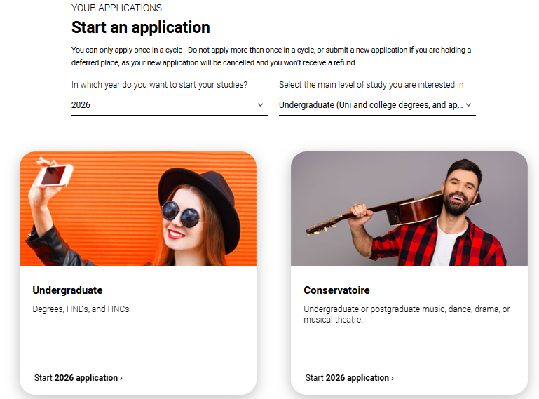
Starting your application
Choose the year you want to start your studies, level of study (it's Undergraduate if you are still at school/college) and type of application you wish to make.
Make sure you choose 2026 if you want to start next year, including if you want to defer entry.
Public

Slide 17
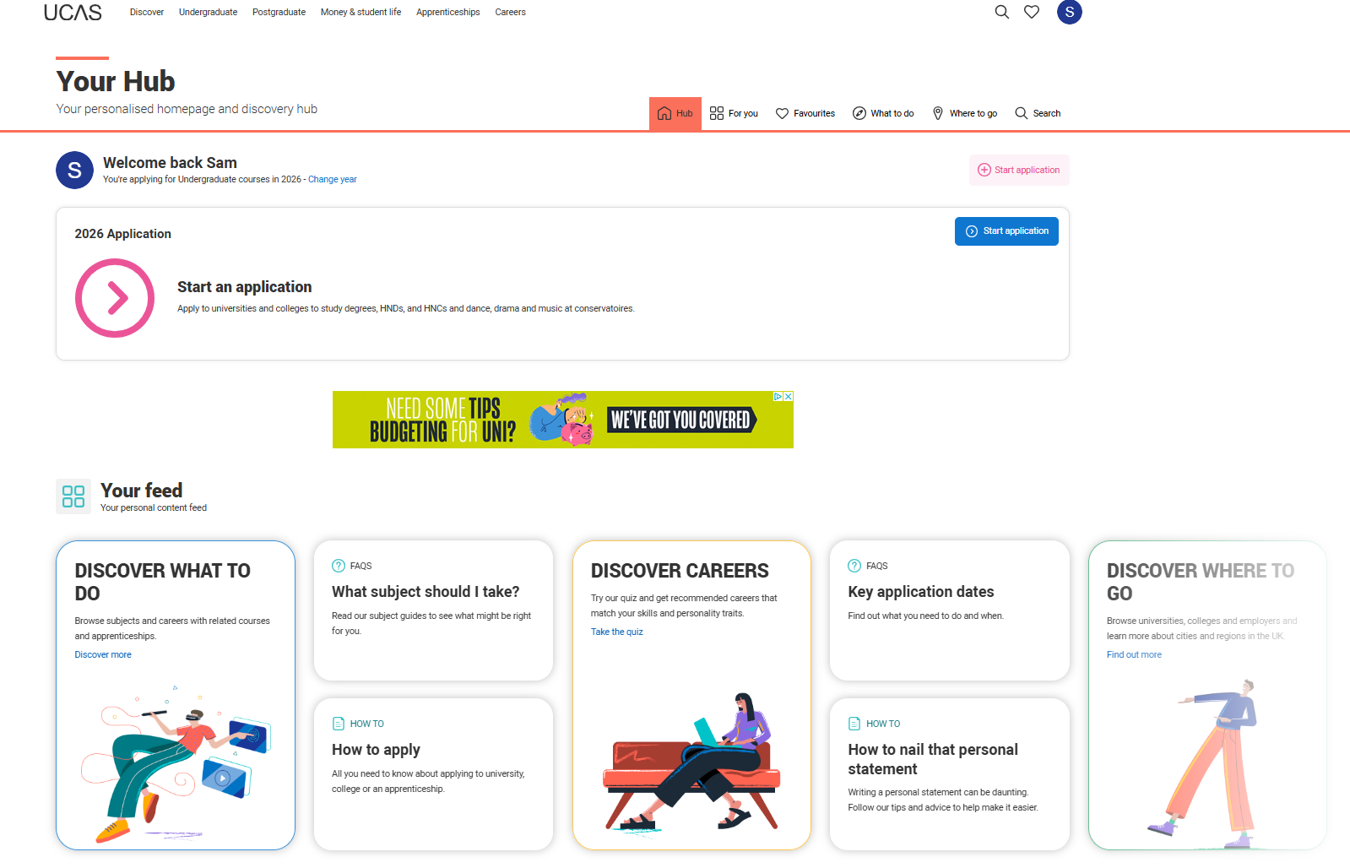
Public

Slide 18
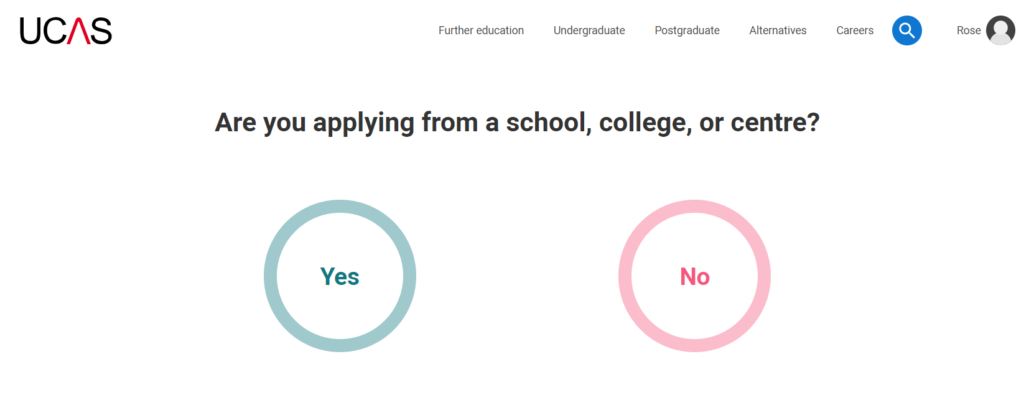
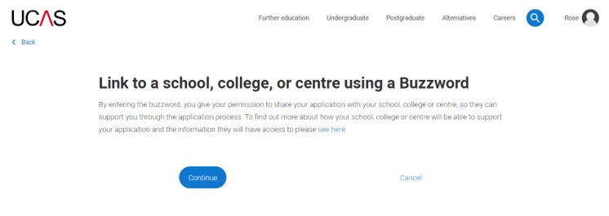
Linking to your school, college or centre
If you're applying with the help of your school, college or centre then select ‘Yes’.
You will then need to enter the Buzzword.
The Buzzword is given to you by your school, college or centre.
Public

Slide 19
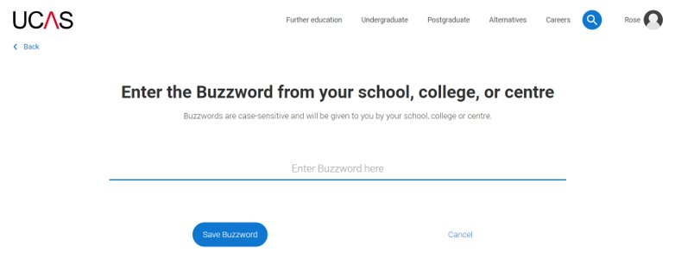
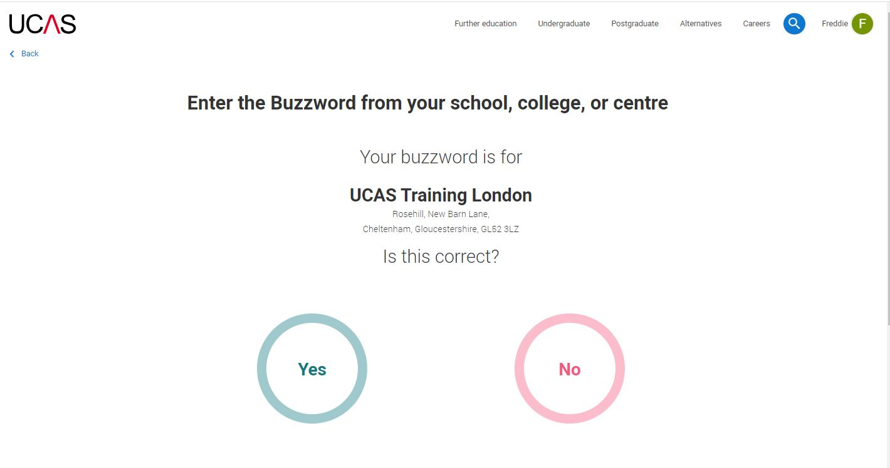
Linking to your school, college or centre
Enter the buzzword, and confirm the details are correct.
This will link your application to your school or college, so they can track your progress and provide support, including adding your reference.
Public

Slide 20
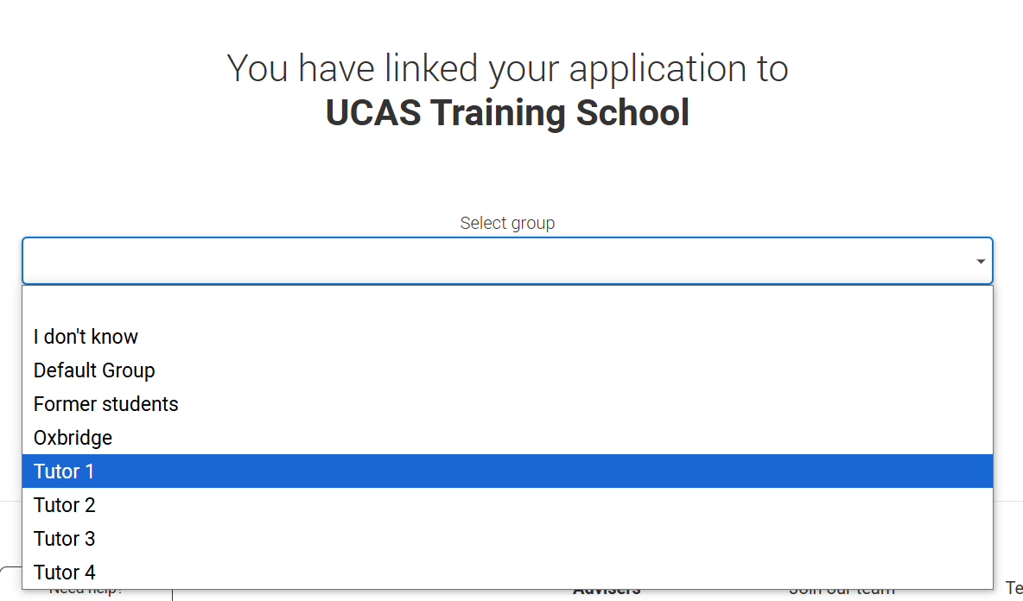
Linking to your school, college or centre
Once your application has been linked, you can then select a group (if this has been set up by your school or college).
Every school and college has a ‘Default Group’.
Public

Slide 21
Application overview
Public

Slide 22
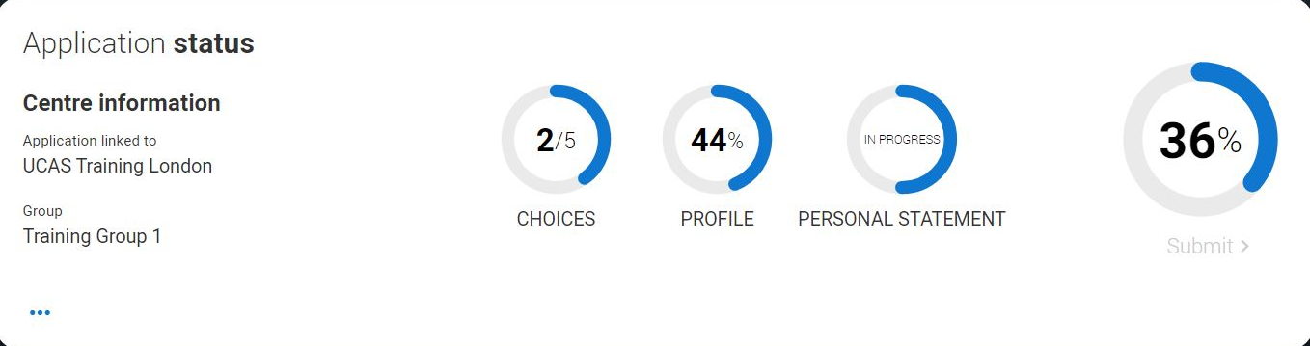
Application overview
Your ‘Application status’ helps track your progress.
The percentage complete updates each time you mark a section as complete.
You don’t need to complete the application straight away; log in and out at any time until you're finished.
Public

Slide 23
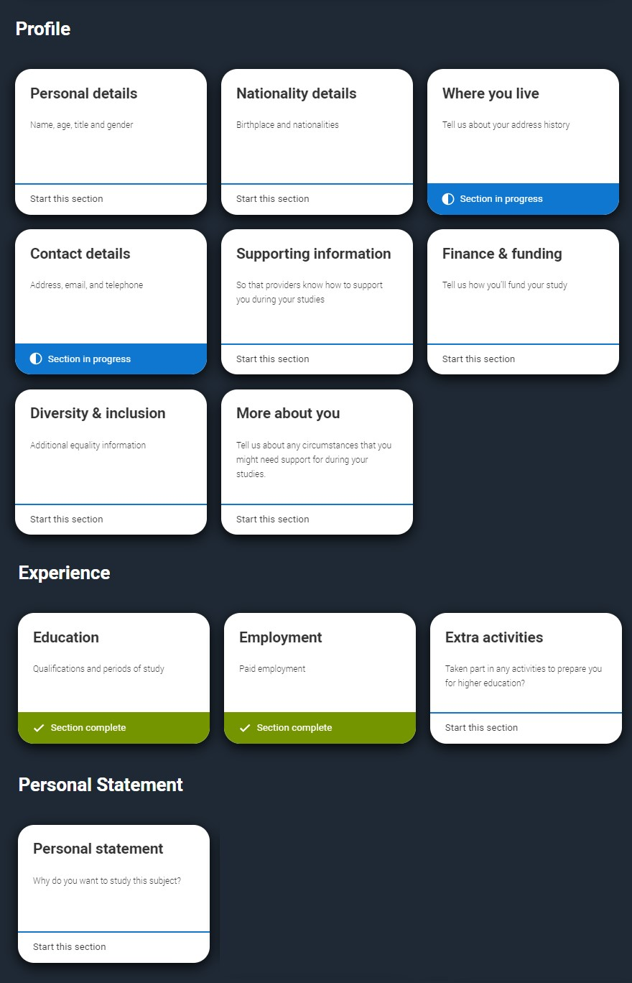
Application overview
The application form is responsive to make it easier to complete.
Once you’ve completed ‘Where you live’ if your permanent residence is in the UK, you’ll also see the ‘Diversity and inclusion’ and ‘Extra activities’ sections to complete.
All sections must be marked as ‘Complete’ to send to your school or college that you may be linked to for review. You must complete all mandatory questions to mark a section as complete (they have a *).
Public

Slide 24
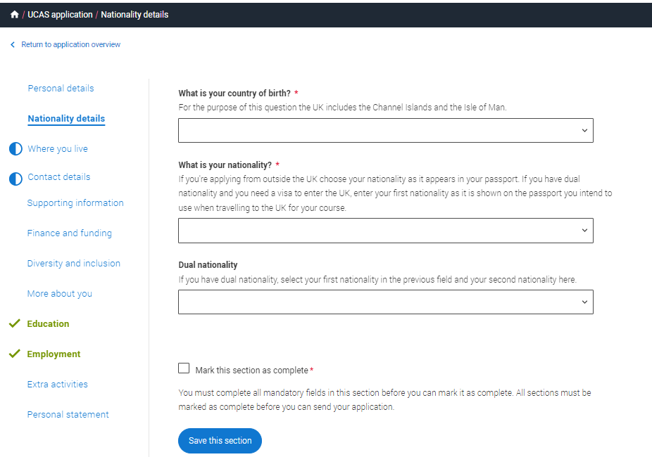
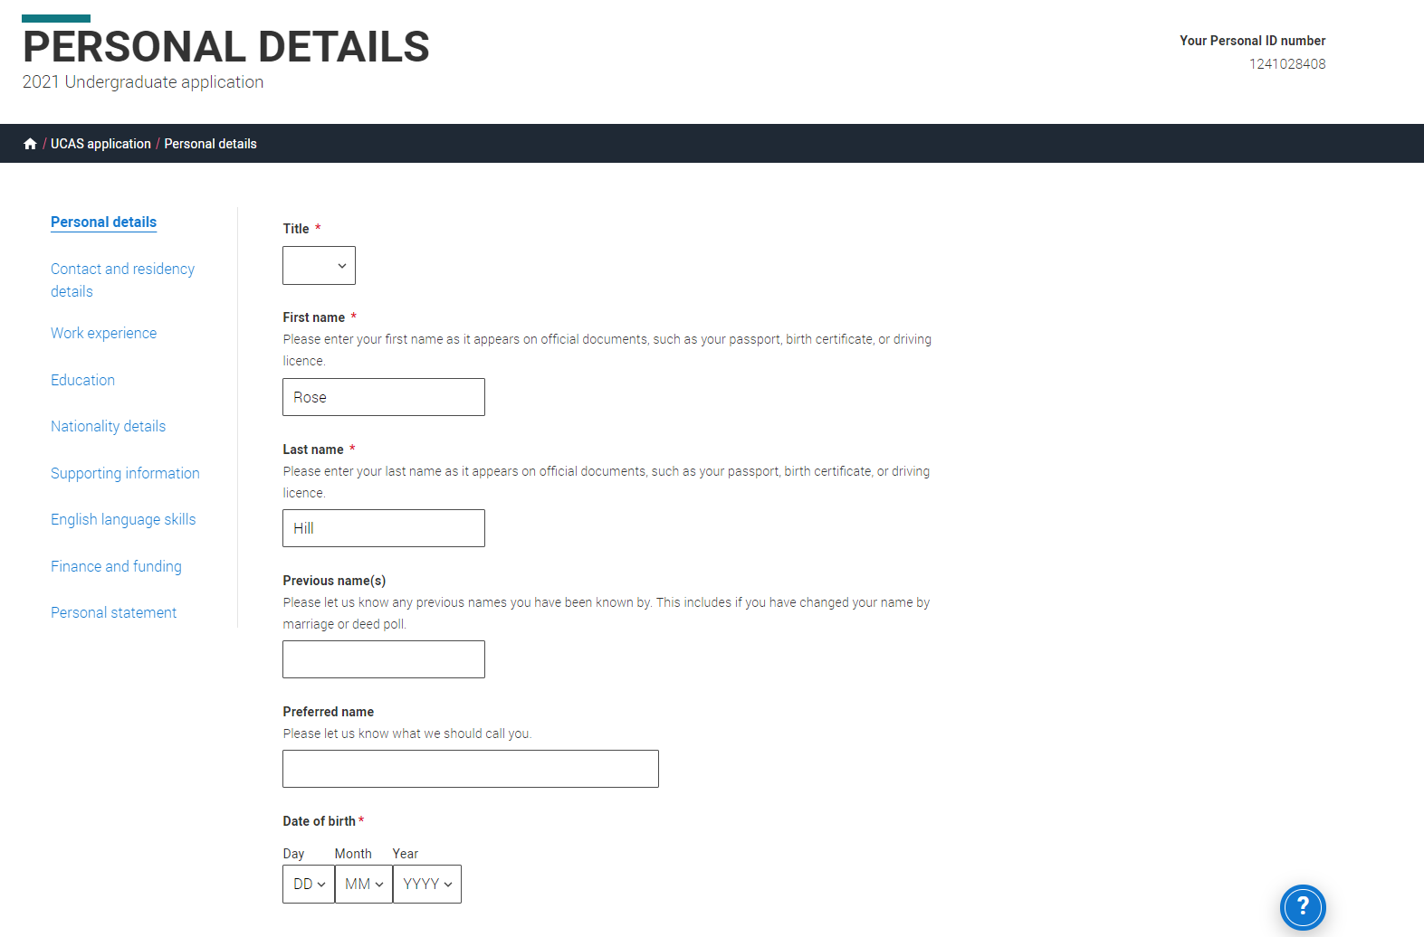
Application overview
The list on the left of each section will show which sections are completed (with a tick), which are in progress (with a half-moon), and which have yet to be started (no icon).
Click on the throughout for help text to provide advice about what to put.
Public

Slide 25
Personal details
Public

Slide 26
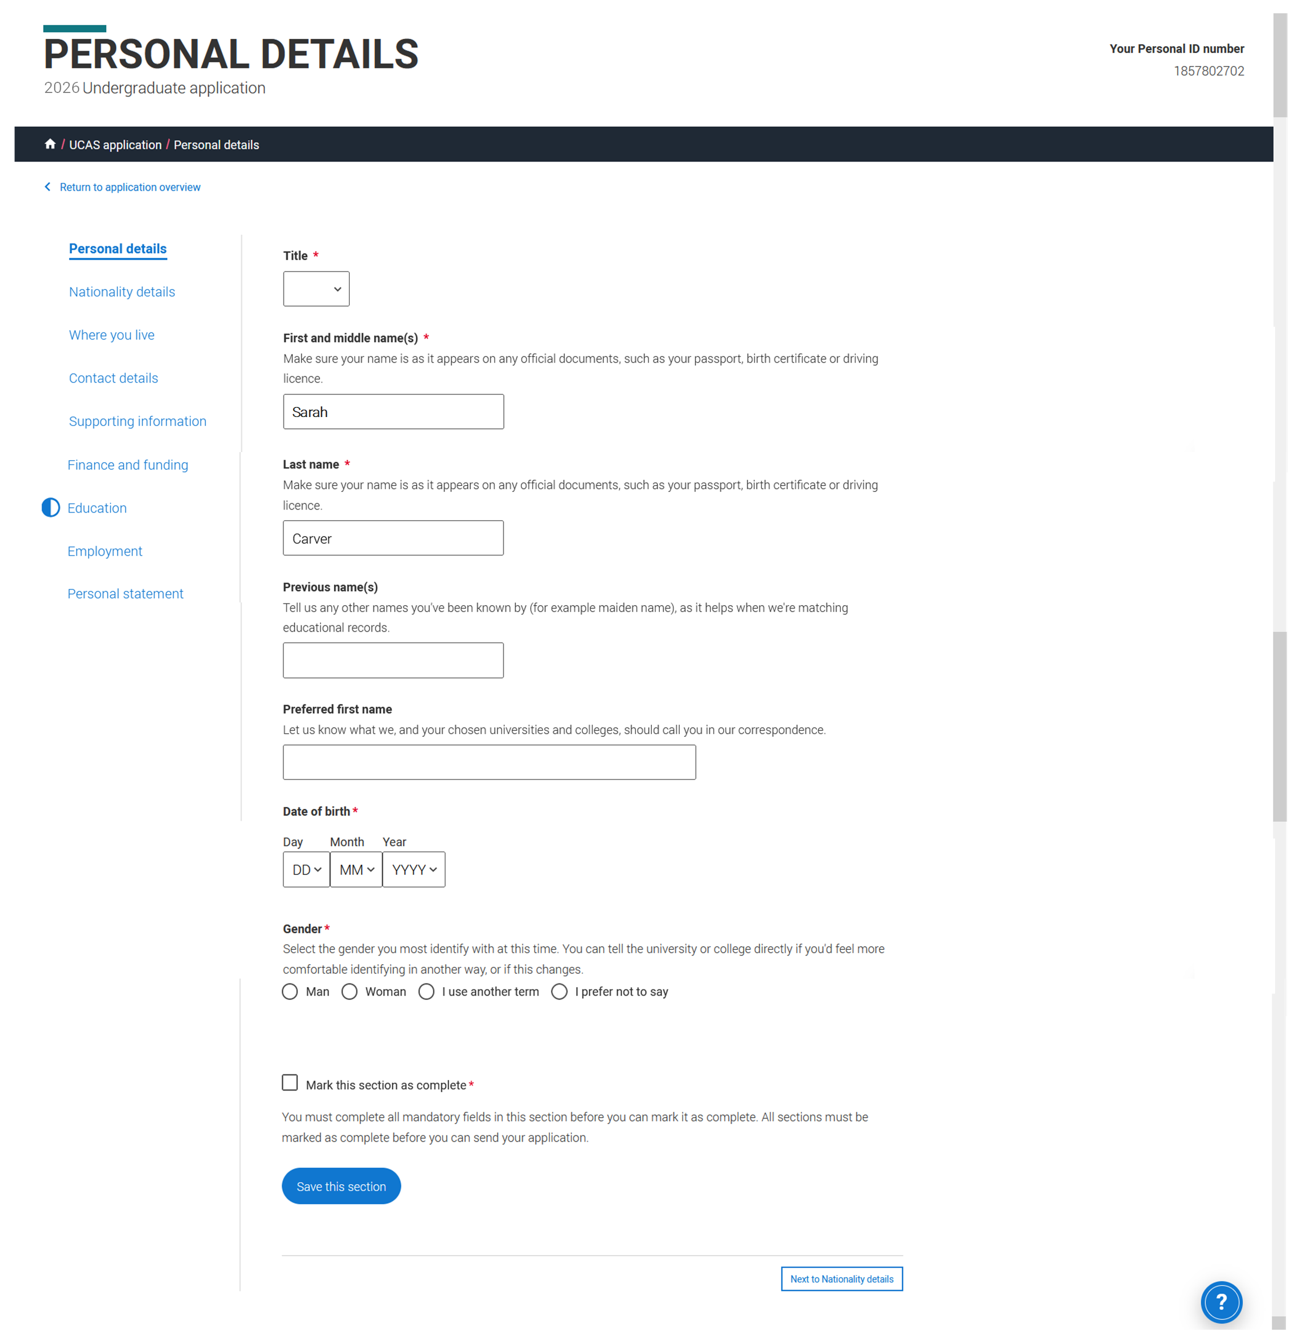
Personal details
Your name should already show, but you'll need to add your title and complete the other mandatory fields (marked with a *).
Once you’ve completed a section you must remember to mark the section as complete and save it at the bottom of each page.
Public

Slide 27
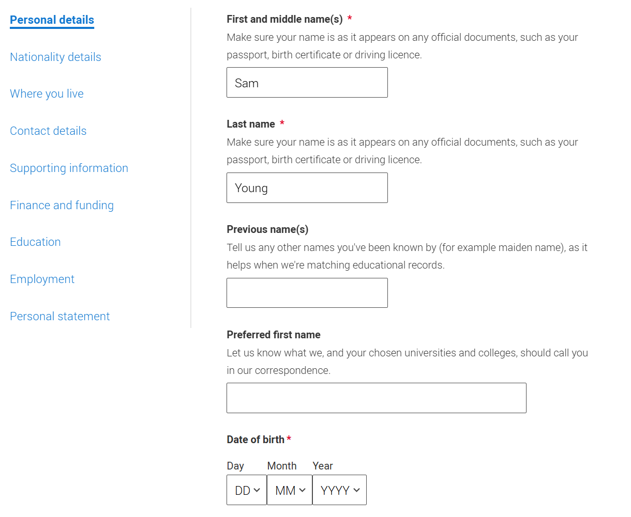
Personal details
Make sure your name and date of birth is entered as it appears on any official documents (e.g. passport, birth certificate).
Use preferred name to let us know what we should call you in our communications.
Public

Slide 28
Nationality details
Public

Slide 29
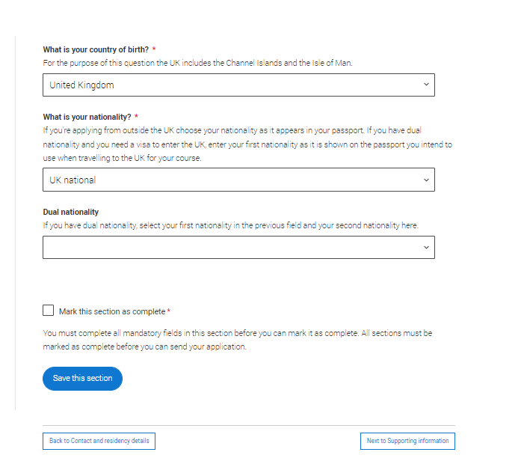
Nationality details
Your nationality is associated with the country that would issue you a passport for international travel. If you don't have a passport, it is usually the country in which you were born.
This is not your ethnicity. Ethnicity refers to your cultural identity and ancestry. UK resident applicants are asked about ethnicity in the diversity and inclusion section.
Additional questions may appear based on the information you provide.
Public
Notes:
Some courses are only available to students with UK nationality. The information you provide will:
determine your eligibility,
determine the fees you need to pay,
help the university or college to assist you with the visa application process, if required.
If any of this information changes after you have applied, contact your chosen universities and colleges immediately.

Slide 30
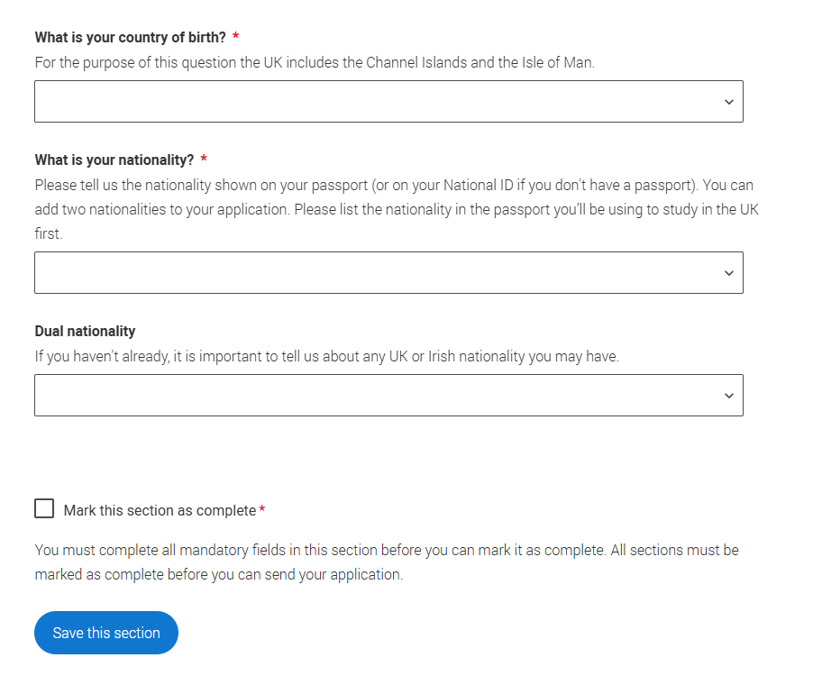
Nationality details
You can add two nationalities, list the nationality of the passport you’ll be using to travel to study first. Include any UK or Irish nationality.
This helps universities determine your fee status and assist with visa applications. Relevant fields will appear based on your answers.
Select to see our help text with advice about this.
Public
Notes:
Please check that the names you have provided in the Personal details section match what’s on your passport.
If you have more than one passport, give the details of the passport you intend to use to enter the UK for the purpose of studying your course.

Slide 31
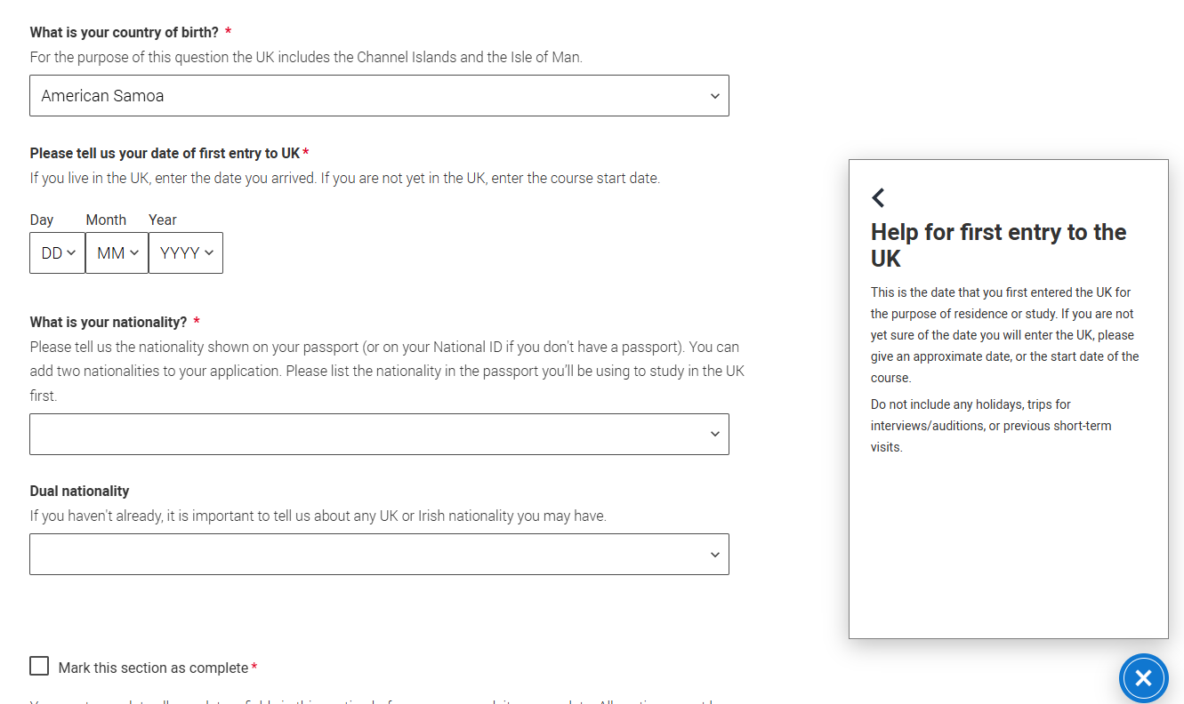
Nationality details
Remember, everything with a red asterisk must be answered.
Don’t forget to read our help text. Just select to bring up advice on how to complete the questions.
Public

Slide 32
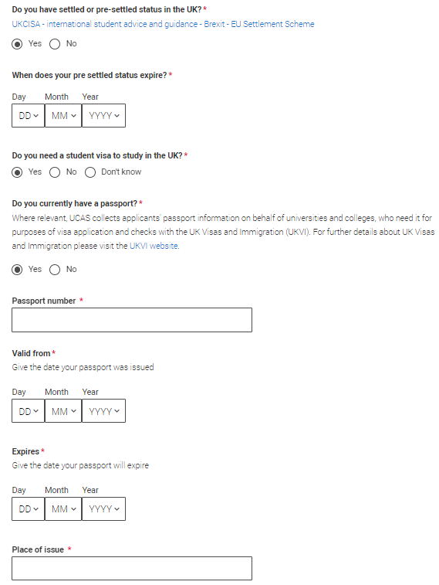
Nationality details
If you select that you have pre-settled status you will be asked for an expiry date.
If you select that you will need a visa, you’ll also be asked for your passport details.
If you have a passport, we ask you for your passport number, valid from and expiry dates; and place of issue.
Select to see our help text with advice about this.
Public
Notes:
Some courses are only available to students with UK nationality. The information you provide will:
determine your eligibility,
determine the fees you need to pay,
help the university or college to assist you with the visa application process, if required.
Please check that the names you have provided in the Personal details section match what’s on your passport.
If any of this information changes after you have applied, contact your chosen universities and colleges immediately.

Slide 33
Where you live
Public

Slide 34
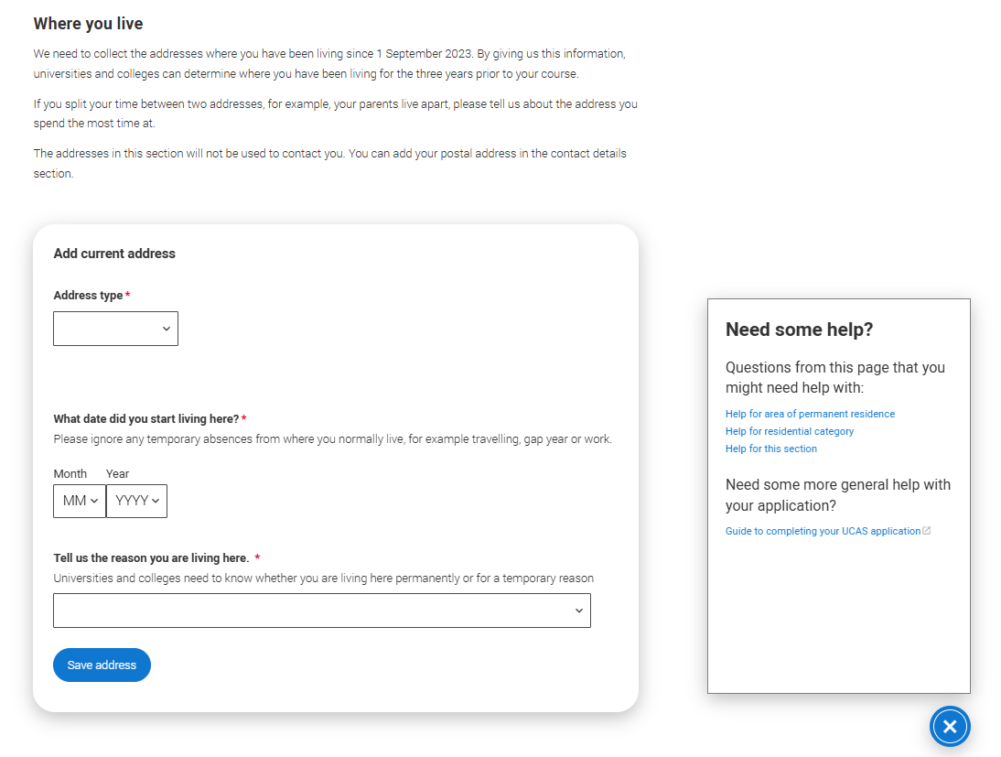
Where you live
You must add three years of residency history between 1 September 2023 and 1 September 2026.
Your current address should be added first, once this has been added it can only be edited not deleted.
Then add your previous addresses until September 2023.
Select to see our help text with advice about to help with this section.
Public

Slide 35
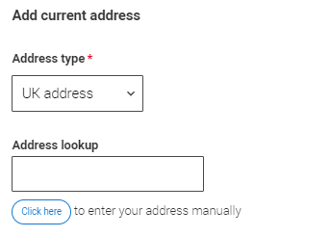
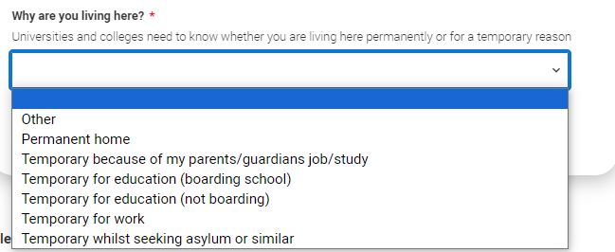
Where you live
Use the look up for UK addresses.
BFPO addresses can be added using the address type.
For each address tell us why you’re living there; for example you may have two permanent homes.
Public

Slide 36
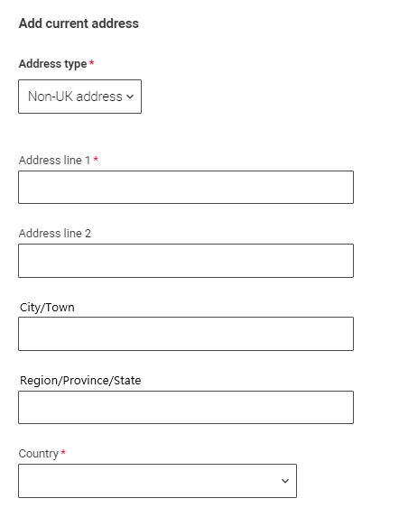
Where you live
International applicants can add a non-UK address by using the address type drop down.
All addresses must be written using the English alphabet.
Public

Slide 37
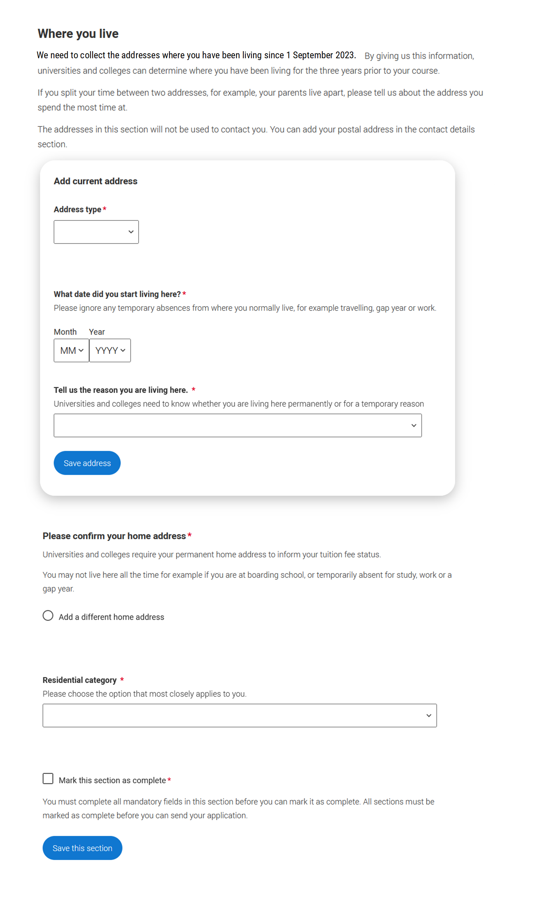
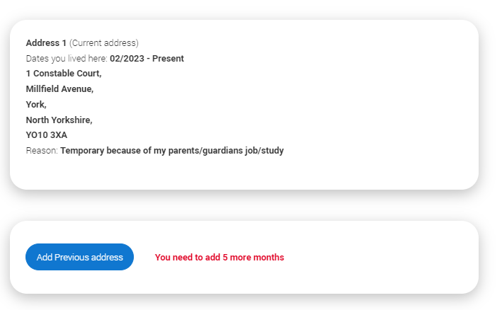
Where you live
Until the required duration of address history is reached, you’ll see the ‘Add previous address’ option.
Gaps in the address history will be flagged for you to fill in so that a full history is provided.​
​
Overlapping addresses are allowed.
Select to see our help text with advice about this.
Public

Slide 38
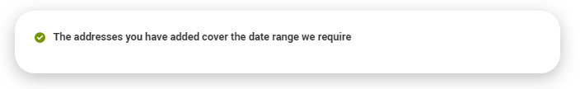
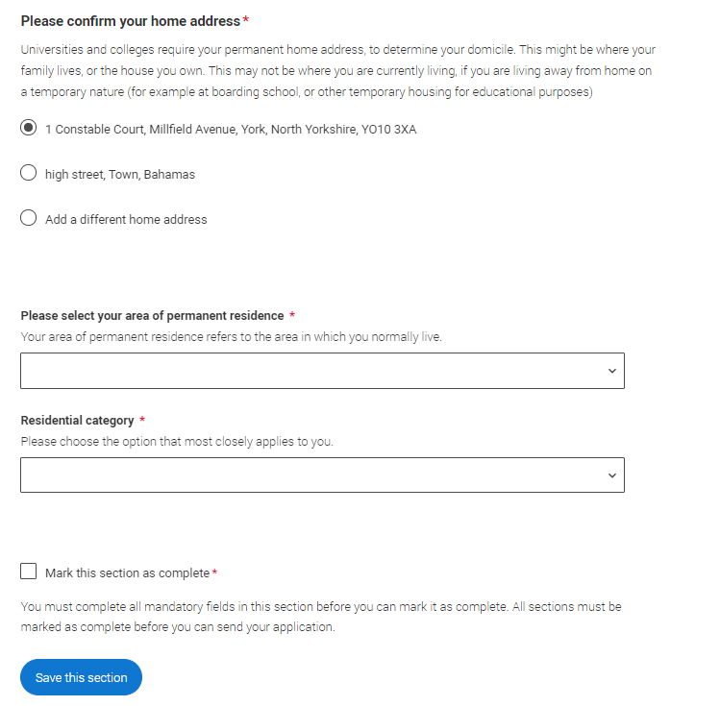
Where you live
Once you’ve added addresses to cover the required date range, you’ll need to confirm your home address.
This can be selected from the list of addresses you entered, or a new one can be added.
You need to select your area of permanent residence and residential category.
Remember to use our help text . .
Public

Slide 39
Contact details
Public

Slide 40
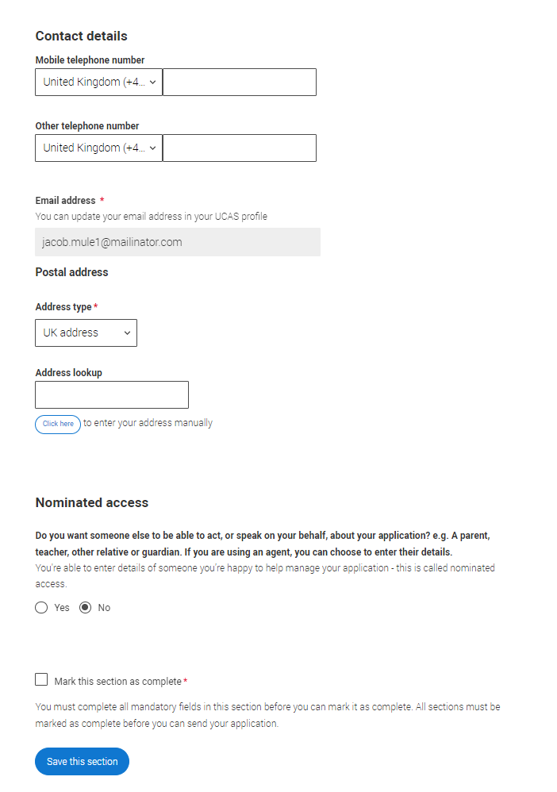
CONTACT DETAILS
Your email will be used by both UCAS and your university and college choices.
If you're using a school or college email address, make sure you can always access it, so you don’t miss anything important.
We would advise using a personal email address, which can be updated in the Hub preferences.
Public

Slide 41
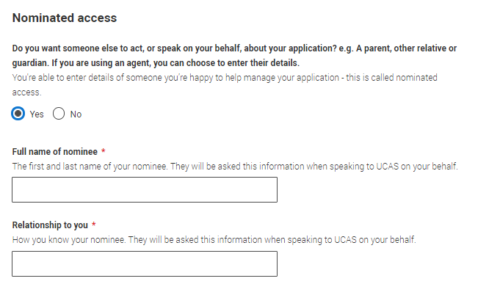
CONTACT DETAILS
If you want someone else to be able to act, or speak on your behalf e.g. a parent, relative, or guardian you need to enter their details. This is called nominated access.
If you are using an agent; you can choose to enter their details.
You'll only see the fields to add the nominated contact details if you answer Yes to the question.
Public

Slide 42
Supporting information
Public

Slide 43
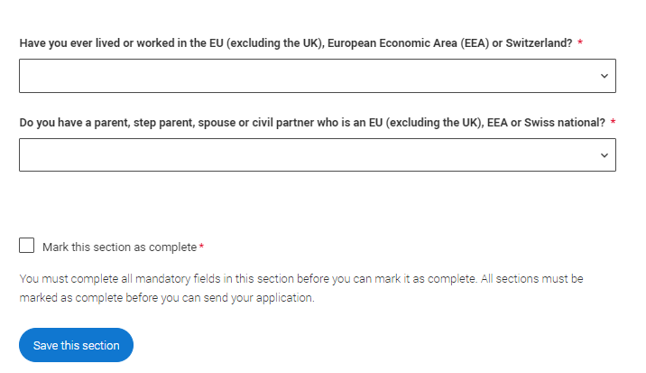
Supporting information
All questions are mandatory (*), but you have the option of
I don't know
Prefer not to say.
Public

Slide 44
Finance and funding
Public

Slide 45
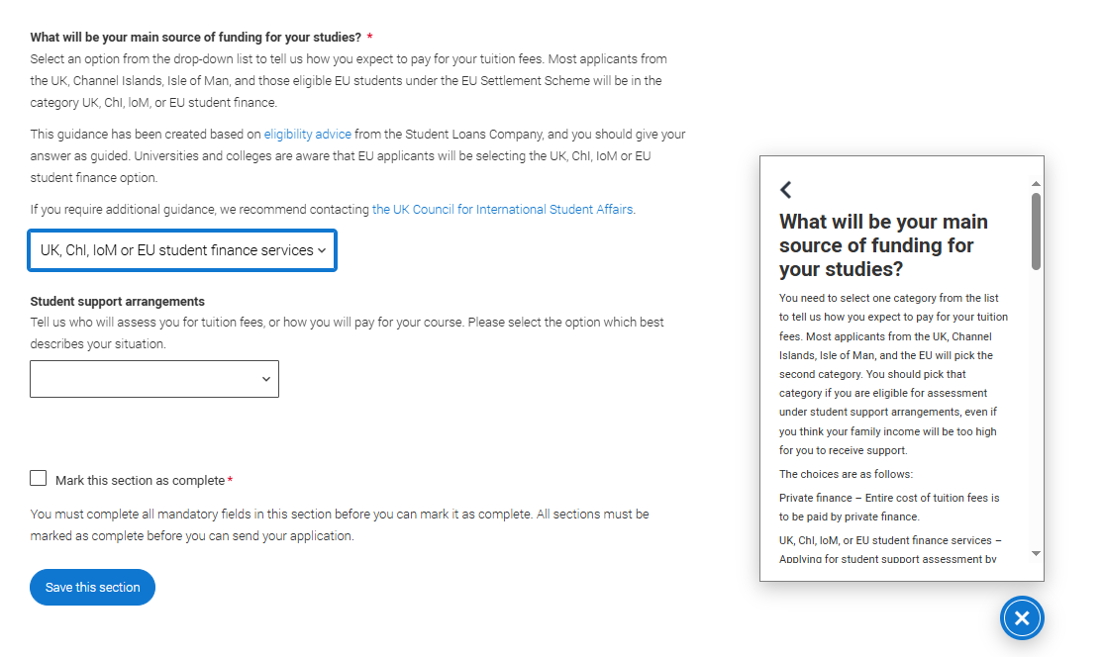
Finance and funding
You will only be asked further questions in finance and funding if you select UK, ChI, IoM or EU Student Finance Services.
We'll ask you for your current local authority under ‘Student support arrangements’.
Select to see our help text with advice about this.
For more information head to: ucas.com/finance
Public

Slide 46
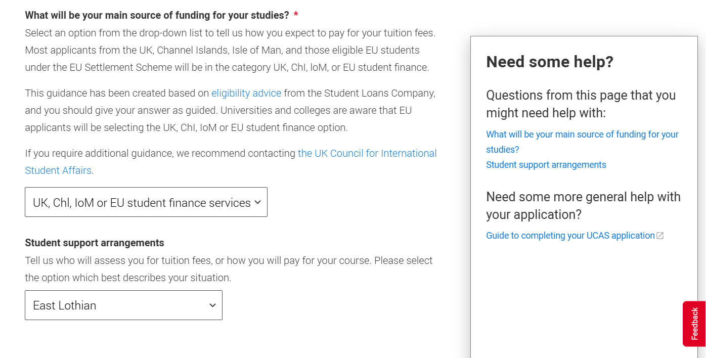
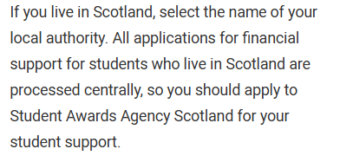
Finance and funding
For Scottish applicants who choose UK, ChI, IoM or EU Student Finance Services, you’ll need to select your local authority from the drop-down list available, rather than SAAS.
You’ll still apply through SAAS for funding as usual.
For Northern Irish applicants you’ll need to select ‘Northern Ireland’ from the drop-down.
Select to see our help text with advice about this.

Slide 47
Diversity and inclusion
You’ll only see these questions if you have a UK home address.
Public

Slide 48
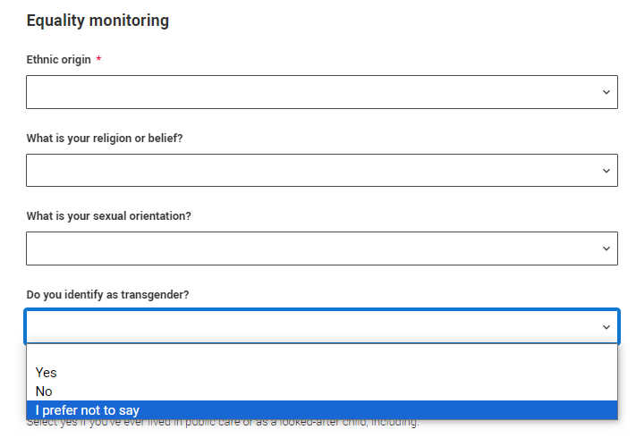
Diversity and inclusion
You’ll only see these questions if you have a UK home address.
There are two mandatory fields(*), but you have the option to respond with I prefer not to say.
This information is only shared with universities or colleges once you have secured a place, it does not influence any decision making. It’s used to ensure applications are treated fairly.
Public

Slide 49
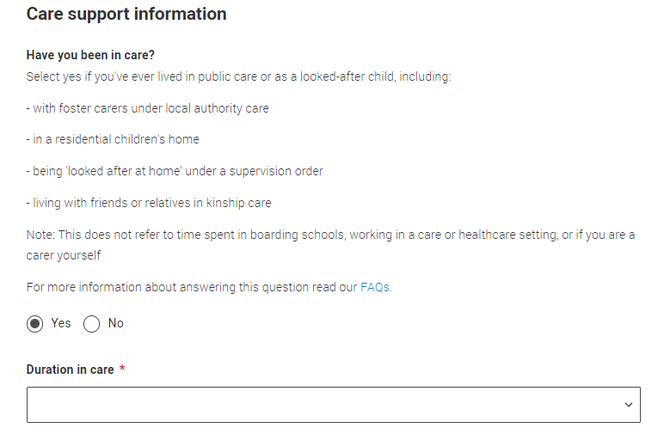
Diversity and inclusion
Growing up in care means you are entitled to a range of practical support; for example, during your application, financial assistance, year-round accommodation, or help with managing your health and wellbeing.
When you give this information, you are letting the university or college know that you may need additional support during your studies. They may get in touch to tell you more about the benefits and options available, if you want it.
Public

Slide 50
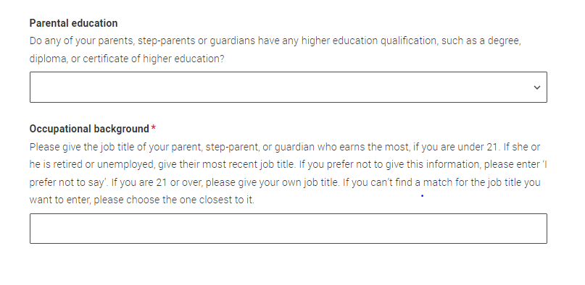
Diversity and inclusion
You can select I prefer not to say for the parental education question.
For the occupational background, you must type at least 3 letters into the response field, and then select an option from the menu that appears below it.
If you prefer not to give this information, please enter ‘I prefer not to say’.
Public

Slide 51
More about you
Public

Slide 52

More about you
You can share any individual needs or circumstances, such as a disability or health condition.
Sharing this information helps the university connect you to the right support – they may send you more information or contact you to discuss what would help you succeed. See our support on individual needs for more advice.
If you don't have any conditions to report, you select "No disability" to mark the section as complete.
Public
Notes:
You will see this question if you have a UK or non-UK home address.
The information you share will always be treated sensitively and only used by those responsible for arranging support and helping you with your application (e.g. the student support team). It is never used when universities or colleges decide whether to offer you a place, but it might be used to make you an offer that looks at your achievements in context.
Information will be shared with those involved in supporting you – not all universities and colleges offer the same support, so it is a good idea to contact them directly to ask any questions before you apply.
We may also use this information (anonymously) for monitoring purposes to inform and improve support for future students.
https://www.ucas.com/applying/applying-university/individual-needs

Slide 53

More about you
You might feel uncertain about sharing personal circumstances, be reassured it’s never used to decide whether to offer you a place, but it might be used to make you an offer that looks at your achievements in context.
These questions are intended to connect you to the right support for your needs.
Select to see our help text with advice about this.
You will only see these questions if you have a UK home address.
Public
Notes:
For more help and support on individual needs or contextual admissions see:
www.ucas.com/applying/applying-university/individual-needs
www.ucas.com/applying/applying-university/individual-needs/contextual-admissions

Slide 54


More about you
UCAS Free Schools meal Application Fee Waiver
You must answer, ‘Yes’ to this question in ‘More about you’ to identify you are eligible for the free school meals application fee waiver.
Read our guidance to check if you’re eligible to have your application fee waived.
Your school or college will need to agree to your eligibility when reviewing your application and may require you to evidence this.
Public
Notes:
The ‘More about you’ section in the application gives you the opportunity to share a range of circumstances and support needs – one of these is your eligibility for free school meals. If you have received UK government funded free school meals at any point during your secondary education, select ‘yes’.
Students who are currently enrolled at school or college and have been in receipt of UK government funded free school meals at some point during the last six years (i.e. during secondary education) up until the end of their final year, will be eligible to have the application fee waived by UCAS.
If you are eligible you must answer ‘Yes’ to this question to be able to see the FSM waiver payment option when you submit your application. If you answer ‘No’ or ‘Don’t know’ the ‘Apply with FSM waiver’ payment option will not be visible.
If you are a teacher or adviser managing applications, please see full guidance on the Free School Meals waiver process at www.ucas.com/advisers/help-and-training/guides-resources-and-training/application-overview/advisers-free-school-meals-application-fee-waiver-guide (this will be updated in April 2025 ahead of the 2026 cycle going live).

Slide 55
Education
Public

Slide 56

Education
You must enter all your qualifications from secondary education onwards – whether you have the result (even any that were ungraded) or you’re still awaiting exams and results.
First you need to add details of where you’ve studied, or are studying, then add qualifications.
Start by clicking Add place of education.
You’ll be asked for a ‘Unique Learner Number’ – if you don’t have one leave the question blank.
Public
Notes:
This includes GCSEs, Nationals and BTECs for UK applicants, or their equivalents.
This also applies to the international equivalent of these qualifications in high school or college.
Please include where you are studying now, as well as qualifications you've completed and qualifications you're still studying for or re-sitting.
If you studied at a uni or college but didn't finish the course, you still need to enter these details. Include the start and finish date, and state that you didn't receive any qualifications there.
Your referee will be asked to add predicted grades for any pending qualifications when adding your reference.
If you've attended university before, please add that here too.

Slide 57
Education
Unique Learner Number (ULN)
Students in England, Wales and Northern Ireland ONLY – This 10-digit is usually printed on your qualification certificates or results slip. Inputting this number can help us to check the information you submit, but if you don't have one or don't know yours, please leave this blank.
English language tests can be entered here too, if you have any other English language tests they can be added as a qualification.
Public

Slide 58


Education
If you are linked to a school/college, when you click on ‘Add place of education’, you’ll be asked to add it.
If you can’t find the name you can type this in and add it.
If you’ve attended another school or college, type the name of where you studied. Once you find your centre, click on the name and the Exam centre number will automatically populate.
Add when you started and finished; if you’re still studying add the month, you’re due to finish.
Public
Notes:
The dates you set here will determine the available date range for selecting pending or achieved qualifications. Make sure to choose the correct end date; otherwise, you may not be able to select the appropriate date for your qualifications.

Slide 59

Education
Tell us how you studied at each place of education.
For type of study did you attend full time, part time or exam only.
For study mode did you attend a centre in person or if you studied a course completely remotely, select online.
Public

Slide 60

Education
There are warning messages to help you.
For example, you can't say you attended two or more places for full-time study during the same date range.
Red text are warnings, it means something is wrong and the section can’t be completed until you change it.
Public

Slide 61

Education
Dual enrolments:
If you’re enrolled at two different educational institutions e.g. two part-time, or you’re taking additional courses with another educational institution, indicate this by selecting part time study and inputting the relevant date.
You should enter qualifications against the relevant institution awarding them.
Blue text warnings indicate we need you to double check the details you have entered.
Public

Slide 62

Education
Once you’ve added where you studied you need to ‘Add qualification’.
Public

Slide 63

Education
If you are linked to your school or college then select ‘All qualifications’ and the shortlisted qualifications provided will appear to help you choose the correct qualifications.
If you are not sure of the qualification you are taking, please check with your school/college or adviser.
If there’s no shortlist, select the qualification category then use the search to narrow this down. If you are searching for a qualification, make sure you use the full qualification title. For more help and advice head to ucas.com.
Public

Slide 64


Education
International qualifications are grouped together and are listed by name and country.
You can also type the country you're looking for to quickly bring up relevant qualifications in the full search.
Don’t worry if yours isn’t there – type ‘Other’ into the search box and select the relevant option.
We have guidance on entering international qualifications available here
Public

Slide 65

Education
It’s important the awarding organisation is entered accurately – speak to your teacher or adviser if you’re not sure what this is.
If you haven't finished the qualification or had your result, then choose Pending* in the Grade field.
When adding qualifications you’ll sometimes have the option of adding modules. Not all universities need you to, but some do, always check the course entry requirements to see if modules are mentioned. If they are, be sure to include them on your UCAS application.
* If presented with a free text box then the result must be left blank.
Public
Notes:
Qualification date is the date the qualification is awarded rather than the date the exam is sat.
Remind students that they are not to add any predicted grades into the qualifications grade box, they must state pending if they don’t have a result. Predicted grades will be add by referee.
It's important that any pending qualifications are entered accurately; they are used by universities and colleges to make decisions until qualifications results are available.
UCAS cannot add your modules or grades after the application has been sent to UCAS.

Slide 66

Education
The education section is an important part of your application. It shows your qualifications and helps universities and colleges decide if you meet their requirements.
Double check all details are correct, especially qualification titles, levels, and awarding organisations.
If you’re not sure which version of a qualification you’re taking, ask your school or college, or exams officer for help.
You must enter at least one qualification or employment record before marking the sections as complete. Warnings will guide you on the next steps.
Public
Notes:
If you are an international student or need to evidence your GCSE or National 5 results, it's really important that you send your results/certificates to your chosen course providers as soon as you receive them.
UCAS will match results for most Level 3 qualifications delivered in the UK to applications, so universities and colleges can make confirmation decisions. All other results including international qualifications will need to be sent to the university or college.
www.ucas.com/applying/after-you-apply/clearing-and-results-day/results-day/sending-exam-results

Slide 67
Employment
Public

Slide 68

Employment
Include details of any paid employment relevant to the courses or subjects you're applying for.
Any unpaid or voluntary work relevant to the courses or subjects you're applying for shouldn’t be included in this section – you may wish mention that in your personal statement.
If you don’t have any paid work experience, leave this section blank, and mark it as complete.
Public
Notes:
This is likely to be recent employment from within the last five years.

Slide 69
Extra Activities
You’ll only see this section if you have a UK home address.
Public

Slide 70

Extra activities
Please add any activity you have taken part in to prepare for higher education.
These include national or regional schemes, university-run programmes, summer schools, taster courses, and booster courses.
Open days are not relevant to this question.
If you haven’t attended any such activity, please leave this section blank and mark it as complete
Public

Slide 71

Extra activities
If this section is relevant to you, you need to include:
type of activity
name of the activity provider (from a drop-down list)
name of the activity/programme (a free-text box)
dates of the activity.
If the type of activity you attended is not listed, please select ‘Other’.
Public

Slide 72

Extra activities
The activity provider is the organiser of the activity. It may be a university or college, or a national, regional, or local organisation.
If the activity provider isn’t listed, please select “Other”. If you’re unsure of the answer, contact whoever organised the activity to find out, and, if you’re still unsure, select ‘Don't know’.
Public

Slide 73

Extra activities
Add the official title of the activity. If you’re unsure of the answer, contact whoever organised the activity to find out.
You can add a maximum of 2 activities.
You can use your personal statement to include more details about these and other activities you took part in; reflecting on the skills learned, and how this prepared you for higher education.
Public

Slide 74
Personal statement
Public
Notes:
For Students
Get inspiration on how to complete your personal statement with our range of subject specific personal statement guides.
Access the guides the Hub or personal statement builder tool.
www.ucas.com/applying/applying-university/writing-your-personal-statement/new-personal-statement-2026-entry
For Teacher and Advisers
Access the full suite of personal statement resources that have been created (including ppt decks) that you can copy and paste into your own materials and guides to support student in writing the personal statement.
www.ucas.com/advisers/help-and-training/guides-resources-and-training/pre-application-support/personal-statements-2026-entry-onwards/personal-statement-2026-entry-classroom-resources
www.ucas.com/applying/applying-university/writing-your-personal-statement/guide-using-ai-and-chatgpt-your-personal-statement

Slide 75

Personal statement
You can save and edit this as many times as you need to.
If it's over the character count you can’t 'Complete' it until it meets the count.
If you try to navigate away without saving your work. We'll remind you with a pop-up warning.
You can expand each question box by dragging the bottom right-hand corner.
Public
Notes:
For Students
Get inspiration on how to complete your personal statement with our range of subject specific personal statement guides.
Access the guides the Hub or personal statement builder tool.
www.ucas.com/applying/applying-university/writing-your-personal-statement/new-personal-statement-2026-entry
For Teacher and Advisers
Access the full suite of personal statement resources that have been created (including ppt decks) that you can copy and paste into your own materials and guides to support student in writing the personal statement.
www.ucas.com/advisers/help-and-training/guides-resources-and-training/pre-application-support/personal-statements-2026-entry-onwards/personal-statement-2026-entry-classroom-resources
www.ucas.com/applying/applying-university/writing-your-personal-statement/guide-using-ai-and-chatgpt-your-personal-statement

Slide 76

Personal statement
Remember we'll carry out checks to verify your personal statement is your own work.
If it looks like it’s been copied from other sources, we’ll tell the universities and colleges you applied to, and they’ll decide what to do next.
We'll also contact you by email to tell you this has happened.
Check out ucas.com for all the support in writing your personal statement.
Public
Notes:
Similarity detection is used by UCAS on all applications, to identify personal statements containing content which has similarities with previously submitted personal statements, or with those held as a library resource. Generating (and then copying, pasting and submitting) all or a large part of your personal statement from an AI tool such as ChatGPT, and presenting it as your own words, could be considered cheating by universities and colleges and could affect your chances of an offer.
For more information see:
www.ucas.com/applying/applying-university/writing-your-personal-statement/guide-using-ai-and-chatgpt-your-personal-statement
www.ucas.com/applying/applying-university/writing-your-personal-statement/fraud-and-similarity

Slide 77
Adding a choice
Public

Slide 78


Adding a choice
Start typing the name of the university or college, select from the options displayed.
Do the same for the course you have selected.
Locations and start dates are displayed according to the course details.
Universities and colleges will display the points of entry available in the UCAS course search, check this if you’re not sure.
Public
Notes:
If the course you're looking for doesn't appear in the drop-down list, reach out to the provider to see when it'll be available

Slide 79

Adding a choice
Some courses may require you to disclose your criminal conviction status.
We'll only show this question if the course choice requires it.
Only tick this box if you have any convictions; otherwise leave it blank.
Public
Notes:
If you have a criminal conviction, see our advice and guidance at www.ucas.com/applying/applying-university/individual-needs/criminal-convictions

Slide 80


Adding a choice
There is a maximum of five choices and choice restrictions may apply. A maximum of four courses from medicine, dentistry, veterinary medicine or veterinary science, and either the University of Oxford OR the University of Cambridge.
Once all choices are added you must mark the section as complete to be able to submit.
Choices do not need to be added in any preference order. Universities / colleges can only see where else you’ve applied once they’ve made their offer and you’ve decided whether to accept them as your firm or insurance choice.
Public

Slide 81

Adding a choice
Some courses have extra admissions tests and assessments.
We'll show these in blue text on the choice card.
This should not be a surprise to you, as you should have seen details of this when researching the course.
Public

Slide 82


Adding a choice
Click anywhere on a choice card to expand it or collapse it.
Any choice combinations that are not permitted will be flagged with red text on the right of each relevant card.
For example, these screens show error messages for students trying to apply to University of Cambridge and University of Oxford.
Public

Slide 83
Submitting the application
Public

Slide 84

Submitting the application
All parts of the application must be complete and showing 'Ready to Send' before being able to review and submit to your school, college or centre.
Public

Slide 85


Submitting the application
View the full application; download as a pdf (in the top right) to help you check it.
Make sure you double check your personal statement, qualifications and choices.
At the bottom of the application, click Accept and proceed (or return to application if you want to make more changes).
Public

Slide 86

Submitting the application
By accepting the terms and conditions you are confirming you have read and understood the terms and conditions, and that the information you have provided is true, complete and accurate.
You can collapse these by clicking the .
Either Accept and proceed, or you can ‘Return to application’.
Public

Slide 87
Pay and Submit
The payment options students see depend on the application fee payment option you select as a Registered Centre.
Make sure to update these slides to match your chosen payment option before sharing them with students.
Public
Notes:
ACTION FOR TEACHERS AND ADVISERS:
Check your ‘Application fee payment method’ in Centre Management in the Adviser Portal when setting up for 2026 cycle. The fee payment method you choose will determine what your linked students see when they ‘review and submit’ their applications.
UK domiciled applicants only: For UCAS to apply a Free School Meals application fee waiver to eligible applicants, you need to enable the new FSM fee waiver option. This can be used alongside the current payment method options to suit your school or college.
Only those students who answer ‘Yes’ to the FSM question in the ‘More about you section’ will have the option ‘Free school meals fee waiver’ when they review, pay and submit. Your centre will not be invoiced for eligible FSM students that you provide agreement for in the adviser portal.
It’s essential that students who might be eligible for the FSM application fee waiver do not enter any card details. Once you pay by card (even if eligible), this cannot be reversed; a fee waiver cannot be applied after the pay and submit process has been completed. If a student has answered ‘No’ or ‘Don’t know’ in ‘More about you’ the ‘Apply with FSM waiver’ payment option will not be visible.
Your centre will not be invoiced for eligible FSM students that you provide agreement for in the adviser portal.
If you are a teacher or adviser managing applications, please see full guidance on the Free School Meals waiver process at www.ucas.com/advisers/help-and-training/guides-resources-and-training/application-overview/advisers-free-school-meals-application-fee-waiver-guide (this will be updated in April 2025 ahead of the 2026 cycle going live).

Slide 88

Pay BY CARD
If you are paying for your application yourself, select ‘Pay by card’ and enter your card details.
Public
Notes:
It’s essential that students who might be eligible for the FSM application fee waiver do not enter any card details. Once you pay by card (even if eligible), this cannot be reversed; a fee waiver cannot be applied after the pay and submit process has been completed.

Slide 89

Free School Meal
Application Fee Waiver
If you are eligible for the free school meals waiver you need to choose ‘Apply with FSM fee waiver’, when you ‘Pay and submit’.
If you can’t see this option but think you’re eligible:
Check you have answered ‘Yes’ to the question in ‘More about you’.
Check with your school or college BEFORE entering any card details.
Once you pay by card (even if you are eligible), this cannot be reversed; a fee waiver cannot be applied after you have completed the pay and submit process.
Public
Notes:
UK domiciled applicants only: For UCAS to apply a Free School Meals application fee waiver to eligible applicants, you need to enable the new FSM fee waiver option. This can be used alongside the current payment method options to suit your school or college.
Only those students who answer ‘Yes’ to the FSM question in the ‘More about you section’ will have the option ‘Free school meals fee waiver’ when they review, pay and submit. Your centre will not be invoiced for eligible FSM students that you provide agreement for in the adviser portal.
It’s essential that students who might be eligible for the FSM application fee waiver do not enter any card details. Once you pay by card (even if eligible), this cannot be reversed; a fee waiver cannot be applied after the pay and submit process has been completed.
All other students should pay by card.

Slide 90


INVOICE
Sometimes, your school or college might pay for your application for you.
If that’s the case, they might tell you to choose ‘Invoice’ when applying.
Only select invoice if you are told to.
Public
Notes:
The invoice option will only be available to students if the invoice or hybrid payment option has been selected in the adviser portal.
UCAS will generate invoices as usual for all applications from your centre but will remove any confirmed FSM students who have answered ‘Yes’ in the ‘More about you’ section and you have agreed are eligible in the adviser portal. Students should use the ‘Apply with FSM Waiver option’
It’s essential that students who might be eligible for the FSM application fee waiver do not enter any card details. Once you pay by card (even if eligible), this cannot be reversed; a fee waiver cannot be applied after the pay and submit process has been completed.

Slide 91

submit
When you've paid and submitted your application, it will go to your school/college to check.
They will submit the application to UCAS.
If you log in after you’ve submitted your application, you’ll see a read-only version of it.
Public

Slide 92

Public

Slide 93
Tracking your application
Public

Slide 94





Tracking your application
Your status will update as changes happen; go to your application for the details.
Public

Slide 95
Tracking your application
It’s important your contact details are kept up to date throughout your application.
We recommend using a personal email address as your primary email, rather than a school/college one, so that you have access to it throughout your application journey.
To update your email address, go to ‘Edit your account’ from drop-down, where you can change your email.
Contact UCAS if you have any problems changing this.
Public

Slide 96


Tracking your application
You’ll be taken to your application status, which displays the key information relevant to your application.
It will update to reflect your status and clearly state any actions you need to take, particularly when you will need to reply to any offers.
All deadlines are in UK time – make sure you keep this in mind and don't miss any.
Public
Notes:
AN IMPORTANT MESSAGE FOR YOUR STUDENTS
If you don’t reply to your offers on or before the reply date shown in your application UCAS will decline them on your behalf (often referred to as declined by default [DBD]). This means you will lose all your offers.
*Please note dates on screens are for illustrative purposes only; please check all dates and deadlines.

Slide 97


your updates
Latest updates – displays offer and decision notifications, click view all updates for full history.
Student bank account info – you’ll need this to open a student bank account (when eligible).
View all correspondence – all correspondence is grouped by choice.
Centre link permission – if you are linked to a centre this enables you to update your sharing preference. Remember if you don’t share with your centre then they will be unable to help support you with your application.
Public

Slide 98

Tracking your application
Your application details are displayed below your choices.
All are read-only except for ’Contact’ details. Here you can edit your phone numbers and postal address.
It's possible to make some other changes once it’s been sent to UCAS. Check on ucas.com to see what’s possible.
Public
Notes:
www.ucas.com/applying/after-you-apply/making-changes-your-application-after-you-apply

Slide 99

Substituting a choice
You can substitute a choice within 14 days of submitting your UCAS application.
Select the option from the actions box and fill out the substitution form.
To change courses at the same university or college, contact them directly first, before you do anything.
Public
Notes:
Important: once a choice has been substituted it cannot be changed back.

Slide 100


Substituting a choice
If you substitute a choice, the original university or college won’t consider your application.
You can’t swap back or substitute the same choice more than once.
Public

Slide 101

Withdraw your choice
You can withdraw a choice at any time, if you no longer want to be considered by that university or college.
You cannot replace a choice that is withdrawn.
Public

Slide 102


Your offers
The details of your offers will be shown including any conditions.
The full text of the offer can be seen by clicking ’View full offer’.
Your inactive choices (withdrawn, declined, unsuccessful) are in an accordion section below the active choices.
Public

Slide 103


interviews
If a university or college has notified UCAS of an interview the invitation details will be shown alongside a button to enable you to respond.
There are three options you can select from to respond to the invitation.
Public

Slide 104


Confirm your choices
Once all decisions have been received, you will make your replies and confirm your choices.
You can accept one offer as your firm choice.
Public

Slide 105

Confirm your choices
If you choose a conditional offer as your firm choice, you have the option to add an optional insurance choice.
If you choose an unconditional offer as your firm choice, you cannot have an insurance choice.
Public

Slide 106

Confirm your choices
Remaining offers are automatically declined when the 'Firm' and 'Insurance' are selected.
You must remember to ‘Save’ your choices.
Before making any decisions, encourage look at our advice on making informed choices – www.ucas.com/undergraduate/after-you-apply/making-right-decision
Public
Notes:
AN IMPORTANT MESSAGE FOR YOUR STUDENTS
If you don’t reply to your offers on or before the reply date shown in your application UCAS will decline them on your behalf (often referred to as declined by default [DBD]). This means you will lose all your offers.

Slide 107

Your choices
The application status updates to show you have replied to your offer(s) and that you are waiting for the university or college to confirm your place when your results are available.
You are able to view the full text at any time by clicking ‘View full offer’.
Your application status on the Hub will also update.
Public

Slide 108

Public

Slide 109


withdraw your application
There is a link to ’Withdraw the whole application’.
If you withdraw, you will not be able to apply again during the academic year, and you will not be eligible for Clearing.
Do not use this if you wish to add another choice or apply somewhere else.
Follow the onscreen warnings or speak to your adviser to ensure you are taking the right action.
Public
Notes:
If you change your mind about applying, you can cancel your application and request a refund within 14 days of applying (Please check the date in your welcome email to verify when you sent your application).
If it has been more than 14 days since you submitted your application, you can completely withdraw it in your UCAS Hub until you have firmly accepted an unconditional offer, or your conditional offer is confirmed. Please note: If you completely withdraw your application you cannot reapply in the same cycle.

Slide 110
UCAS Extra
Public

Slide 111

Extra
If you've used all five choices and have no offers, you can add one more choice through Extra from late February.
Before doing so, check with the university or college to confirm they have vacancies.
For more advice head to the UCAS website.
Public
Notes:
www.ucas.com/applying/after-you-apply/types-undergraduate-offers/extra-choices

Slide 112



Extra
Before using Extra, check with the university or college to confirm course vacancies. If you don’t get an offer, you can still use Clearing from July.
Public
Notes:
IMPORTANT: Once you add a choice in Extra it's locked for 21 days or until the university or college makes a decision, whichever's first.
For advice in Clearing see: www.ucas.com/applying/after-you-apply/clearing-and-results-day/what-clearing

