Slide 1

Confirmation and clearing 2025
The student application journey
Last updated 03/04/2025
Public

Slide 2

Using this deck
This presentation provides key information to assist you in supporting your students through Confirmation and Clearing 2025.
You are welcome to use the included screenshots in your own materials and guidance resources.
The screenshots reflect the intended design of the UCAS Hub and application for 2025 Confirmation and Clearing. Please note that layouts may vary on mobile devices.
We will continue to make incremental updates based on user feedback to enhance the user experience. This deck will be updated periodically to reflect any changes.
Public

Slide 3
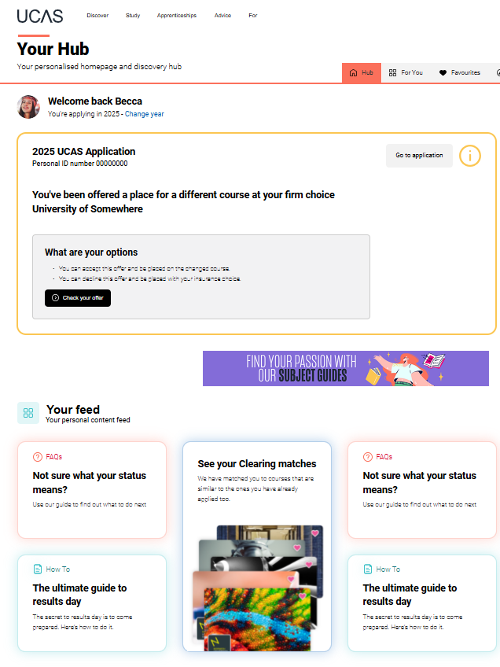
New for 2025
Enhanced on-screen support helps students clearly understand their next steps.
By visiting the UCAS Hub, their personalised homepage, they can view tailored options based on their status.
Their feed is regularly updated with timely advice and guidance to support informed decision-making.
Public

Slide 4
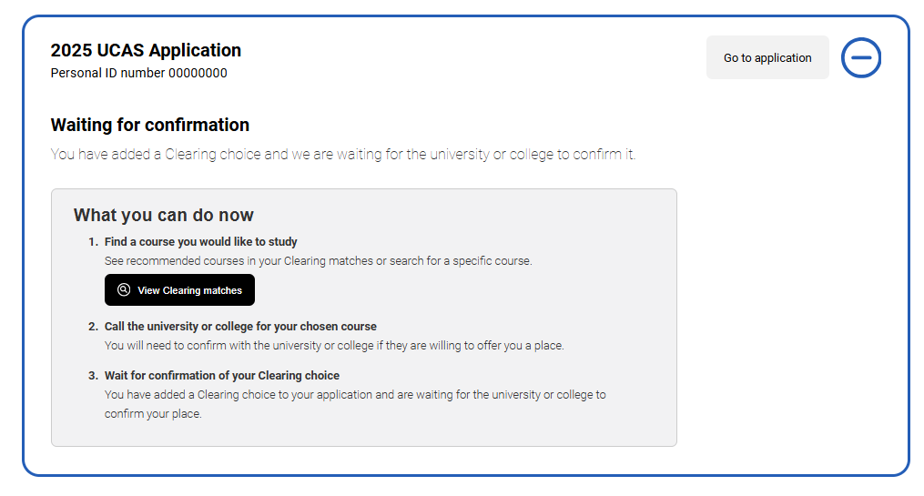
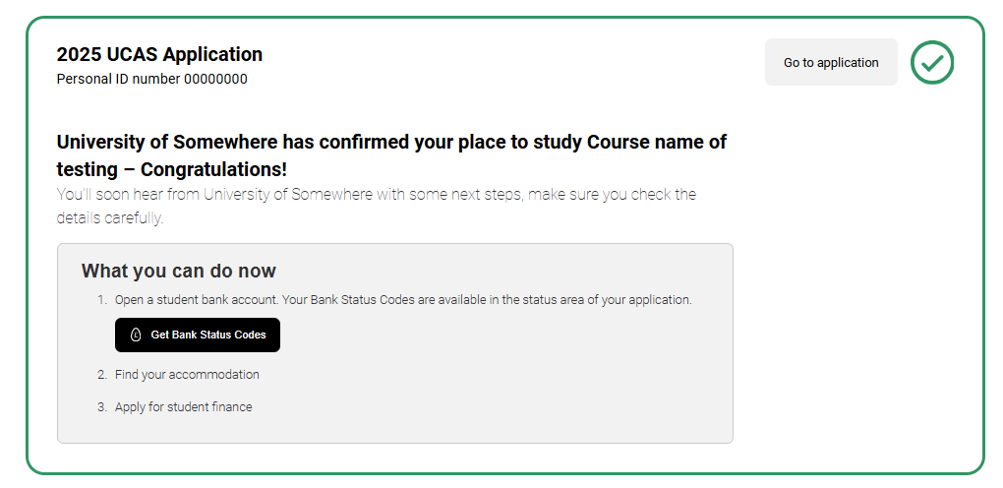
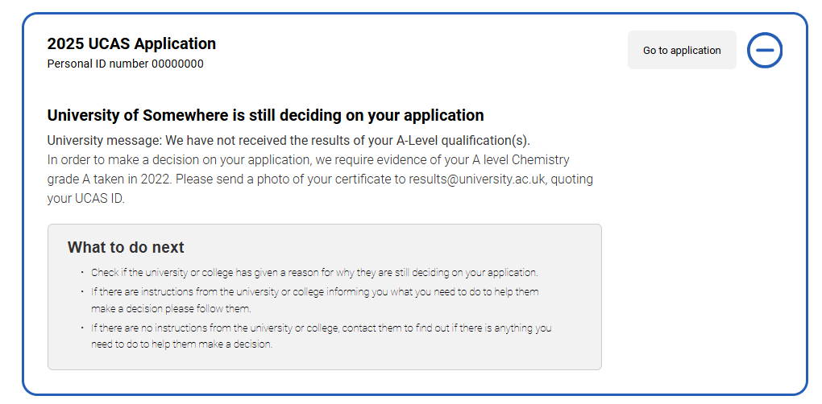
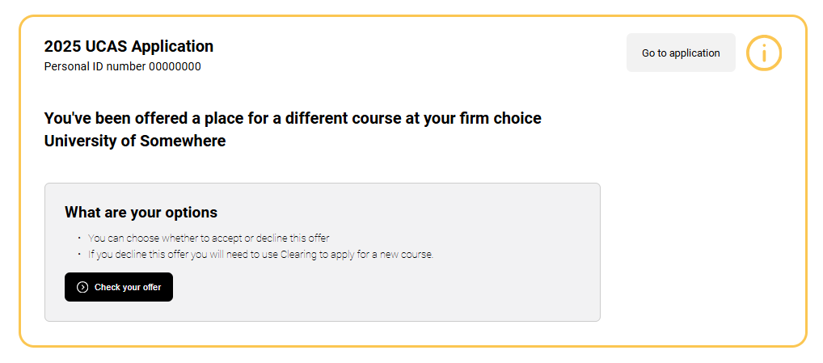
Helping students to know what’s next
Public

Slide 5
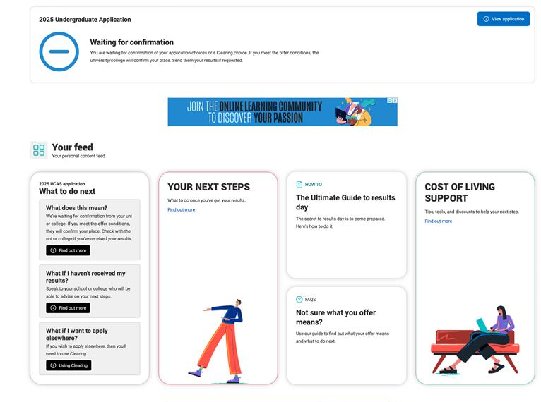
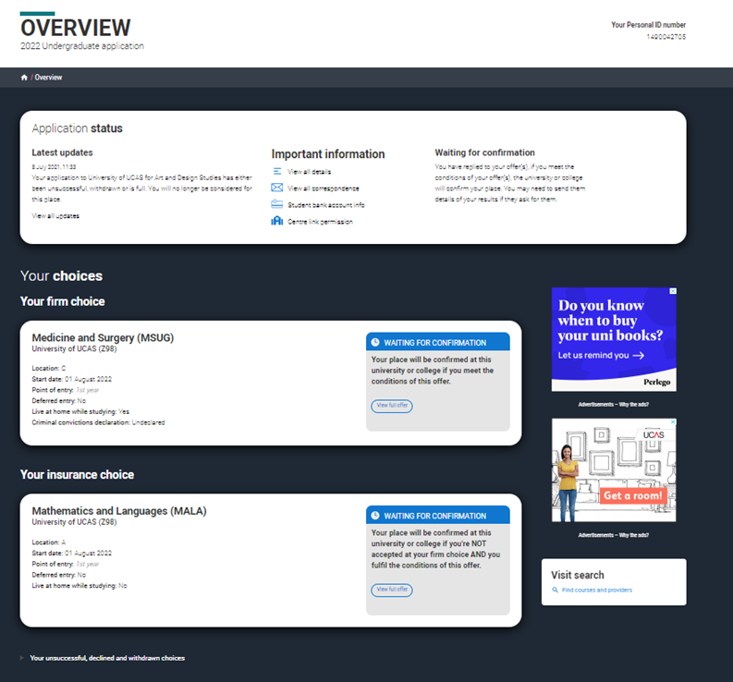
Waiting for confirmation
Students holding a Conditional offer will see a ‘Waiting for Confirmation’ status while universities or colleges review their qualifications and entry criteria.
Within their application, both firm and insurance choices will display a ‘Waiting for Confirmation’ banner.
Public

Slide 6
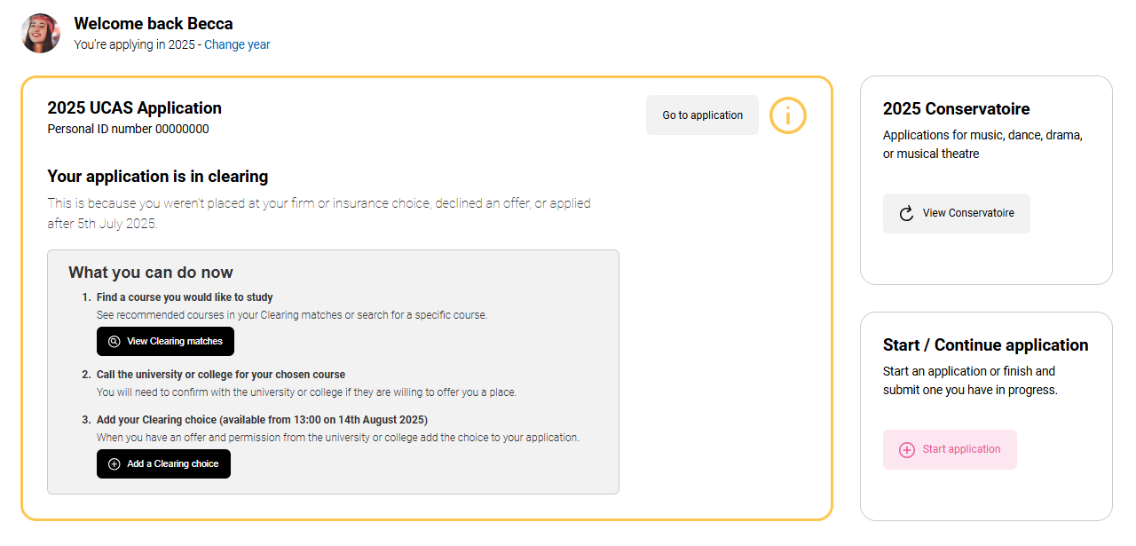
Find a course in clearing (from 5 July)
Applicants who have no offers, are not awaiting any decisions, or have declined all received offers will see that they are in Clearing.
Before adding a Clearing choice, applicants must first contact the university or college.
They should only enter a Clearing choice if they’ve been advised to do so.
Public

Slide 7
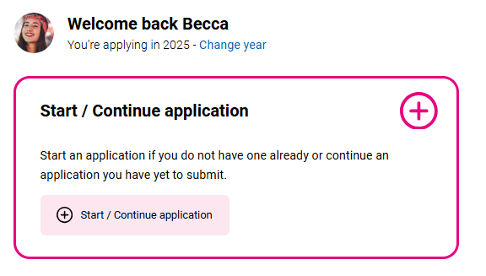
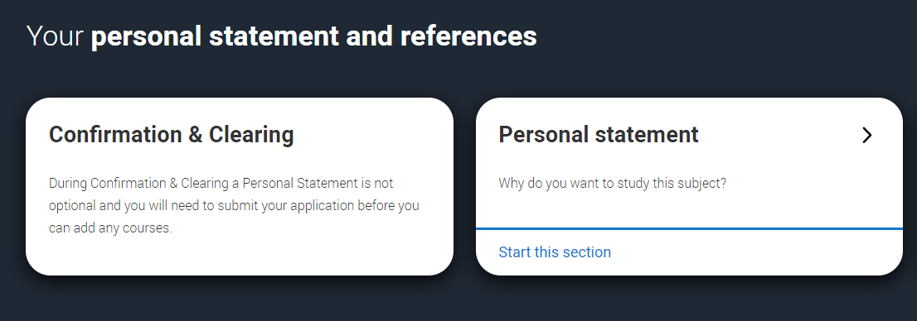
MAKING AN APPLICATION DIRECT TO Clearing
Applicants who have not started a 2025 application will have the option to begin a direct-to-Clearing application. All sections, including the personal statement and reference, should be completed.
They should submit the application without any choices, then add their Clearing choice once advised by a university or college.
For applicants who started an application and added choices before 30 June, those choices will be automatically removed if the application is submitted after 30 June.
Public

Slide 8
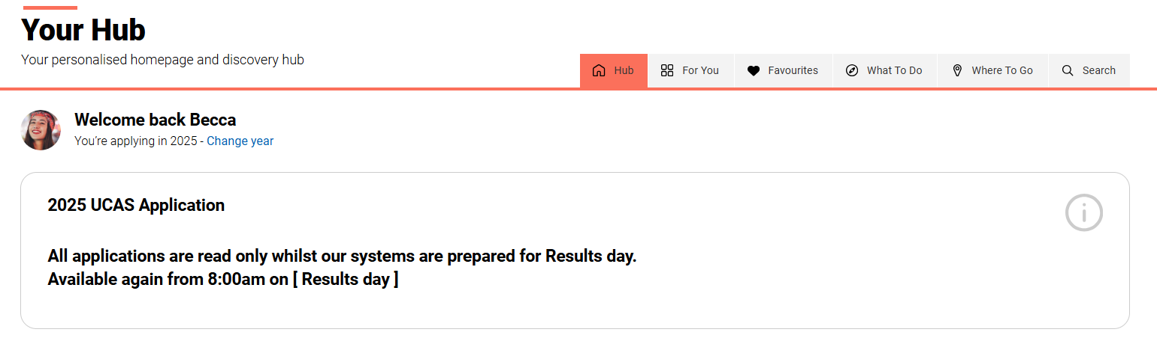
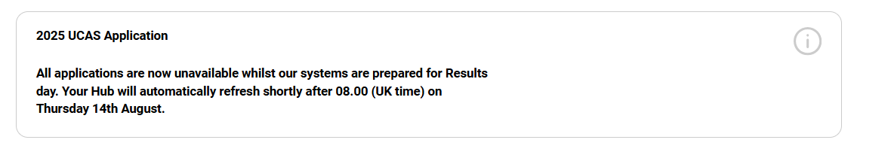
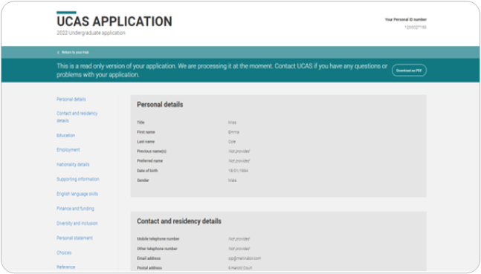
During the results embargo
During the results embargo periods, applicants will only have access to a read-only version of their application.
In the lead-up to both results days, applications will be temporarily unavailable while our systems are prepared.
Please note that the 2026 application service will be unavailable on 5 and 14 August.
Public

Slide 9
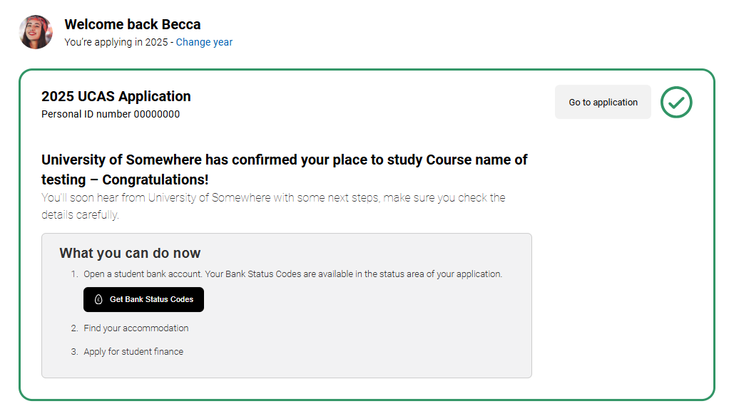
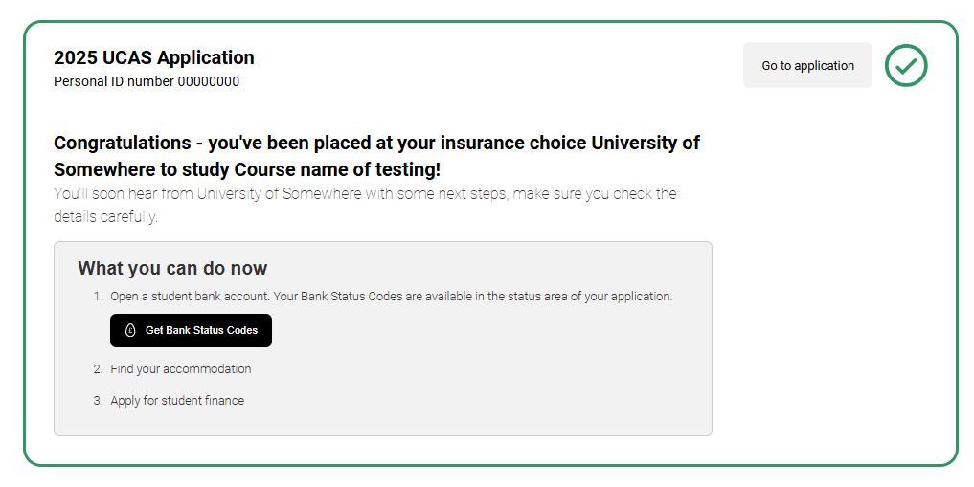
You’ve been placed
If successful, applicants will see a confirmation banner and receive an email confirming their place at their firm or insurance choice.
They will also get further instructions from the university or college.
Applicants cannot swap between their firm and insurance place. If they wish to attend their insurance, they must do so through Clearing.
Public

Slide 10
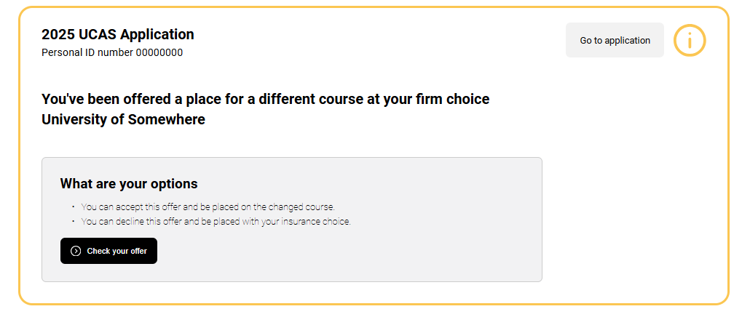
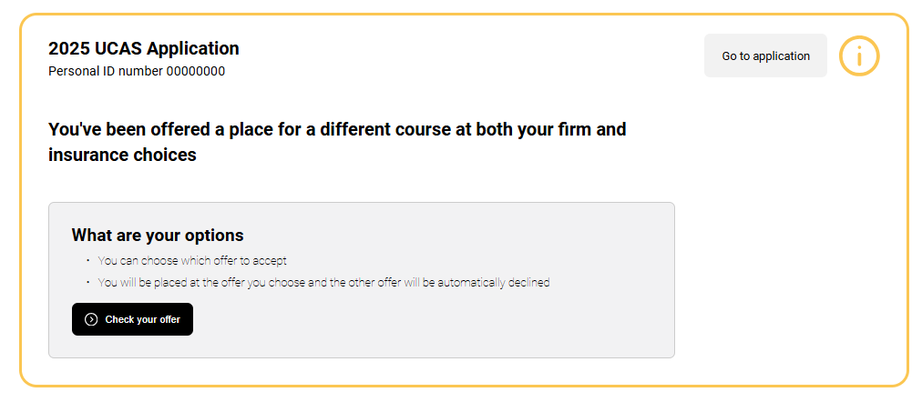
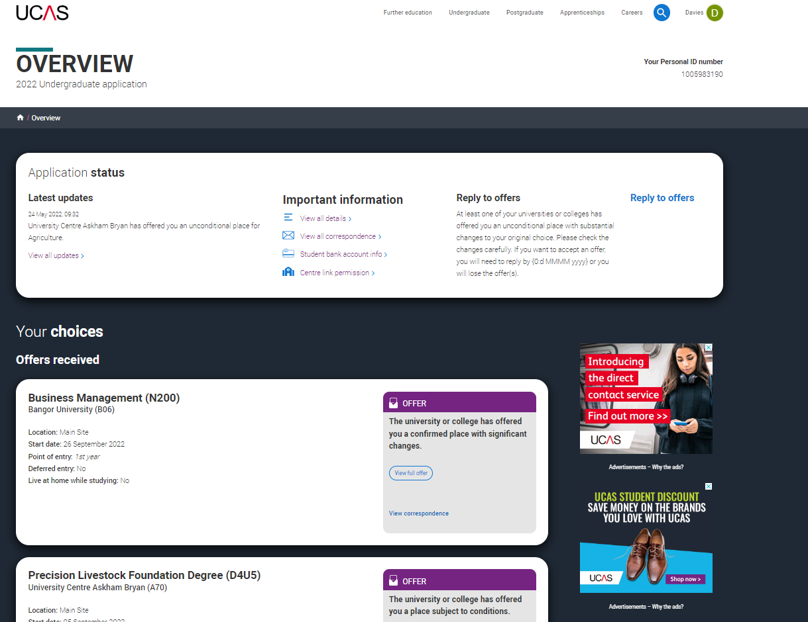
Unconditional change of course
Students may be offered a place for a different course at their firm and/or insurance choices.
This typically occurs if the applicant didn't meet the original conditions, but the university or college is offering a different course, start date, or point of entry.
It’s important to review the offer details carefully in their application and respond within 5 days.
If they have any questions or concerns about the changes, they should contact the university or college for clarification.
Public

Slide 11
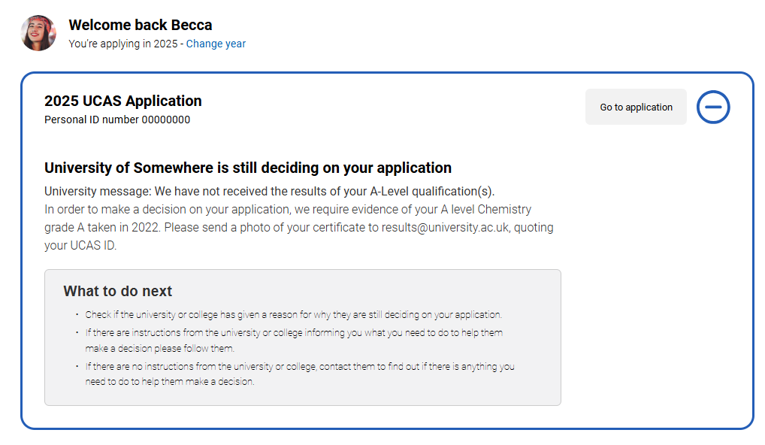
Waiting for confirmation
A university or college may not have been able to make a confirmation decision.
This may be because the applicant has not yet provided proof of qualifications or other required documentation.
A reason may be provided explaining why the conditional offer hasn't been confirmed yet.
If they have concerns, applicants should contact the university or college for clarification.
Public

Slide 12
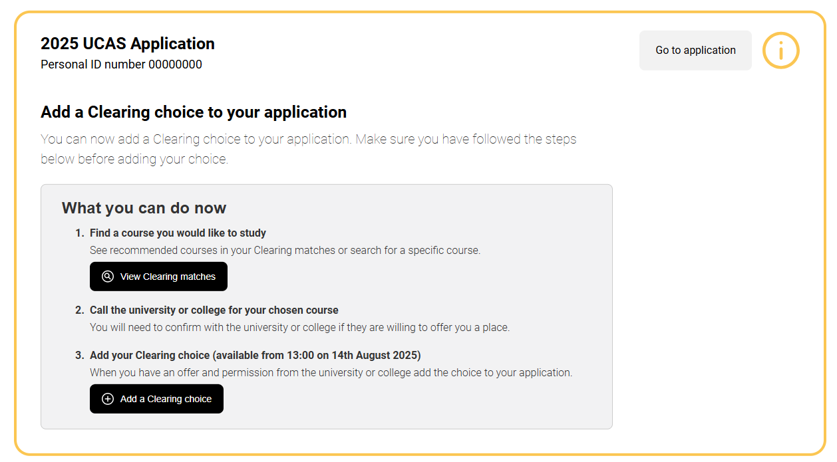
Eligible for clearing
If an applicant doesn’t meet the conditions of their firm or insurance offer, they can use Clearing to search for another course and view personalised course matches through Clearing Plus.
Applicants can add a Clearing choice from:
10:00 on SQA results day (5 August)*
13:00 on JCQ Level 3 results day (14 Aug)*.
*All timings are UK time
Public

Slide 13
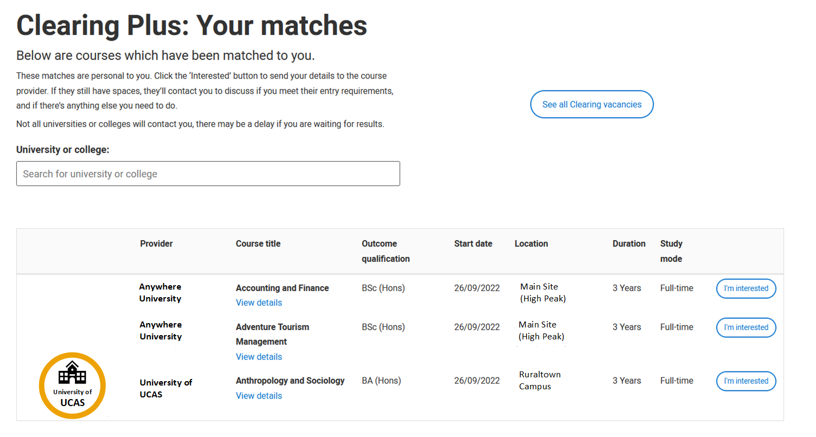
Clearing Plus
In Clearing Plus, the course matches an applicant sees are personalised and continuously updated.
Students can express interest in up to 5 courses, and the corresponding university or college can contact them.
However, courses in Clearing fill up quickly, and there’s no guarantee they’ll be contacted by a university or college.
We’d also recommend proactively using our search tool to explore additional courses in Clearing.
Public

Slide 14
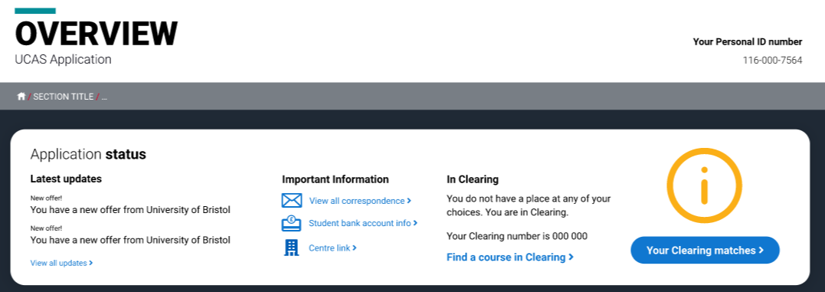
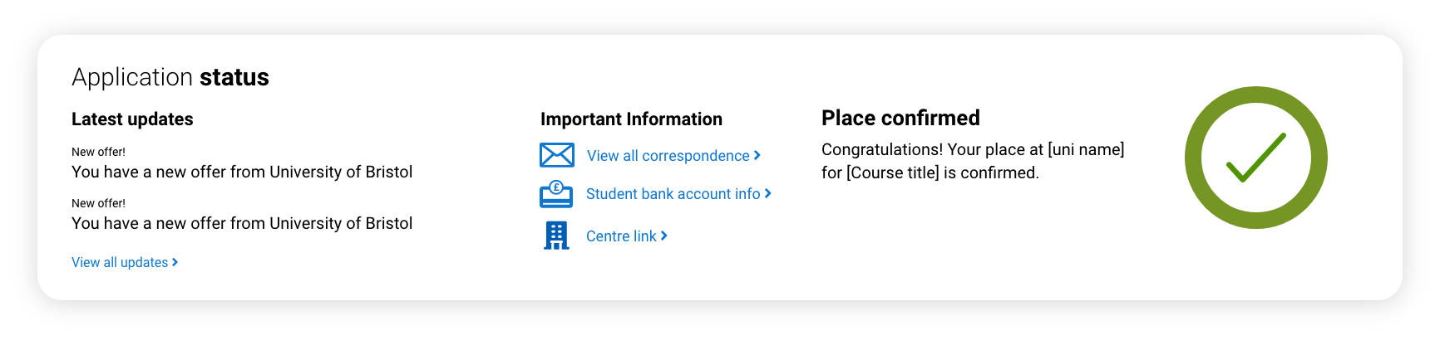
Application status
The status bar at the top of the application displays the application status and Clearing eligibility.
Latest updates will reflect recent actions.
It will display their:
Clearing number (six digits) if eligible.
Personal ID (ten digits)
Students may need to quote one or both when contacting universities and colleges in Clearing.
For more information see our advice on what different application statuses mean.
Public

Slide 15
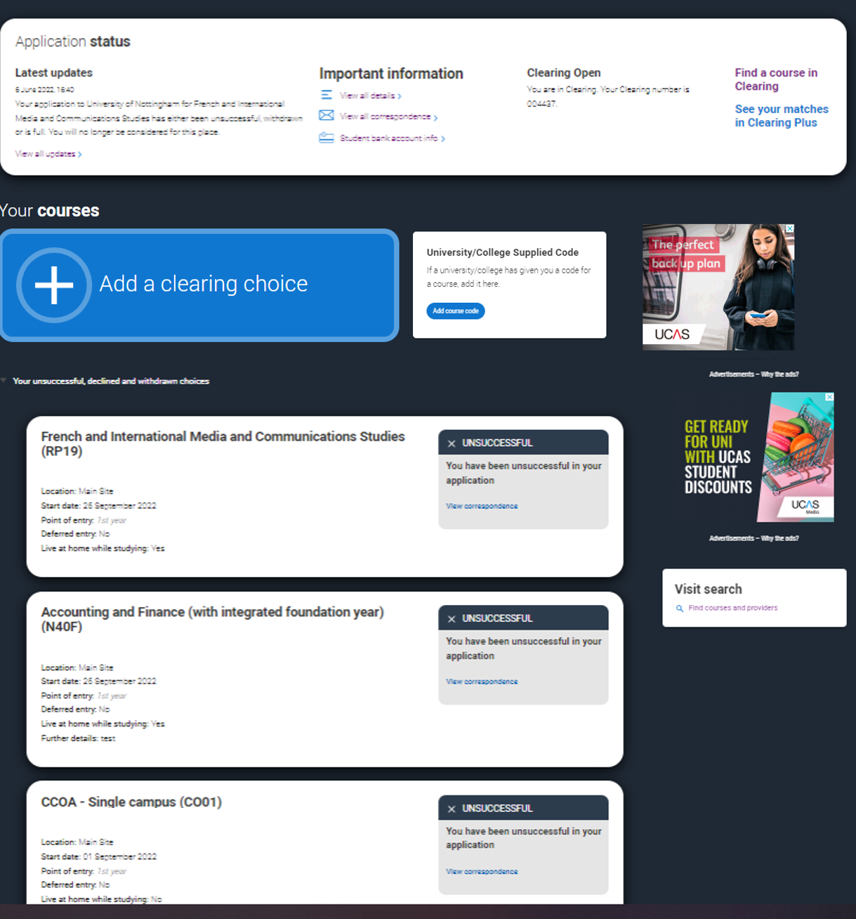
Adding a clearing choice
Eligible applicants can add a Clearing choice from:
10:00 on SQA results day*.
13:00 on JCQ Level 3 results day*.
*All timings are UK time
Public

Slide 16
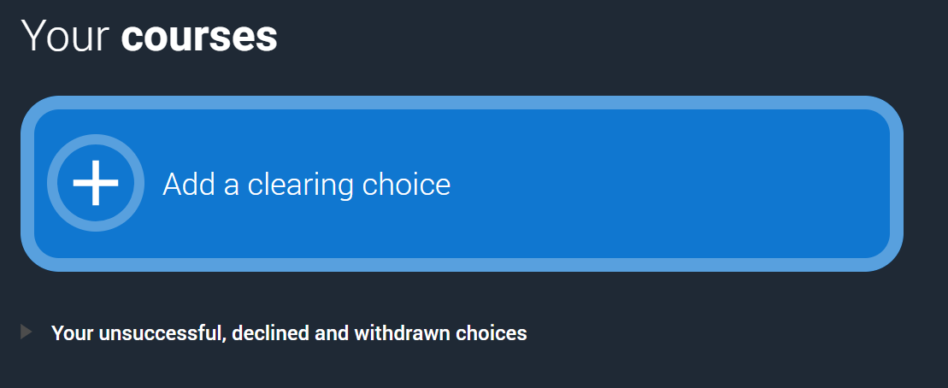
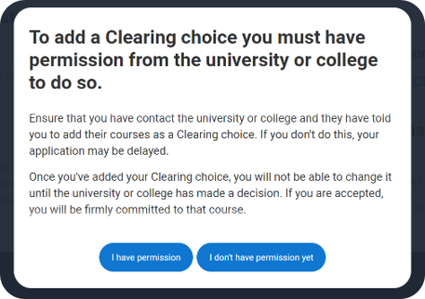
Adding a clearing choice (step 1)
Public

Slide 17
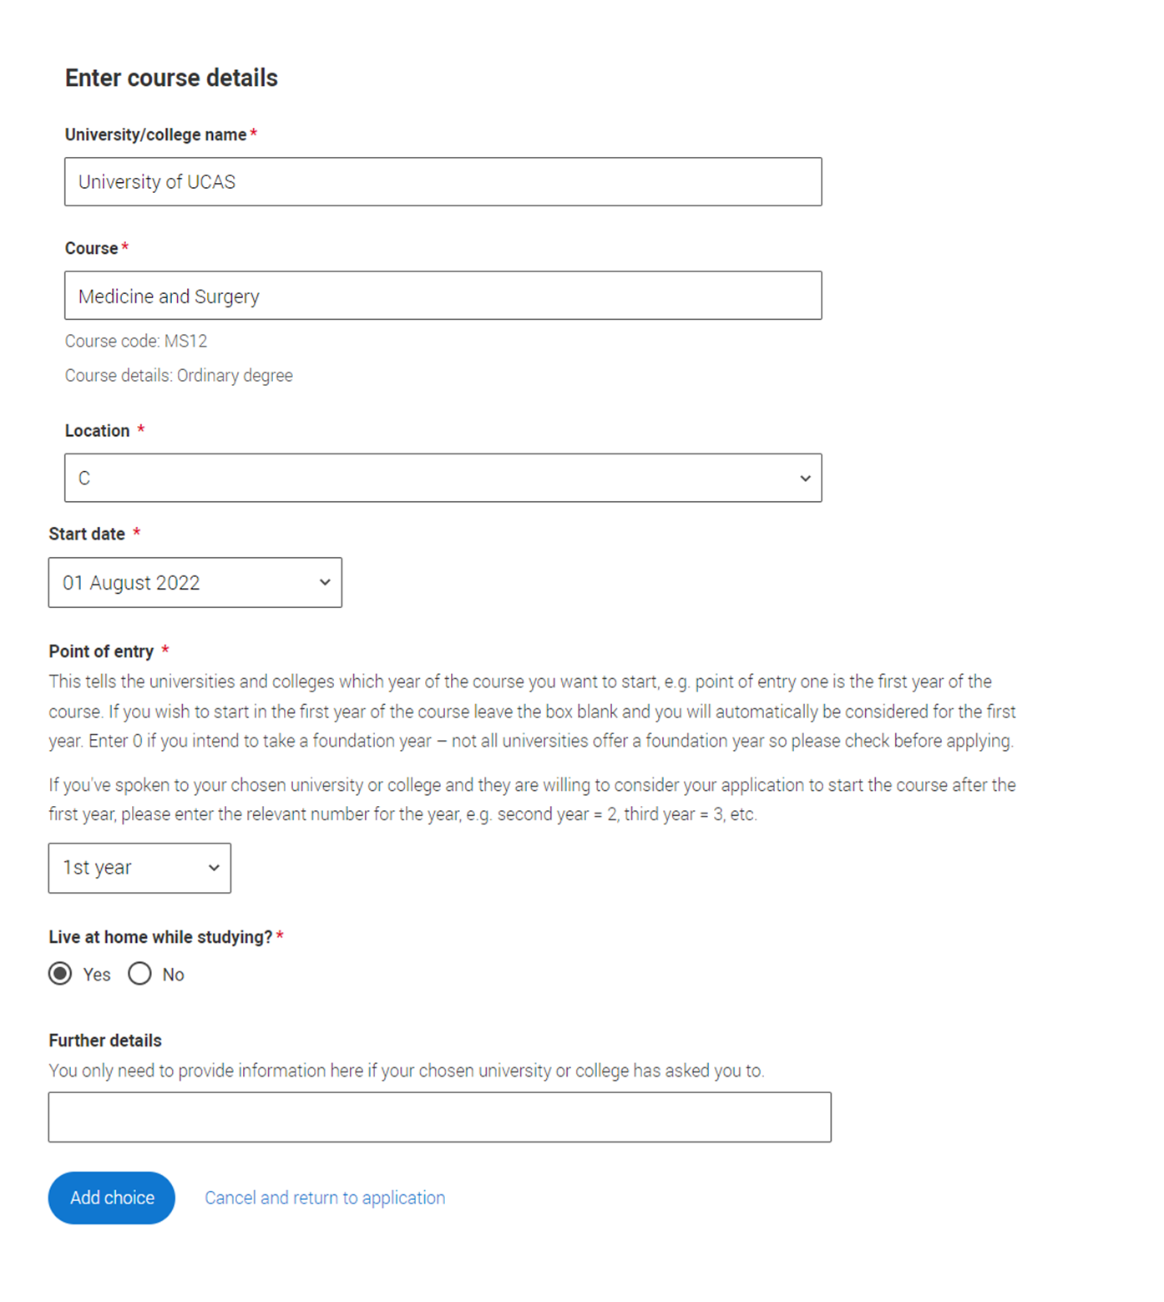
Adding a clearing choice (step 2)
Applicants should only add a Clearing choice once they have permission from the university or college.
They must enter the course details by the deadline provided by the university or college.
Public

Slide 18
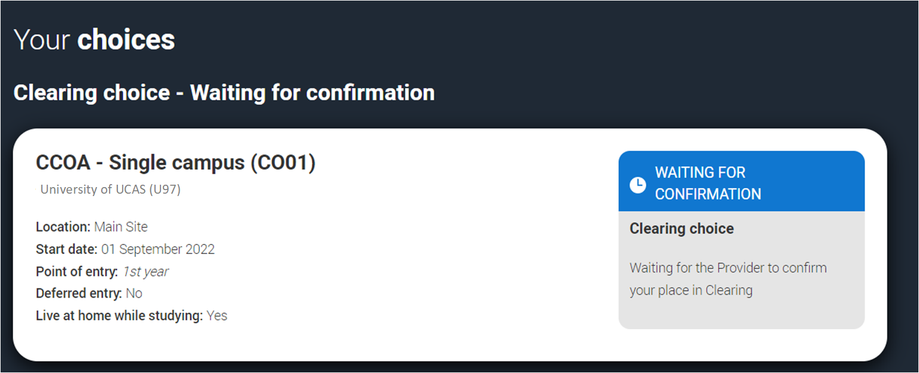
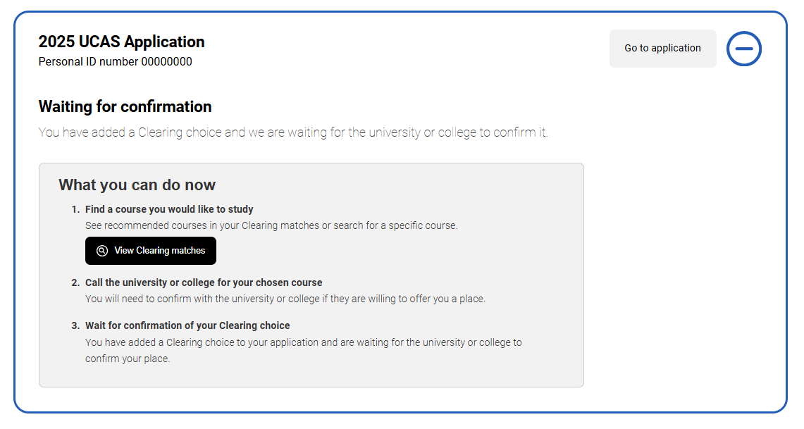
Adding a clearing choice (step 3)
Only one Clearing choice can be added at a time.
If the university/college does not accept the Clearing choice (Unsuccessful) or the applicant chooses to use 'Decline my place' after a Clearing choice has been accepted, then they'll be able to add a new Clearing choice.
Public

Slide 19
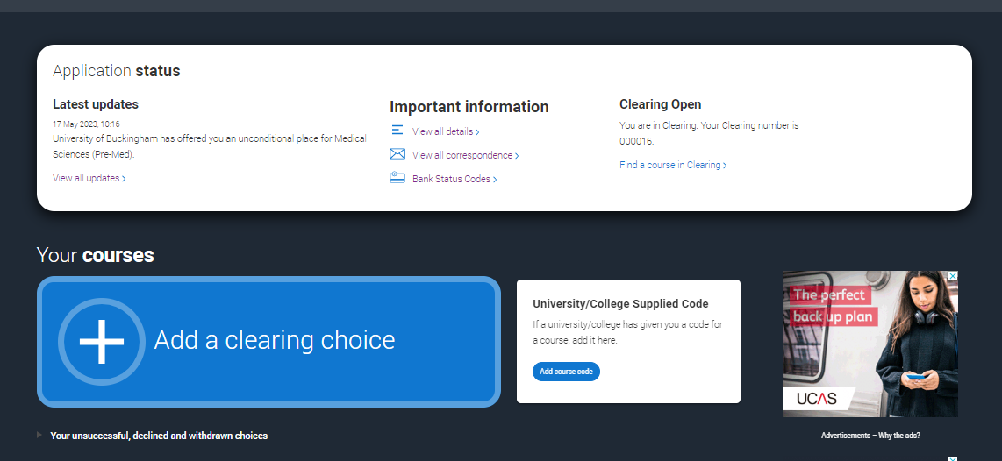
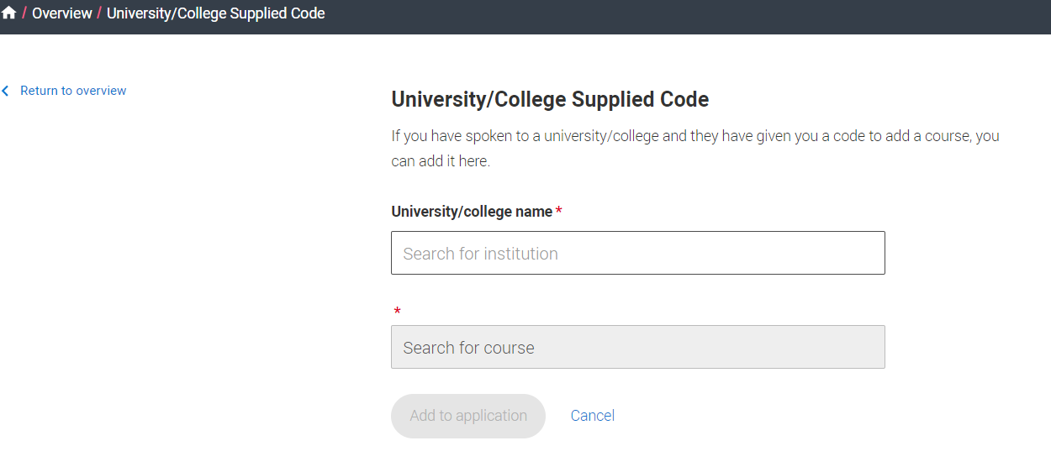
University / college supplied code
If the university or college provides a specific course code for a course available in Clearing, the applicant must enter it using this option.
This may be the case for competitive courses where vacancies are limited and fill quickly.
Public

Slide 20
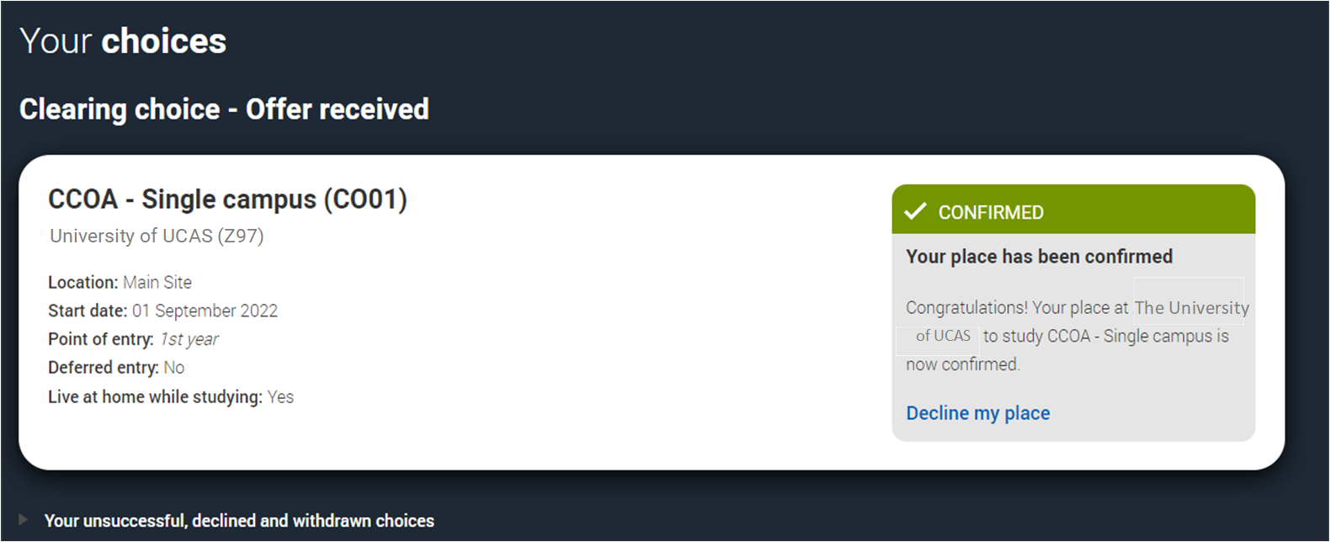
Clearing choice
Applicants don’t need to reply to a Clearing offer.
Once the choice is added, it’s up to the university or college to confirm the place.
The confirmation will reflect in their application.
Public

Slide 21
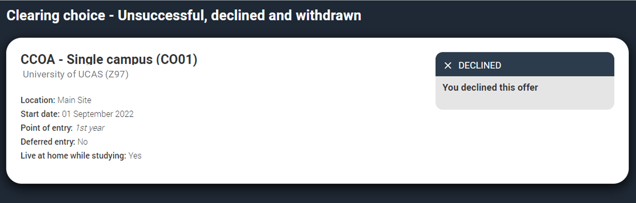
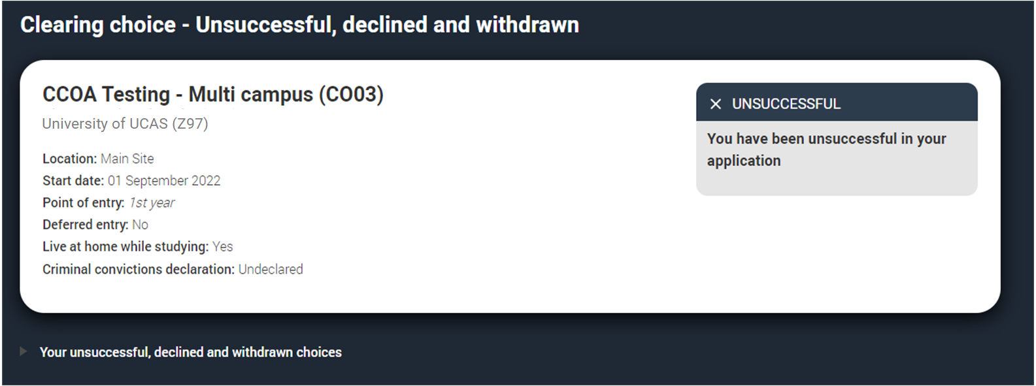
Clearing choice
If the university/college does not accept the Clearing choice (Unsuccessful) or the applicant chooses to use 'Decline my place' after acceptance, they can add a new Clearing choice.
Public

Slide 22
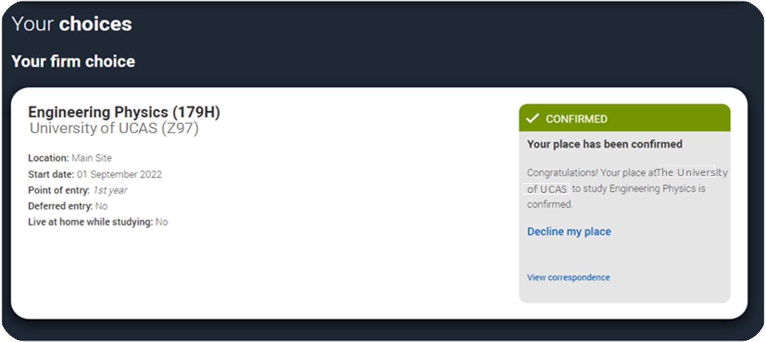
Decline my place (step 1)
Starting from 5 July, applicants holding an unconditional firm place can release themselves into Clearing by using the ‘Decline your place’ button in the application.
This option is available until 3 September 2025.
After this date, applicants will need to contact the university or college directly.
Public

Slide 23
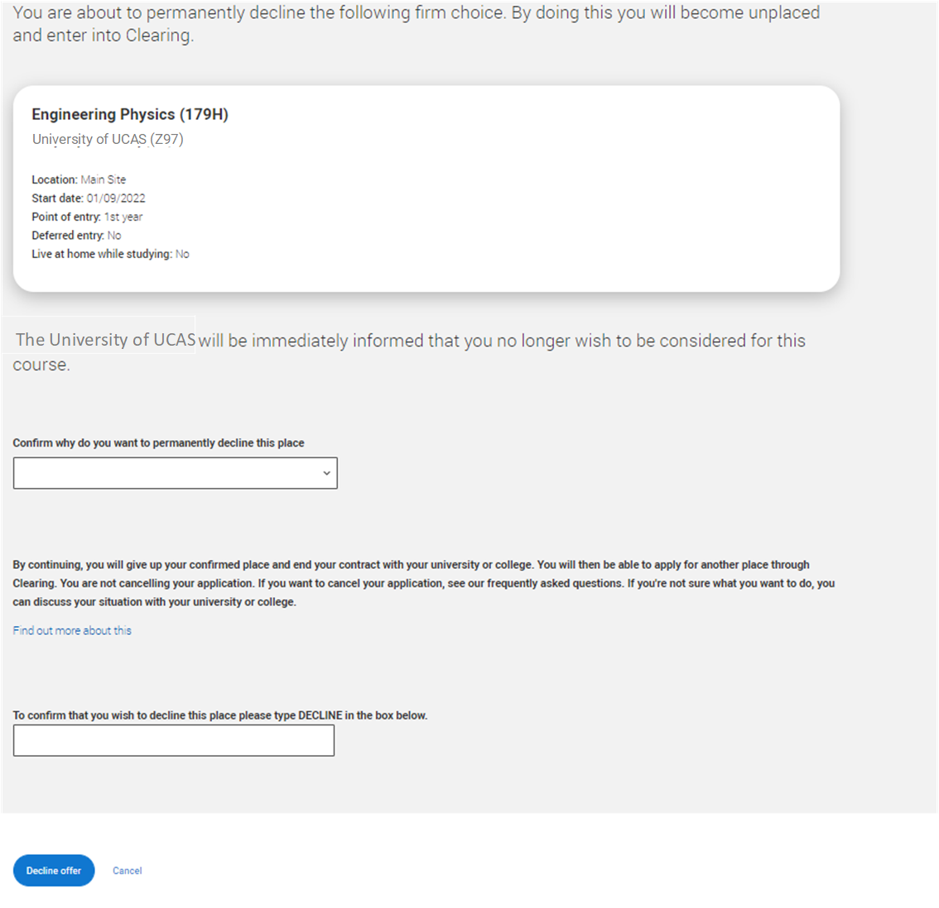
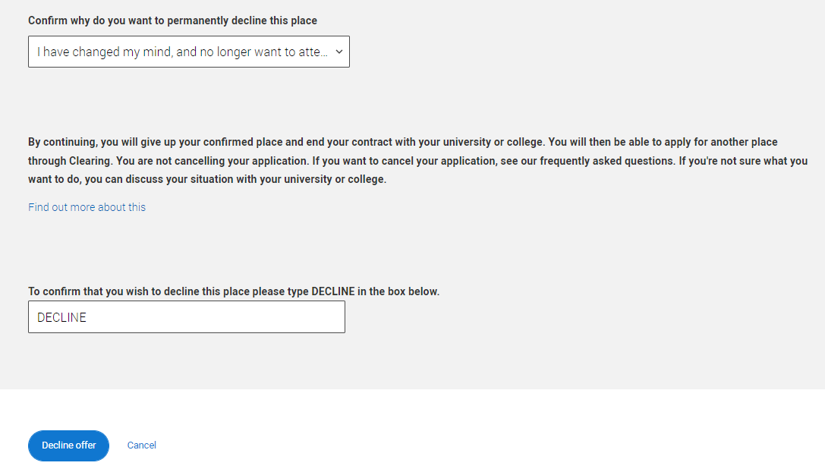
Decline my place (step 2)
They should only use this if they no longer wish to take up their place at the university or college.
Doing so will decline their place and cancel their contract with the university or college, including any accommodation or scholarship arrangements.
We advise students to secure a new place before declining their current one if they still wish to attend university or college, as this decision is irreversible.
Public

Slide 24
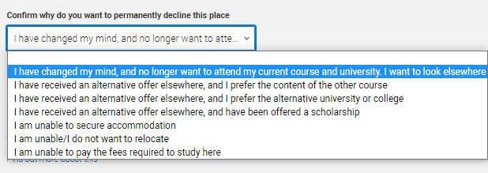
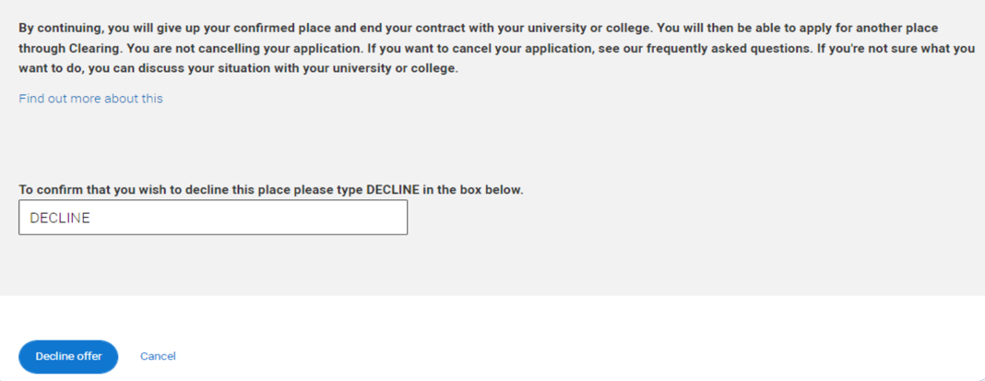
Decline my place (step 3)
Students must understand that declining their place will put them in Clearing.
It may not always be the best option to decline, there may be alternatives available.
Applicants should never feel pressured to decline. If they are uncertain, suggest they contact UCAS to discuss their options.
To confirm the decision, students must type ‘Decline’ when prompted.
Public

Slide 25
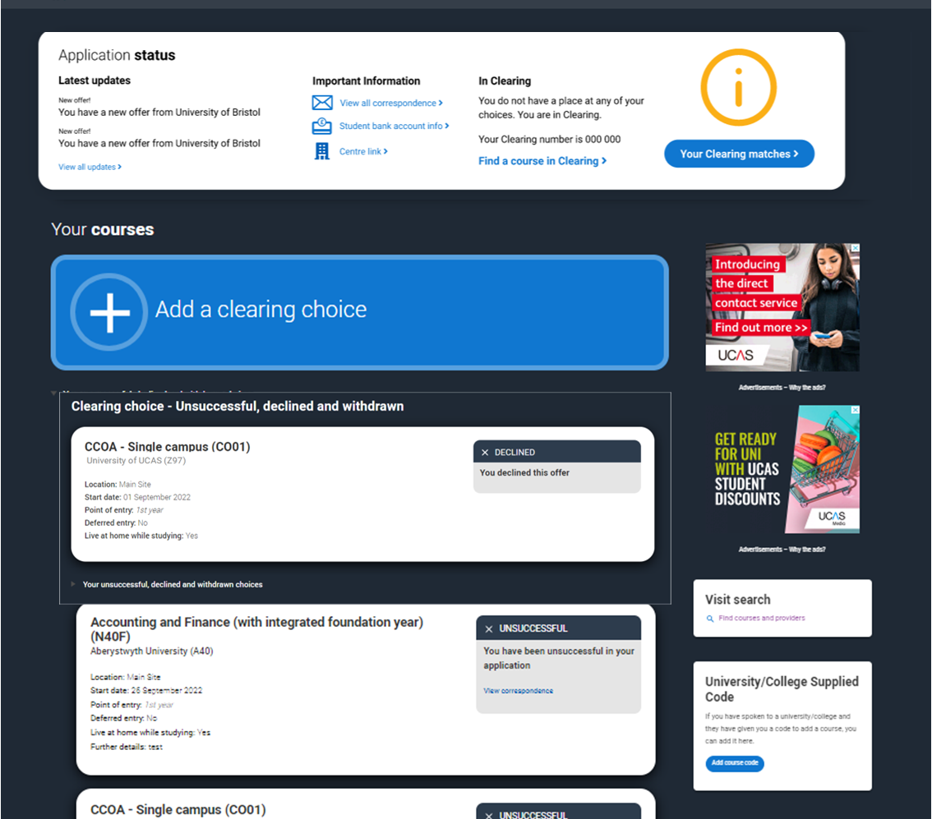
Decline my place (step 4)
Swapping between the firm and insurance choice is not possible. If they wish to attend their insurance choice, they must do so through Clearing. They should first contact the insurance choice to confirm acceptance before declining their firm place.
If an applicant uses ‘Decline my place’ they will then enter Clearing.
Public

