Slide 1

Confirmation and Clearing 2025
What you need to know
Public

Slide 2
Key dates
30 June
5 July
14 August
20 October
Applications received after this are entered into Clearing*
Clearing Opens
Level 3 results day (JCQ)
Last date to add 2025 Clearing choice
Last date to apply for a course in Extra
Scottish results day (SQA)
Final date for 2025 applications
4 July
5 August
24 September
* 18.00 UK time
Public

Slide 3
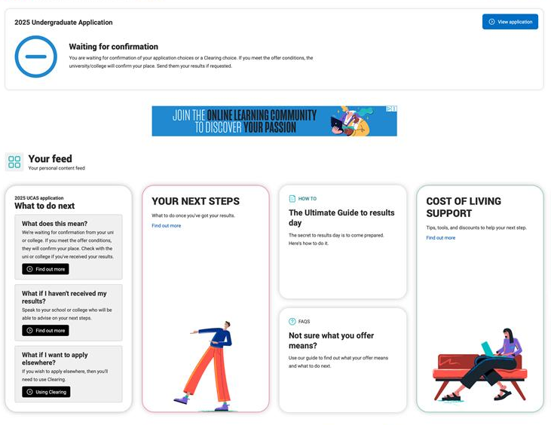
What is confirmation?
Confirmation is when universities and colleges check if you’ve met the conditions of your offer based on your results.
It’s the final step to secure your place at your chosen university or college.
If you meet the requirements, your place is confirmed. If not, you’ll have other options to explore.
UCAS will provide personalised updates throughout the process.
Public

Slide 4
What could happen at confirmation?
You meet the conditions of your firm or insurance
University/college confirms your place.
You don’t meet the conditions of your firm or insurance
University/college may choose to confirm your place even if you slightly miss the grades.
University/college may offer a change of course offer.
You exceed the conditions of your firm or insurance
You can look for a new opportunity in Clearing and decline your confirmed place.
University/college confirms your place.
You're not placed at the university/college.
You can look for a new opportunity in Clearing and decline your confirmed place.
More info on ucas.com on our page:
what your application status means.
Public

Slide 5
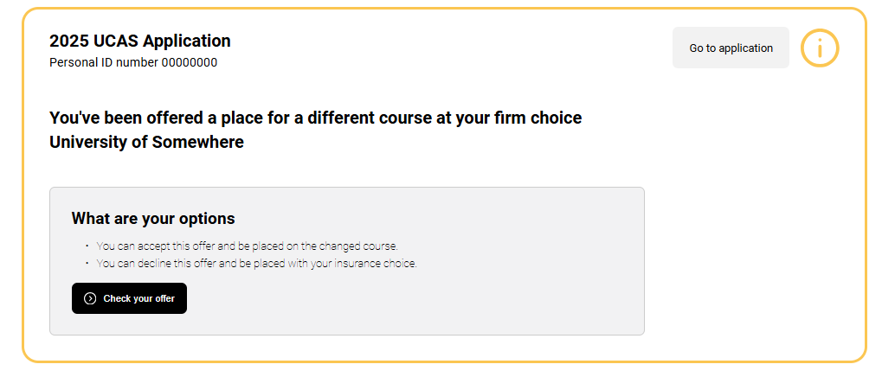
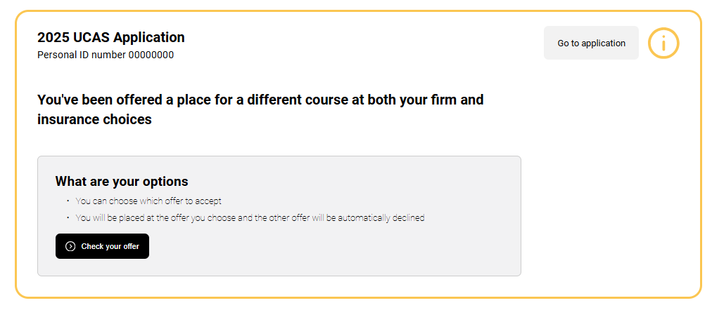
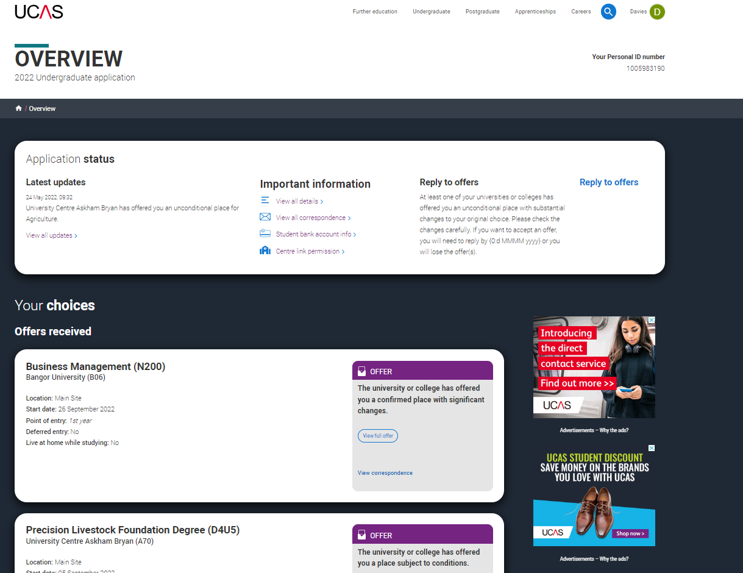
What is a change of course offer?
You may find your firm or insurance choice offers you a different course, start date, or point of entry.
You have five calendar days to accept or decline a course change (in your application).
It’s important to review the details carefully and read UCAS advice on what to do next.
If you have any questions about the changes, contact the university or college.
Public

Slide 6
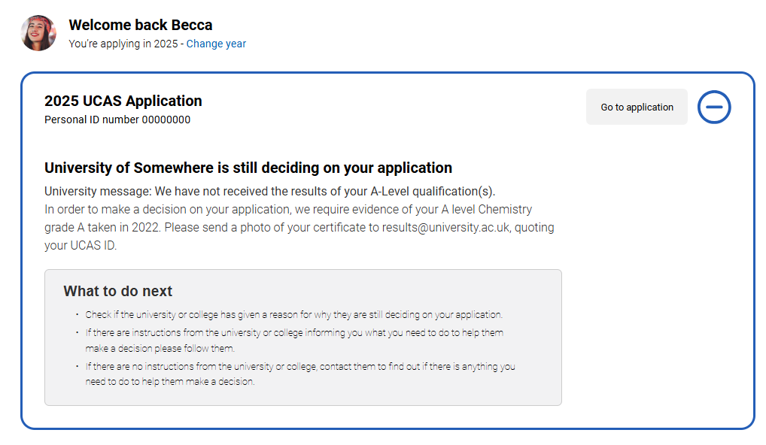
Still waiting for a decision?
Your choice may not have made a confirmation decision yet.
If this happens, there may be an explanation in your application, such as needing to send your results directly or still needing to meet one of the conditions.
If you have any concerns, check your emails and contact the university or college to discuss.
Public

Slide 7
Clearing made simple
Clearing | Not holding a place? You can still secure a place at a university or college through Clearing and start your studies this year.
Clearing Plus | If you’re eligible for Clearing use ‘My matches’ in your application to find courses matched to you.
Decline my place | Changed your mind? You can use Clearing if you no longer want to attend your confirmed place or want to explore other options.
Public

Slide 8
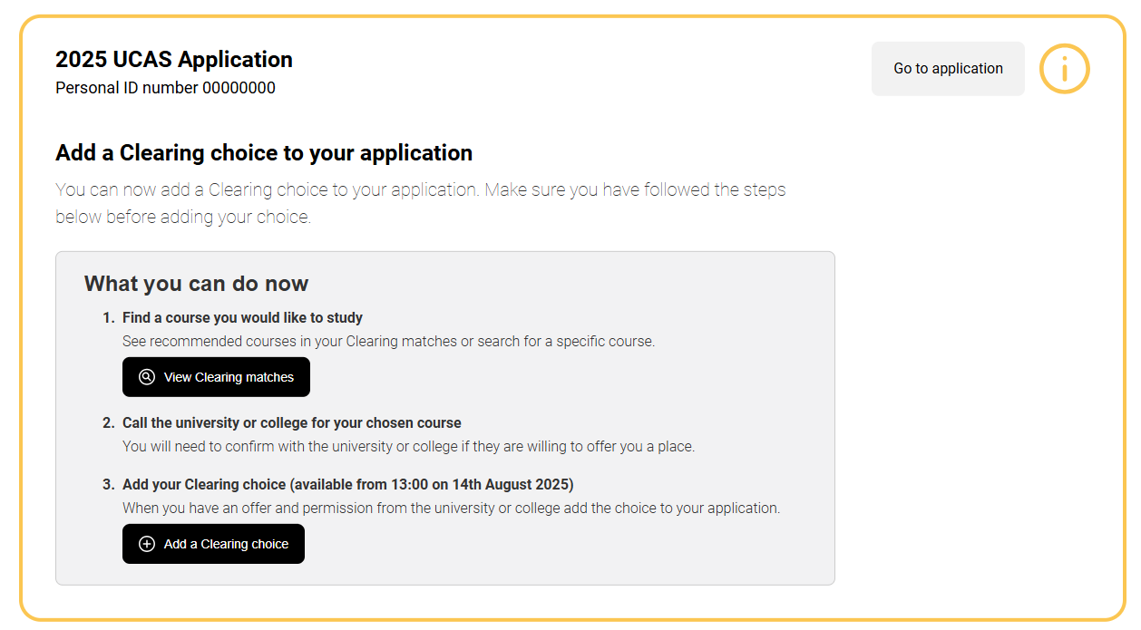
Clearing explained
Your chance to find an opportunity; Clearing runs between 5 July – 20 October.
To use it you need to have:
applied before 30 June and have no offers
applied before 30 June and declined any offers received
didn’t meet the conditions of your firm or insurance choice
applied after 30 June (a new application; you haven’t applied yet)
Public

Slide 9
How Clearing works
1
Research options
2
Make contact
3
Get offers
4
5
Add your choice
The university or college reviews your full UCAS application.
Check course details and entry requirements.
Explore available courses on UCAS.
Contact universities and colleges you're interested in.
Ask about availability and discuss your application.
Receive verbal offers (you can get more than one).
Compare and decide which is best for you.
Choose one course to add to your application.
Be sure to do this within the time limit given.
Confirmation
If all good – you’re officially placed on the course
If unsuccessful, you can start again.
Public

Slide 10
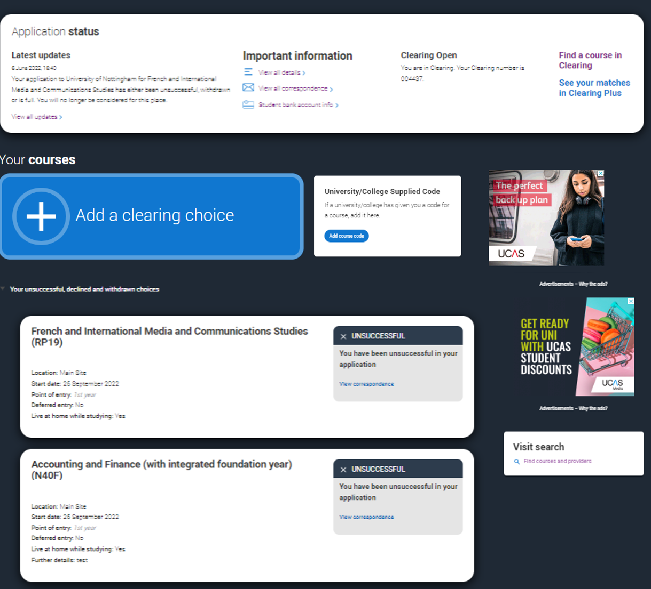
Adding a clearing choice
You can add a Clearing choice from:
10:00 on SQA results day*.
13:00 on JCQ Level 3 results day*.
*All timings are UK time
Public

Slide 11
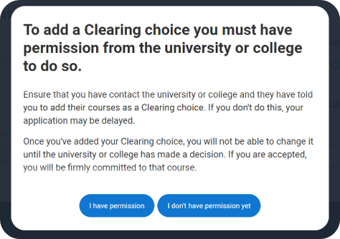
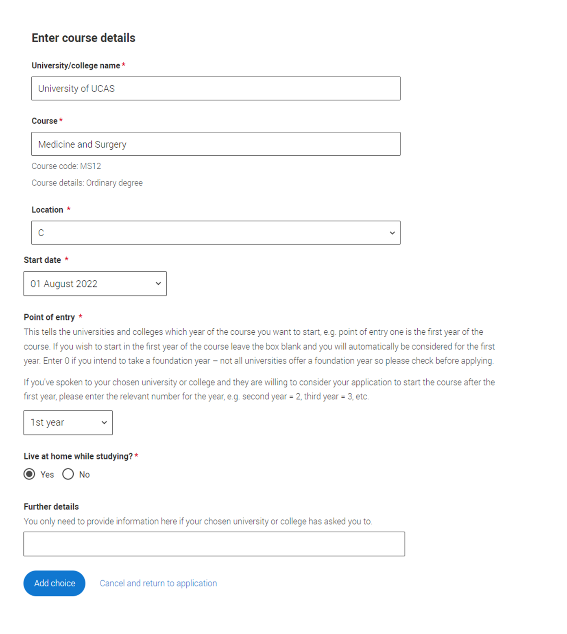
Adding a clearing choice
You should only add a Clearing choice after getting permission from the university or college.
You must enter your chosen Clearing choice within the deadline set by the university or college.
Public

Slide 12
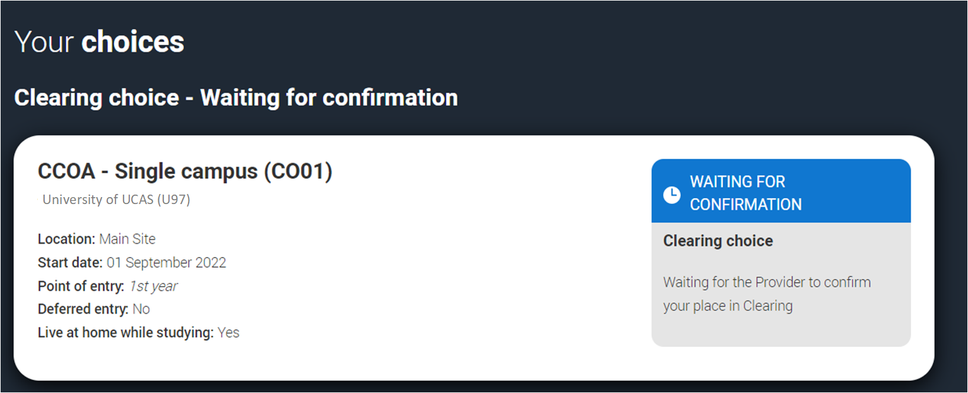
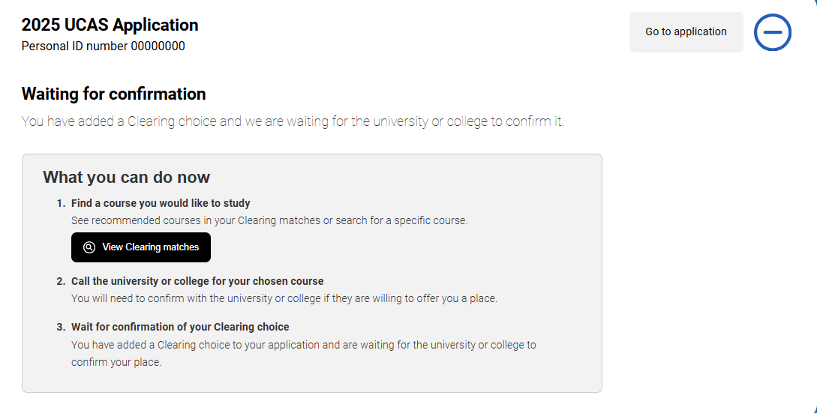
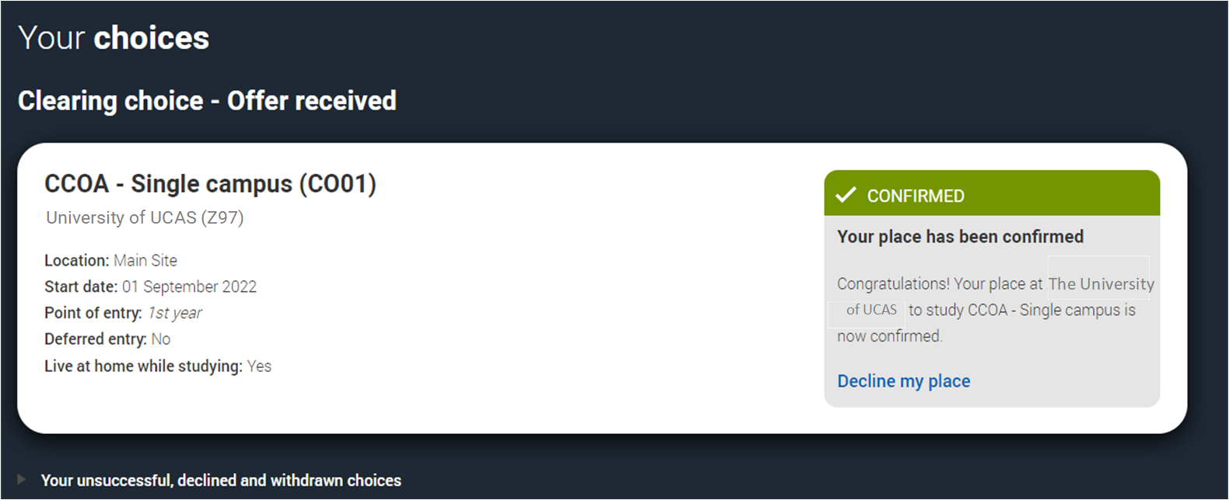
Adding a clearing choice
You can only add one Clearing choice to your application.
If the university or college doesn't accept your Clearing choice (Unsuccessful) or if you choose to use 'Decline my place' after it’s been accepted, you’ll be able to add a new Clearing choice.
Public

Slide 13
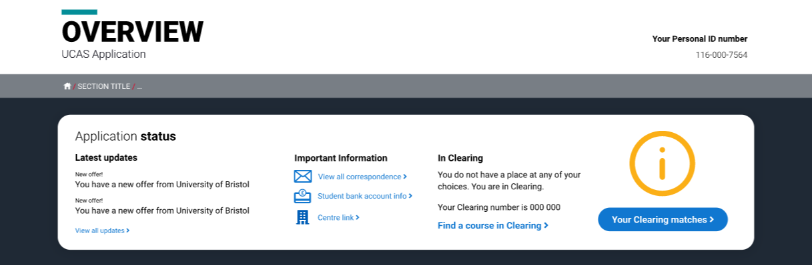
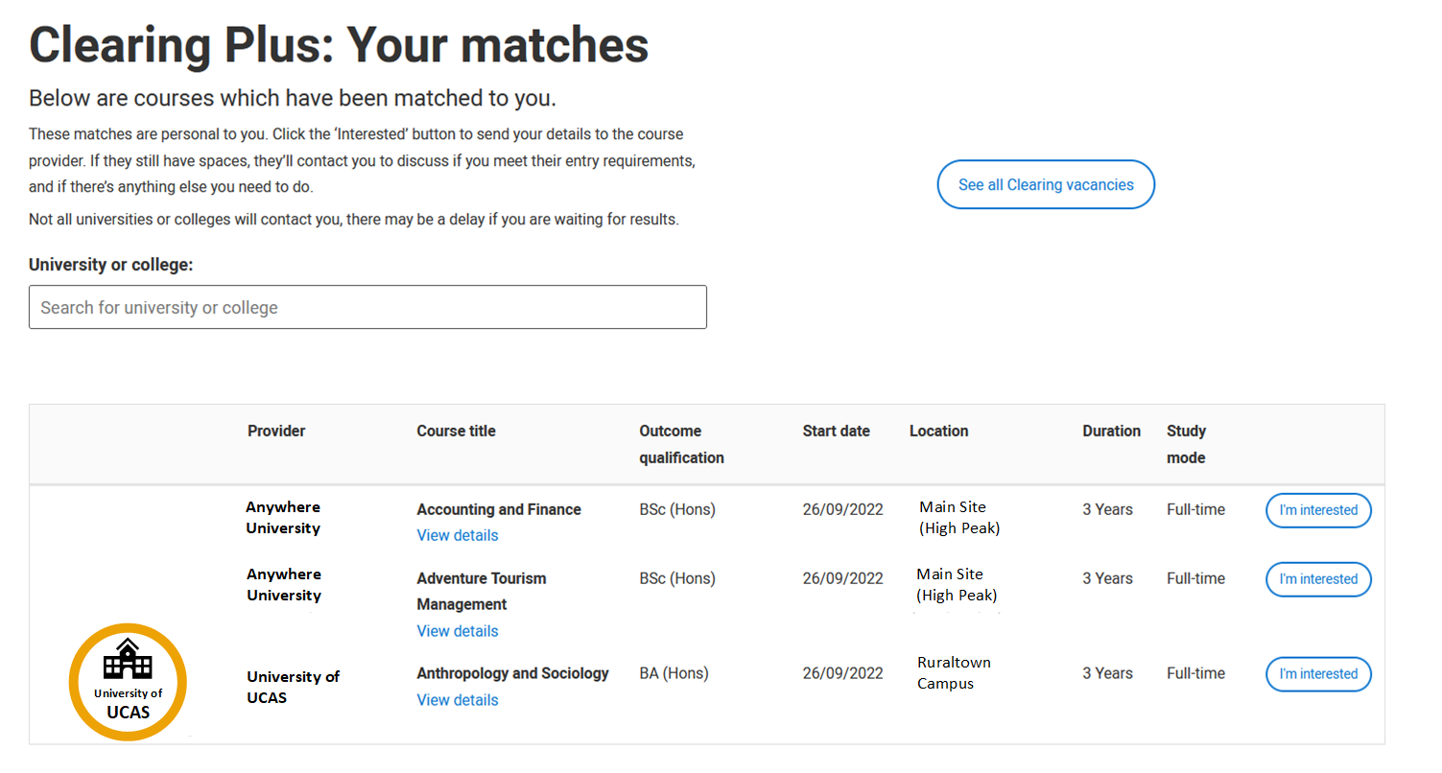
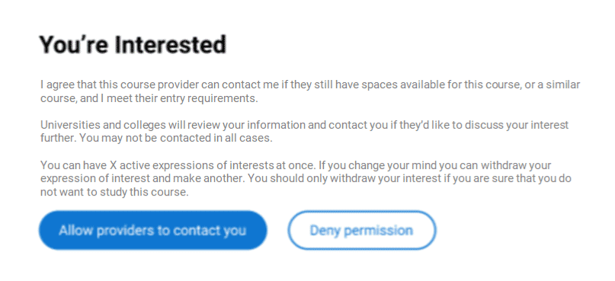
What’s clearing plus?
If you’re eligible, we'll match you to up to 50 courses based on your application and what universities and colleges are looking for.
It might help you discover courses you hadn’t thought of.
You can select ‘I'm interested’ to show your interest, and universities may contact you.
You can have 5 active interests at a time, but it's not your only option. If none of the matches interest you, you can search for other courses using the UCAS tool.
Universities may not contact you, so it’s important to keep looking for available courses in Clearing using our search tool.
Public

Slide 14
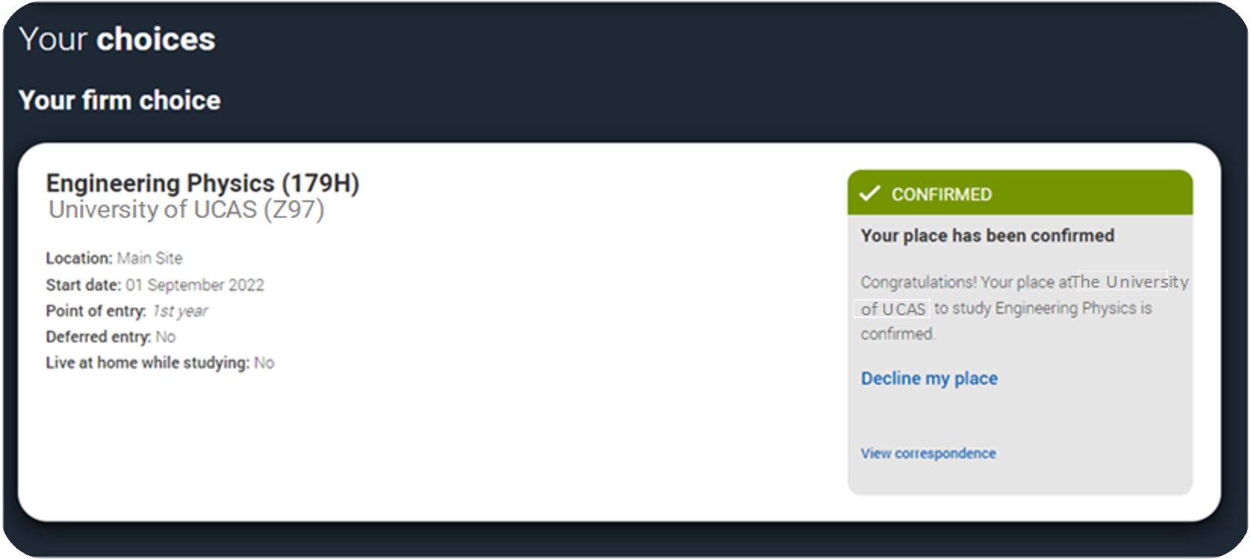
What’s ‘decline my place’?
Starting from 5 July, if you’re holding an unconditional firm place, you can release yourself into Clearing, using ‘Decline my place’.
We recommend you secure a new place before declining if you still want to go to university or college, because once you decline, you can't undo it.
This option is available until 3 September 2025. After that date you’ll need to contact the university or college directly.
Public

Slide 15
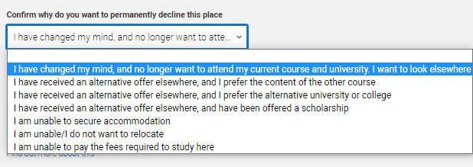
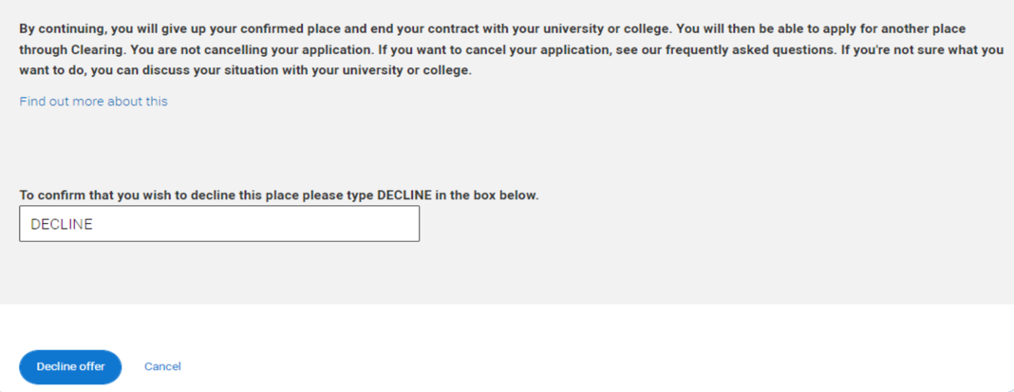
When should I use ‘Decline my place’?
Only decline your place if you don’t want it anymore. There may be other options, and we’ll give advice based on what you say.
Declining cancels your place and contract with the university. If you want to change your course, talk to them first.
Keep in mind, declining your place will also cancel any arrangements for accommodation, scholarships or bursaries you’ve made.
Public

Slide 16
You can’t swap your firm and insurance choices.
If you're confirmed at your firm choice, your insurance is automatically declined.
If you want to go to your insurance, you’ll need to go through Clearing.
First, check with your insurance to see if they can accept you, then use ‘Decline my place’ to enter Clearing.
Don't decline your place until you're sure your insurance can offer you a spot.
Can I swap between my firm and insurance?
Public

Slide 17

What can you do to prepare ?
Public

Slide 18

Plan your b, c & D
Plan for different outcomes.
Browse your options, start exploring universities, colleges, and courses before you get your results. Don’t forget apprenticeships or a gap year! :
UCAS Search
University and college websites.
Chat to students on UCAS Hub
Social media
Revisit and reconsider look back at your original choices. Would you still be happy going there if a place opens up?
Check course details, especially entry requirements, for any new courses you’re considering.
Public

Slide 19
5 steps to prep
Make a list of top choices
Know how to contact
Know why you want that place
THINK ABOUT what matters to you
Take control
Write down the courses you’d be interested in so you can quickly check if they’re in Clearing.
Check ucas.com for available options on results day.
Find the best way to reach each university, whether by phone, email, or another method.
Check out their Clearing webpages for details.
Be ready to explain why the course interests you.
Have bullet points prepared, keep your personal statement handy (if helpful) and have your grades ready.
Prepare questions about things like location, accommodation, societies, student life, and available bursaries.
Can you do a campus tour? Find the best fit for you.
Remember universities and colleges want to speak to you, not your parents or anyone else.
Being prepared helps you take the lead and make confident decisions.
Public

Slide 20

On the day checklist
Pause. Think. Take time to reflect.
Fully charged mobile phone – to make calls and stay connected.
Personal ID Number – you’ll need this to speak with UCAS and universities. You can find it in your application.
Clearing number – found in your application; you may need it for Clearing.
Your grades – have them ready to share when needed.
A copy of your personal statement – helpful for inspiration if asked why you’re interested in the course.
Double check entry requirements – these may change during Clearing, contact universities if you’re unsure.
Confirm offer timescale - if you’re offered a course ask how long you have to decide and add it to your application.
Pen and paper – to take notes and jot down important details!
Remember, it might be busy, so you may have to wait.
Public

Slide 21
How can we help?
ucas.com/Clearing for top tips and more info.
Check out ‘The Ultimate Guide to Clearing’.
UK number
0371 468 0 468
From outside the UK:
+44 330 3330 230
Follow us on TikTok, YouTube and Threads.
Send us a direct message on Facebook, Instagram or X.
@ucas_online
Head Online
Give us a ring
Get on social
Public

