Slide 1


Highlights from Applicant experience surveys 2014
April 2015
Susie Price
Senior Market Researcher
s.price@ucas.ac.uk

Slide 2


Why do we do learner research?
  To understand them
  To find out what they think and expect of UCAS
  To improve their Customer Experience
Enjoyable
Easy
Fulfilling

Slide 3
The learner insight we provide
  New Applicant survey (monthly – sent no more than one month after they apply. Focus on research and Apply)
  End of Cycle applicant survey (annual, October. Looking back at the whole customer journey)
  Lifestyle surveys (annual, December – for UCAS Media)
  18+ online focus groups (all schemes, throughout the year)
  Ad hoc research
  Secondary research.

Slide 4
End of Cycle Applicant survey 2014
  All 2014 UCAS applicants were invited to participate in the survey.
  Open 30 September to 20 October 2014.
  Our third annual EoC applicant survey.
  The survey explored what applicants THINK and FEEL.

Slide 5
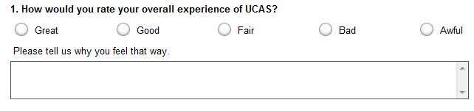
We asked both closed and open questions

Slide 6
40,000 applicants responded this year, an uplift of 145% on 2013

Slide 7
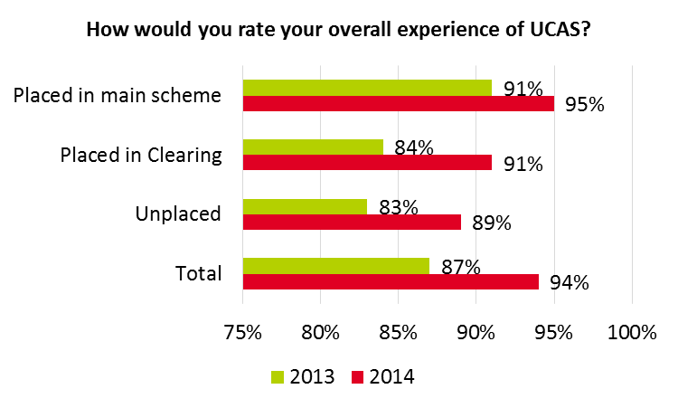
In 2014, 94% of respondents rated their overall experience of UCAS as ‘great’ or ‘good’
This compares with 87% in 2013, an uplift of 8%.

Slide 8
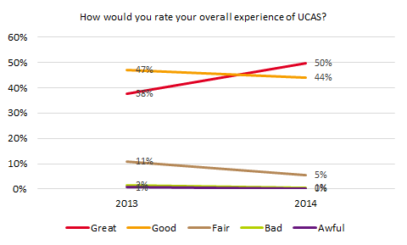
In 2014, 50% of respondents rate their overall experience as ‘great’, an uplift of 32% since 2013
Respondent base: all respondents 2013 (15,653), all respondents 2014 (31,178)

Slide 9
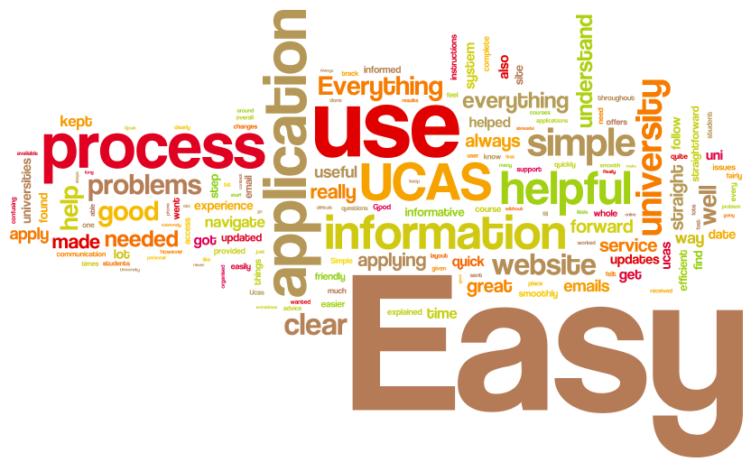
‘Great’ or ‘good’ overall experiences of UCAS

Slide 10
‘Great’ or ‘good’ overall experiences of UCAS
Overall my UCAS experience was AMAZING. [You] kept me up to date with all the things that a student needs to know, e.g. student finance [and] the progress of my application.
I found the process really easy to use and understand.
I found the process really easy to follow. The most helpful was the video information and the email notification.
It was easy to use and simple to track my progress.

Slide 11
‘Bad’ or ‘awful’ overall experiences of UCAS
  Website navigability and outages
  Difficulty completing Apply
  Long, complex process
  Unwanted advertising emails
  ABL problems/UCAS mistakes
  Personal statements
  Applicant was unsuccessful.
The website is so clunky and always down when you need to use it.
[Apply was a] bit of a pain to deal with especially the education part.
The amount of emails after applying are painful. Stop sending these spam ads mail.
I got all rejections.

Slide 12
Those with a disability are a little less likely to have a positive customer experience
  89% of those with a disability had a ‘great’ or ‘good’ experience, compared with 95% of those without.
Online chat instead of having to call. This is hard when unwell.
UCAS could offer additional backgrounds and font colours for people who suffer from visual stress.
Give more attention to the emotional and mental strain uni life can give students . Perhaps send students emails about that?
[Tell us] what universities have to offer students with learning difficulties. I had little to no idea what was available for me.

Slide 13
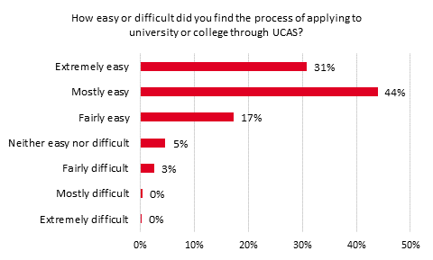
Although overall experience is positive – it’s not necessarily EASY to apply
Respondent base: all respondents: 39,661

Slide 14
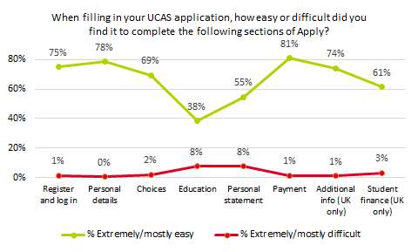
Pain points of Apply are the Education and Personal Statement sections
New Applicant survey: Respondent base: all respondents (20,033)

Slide 15
EU and international respondents would like us to make it easier to input their qualifications in Apply
To complete the lists of overseas qualifications. I find it sometimes quite difficult as an EU student to make an option choice from the qualification list.
And…
Clear email alerts for International students regarding deadlines..
It'd be great if UCAS can give suggestions or advice on which universities to pick based on our interests, course intended to take, uni rankings etc. as there are so many to choose from!
Explain what kind of style should the Personal Statement be in.
Easy step by step guide [to applying].

Slide 16
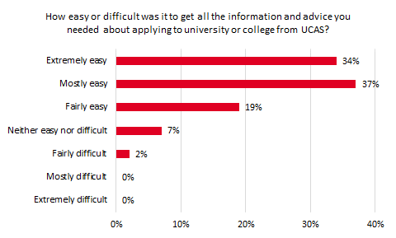
And it’s not necessarily EASY to get all the I&A they need, either
Respondent base: all respondents (39,436)

Slide 17
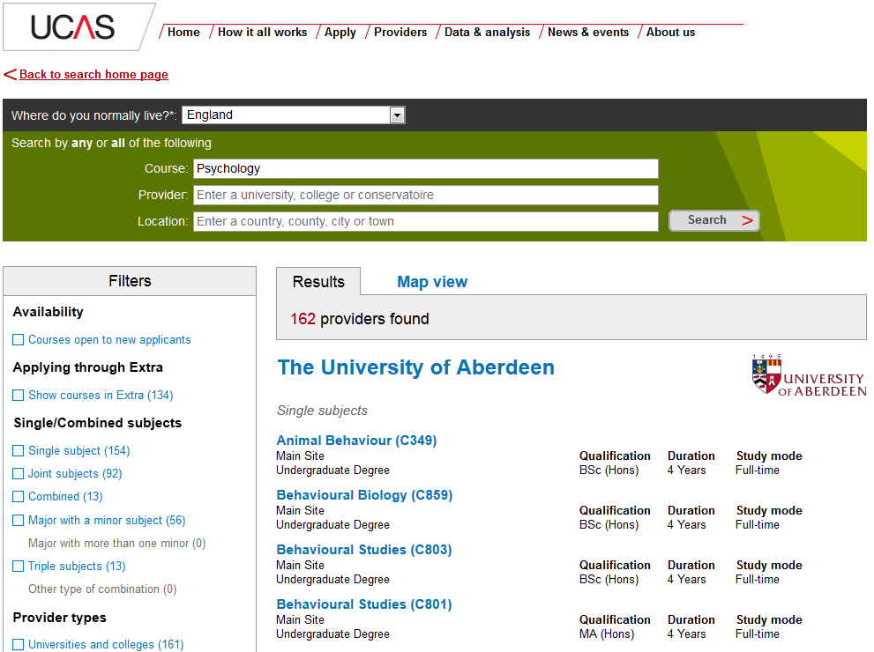
What do learners think about our search tool?
72% net easy score
75% satisfaction score
20% say it doesn’t deliver all the information they want to see about HEPs
They want to filter courses by entry requirements.

Slide 18











What other sites are they using?

Slide 19
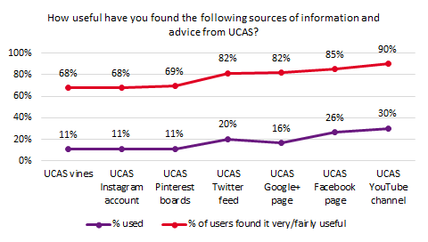
Aside from ucas.com, the most used and most useful digital I&A sources are the YouTube channel and the Facebook page
New Applicant survey: Respondent base: all respondents (13,792)

Slide 20
Both international and UK respondents want more comprehensive, personalised I&A from UCAS
Information should not be packed with excessive links to other sites as this is a "turn off“. Students also do not like to read lengthy manuals just to get answers to a simple question.
UCAS was unable to provide holistic information which I require and I had to visit other websites to do comparisons etc.
Enable us to ask questions via email.
Have an online webchat service for applicants to ask questions.
More information for students who are applying with different circumstances.
Too many general information. You need to research a lot to find information (like medicine courses).

Slide 21
What other I&A is missing?
I had a problem finding equivalencies between the UCAS point system and the marks in other European education systems.
Leaflets, booklets etc. given out by schools outlining the steps of the process. Something physical to refer back to with a checklist or flow chart.
Make it easier for overseas students, maybe offer detailed instructions in a variety of different languages, in order for the references to grasp what is expected of them.
Have a forum for students to discuss.
Improve the degree search engine to something similar to UNISTATS.

Slide 22
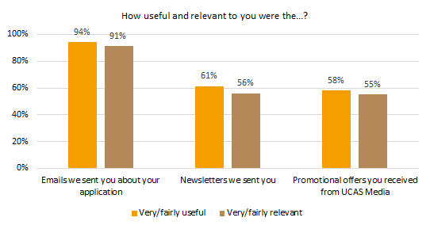
Only just over half of respondents say our newsletters and promotional offers are relevant to them
Respondent base: all respondents 2014:c35,500

Slide 23
Respondents feel very strongly that we should tailor our newsletters and emails
I am a stay at home student and I felt the majority of offers were aimed at those who would be living in halls.
Maybe don't send everyone everything - sort people into groups.
As a mature student I occasionally found that the emails/information was aimed at a younger demographic.
Send fewer newsletters whilst people are expecting offers/rejections as it caused me a lot of stress last year.

Slide 24
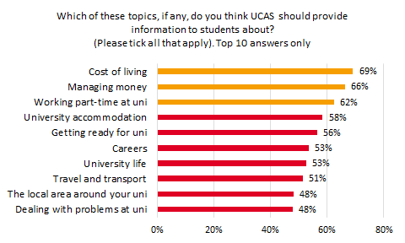
  Respondents want UCAS to provide more information about financial topics
Respondent base: all respondents (31,550)

Slide 25
93% of respondents said their school, college or centre was very/fairly supportive throughout the UCAS process
Respondent base: all respondents who made their application through a school, college or centre (excludes NA or not needed) (25,201)

Slide 26
What could unsupportive centres could have done better?
[My school in Japan was] not very familiar with applying through UCAS, and they failed to give me useful support.
Support students who aren't doing Oxbridge or Medicine.
Given us one-to-one scheduled sessions [and] given us advice on our personal statement that was not generic advice.
My college failed to provide my reference on time, therefore I had to [use Clearing].
My tutor told me to aim lower and not try for certain universities as they would 'laugh at my application'.

Slide 27
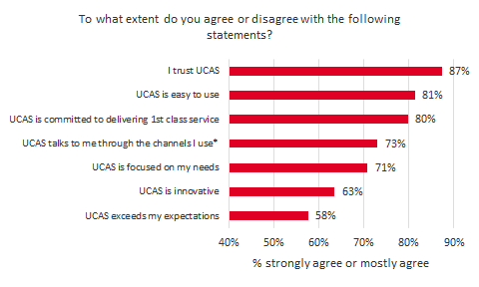
  We’re not very innovative. And we didn’t exceed their expectations
*(…email, social media etc)

Slide 28
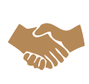
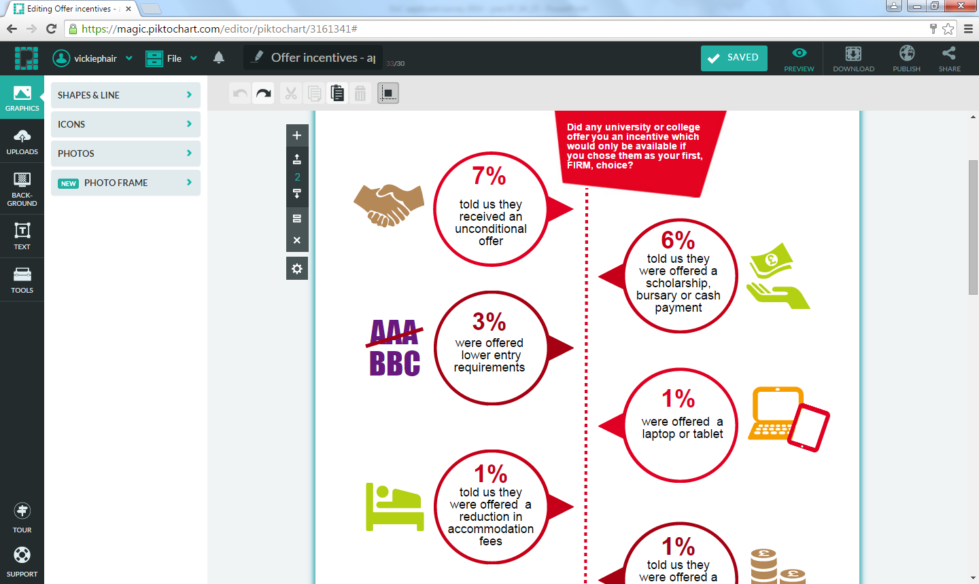
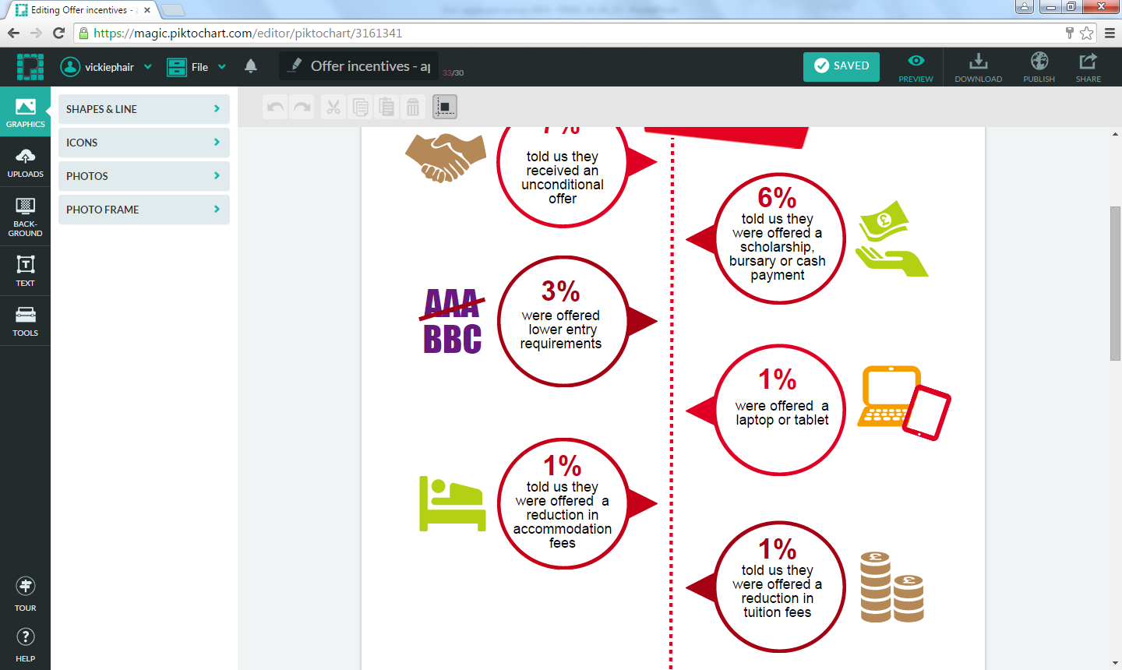
  18% told us they were offered an incentive by a HEP in return for choosing them as their firm choice
  Unconditional offer (7%)
  Scholarship, bursary or cash payment (6%).
  Lower entry requirements (3%)
  1% were offered a laptop or tablet
  1% were offered a reduction in accommodation fees
  1% were offered a reduction in tuition fees.

Slide 29
  Those who were incentivised to firm a HEP had mixed views about the practice
Nope, did not impact on my decision. As I thought it was more important to choose the university I thought was best suited to me instead of money.
I thought it was fantastic! [University X] said that if I supply my results ASAP for my HND then they would switch my conditional to an unconditional which meant I was definitely on the course!
This for me shows a sign of desperation.
The university was my first choice anyway, however it was good to know that there would be more financial support than expected.

Slide 30
  94% of those placed in the main scheme felt that they applied for the right HE courses for them
I [was also considering] apprenticeships, though there is next to no support, at school, or online for people who would go down that route.
I think I aimed higher than I could reach.
I wasn't aware of my loan entitlement before I applied.
Perhaps if there were student reviews of each course on the UCAS website along side the search facility, I would have felt more confident.

Slide 31
  94% of those placed in Clearing also felt that they ended up on the right HE course for them
Nothing to do with UCAS, but I rushed into it. Sometimes wish I'd just taken a Gap Year and reapplied.
When feeling like uni places are going by the second, I made quick decisions with less research.
I'm not sure how good the university is, I don’t know if the degree I’ll receive at the end of the course will be as recognised by employers.
I didn't think about what the course required of me or the pros and cons. I was just desperate to get into somewhere.

Slide 32
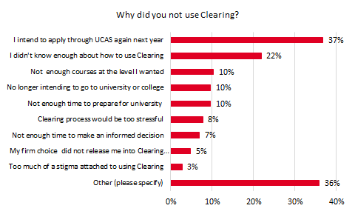
  More than one fifth of Unplaced respondents say they didn’t use Clearing because they didn’t know how to use it (22%)
Respondent base: Unplaced who did not look at the courses available in Clearing (1,577)

Slide 33
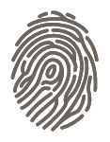
Ways we can improve the applicant Customer Experience
  Applicants now expect a much more personalised experience.
  Identity initiative:
    Personalised view of ucas.com
    Ability for users to create and amend the ‘view’ they see
    Personalised emails, based on choices, circumstances and interests
  Work out how we can be ‘innovative’ and ‘exceed expectations’.

Slide 34
Ways we can improve the applicant User Experience
  Make it easier for learners to use Apply and to get the I&A they need, especially International students.
  Fix Apply pain points
  Help international applicants understand the value of their qualifications
  Provide an open day search facility
  Online chat and email as options to contact UCAS
  Promote the accessibility pages of ucas.com.

Slide 35
Some quick wins?
    Promote usefulness of attending open days
    Encourage use of Clearing. Explain how to use it
    Deadline reminders
    Encourage advisers to be more supportive.
  Provide I&A about:
      Financial topics
      Coping with disabilities, stress and emotions at university.

Slide 36
Key points to remember
  Most learners had a positive Customer Experience of UCAS overall.
  But the learner User Experience can disappoint.
  We need to make it easier for learners to
      Apply
      Get the right I&A
  Our emails could be more useful and relevant.

Slide 37
For more information please contact:
Susie Price
Tel: 01242 545 474
s.price@ucas.ac.uk

