Slide 1

Free School Meals (FSM) step by step.
For Registered Centres in 2026 Cycle
Public

Slide 2
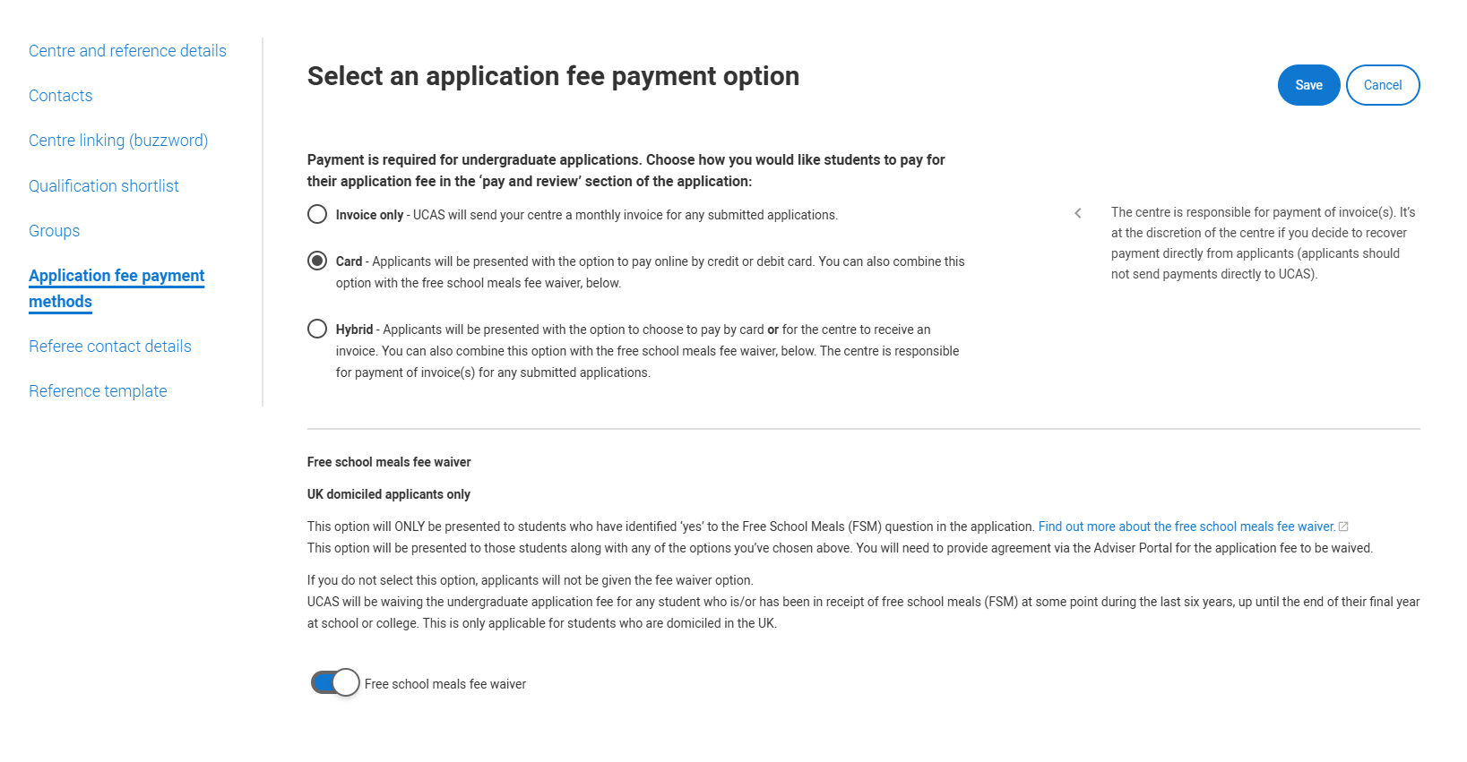
NEW FOR 2026
A new Free School Meals Waiver payment option.
This can be used in conjunction with any payment method in the Adviser Portal.
If selected it allows applicants who answer ‘Yes’ to the Free School Meals question in the application, to use the FSM waiver.
Any applicant who answers ‘No’ or ‘Don’t know’ to this question will not see the waiver as an option when they come to review, pay and submit their application.
Public

Slide 3
FSM process (uk only)
Step 1 | Choose the application fee payment option in the Adviser Portal that best suits your school or college.
Step 2 | Apply the FSM Fee Waiver Payment option to work in conjunction with the main application fee payment method. If you do not select this option students will not be able to apply with the FSM fee waiver. If applied, it will only show to students who answer ‘Yes’ to the FSM question in the ‘More About You’ section of the application to choose the FSM Waiver payment option when submitting their application.
Step 3 | Students who are eligible for the waiver must answer ‘Yes’ to the FSM question in the ‘More about you’ section. Adviser can check answers on in-progress applications and email students for more information Any applicants who answer ‘No’ or ‘Don’t know’ for this question will not see the FSM Waiver option and therefore won’t be able to use it.
Step 4 | If FSM Fee Waiver payment option has been turned on and the applicant has answered ‘Yes’ to the Free School Meals question they will have a Free School Meals waiver option available, along with ‘Pay by Card’ or ‘Invoice’ option depending on the application fee payment option selected. If they have answered ‘No’ to the Free School Meals question (or the FSM Fee Waiver has not been applied) they will NOT see the FSM Waiver option.
Step 5 | If the FSM waiver has been used by the student advisers will need to agree to this in the adviser portal before sending to UCAS. If you do not agree, the centre will be charged for this application if sent to UCAS - you can return the application at this point and ask the student to pay by card. It’s essential that students who might be eligible for the FSM application fee waiver do not enter any card details. Once you pay by card (even if eligible), this cannot be reversed; a fee waiver cannot be applied after the pay and submit process has been completed.
Public

Slide 4
FSM payment process
Choose application fee payment option in adviser portal
Turn on the Free School Meals Waiver option in ADVISER Portal
Only applicants that answer ‘Yes’ to Free School Meals in ‘More About You’ will see the FSM waiver option
Agreement will need to be supplied in Adviser Portal. If no agreement, your centre will be charged if the application is sent to UCAS
Public

Slide 5
Student journey
Public

Slide 6
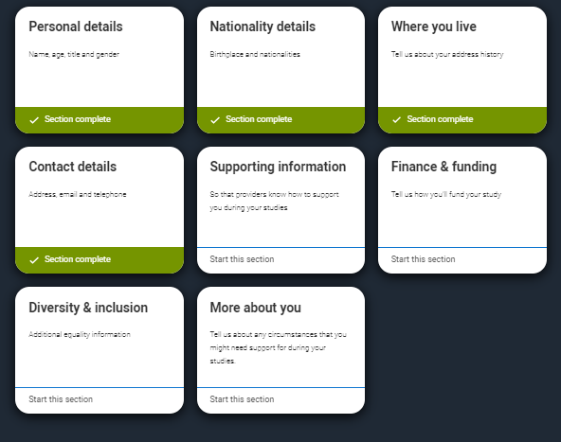
More about you
Eligible students who want to apply with the FSM application
fee waiver must share that they are, or have been, in receipt of
free school meals in the ‘More about you’ section.
Public

Slide 7
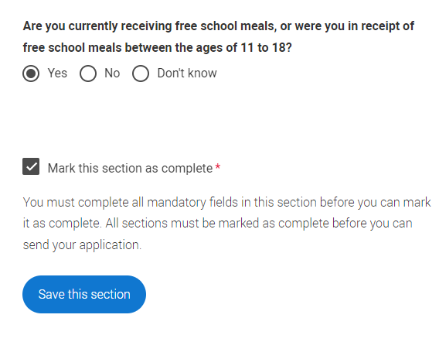
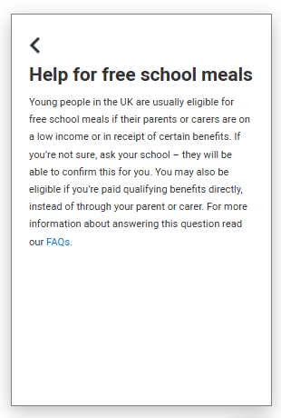
More about you
UCAS Free School Meals Application Fee Waiver
You must answer, ‘Yes’ to this question in ‘More about you’ to identify you are eligible for the free school meals application fee waiver.
Read our guidance to check if you’re eligible to have your application fee waived.
Your school or college will need to agree to your eligibility when reviewing your application and may require you to evidence this.
Public
Notes:
The ‘More about you’ section in the application gives you the opportunity to share a range of circumstances and support needs – one of these is your eligibility for free school meals. If you have received UK government funded free school meals at any point during your secondary education, select ‘yes’.
Students who are currently enrolled at school or college and have been in receipt of UK government funded free school meals at some point during the last six years (i.e. during secondary education) up until the end of their final year, will be eligible to have the application fee waived by UCAS.
If you are eligible you must answer ‘Yes’ to this question to be able to see the FSM waiver payment option when you submit your application. If you answer ‘No’ or ‘Don’t know’ the ‘Apply with FSM waiver’ payment option will not be visible.

Slide 8
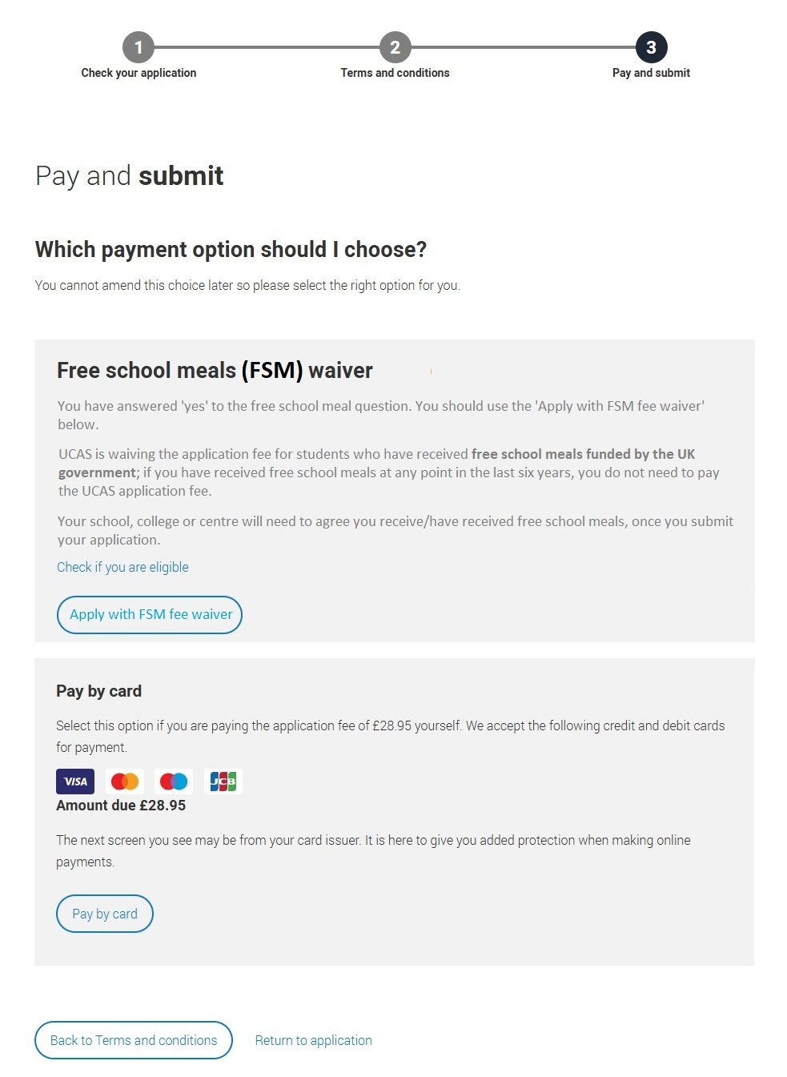
Free School Meal
Application Fee Waiver
If you are eligible for the free school meals waiver you need to choose ‘Apply with FSM fee waiver’, when you ‘Pay and submit’.
If you can’t see this option but think you’re eligible:
Check you have answered ‘Yes’ to the question in ‘More about you’.
Check with your school or college BEFORE entering any card details.
Once you pay by card (even if you are eligible), this cannot be reversed; a fee waiver cannot be applied after you have completed the pay and submit process.
Public
Notes:
UK domiciled applicants only: For UCAS to apply a Free School Meals application fee waiver to eligible applicants, you need to enable the new FSM fee waiver option. This can be used alongside the current payment method options to suit your school or college.
Only those students who answer ‘Yes’ to the FSM question in the ‘More about you section’ will have the option ‘Free school meals fee waiver’ when they review, pay and submit. Your centre will not be invoiced for eligible FSM students that you provide agreement for in the adviser portal.
It’s essential that students who might be eligible for the FSM application fee waiver do not enter any card details. Once you pay by card (even if eligible), this cannot be reversed; a fee waiver cannot be applied after the pay and submit process has been completed.
All other students should pay by card.

Slide 9
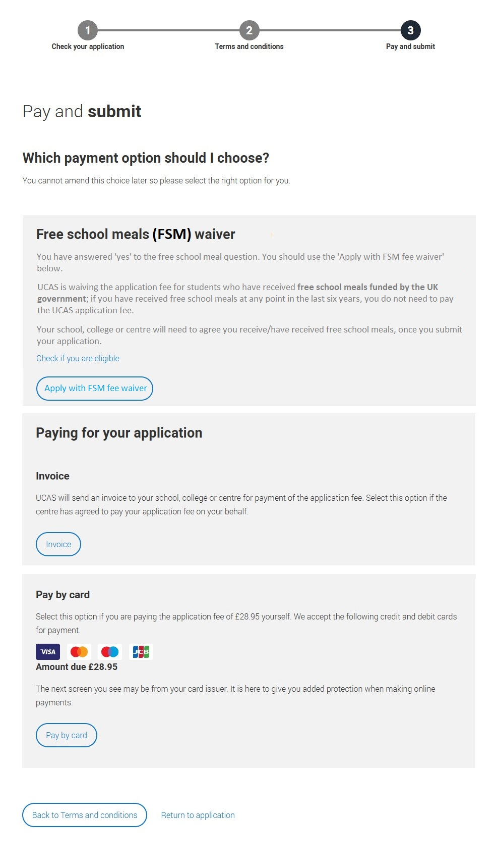
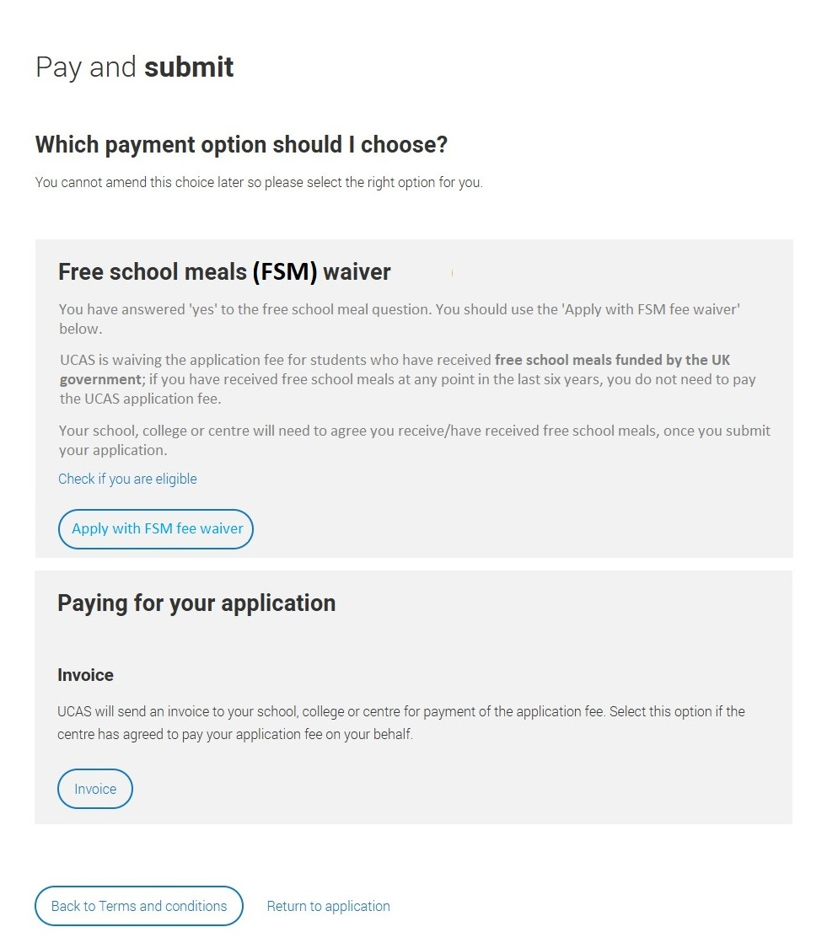
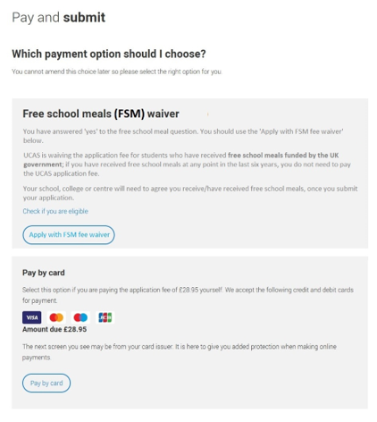
If FSM waiver is applied ELIGIBLE STUDENTS will see this option alongside the application payment option selected by the centre.
Invoice only
Card only
Hybrid – card and invoice
Public

Slide 10
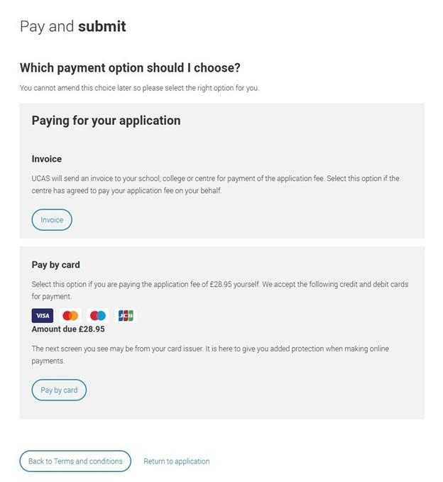
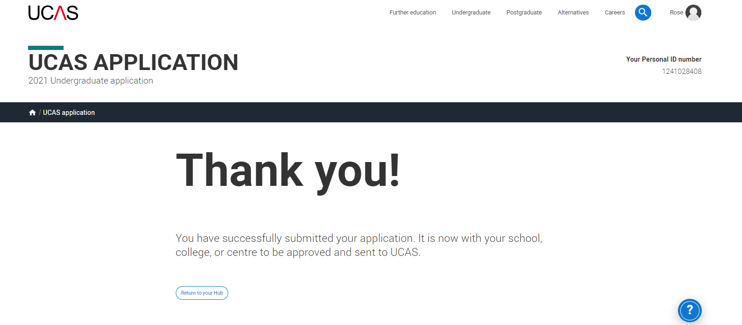
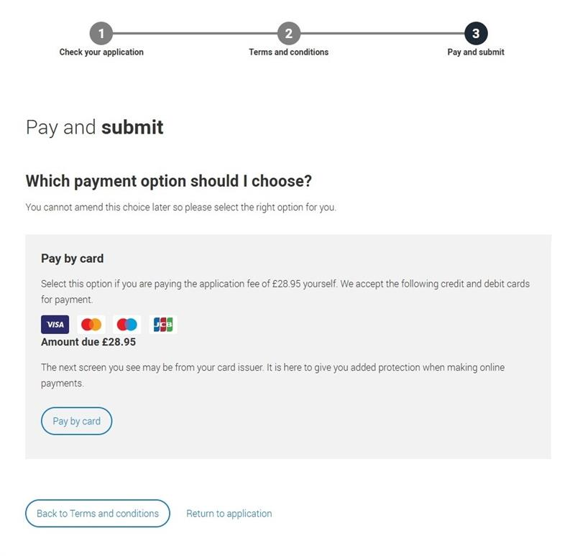
If student is not eligible or FSM waiver is not applied/Applicable STUDENTS will see the application payment option selected by the centre.
Invoice only
Card only
Hybrid – card and invoice
Public

Slide 11
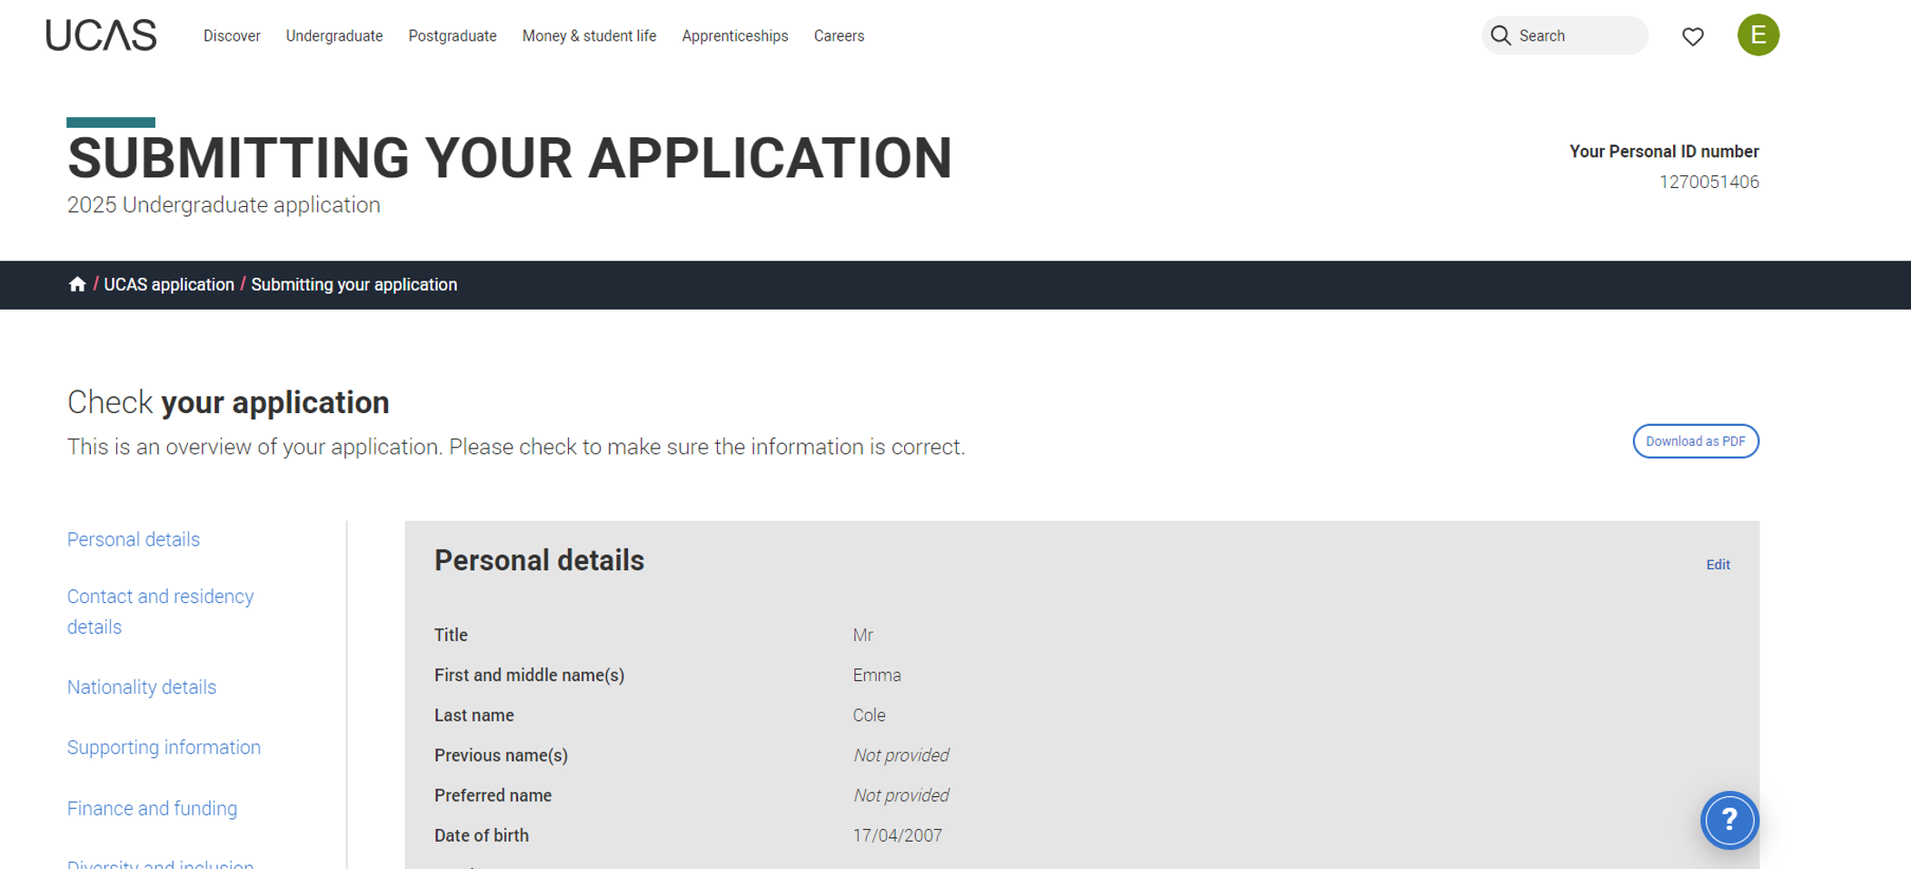

When you review your application, you'll see all of it onscreen, but you can download it as a pdf (in the top right) to help you check it.
At the bottom of the application, click Accept and proceed (or return to application if you want to make changes).
Public

Slide 12
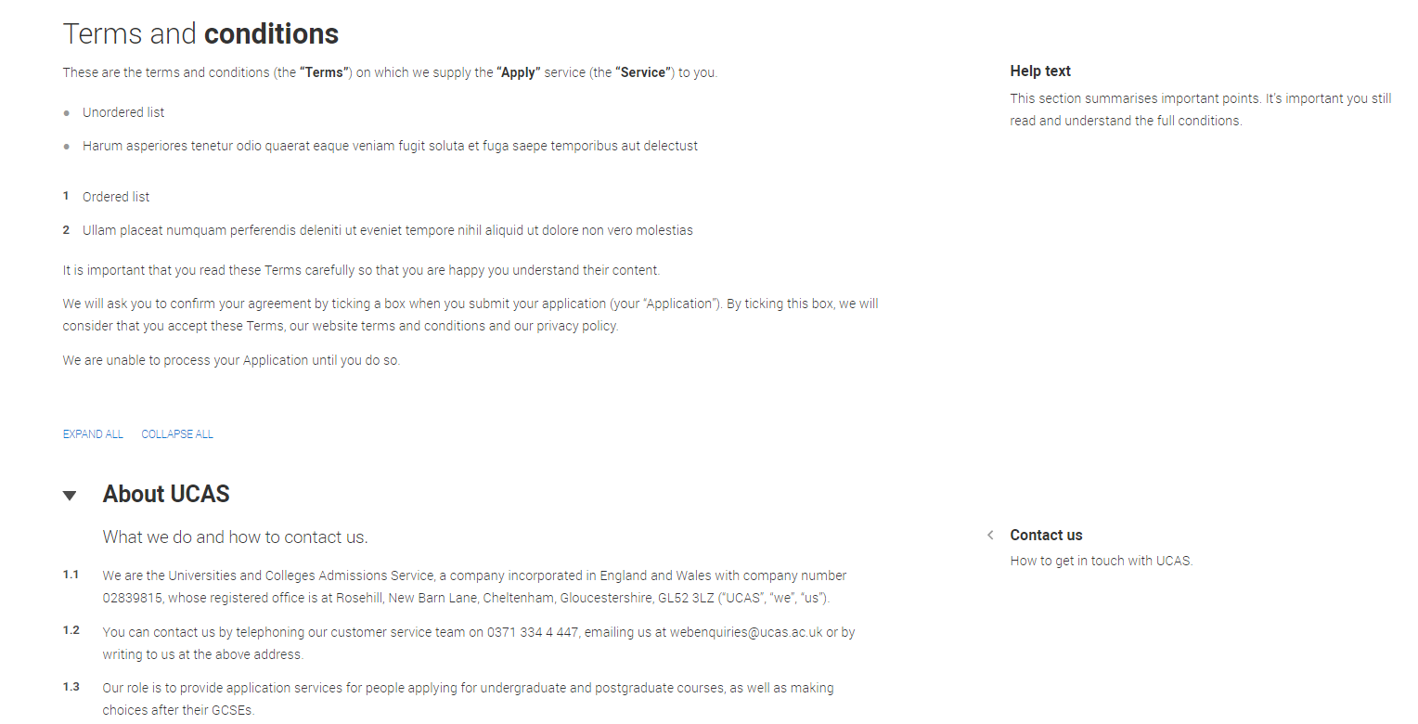
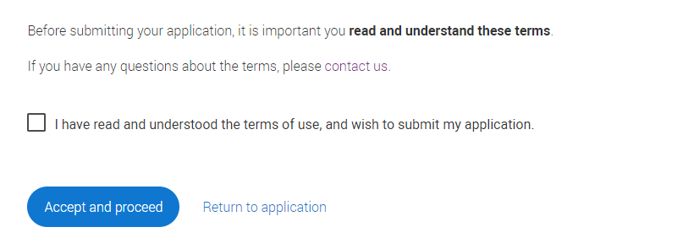
You must tick the box at the bottom of the page to confirm you have read and understood the terms and conditions.
You can collapse these sections by clicking the .
Then click Accept and proceed, or you can return to application.
Security marking: PUBLIC
| 12

Slide 13
Reviewing your payment method
Public

Slide 14
Free Schools Meals application payment option
Access Centre Management.
Enable the FSM waiver option. Option (UK applicants only).
Save changes to ensure the FSM application fee waiver is visible for eligible applicants when they pay and submit..
Public

Slide 15
Agreeing in Adviser Portal
You must provide agreement in the Adviser Portal for students who have shared that they are, or have been, in receipt of Free School Meals in the last six years.
Public
Notes:
Your school/college/centre will not be invoiced for eligible FSM students that you provide agreement for in the Adviser Portal.

Slide 16
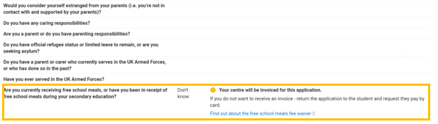
Application details – in progress application
Student answers to the FSM question will be visible as soon as students have linked to your centre, so you can start to identify eligible students.
Please note: the FSM agreement tick box and further details link will only appear when a student has completed the ‘Pay and submit’ process.
There’ll be a warning message if the applicant selects ‘No’ or ‘Don’t know’ to alert you.
Public

Slide 17
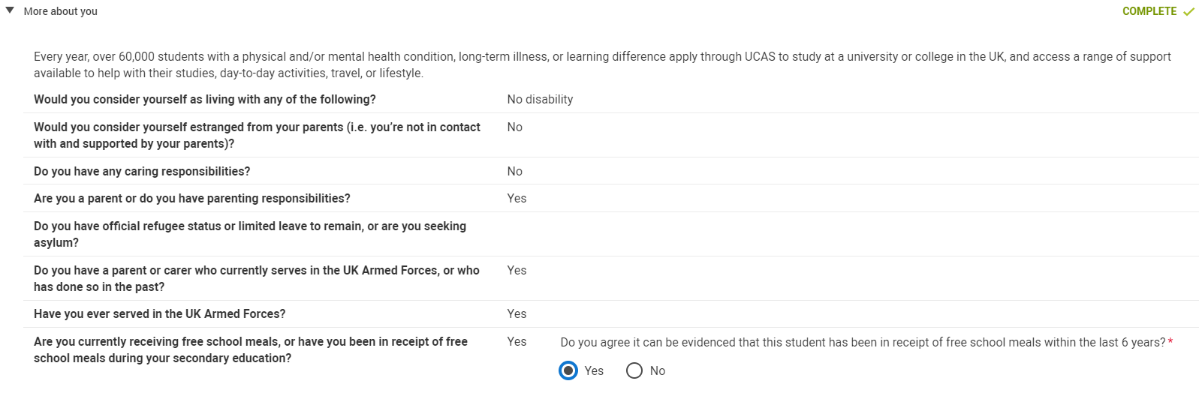
Application details - submitted to centre
For eligible students answering ‘Yes’ to FSM question:
Advisers will need to provide a response to agree eligibility for the UCAS application fee waiver to be applied.
If you select ‘Yes’ in the Adviser Portal, UCAS will apply the fee waiver, and the school/college/centre will not be invoiced.
Public

Slide 18
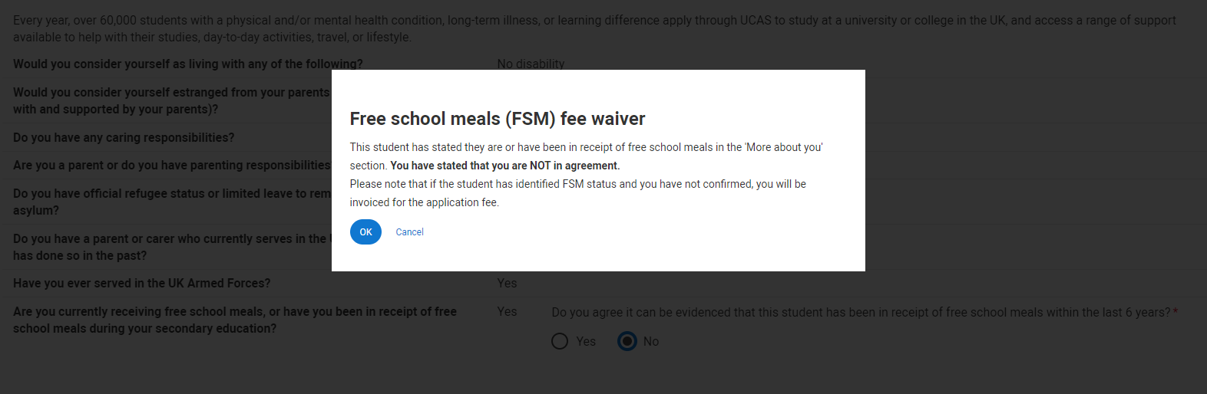
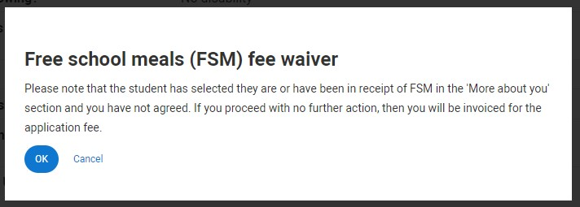
Application details - Submitted to centre
If a student selects ‘Yes’ to the FSM question, advisers are required to provide a response.
If you do not agree the student is eligible for the FSM application fee waiver, a warning message will appear to explain if this application is sent to UCAS, an invoice will be generated.
At this stage you can return the application to the student to:
  review their answer
  update their payment option and ‘Pay by card’
Public

Slide 19
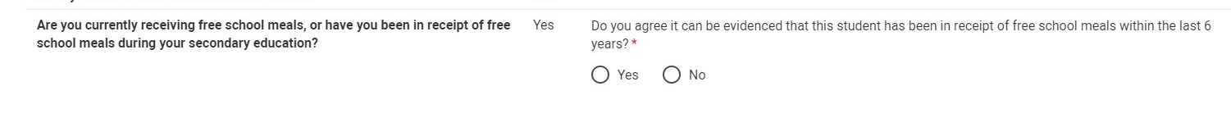
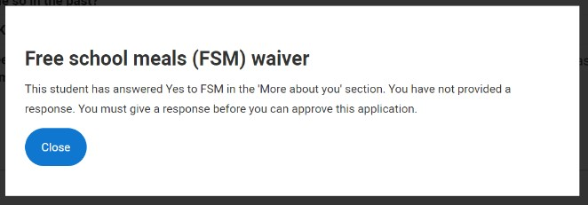
Approving an application – warning message
If a student has answered ‘Yes’ to the FSM question and agreement has not been provided, a warning message will prompt a review of the answer.
Public

Slide 20
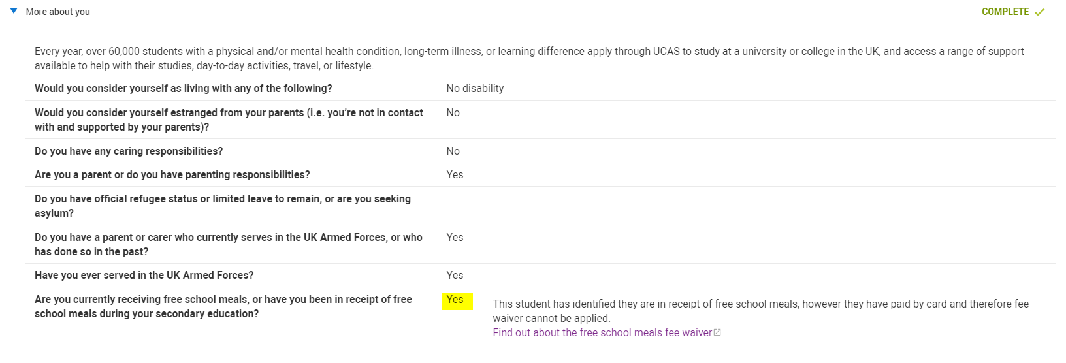
Submitted to centre – ‘Pay by card’
You’ll see a flag if a student answers ‘Yes’ to FSM but chose to ‘pay by card’ when submitting their application.
Advisers will not need to agree eligibility.
UCAS are unable to apply the FSM fee waiver retrospectively; no further action is required.
Public

Slide 21
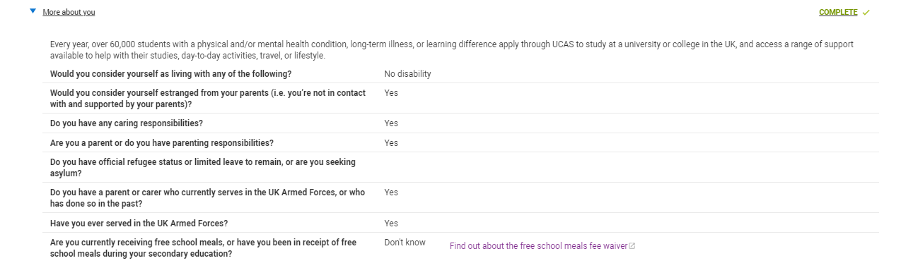
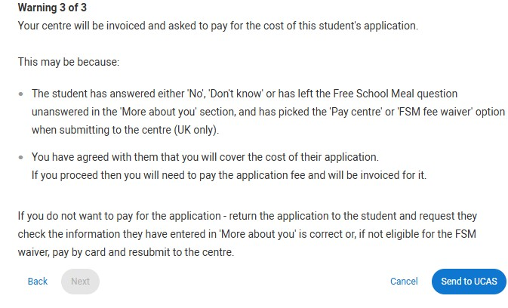
Application details - submitted to centre
For students who have answered, ‘no’, ‘don’t know’ or not answered the question:
Advisers will not need to agree eligibility in the Adviser Portal.
You may want to check these students haven’t chosen the ‘Apply with FSM waiver’ or ‘Invoice’ option by mistake using the ‘Payment options’ column (to avoid invoices being generated to the centre). If they have, you’ll receive a warning message when you come to ‘Send to UCAS’.
A link to further details on FSM is shown for reference only.
Public

Slide 22
Checks using filters and columns
In addition to the warnings and flags, you can use the filters and columns in application management to carry out some checks before applications are sent to UCAS, to prevent any errors.
Public

Slide 23
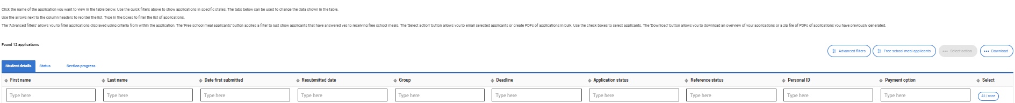

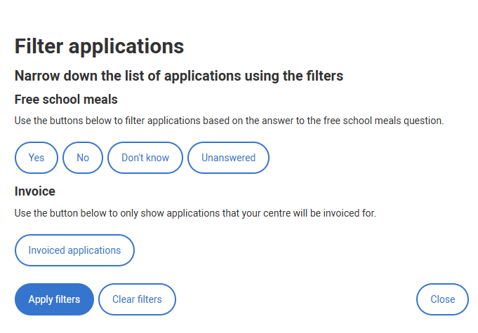
FSM Filter
Use the added Advanced filter in Application Management
to identify those students who have selected ‘Yes’, ‘No’, ‘Don’t know’ to FSM question, or left the question unanswered
to identify applications your centre will be invoiced for
Results will show you applicants in all application statuses (in progress, awaiting approval, returned to applicant, etc).
Public

Slide 24
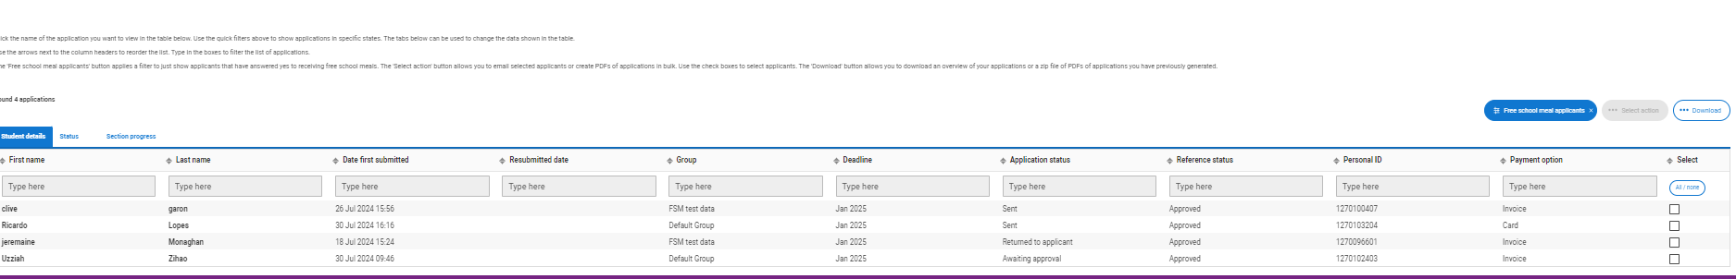
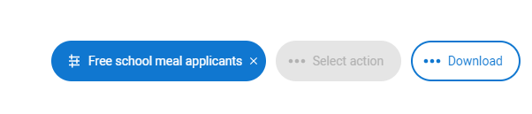
FSM Filter
Use the 'Free school meal applicants' filter in Application Management to quickly identify those students who have selected ‘Yes’ to FSM question.
Results will show you applicants in all application statuses (in progress, awaiting approval, returned to applicant, etc).

Slide 25
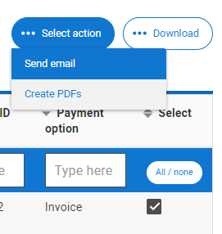
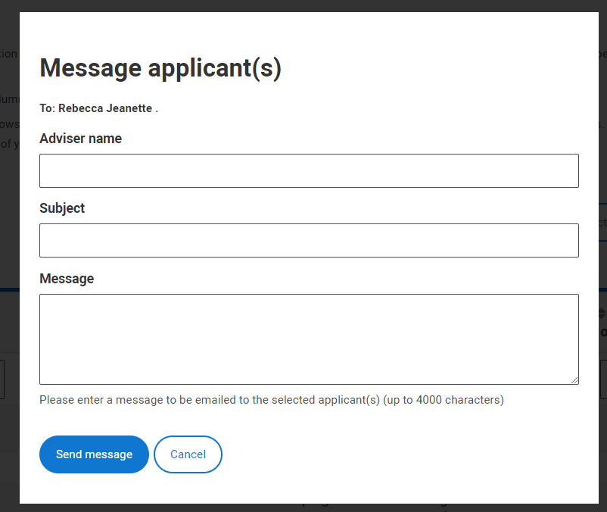
Using the email function
If you have students who have answered ‘Yes’ to the FSM question you can use the new filter to identify them. If you need to double check this or ask for more details, you can use the email function.
You can email individual or multiple groups of students.
Public

Slide 26
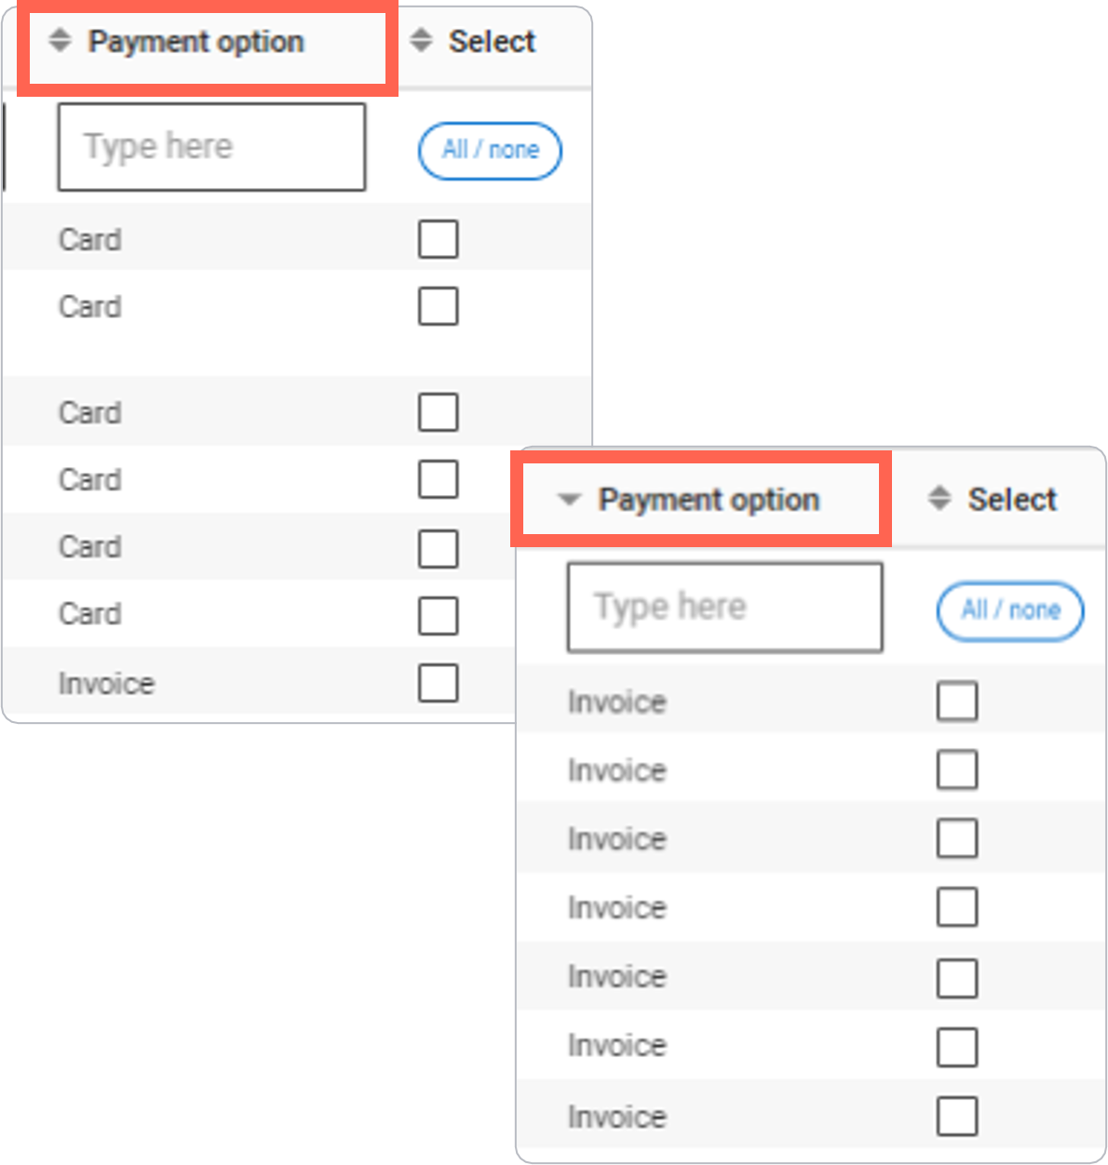
‘Payment options’ column
‘
You can quickly check students included in your invoice using the sort function on the ‘Payment option’ column.
Your centre will not be invoiced for eligible FSM students that you provide agreement for in the Adviser Portal.
If you identify students who incorrectly used the ‘Apply with waiver’ or ‘Pay centre’ option, you can return their application and ask them to resubmit with ‘Pay by card’.
Please note: this column is only populated once students have completed the pay and submit process.
Public

Slide 27
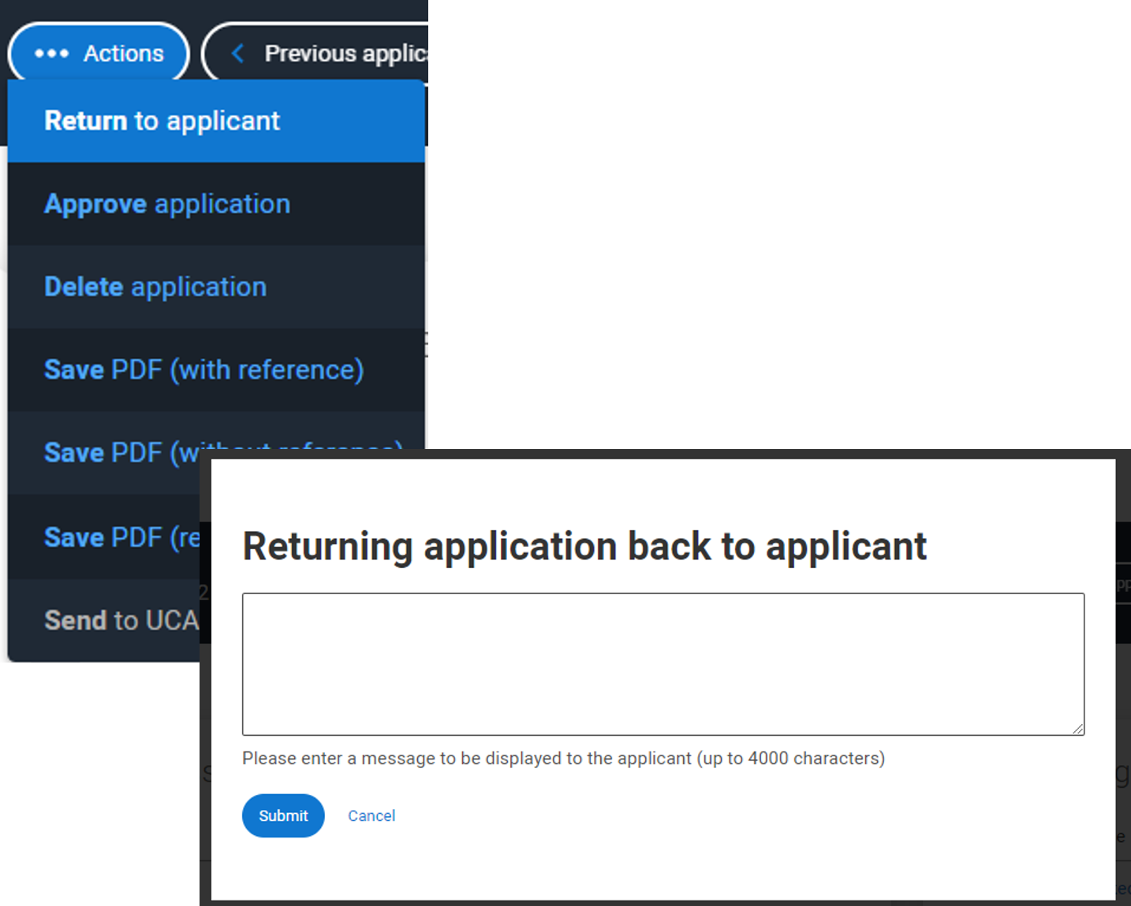
Return to applicant
You can return applications to any students who have incorrectly used the ‘Apply with waiver’ or ‘Pay centre’ option and ask them to resubmit with ‘Pay by card’.
IMPORTANT
Once a centre has sent an application to UCAS:
the application cannot be returned to the student
the payment option cannot be changed
the fee waiver cannot be retrospectively waived
Students who pay by card accidently cannot have the application fee waiver applied retrospectively.
Public

