Slide 1
PERSONAL STATEMENT BLUEPRINT

Slide 2
What ARE THE QUESTIONS?

Slide 3
What are the questions?
“
“
“
Why do you want to study this course or subject?
How have your qualifications and studies helped you to prepare for this course or subject?
What else have you done to prepare outside of education, and why are these experiences useful?
“
“
“
Notes:
Remember it is one personal statement per application.

Slide 4
Q1: why do you want to study this course or subject?
You’ll want to show evidence of passion, curiosity and interest; this might include:
Motivations for studying this course(s):
Knowledge of this subject area and interests:
Future plans; demonstrate why this course/subject is a good fit:
Have you been inspired by a key role model or moment in your life?
Is it a subject you love and want to pursue further?
What is your drive?
How has your path led you to this course or subject area?
Is there a particular subject area you’ve researched?
Something you can’t wait to learn more about?
What about a book or subject expert doing great things that’s sparked your interest?
Do you already have a particular profession in mind?
How might you use your studies to launch your career?
What’s important to you and your future, and how might the knowledge gained from this course(s) help you achieve this?
Remember these are just some examples, you don’t need to include it all. The key is to research the course(s) to find out what might be most relevant.
Check out the UCAS personal statement guidance.
Notes:
Remind students that examples don't need to be something 'grand' or academic as the very first starting point if that's not the truth! If the starting point was something 'pop culture', social media or a holiday and they then expanded on this in depth through a variety of methods, then that's great as it shows progression!
Universities and colleges want to see students have done their research so they can be confident this is something they will enjoy and excel in. This is one place to highlight super-curricular activities as evidence of curiosity and interest in the subject outside of the classroom.
Here are some more examples for this section:
Personal life experiences e.g. being a carer, the environment where you grew up or lived, an inspirational friend, colleague or family member, a book you read, a news article or blog/vlog, a YouTube video, a podcast, a show you saw, Subject Spotlights
Understanding of the area and the qualities you might need to succeed in it – research into the course/area

Slide 5
Q2: How have your qualifications and studies helped you to prepare for this course or subject?
Focus on what’s most recent and relevant to your subject or course(s), examples could include:
How your studies or training relate to chosen course(s) or subject area:
What relevant or transferable skills have you got that make you a great candidate:
Any relevant educational achievements
Are there a couple of subjects that helped you develop a core set of relevant skills required for your chosen course(s)?
Maybe a particular module or project helped you understand where your interests and strengths lie.
Universities and colleges will see your grades on your application - don’t waste space talking about these.
Focus on your other accomplishments like a competition, holding a position of responsibility or representing the school/college.
This could be your current or previous studies.
This could be from any form of formal education – think school, college, training, or short online courses.
Remember these are just some examples, you don’t need to include it all. The key is to research the course(s) to find out what might be most relevant.
Check out the UCAS personal statement guidance.
Notes:
This is the chance for students to show evidence of the relevant or transferable skills they've gained from their formal education and highlight their understanding of how this will help them succeed in this subject area.
Here are some more examples for this section:
Specific modules or topics
Essays or projects that explore a particular viewpoint or technique
EPQ – Extended Project Qualification
School, local, or national competitions e.g. UK Maths Trust
Private lessons and qualifications e.g. music, stage school or sports if relevant to the course
Tutoring or mentoring
Online courses leading to a qualification

Slide 6
Q3: what else have you done to prepare outside of education, and why are these experiences useful?
Examples should be reflective and demonstrate further suitability for your subject or course(s), this could include:
Work experience, employment, or volunteering
Personal life experiences or responsibilities
Hobbies and any extracurricular or outreach activities:
Achievements outside of school or college
In-person or virtual work experience.
Paid for work or volunteering.
The key thing is reflection on the experiences and the skills gained relevant to your chosen course(s).
Is there a situation you’ve personally overcome that has influenced your decision?
Are there personal experiences that have helped you develop essential qualities for the course?
Think sports, reading, community work, summer schools.
Any activities outside of core studies that help further showcase why you’d make a great student.
This could be a position of responsibility for local clubs or groups, competitions, or qualifications you’ve attained outside of the classroom.
Remember these are just some examples, you don’t need to include it all. The key is to research the course(s) to find out what might be most relevant.
Check out the UCAS personal statement guidance.
Notes:
This is students' chance to talk about any other activities they have undertaken outside of their formal education or personal experiences which further demonstrate their suitability for the course. This section is likely to be highly personal to them and anything they do include should reflect on why they're including it.
Here are some more examples for this section:
Extra and super-curriculars
Volunteering
Personal life experiences e.g. caring for a family member, overcoming a challenge
Young enterprise
Work experience
Job/employment – part-time or full-time
Work-based learning/CPD
Shadowing
Online learning activities e.g. Springpod, MOOCs etc.
Tutoring
Trips and visits (online or in person) e.g. Museums, exhibitions, galleries, sites of historic interest, relevant sites connected to your course e.g. magistrate courts for law etc.
Podcasts, TED talks, documentaries etc.
Duke of Edinburgh/Duke of York awards

Slide 7
Format and structure
Three sections with question prompts
4,000-total character count split across sections
Minimum character count 350 characters per section
Don’t waste characters listing grades and subjects
Don’t repeat information across sections

Slide 8
Skills mapping
Using the comparison chart worksheet, start mapping out skills, evidence and examples across your 5 choices.
The chart has columns for:
UCAS Choice (Course) – the course and university or college name.
Key Transferable Skills (e.g., communication, problem-solving, teamwork).
Subject-Specific Skills (or knowledge) (e.g., research skills, technical knowledge like Excel or graphics programmes )
These may be skills you already have or those you will develop on the course.
Personal Evidence (e.g. real-life experiences or achievements)

Slide 9
What can I use to help me?
There are lots of ways you can research the details of the course(s) / subject you're looking to apply to:
Remember requirements may differ for each university or college, as well as depending heavily on the course.
It is important to look in detail at the course, modules, and assessment details as this will give you clues as to what exactly is being looked for in a potential student for that course.
So, this research on your chosen area of study is vital before you start writing your personal statement.
The course description is key as this’ll help you with what to include and give you a good idea of what they are looking for.
Did you attend an open day? What did you learn about the course there?
What can you find on the university or college website?

Slide 10
Your comparison chart
UCAS CHOICE (COURSE) | KEY TRANSFERABLE SKILLS | SUBJECT SPECIFIC SKILLS (OR KNOWLEDGE) | PERSONAL EVIDENCE OR EXAMPLES

Slide 11
Your comparison chart – example only
UCAS CHOICE (COURSE) | KEY TRANSFERABLE SKILLS | SUBJECT SPECIFIC KEY SKILLS (OR KNOWLEDGE) | PERSONAL EVIDENCE OR EXAMPLES
Business XXX University | Research strengths, analytical skills, quantitative skill, communication, leadership. | Corporate governance, marketing, new technologies. | What examples and evidence do you have to demonstrate these skills e.g. Online course: Society & Environment: What Are The Ethical Responsibilities Of A Business? Personal project written about What responsibility do businesses have to their consumers? Budgeting my money from part time job salary. Delivering a presentation in final unit studies.
Business management The University of xxx | Leadership, teamwork, communication. | The global environment, new technologies, entrepreneurial innovation, marketing
Business management with marketing XXX College | Presenting, budgeting and evaluation. | Legal, ethical and efficient practices, supporting innovation. Environmental and technological influences.
Business management XXX University | Problem solving, communication with others, project management, analytics. | Agile delivery, digital marketing principles, suitability in business management.
Business management with marketing XXX University | Group work and problem solving., teamwork. Independence. | Marketing data analysis, digital software usage, and creative content strategies.

Slide 12
Ideas under construction
Take some time to reflect before you start your first draft. Look through your comparison chart and take some time to:
Don’t worry about making this perfect; it’s about checking you fully understand the course and have specifics to refer to in your personal statement.
Whether you know what you’re applying to or still considering your options, the more prep you do now the easier it will be to write.
Highlight the common skills that appear across multiple choices.
Rank your evidence and examples that are MOST relevant to the course(s) you're thinking of applying to.
Make sure you look at the UCAS personal statement guides for ideas on what to include in each question.

Slide 13
Using AI in your personal statement
AI features can support in researching and reviewing your personal statement document. Make sure you read UCAS guidance on using AI when writing your personal statement.
There are a few ways AI tools can assist you.
Brainstorm some ideas about topics that are relevant to your chosen subject, which you can then relate to your own experiences and opinions. Or you could ask it to list skills that are relevant to the course you're applying for, allowing you to think about your own talents and how to convey them.
Help with structure you may want some suggestions of structuring your personal statement.
Checking readability for example ways to rephrase certain sentences to make them more concise, while maintaining their meaning.
Notes:
Remember the more people that use tools like ChatGPT to write personal statements, rather than as a research, structuring, and ideas tool, the more the model will use these examples for future personal statements. These will then be more detectable through similarity software. It's not worth the risk, so stick to using AI tools to help prompt your personal statement journey, rather than doing it for you (and more than likely doing it inaccurately!).
Remind students that when they complete their application, they must declare that their personal statement hasn't been copied or provided from another source, including artificial intelligence software.
As part of UCAS’s responsibility to applicants and universities and colleges, the UCAS Verification Team run checks to detect fraudulent applications and patterns of similarity in personal statements. Read our guide to fraud and verification and similarity.
If UCAS software detects elements of a personal statement that are similar to others, the universities or colleges it is intended for may be notified.

Slide 14
AI Dos and don’ts
DO
DON’T
Do use AI carefully and make sure you understand how the data you input is being used. Read our guidance.
Do fact check everything that AI tools suggest. They do get things wrong!
Do double check if the universities or colleges you are applying to have specific guidance around using AI tools.
Don’t copy and paste from AI tools and use as your final text.
Don’t forget that AI can only state facts but cannot reflect your own skills, experiences and thoughts in your voice, which is what universities are looking for!
Don’t forget to check how AI tools might use your data!
Remember UCAS run checks to
detect similarity in personal statements.
Notes:
Remind students that when they complete their application, they must declare that their personal statement hasn't been copied or provided from another source, including artificial intelligence software.
Remember the more people that use tools like ChatGPT to write personal statements, rather than as a research, structuring, and ideas tool, the more the model will use these examples for future personal statements. These will then be more detectable through similarity software. It's not worth the risk, so stick to using AI tools to help prompt your personal statement journey, rather than doing it for you (and more than likely doing it inaccurately!).
As part of UCAS’s responsibility to applicants and universities and colleges, the UCAS Verification Team run checks to detect fraudulent applications and patterns of similarity in personal statements. Read our guide to fraud and verification and similarity.
If UCAS software detects elements of a personal statement that are similar to others, the universities or colleges it is intended for may be notified.

Slide 15
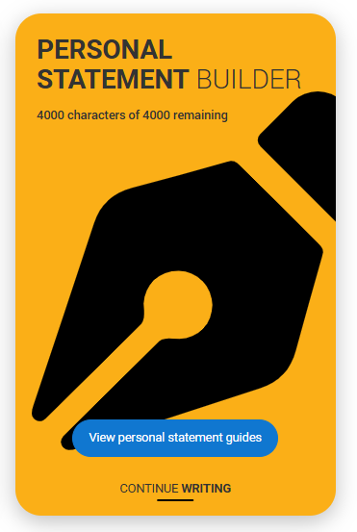
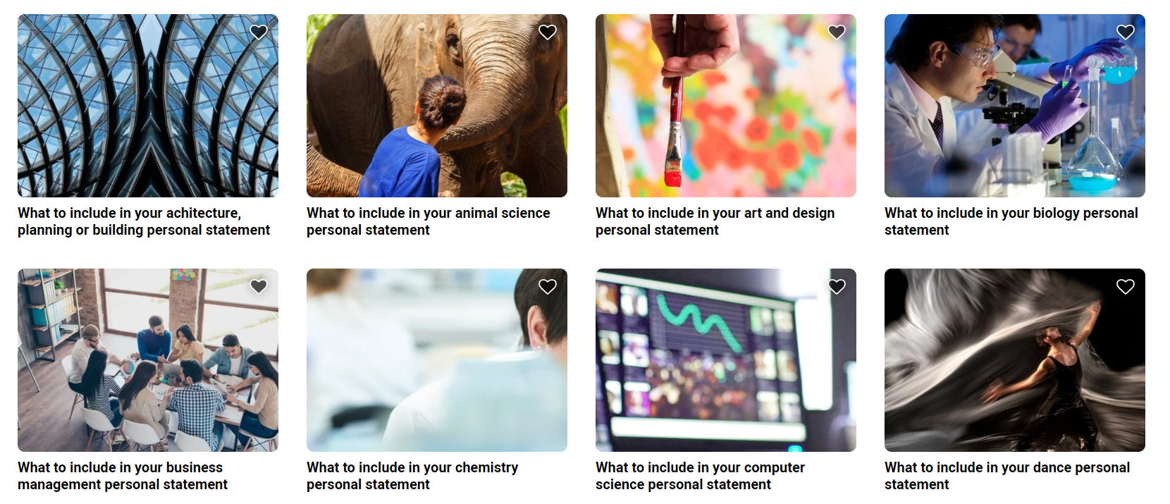
READY, SET, DRAFT – YOUR SUPPORT
www.ucas.com/applying/applying-university/writing-your-personal-statement/2026-personal-statement-guides
Notes:
www.ucas.com/applying/applying-university/writing-your-personal-statement/2026-personal-statement-guides

