Slide 1
Notes:
This PowerPoint has been prepared to support Lesson Plan 2 – Preparing for work experience.
This is an editable version for you to tailor to suit the needs of your students.

Slide 2
1. Why is it important to learn about the world of work?
Notes:
Task 1: In pairs/groups identify how work experience will benefit and motivate you and suggest the new skills you may learn.

Slide 3
2. Why does work experience matter?
Notes:
Task 1: In pairs/groups identify how work experience will benefit and motivate you and suggest the new skills you may learn.

Slide 4
The value of work experience
Helps you explore potential career paths.
Offers real-world insight into daily job tasks and workplace environments.
Assists in making informed choices about future studies or training.
Builds key employability skills like communication, teamwork, and time management.
Boosts confidence in navigating different workplace scenarios.
Adds valuable experience to university and job applications.
Shows initiative and a proactive attitude to future employers or educational institutions.
Provides connections with professionals in industries of interest.
May lead to references, mentorship, or even future job offers.
Help you to feel more motivated by giving you a clearer idea of what you want to do after school.
Notes:
Top ten examples of what students can gain from work experience. Students in the class may think of more examples for their personal requirements.

Slide 5
Student feedback
‘It consolidated my passion/ interest in Law, as it gave me a real insight into the career and helped me to understand how it might be for me on a day-to-day basis.’
‘I found out that I would like to have a really social job.’
‘It helped me to understand how to be professional whilst working within a team, and built my confidence in meeting new people.’
‘I had work experience in a Nursery, and it made me realise that I don’t want to work with young children every day… It was exhausting!’
‘I had work experience with a builder who is my mate’s Dad. I loved it! I now know I want to become an electrician!’
‘I got a placement in a recruitment agency. At first I wasn’t sure it would be for me, but by the middle of the week I loved the type of work, and got on so well with the team that they offered me part-time work AND the opportunity for an apprenticeship next year!’
Notes:
Real student voices share their feedback from their placements.
Work experience not only shows what you might like to do one day but also what you do NOT want to do one day.

Slide 6
Work Experience
How will it benefit you?
How will it motivate you?
What new skills might you learn?
What do you need to do next?
Notes:
Extension task – students can fill in the grid to document the key benefits, motivations, skills and actions. Printable copy available on the lesson plan webpage.

Slide 7
Reality check
Securing a face-to-face work experience placement requires initiative, persistence, and creative thinking.
You could start with a Virtual Work Experience to explore the options. Some sessions are pre-recorded; others you can book - check dates.
Explore: Virtual work experience
Notes:
https://www.ucas.com/careers-advice/virtual-work-experiences

Slide 8
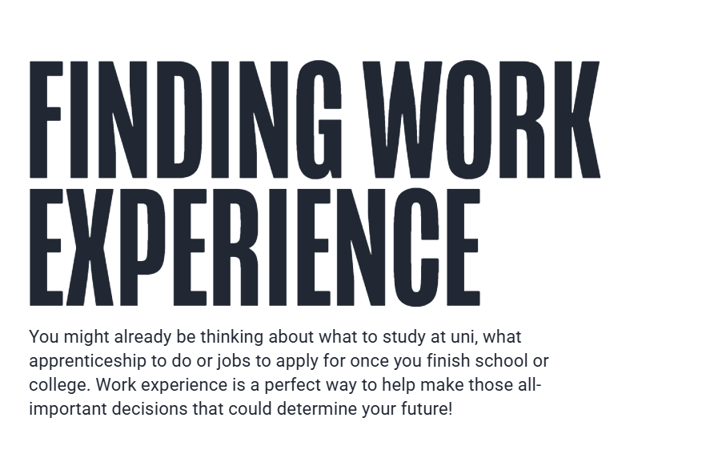
Notes:
Show them UCAS Ultimate Guide: Finding Work Experience. ultimateguides.ucas.com/findingworkexperience/

Slide 9
What are employers looking for?
Notes:
Task 2: Match the quotes from employers to the skills and qualities they expect from students on a work experience placement.

Slide 10
Presentation + Self management | Communication | Initiative | Ambition/curiosity | Learning outcomes
Notes:
Grid for the card matching – printable version provided on the lesson plan webpage.

Slide 11
Presentation + Self management | Communication | Initiative | Ambition/curiosity | Learning outcomes
Connie arrived on time everyday | She was well prepared with good questions… | Really good at meeting new people | They expressed a real interest in our roles | Tommy was so motivated, polite and keen to learn that I’ve offered him an apprenticeship.
He was smartly dressed | It was clear that Jaz was really keen to learn; she asked me lots of questions! | Showed us how to use Canva and Instagram | He was well prepared with good questions | Lily was thrilled that she was allowed to fill a jet engine!
Jay had a warm handshake and smile | Tommy offered to make us tea and coffee which was so welcome | Harvey explained a task to another student on placement which was really helpful | Chloe asked us questions about how to get a job in this field | Ben taught a group of year 5’s tag-rugby.
Noah was solution- focussed and able to be calm under pressure. | I was impressed that he asked for advice about routes into becoming an architect. | Lucy designed a new area of the forest school considering the needs of SEN students. | By the end of the week we were sad to see him go, he had fitted in so well with our team. | They were such an asset that we’ve offered them summer work
Toby was ill one day; he called in early and made us aware | Good eye contact | During a quiet morning, Hazel tidied our cluttered office | It was good to be asked what are the most challenging parts of my role- | He created a great new smoothie recipe which tasted amazing!
Notes:
Answers for the card matching task

Slide 12
How to prepare
What are your next steps in securing a work placement?
Identify your interests to help you find a suitable placement.
Use your network to start making enquiries.
Search online to start exploring the options.
Contact businesses directly.
Be open-minded.
Family
Friends
Neighbours
LinkedIn
Careers adviser
If you have already secured your placement, help a friend by talking them through the process and sharing what worked for you.
Council office
Company websites
Notes:
How to prepare for a work experience placement effectively.

Slide 13
Tips to secure a placement
Be prepared. Be polite. Be persistent. Be resilient.
Ask to speak to the manager/ the person responsible for work experience.
Know the dates of your work experience activity and what you are hoping to learn from the placement.
Use a script to glance at if you need to. This is especially useful if you have to leave a voicemail.
Know your phone number so that you can ask them to call you back.
Have a pen and paper handy - they may ask you to send them an email with your request in writing, attach a CV or Cover Letter.
If they can’t help you, ask them if they know of anywhere else in their organisation that may accept work experience students.
Be flexible, it may be the employer offers you a couple of days instead of a full week.
You may get a few responses saying ‘no’ before you get a yes!
Notes:
How to prepare for a work experience placement effectively.

Slide 14
What questions do you have for employers?
Notes:
Task 3: To help research create a mind map of ideas/questions you would want to find answers for if on a work experience placement. Examples provided on the next slides.

Slide 15
Example employers
Architecture firm | Electrician | Law Firm | School | Gym
Police station | Engineering firm | Doctor’s Reception | Veterinary practise | Science lab
Railway station | Dental surgery | Marketing agency | Café | Estate agency
Farm | Hairdressing salon | Product manufacturer | Nursery | Fashion shop
Example questions
Placement:
Vehicle recovery service centre
‘How long would I be on-call for?’
‘Does the company provide a van for employees?’
‘How far is a designated travel zone?
‘Do you get paid per job?’
‘Is there a bonus for night hours?’
Notes:
What questions could you prepare for your work placement in one of these locations. Students may prefer to pick another location they are hoping to go to.

Slide 16
Suggested questions for employers
What is the main purpose of your role and how does it support your business?
What does a ‘typical day’ in your job look like?
What parts of your job do you most enjoy? What excites you every day about going to work or working in your organisation / sector?
What skills are needed for your job?
What are the challenges you face in your job?
What sort of training/qualifications have you needed to complete?
On reflection, which subjects in school most developed your skills for this job?
What other transferable skills have you had to make use of – or develop – to support your work?
What previous jobs have you had? How did these prepare you for this role?
Do you have ambitions for further progression or promotion in this career?
Notes:
Example questions students could use when they are completing a placement. They could also be used if a student can only secure a short time with an employer in person or online.

Slide 17
Challenges and solutions
Struggling to find the ‘ideal’ placement?
Recognise the skills within the ‘ideal’ role and consider what other roles use a similar skillset, then approach organisations.
Example placement: Law
Skills used within this industry: Research, organisation, communication, teamwork, working under pressure.
Alternative placements using a similar skillset:
Library, school, university, reception, county council, or bigger companies that have a law/legal department.
Notes:
Helping students to understand the wider circle of opportunity and development on a placement.

Slide 18
Helpful links
What do you want for you?
https://ultimateguides.ucas.com/findingyourpassion/
Career quiz: https://www.ucas.com/explore/career-compass
More help with work experience:
https://ultimateguides.ucas.com/findingworkexperience/
Virtual work experience
Help with applying:
CV: https://www.ucas.com/careers-advice/how-write-cv
Cover letter: https://www.ucas.com/careers-advice/how-write-cover-letter
Notes:
Useful links that students can use after this class session.

Slide 19
REFELCTION
Notes:
Looking back at the tasks in this session:
- What are you hoping to learn or experience during a work placement?
- What skills or strengths could you develop on a placement?
- How might a placement help shape your career ideas or goals?

Slide 20
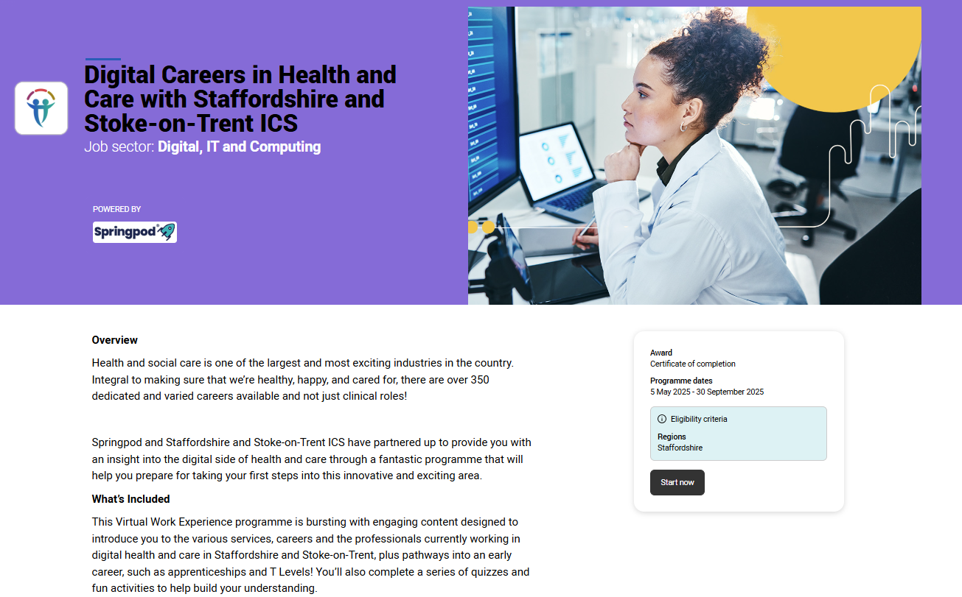
Virtual work experience
Notes:
Finally - Why not complete a Virtual Work Experience Programme in the UCAS Hub?
Virtual Work Experience programmes help you understand industries and organisations as if you were already working there. Thanks to programmes led by industry experts from the world's leading employers, Virtual Work Experiences give you a taste of what a career would look like, as well as giving you invaluable experience to include in your personal statements and apprenticeship applications.
Virtual Work Experiences vary in length, from 6-10 hours, and you can pause and come back to the program at any time. The in-depth experiences are recognised by employers, and you receive a completion certificate at the end of the program.
Once you set up a UCAS account, you can browse Virtual Work Experiences via UCAS search, industry guides, and across UCAS.com. On finding the perfect Virtual Work Experience, click ‘Take Virtual Work Experience' and follow the steps to create and link a Springpod profile.

