Slide 1

STUDENT ACCOMMODATION REPORT 2024/25
Public

Slide 2

INTRODUCTION
The availability and quality of student accommodation is crucial to delivering a positive student experience.
The transition from home to university is often the first time in a young person's life when they experience true independence. And if they can live in the type of accommodation they prefer, at a price that suits their budget, it can have a huge impact on the success of their studies.
But finding the right flat has always been a challenge. Demand has outstripped supply for decades – as student numbers have grown and construction has struggled to keep pace.
Now – it looks like things are changing. We’re seeing the supply and demand pendulum start to slow down, with a growing trend of students deciding to live at home. We’re also seeing more mature students choose student accommodation, as well as a general increase in the distance that students not living at home are travelling to campus.
This report will give you the data you need to explore the impact of these changes.
Stephen Cleal
Senior Sales Manager
Student Accommodation
Public

Slide 3

A NEW SWING IN SUPPLY & DEMAND
In 2024, applicant numbers to university fell to their lowest rate since the pandemic.
But at the same time, we saw one of the highest rates of acceptances for more than a decade.
Public

Slide 4
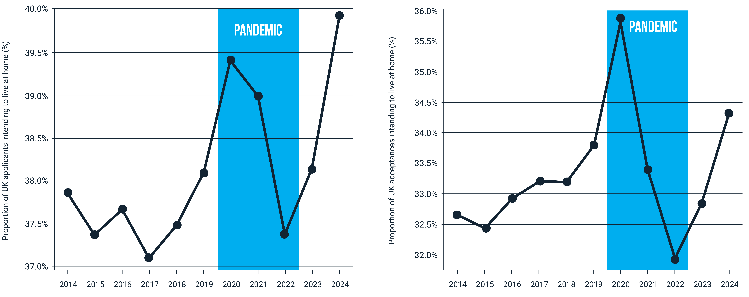
This growth in student numbers comes in tandem with a fall in the proportion of students looking for beds:
In 2024, more applicants intended to live at home than at any point in the last decade.
And for acceptances, it’s the second highest year on record.
Public

Slide 5
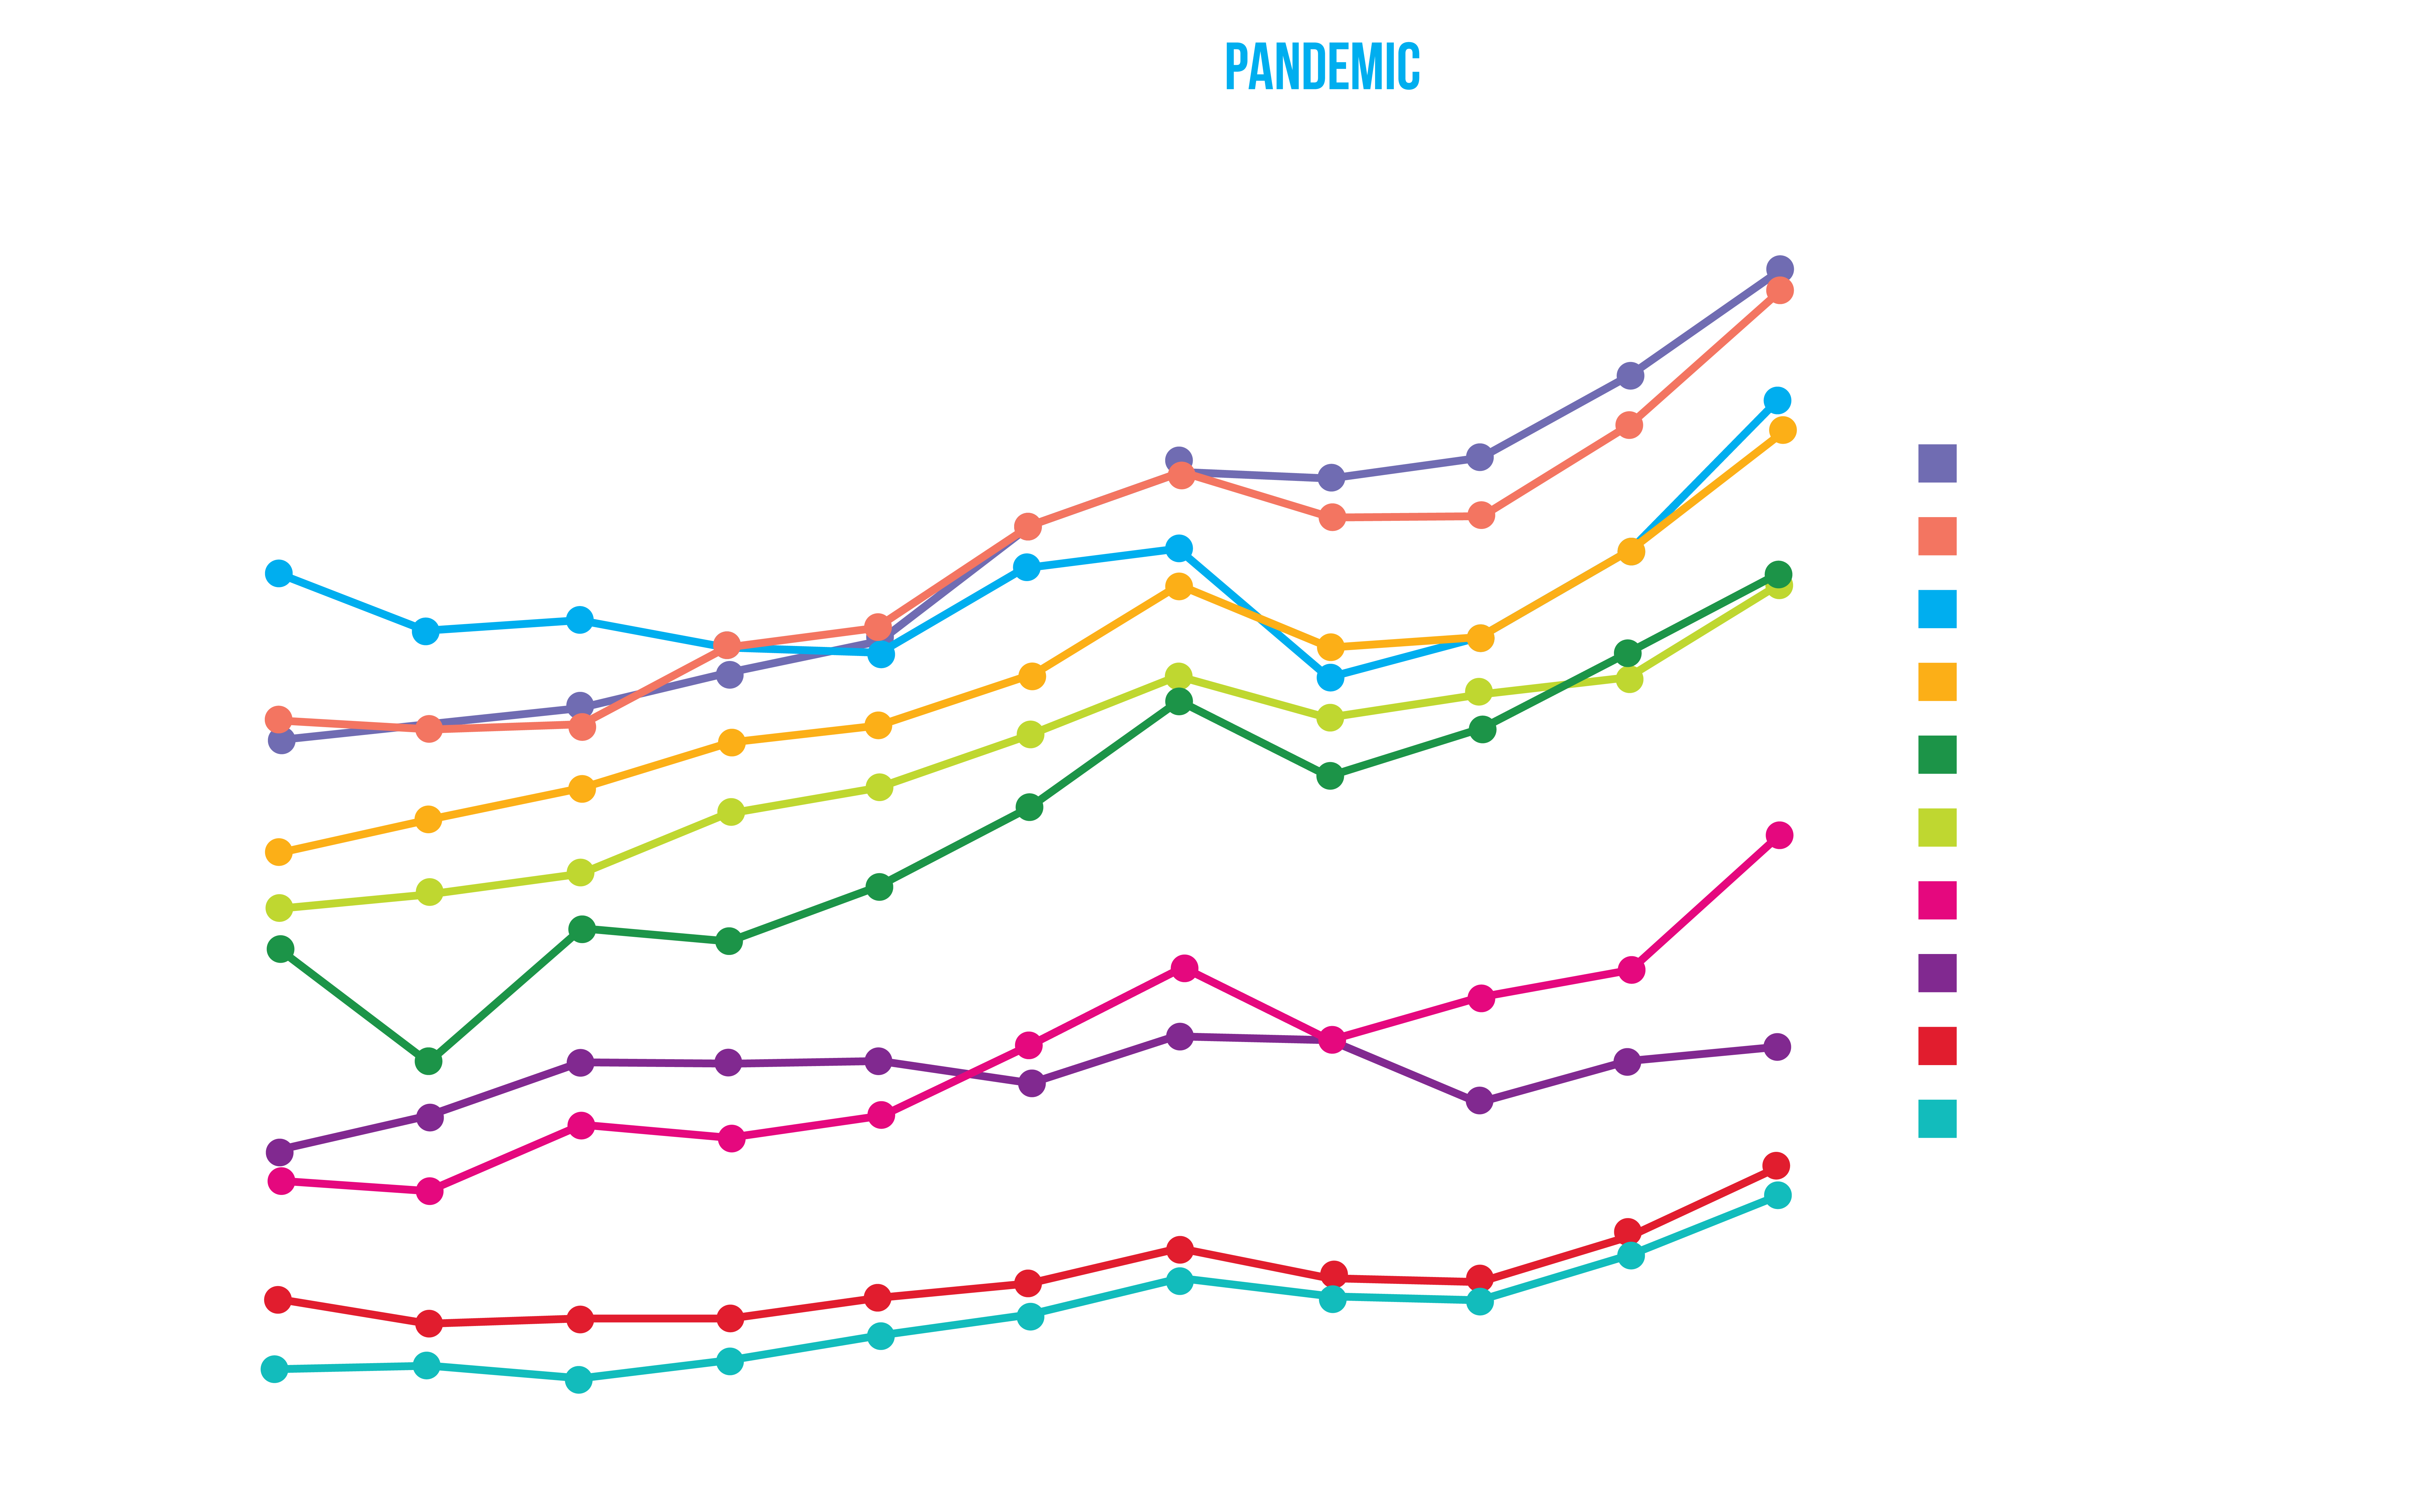
In numbers, there was some growth in those who intend to leave home (+0.3%) – driven by a strong cycle of acceptances – but as a proportion the pattern shows a growing tendency to stay home.
Across all regions of the UK, all socioeconomic groups, and all genders. The trend is the same – more students are intending to stay at home.
Public

Slide 6
Public

Slide 7
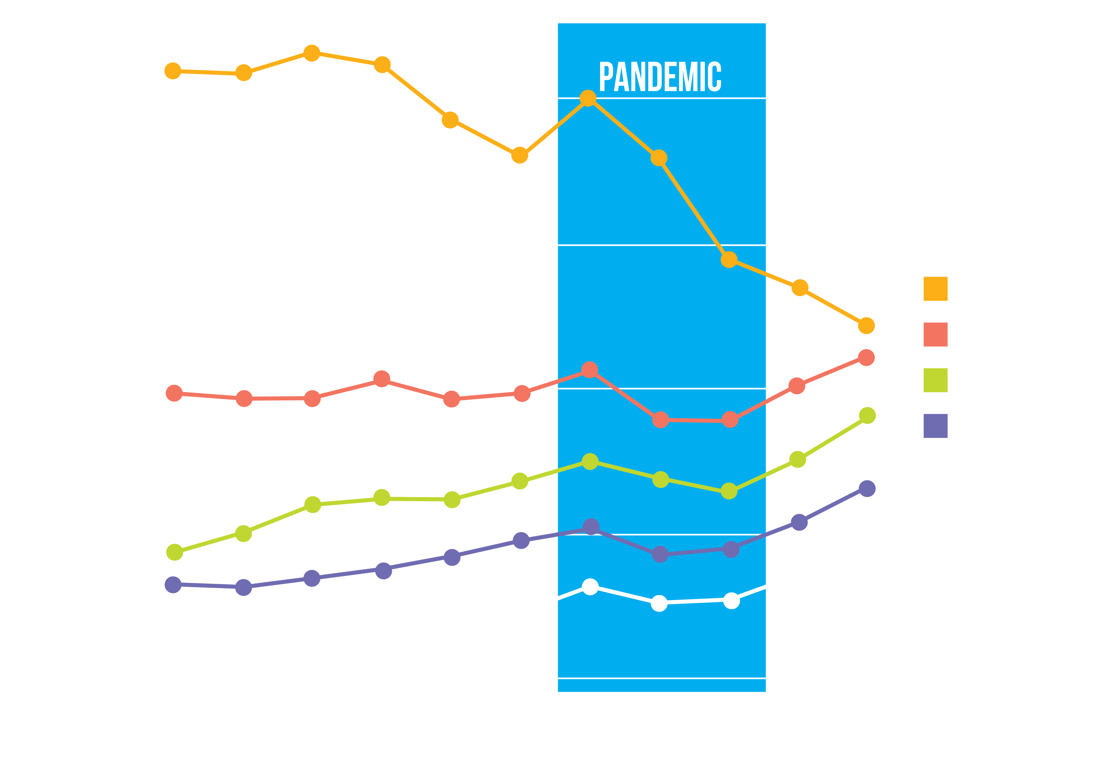

Mature students
The third difference of this cycle concerns age.
Compared to 2017, the number of 21+ year old students intending to move out of home for university has increased by more than 60%.
Public

Slide 8

Who is staying at home?
Excluding the pandemic, more students want to stay home for their studies.
It’s a rising trend across the nation. But regionally, there are some important differences in the number of potential accommodation customers.
Public

Slide 9

Proportion of applicants intending to move out of home
Proportion of 18-year old applicants intending to move out of home 2024.
Proportion of applicants ALL AGES intending to move out of home 2024.
Scotland 56%
-1pp
Scotland 45%
-1pp
North East 63%
North East 57%
-4pp
-2pp
North West 61%
North West 55%
-3pp
-2pp
Yorkshire & The Humber 65%
-2pp
Yorkshire & The Humber 59%
-1pp
Wales 76%
Wales 65%
-1pp
-1pp
West Midlands 60%
-3pp
West Midlands 55%
-1pp
East Midlands 71%
East Midlands 64%
-3pp
-1pp
South East 79%
South East 74%
-2pp
-2pp
South West 79%
South West 73%
-2pp
-2pp
East of England 76%
-3pp
East of England 70%
-2pp
London 58%
London 53%
-3pp
-2pp
Public

Slide 10
NUMBER of applicants intending to move out of home
NUMBER of 18-year old applicants intending to move out of home 2024.
NUMBER of applicants ALL AGES intending to move out of home 2024.
Scotland 15K
+1%
Scotland 26K
+1%
North East 8K
North East 11K
-4%
-5%
North West 27K
North West 39K
-3%
-3%
Yorkshire & The Humber 20K
-2%
Yorkshire & The Humber 28K
-3%
Wales 11K
Wales 16K
-2%
-2%
West Midlands 22K
-3%
West Midlands 31K
-4%
East Midlands 19K
East Midlands 26K
-3%
-5%
South East 44K
South East 61K
0%
-2%
South West 20K
South West 31K
-3%
-4%
East of England 27K
East of England 37K
-1%
-2%
London 45K
London 64K
-1%
-2%
Public

Slide 11
NUMBER of acceptances intending to move out of home
NUMBER of 18-year old acceptances intending to move out of home 2024.
NUMBER of ACCEPTANCES ALL AGES intending to move out of home 2024.
Scotland 9K
+3%
Scotland 16K
+2%
North East 6K
North East 8K
-2%
-3%
North West 19K
North West 32K
-2%
+1%
Yorkshire & The Humber 14K
-1%
Yorkshire & The Humber 23K
-1%
Wales 9K
Wales 13K
0%
-1%
West Midlands 15K
-3%
West Midlands 24K
0%
East Midlands 14K
East Midlands 20K
-3%
-5%
South East 36K
South East 50K
0%
-1%
South West 16K
South West 24K
-2%
-3%
East of England 22K
East of England 31K
-1%
-1%
London 31K
London 53K
-1%
0%
Public

Slide 12
Students in the north are proportionally less likely to move out of home (63%) and students in the south are the most likely (79%).
London is an anomaly, as the second most likely region for students to stay home (58%).
By combining this data with student migration patterns, we can see the hotspots that are most likely to see an increased demand for student accommodation.
The North West and South East remain the largest by student migration population, but there is a noticeable shrinkage in the southern regions and noticeable growth in northern regions – including Scotland.
NUMBER OF 18-year old acceptances intending to move out of home – BY INSTITUTION REGION 2024.
NUMBER of acceptances ALL AGES intending to move out of home – BY INSTITUTION REGION 2024.
Scotland 13K
+6%
Scotland 20K
+3%
North East 12K
North East 16K
+12%
+7%
North West 25K
North West 41K
-2%
+2%
Yorkshire & The Humber 20K
-2%
Yorkshire & The Humber 30K
-3%
Wales 12K
Wales 17K
-2%
-1%
West Midlands 15K
+1%
West Midlands 22K
-1%
East Midlands 23K
East Midlands 32K
-1%
-1%
South East 28K
South East 46K
-7%
-3%
South West 23K
South West 33K
-3%
-5%
East of England 7K
East of England 10K
+2%
0%
London 14K
London 31K
-2%
-2%
Public

Slide 13

MIGRATION behaviour
Students looking to move out of home and into London fell from every region in the UK according to application data. With a falling proportion of applicants wanting to move out of London, this had a knock impact to many regions in the UK.
In the meantime, acceptances out of London see less London applicants being accepted into universities in the Southeast, London or the East Midlands.
Public

Slide 14
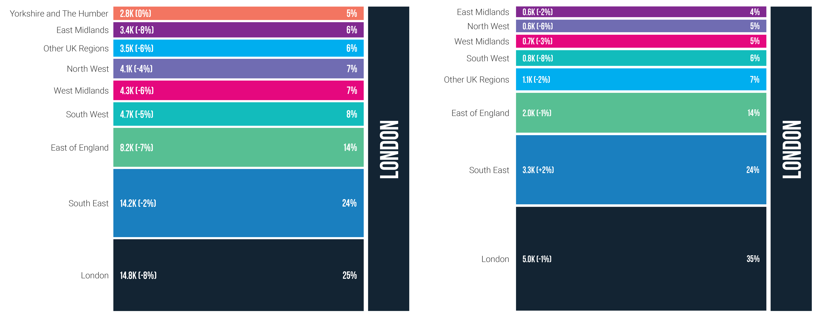
Applications & ACCEPTANCES into London
Applications
Acceptances
Public

Slide 15
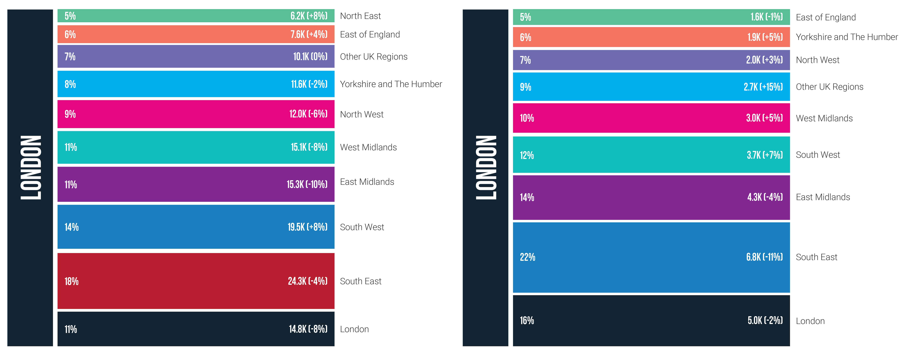
APPLICATIONS & ACCEPTANCES out of London
Applications
Acceptances
Public

Slide 16
Conclusion
To discuss these findings, access more data, or find out how we can help you reach your target audience, please email: accommodation@ucas.ac.uk.
There are several important new trends, patterns, and behaviours that we observed in the 2024/25 cycle, which student accommodation providers need to be aware of heading into 2025/26:
1
Applications have fallen, but acceptances have risen. There are now more students going to university than at any point since 2014.
4
Besides London, students in the north are proportionally less likely to move out of home (63%) and students in the south are the most likely (79%).
2
But behaviour towards accommodation is also changing. The number of acceptances intending to live at home was the second highest on record.
5
The North West and South East remain the largest areas by student population, but there is a noticeable shrinkage in southern regions and noticeable growth in the north – including Scotland.
3
There are new migration patterns too. Lesser tendency to move out for those who can commute means that those who are moving are likely to live (and attend universities) further away from their hometowns.
6
There is growth in the mature student market for accommodation. Compared to 2017, the number of 21+ year old students intending to move out of home has increased by more than 60%.

