Slide 1

CONFIRMATION AND CLEARING 2026
What you need to know
Last updated 09/04/2026
Public

Slide 2

HERE TO SUPPORT YOU
This presentation provides essential information to help you support your students through Confirmation and Clearing 2026.
You’re welcome to use the screenshots throughout this deck in your own materials and guidance resources.
The images illustrate the intended design of the UCAS Hub and application for 2026 Confirmation and Clearing. Please note layouts may vary on mobile devices.
We continue to make incremental improvements based on feedback to enhance overall experience. This deck will be updated periodically to reflect any changes.
Public

Slide 3
KEY DATES
30 June
Applications received after this are entered into Clearing*
13 August
Level 3 results day
24 September
Final date for 2026 applications
1 July
Last date to apply for a course in Extra
7 August
Level 3 results embargo: 08:00
2 July
Clearing Opens
4 August
Qualifications Scotland results day (SQA)
19 October
Last date to add 2026 Clearing choice
28 July
Results embargo: 08:00
Public

Slide 4
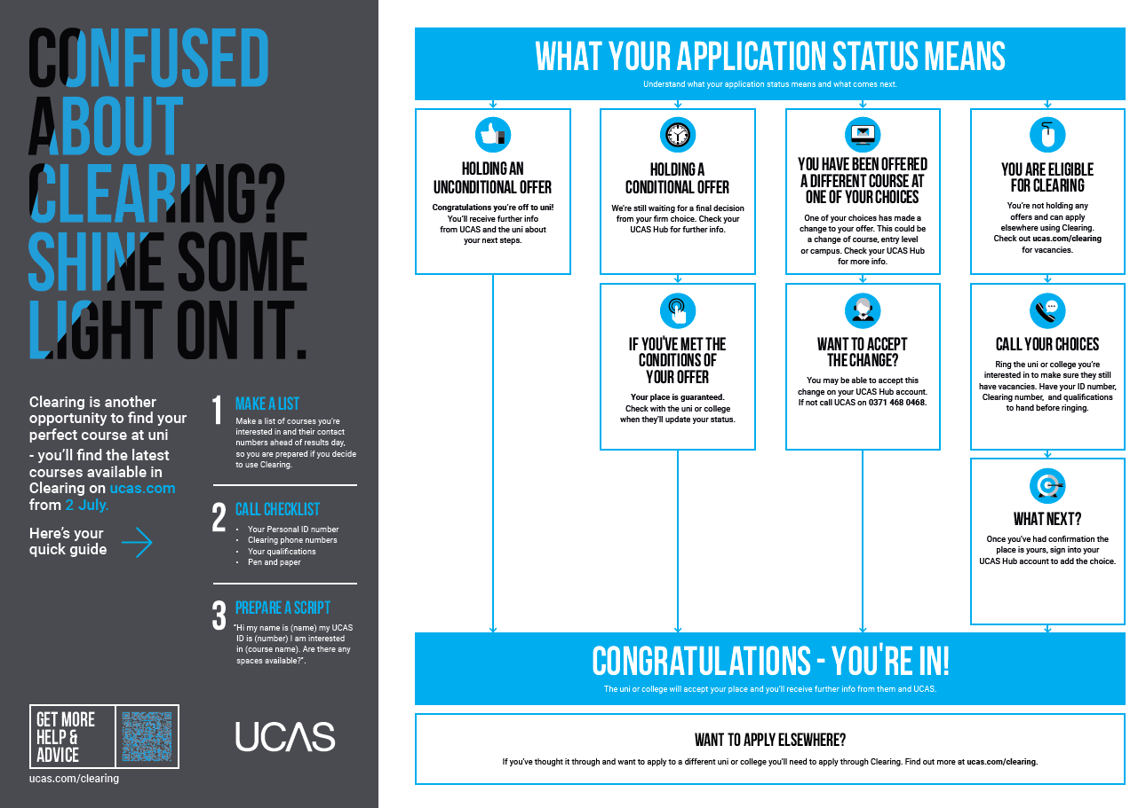
Public

Slide 5
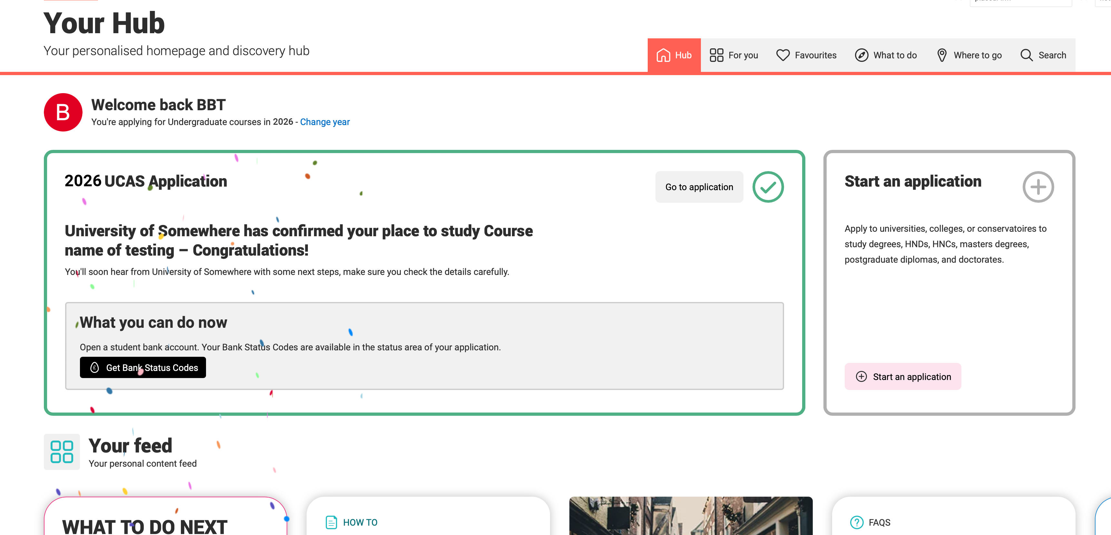
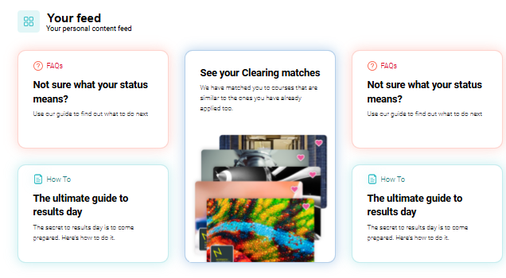
WHAT IS CONFIRMATION?
Confirmation is when your university or college checks your results to see if you’ve met the conditions of your offer.
If you meet the conditions, your place is confirmed.
If you don’t, you’ll still have other options to explore; you won’t be left without choices.
When you log in to your UCAS Hub, you’ll see personalised guidance based on your application status.
We’re here to make your next steps clear and simple.
Public

Slide 6
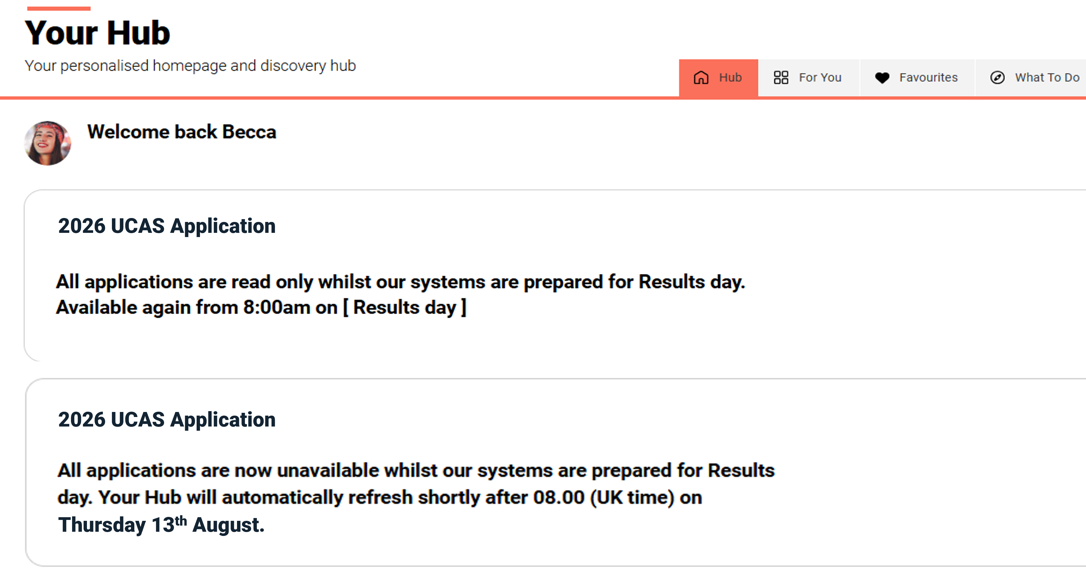
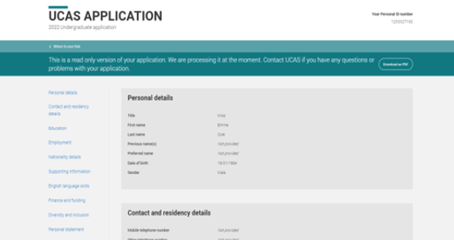
UCAS RESULTS EMBARGO
The results embargo is a short period before results day where universities and colleges have time to make decisions on your application.
During the results embargo your application will be in read only mode - meaning you can see it, but you won’t be able to make any changes.
The 2027 application service will also be unavailable on 4 August and 13 August.
Public

Slide 7
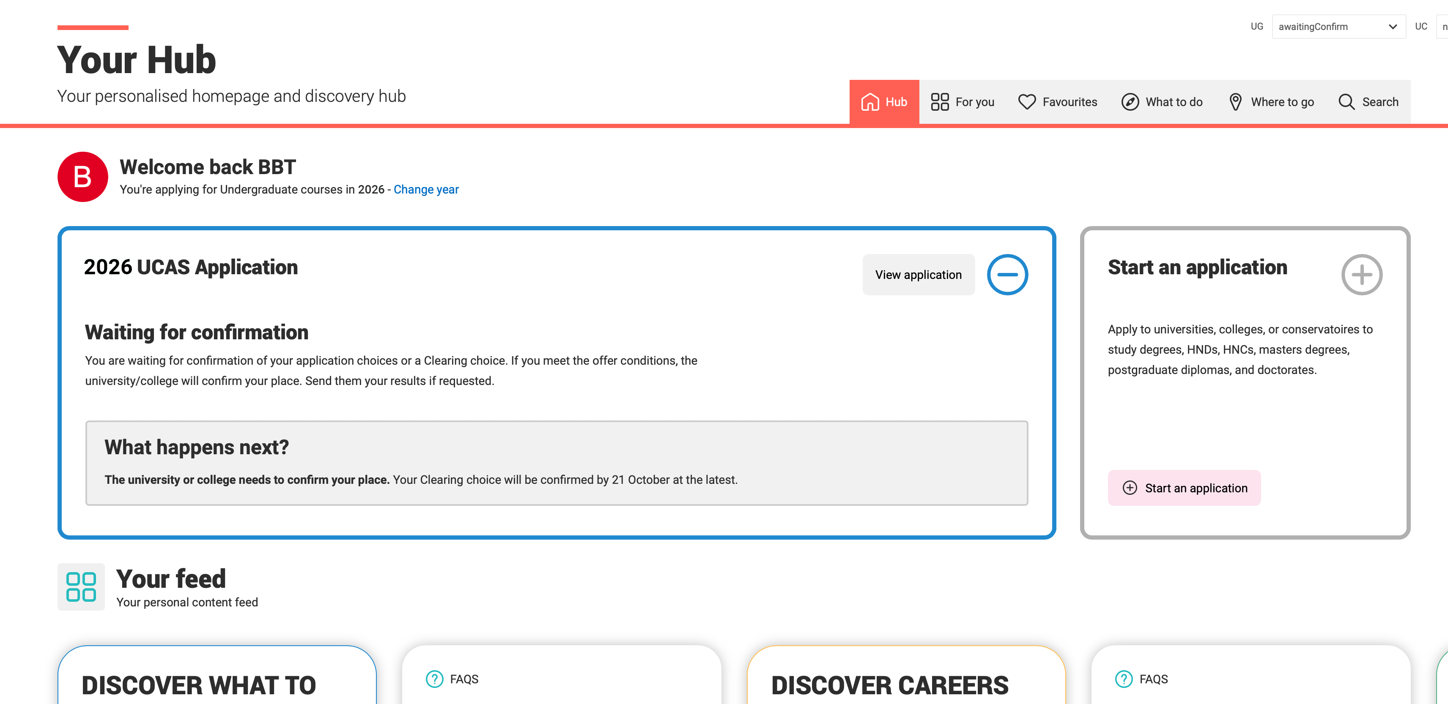
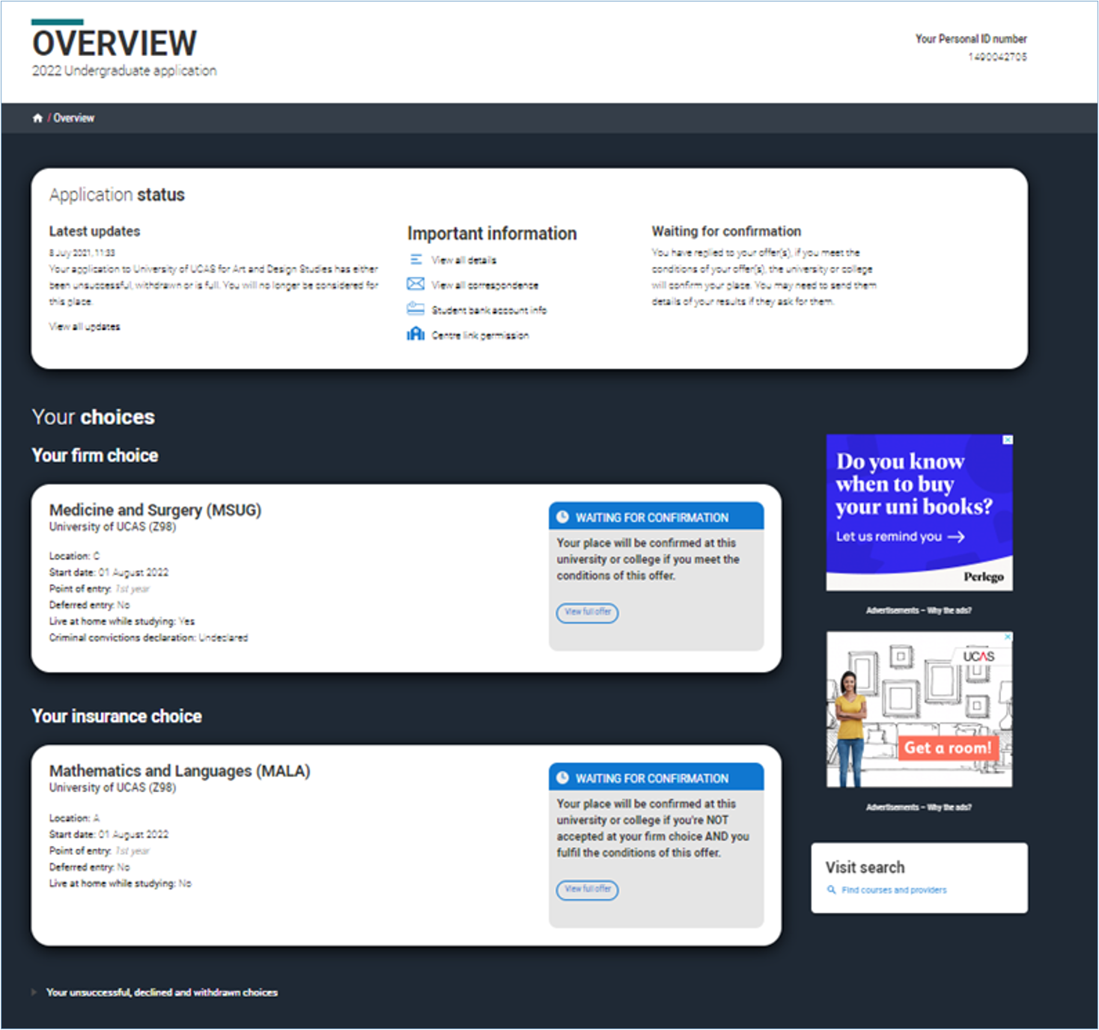
WAITING FOR CONFIRMATION
If you have a Conditional offer your application will show a ‘Waiting for Confirmation’ status while the university or college waits to check your qualification results.
You’ll see this status next to both your firm and insurance choices.
Public

Slide 8
CONGRATULATIONS - YOU’VE BEEN PLACED
If your place is confirmed, you’ll see a confirmation banner in your application and you’ll get an email letting you know you’ve been accepted by your firm or insurance choice.
Your university or college will contact you with next steps, such as enrolment details, accommodation information, or anything else you need to do.
You won’t be able to switch between your firm and insurance choices. If you decide you’d prefer to go to your insurance choice, you’ll need to do this through Clearing.
Public

Slide 9
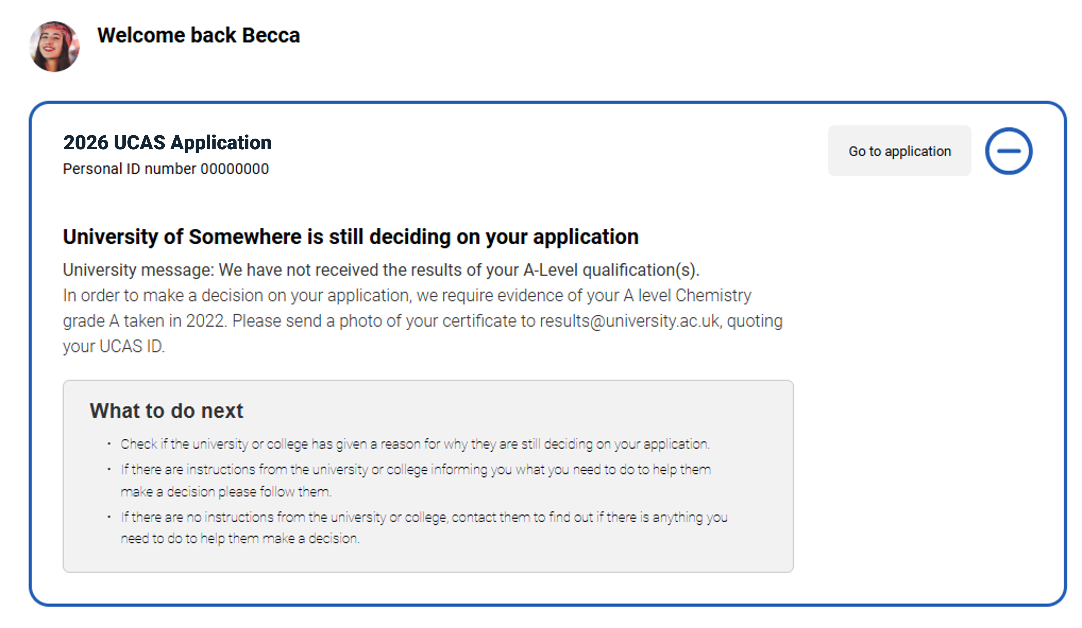
STILL WAITING FOR A DECISION?
Sometimes a university or college might not be able to confirm your place straight away.
This can happen if they’re still waiting for you to send proof of your qualifications or other important documents.
Your application may include a message explaining why your offer hasn’t been confirmed yet.
If you’re worried or unsure what you need to do, contact the university or college.
Public

Slide 10
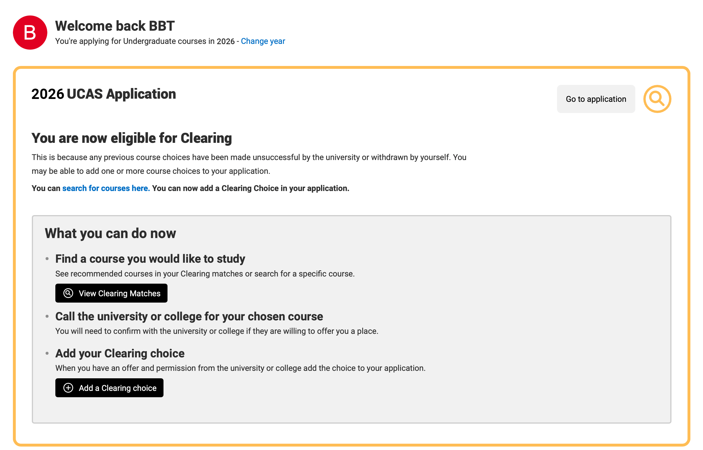
CLEARING EXPLAINED
Your chance to find an opportunity; Clearing runs between 2 July – 19 October.
If you don’t have any offers, aren’t waiting on decisions, or have declined all your offers, your application will show that you’re in Clearing.
You’ll also see personalised course suggestions to help you find matches.
Before you add a Clearing choice, make sure you’ve spoken to the university or college first.
Public

Slide 11
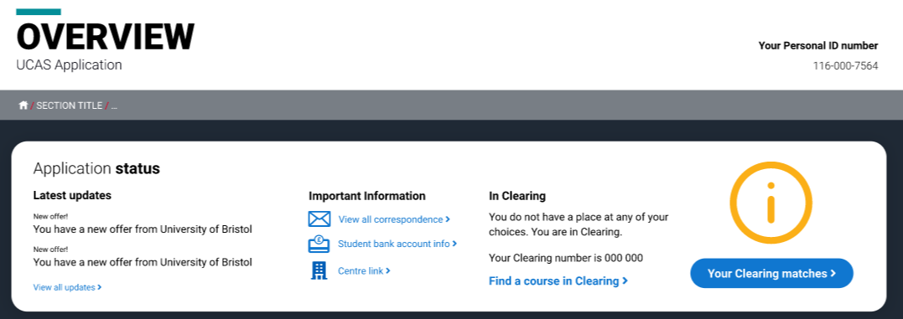
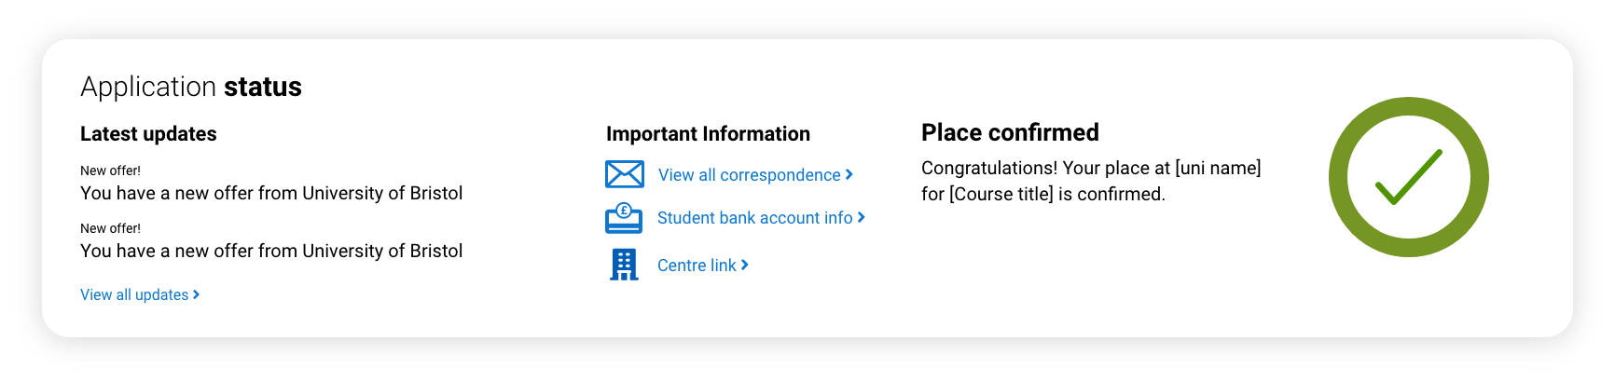
APPLICATION STATUS
The status bar at the top of your application shows your current application status and whether you’re eligible for Clearing.
It updates automatically as you take actions or as universities make decisions.
You’ll see your:
Clearing number (a six‑digit number) if you’re eligible
Personal ID (a ten‑digit number)
You might need these when speaking to universities or colleges during Clearing.
For more information check our guidance on
what different application statuses mean.
Public

Slide 12
HOW CLEARING WORKS
1
Research options
2
Make contact
3
Get offers
4
5
Add your choice
The university or college reviews your full UCAS application.
Check course details and entry requirements.
Explore available courses on UCAS.
Contact universities and colleges you're interested in.
Ask about availability and discuss your application.
Receive offers (you can get more than one).
Compare and decide which is best for you.
Choose one course to add to your application.
Be sure to do this within the time limit given.
Confirmation
If all good – you’re officially placed on the course
If unsuccessful, you can start again.
Public

Slide 13
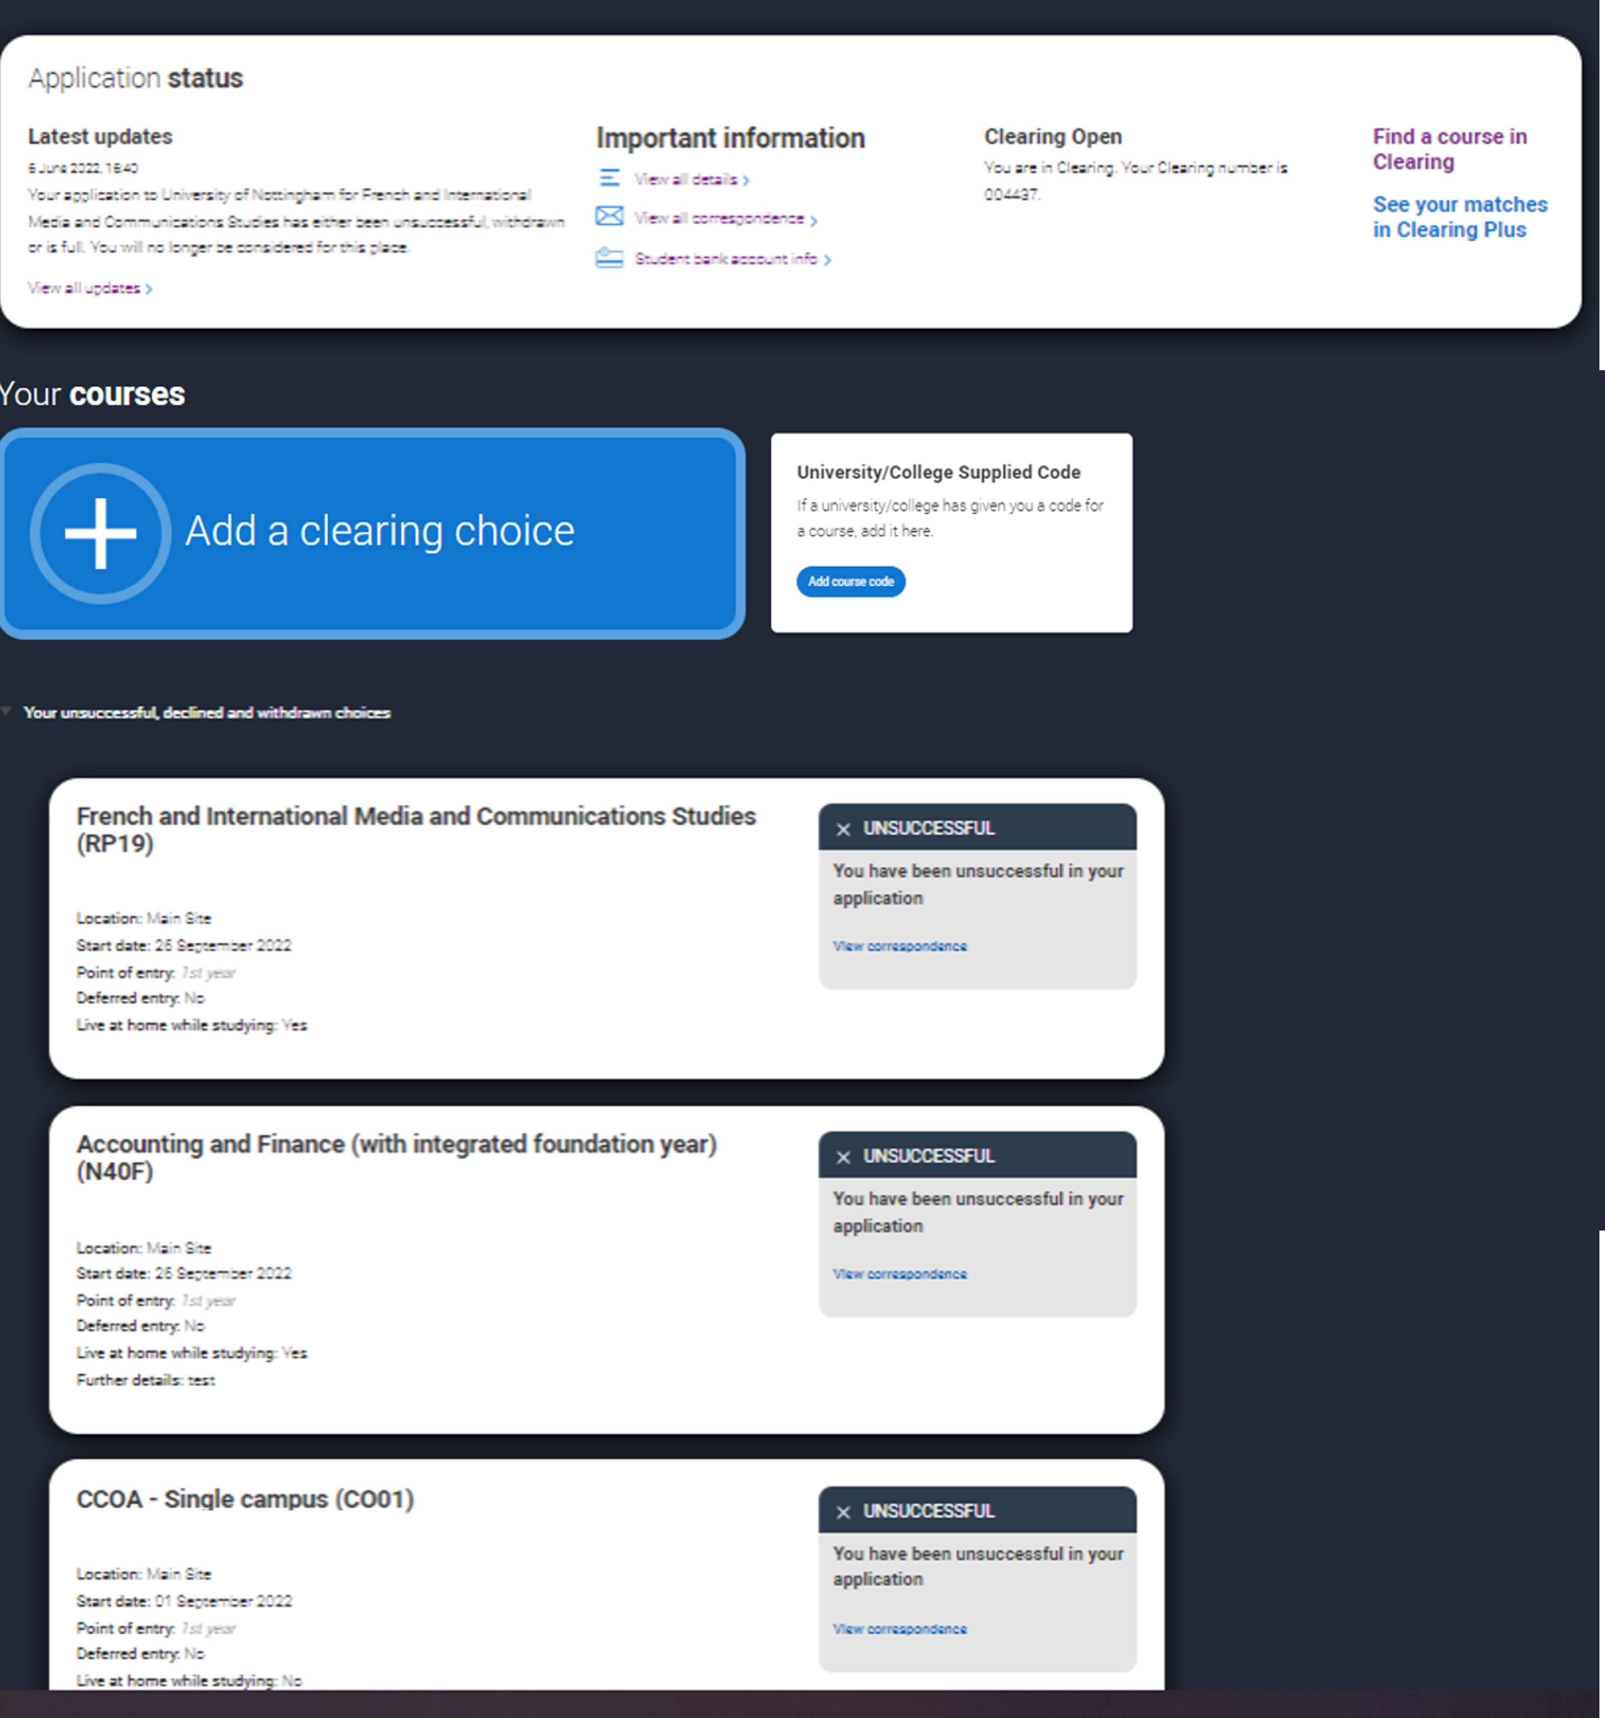
ADDING A CLEARING CHOICE
Clearing opens on 2 July, if you’re eligible you can add a choice once you have your results.
On UK results days you can add a choice from:
10:00 on Qualifications Scotland results day
13:00 on JCQ Level 3 results day
*All timings are UK time
Public

Slide 14
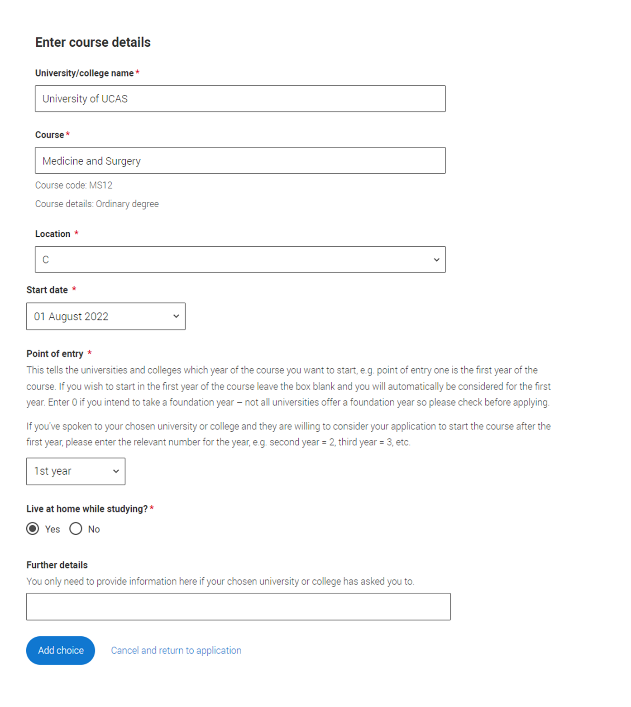
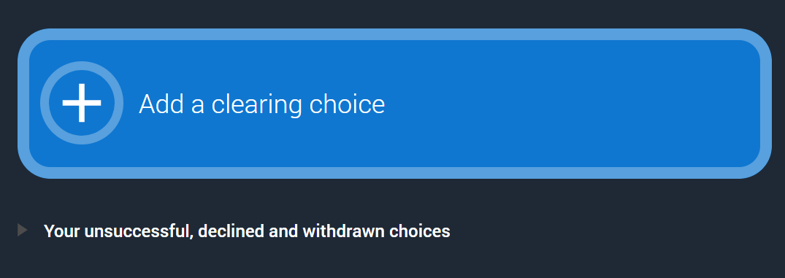
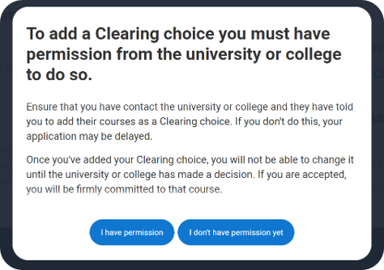
ADDING A CLEARING CHOICE
Only add a Clearing choice once a university or college has told you they can offer you a place.
Make sure you enter the course details before the deadline they give you; otherwise, the place may not be held for you.
Public

Slide 15
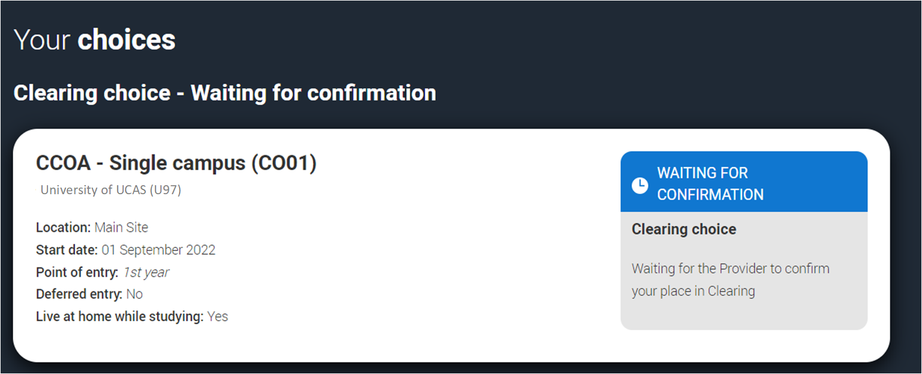
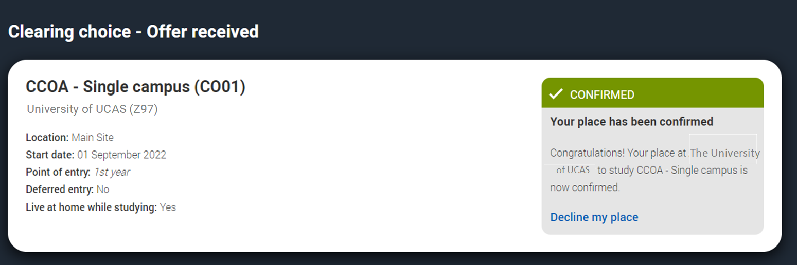
ADDING A CLEARING CHOICE
You can only add one Clearing choice at a time.
If your Clearing choice is not accepted (it will show as ‘Unsuccessful’), or if you choose ‘Decline my place’ after accepting a Clearing offer, you’ll be able to add a new choice.
You don’t need to reply to a Clearing offer. Once you add your choice, the university or college will make the decision.
If they confirm your place, you’ll see it updated in your application.
Public

Slide 16
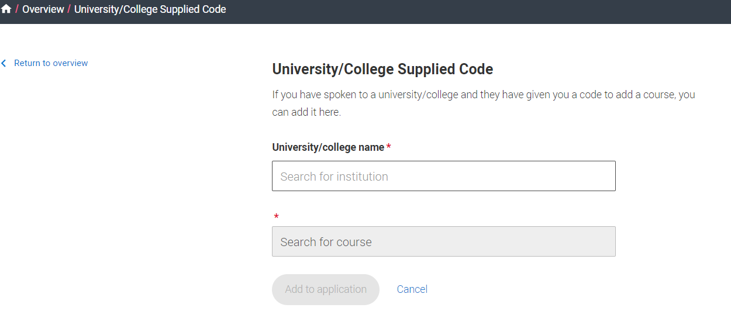
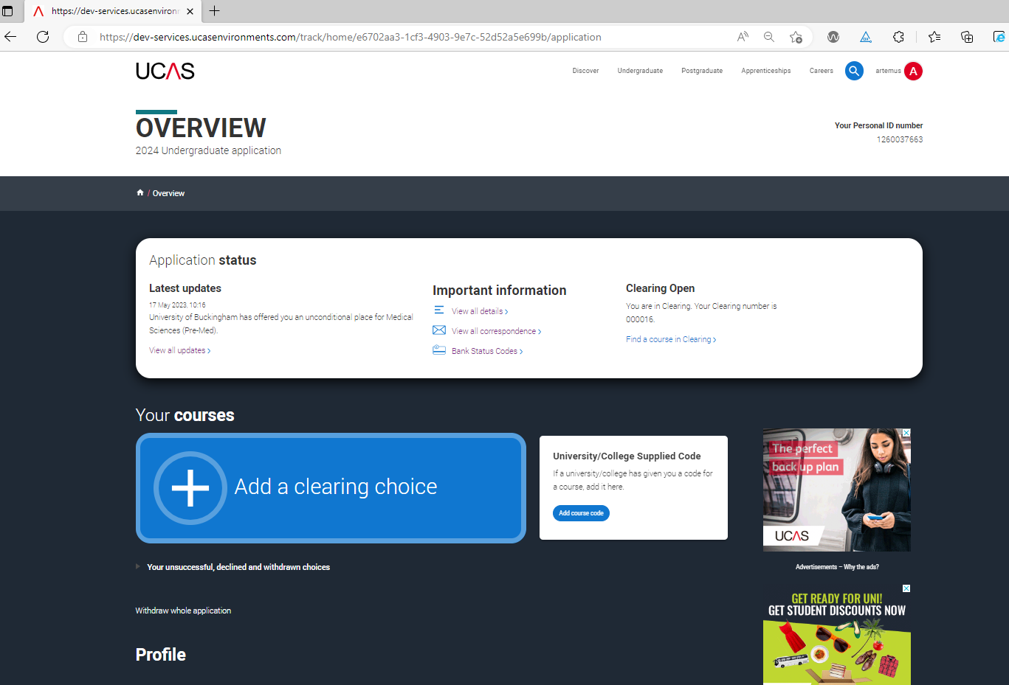
UNIVERSITY SUPPLIED CODE
If a university or college gives you a specific course code for a Clearing place, make sure you enter that exact code when you add your choice.
Add this where it says, ‘Add course code’.
This may happen with competitive courses where places are limited and fill up quickly.
Public

Slide 17
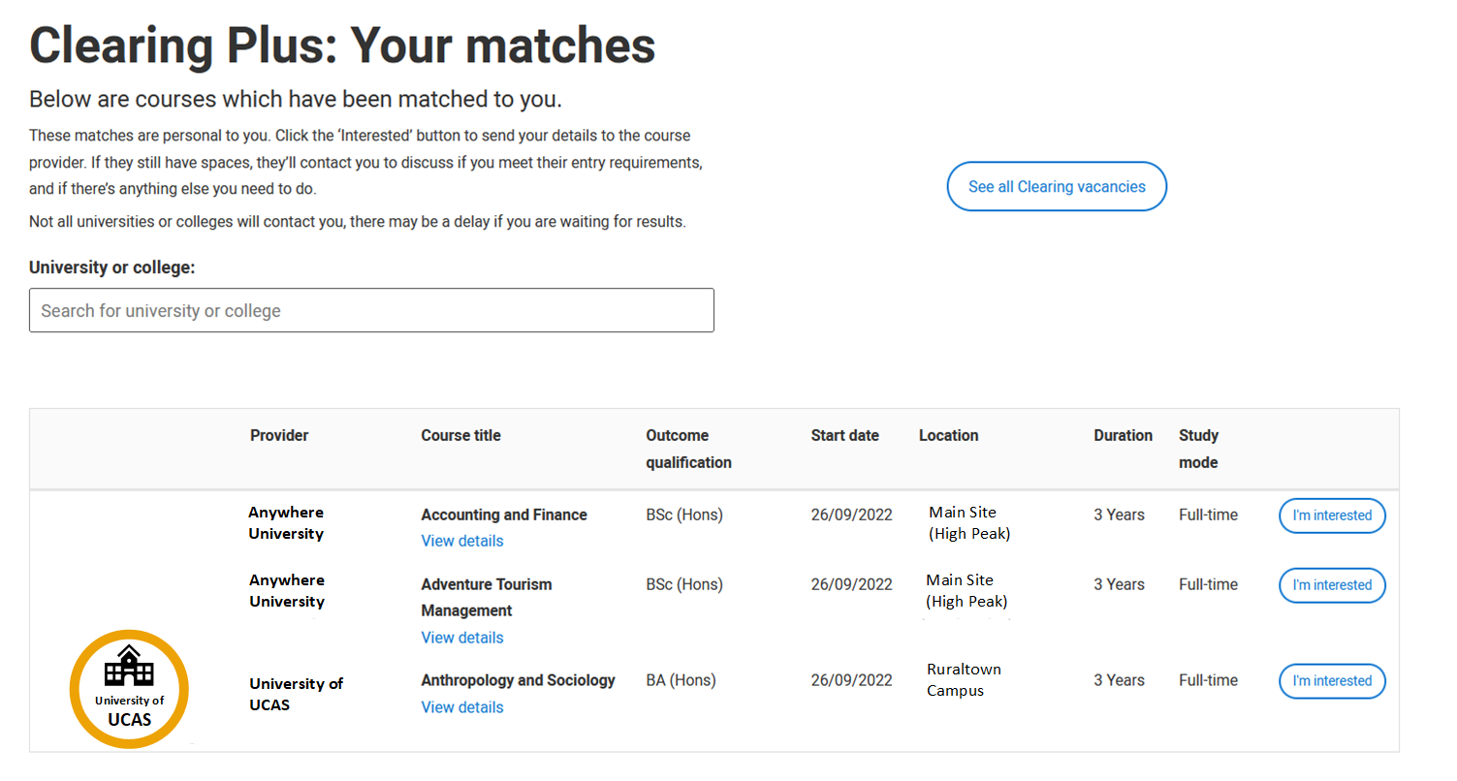
YOUR CLEARING MATCHES
Discover courses you hadn’t thought of by viewing your personalised matches.
These update regularly based on your application and what universities or colleges are looking for.
You can show interest in up to 5 courses, and the university or college may contact you if they think you’re a good fit.
Remember Clearing places can fill up quickly, so there’s no guarantee you’ll be contacted. We recommend using the UCAS course search to look at other Clearing courses, it’s the best way to keep your options open.
Public

Slide 18
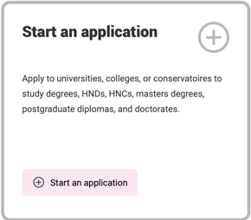
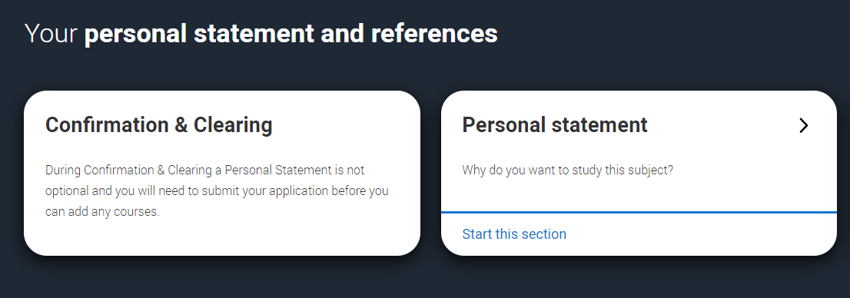
APPLYING DIRECTLY TO CLEARING
If you haven’t started a 2026 application yet, you’ll be able to begin a direct‑to‑Clearing application. You’ll need to complete all sections, including your personal statement and reference.
Submit your application without any choices. Once a university or college has confirmed they can offer you a place, you can then add your Clearing choice.
If you started an application and added choices before 30 June, those choices will be automatically removed if you submit it after 30 June.
Public

Slide 19
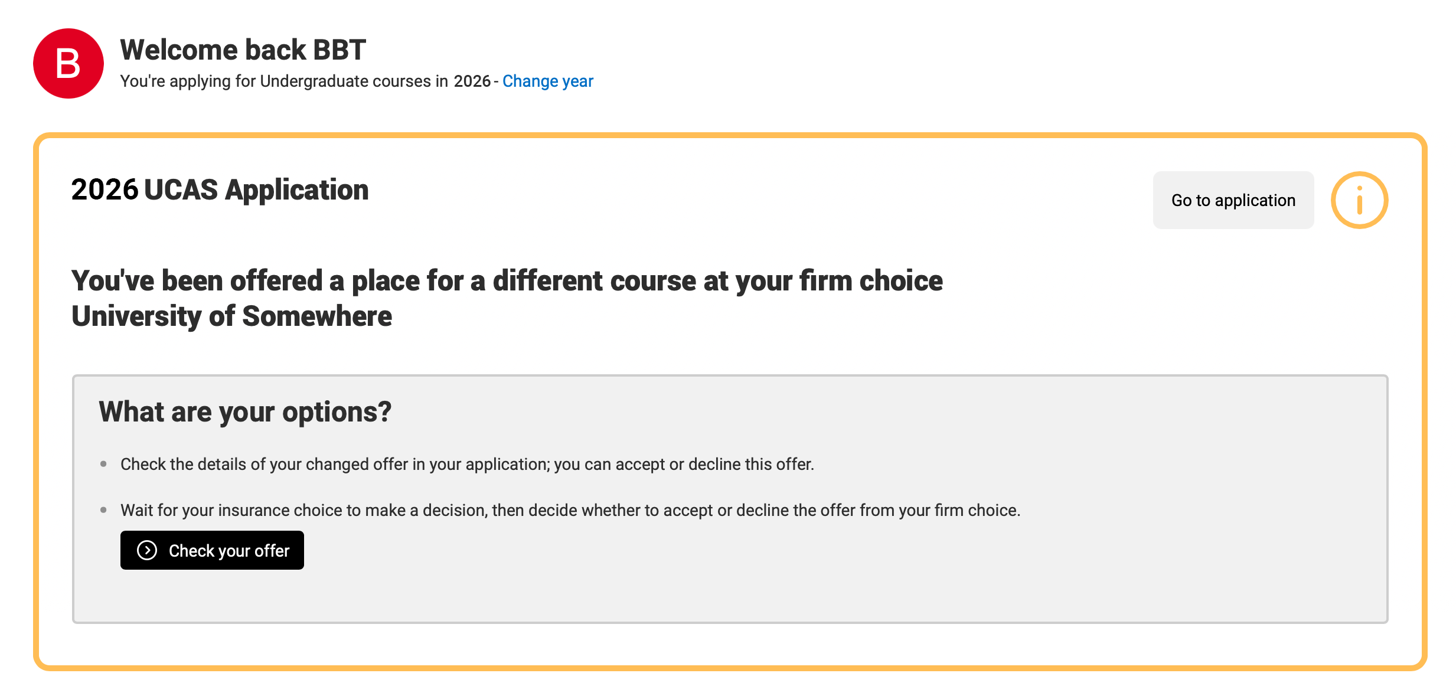
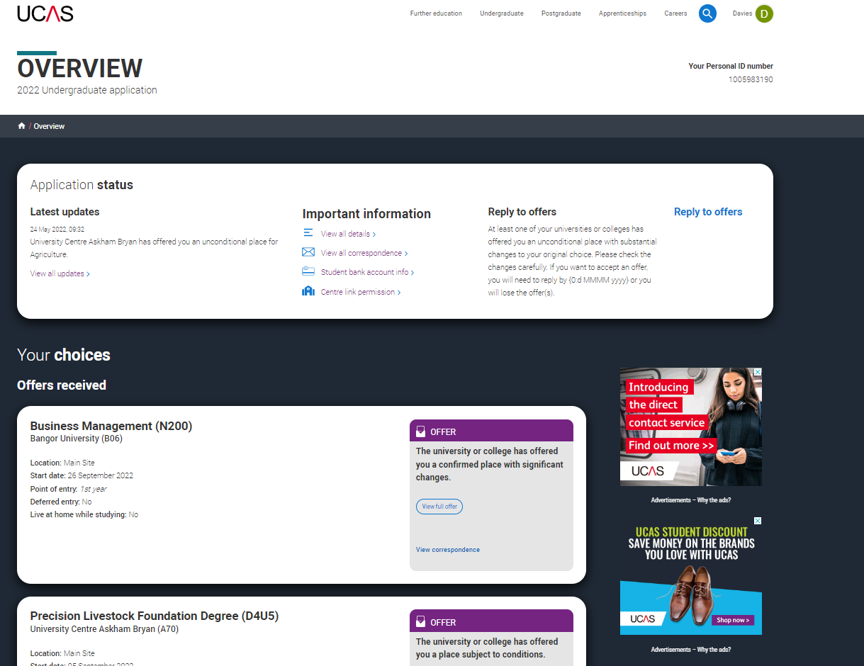
WHAT’S A CHANGE OF COURSE OFFER?
Sometimes a university or college might offer you a place on a different course at your firm or insurance choice.
This usually happens if you didn’t meet the original conditions, but they still want to offer you a place, just on a different course, start date, or year of entry.
Make sure you read the new offer details carefully in your application and respond within 5 days.
If anything is unclear or you’re unsure about the changes, contact the university or college; they’ll be happy to explain your options.
Public

Slide 20
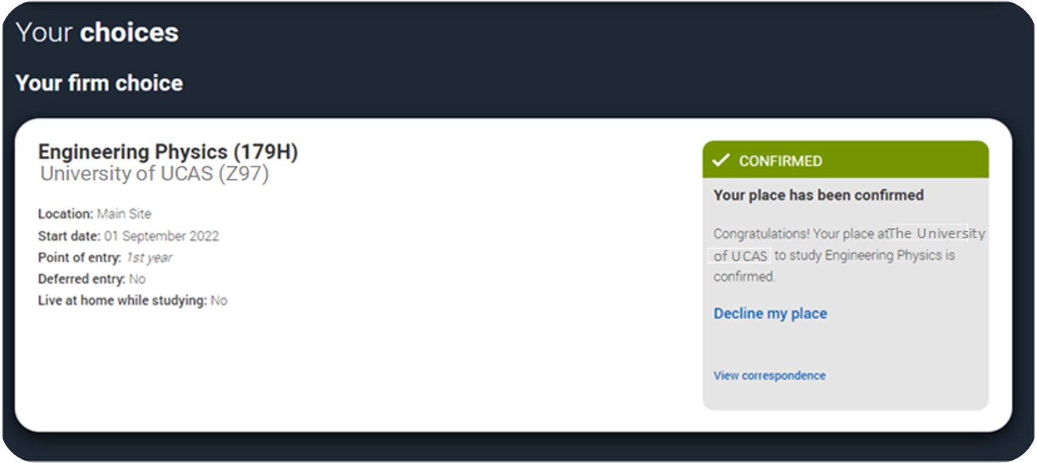
WHAT’S DECLINE MY PLACE?
From 2 July, if you’re holding an unconditional firm place, you can choose to enter Clearing by using ‘Decline your place’.
This option is available until 2 September 2026. After this date, you’ll need to contact the university or college directly if you want to enter Clearing.
Public

Slide 21
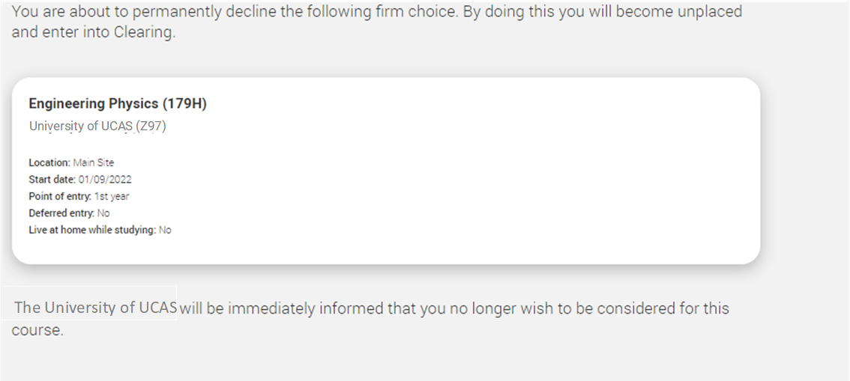
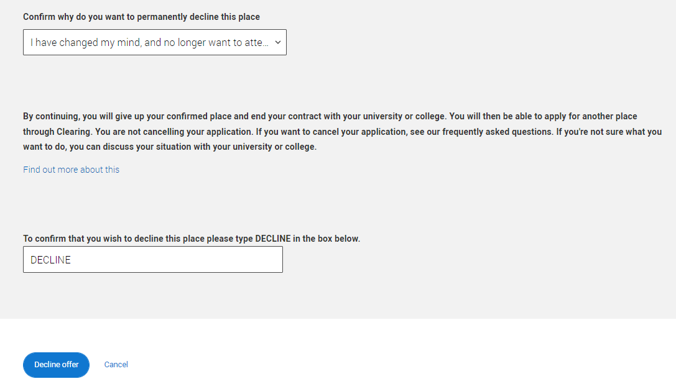
USING DECLINE MY PLACE
Only use ‘Decline my place’ if you’re sure you no longer want to take up your place at that university or college.
Using it will cancel your place and end any agreements you’ve made with the university or college; including accommodation, scholarships, or other arrangements.
If you still want to go to university or college, we strongly recommend finding a new place first.
Public

Slide 22
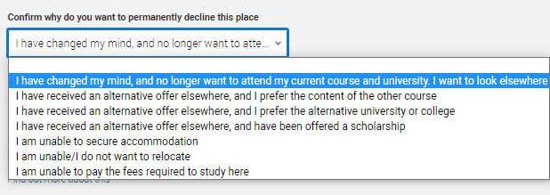
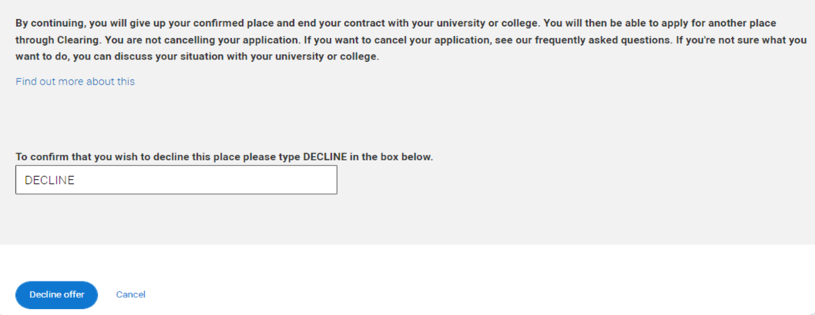
USING DECLINE MY PLACE
Once you decline your place, the decision can’t be undone; and you will automatically enter Clearing.
It’s not always the only option; there may be other choices available, depending on your situation. You should never feel pressured to decline your place.
If you’re unsure, contact UCAS and we can talk you through your options.
To confirm the decision, you’ll be asked to type ‘Decline’.
Public

Slide 23
Can I swap between my firm and insurance?
You can’t swap your firm and insurance choices.
If you're confirmed at your firm choice, your insurance is automatically declined.
If you want to go to your insurance, you’ll need to go through Clearing.
First, check with your insurance to see if they can accept you, then use ‘Decline my place’ to enter Clearing.
Don't decline your place until you're sure your insurance can offer you a spot.
Public

Slide 24

WHAT CAN YOU DO TO PREPARE?
Public

Slide 25

PLAN YOUR B, C & D
Plan for different outcomes.
Browse your options, start exploring universities, colleges, and courses before you get your results. Don’t forget apprenticeships or a gap year! :
UCAS Search
University and college websites.
Chat to students on UCAS Hub
Social media
Revisit and reconsider look back at your original choices. Would you still go there if there’s a place?
Check course details, especially entry requirements, for new courses to consider.
Public

Slide 26
5 STEPS TO PREP
MAKE A LIST OF TOP CHOICES
KNOW HOW TO CONTACT
KNOW WHY YOU WANT IT
WHAT MATTERS TO YOU
TAKE CONTROL
Taking a few minutes to list courses you would be interested in.
This can help you feel more prepared if you choose to use Clearing.
Check the best way to contact each university or college ahead of time.
Check out their Clearing webpages for details.
Have a few notes on why the course interests you, plus your grades (and personal statement if useful).
Have questions ready about location, accommodation, student life, and bursaries to help you find the right fit.
It’s also useful to ask if you can visit the campus?
Remember universities and colleges want to speak to you, not your parents or anyone else.
Being prepared helps you take the lead and make confident decisions.
Public

Slide 27

ON THE DAY CHECKLIST
Pause. Think. Take time to reflect.
Fully charged mobile phone – to make calls and stay connected.
Personal ID Number – you’ll need this to speak with UCAS and universities. You can find it in your application.
Clearing number – found in your application; you may need it for Clearing.
Your grades – have them ready to share when needed.
A copy of your personal statement – helpful for inspiration if asked why you’re interested in the course.
Double check entry requirements – these may change during Clearing, contact universities if you’re unsure.
Confirm offer timescale - if you’re offered a course ask how long you have to decide and add it to your application.
Pen and paper – to take notes and jot down important details!
Remember, it might be busy, so you may have to wait.
Public

Slide 28
HOW CAN WE HELP?
ucas.com/Clearing for top tips and more info.
Check out ‘The Ultimate Guide to Clearing’.
UK number
0371 468 0 468
From outside the UK:
+44 330 3330 230
Follow us on TikTok and YouTube.
Send us a direct message on Facebook, Instagram or X.
@ucas_online
HEAD ONLINE
GIVE US A RING
GET ON SOCIAL
Public

